Slide 1
Netzwerk Academy
SQL-CLASS4

Slide 2
Topics
Search Conditions
Combining predicates
Sorting, Distinct
Join operation

Slide 3
SEARCH conditions
Comparision
Compare the values of one expression with the value of another.
Operator - =, <>, <, >, !=, <=, >=
Range
To check if value lies within certain values.
BETWEEN
SET
If the value equals any value in a set.
IN(‘Python’,’Maths’)

Slide 4
Combining Predicates
Using logical operators combination of conditions are used.
AND, OR, NOT
Rules:
An expression is evaluated LEFT to RIGHT.
Sub-expression in brackets are evaluated first.
NOTs are evaluated before AND and OR
ANDs are evaluated before OR.
Ex: SELECT Employee_name from Employee where Salary > 25000 AND Salary<50000

Slide 5
Sorting, Distinct
"ORDER BY" clause is used to sort based on attribute(s).
Default is Ascending, to get in descending order, we should mention DESC.
Ex: SELECT stu_nbr, enrol_mark FROM enrolment ORDER BY enrol_mark DESC
Use "DISTINCT" as part of SELECT clause to get unique rows of an attribute.
Ex: SELECT DISTINCT stu_nbr FROM enrolment WHERE enrol_mark IS NULL;

Slide 6
Joins
SQL Joins are used to combine the data of two or more tables.
There are two types of JOINS
INNER JOIN
LEFT OUTER JOIN
CROSS JOIN

Slide 7
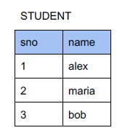
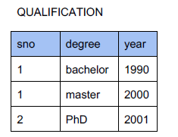
Inner Join
Using inner join only the rows which match in both the tables are returned.

Slide 8
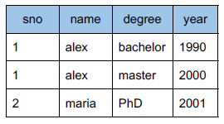
Inner Join
Using inner join only the rows which match in both the tables are returned.

Slide 9
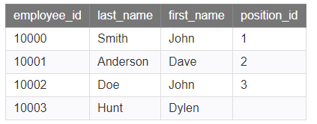
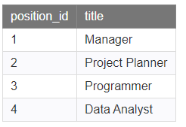
LEFT OUTER JOIN
LEFT OUTER JOIN would return the all records from table1 and only those records from table2 that intersect with table1.

Slide 10
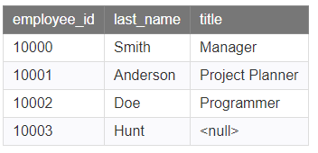
LEFT OUTER JOIN

Slide 11
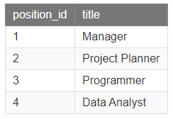
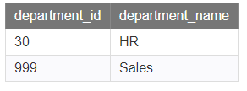
CROSS JOIN
This type of join returns a combined result set with every row from the first table matched with every row from the second table.

Slide 12
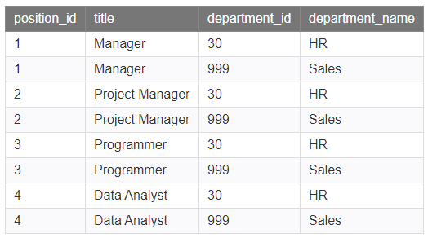
CROSS JOIN

