Slide 1
MongoDB
Class - 1

Slide 2
Topics
Introduction to Databases
Types of databases
MongoDB overview
SQL vs MongoDB

Slide 3
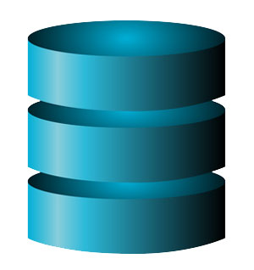
Introduction to Databases
A database is an organized collection of data, where data is stored and accessed electronically from a computer system.

Slide 4
Types of databases
Relational database
Non-relational database

Slide 5
Relational database
Relational database is a collection of data with pre-defined relationships between them.
These are organized as set of tables with columns and rows.

Slide 6
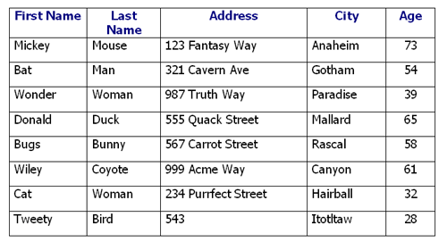
Example
Cell – Intersection of a row and a column
Column – is also called field or attribute
Record – also called as row or tuple
A table is also called as an entity or relation

Slide 7
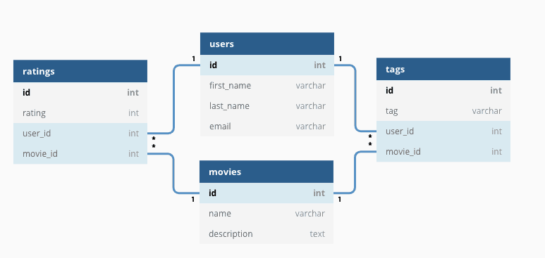
Relational database

Slide 8
Advantages
Accessing data is easy
Data integrity ( Data typing and validity checks)
Flexibility to add, remove and modify tables and columns
Supports standard language such as SQL which is simple to implement and understand.

Slide 9
Disadvantages
Can become complex as number of rows increase, relations between pieces of data becomes more complicated.
The expense of maintaining and even setting up a database system is relatively high and one of the drawbacks of relational databases.
Relational databases impose limits on field lengths.

Slide 10
Non-relational databases
Non-relational databases are the ones which does not follow a pre-defined schema of rows and columns.
The storage model is optimized as per the requirements of the type of data.

Slide 11
MongoDB
Open source document database
Leading NoSQL database
Cross-platform
Document-oriented – JSON, BSON

Slide 12
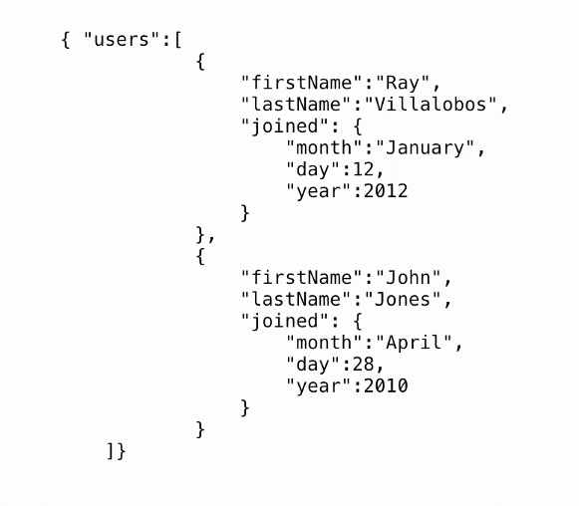
JSON Structure

Slide 13
MongoDB terminologies
Document - A document is a set of key-value pairs. Documents have dynamic schema.
Field – It is a key value which is equivalent to columns in a relational database.
Collection - Collection is a group of MongoDB documents. It is the equivalent of an RDBMS table. A collection exists within a single database.
Database – Physical container for collections, each database gets its own set of files. A single server can contain many databases.

Slide 14
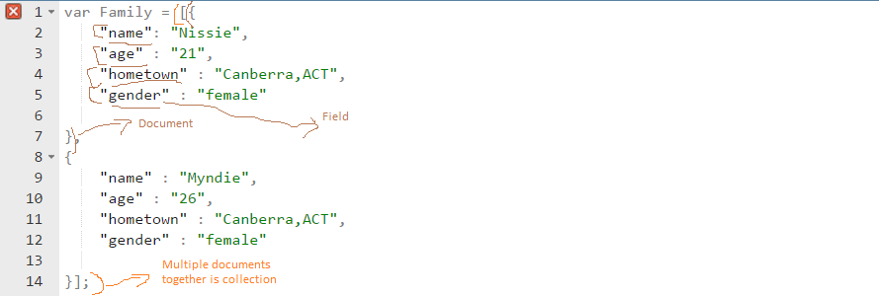
JSON document

Slide 15
Advantages
Schema less – Can add any type of data in different documents.
No complex joins – Unlike relational databases, no complex queries are needed.
Easily scalable – Horizontally scalable database. When you have to handle a large data, you can distribute it to several machines.
High speed - MongoDB is a document-oriented database. It is easy to access documents by indexing. Hence, it provides fast query response.
High availability - MongoDB has features like replication and gridFS. These features help to increase data availability in MongoDB. Hence the performance is very high.

Slide 16
Disadvantages
Joins not Supported - MongoDB doesn’t support joins like a relational database.
High Memory Usage - MongoDB stores key names for each value pairs. Also, due to no functionality of joins, there is data redundancy.
Limited Data Size – Document size no more than 16mb.
Limited Nesting - You cannot perform nesting of documents for more than 100 levels.

Slide 17
SQL vs MongoDB
SQL | MongoDB
Relational database | Non-relational database
Table based | Collection based
Supports SQL query language | Supports JSON query language
Schema is predefined | Dynamic schema
Not fit for hierarchical data storage | Best fit for hierarchical data storage

