Slide 1
MongoDB
Class 3

Slide 2
Topics
Insert documents
Query document
Update document
Delete document
Projection
Limiting
Sorting

Slide 3
Insert document
Once collection is created, next step is to add document(s) in a collection.
db.COLLECTION_NAME.insert(document)
This might be removed in coming versions

Slide 4
Insert one document
Insert only one document at a time.
db.COLLECTION_NAME.insertOne(document)

Slide 5
Insert many documents
If you want to insert more than one document, then go for insert many method.
db.COLLECTIONNAME.insertMany(documents)

Slide 6
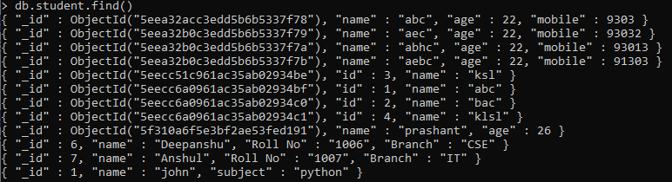

Query documents
To retrieve the documents from the collection, find() method is used.
db.collectionname.find()

Slide 7
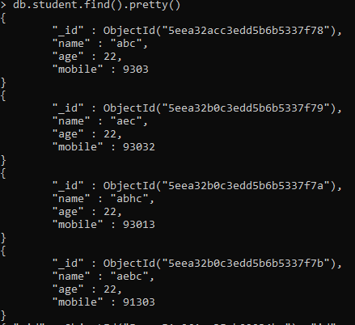
Query documents
To retrieve the documents from the collection in a formatted way, find().pretty() method is used.
db.collectionname.find().pretty()

Slide 8
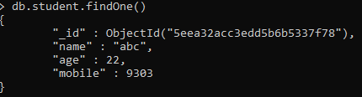
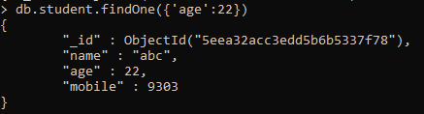
Query document
To retrieve single document, findOne() method is used.
db.COLLECTIONNAME.findOne()

Slide 9
Logical operations
Along with the find method, can use logical operations to extract conditional records
Logical operator | Mongodb keyword
AND | $and
OR | $or
NOT | $not
NOR | $nor

Slide 10
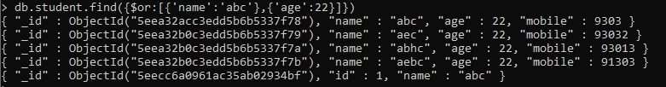
Logical operators - OR

Slide 11
Logical operators - AND

Slide 12
To-Do
Try using NOT and NOR operations

Slide 13
Update document
We can update the documents which are already inserted in a collection.
db.Collectionname.update(Selection_criteria, update_data)

Slide 14
Update one document
We can update only one document which matches the selection criteria.
db.Collectionname.updateOne(Selection_criteria, update_data)

Slide 15
Update Many document
We can update all the documents which are already inserted in a collection and match the conditions.
db.Collectionname.updateMany(Selection_criteria, update_data)

Slide 16

Projection
When a record is retrieved, you can choose which fields to project or display.
db.collectionname.find({},{key:1})

Slide 17
Limit
You can choose how many records should be displayed by using limit function.
db.collectionname.find().limit(number)

Slide 18

Sort
Can sort records according to the specified key.
db.collectionname.find().sort({key:1})
Specify key:-1 for descending order.

Slide 19

Delete
To delete the document(s) from a collection, will use remove() method.
db.collectionname.remove({deletion_criteria})

Slide 20
Assignment
Insert 5 documents consisting of name, age, gender, mobile number (You can name anything to the fields).
Retrieve all the records having age greater than 25
Retrieve all the records of male.
Display the records according to the sorted mobile numbers in descending order.
Delete the records which has gender as female.

