Slide 1

Does Curricular Complexity in Computer Science Influence the Representation of Women CS Graduates?
Albert Lionelle
Khoury College of Computer Sciences
Northeastern University
McKenna Quam
Khoury College of Computer Sciences
Northeastern University
Carla Brodley
Center for Inclusive Computing
Northeastern University
Catherine Gill
Center for Inclusive Computing
Northeastern University

Slide 2
What is Curricular Complexity?
Curriculums have an innate structure
Prerequisites, course requirements
Curricular Complexity – the complexity of that structure
Not to be confused with course complexity
Four measurements to compare curricular structure
Developed by Gregory L. Heileman and Ahmad Slim
Complexity
Centrality
Delay Factor
Blocking Factor

Slide 3
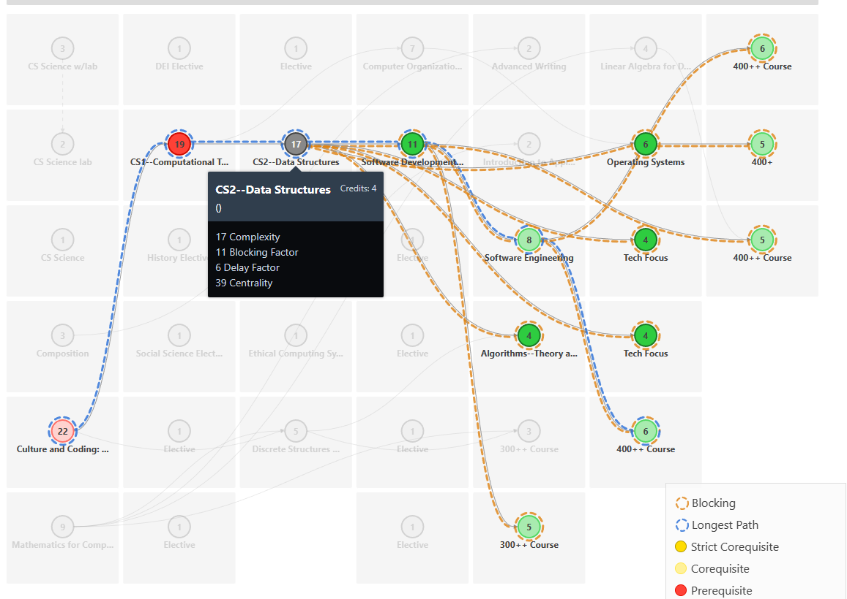

Curricular Analytics
Blocking Factor
Number of courses that require course. 11 in example
Delay Factor
Measures sequential ordering (max) that it is a member. 6 in the example
Centrality
Sum of delay factors “how many course chains include this course”.
Complexity
Combination of Blocking + Delay
Curricular Complexity
Sum of all course complexities. 175 in example
https://www.curricularanalytics.org/

Slide 4

Why does this matter?
Curricular Structure
Influences students directly
How long until graduation, ordering, etc
Measure to compare “best practices” in curricular design
Heileman et al. found¹
Higher ranked programs had lower curricular complexity
Meaning
The structure of the curriculum was less complex
Making it easier to
Take courses in different orders
Transfer into the program later
Less assumptions about previous knowledge going into courses (hopefully)
¹ https://doi.org/10.18260/1-2--32677

Slide 5
Our Question
Is there a relationship between structural complexity and the representation of women in a program?
IPEDs for graduation rates divided by men and women (CIP 11.01, 11.07)
Paper addresses intersectional identity limitations and binary limitations of our data
Grouped into 3 groups based on normalized percent women graduating
> 20%,
20% to 15%
15% and below
Sampled 60 programs (20 each group)
Built 60 degree maps
By public facing websites
Assumed calculus ready, no AP credits, bias towards reduced prerequisites, and ‘quickest path’ to graduation
Analyzed: structural complexity, blocking, delay, and common courses

Slide 6
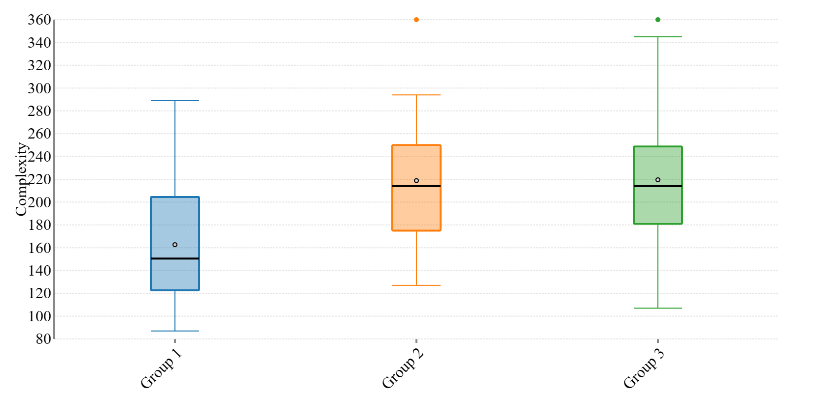
Degree Complexity
 | % women | Mean Complexity | Median longest delay factor
Group 1 | n > 20% | 162.7 ± 12.8 | 5
Group 2 | 20% >= n > 15% | 218.9 ± 13.1 | 6
Group 3 | n < 15% | 219.6 ± 14.4 | 6
p = 0.003

Slide 7
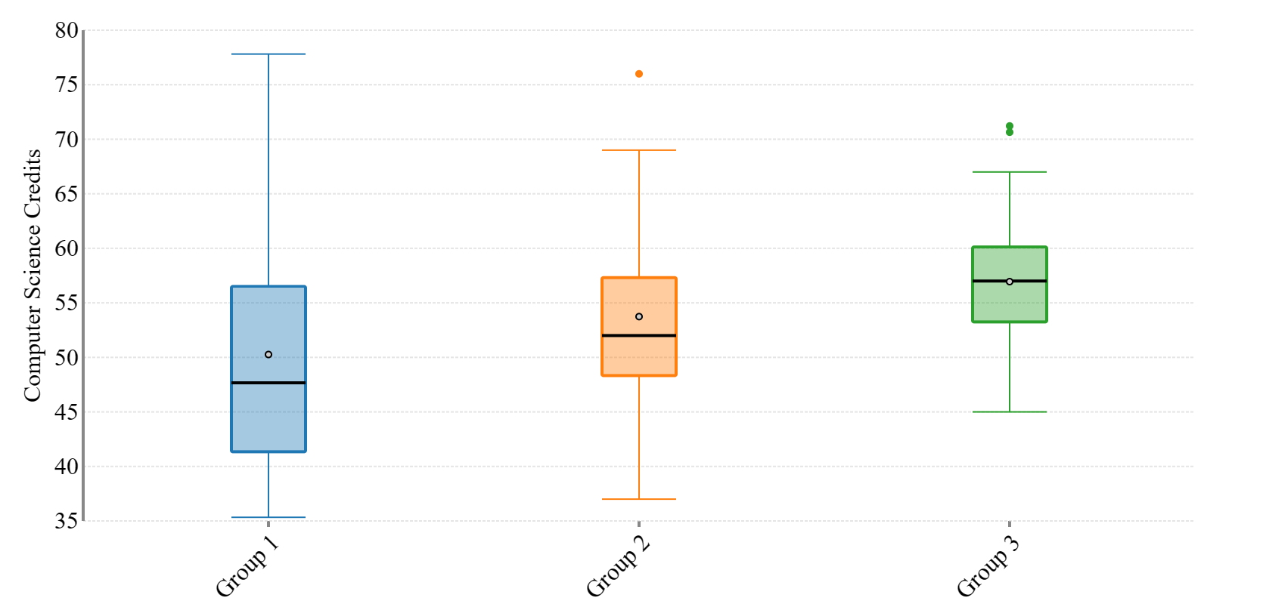
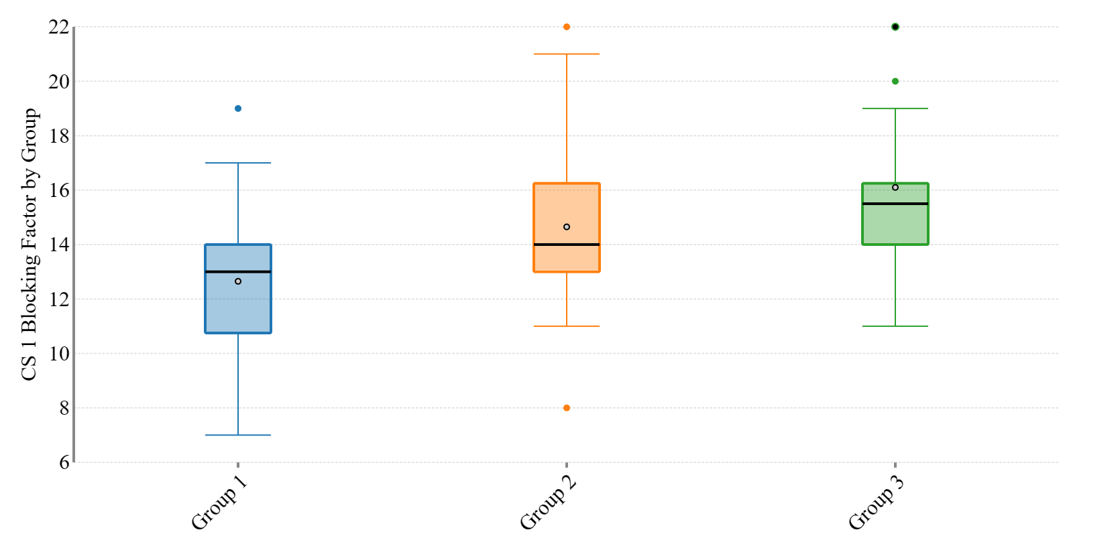
Computer Science Credits
Normalized to 120 credit degree programs
Between 40-60 required CS credits common
53 median credits (across all schools)
Greater diversity has slightly less CS credits
50 median
While CS 1 blocks progress
Slightly less in programs with greater diversity
Observation: due to optional pathways to take

Slide 8
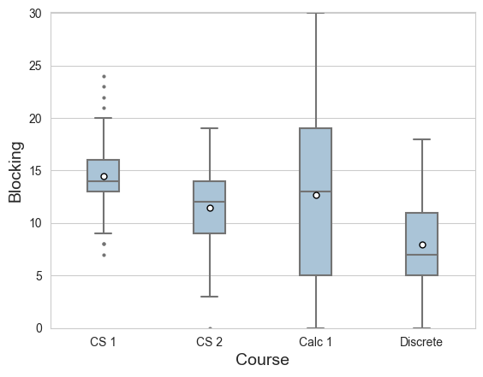
Blocking Overall
Blocking prevents progress
Across all 60 schools
CS 1 should be blocking (mostly)
Calculus I, no consensus!

Slide 9
Best Practices Observed
Comparing programs via structural complexity can build best practices
Five Best Practices we observed
Minimize Delay on Transfer Students
Eliminate choke points preventing progress
Offer flexibility around when calculus must be completed
Small core, with flexible options after core
How you communicate degree plans matter

Slide 10
Minimize Delay on Transfer Students
The number of transfer students
Increase every year
Primary concern: time to graduation
Use curricular maps to look at time to graduation
Reduce if transfer students have “added” complexity
Extremely common!

Slide 11
Flexibility
Programs with greater representation had
More options for students at various points
Smaller core requirements
26% - group 1 compared to 33% group 3
Group 1 is characterized by minimal prerequisite
Often 300/3000 lvl upper division only required Data Structures

Slide 12
Choke Points and Calculus
Choke points
Very evident in a curricular map
Programs with greater diversity often had ‘pathways’
Allows progression to prevent frustration of a choke point
Calculus 1 – if placed early becomes a choke point
Yet, there is NO consensus between programs
Suggestion:
Only require it *as needed* for a course
Delay when it is needed
Allows time for precalc requirements
CS2023: ACM/IEEE-CS/AAAI Computer Science Curricula

Slide 13

Communication Matters
Students do use websites
We found:
Some programs made it very difficult to find information
Requirements often listed across multiple pages (university, college, degree)
Often contradicting information
Sometimes prereqs listed, sometimes not
Nearly everyone had a single “calc ready” suggested plan
Suggestion:
Have a clean page that lists / links to courses, prereqs and plans.
Have multiple degree plans
Calc ready
No mathematical background
Transfer student plans (internal and external transfers)
These present to the students that everyone belongs
Additional Reading: Top Ten List for Making a Great “Major Requirements” Web Page
McKenna Quam - https://cic.northeastern.edu/resources/

Slide 14
Conclusion
60 School degree maps, looking at
Structural complexity
Blocking factor
Delay factor
Is there a relationship between structural complexity and the representation of women in a program? YES
Schools with greater representation of women had less structural complexity to their degrees
Often complexity is not needed
Both from performance and representation
Additionally
No consensus on calculus among the programs
Call for future research on best practices

Slide 15
Thank you!
https://dl.acm.org/doi/10.1145/3626252.3630835

