Slide 1
Sinhgad Technical Education Society’s SINHGAD COLLEGE OF ENGINEERING , PUNE-41 Department of Information Technology
Project Based Presentation
E-learning on Cloud using Advanced Encryption Standard
By
YASH PAWAR VAIBHAVI PAWAR ABHISHEK PUJARI PRANALI WAGH
Guided by
Dr.Mrs.K.S.Thakare

Slide 2
CONTENTS
Problem Statement
Scope of the Project
Aim and Objective
Abstract
Introduction
System Architecture
Literature Survey
Project Modules
Algorithms
UML Diagrams
System Requirements
Conclusion
References

Slide 3
Problem statement
To propose and to implement the improved e-learning system that provides content services to the provision and sharing of various forms of educational content, including text, images, videos, 3D objects and scenes of virtual reality and augmented reality.

Slide 4
Scope of the project
The scope of this project is to provide infrastructure based on modern methodologies and tools of e-learning. Since there are various infrastructure challenges that are faced while searching a required resource material online, a design of e-learnings environment is a need to develop an education based e-learning system.
With the help of this system any stakeholder will be able to access any resource material :including text, images, videos, 3D objects and scenes of virtual reality and augmented reality.
In addition to this professors are given a facility to upload their course materials on the system.

Slide 5
Aim & objectives
Aim
The aim is to develop an e-learning system that will improvise on the traditional learning, large class learning techniques used in teaching.
Objectives
To design an e-learning system with various multimedia features like text, images, videos, audios.
To create a database for easy retrieval, storage & maintenance of student records as well as sharing of data between users.
To create a user friendly frontend design which will be linked to database for information retrival
To make the training process easier for the trainer as well for uploading materials using Advanced Encryption Standard.

Slide 6
Abstract
Various benefits of Information Technology have created different tools that helps learning at any place and anytime.
As the technology is changing,education system also needs to be changed for faster,comfortable and easy learning.
Information Technology has been involved in learning process which is known as E-learning,nowdays modern learning.
Application model of Hybrid Cloud is intergration of private and public cloud which has various advantages such as safety,privacy,cost effectiveness.
Various computing features and services has been revolutionzed by cloud computing where various resources are offered as a service over the internet.

Slide 7
Introduction
Information technology has made it possible to work and study from distance learning in user comfortable spaces other then traditional classrooms .
The most important feature is the direct interaction between teachers and students which should be powered by information technology to make the learning process more efficient.
Cloud provides integrated computing resources including processing power ,data storage,relevant softwares over the internet for remote access.
Essential characteristics of cloud computing are on demand services,broad network access,resource pooling,rapid elasticity and measured service.
E-learning is the future of education which can provide courses and various opportunities to students in traditional form of education.

Slide 8
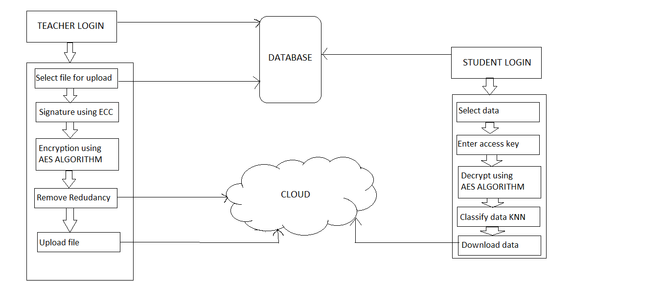
Fig: system architecture

Slide 9
Literature survey
Sr. No. | Reference paper name (year) | Seed Idea | Advantages | Disadvantages
1. | Smart Tools for Cloud E-learning System [2017] | Author tries a new and innovative solution for media services that can be accessed from smart devices cloud-based intelligent service environment with a fully integrated system. Indexation has been used. | It can be utilized under circumstances where the availability of resources is limited. | Post problems related to searching are tedious, costly in resources and time.
2. | On-campus or online: examining self regulation and cognitive transfer skills in different learning settings [2016] | Author set to recognize self-regulation skills necessary for online education and to illustrate cognitive move of on-campus and online students. The study integrated two groups of undergraduate students who studied the same course. Algorithm: Self-regulated learning (SRL), diverse learning | students pointed out that learning from a distance gives them flexibility with respect to time. | The study was conducted in one higher education institution with a relatively small number of participants eighty-four science and engineering students.

Slide 10
Sr. No. | Reference paper name(year) | Seed Idea | Advantages | Disadvantages
3 | Implementation of Learning Management System Based on Cloud Computing [2017] | The author has used basic services of cloud like SaaS providing various software like learning system, examination system , PaaS providing on platform software like MySQL, Cfree, oracle,IaaS for providing different kinds of services in this learning model on open stack cloud computing systems using Microsoft ASP.net and SQL . | Efficient model On demand computer resources sharing | Integrating these services is difficult
4 | Analysing e-Learning and Modern Learning Environments | e-learning makes it possible to study regardless of time and space. It may also provide new groups of students opportunities that are not available with other forms of education. Algorithm: Traditional storage algorithm | 1.helps in meeting new 2.People. exchanging ideas between individual students and student groups | e-learning has failed to satisfy the needs of a mobile user

Slide 11
Project Modules
Student Login
Teacher Login
Classification of data using K nearest neighbor(KNN)Algorithm
Data uploaded by teacher on AWS Cloud
Data encrypted using Advanced Encryption Standard(AES)Algorithm
Digital Signature for each file is generated using
Elliptical Curve Cryptography(ECC)Algorithm
Student enters accurate key to download the file
Data decrypted using Advanced Encryption Standard(AES)Algorithm
Logout

Slide 12
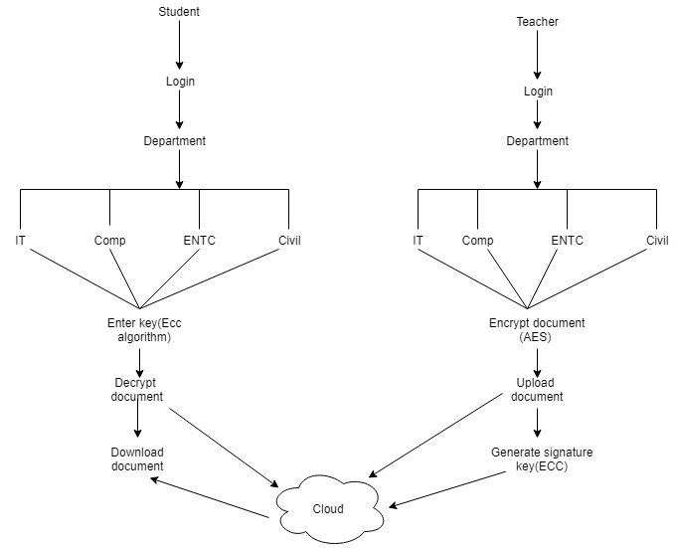
Departmentwise Data Arrangement

Slide 13
AES (Advanced Encryption Standard)Algorithm
AES(Advanced Encryption Standard):-The more popular and widely adopted symmetric encryption algorithm likely to be encountered nowadays is the Advanced Encryption Standard (AES). It is found at least six time faster than triple DES.
A replacement for DES was needed as its key size was too small. With increasing computing power, it was considered vulnerable against exhaustive key search attack. Triple DES was designed to overcome this drawback but it was found slow.
The features of AES are as follows :-
Symmetric key symmetric block cipher
128-bit data, 128/192/256-bit keys
Stronger and faster than Triple-DES
Provide full specification and design details
Software implementable in C and Java

Slide 14
Pseudo Code For AES Algorithm
AddRoundKey(State,&w[0])
for i=1 step 1 to 9
subBytes(state)
shiftrows(state)
mixcolumns(state,&w[i*4])
end for
subbytes(state)
shiftrows(state)
AddRoundKey(state,&w[40])

Slide 15
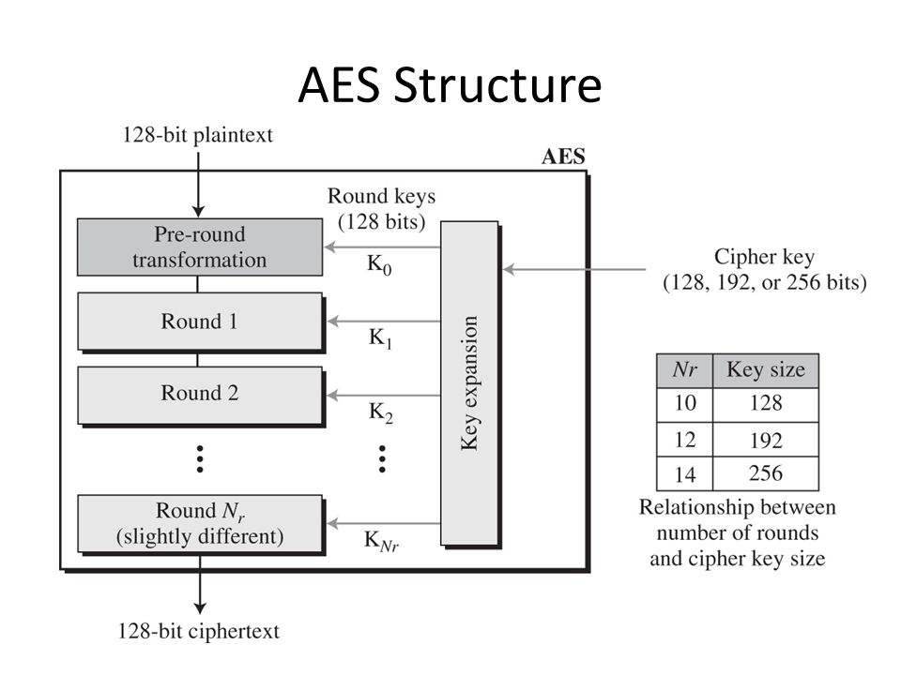

Slide 16
ECC (Elliptical Curve Cryptography)
This algorithm is used for key generation(digital signature).
To sign a message m by the sender, it performs the following steps:-
Step 1. It calculates a cryptographic hash function
Step 2. The sender then selects a random integer k from [1,n-1]
Step 3. The it computes a pair (r,s)
Step 4. r= x1 (mod n ) where (x1,y1) =k*G
Step 5. s= k-1(e+ dA*r)
Step 6. This pair (r,s) defines the signature
Step 7. This signature is sent to the receiver
Terms:K=key(fixed), (r,s)=signature key pair,x1=distance1,y1=distance2

Slide 17
KNN Algorithm(K Nearest Neighbor)
Calculate “d(x, x_{i})” i =1, 2, ….., n; where d denotes the Euclidean distance between the points.
Euclidean distance =√(x2−x1)²+(y2−y1)²
Arrange the calculated n Euclidean distances in non-decreasing order.
Let k be a +ve integer, take the first k distances from this sorted list.
Find those k-points corresponding to these k-distances.
Let k_{i} denotes the number of points belonging to the i^{th} class among k points i.e. k ≥ 0
If k_{i} >k_{j} ∀ i ≠ j then put x in class i.
Terms:n=training sample, x_{i=} training data point,k=user defined( K value we can make boundaries of each class).

Slide 18
UML DIAGRAMS
DFD-0(Data Flow Digram-0)
DFD-1(Data Flow Diagram-1)
DFD-2(Data Flow Diagram-2)
Sequence Diagram
Activity Diagram
Class Diagram
Usecase Diagram
Package Diagram
Deployment Diagram

Slide 19
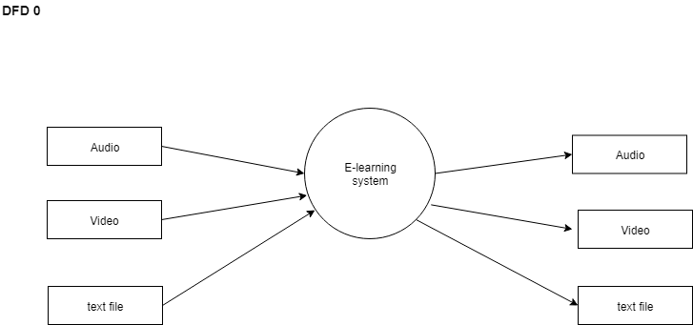
DFD-0

Slide 20
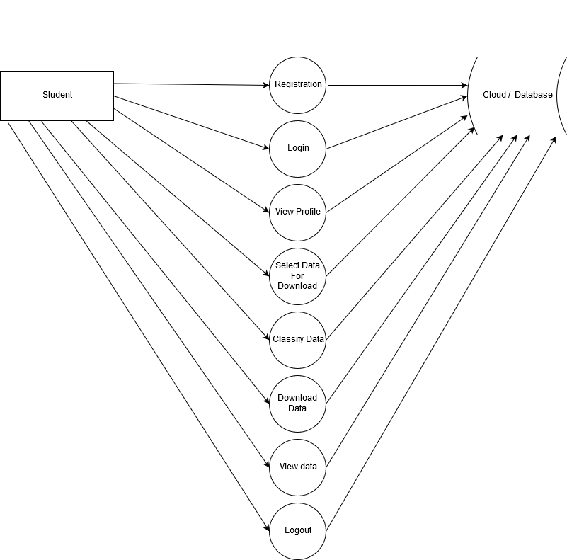
DFD1 Student diagram

Slide 21
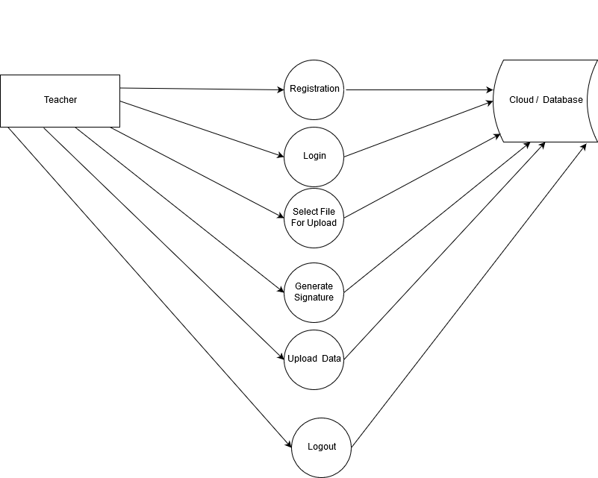
DFD1 Teacher Diagram

Slide 22
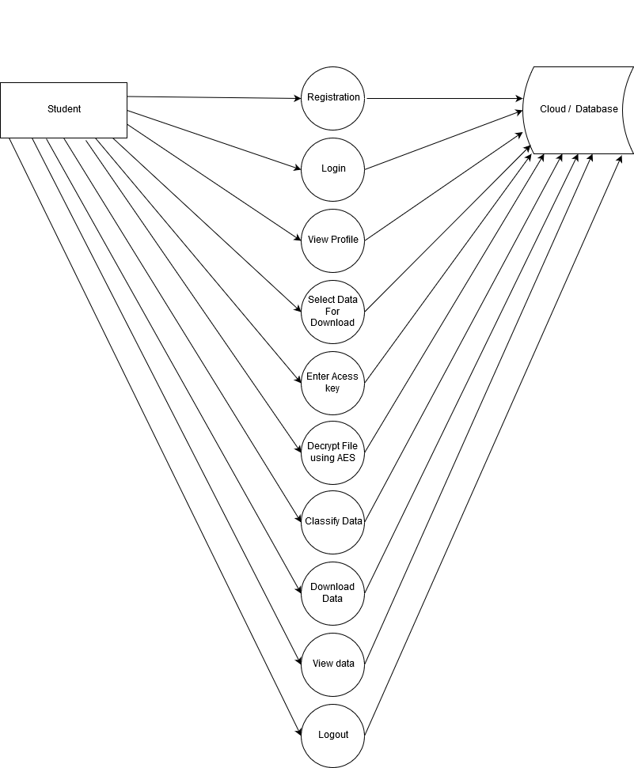
DFD2 Student Diagram

Slide 23
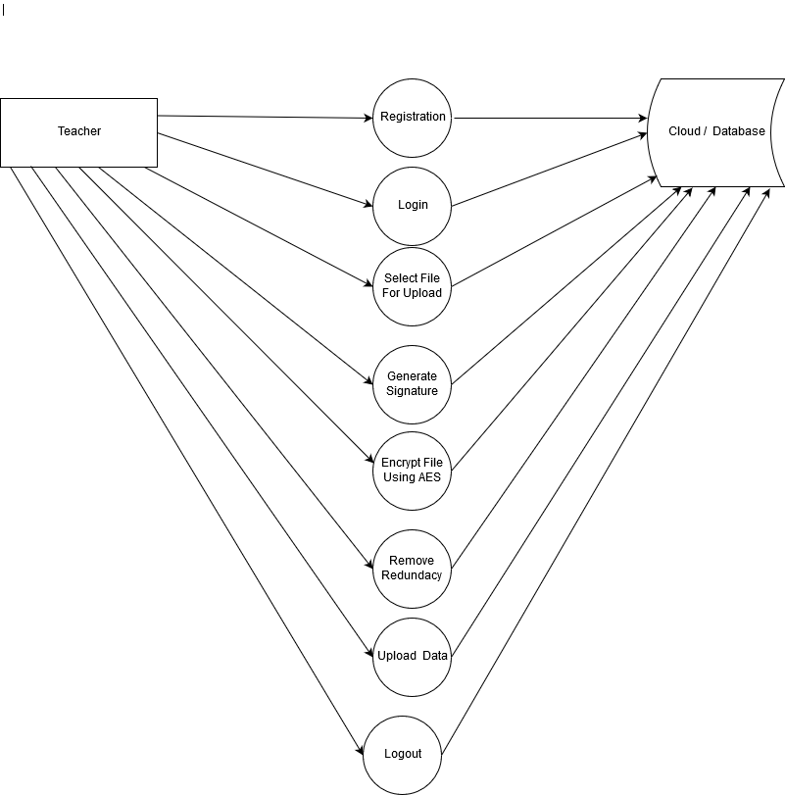
DFD2 Teacher Diagram

Slide 24
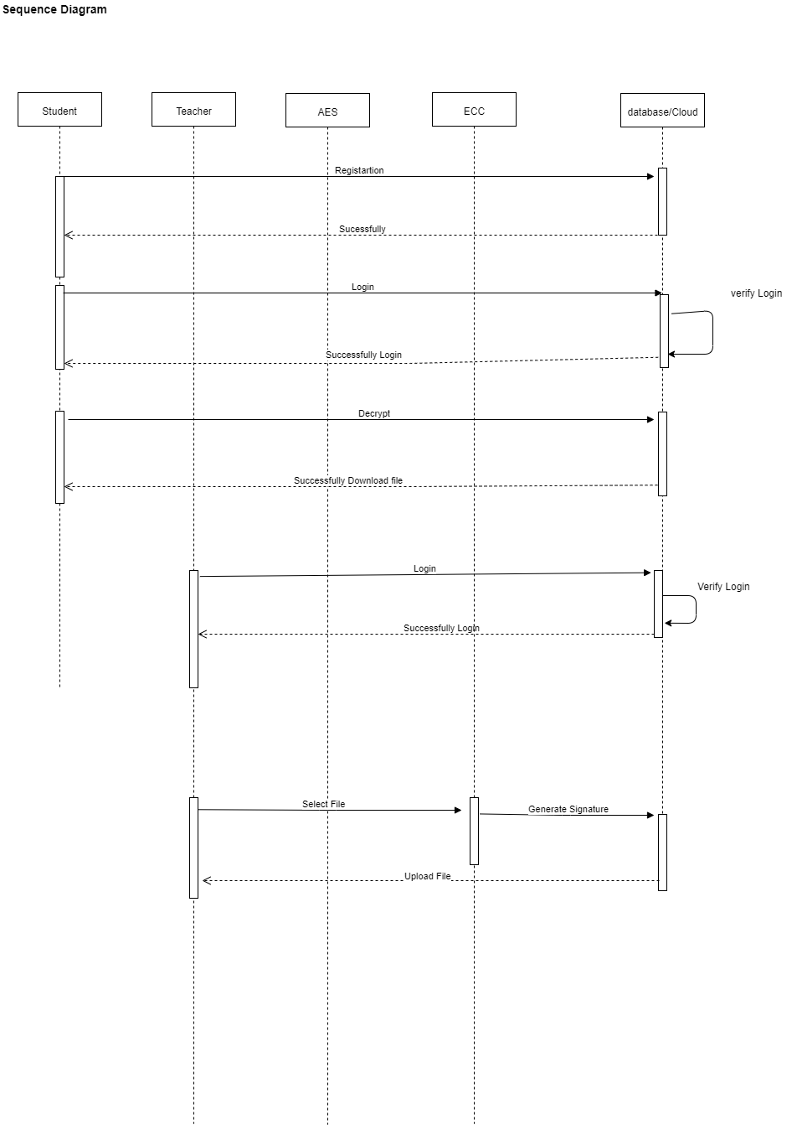
Sequence diagram

Slide 25
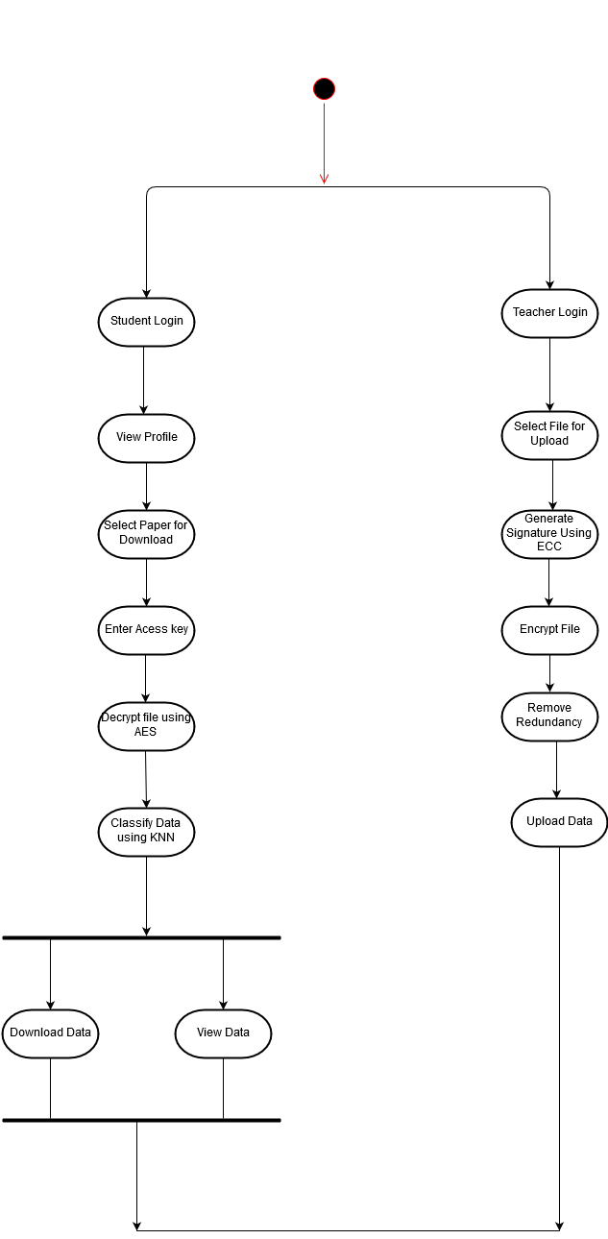
Activity diagram

Slide 26
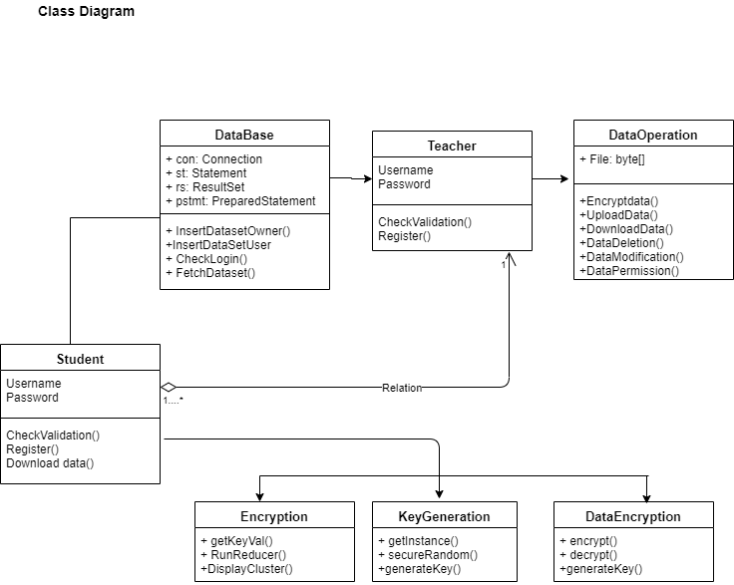
Class Diagram

Slide 27
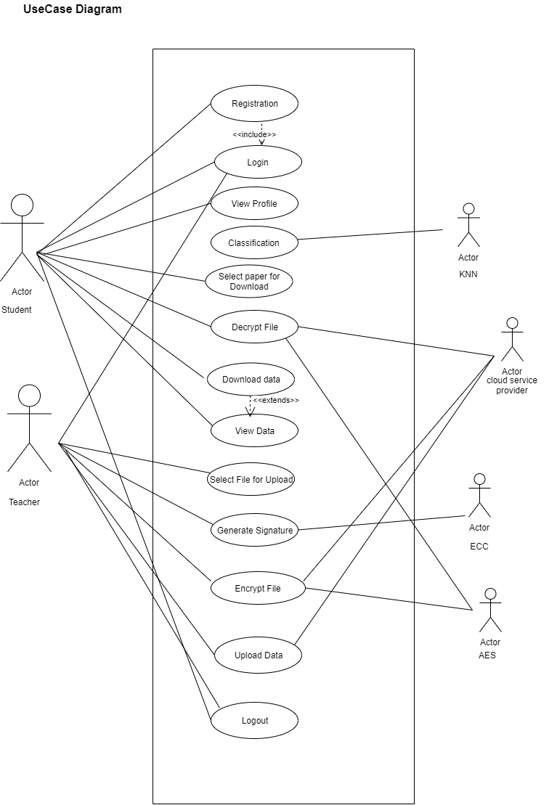
Usecase Diagram

Slide 28
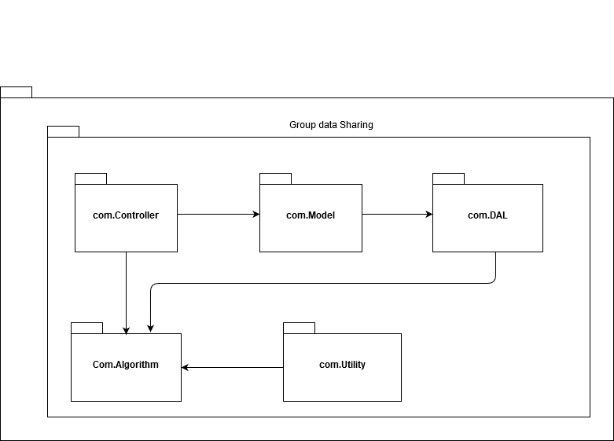
Package Diagram

Slide 29
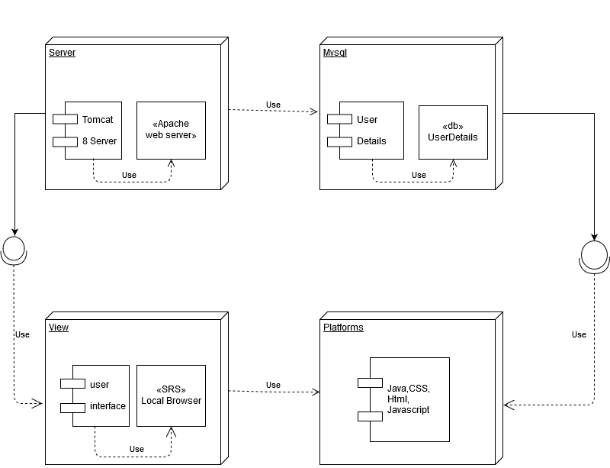
Deployment Diagram

Slide 30
System Requirements
Hardware Requirements
Processor – Intel Core2Duo, Pentium –i3
Speed – 2.4 GHz (min)
RAM - 2 GB (min)
Hard Disk - 50 GB (min)
Software Requirements
System: Ubuntu 14.04 / Windows 7
IDE: Eclipse
Front End: Java ,HTML,CSS,Javascript,jsp
Back End:Database: MySql Workbench 8.0 Webserver: Apache Tomcat 8.0
Cloud:Amazon Simple Storage Service(S3)

Slide 31
Conclusion
We have tried in our system to provide a new and innovative solution for media services that can be accessed from smart devices cloud based intelligent service environment with a fully integrated system,which will access files from the cloud and use it for their well being. We have used KNN algorithm for classification and advanced encryption standards to encrypt the data being stored on the cloud.

Slide 32
references
[1] Strahil A. Sokolov, Asen P.Zahariev, Stefan M. Vlaev , “Technology E-learning Evironment for Hybrid Cloud”, International Symposium for Design and Technology in Electronic Packaging, vol. 3, pp. 38-42, 2017.
[2]Haibo Yi, Zhe Nie,“Implementation of Learning Management System Based on Cloud Computing”, International Conference on Information Science and Control Engineering, vol. 2, pp. 478-481, 2017.
[3] Qasim Alajmi, Ali Sadiq “E-Learning Models: The Effectiveness of the Cloud Based E-Learning Model over the Traditional Elearning Model”4(3), pp. 311-316, 2017.
[4], Abiodun Kilanko, Falade Adesola and Isaac Odun-Ayo Member, “Elearning on Cloud-An Analysis”,International MultiConference of Engineers and Computer Scientists vol. 49, pp. 399-404, 2019.
[5] M. A. H. Masud and X. Huang, "An e-learning system architecture based on cloud computing," system, vol. 10, 2017.
[6] Q. Alajmi and A. Sadiq, "in the preceding of Information Technology, Electronics and Mobile Communication Conference (IEMCON) IEEE 7th Annual,pp.1-5, 2016.
[7] C. Lee, Handbook of Research on Cloud-Based STEM Education for Improved Learning Outcomes. IGI Global, 2016.

Slide 33
THANK YOU

