Slide 1
Linear Regression

Slide 2
Is there a relationship between advertising budget and sales?
How strong is the relationship between advertising budget and sales?
Which media contribute to sales?
How accurately can we estimate the effect of each medium on sales?
How accurately can we predict future sales?
Is the relationship linear?
Is there synergy among the advertising media?

Slide 3



Simple Linear Regression

Slide 4
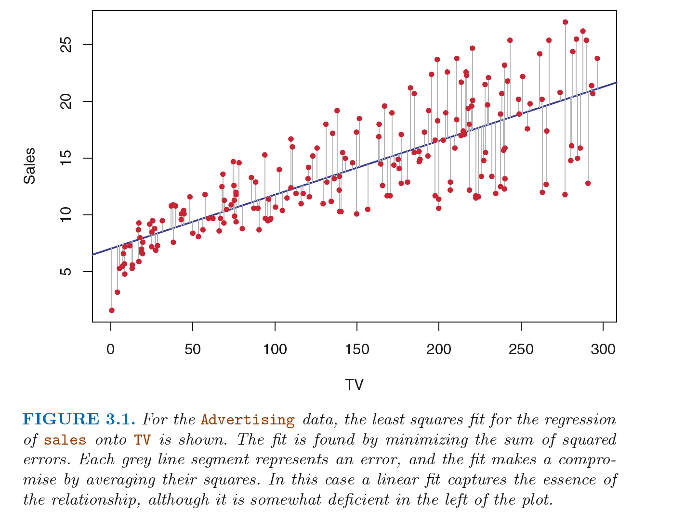

Slide 5
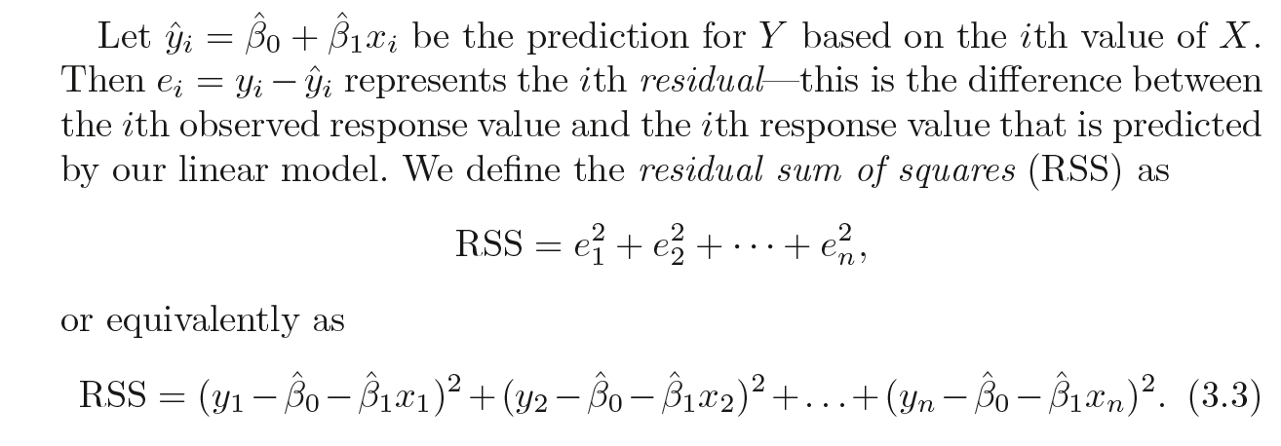
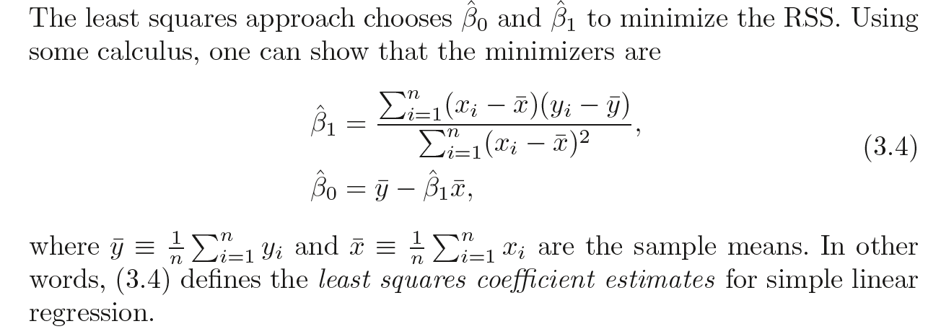

Slide 6
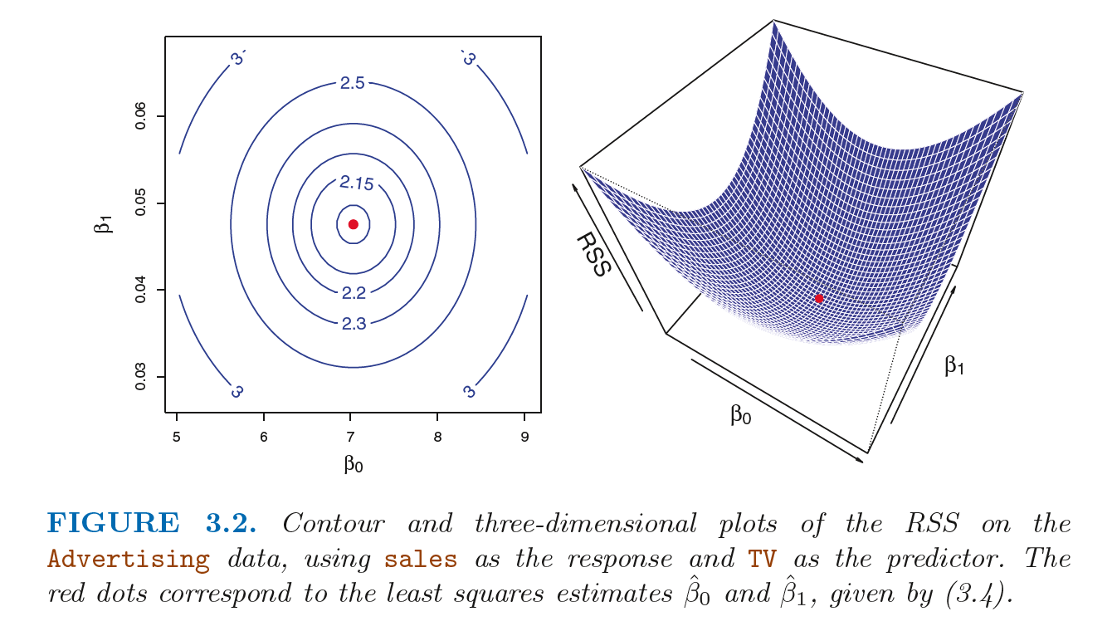

Slide 7


Assessing the Accuracy of the Coefficient Estimates
Population Regression Line

Slide 8
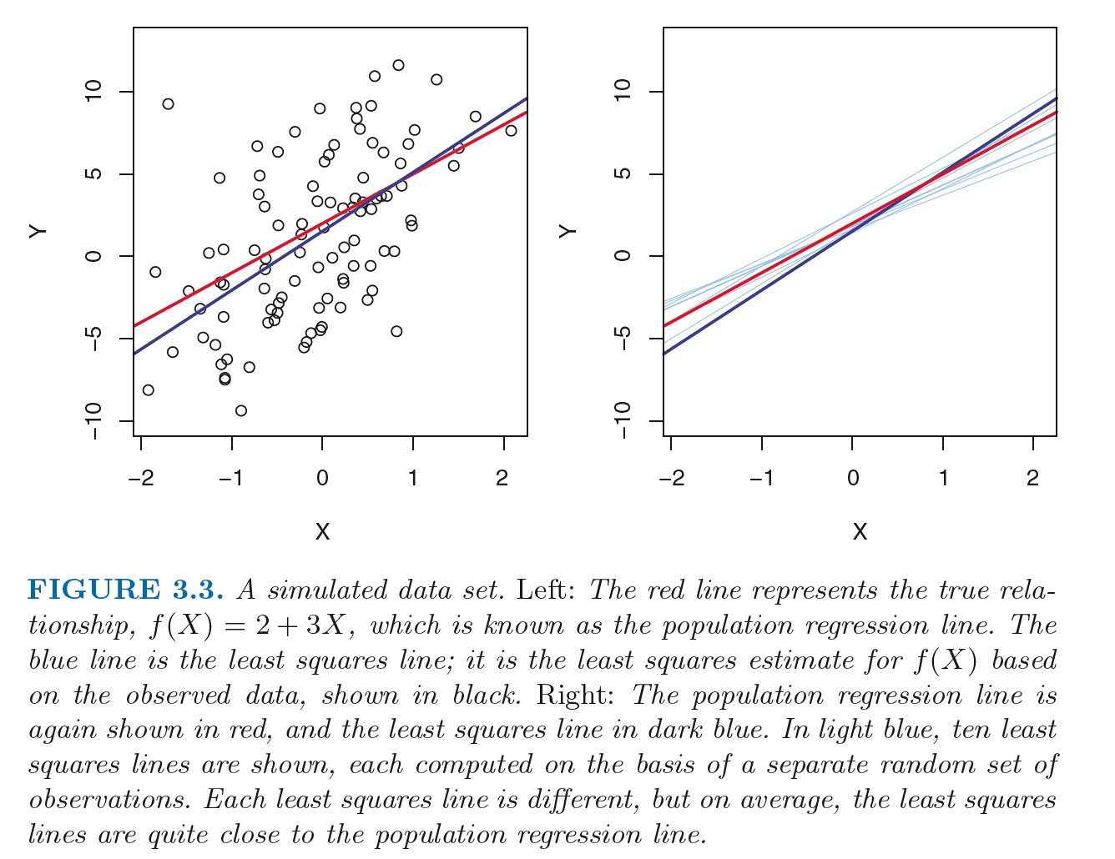

Slide 9
population regression line and the least squares line?
Concept of these two lines is a natural extension of the standard statistical approach of using information from a sample to estimate characteristics of a large population

Slide 10
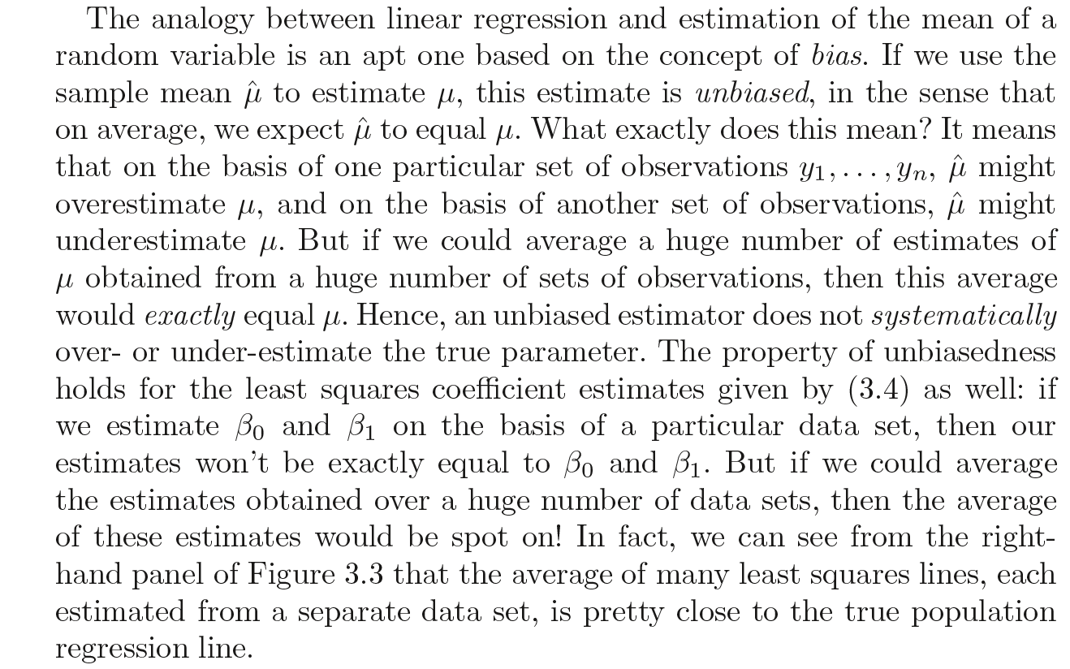

Slide 11
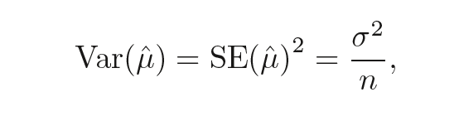
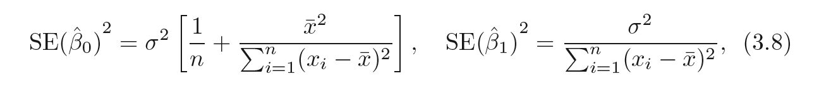


Slide 12
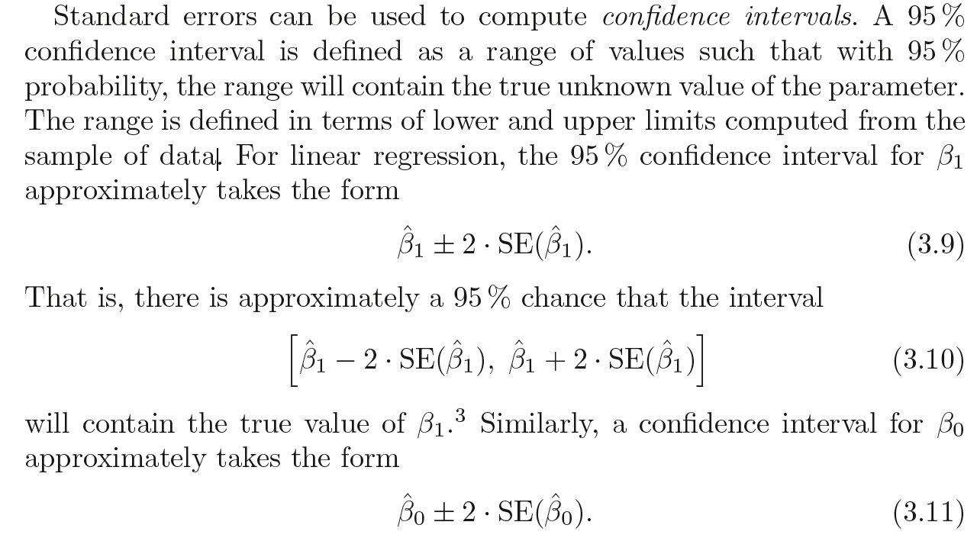

Slide 13
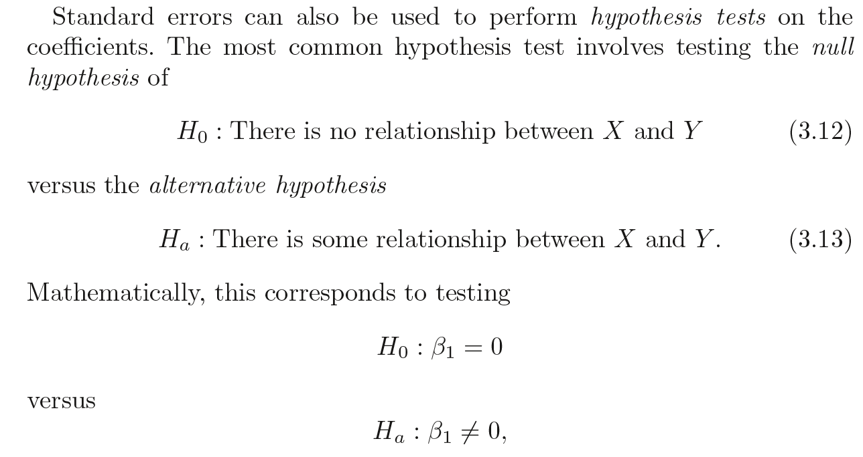

Slide 14
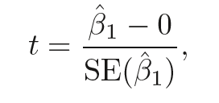
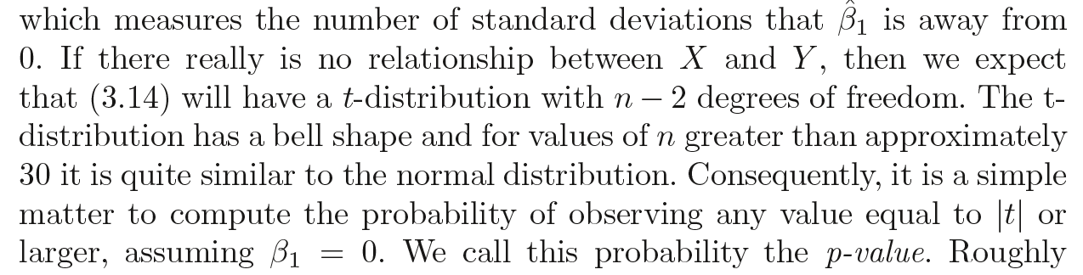
t-statistics

Slide 15
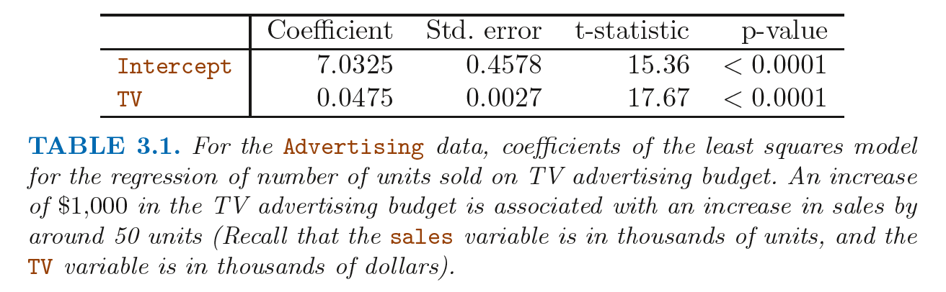

Slide 16
Assessing the Accuracy of the Model
Once we have rejected the null hypothesis (3.12) in favor of the alternative hypothesis (3.13), it is natural to want to quantify the extent to which the model fits the data.
We use
RSE – Residual Standard Errors
R square

Slide 17
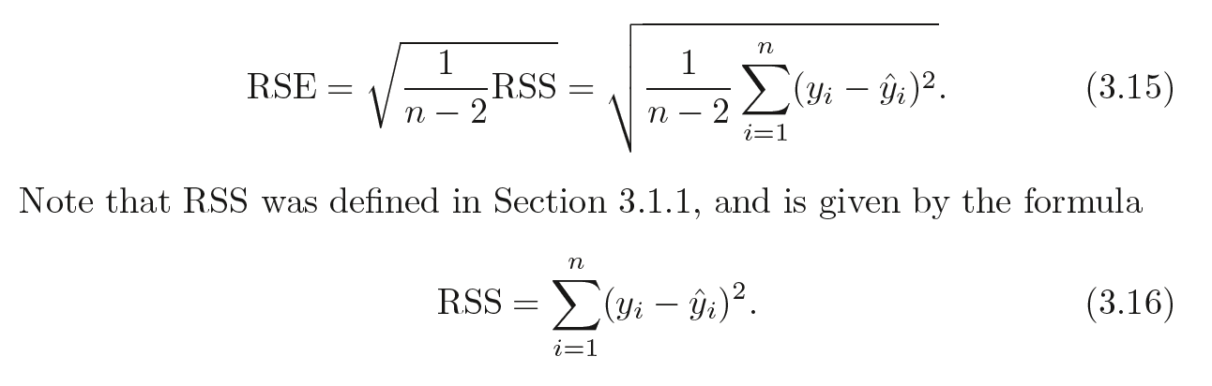
Residual Standard Error
Population Regression Line
The RSE is an estimate of the standard deviation of e
Roughly speaking, it is the average amount that the response will deviate from the true regression line

Slide 18
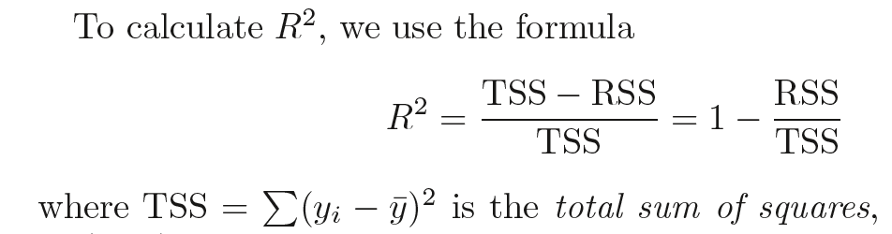
R² Statistic
The RSE provides an absolute measure of lack of fit of the model to the data. But since it is measured in the units of Y, it is not always clear what constitutes a good RSE.
R² takes the form of a proportion - the proportion of variance explained
takes on a value between 0 and 1, and is independent of the scale of Y

Slide 19
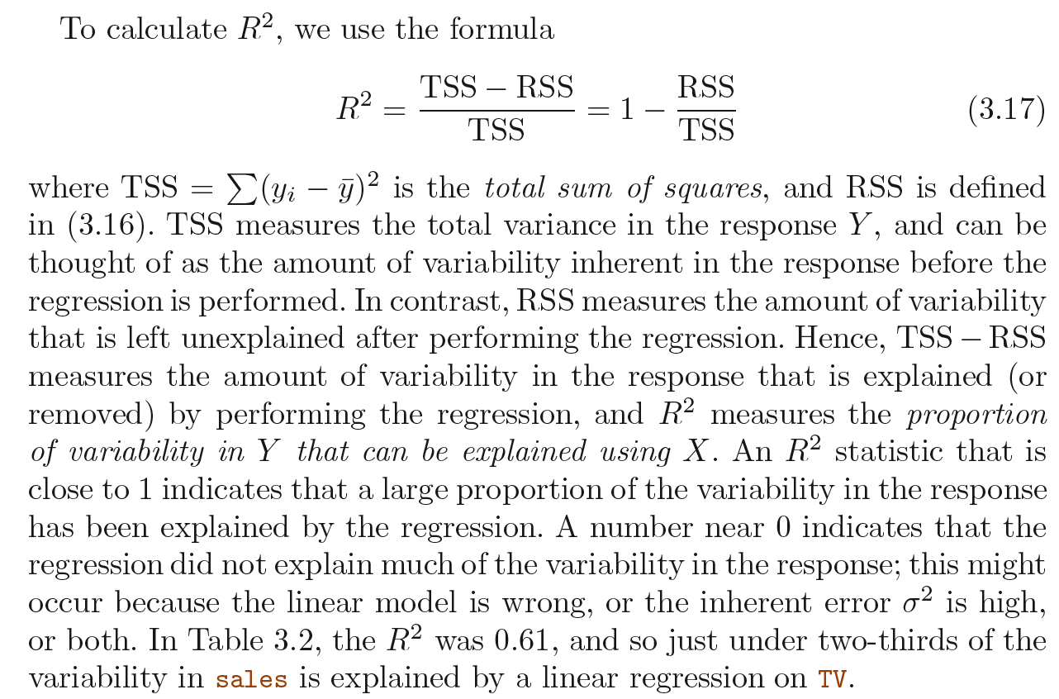

Slide 20
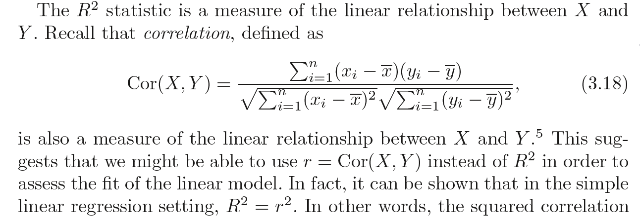
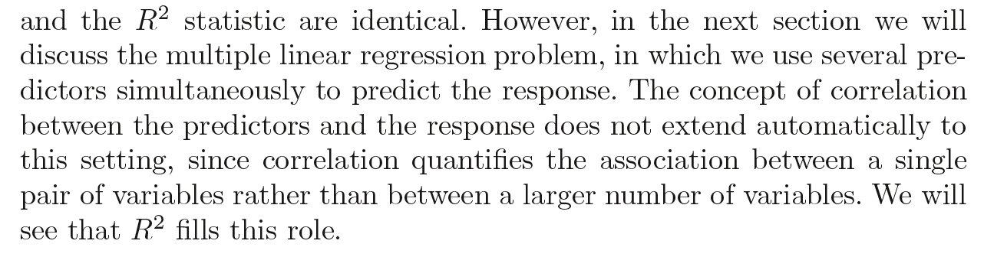

Slide 21

Multiple Linear Regression

Slide 22
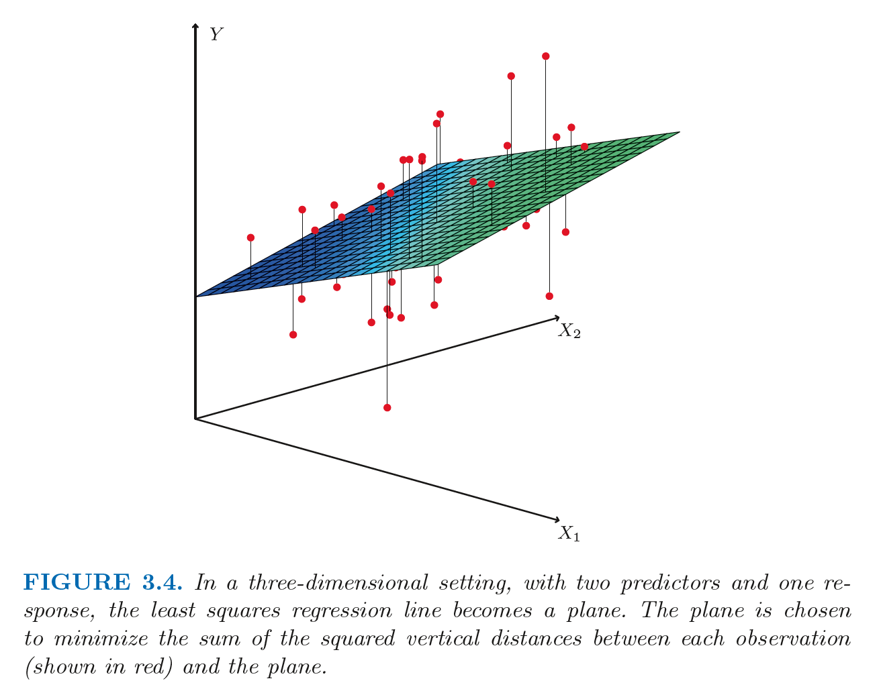

Slide 23
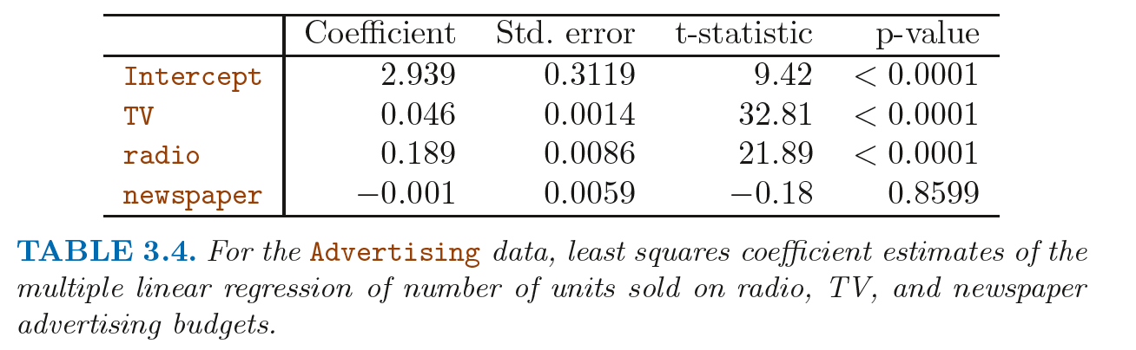

Slide 24
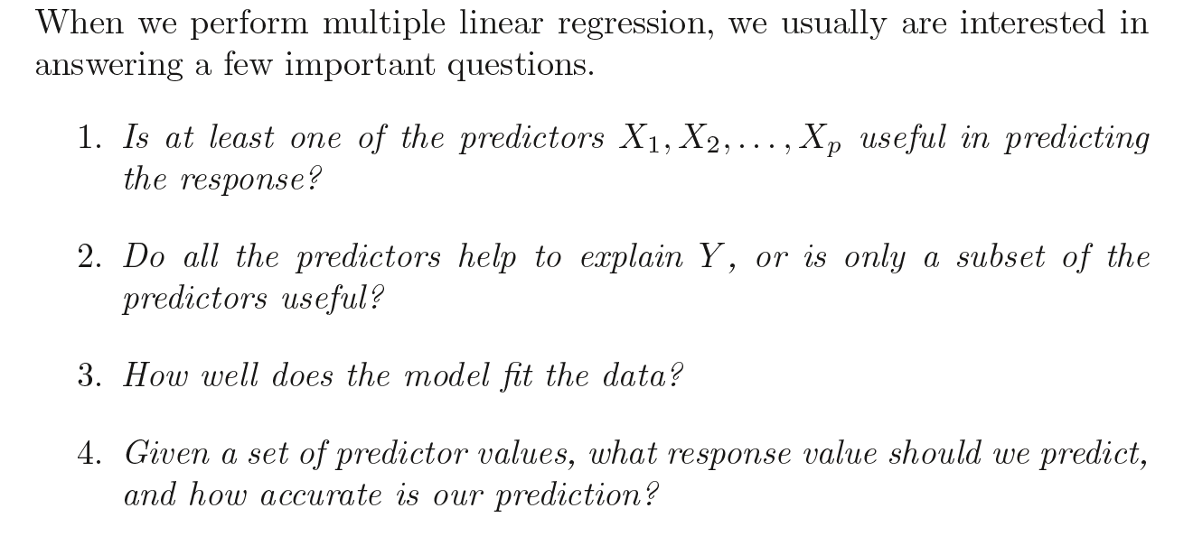
Some Important Questions

Slide 25
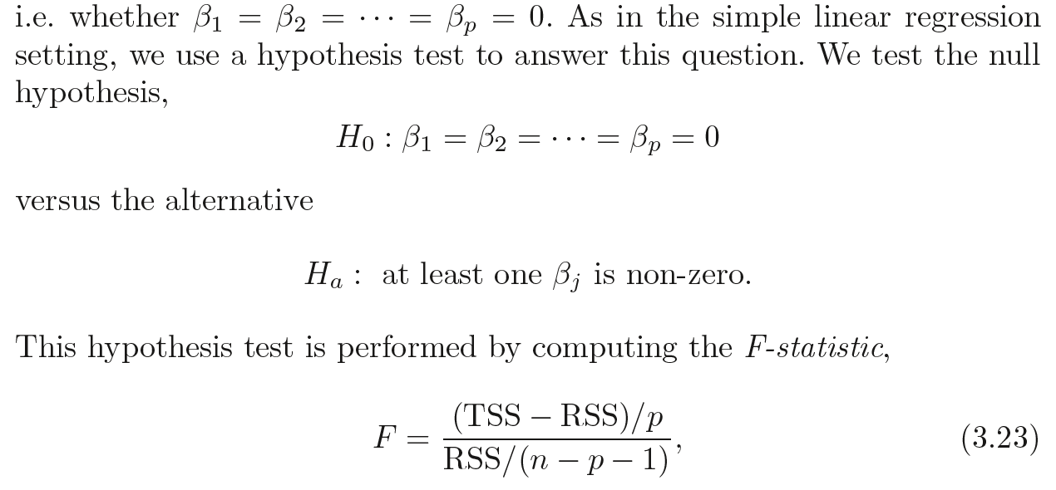



Is There a Relationship Between the Response and Predictors?

Slide 26
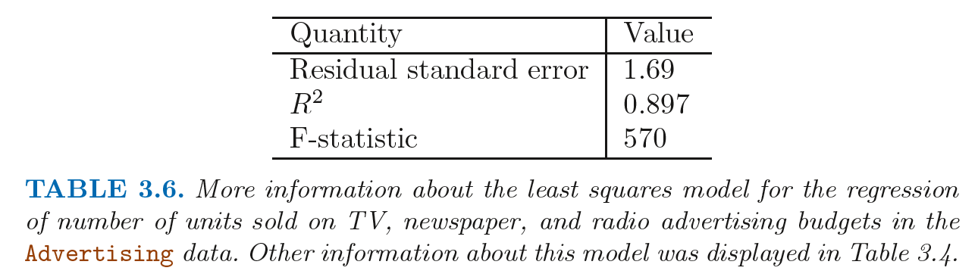
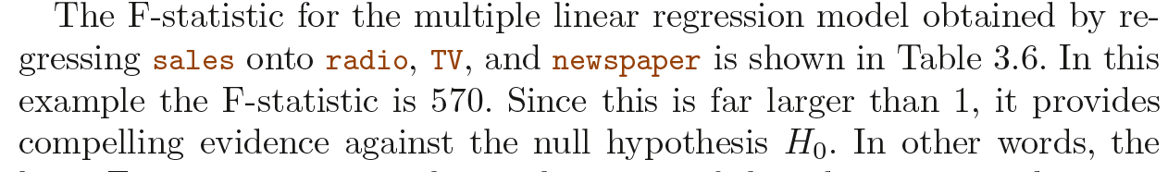

Slide 27
Do all the predictors help to explain Y, or is only a subset of the predictors useful?
The task of determining which predictors are associated with the response, in order to fit a single model involving only those predictors, is refe
if p = 2, then we can consider four models: (1) a model containing no variables, (2) a model containing X1 only, (3) a model containingX2 only, and (4) a model containing both X1 and X2
Unfortunately, there are a total of 2p models that contain subsets of p variables.
if p = 30, then we must consider 230 = 1, 073, 741, 824 models! This is not practical

Slide 28
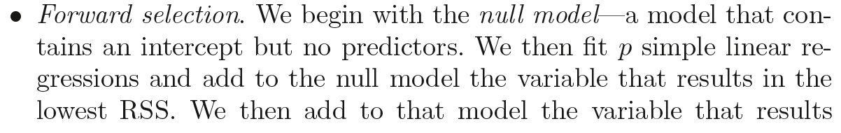
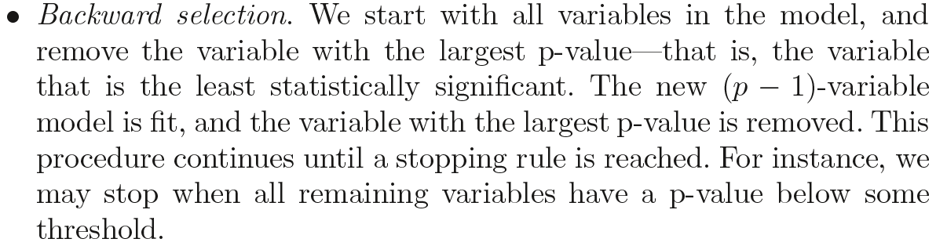
Variable Selection Approaches
We need an automated and efficient approach to choose a smaller set of models to consider. There are three classical approaches for this task:
Forward selection
Backward selection
Mixed selection
This is a combination of forward and backward selection

Slide 29
How well does the model fit the data?

Slide 30
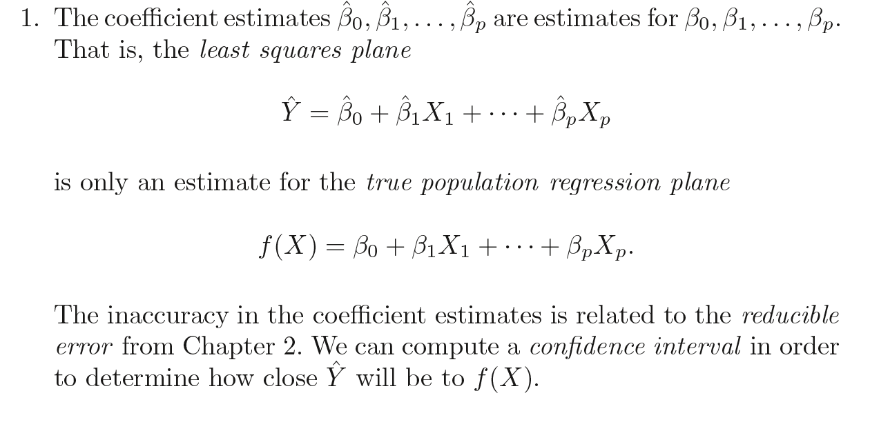
Given a set of predictor values, what response value should we predict, and how accurate is our prediction?
Three sorts of uncertainty associated with prediction

Slide 31
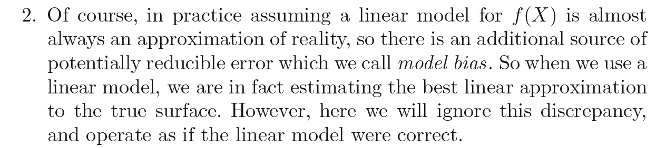
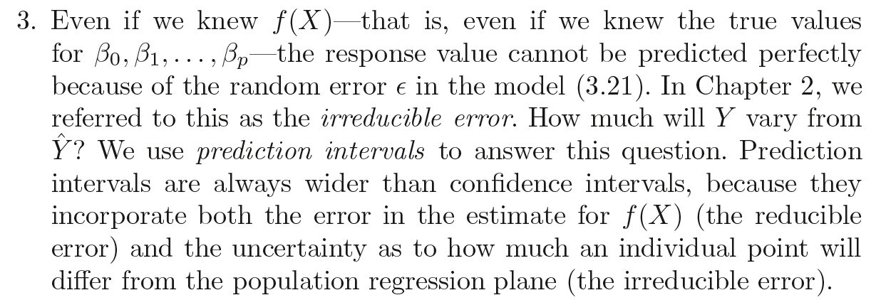

Slide 32
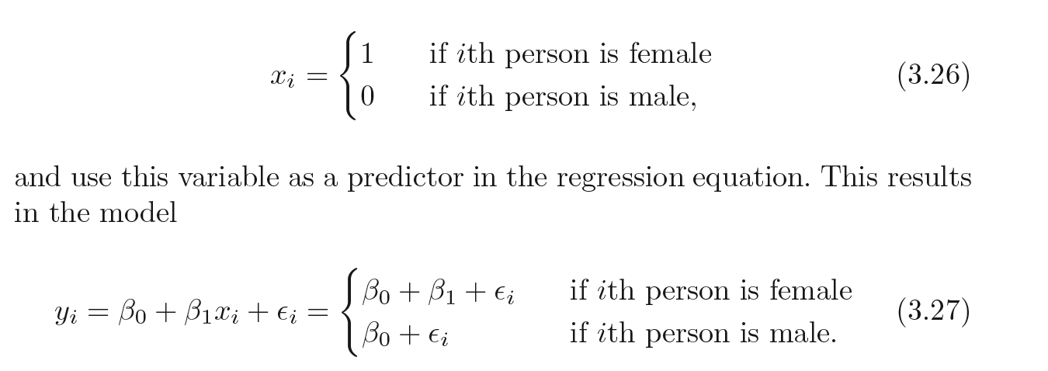
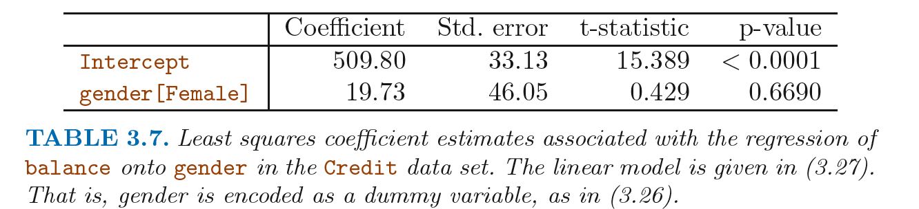
Other Considerations in the Regression Model
Qualitative Predictors

Slide 33
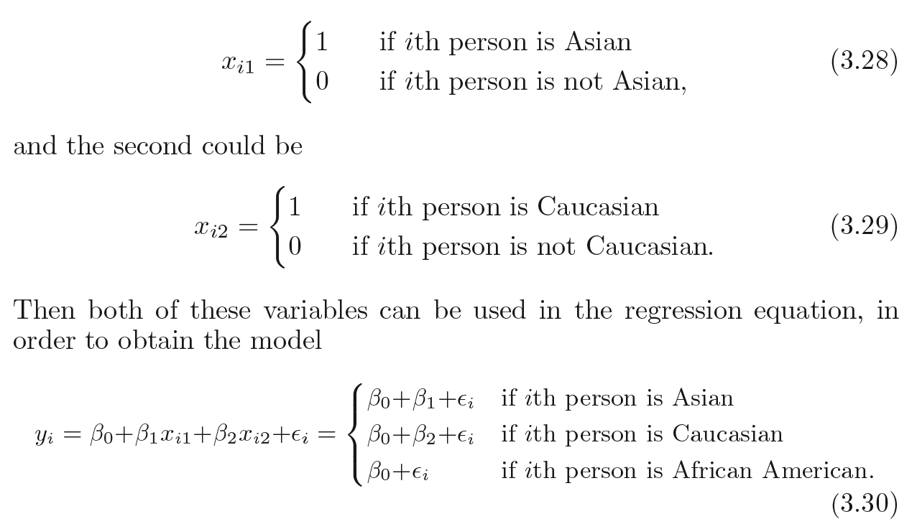
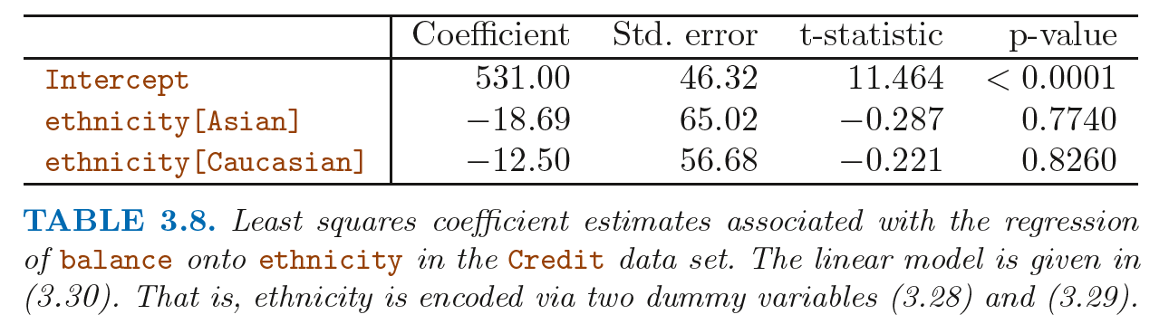
Qualitative Predictors with More than Two Levels

Slide 34
Extensions of the Linear Model
Linear regression makes highly restrictive assumptions that are often violated in practice
Additive
Linear
polynomial regression.

Slide 35
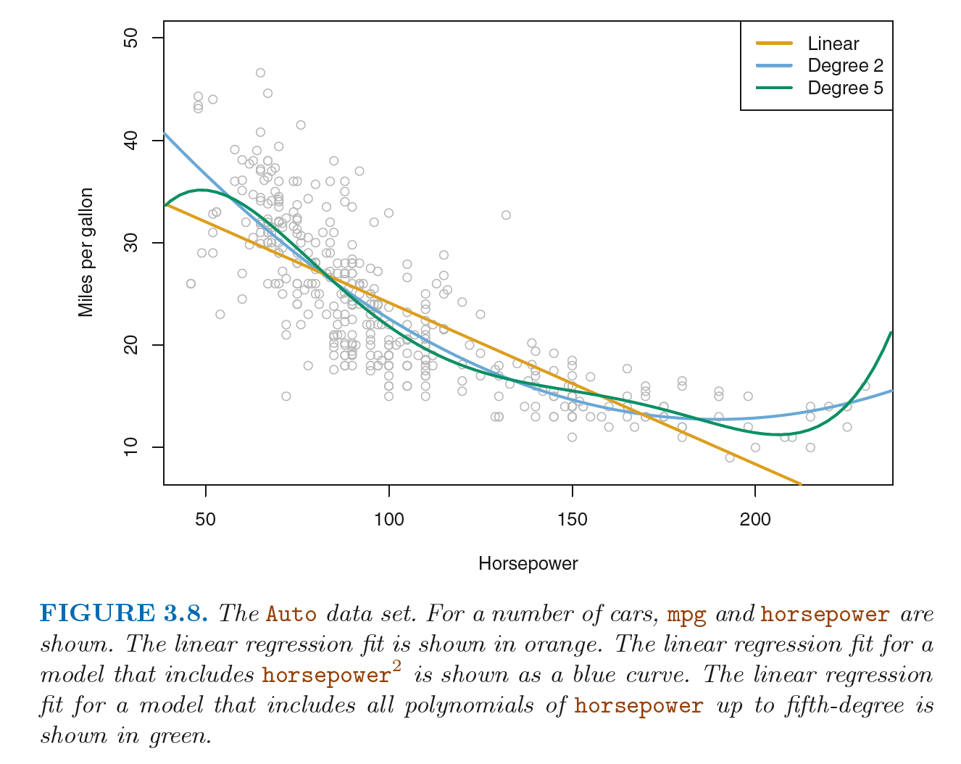
Polynomial regression

Slide 36
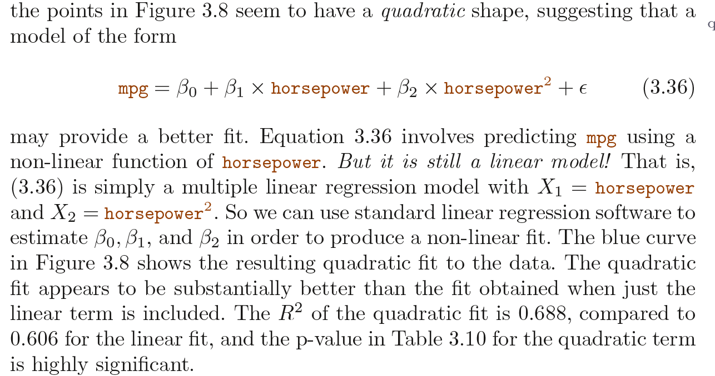

Slide 37
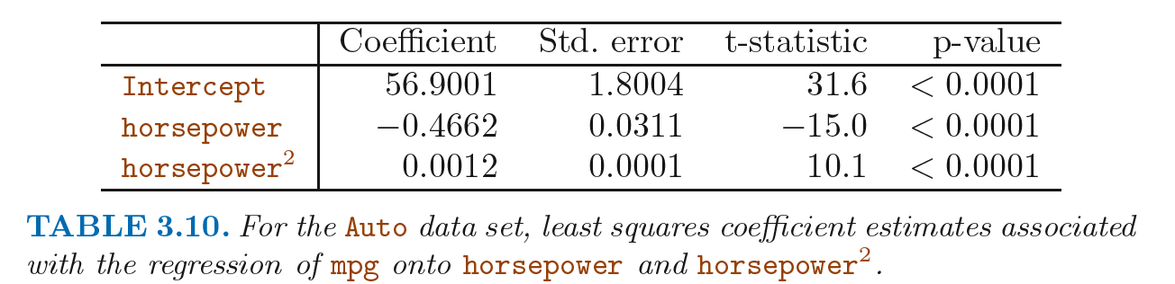
If including horsepower2 led to such a big improvement in the model, why not include horsepower3 , horsepower4 , or even horsepower5

Slide 38
Comparison of Linear Regression with K-Nearest Neighbors
Linear regression is an example of a parametric
assumes a linear functional form for f (X )
K-nearest neighbors regression
non-parametric methods
do not explicitly assume any function

Slide 39
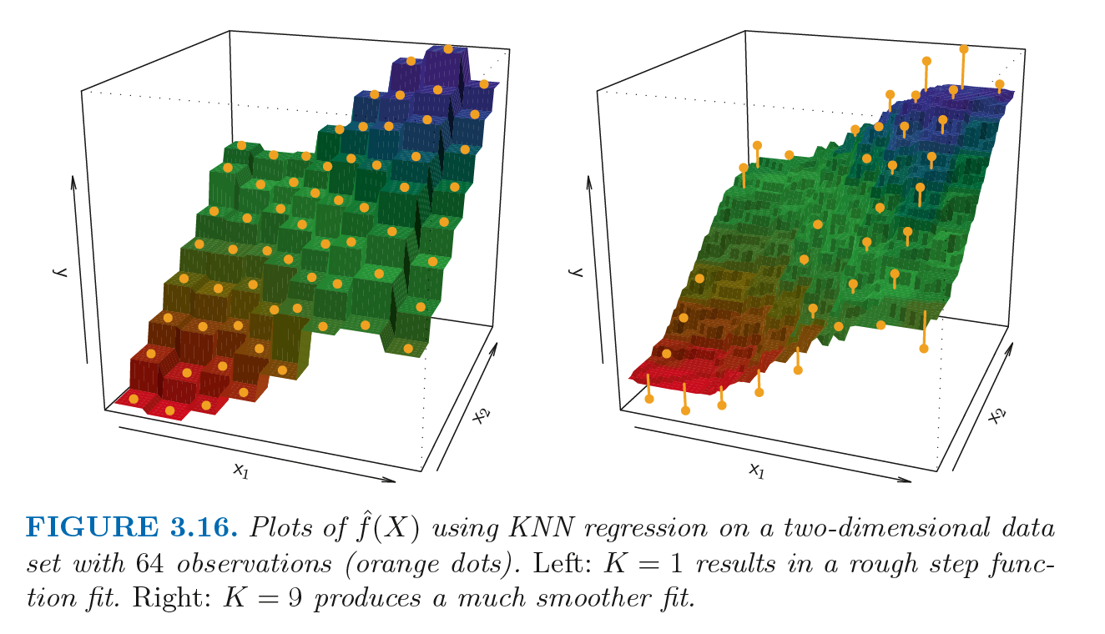

Slide 40
