Slide 1
Chapter5 - Resampling methods
Resampling methods are an indispensable tool in modern statistics. They involve repeatedly drawing samples from a training set and reﬁtting a model of interest on each sample in order to obtain additional information about the ﬁtted model. The process of evaluating a model’s performance is known as model assessment, whereas the process of selecting the proper level of ﬂexibility for a model is known as model selection.
Two of the most commonly used resampling methods
Cross-validation
The Validation Set Approach
Leave-One-Out Cross-Validation
k-Fold Cross-Validation
Bootstrap

Slide 2
The Validation Set Approach
Suppose that we would like to estimate the test error associated with ﬁtting a particular statistical learning method on a set of observations. The validation set approach, displayed in Figure 5.1, is a very simple strategy for this task. It involves randomly dividing the available set of observations into two parts, a training set and a validation set or hold-out set. The model is ﬁt on the training set, and the ﬁtted model is used to predict the responses for the observations in the validation set. The resulting validation set error rate—typically assessed using MSE in the case of a quantitative response—provides an estimate of the test error rate

Slide 3
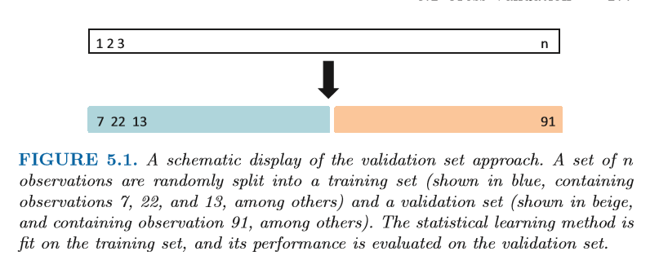
We illustrate the validation set approach on the Auto data set. Recall from Chapter 3 that there appears to be a non-linear relationship between mpg and horsepower, and that a model that predicts mpg using horsepower and horsepower2 gives better results than a model that uses only a linear term.

Slide 4
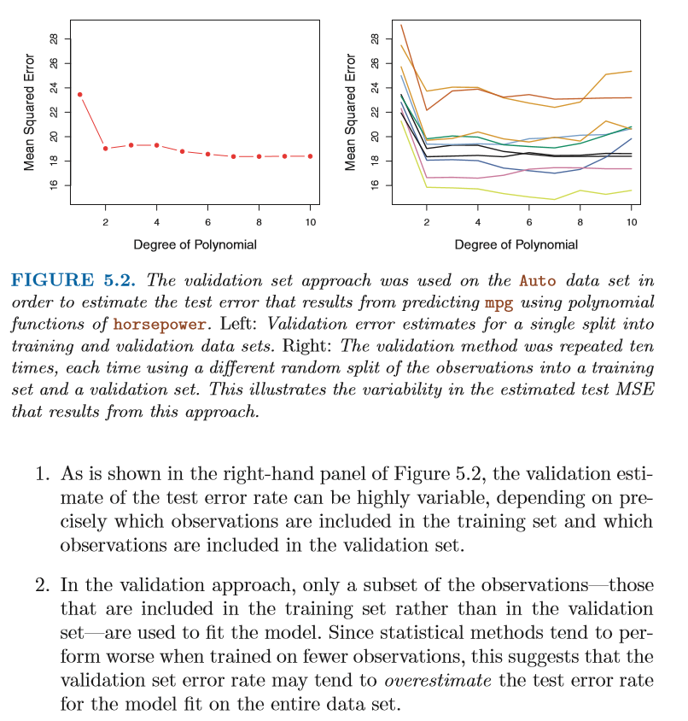

Slide 5

Leave-One-Out Cross-Validation
Leave-one-out cross-validation (LOOCV) is closely related to the validation set approach, but it attempts to address that method’s drawbacks.
Like the validation set approach, LOOCV involves splitting the set of observations into two parts. However, instead of creating two subsets of comparable size, a single observation (x1,y1) is used for the validation set, and the remaining observations {(x2,y2),...,(xn,yn)} make up the training set. The statistical learning method is ﬁt on the n − 1 training observations, and a prediction ˆ y1 is made for the excluded observation, using its value x1. Since (x1,y1) was not used in the ﬁtting process, MSE1 =(y1 − ˆ y1)2 provides an approximately unbiased estimate for the test error. But even though MSE1 is unbiased for the test error, it is a poor estimate because it is highly variable, since it is based upon a single observation (x1,y1). We can repeat the procedure by selecting (x2,y2) for the validation data, training the statistical learning procedure on the n−1 observations {(x1,y1),(x3,y3),...,(xn,yn)}, and computing MSE2 =( y2−ˆ y2)2. Repeating this approach n times produces n squared errors, MSE1,..., MSEn. The LOOCV estimate for the test MSE is the average of these n test error estimates:

Slide 6
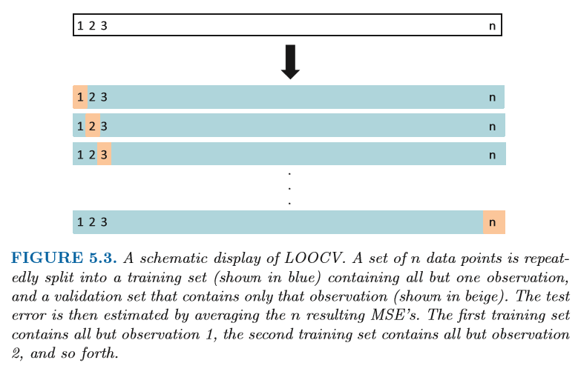

Slide 7
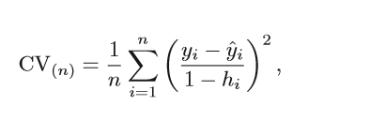

We used LOOCV on the Auto data set in order to obtain an estimate of the test set MSE that results from ﬁtting a linear regression model to predict mpg using polynomial functions of horsepower. The results are shown in the left-hand panel of Figure 5.4. LOOCV has the potential to be expensive to implement, since the model has to be ﬁt n times. This can be very time consuming if n is large, and if each individual model is slow to ﬁt. With least squares linear or polynomial regression, an amazing shortcut makes the cost of LOOCV the same as that of a single model ﬁt! The following formula holds:
where ˆ yi is the ith ﬁtted value from the original least squares ﬁt, and hi is

Slide 8
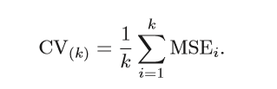
k-Fold Cross-Validation
An alternative to LOOCV is k-fold CV. This approach involves randomly dividing the set of observations into k groups, or folds, of approximately equal size. The ﬁrst fold is treated as a validation set, and the method is ﬁt on the remaining k − 1 folds. The mean squared error, MSE1, is then computed on the observations in the held-out fold. This procedure is repeated k times; each time, a diﬀerent group of observations is treated as a validation set. This process results in k estimates of the test error, MSE1,MSE2,...,MSEk. Thek-fold CV estimate is computed by averaging these values,

Slide 9
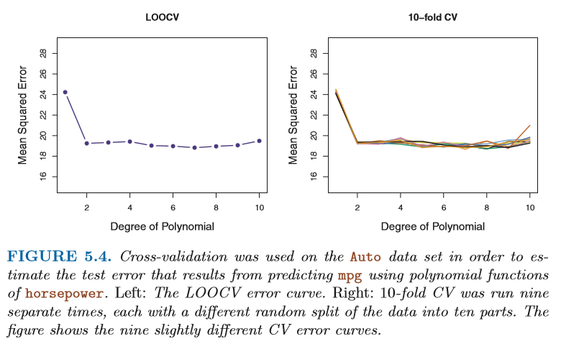
The right-hand panel of Figure 5.4 displays nine diﬀerent 10-fold CV estimates for the Auto data set, each resulting from a diﬀerent random split of the observations into ten folds. As we can see from the ﬁgure, there is some variability in the CV estimates as a result of the variability in how the observations are divided into ten folds. But this variability is typically much lower than the variability in the test error estimates that results from the validation set approach (right-hand panel of Figure 5.2).

Slide 10
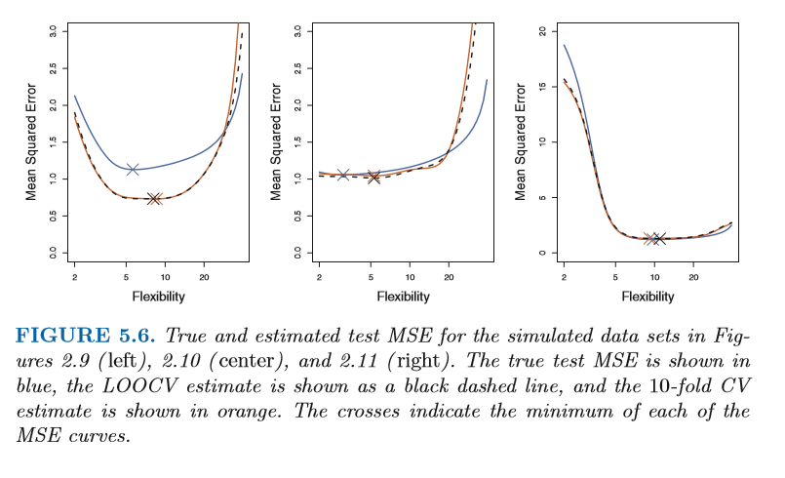
In Figure 5.6, we plot the cross-validation estimates and true test error rates that result from applying smoothing splines to the simulated data sets illustrated in Figures 2.9–2.11 of Chapter 2. The true test MSE is displayed in blue. The black dashed and orange solid lines respectively show the estimated LOOCV and 10-fold CV estimates. In all three plots, the two cross-validation estimates are very similar. In the right-hand panel of Figure 5.6, the true test MSE and the cross-validation curves are almost identical. In the center panel of Figure 5.6, the two sets of curves are similar at the lower degrees of ﬂexibility, while the CV curves overestimate the test set MSE for higher degrees of ﬂexibility. In the left-hand panel of Figure 5.6, the CV curves have the correct general shape, but they underestimate the true test MSE.

Slide 11
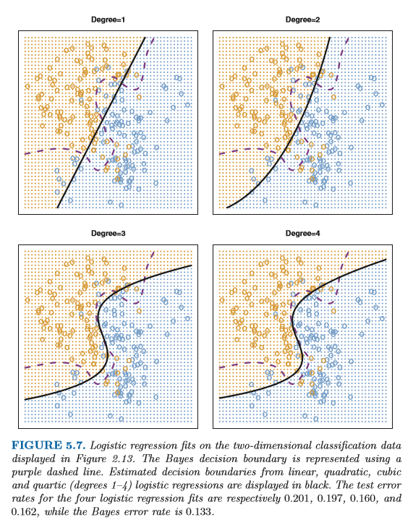
Cross-Validation on Classiﬁcation Problems

Slide 12
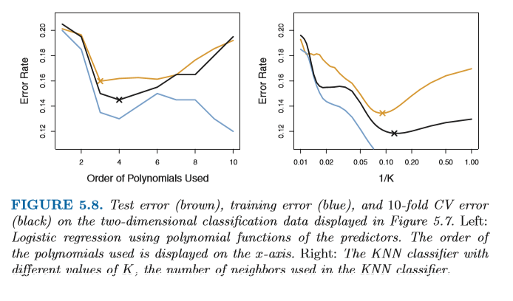
The left-hand panel of Figure 5.8 displays in black the 10-fold CV error rates that result from ﬁtting ten logistic regression models to the data, using polynomial functions of the predictors up to tenth order. The true test errors are shown in brown, and the training errors are shown in blue. As we have seen previously, the training error tends to decrease as the ﬂexibility of the ﬁt increases

Slide 13

The Bootstrap
The bootstrap is a widely applicable and extremely powerful statistical tool that can be used to quantify the uncertainty associated with a given estimator or statistical learning method. As a simple example, the bootstrap can be used to estimate the standard errors of the coeﬃcients from a linear regression ﬁt. bootstrap approach allows us to use a computer to emulate the process of obtaining new sample sets, so that we can estimate the variability of ˆ α without generating additional samples. Rather than repeatedly obtaining independent data sets from the population, we instead obtain distinct data sets by repeatedly sampling observations from the original data set.
Suppose that we wish to invest a ﬁxed sum of money in two ﬁnancial assets that yield returns of X and Y , respectively, where X and Y are random quantities. We will invest a fraction α of our money in X, and will invest the remaining 1−α in Y . Since there is variability associated with the returns on these two assets, we wish to choose α to minimize the total risk, or variance, of our investment. In other words, we want to minimize Var(αX +(1−α)Y ). One can show that the value that minimizes the risk is given by
where σ2 X = Var(X),σ2 Y = Var(Y ), and σXY = Cov(X,Y)

Slide 14


It is natural to wish to quantify the accuracy of our estimate of α. To estimate the standard deviation of ˆ α, we repeated the process of simulating 100 paired observations of X and Y , and estimating α using (5.7) 1,000 times. We thereby obtained 1,000 estimates for α, which we can call ˆ α1, ˆ α2,...,ˆ α1,000. The left-hand panel of Figure 5.10 displays a histogram of the resulting estimates. For these simulations the parameters were set to σ2 X =1,σ2 Y =1 .25, and σXY =0 .5, and so we know that the true value of α is 0.6. We indicated this value using a solid vertical line on the histogram. The mean over all 1,000 estimates for α is
very close to α =0 .6, and the standard deviation of the estimates is
This gives us a very good idea of the accuracy of ˆ α: SE(ˆ α) ≈ 0.083. So roughly speaking, for a random sample from the population, we would expect ˆ α to diﬀer from α by approximately 0.08, on average.

Slide 15
