Slide 1
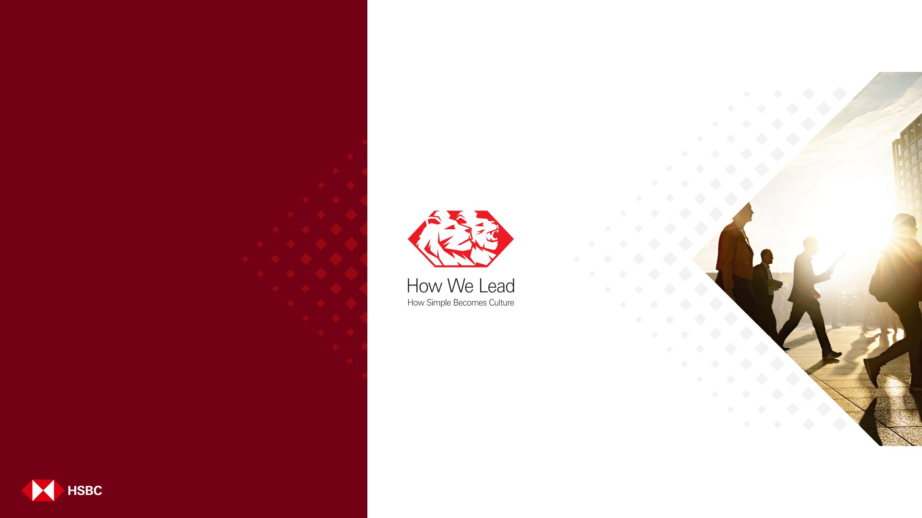
PORTFOLIO MANAGEMENT
Presented by Team: RunTime_Rebels Team Members: Prince Singh Prithiviraj
Vishnu priya Shreeya
‹#›

Slide 2
The Problem & The Solution
The Problem
Fragmented Investment Management
Investors rely on multiple disconnected platforms to manage different asset classes — creating silos, blind spots, and operational overhead.
The Solution
One Centralized Platform — Wealth Ledger brings every major asset class under a single roof, eliminating the fragmentation that plagues modern retail investors.
Manual P/L Tracking
Profit and loss calculations done by hand are time-consuming, error-prone, and impossible to scale across a growing portfolio.
All Asset Classes
Stocks, ETFs, Fixed Deposits, Cash & Commodities
Single Dashboard
Complete portfolio view with real-time performance
Global Complexity
Currency conversion across international investments adds a further layer of friction — with no automated tooling to reconcile multi-currency holdings.
Automated Tracking
Transactions, P/L, and currency conversion
— hands-free

Slide 3
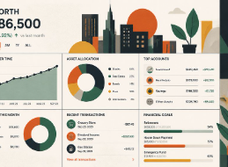
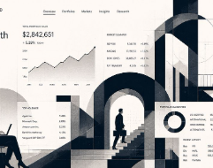
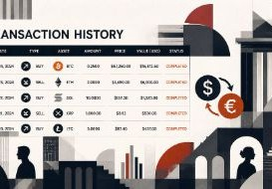
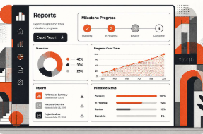
Key Features
Portfolio Dashboard
Investment Management
Transaction Management
Reporting G Milestones
Total Net Worth & Daily Change Asset Allocation Overview
Top Gainers & Recent Activity
Add, Edit & Delete Investments Stocks, ETFs, Fixed Deposits, Cash & Commodities
Buy/Sell Tracking with P/L Calculations
Transaction History & FX Conversion
Export Portfolio Data
Track Milestones & Financial Goals

Slide 4
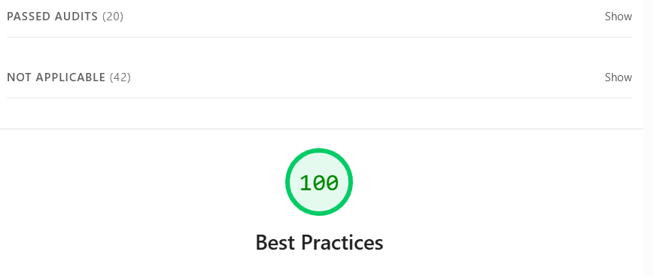
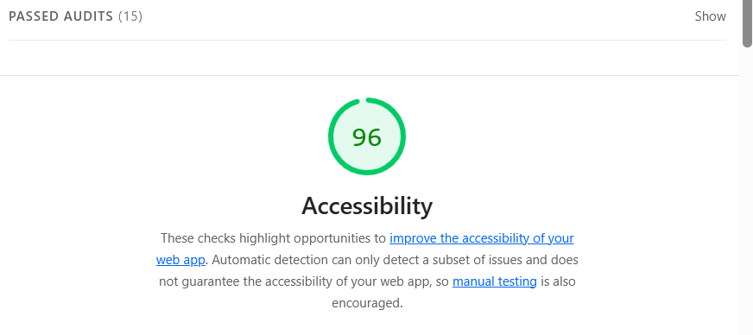
Lighthouse Screenshots

Slide 5
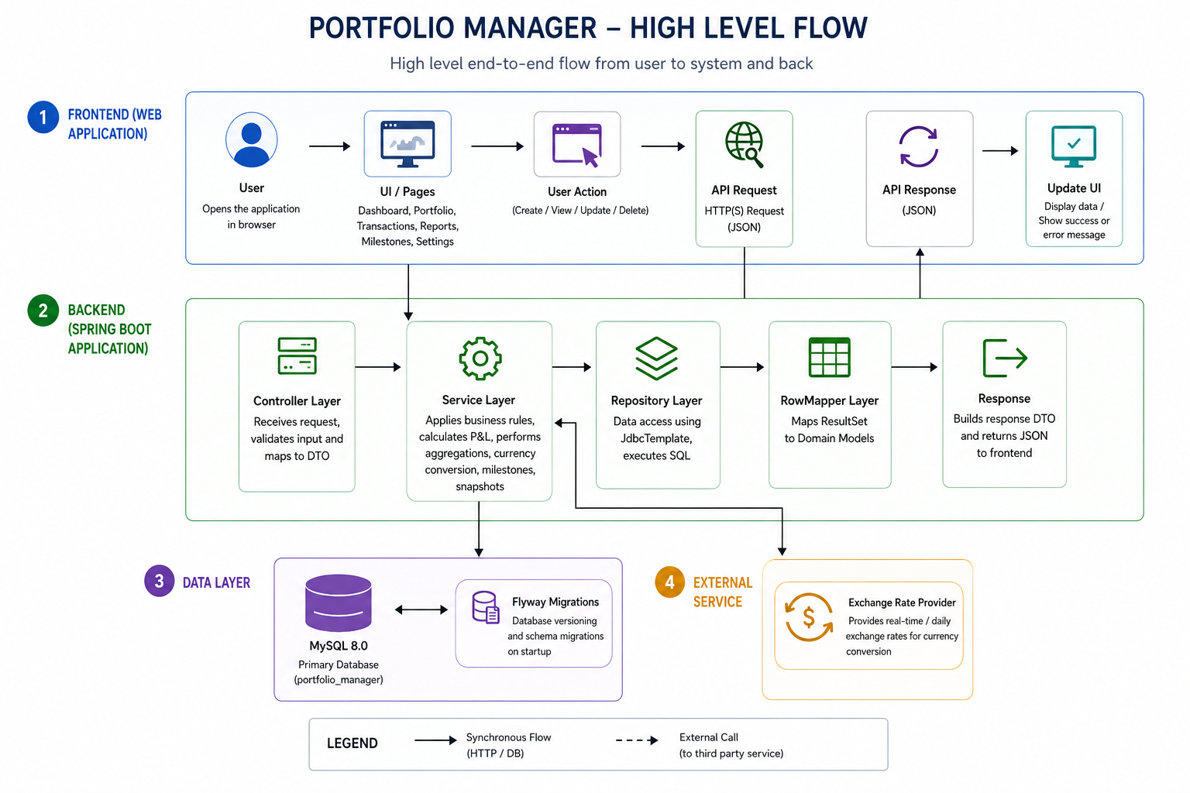

Slide 6
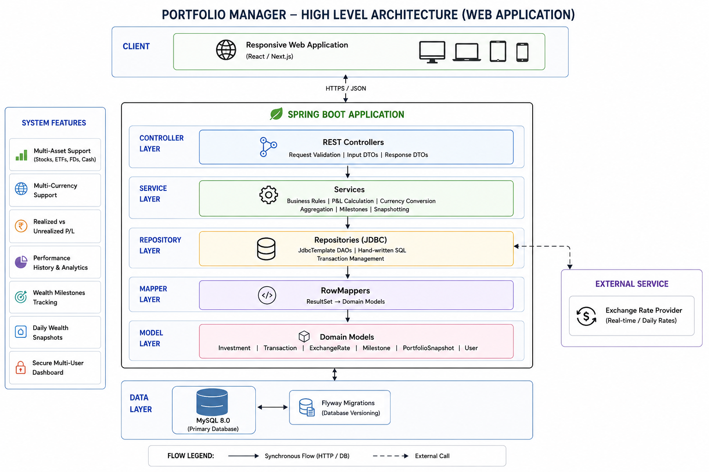

Slide 7
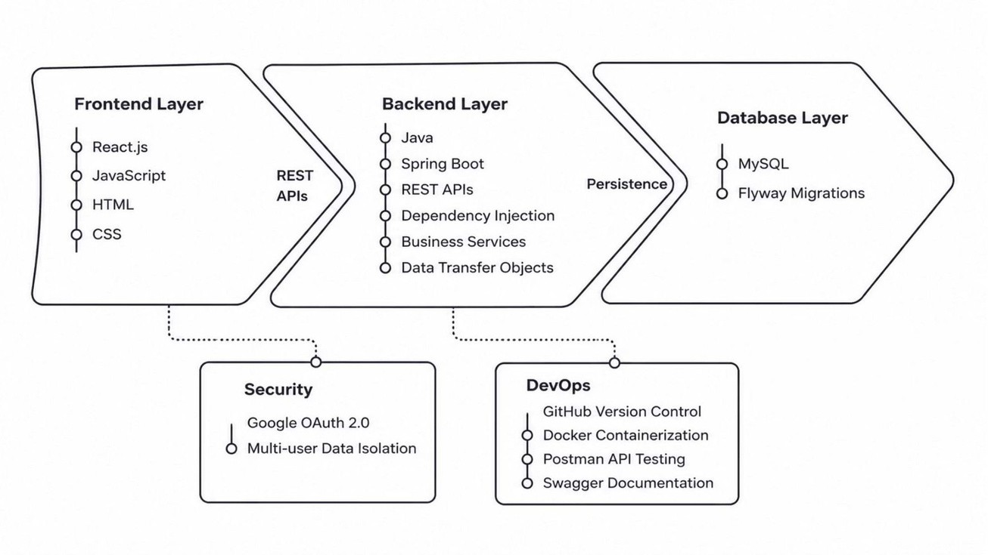
TECHNOLOGY STACK

Slide 8

THANK YOU
‹#›

