Slide 1
Payments Processing System
Presenter: Felix, Ellan, Vianne, Mia
2026.7.31
Notes:
Good morning/afternoon everyone. Welcome to our course project presentation.
Today we will show you our Payments Processing System – a complete lifecycle management system for financial payments.
We built it with Spring Boot 3 on the backend, and Vue 3 on the frontend.
Let’s walk through what we did, how it works, and what I personally contributed.

Slide 2
Agenda
• Project Background and Goals
• System Architechure
• Core Feature Modules Overview
• Our Contribution
• Live Demo
• Summary
Notes:
Here is our agenda for today.
We’ll start with the project background and goals.
After that, we’ll show the system design and tech stack.
Then we’ll share our contributions in detail.
We’ll do a live demo of the main features.
Finally, we’ll cover testing and summary.
Feel free to ask questions at the end.

Slide 3
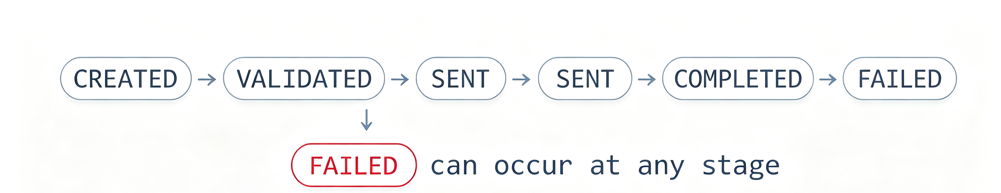
Project Background and Goals
Project background
Full-stack development hands-on training that simulates a real-world payment system lifecycle.
Goals
Build a payment full-lifecycle management system:
Notes:
This project is a full-stack development training exercise. We are simulating a real-world payment system lifecycle – the kind you would find in a bank or a fintech company. The goal is to give us hands-on experience with REST APIs, database design, and frontend integration, all while following professional teamwork practices."
Our primary goal is to build a complete payment lifecycle management system. This means we handle a payment from the moment it is created, through validation, then sending, and finally either completion or failure. In other words, we cover the entire journey of a financial transaction."

Slide 4
System Architecture
Frontend
Backend: Spring Boot 3
Database
Vue 3 + Element Plus
HTTP
API
Controller / Service / Validator
MySQL
vue-router + vue-i18n
StateMachine / MyBatis-Plus
Fig.1 Application Layer Architecture
Notes:
On the frontend, we use Vue 3 with Element Plus for UI components, vue-router for navigation, and vue-i18n for three languages: English, Chinese, and German.
On the backend, it’s Spring Boot 3, MyBatis-Plus for database access, and MySQL. We follow a clear layered architecture: Controller, Service, Validator, and State Machine.
All API responses follow a uniform format: { success, data, errorCode, message }.
We have global exception handling using @RestControllerAdvice to convert errors into that same format.
We also provide Swagger/OpenAPI documentation for all endpoints.
And we have a scheduled task that simulates network delay – it automatically advances payments asynchronously.

Slide 5
Core Feature Modules Overview
Payment creation
Payment details view + failure error details display
Payment status history timeline
Payment list retrieval
Recycle bin
Manual status transition interface
Notes:
Let me quickly list the main features we built:
Create a payment with an idempotency key to prevent duplicate submissions.
View payment details, including failure error details.
See the full audit trail – the history timeline of state changes.
List all payments with filtering by status and pagination.
A recycle bin – for soft delete, restore, and permanent delete – with a 30‑day retention rule.
And manual state transition endpoints – these are useful for demos and testing.

Slide 6
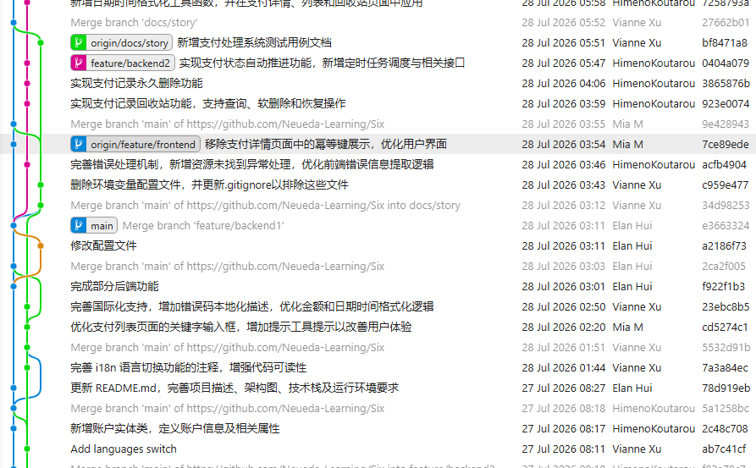

Slide 7
Our Contribution

Slide 8
Elan Hui’s Contribution
🏗️
🗄️
Overall Architecture Design
Database Design
🔌
⚙️
API Interface Design
Implementation of some Backend Functions

Slide 9
Felix W H Gou's Contribution
🗑
⏱
🖥
Recycle Bin
Auto Status Flow
Time Style Sync

Slide 10
Vianne W Q Xu’s Contribution
🌐
⚡
Internationalization (i18n)
Auto-Transition with Random Failure
💰
📝
Balance Sufficiency Check
Test Documentation & JUnit 5
Notes:
I designed and implemented the multi-language feature on the frontend.
I added vue-i18n to support Chinese, English, and German.
On first visit, the system detects the browser language automatically. After that, the user’s choice is saved in localStorage.
Error codes are mapped to localized messages on the frontend, which gives better user experience than using backend-fixed messages.
Importantly, all these changes are only on the frontend – no backend changes were needed.
(为什么使用vue-i18n是因为手动实现需要遍历dom树，这样可以通过t()自动绑定，支持语言包懒加载，更快实现)
Originally, the auto-transition always ended in COMPLETED – so we couldn’t show the FAILED path.
I added a configurable failure-probability, set to 20% by default.
When a failure is triggered, the system picks a realistic error code – like PROCESSING_ERROR or NETWORK_ERROR – depending on the current stage.
With a 20% chance per step we can demo both happy and failure paths.
But we made sure that real business rules – like balance checks – always take priority over the random demo logic.
The requirement was to check if the account has enough balance – but we do not deduct any money, and we don’t handle concurrency conflicts. The balance never changes.
I added a balance field to the payment table via a separate migration script – without modifying the original schema.
The method hasSufficientBalance() performs a read‑only query – no UPDATE at all.
This check is triggered only during the CREATED→VALIDATED transition.
If the balance is insufficient, the target state is forced to FAILED with error code INSUFFICIENT_FUNDS.
Both the manual API and the scheduled auto‑transition reuse the same validation logic.
I wrote a test cases document – test-cases.md – with many test cases covering core scenarios.I only completed half of it; the other half was done by another colleague.
I wrote the paymentvalidatortest class.
PaymentValidatorTest – 15 cases covering amount, account, and balance checks.
PaymentStateMachineTest – uses parameterized tests to cover 25 state transition combinations.
PaymentServiceImplTest – covers state parsing and optimistic lock scenarios, as they exist in the current code.
All tests use Mockito to isolate the database and background scheduler – so they are stable and repeatable.

Slide 11
Mia W T Mai’s Contribution
🎨
📄
✅
Global Design Systems
Some Core Pages
Smart Form Validation
🏷️
📋
🔌
Visual Status Design
Audit Trail Timeline
Clean API Layer

Slide 12
Live Demo

Slide 13
Summary
• This project is more than pages and APIs. It brings payment logic into a working system.
• We expanded basic CRUD into a fuller prototype.
• The system covers status, errors, recovery, scheduling, and testing.

Slide 14
What we’ve learnt
• Team Cooperation
• How to build up a system from zero
• Technology we may need in the future

Slide 15
Thanks for listening
Q & A

