Slide 1
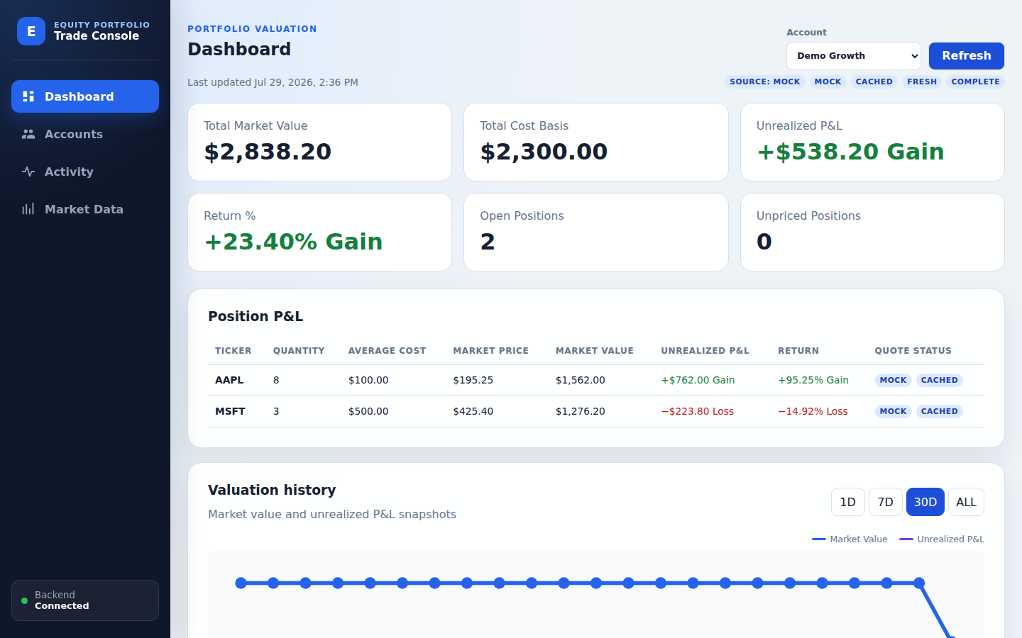
GROUP 5 / GIVE ME FIVE
Equity Trade
Booking Engine
Trade facts · Replayable positions · Explainable quotes · Consistent P&L
A trusted loop from booking to valuation
JAVA 21
SPRING BOOT
REACT 19
MYSQL + REDIS
DOCKER COMPOSE
2026.07
Notes:
Hello everyone. We are Group 5, “Give me five.” Today we are presenting the Equity Trade Booking Engine. It is designed for a single user managing multiple securities accounts, and it connects account setup, trade booking, lifecycle management, position calculation, market quotes, and unrealized P&L in one auditable workflow. Our goal is not simply to demonstrate a user interface. We want to show a trading back office whose data integrity, failure behavior, and engineering quality can all be explained, tested, and demonstrated.

Slide 2
WHY THIS SYSTEM
02
From Fragmented Tasks to a Trusted Loop
COMMON RISKS
OUR RESPONSE
!
Mutation erases history
✓
Audit-preserving lifecycle
!
Position drift after changes
✓
Chronological trade replay
!
Quote failure can mislead
✓
Explicit source and staleness
Trades are facts. Positions are replayed. Quotes value. The backend calculates.
Notes:
Many demonstration systems treat accounts, trades, quotes, and P&L as unrelated CRUD screens. That leaves three important questions unanswered: can an amended trade still be audited, does a sell or cancellation keep the position correct, and what happens when the quote provider fails? This project turns those concerns into one closed loop. Trades are the business facts, positions are replayed from valid trades, market data is used only for valuation, and P&L is calculated centrally by the backend. As a result, every number has a traceable origin and every failure state has an explicit meaning.

Slide 3
BUSINESS FLOW
03
End-to-End Business Loop
01
02
03
04
05
Account
Activity
Position
Market Data
Dashboard
ACTIVE / INACTIVE
BUY / SELL
Replay BOOKED
SOURCE + AGE
P&L + HISTORY
CSV IMPORT
Cancel, delete, or amend recalculates downstream values without erasing evidence.
MYSQL = SYSTEM OF RECORD
Notes:
The workflow starts with a securities account. Activity supports verified BUY and SELL booking as well as CSV bulk import. A normalized content fingerprint warns before the same complete table is imported again. BOOKED trades are replayed chronologically into positions; quotes then value those positions, and the dashboard presents current P&L plus persisted history. Cancelling, deleting, or amending a trade recalculates downstream values without erasing the original evidence.

Slide 4
DOMAIN INTEGRITY
04
Lifecycle and Business Invariants
BOOKED
Valid business fact
CANCELLED
Reason is recorded
Reasons: CANCELLED / DELETED / AMENDED
Amendment links a replacement via supersedesTradeId
3
Non-negotiable invariants
Idempotent cancellation
No negative point in time
Only BOOKED trades count
✓
✓
✓
Notes:
The key lifecycle question is not whether a trade can be changed, but whether we can still explain what happened afterward. A normal trade is BOOKED. Cancellation moves it to CANCELLED and records a reason. Deletion is audit-preserving soft cancellation, while amendment cancels the original and creates a replacement linked through `supersedesTradeId`. Three invariants protect the model: cancellation is idempotent, the chronological trade timeline may never produce a negative position, and only BOOKED trades contribute to positions. These rules are represented in both the domain model and the automated tests.

Slide 5
CALCULATION MODEL
05
Position and P&L Calculation
AAPL · DEMO GROWTH
WEIGHTED-AVERAGE COST
BUY increases quantity and cost basis
Quantity
Avg cost
Market price
8
$100.00
$195.25
SELL reduces cost basis at the current average cost
Cost basis
Market value
$800.00
$1,562.00
marketValue = quantity × marketPrice
unrealizedPnl = marketValue − costBasis
Unrealized P&L / Return
pnlPercent = unrealizedPnl ÷ costBasis × 100
+$762.00 / +95.25%
Decimal arithmetic on the backend · Missing quotes remain null
Notes:
Positions use weighted-average cost. A buy increases quantity and cost basis. A sell reduces cost basis at the current average cost, so the sale price does not distort the average cost of the remaining position. Valuation is straightforward: market value equals quantity times market price; unrealized P&L equals market value minus cost basis; and return percentage equals unrealized P&L divided by cost basis. Core calculations use backend decimal arithmetic to avoid browser floating-point differences. If a quote is missing, the value stays null—the UI never invents a zero market price.

Slide 6
SYSTEM DESIGN
06
Modular Monolith Architecture
USER EXPERIENCE
SPRING BOOT 3.5 · JAVA 21
DATA & EXTERNALS
Account
Trade
Position
React 19
TypeScript + Vite
MySQL 8.4
Accounts · Trades · Imports · History
Market Data
P&L
Redis 7.4 · Disposable quote cache
Nginx
Reverse proxy
HTTP API
Application
Domain
Infrastructure
Mock / Finnhub provider
Desktop + mobile
API → Application → Domain ← Infrastructure
REDIS ≠ SYSTEM OF RECORD
Notes:
The product is a modular monolith: React 19 and TypeScript run behind Nginx, while Spring Boot 3.5 on Java 21 is divided into Account, Trade, Position, Market Data, and P&L modules. Dependencies flow from API to application to domain, with infrastructure implementing ports. MySQL stores accounts, trades, the CSV import registry, quote snapshots, and valuation history. Redis remains a disposable quote cache, never the system of record.

Slide 7
RESILIENCE
07
Market-Data Resilience and Honest Degradation
STATUS MUST BE VISIBLE
Request quote
Provider
Mock or Finnhub
Redis
Fresh + retained
Valuation result
MOCK
LIVE
STALE
CACHED
CACHE WINDOWS
Fresh TTL · default 60s
Retention TTL · stale fallback on failure only
Unavailable
A failed real provider never silently falls back to generated Mock data.
MYSQL QUOTE + VALUATION SNAPSHOTS
Notes:
Market data can come from deterministic Mock data or explicitly configured Finnhub. A successful provider quote is cached in Redis and appended to a MySQL quote-snapshot history. Fresh cache values are reused normally; retained values are used only as stale fallback during a provider failure. The UI exposes MOCK, LIVE, CACHED, STALE, and incomplete states. A failed real provider never silently becomes Mock, and missing data never becomes a zero price.

Slide 8
PRODUCT EXPERIENCE
08
From Trades to Portfolio Insight
One backend model
1
Source + freshness
2
Persisted 1D / 7D / 30D / ALL history
3
No fake zero prices or fabricated history
Notes:
The dashboard combines the same backend position and valuation model for all accounts or one account. It shows market value, cost basis, unrealized P&L, return, open and unpriced positions, and quote status by ticker. Scheduled valuation snapshots support 1D, 7D, 30D, and ALL views. The chart contains only locally persisted observations, so the system does not fabricate earlier history.

Slide 9
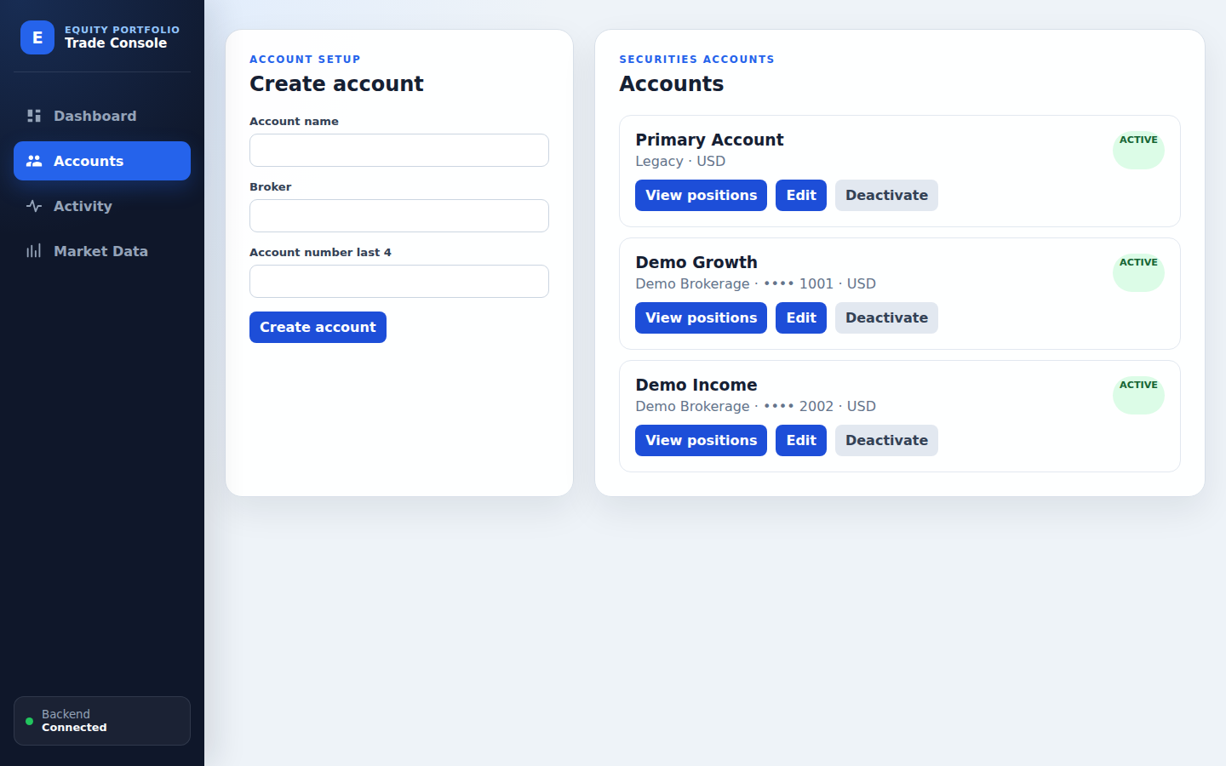
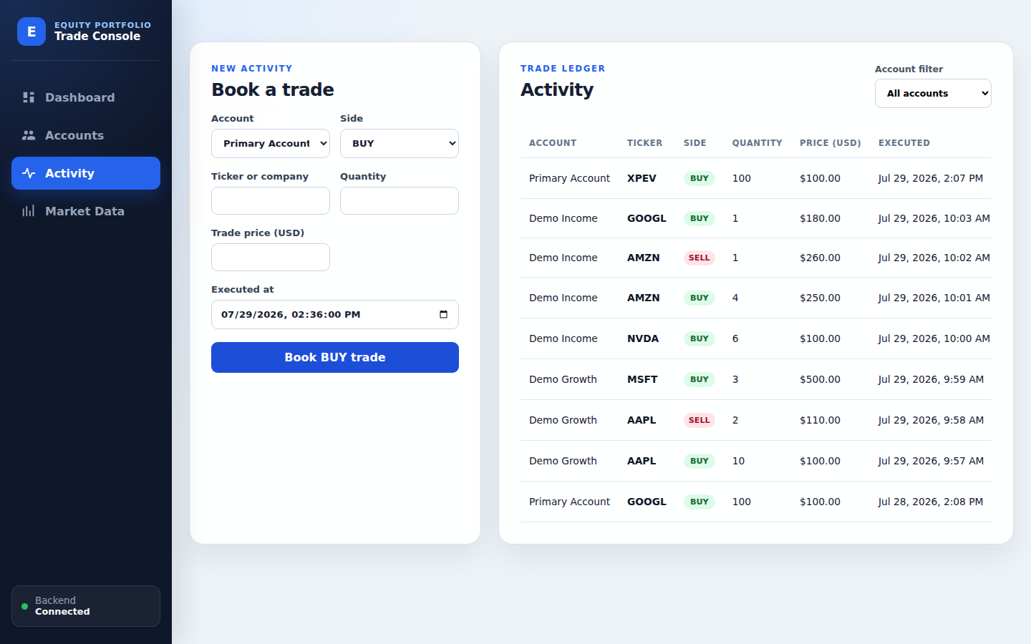
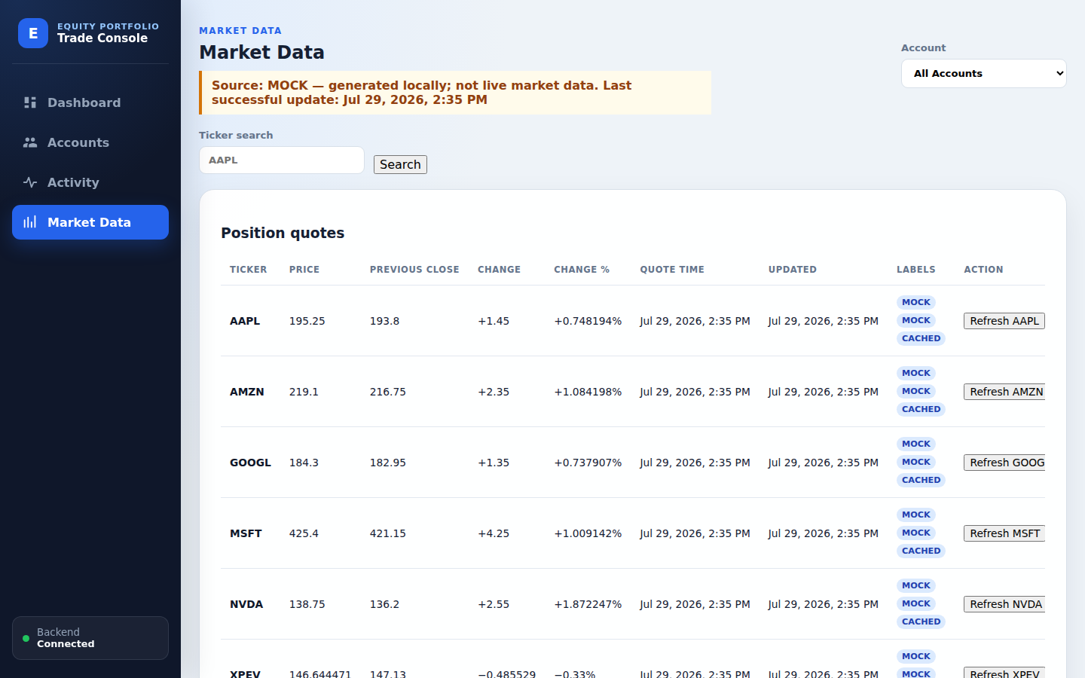
OPERATIONS
09
Product Workbench
Accounts
Activity
Market Data
Account status + account-level positions
Booking + CSV import + audit actions
Search + refresh + outage simulation
Responsive desktop/mobile UI · English, Chinese, and Portuguese · Text-labelled states
Notes:
The operational workbench has Accounts, Activity, and Market Data areas. Accounts supports active and inactive securities accounts and account-level positions. Activity covers verified booking, pagination, audit-preserving cancellation, deletion, amendment, and CSV bulk import with duplicate confirmation. Market Data supports search, refresh, provider status, and opt-in outage controls. The responsive interface is available in English, Simplified Chinese, and Brazilian Portuguese, with important states expressed in text as well as color.

Slide 10
QUALITY GATE
10
Engineering Quality and Delivery
BACKEND
FRONTEND
COMPOSE
E2E
✓
Unit + API +
Testcontainers
Vitest + ESLint +
Production build
Lifecycle + P&L +
Stale fallback
Playwright desktop +
mobile journey
QUALITY GATE
COVERAGE BY RISK
Domain rules
Trade / Position / P&L
Every failure produces useful diagnostics
Architecture
ArchUnit dependency checks
Real dependencies
MySQL 8.4 + Redis 7.4
Reports · traces · screenshots · videos · isolated Compose logs
User journey
Booking → outage → recovery
Notes:
The quality strategy covers everything from domain rules to the complete user journey. The backend includes domain unit tests, API integration tests, MySQL and Redis Testcontainers tests, and ArchUnit dependency checks. The frontend uses Vitest, Testing Library, ESLint, and a production build. The Compose smoke test verifies lifecycle behavior, P&L, cache fallback, and container restart. Playwright runs the end-to-end workflow at both desktop and mobile sizes. GitHub Actions combines backend, frontend, compose-smoke, and E2E jobs into one quality gate, so no partial success can be reported as a passing build.

Slide 11
WHAT COMES NEXT
11
Boundaries and Roadmap
CURRENT BOUNDARIES
ROADMAP
Single user
USD only
Auth · authorization · ownership
01
No cash ledger
No shorting
Cash · FX · realized P&L · tax lots
02
More providers · WebSocket streaming
Unrealized P&L only
Weighted average only
03
Secrets · observability · deployment
04
Explicit boundaries create a testable starting point for the next increment.
Notes:
The current release deliberately limits scope: it is single-user, USD-only, has no cash ledger, does not allow short positions, calculates unrealized P&L only, and uses weighted-average cost. Likely next increments include authentication and ownership, cash and multi-currency accounting, realized P&L and tax lots, more providers and streaming quotes, plus production secret management, observability, and deployment hardening.

Slide 12
TAKEAWAY
Trade facts → Trusted valuation
THANK YOU
AUDITABLE
RESILIENT
VERIFIABLE
Questions & discussion
LIVE DEMO PATH
ACCOUNTS
ACTIVITY
CSV IMPORT
DASHBOARD
MARKET DATA
Group 5 · Give me five
Notes:
To conclude, the system connects auditable trade facts, replayable positions, transparent quote handling, and consistent valuation. A live demo can move through Accounts, Activity, CSV import, Dashboard, and Market Data, then show how audit-preserving changes and stale quote fallback affect downstream values without hiding their origin. Thank you, and we welcome your questions.

