Slide 1
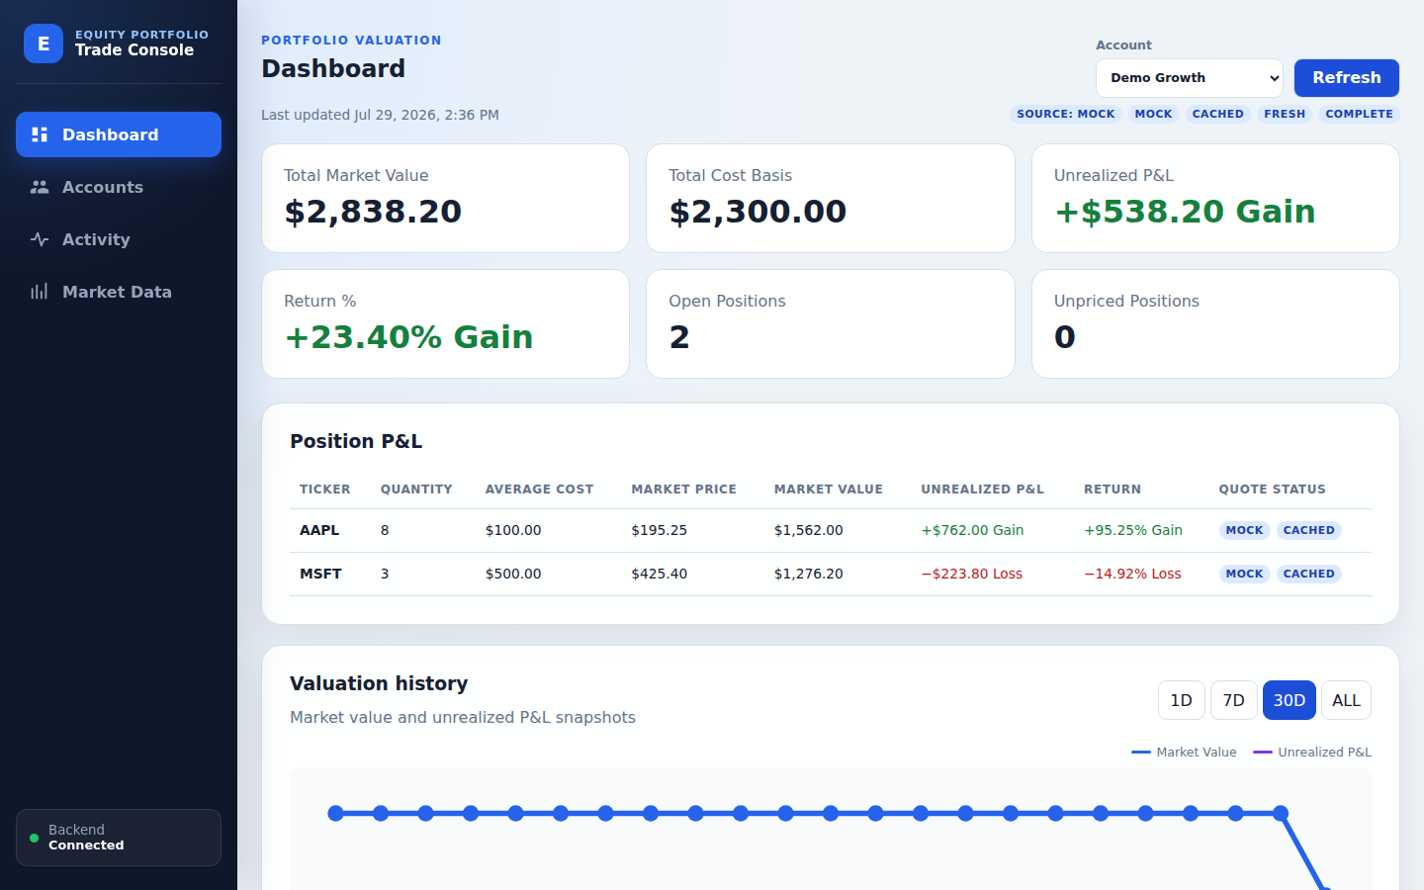
GROUP 5 / GIVE ME FIVE
Equity Trade
Booking Engine
Trade facts → trusted valuation
Current product capabilities · live demo
AUDITABLE
REPLAYABLE
RESILIENT
JAVA 21 · SPRING BOOT · REACT 19 · MYSQL · REDIS
Notes:
Suggested time: 00:15. Choose one language. ENGLISH Hello, we are Group 5. This presentation follows the current TradeFlow product from trade booking to auditable positions, market valuation, and resilient quote handling. 中文 大家好，我们是第五组。这份演示会基于当前 TradeFlow 产品，从交易登记开始，展示可审计持仓、市场估值和具有韧性的行情处理。

Slide 2
WHY THIS SYSTEM
02
Three promises behind every number
01
02
03
AUDITABLE
REPLAYABLE
EXPLAINABLE
Changes never erase history
Positions come from BOOKED trades
Quote source and age stay visible
Trades are facts. Positions are replayed. Quotes value.
Notes:
Suggested time: 00:15. Choose one language. ENGLISH TradeFlow makes three promises. Changes remain auditable, positions are recalculated from BOOKED trade facts, and every quote exposes its source and freshness. These promises connect the entire demo. 中文 TradeFlow 有三个核心承诺：所有修改都可审计；持仓从 BOOKED 交易事实重新计算；每个行情都明确展示来源和新鲜度。这三个承诺连接了整个演示。

Slide 3
DEMO ROUTE
03
One business loop, four live steps
01
02
03
04
DASHBOARD
ACTIVITY
POSITIONS
MARKET DATA
Baseline
Book
Replay
Explain
AAPL 8
BUY 1
8 → 9 → 8
MOCK / LIVE / STALE
The next slides follow this exact click path.
Notes:
Suggested time: 00:15. Choose one language. ENGLISH The live path has four steps: establish the Dashboard baseline, book one AAPL share, replay the position through deletion, and finish with explicit market-data status. 中文 现场路径只有四步：先建立仪表盘基线；登记一股 AAPL；通过删除演示持仓重算；最后展示明确的市场数据状态。

Slide 4
DEMO · DASHBOARD
04
Start with a trusted baseline
AAPL QUANTITY
MSFT QUANTITY
8
3
QUOTE STATUS
MOCK · FRESH
ONE GAIN + ONE LOSS
Valuation history is persisted locally
REMEMBER AAPL = 8
Notes:
Suggested time: 00:20. Choose one language. ENGLISH Select Demo Growth and refresh. The baseline is AAPL quantity 8 and MSFT quantity 3, with both a gain and a loss. The source flags say MOCK and FRESH, and the valuation history contains only persisted local snapshots. 中文 选择 Demo Growth 并刷新。基线是 AAPL 数量 8、MSFT 数量 3，同时包含盈利和亏损示例。行情标签明确显示 MOCK 和 FRESH，估值历史只展示本地持久化快照。

Slide 5
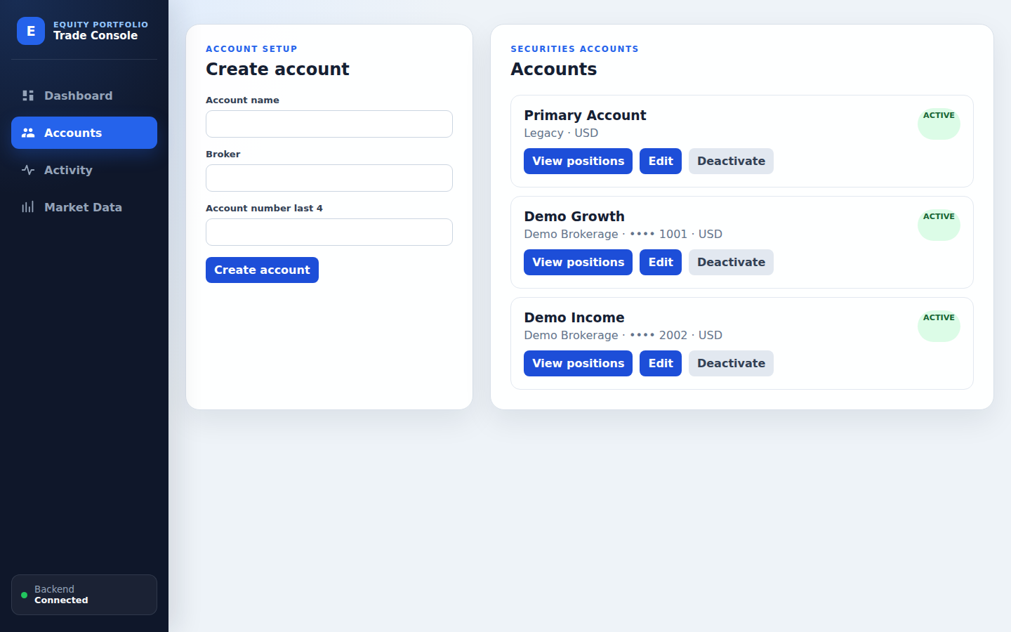
DEMO · ACCOUNTS
05
Multiple accounts, one clear boundary
MULTI-ACCOUNT
Demo Growth + Demo Income
ACTIVE / INACTIVE
Deactivate without deleting history
USD ONLY
Explicit current product boundary
VIEW POSITIONS
Notes:
Suggested time: 00:20. Choose one language. ENGLISH Accounts separate securities activity. Demo Growth and Demo Income each keep their own positions. An account can be deactivated without deleting history, and the current product boundary is USD only. 中文 账户用于隔离证券交易活动。Demo Growth 和 Demo Income 各自维护独立持仓。账户可以停用，但不会删除历史；当前产品边界是仅支持 USD。

Slide 6
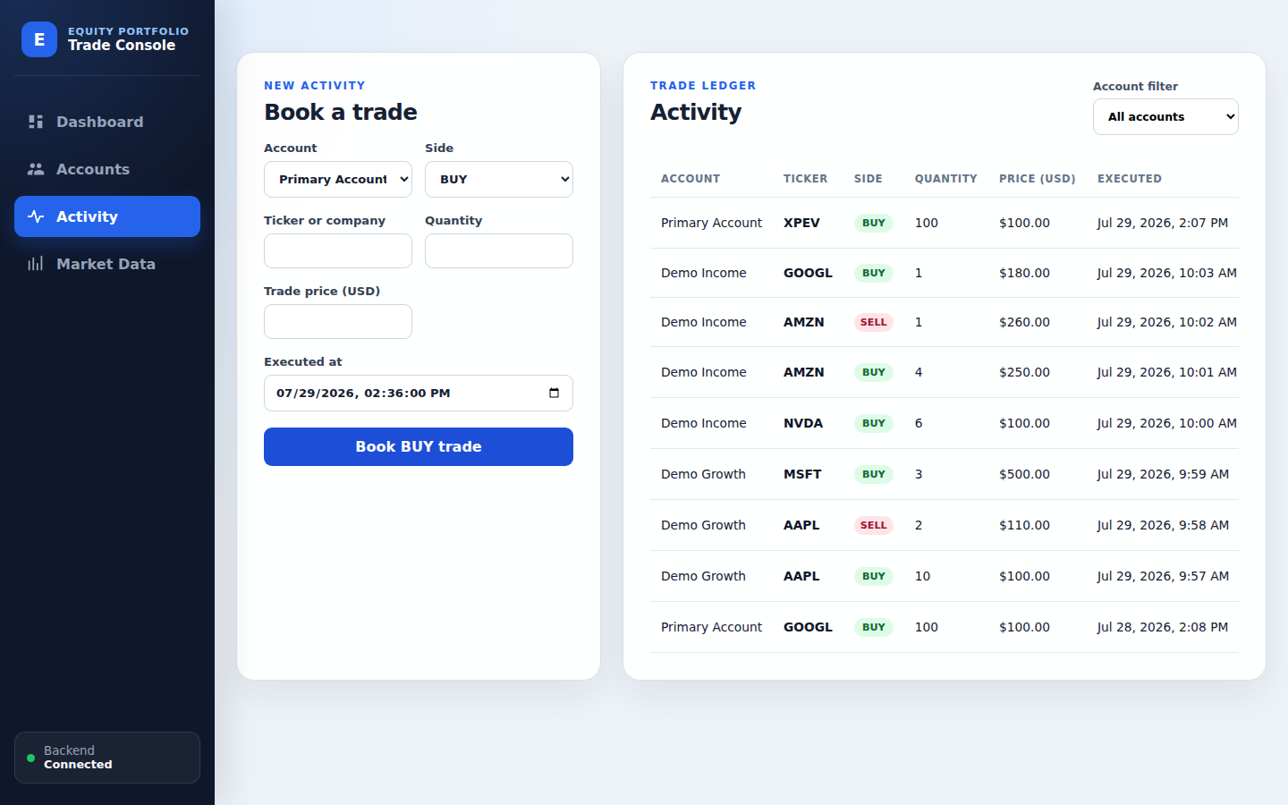
DEMO · ACTIVITY
06
Book one verified AAPL trade
Demo Growth
1
Select account
BUY
2
Choose side
AAPL
3
Select search result
1 × $100
4
Enter quantity and price
BOOKED
5
Submit
VERIFIED: AAPL
NEW BOOKED ROW
Notes:
Suggested time: 00:25. Choose one language. ENGLISH Open Activity, select Demo Growth and BUY, then type AAPL and choose the search result. The form requires Verified: AAPL, so the ticker is not arbitrary. Enter quantity 1 and price 100, keep the execution time, and book the trade. A new BOOKED row appears. 中文 进入交易活动，选择 Demo Growth 和 BUY，然后输入 AAPL 并选择搜索结果。表单要求显示 Verified: AAPL，所以股票代码不是任意字符串。输入数量 1、价格 100，保留成交时间并提交。账本会新增一条 BOOKED 记录。

Slide 7
TRADE LIFECYCLE
07
Numbers change. Evidence stays.
BOOKED
CANCELLED
CANCELLED · DELETED · AMENDED
Audit reason is always explicit
8
9
8
→
→
BASELINE
AFTER BUY
AFTER DELETE
Delete recalculates the position — it never erases the record.
Notes:
Suggested time: 00:25. Choose one language. ENGLISH The new BUY moves AAPL from 8 to 9. Delete that row and confirm: the record remains as CANCELLED with reason DELETED, while the position returns to 8. Amendment follows the same audit-preserving idea by creating a linked replacement. 中文 新的 BUY 使 AAPL 从 8 变成 9。删除该记录并确认后，原记录会保留为 CANCELLED，原因是 DELETED，同时持仓恢复为 8。修改交易也采用相同的审计保留思路，通过创建关联的替代交易完成。

Slide 8
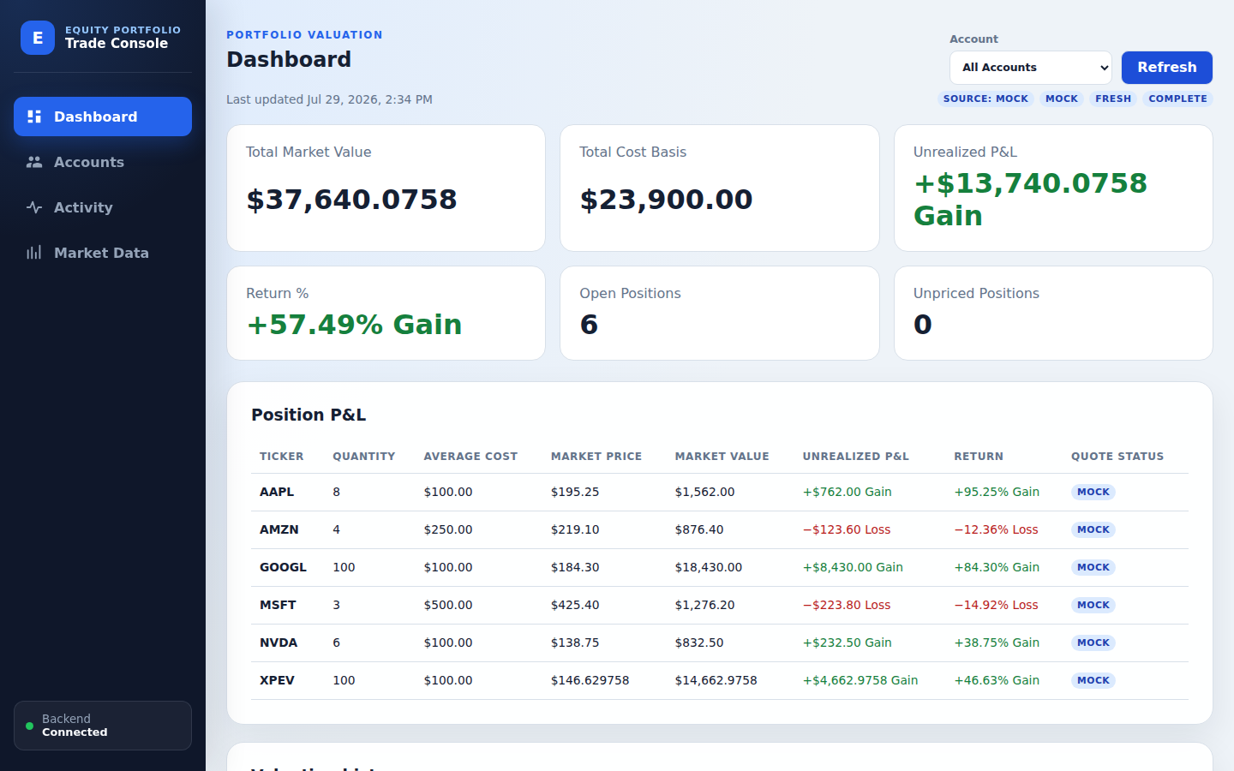
POSITION AND P&L
08
One calculation model, everywhere
MARKET VALUE
quantity × market price
UNREALIZED P&L
market value − cost basis
RETURN
P&L ÷ cost basis × 100
WEIGHTED-AVERAGE COST · DECIMAL ARITHMETIC
QUANTITY
AVERAGE COST
MISSING QUOTE
8
$100
NULL
Notes:
Suggested time: 00:20. Choose one language. ENGLISH Positions use weighted-average cost. Market value, unrealized P&L, and return are calculated by the backend with decimal arithmetic. A missing quote remains null; the interface never substitutes a zero market price. 中文 持仓采用加权平均成本。市场价值、未实现盈亏和收益率都由后端使用十进制运算统一计算。如果行情缺失，值保持为 null，界面不会用零价格代替。

Slide 9
BULK BOOKING
09
CSV import with a duplicate safety net
CSV
NORMALISE
FINGERPRINT
WARN
Validate
Table content
Stable UUID
Import again?
Filename changes
Row order changes
1 vs 1.0
do not bypass
do not bypass
does not bypass
The user must explicitly confirm a second full import.
Notes:
Suggested time: 00:20. Choose one language. ENGLISH CSV bulk booking validates every row and registers a stable fingerprint of normalized table content. Renaming the file, reordering rows, or using equivalent number formats does not bypass the duplicate warning. A second full import requires explicit confirmation. 中文 CSV 批量登记会校验每一行，并为规范化后的整张表生成稳定指纹。修改文件名、调整行顺序或使用等价数字格式，都无法绕过重复提醒。再次完整导入必须由用户明确确认。

Slide 10
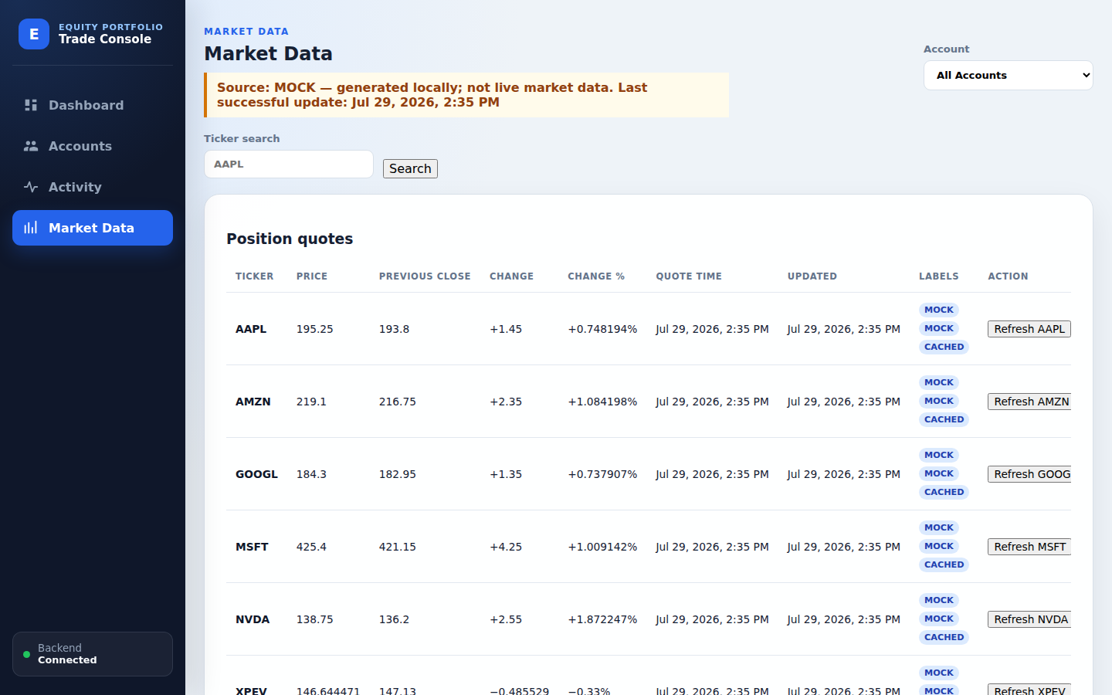
MARKET DATA
10
Resilience without hiding the truth
DEFAULT
Generated locally
Never shown as live
MOCK
FINNHUB DEMO
LIVE
→
CACHED
STALE
No cache → clear 503
No silent Mock fallback. No zero price.
SOURCE
CACHE
STALE?
COMPLETE?
Notes:
Suggested time: 00:25. Choose one language. ENGLISH The default provider is clearly labelled MOCK. In Finnhub demo mode, a successful quote is LIVE. During an outage, a retained Redis quote becomes CACHED and STALE. Without cache, the API returns a clear 503. It never silently switches to Mock or invents a zero price. 中文 默认行情源会明确标记为 MOCK。在 Finnhub 演示模式下，成功报价显示为 LIVE。数据源故障时，Redis 中保留的报价会标记为 CACHED 和 STALE。如果没有缓存，接口会返回清晰的 503，绝不会偷偷切换到 Mock 或编造零价格。

Slide 11
TAKEAWAY
11
A trusted loop from booking to valuation
BOOK
REPLAY
VALUE
Verified securities
and explicit trade facts
Positions recalculate
without erasing history
Quotes expose source,
cache, and staleness
TRADES ARE FACTS.
Trust comes from explainable change.
Q & A
Notes:
Suggested time: 00:10. Choose one language. ENGLISH TradeFlow connects verified booking, replayable positions, audit-preserving corrections, and transparent valuation in one trusted loop. Trades are facts, and trust comes from explainable change. Thank you. 中文 TradeFlow 把已验证交易登记、可重算持仓、保留审计的纠错以及透明估值连接成一个可信闭环。交易是事实，信任来自可解释的变化。谢谢大家。

