Slide 1
MODULE 1 · RULE
Application Verification
Student Brief v5 — what we expect from your module; discovering the rest is part of the job
Customer Digital Journey · neo-capstone · Module 1 of 10 · your instructor is the customer — book time, ask questions

Slide 2
MODULE 1 · verification / verify-application
The mission
Rule
THE ONE QUESTION YOUR MODULE ANSWERS
Is this a valid, processable request for this specific offer?
NON-NEGOTIABLES (PLATFORM RULES)
• Only the orchestrator calls you: POST /api/v1/verification/execute → answer 202 immediately → decide off-thread → POST your outcome to /api/v1/callbacks.
• You receive the WHOLE application, every time. Use what you need, ignore the rest.
• Never call another module; never depend on another step's result.
• Never store the application payload — only applicationId. Your UI fetches applicant detail live through your own GET proxy.
• Big lists (search, boards) start EMPTY and never show more than 10 rows.
• The api-contract is LOCKED. Need something it doesn't have? Ask your instructor — do not invent.
• Every API you expose is idempotent — same request twice, same result once. This is a design principle, not an optimisation.
• You are the first check every credit-card application meets. Everything downstream trusts you: what you let through, others must be able to process.
• You do not design the form (the orchestrator owns the fields) and you do not decide who the bank wants as a customer (module 2 does). You verify what arrived.
• Think: age, whether the product is really on sale, whether it is sold the way this applicant applied — and whether the form is complete at all.
• In the real world this is the validation tier of Temenos Infinity or Backbase — the reason a banking app can point at the exact field to fix, instantly, before any paid check runs. Research it.
Application Verification · Student Brief — the onboarding saga

Slide 3
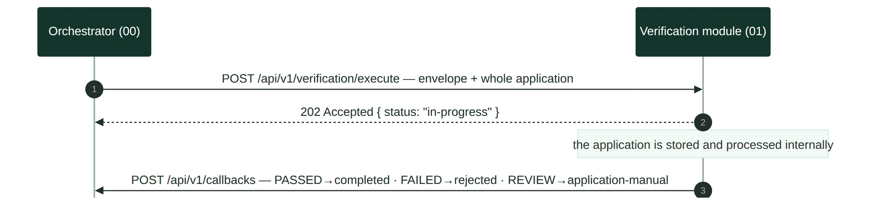
MODULE 1
The contract in one picture
Rule
outcome
callback status
journey effect
PASSED
completed
next step runs
FAILED
rejected
journey ends REJECTED
REVIEW
application-manual
parks for a person
A fourth status exists: local-manual. Find out when it is yours to send.
Application Verification · Student Brief — two calls, one gap in the middle

Slide 4
MODULE 1
Your use cases
Rule
#
use case
what it means
primary screen
00
Process Application
the front door — every /execute is acknowledged and stored; nothing else exists without it
— feeds every screen (row visible on the board)
01
Search Cases
find a case by application id or applicant name — empty by default, never more than 10 rows
Verification Board
02
Review Case
open one case — outcome + every check's result and every reason; the rule engine lives here
Case Detail
03
View Applicant
see the person behind a case, fetched live from the orchestrator — never stored
Case Detail sidebar
04
View Failure Patterns
which checks fail most often over a date range — is a rule too strict, or a form broken?
Failure Patterns
05
Override Case
a person corrects a wrong decision — with a reason, leaving a trace, resuming the journey
Override modal
06
Create Product Version
change a product's rules as data, never as a deploy — insert-only versions
Product Configuration
07
View Version History
every version a product ever had, so old decisions stay explainable
Product Configuration
08
Employment-status eligibility
CANDIDATE — a 4th rule; touch it only when 01–07 are complete
Case Detail (rule 4)
For every use case your customer holds detailed acceptance criteria. Your job: elicit them, agree them, complete them — a use case without agreed acceptance criteria is not started, let alone done.
Application Verification · Student Brief — the scope; the depth of each one is yours to elicit

Slide 5
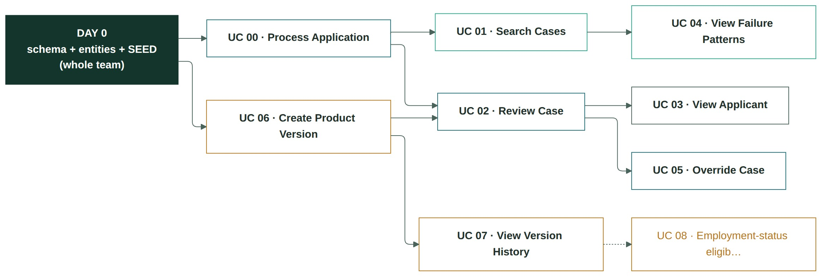
MODULE 1
Build order — what depends on what, and where to start
Rule
SUGGESTED SEQUENCE — AND WHY
1 UC 00 · Process Application — the front door, first: 202 + one durable row keyed by applicationId (the template gives the endpoint; you make it durable and idempotent). Nothing else in this module exists without this row.
2 UC 06 · Create Product Version — it all starts here: the engine's first line is "fetch the current config". Verify the Day-0 seed, own the entity and its read path — without a product row, no case can be decided, let alone reviewed.
3 UC 02 · Review Case (the engine) — plain functions over the application + the seeded ProductConfig; the module's heart.
4 UC 01 · Search Cases — the screen every flow opens from.
5 UC 03 · View Applicant — proves the no-payload rule and the proxy early.
6 UC 05 · Override Case — first write path and first callback; needs 02's rows.
7 UC 04 · Failure Patterns — read-only aggregate; easy win once decided rows exist.
8 UC 07 · Version History — closes the config/audit story 06 opened.
9 UC 08 · Candidate — only when every AC above is green.
Application Verification · Student Brief — the graph is the law; the order is advice. Deviate knowingly.

Slide 6
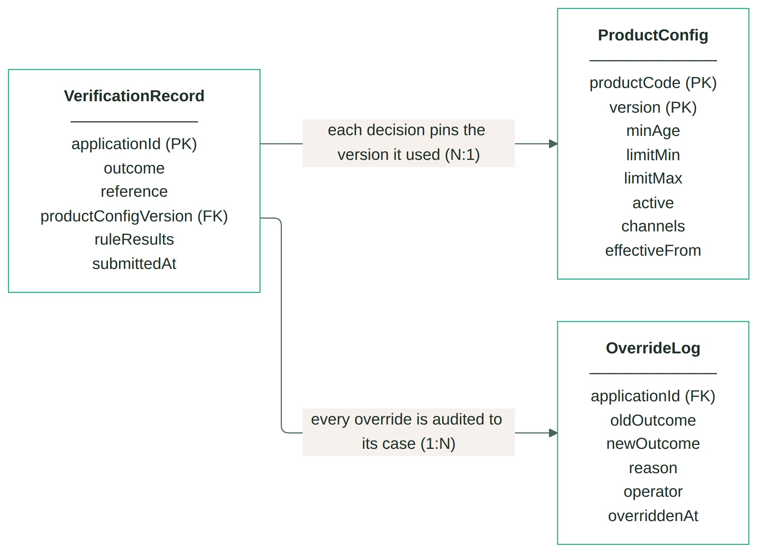
MODULE 1
Entity design comes first
Rule
• One of your very FIRST tasks is entity design. Agree the data model as a whole team before anyone writes code — the biggest problem teams have is starting with a model that is too complicated.
• Suggested key entities: VerificationRecord — one row per applicationId (unique) · ProductConfig — insert-only, versioned product terms; the current version is the highest per product · OverrideLog — audit trail; one row per manual override, none ever deleted. A starting point, not a mandate — be ready to defend deviations to your customer.
• Draw the ER diagram and keep it in your documentation (docs/) — updated in the same PR as any schema change. The suggestion on the right is the shape to beat.
• Every incoming request from the orchestrator is persisted. Each /execute stores exactly ONE row, keyed by applicationId — and that id is the ONLY applicant data in your schema. The application payload itself is NEVER stored.
SUGGESTED ER — STARTING POINT
Application Verification · Student Brief — agree the model on Day 0; the ER diagram is part of your documentation

Slide 7
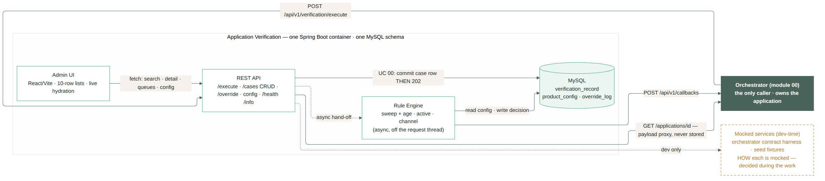
MODULE 1
The shape of what you build
Rule
One Spring Boot container, one schema, no external provider — the engine and the versioned ProductConfig are the whole story. The intake path (UC 00) commits the row before the 202; the worker decides after, and everything the UI shows comes off that row.
Application Verification · Student Brief — components and the calls between them; your names may differ, the shape should not

Slide 8
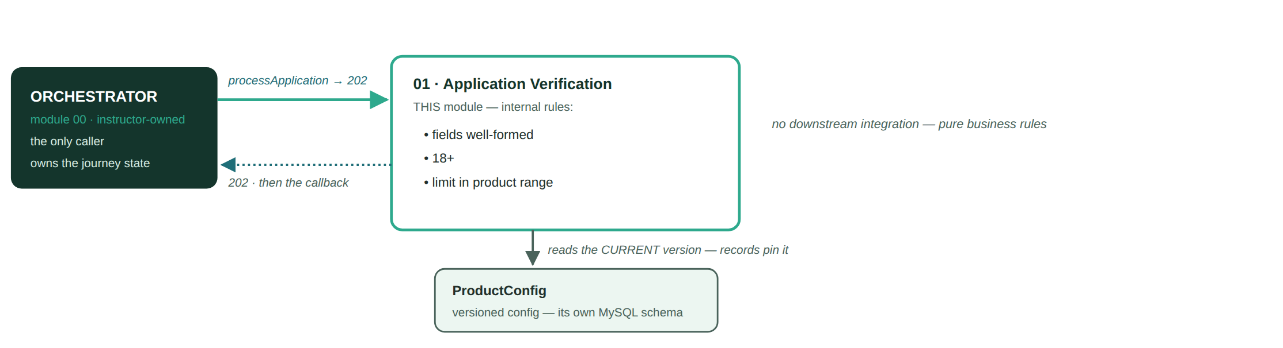
MODULE 01
Where you sit — in one picture
Rule
Application Verification — the orchestrator calls you · your rules decide · your config is versioned · your downstream is mocked

Slide 9
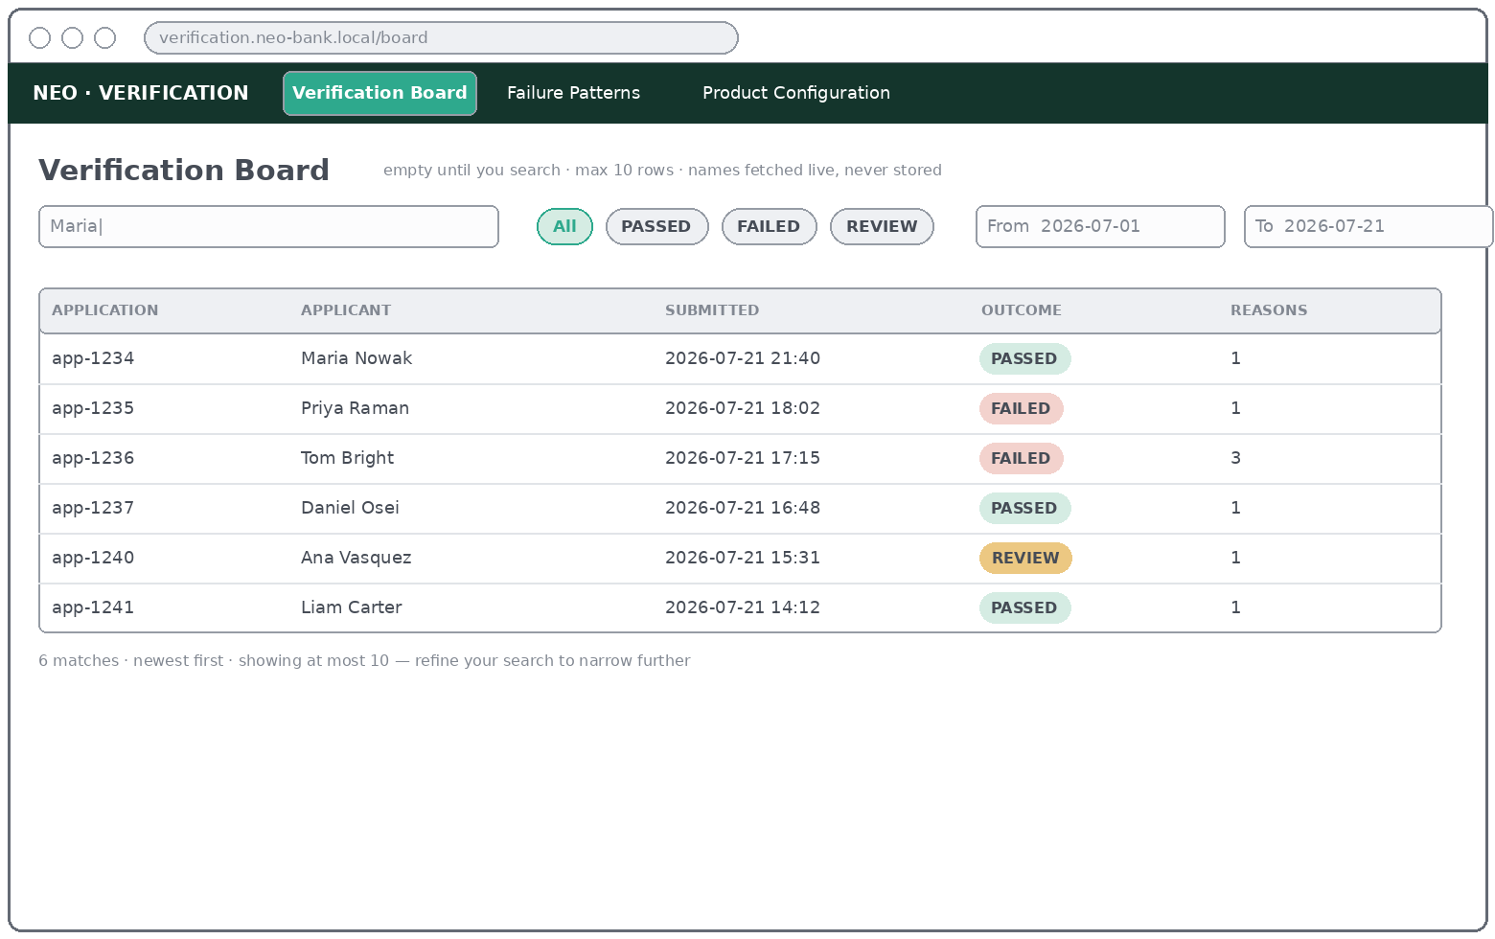
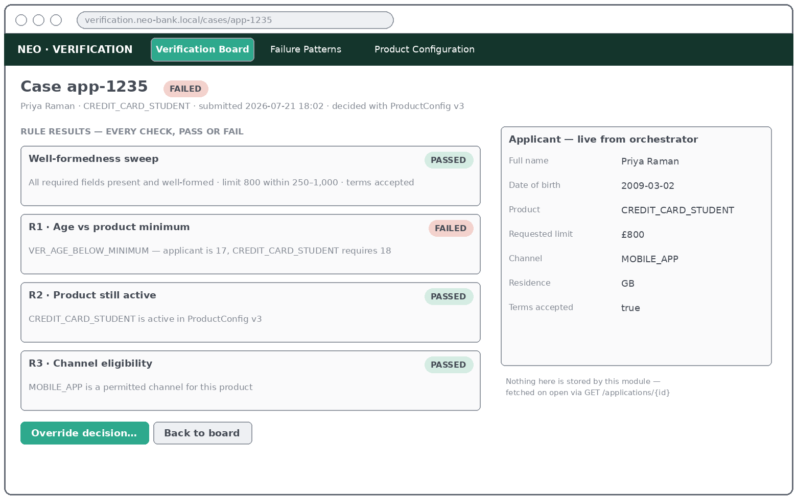
MODULE 1
How it is used — steps per use case (1/2)
Rule
UC 00 · Process Application
UC 01 · Search Cases
• 1 No human involved — the orchestrator POSTs, the 202 goes back instantly
• 2 The row exists before the ack; a crash after it loses nothing
• 3 Search the id on the board: the case shows as in-progress until the engine decides
• 1 Type a name or application id — the board is empty until you do
• 2 At most 10 rows appear, newest first; refine if flagged "more"
• 3 Click a row → Case Detail
UC 02 · Review Case
UC 03 · View Applicant
• 1 Open a case from the board
• 2 Read the outcome badge + one card per check
• 3 Every reason is on screen — never just the first
• 1 Open any case — the sidebar loads the applicant live
• 2 Orchestrator down? The case still renders; the sidebar degrades
• 3 Nothing applicant-related is ever stored locally
Application Verification · Student Brief — your UI may look different, the JOB each screen does may not

Slide 10
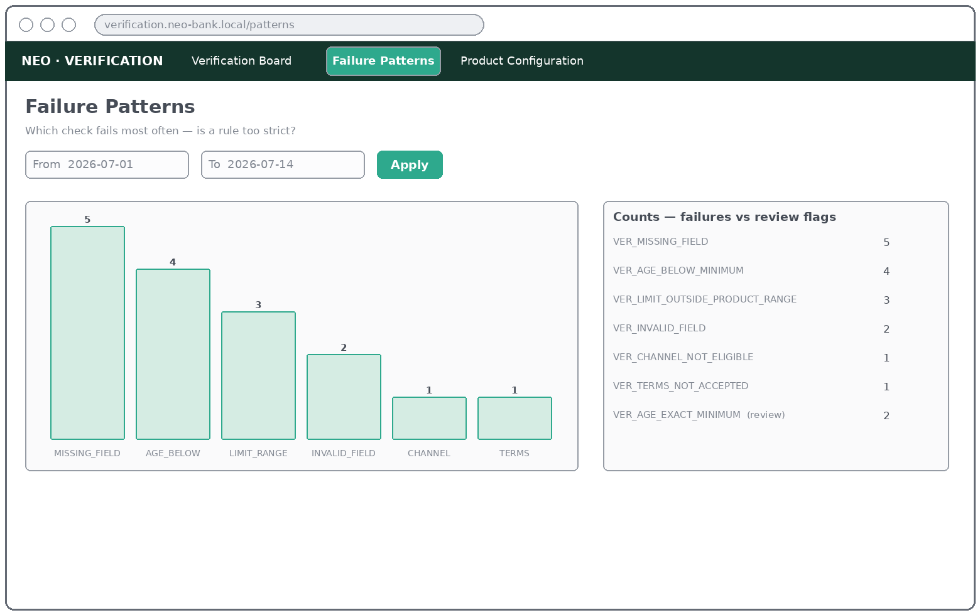
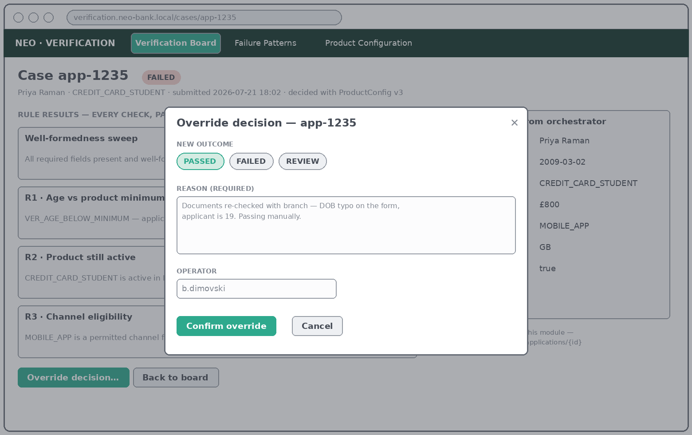
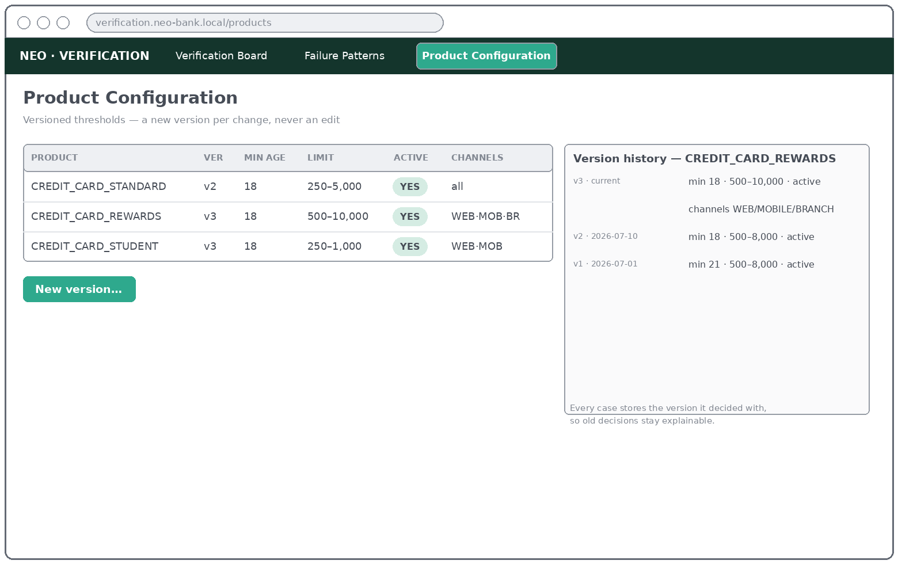
MODULE 1
How it is used — steps per use case (2/2)
Rule
UC 04 · View Failure Patterns
UC 05 · Override Case
• 1 Pick a from/to range and apply
• 2 Read the ranked chart — failures vs review flags
• 3 A spike in one code = a rule too strict or a form broken
• 1 Open the case → "Override decision…"
• 2 Pick the new outcome; reason + operator are mandatory
• 3 Confirm — the trace is permanent, the journey resumes
UC 06 · Create Product Version
UC 07 · View Version History
• 1 Product Configuration → "New version…"
• 2 Change thresholds / channels / active — save
• 3 A NEW version appears; nothing old is edited
• 1 Select a product — its full history loads beside it
• 2 The current version is marked
• 3 Old cases still point at the version that decided them
Application Verification · Student Brief — your UI may look different, the JOB each screen does may not

Slide 11
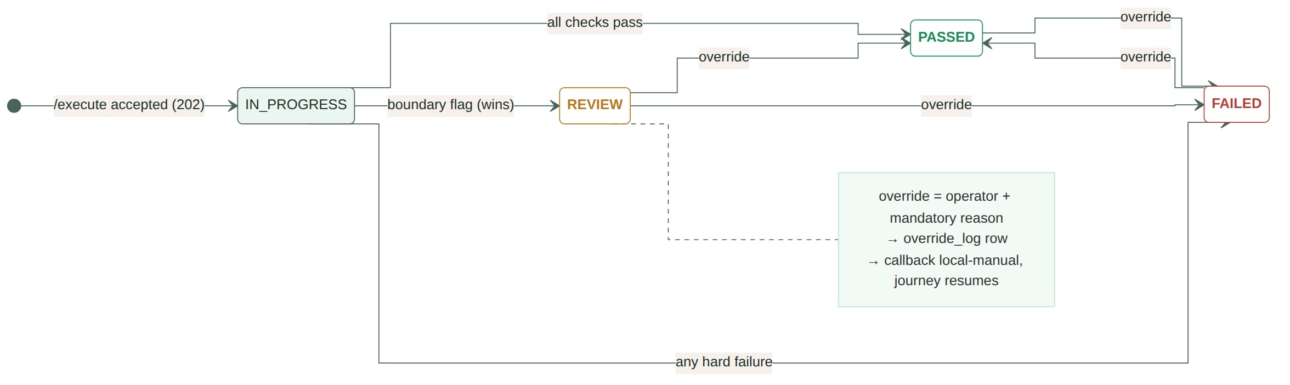
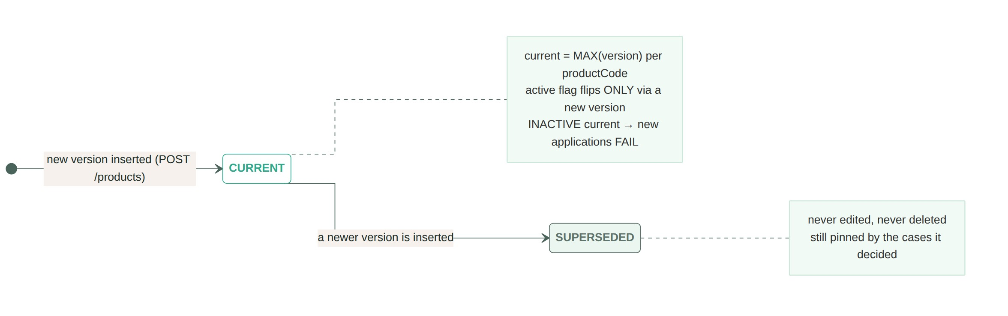
MODULE 1
Expected state transitions
Rule
Dashed amber = operator override — the ONLY way an outcome ever changes. What must an override always carry, and what trace must it leave? What happens to a journey that was parked? A repeated /execute for the same applicationId must NOT create a second row or a second decision. Prove it.
Rules change on Tuesday; an auditor asks on Friday why Monday's case failed. What must your case record remember for the old answer to still be explainable? And what does a product being taken off sale do — to new applications, and to old cases?
Application Verification · Student Brief — outcomes are terminal for the machine

Slide 12
MODULE 1
You are done when
Rule
• Every use case's acceptance criteria are complete — elicited from your customer, agreed, and verified per case against the running app. This is THE definition of done; nothing below substitutes for it.
• The orchestrator's contract check passes against your running container — 202 then callback, statuses mapped exactly as the table on slide 3, and a repeated /execute changes nothing.
• A bank employee can do their whole job from your UI — find a case, understand exactly why it decided what it decided, fix a wrong decision with a reason, and change product rules without a deploy.
• Your schema contains zero applicant data — and your lists stay within the 10-row rule.
• Quality holds — ≥ 70% line coverage on business logic, main green on a fresh clone, docker compose up works offline.
• The deliverables exist — presentation, user instructions a new operator could follow, the what-we-mocked register, upgrade notes, C4 diagram.
• The API is documented and idempotent — OpenAPI 3.0 (Swagger) served per service (mock app included), and repeating any call changes nothing the second time.
A far more detailed version of this brief exists — your instructor holds it, in the role of your customer. The teams that do best are the ones that ask the most precise questions, earliest.
Application Verification · Student Brief — an acceptance criterion that fails beats an extra that works

Slide 13
MODULE 1 · APPENDIX
Worked examples — the cast
Rule
who / what arrives
outcome
status
what we expect to see
Maria Nowak — 29, REWARDS card, £3,000, mobile app
PASSED
completed
the happy path — one reason: VER_ALL_CHECKS_PASSED
Priya Raman — 17, student card
FAILED
rejected
the age rule names her exact problem, field and all
Tom Bright — loses signal, half a form
FAILED
rejected
EVERY missing/malformed field reported — not just the first found
An applicant exactly at a boundary (think: age, limit)
REVIEW
application-manual
a person decides — not an auto-pass, not an auto-fail
A product no longer on sale
FAILED
rejected
new applications fail cleanly; nothing old breaks
An operator overrides a decision
(changes)
local-manual
reason + who + when survive forever; the journey resumes
The locked reason codes for your domain: VER_ALL_CHECKS_PASSED · VER_MISSING_FIELD · VER_INVALID_FIELD · VER_AGE_BELOW_MINIMUM · VER_LIMIT_OUTSIDE_PRODUCT_RANGE · VER_TERMS_NOT_ACCEPTED. Read that list against the examples above very carefully.
Application Verification · Student Brief — examples, not the target: your target is the acceptance criteria per use case

