Slide 1
NEUEDA · CAPSTONE 2026 · KICKOFF
Neo Bank
Project Brief · 项目简报
Monday, 27 July 2026 · 2026年7月27日 星期一
Notes:
Opening slide. Welcome everyone, high energy. This is the capstone kickoff for the whole group.

Slide 2
THE CHANGE · 改变
Every year until now, every team — in every location in the world — built the same capstone project.
直到今年，世界各地的每一个团队，做的都是同一个毕业项目。
Notes:
The same topic has been used since the very start of these trainings, in every location in the world.

Slide 3
THE CHANGE · 改变
That was the plan for you too — until we saw how good you are with AI.
原本你们也是这样安排的——直到我们看到你们运用 AI 工具的实力。
Notes:
After seeing how well this group uses AI tools, we decided to make a revolutionary change.

Slide 4
THE CHANGE · 改变
So we made a revolutionary change: each team gets its own project — and every project is a piece of one bigger platform.
于是我们做了一个革命性的改变：每个团队有自己的项目——所有项目共同组成一个更大的平台。
Notes:
Instead of everybody building the same thing, each team receives a designated project that fits into a bigger platform.

Slide 5
THE CHANGE · 改变
No more ten identical demos — your managers will watch one story, told by ten teams.
不再是十场一模一样的演示——你们的经理将看到由十个团队共同讲述的一个故事。
Notes:
Managers no longer sit a full day listening to the same project ten times.

Slide 6
WHAT WE BUILD · 我们要做什么
Together we will build a real, working customer journey of a bank.
我们将一起构建一个真实可运行的银行客户旅程。
Notes:
A real functioning customer journey of a bank.

Slide 7
THIS WEEK · 这一周
Last week we said individual progress doesn't count. This week it is all ten teams — done or not done as one organisation; if one team is behind, we all help.
上周我们说过：个人进度不算数。这一周是全部十个团队——作为一个组织，要么一起完成，要么都没完成；哪支队伍落后，大家一起帮。
Notes:
Raise the bar from team to organisation: last week individual progress didn't count — the team did. This week the unit is all ten teams together. One team behind = everyone helps.

Slide 8
WHAT WE BUILD · 我们要做什么
We will mock a lot of things — but the core will be real.
很多环节会用模拟实现——但核心是真实的。
Notes:
Plenty of mocking, but the core of the journey genuinely works end to end.

Slide 9
WHAT WE BUILD · 我们要做什么
It runs on AWS and ships through a real GitHub pipeline — just like it will in your job.
平台部署在 AWS 上，通过真实的 GitHub 流水线发布——和你未来的工作完全一样。
Notes:
Entire platform deployed on AWS, real GitHub pipeline — exactly like their future work.

Slide 10
LESSON ONE · 第一课
Remember the airplanes.
记住纸飞机。
Notes:
Callback to the Airplane Factory game from week 1.

Slide 11
REMEMBER THE AIRPLANES · 纸飞机
First we agree on the model plane, and everyone understands the requirements — only then do we start building.
先就飞机模型达成一致、每个人都理解需求——然后才开始制造。
Notes:
Agree on the model, review requirements, shared understanding — ONLY THEN we start building.

Slide 12
REMEMBER THE AIRPLANES · 纸飞机
Nobody is impressed by 25 planes when only 14 of them fly.
造出25架飞机、却只有14架能飞——没有人会为此喝彩。
Notes:
Quantity without quality impresses no one.

Slide 13
REMEMBER THE AIRPLANES · 纸飞机
If we say 12, then 12 out of 12 reach the destination — otherwise we commit to less.
如果我们承诺12架，就要12架全部抵达目的地——做不到，就承诺得更少。
Notes:
Commitment means delivery. Predictability beats volume.

Slide 14
HOW WE WORK · 工作方式
Communication is key.
沟通是关键。
Notes:
We help each other, even cross-team.

Slide 15
HOW WE WORK · 工作方式
Any problem — infra, AWS, CI/CD, Git, Java — goes on the shared channel, so one answer helps all ten teams.
任何问题——基础设施、AWS、CI/CD、Git、Java——都发到公共频道：一次解答，十个团队受益。
Notes:
Publish issues on the channel so others see them and we don't answer the same question multiple times. Cross-team help is expected.

Slide 16
HOW WE WORK · 工作方式
The setup 组织方式
10
10
1
1
Teams
GitHub repositories
OneDrive document for collaboration
Teams community for all communication
十个团队
十个代码仓库
一份 OneDrive 协作文档
所有沟通都在一个 Teams 社区
One team = one repository = one sub-system of the platform. · 一个团队 = 一个仓库 = 平台的一个子系统。
Notes:
10 teams, 10 GitHub repositories, 1 OneDrive document for collaboration, Microsoft Teams for communication.

Slide 17
HOW WE WORK · 工作方式
The daily rhythm 每日节奏
09:00
11:00
14:00
17:00
All-hands — status update
Coordinators check-in
Coordinators check-in
All-hands — status update
全员状态会
协调人碰头
协调人碰头
全员状态会
Four fixed touchpoints per day — everything else is asynchronous on Teams. · 每天四个固定节点，其余时间在 Teams 异步沟通。
Notes:
9am all-hands status, 11am coordinators, 2pm coordinators, 5pm all-hands status. Check-ins with coordinators 4 times per day.

Slide 18
HOW WE WORK · 工作方式
Three roles in every team 每队三个角色
Coordinator
DevOps
Presentation
协调人
运维负责人
演示负责人
Speaks for the team at every status meeting.
First responder for Docker, AWS, MySQL, CI/CD and GitHub issues.
Owns the slides — and brings them to us early for input.
在每次状态会上代表团队汇报进展。
负责处理 Docker、AWS、MySQL、CI/CD 和 GitHub 的问题。
负责演示文稿，并尽早请讲师提出反馈。
Everyone codes — these are responsibilities on top, not job titles. · 每个人都要写代码——这些是附加职责，不是头衔。
Notes:
Coordinator gives status updates, DevOps handles Docker/AWS/MySQL/CI-CD/GitHub, presentation owner takes care of slides and gets instructor input.

Slide 19
HOW WE WORK · 工作方式
All comms go on Microsoft Teams 所有沟通都在 Microsoft Teams
Questions, blockers, announcements, status, files — one place, and everyone sees it. · 提问、卡点、通知、状态、文件——都在同一个地方，所有人都能看到。
TASK 0
Everyone joins the Teams community — right now, before anything else.
每个人现在就加入 Teams 社区——先做这件事。
TASK 1
Fill in the action tracker — team name, members, roles and your links.
填写行动跟踪表——团队名称、成员、角色和相关链接。
Done with both? Then you exist. · 两件都完成，你们才算正式上场。
Notes:
One place for questions, blockers, announcements, status and files. Task 0: everyone joins the Teams community. Task 1: fill in the action tracker.

Slide 20
HOW WE WORK · 工作方式
Try for 30 minutes — if it doesn't work, ask for help: time is our enemy.
先自己尝试30分钟——不行就求助：时间是我们的敌人。
Notes:
Don't sit on a blocker. 30 minutes, then raise it on the channel.

Slide 21
THE PROJECT · 项目
We implement one set of use cases at a time.
我们一次只实现一组用例。
Notes:
One set of use cases per iteration — like the airplanes: small committed batches.

Slide 22
THE PROJECT · 项目
From branch to production — the flow 从分支到生产
YOU · 你们的循环
1 Branch from main
→
2 Develop a use case
→
3 Test it thoroughly
→
4 Merge to main
从 main 拉分支
开发一个用例（功能）
自己先充分测试
合并回 main
merge triggers the pipeline · 合并即触发
PIPELINE · 流水线 automatic — nobody clicks anything · 全自动，无人工操作
runs the tests again
→
builds the Docker image
→
deploys to DEV
→
updates the DEV DB — Liquibase
再跑一遍全部测试
构建 Docker 镜像
自动部署到 DEV
用 Liquibase 更新 DEV 库
MANUAL APPROVAL · 手动审批
the pipeline waits — a person decides to promote · 流水线等待，由人决定是否晋级
→
PROD — the same procedure · 生产环境，同样的流程
same image · deploy · Liquibase updates the PROD DB — no shortcuts · 同一镜像、部署、Liquibase 更新生产库——没有捷径
⚠ Don't pile up versions: merge small and promote often, one use case at a time — DEV and PROD must never drift a stack of releases apart. · 不要堆积版本：小步合并、及时晋级，一次一个用例——DEV 和 PROD 不能相差一摞版本。
Notes:
Branch from main, develop one use case, test thoroughly, merge. The pipeline re-runs the tests, builds the Docker image, auto-deploys to DEV and updates the DEV DB via Liquibase. A manual approval promotes to PROD — same procedure. Don't pile up versions between DEV and PROD.

Slide 23
THE PROJECT · 项目
Your first three tasks 前三个任务
TASK 0
Everyone checks out the project and runs it locally.
每个人签出项目，并在本地把它跑起来。
TASK 1
One person drives, the team observes: branch → change → merge → see it on DEV → publish to PROD.
一人操作、全队观察：拉分支 → 修改 → 合并 → 在 DEV 上验证 → 发布到 PROD。
TASK 2
Everyone repeats the whole flow — and PROD deployments are sequenced, never simultaneous.
每个人都完整走一遍——PROD 部署必须排好顺序，绝不同时进行。
Notes:
Task 0: everyone checks out and runs locally. Task 1: one executes, others observe — branch, change, merge, dev, prod. Task 2: everyone does it; sequence prod deploys.

Slide 24
THE FINALE · 最终演示
Presentations are about the topic — not the technology.
演示的重点是业务主题——而不是技术。
Notes:
The story of your sub-system and what it does for the customer journey — not a tech showcase.

Slide 25
THE FINALE · 最终演示
Your presentation, in six parts 演示的六个部分
1
The team
2
The role of your sub-system in the platform
介绍团队
你的子系统在平台中的角色
3
The technology — what was mocked, what was built, test coverage
4
Supported use cases — what your system can do
技术——模拟了什么、构建了什么、测试覆盖率
支持的用例——你的系统能做什么
5
A slim process overview of the key use cases
6
Live demo — up to 3 flows, covering scenarios from the acceptance criteria
关键用例的精简流程总览
现场演示——最多3条流程，覆盖验收标准中的不同场景
All teams use a similar — not identical — template. · 所有团队使用相似（而非相同）的模板。
Notes:
Present the team; role of your sub-system; technology (mocked, built, test coverage); supported use cases; slim process overview; live demo up to 3 flows based on acceptance criteria. Similar (not identical) template for all.

Slide 26
WHY THIS DESIGN · 设计初衷
Think IKEA: the parts come prepared — the real work of assembly is yours.
就像宜家：零件已经备好——组装的真功夫，要靠你们自己。
Notes:
The IKEA approach — we prepared the parts, the craft of assembly is theirs.

Slide 27
WHY THIS DESIGN · 设计初衷
This was never about how many tokens you can burn — you get the input real engineers get: from business analysts, product managers, risk managers and architects.
这从来不是比谁烧掉的 token 多——你们得到的输入，正是真实工程师从业务分析师、产品经理、风险经理和架构师那里得到的。
Notes:
We identified the problem and provided the inputs engineers would usually get from BA / PM / risk / solutions architect.

Slide 28
WHY THIS DESIGN · 设计初衷
The goal is not one brilliant individual — not even one brilliant team — but 40+ people working as one organisation, in harmony.
目标不是一个出色的个人，甚至不是一个出色的团队——而是四十多人像一个组织一样协调运转。
Notes:
A fully functioning organisation of 40+ people working in harmony.

Slide 29
THE PLATFORM · 平台
Meet the platform.
来认识这个平台。
Notes:
Transition into the platform overview — what the ten projects add up to.

Slide 30
THE PLATFORM · 平台
One customer journey: apply for a credit card — and walk away with an active account and a card in the post.
一条完整的客户旅程：申请一张信用卡——最终拥有激活的账户，和一张寄到手中的卡。
Notes:
The product is a credit card. The journey runs from application to an active card account with an approved limit, and a physical card in the post.

Slide 31
THE PLATFORM · 平台
The system — who calls whom, and what is mocked 谁调用谁、什么是模拟的
00 · ORCHESTRATOR 编排器 instructor-owned · the only entry point · the only caller · 讲师负责 · 唯一入口 · 唯一调用方
journey state machine · outputs enricher (limit/APR · agreementId · accountId · cardId) · customer registry · signing pages · applications read API · built-in mock of every step
processApplication — POST /api/v1/{domain}/execute · envelope (+ outputs) → 202 → callback
Ticket · open-case
reads the feed
1 Rule
2 Rule
3 Integration
4 Rule
5 Rule
6 Integration
7 Integration
8 Integration
9 Support
10 Observer
Application Verification
Customer Policy
Identity (KYC)
Fraud & AML Screening
Credit Decisioning
Agreement Mgmt
Card Account Setup
Card Issuing
Customer Support
Portfolio & Reg. Analytics
verify-application
check-policy
verify-identity
screen-applicant
assess-credit
request-signature
open-card-account
issue-card
open-case
never invoked
申请校验
准入政策
身份核验
反洗钱筛查
信贷决策
协议管理
卡账户开立
发卡
客户服务
监管分析
each integration module builds and ships its own mock · 每个集成模块自带并交付自己的模拟依赖
mock: ID provider
mock: e-sign / doc store
mock: core banking
mock: card bureau
→ invoked by the orchestrator 由编排器调用 ⇠⇢ reads / observes 只读观察 ▮ mocked downstream dependency 模拟的下游依赖
Notes:
The system flow: the orchestrator is instructor-owned, the only entry point and the only caller. Modules 1-8 all serve the same processApplication contract (202 + callback). 9 is invoked with a Ticket (open-case), 10 is never invoked — it reads the journey feed. Each integration module (3, 6, 7, 8) builds and ships its own mock; module 6 also serves the contract PDF and hosts signing.

Slide 32
THE PLATFORM · 平台
What the orchestrator sends each box 编排器发给每个格子什么
1–8
The Application — via processApplication
6
…plus the contract, with sign
One intake API per module: envelope { applicationId, correlationId, command, application, outputs } → 202 Accepted → decide off-thread → callback. Commands in journey order: verify-application → … → issue-card.
Agreement Mgmt also serves the agreement itself: GET …/document returns the one-page PDF (byte-identical forever); the orchestrator-hosted signing page posts SIGN / DECLINE as signature-events.
所有 saga 模块共用同一个信封：应答 202，线下决策，再回调编排器。
模块6还要提供协议 PDF 与签署事件接口；面向客户的页面属于模块00。
9
A Ticket
10
Nothing — it comes and gets it
Not a saga step, but IS invoked: POST /support/execute, command open-case, with { category, description, channel }. The case lives for hours or days; ONE callback at closure — always completed.
Never called directly. It reads the journey feed from the applications read API on its own schedule, stores snapshots, and answers every question from its own copies.
不是 saga 步骤，但会被调用：工单关闭时回调一次，结果永远是 completed。
从不被调用：按自己的节奏拉取旅程数据、存快照，用自己的副本回答一切。
Locked in api-contract.md — outcomes ride in outputs, statuses in the callback, reason codes per domain (VER_* · POL_* · KYC_* · SCR_* · CRE_* · AGR_* · ACC_* · CRD_*). · 契约已锁定在 api-contract.md。
Notes:
1-8: the same processApplication envelope. 6: additionally serves the agreement PDF + signature-events. 9: a Ticket (open-case). 10: nothing — it polls the applications read API. All locked in api-contract.md.

Slide 33
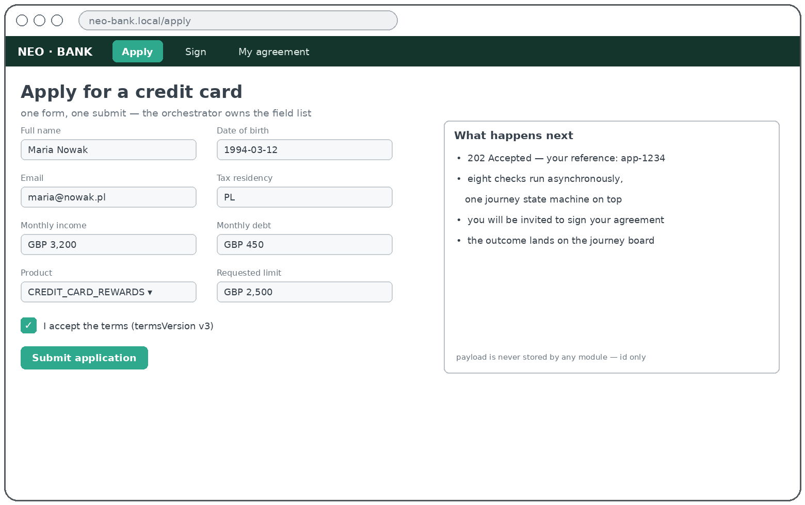
THE PLATFORM · 平台
Module 00 on screen — Apply for a product 申请产品
before the journey — step 0 · the application form — module 00 owns the field list
THE FLOW · 流程
1
Customer fills the one form — no module ever collects data itself.
2
Submit: the Application is stored, journey RECEIVED, reference app-1234 returned.
3
The saga engine dispatches step 1 — verify-application — immediately.
SERVICES INVOKED · 调用的服务
→ 01 verification the first dispatch, fired on submit
everything else waits its turn in the saga
lives in module 00 — teams rely on it, they don't build it · 属于模块00：大家依赖它，但不用自己造它
Notes:
Module 00 walkthrough — Apply for a product (screen 1 of 6). Customer fills the one form — no module ever collects data itself. Submit: the Application is stored, journey RECEIVED, reference app-1234 returned. The saga engine dispatches step 1 — verify-application — immediately.

Slide 34
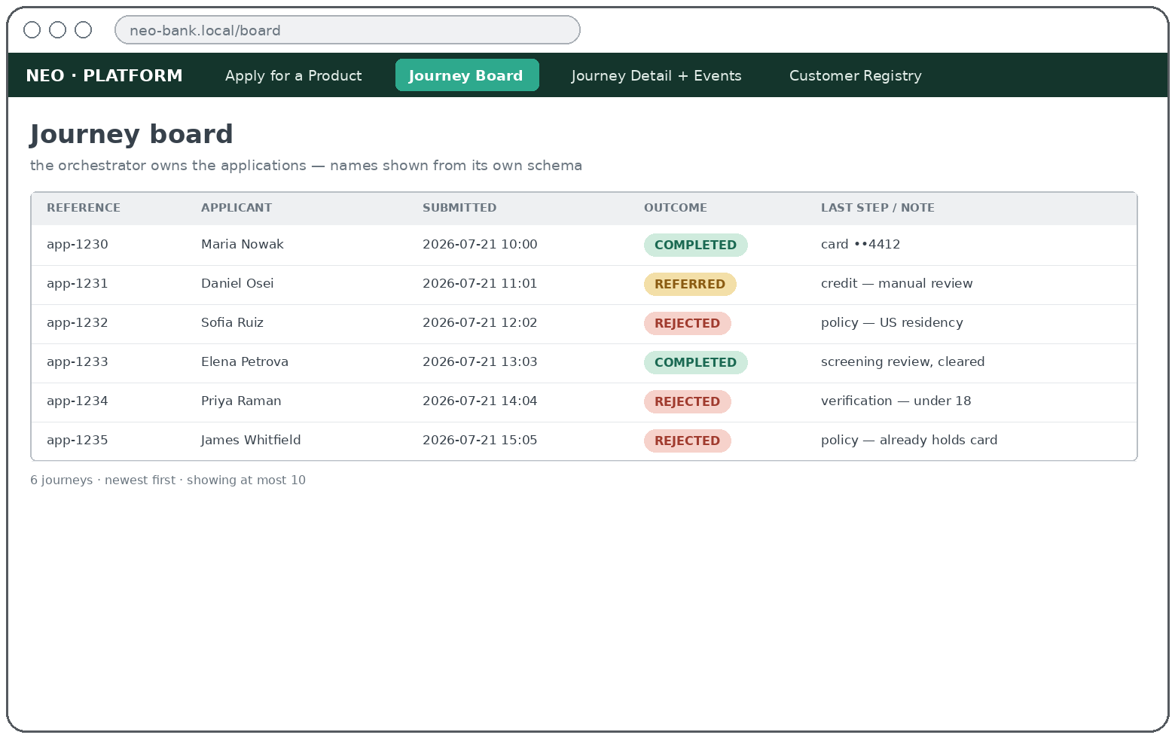
THE PLATFORM · 平台
Module 00 on screen — Journey board 旅程看板
the whole time — steps 1→8 · every application, outcome at a glance
THE FLOW · 流程
1
The board reads the orchestrator's own schema — applications + journey events, no hydration calls.
2
Every dispatch, 202 and callback appends an event; rows update live as the saga walks 1→8.
3
A terminal state colours the outcome pill — COMPLETED · REFERRED · REJECTED.
SERVICES INVOKED · 调用的服务
none drawn from module 00's own MySQL schema
mock or real the board looks identical either way
lives in module 00 — teams rely on it, they don't build it · 属于模块00：大家依赖它，但不用自己造它
Notes:
Module 00 walkthrough — Journey board (screen 2 of 6). The board reads the orchestrator's own schema — applications + journey events, no hydration calls. Every dispatch, 202 and callback appends an event; rows update live as the saga walks 1→8. A terminal state colours the outcome pill — COMPLETED · REFERRED · REJECTED.

Slide 35
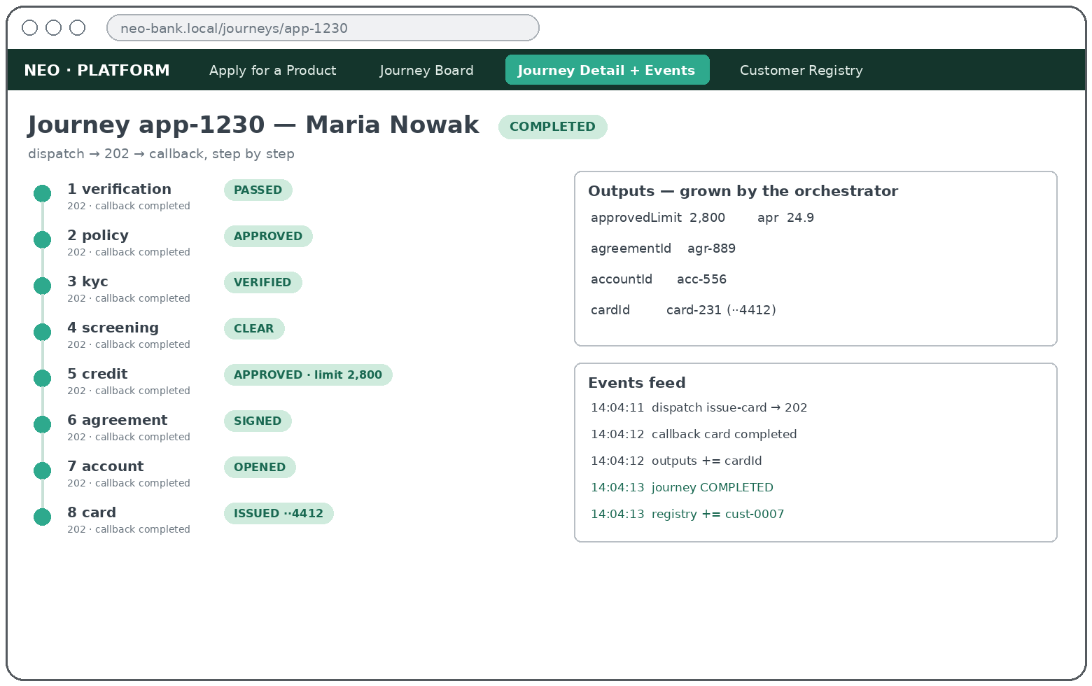
THE PLATFORM · 平台
Module 00 on screen — Journey detail + events 旅程详情与事件
after every callback · the saga step-by-step, callback by callback
THE FLOW · 流程
1
Every step runs the same wire: dispatch → 202 Accepted → off-thread decision → callback.
2
Each callback advances the state machine and lands in the events feed — “my module never called back” shows up here first.
3
Outputs grow after steps 5–8 (limit/APR · agreementId · accountId · cardId); later steps read them from the envelope.
SERVICES INVOKED · 调用的服务
→ 01…08 in order each: processApplication → 202 → callback
per-step flip mock until that team goes live
lives in module 00 — teams rely on it, they don't build it · 属于模块00：大家依赖它，但不用自己造它
Notes:
Module 00 walkthrough — Journey detail + events (screen 3 of 6). Every step runs the same wire: dispatch → 202 Accepted → off-thread decision → callback. Each callback advances the state machine and lands in the events feed — “my module never called back” shows up here first. Outputs grow after steps 5–8 (limit/APR · agreementId · accountId · cardId); later steps read them from the envelope.

Slide 36
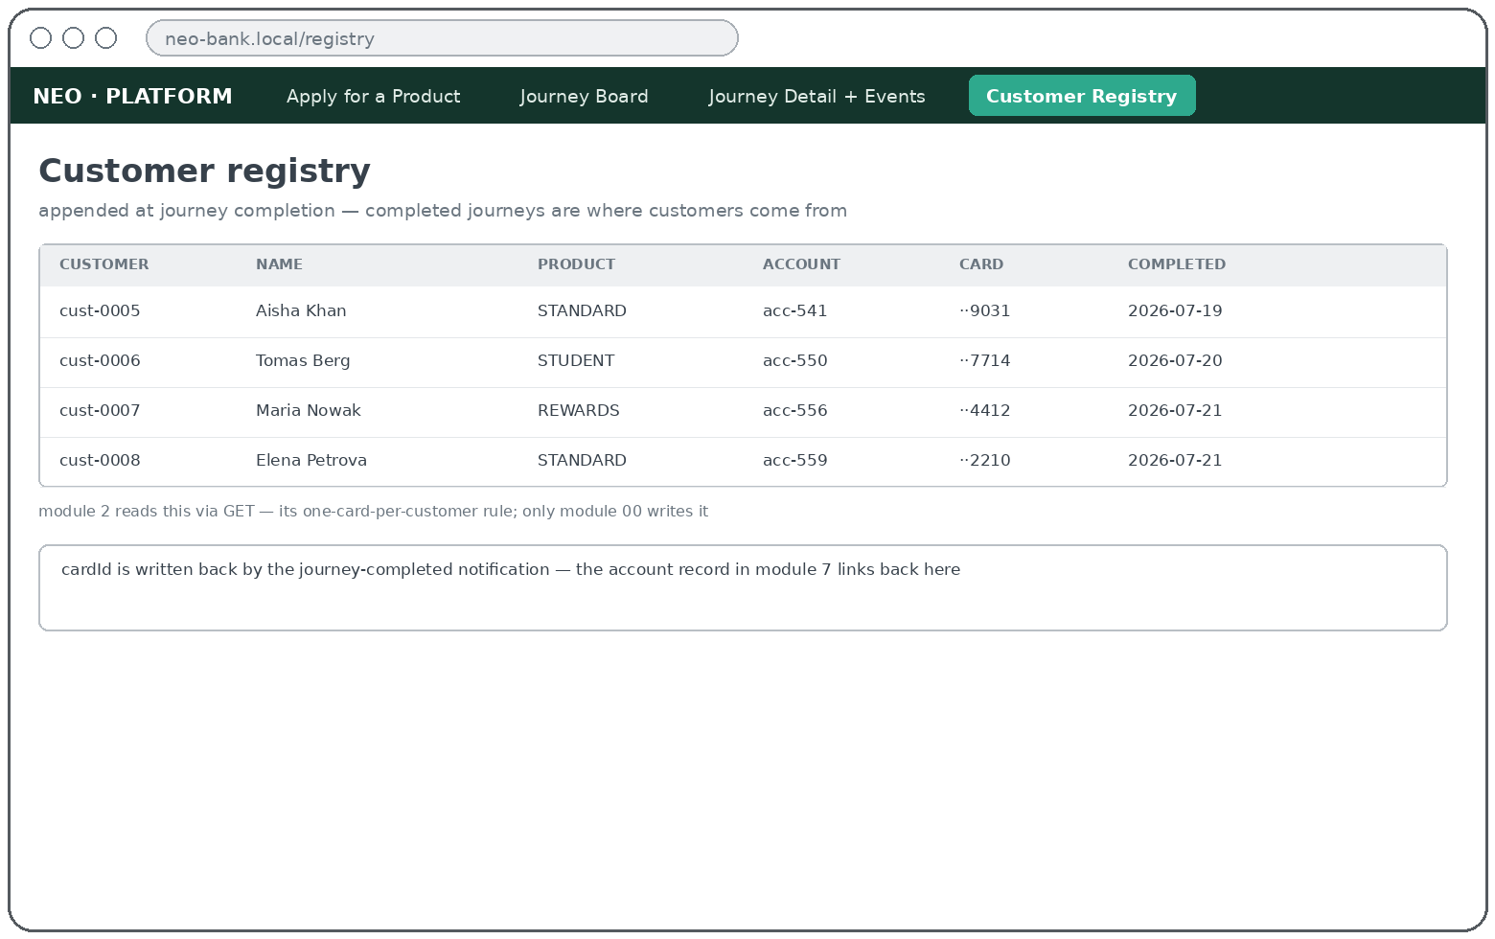
THE PLATFORM · 平台
Module 00 on screen — Customer registry 客户名册
once, at COMPLETED · appended at journey completion — module 2 reads it
THE FLOW · 流程
1
The journey reaches COMPLETED — only then is the customer appended and the customerId minted.
2
The journey-completed notification writes the cardId back, so the account record links here.
3
Every LATER application meets this list at step 2 — the one-card-per-customer rule.
SERVICES INVOKED · 调用的服务
written by 00 only at journey completion
read by → 02 policy GET — one card per customer
write-back → 07 account journey-completed carries the cardId
lives in module 00 — teams rely on it, they don't build it · 属于模块00：大家依赖它，但不用自己造它
Notes:
Module 00 walkthrough — Customer registry (screen 4 of 6). The journey reaches COMPLETED — only then is the customer appended and the customerId minted. The journey-completed notification writes the cardId back, so the account record links here. Every LATER application meets this list at step 2 — the one-card-per-customer rule.

Slide 37
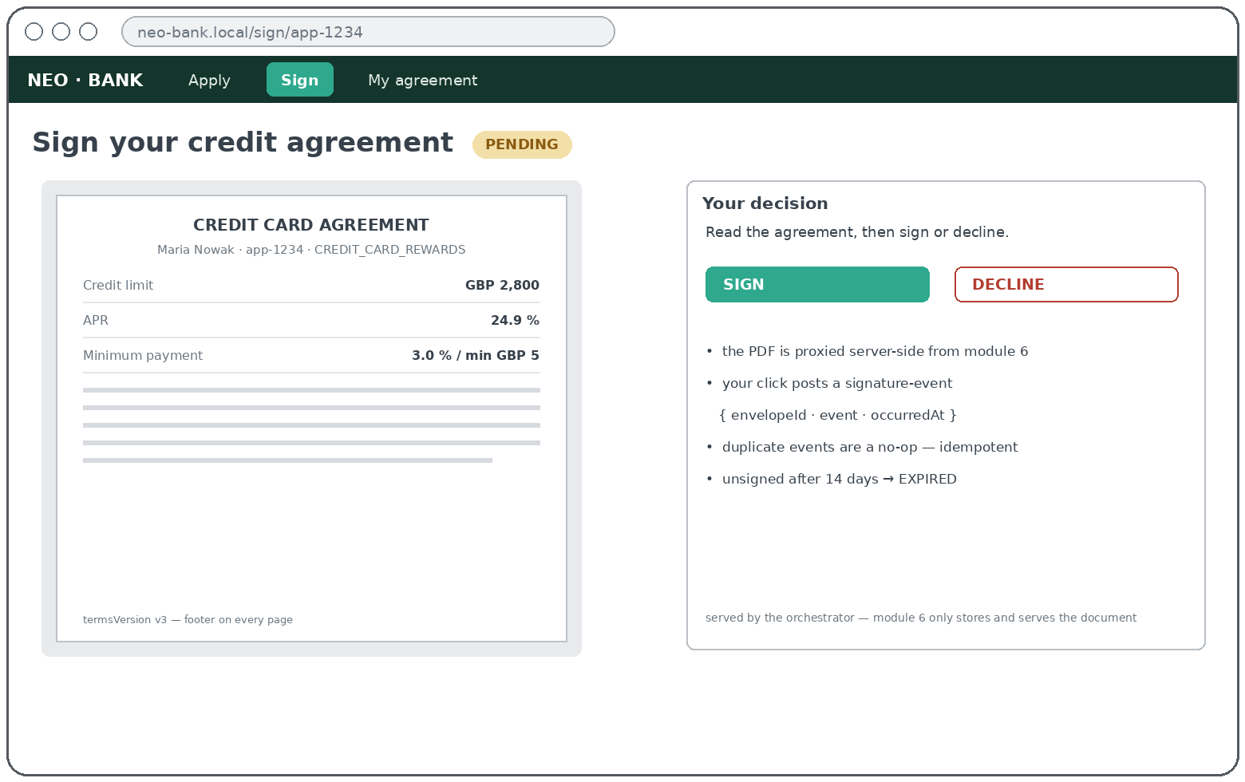
THE PLATFORM · 平台
Module 00 on screen — Signing page 签署页
inside step 6 — journey parked · customer signs — the PDF is proxied from module 6
THE FLOW · 流程
1
request-signature makes the agreement PENDING — the journey parks and waits.
2
The PDF is fetched from module 6 and proxied server-side — no CORS, no direct module access.
3
SIGN / DECLINE posts a signature-event — idempotent, accepted only from PENDING.
4
Module 6 calls back → the journey resumes with step 7, open-card-account.
SERVICES INVOKED · 调用的服务
→ 06 agreement GET /cases/{id}/document — proxy
→ 06 agreement POST /cases/{id}/signature-events
lives in module 00 — teams rely on it, they don't build it · 属于模块00：大家依赖它，但不用自己造它
Notes:
Module 00 walkthrough — Signing page (screen 5 of 6). request-signature makes the agreement PENDING — the journey parks and waits. The PDF is fetched from module 6 and proxied server-side — no CORS, no direct module access. SIGN / DECLINE posts a signature-event — idempotent, accepted only from PENDING. Module 6 calls back → the journey resumes with step 7, open-card-account.

Slide 38
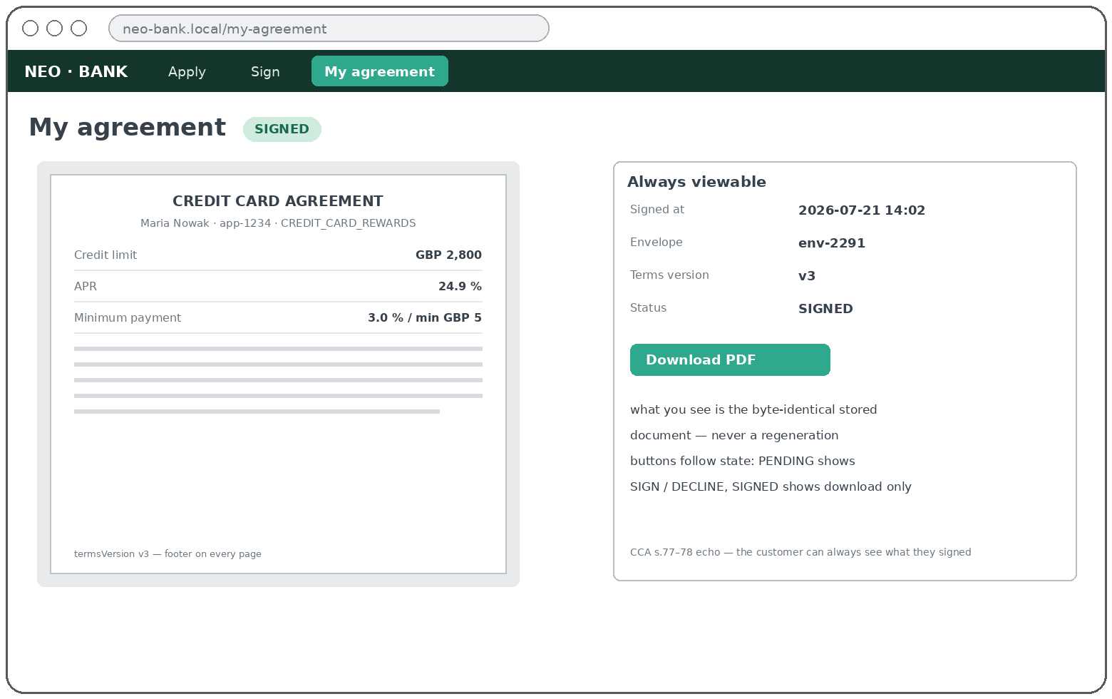
THE PLATFORM · 平台
Module 00 on screen — My agreement 我的协议
step 6 onwards — forever · always viewable, actions depend on state
THE FLOW · 流程
1
Available from the moment the document exists — and forever, even after the journey ends.
2
Always the byte-identical stored PDF, never a regeneration — years later you can prove what was signed.
3
Buttons follow state: PENDING → sign / decline · SIGNED → download only · DECLINED / EXPIRED → view + status.
SERVICES INVOKED · 调用的服务
→ 06 agreement GET document — the stored blob, proxied
nothing else no other module is involved
lives in module 00 — teams rely on it, they don't build it · 属于模块00：大家依赖它，但不用自己造它
Notes:
Module 00 walkthrough — My agreement (screen 6 of 6). Available from the moment the document exists — and forever, even after the journey ends. Always the byte-identical stored PDF, never a regeneration — years later you can prove what was signed. Buttons follow state: PENDING → sign / decline · SIGNED → download only · DECLINED / EXPIRED → view + status.

Slide 39
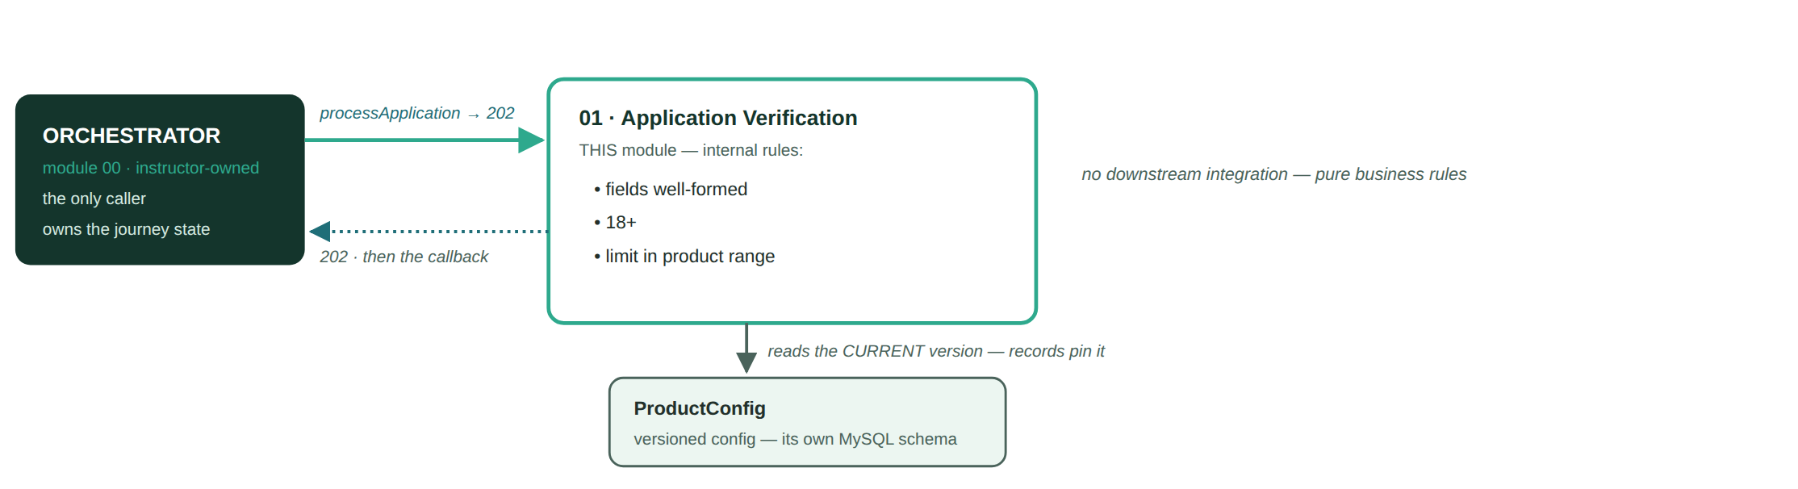
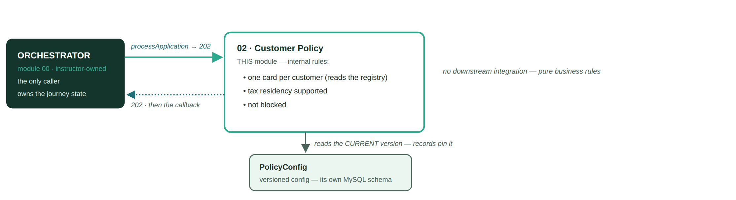
THE PLATFORM · 平台
Inside each box — 01 Application Verification · 02 Customer Policy 模块内部
orchestrator → module + internal rules → versioned config → mocked downstream (dashed) · 编排器 → 模块与规则 → 版本化配置 → 模拟下游（虚线）
Notes:
Inside each box — 01 Application Verification · 02 Customer Policy. Same anatomy for every module: intake API, internal rules/integration, versioned config, own MySQL schema, and (for integration modules) the mocked downstream dependency.

Slide 40
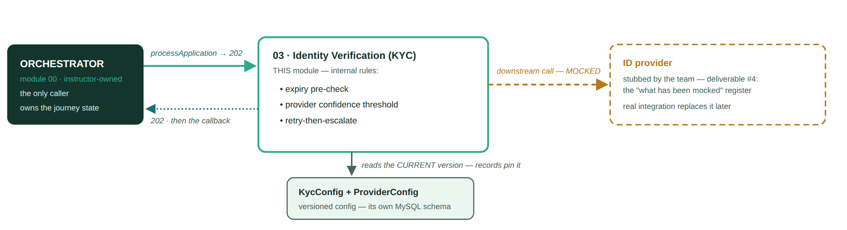
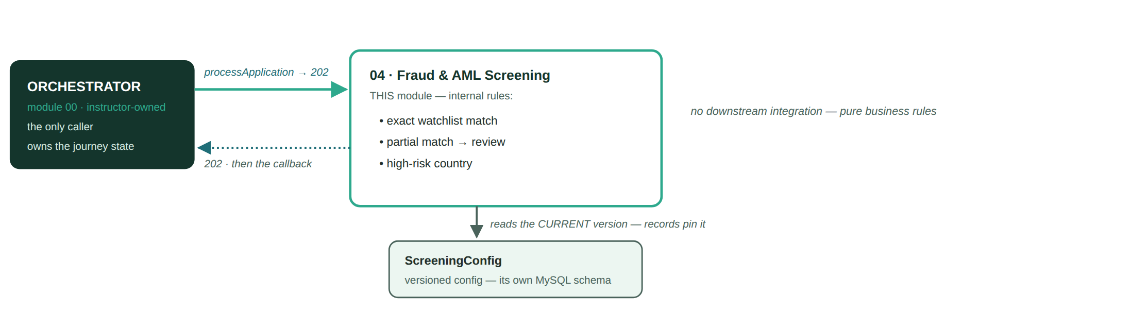
THE PLATFORM · 平台
Inside each box — 03 Identity (KYC) · 04 Fraud & AML Screening 模块内部
Notes:
Inside each box — 03 Identity (KYC) · 04 Fraud & AML Screening. Same anatomy for every module: intake API, internal rules/integration, versioned config, own MySQL schema, and (for integration modules) the mocked downstream dependency.

Slide 41

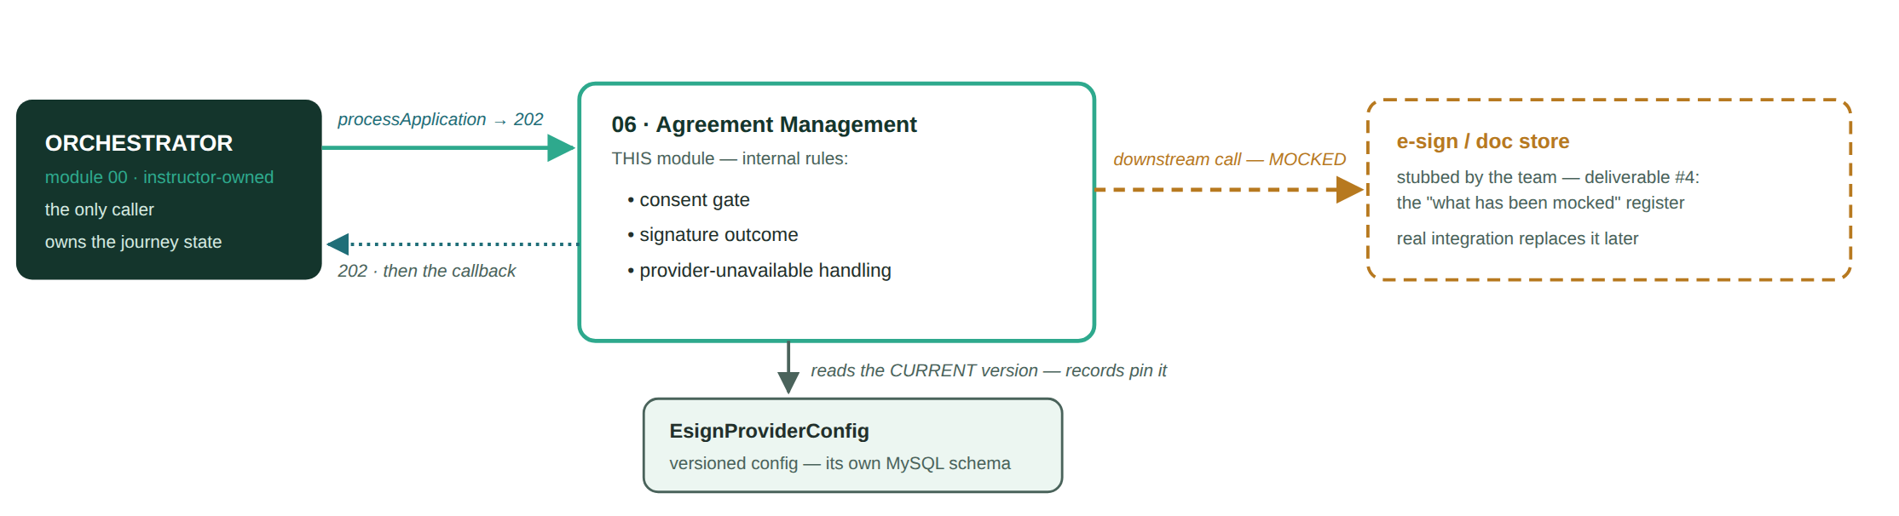
THE PLATFORM · 平台
Inside each box — 05 Credit Decisioning · 06 Agreement Mgmt 模块内部
Notes:
Inside each box — 05 Credit Decisioning · 06 Agreement Mgmt. Same anatomy for every module: intake API, internal rules/integration, versioned config, own MySQL schema, and (for integration modules) the mocked downstream dependency.

Slide 42
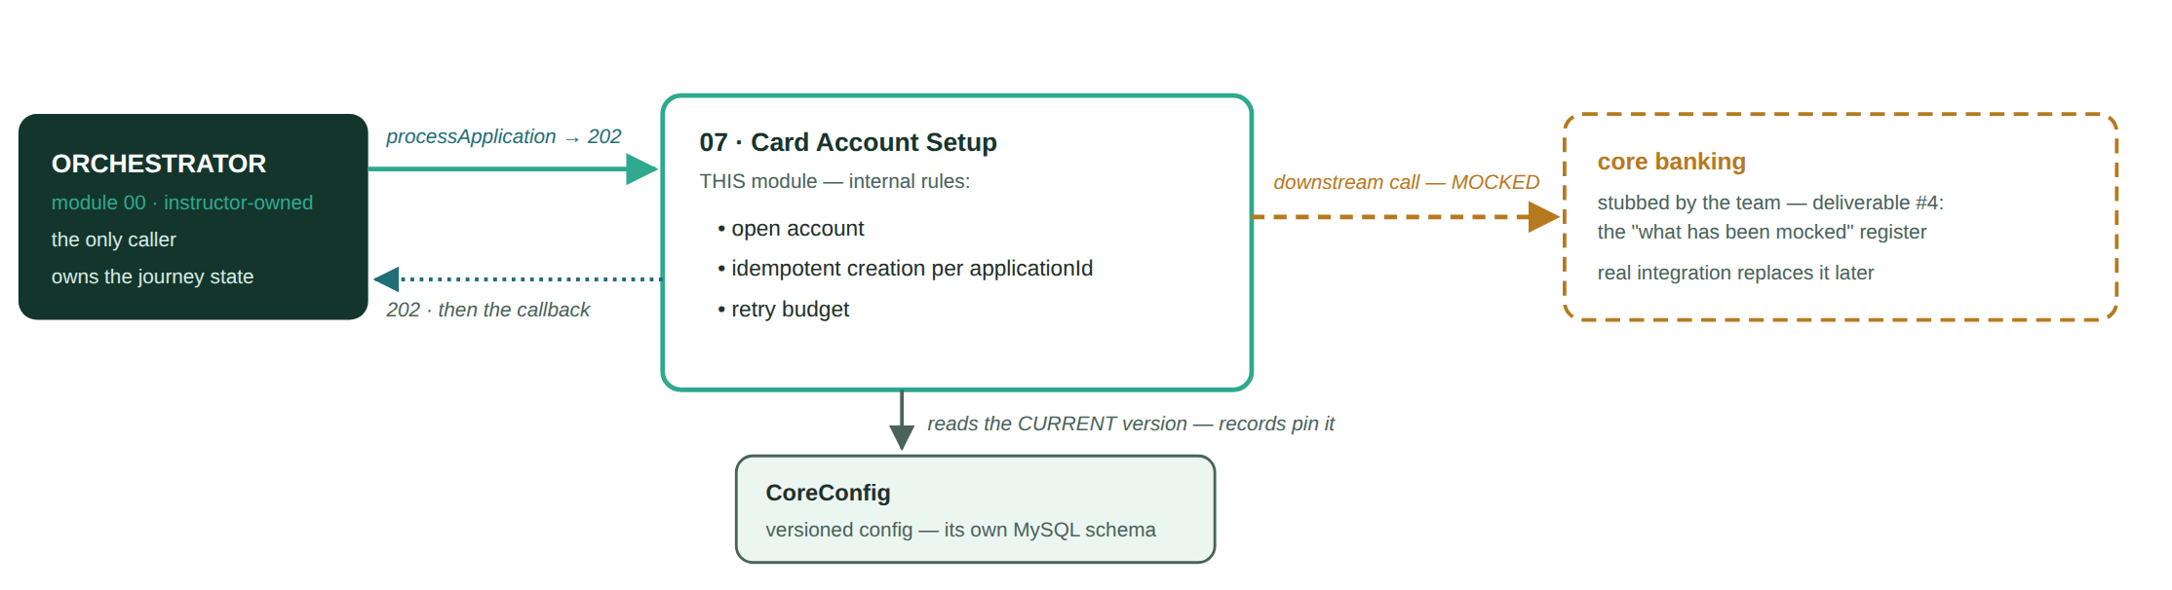

THE PLATFORM · 平台
Inside each box — 07 Card Account Setup · 08 Card Issuing 模块内部
Notes:
Inside each box — 07 Card Account Setup · 08 Card Issuing. Same anatomy for every module: intake API, internal rules/integration, versioned config, own MySQL schema, and (for integration modules) the mocked downstream dependency.

Slide 43
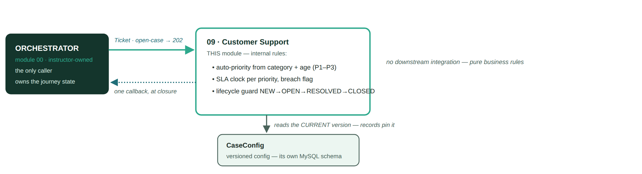
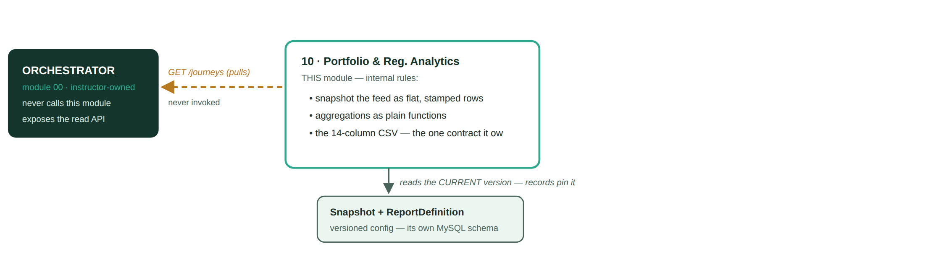
THE PLATFORM · 平台
Inside each box — 09 Customer Support · 10 Portfolio & Reg. Analytics 模块内部
Notes:
Inside each box — 09 Customer Support · 10 Portfolio & Reg. Analytics. Same anatomy for every module: intake API, internal rules/integration, versioned config, own MySQL schema, and (for integration modules) the mocked downstream dependency.

Slide 44
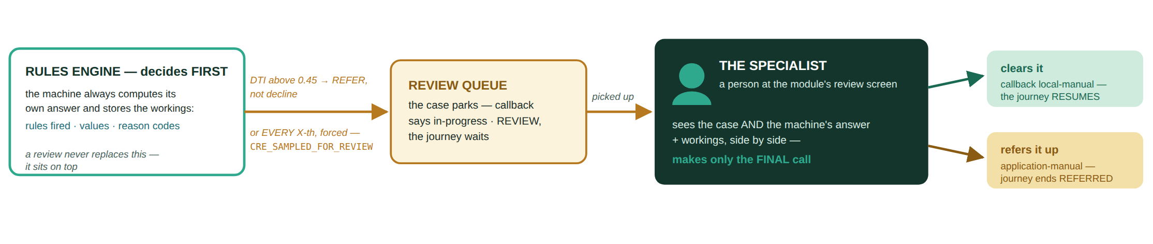
THE PLATFORM · 平台
When the machine isn't sure — a specialist reviews the case 机器拿不准时，由专员复核
modules 02–05 only — Customer Policy · Identity (KYC) · Screening · Credit Decisioning · 仅限模块02–05
Two ways in 两条进入路径
The specialist's rule 专员的规则
Two ways out 两个出口
The rules land on REVIEW / REFER — no clean yes or no. Or nothing is wrong at all: every X-th application is force-flagged (…_SAMPLED_FOR_REVIEW) so the queue gets traffic in every demo — QA sampling, like a real bank.
The review never replaces the machine: the module always computes and shows its own decision — rules fired, values seen, score, reason codes. The person sees the case AND the workings, and makes only the FINAL call.
Clear it → callback local-manual — the journey RESUMES as if the step passed. Refer it up → callback application-manual — the journey ends REFERRED. Either way the orchestrator never sees the queue.
Elena Petrova walks this path live: screening flags her high-risk residence, the specialist clears it, her journey completes. · Elena 现场走通这条路：筛查标记 → 专员放行 → 旅程完成。
Notes:
Manual review, modules 02-05 only. Engine decides first and stores its workings; queue fills via rule triggers or every X-th sampled case; specialist makes only the final call; local-manual resumes, application-manual refers.

Slide 45
THE PLATFORM · 平台
Building one box alone — the orchestrator as a sidecar 单独构建你的格子
You never need the other nine modules running: a tiny orchestrator simulator plays module 00's part — same wire, same envelopes. · 你不需要其他九个模块在跑：一个小小的编排器模拟器扮演模块00——同一条线、同样的信封。
your laptop · docker compose
YOUR MODULE 你的模块
the one real box under test
processApplication (envelope)
ORCHESTRATOR SIM 编排器模拟器
sidecar container — plays module 00
REST API — processApplication · cases · override · /health · /info
Business rules / integration — your actual work, plus your own downstream mocks
MySQL (own schema) + admin UI — Liquibase migrations · React board
202 · then callback
Fires seeded processApplication envelopes — the ten cast applications, replayable
Answers GET /applications/{id} so payload hydration works
Receives your 202s + callbacks, logs them, checks the contract
GET /applications/{id}
Same wire as production 与生产同一条线
Seeded scenarios 内置十个剧本
Go-live is a config flip 上线只改一个配置
Envelopes, 202s, callbacks, hydration GET — nothing in your module knows it is talking to a stand-in.
It replays the ten cast applicants (Maria, Daniel, Marek…) deterministically — happy path, referrals and rejections on demand, offline.
Point the base URL at the real module 00 and pass its contract self-check — the sidecar retires, your box slots in unchanged.
Notes:
The sidecar: a team never needs the other nine modules. The simulator speaks the locked contract; go-live = point the base URL at the real module 00 and pass the contract self-check.

Slide 46
THE PLATFORM · 平台
Each team owns one module — one repo, one box on the map, one chapter of the same story.
每个团队负责一个模块——一个仓库、地图上的一个格子、同一个故事中的一章。
Notes:
Ten designated projects, ten repos — every one a sub-system of the same platform.

Slide 47
THE PLATFORM · 平台
The whole journey already runs as a mock — your job is to replace your box with the real thing.
整条旅程已经可以用模拟系统跑通——你们的任务，就是用真实系统换掉属于你的那个格子。
Notes:
neo-mock runs the full journey end to end (python3 run.py). The mock is the spec: the platform works before any team writes a line, and each team swaps in their real module.

Slide 48
THE PLATFORM · 平台
You are not starting from scratch 你们不是从零开始
Last week we united everything you used in this course into one base template repository. · 上周，我们把课程中用到的所有技术整合成一个基础模板仓库。
Spring backend
React frontend
MySQL
Liquibase
后端
前端
数据库
数据库版本管理
Docker + compose
GitHub Actions
Tests
GitHub repo
容器化
CI/CD 流水线
测试
代码仓库
A real working environment — engineers rarely begin with an empty folder. · 这就是真实的工作环境——工程师很少从一个空文件夹开始。
Notes:
Last week we united all the elements used throughout the course into a base template repository: Spring backend, React frontend, MySQL, Liquibase, Docker, docker-compose, GitHub Actions CI/CD, tests. Emulates a real working environment.

Slide 49
LET'S GO · 出发
Let's build a bank.
我们一起，建一家银行。
Up next: your team's project brief · 接下来：各队项目简报
Notes:
Hand over to team assignments / the detailed overview deck (neo-capstone-overview.pptx) as needed.

