Slide 1
MODULE 2 · RULE
Customer Policy
Student Brief v5 — what we expect from your module; discovering the rest is part of the job
Customer Digital Journey · neo-capstone · Module 2 of 10 · your instructor is the customer — book time, ask questions

Slide 2
MODULE 2 · policy / check-policy
The mission
Rule
THE ONE QUESTION YOUR MODULE ANSWERS
Is the bank allowed — and willing — to have this person as a customer at all?
NON-NEGOTIABLES (PLATFORM RULES)
• Only the orchestrator calls you: POST /api/v1/policy/execute → answer 202 immediately → decide off-thread → POST your outcome to /api/v1/callbacks.
• You receive the WHOLE application, every time. Use what you need, ignore the rest.
• Never call another module; never depend on another step's result. Your registry read goes to the orchestrator — module 00 — not to a team.
• Never store the application payload — only applicationId. Your UI fetches applicant detail live through your own GET proxy.
• Big lists (search, boards, queues) start EMPTY and never show more than 10 rows.
• The api-contract is LOCKED. Need something it doesn't have? Ask your instructor — do not invent.
• Every API you expose is idempotent — same request twice, same result once. This is a design principle, not an optimisation.
• You decide whether the bank is allowed — and willing — to take this person on as a customer. Module 1 checked the form; you check the relationship.
• You do not judge creditworthiness (module 5 does), and you do not match against government watchlists (module 4 does). Your rules are the bank's own policy: one card per customer, tax residency inside the footprint, not on the bank's own restriction list.
• One of your inputs does not live in your module at all. Work out which rule needs it, who owns it, and what you do when its owner does not answer.
• In the real world this is a business-rules engine — IBM ODM or Drools territory — whose defining property is that policy changes ship as data, not as code releases. Research it.
Customer Policy · Student Brief — the onboarding saga

Slide 3
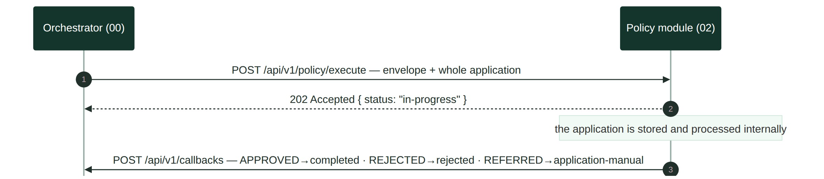
MODULE 2
The contract in one picture
Rule
outcome
callback status
journey effect
APPROVED
completed
next step runs
REJECTED
rejected
journey ends REJECTED
REFERRED
application-manual
parks for a person
Every so often your module must disobey its own rules — on purpose, on a schedule. Find out why a bank would want that.
Customer Policy · Student Brief — two calls, one gap in the middle

Slide 4
MODULE 2
Your use cases
Rule
#
use case
what it means
primary screen
00
Process Application
the front door — every /execute is acknowledged and stored; nothing else exists without it
— feeds every screen (row visible on the board)
01
Search Cases
find a policy case by application id or applicant name — empty by default, never more than 10 rows
Policy Board
02
Review Decision
open one decision — outcome, machineOutcome and every rule's result; the rule engine lives here
Decision Detail
03
View Applicant
see the person behind a case, fetched live from the orchestrator — never stored
Decision Detail sidebar
04
Work Referral Queue
a person works the REFERRED cases — machine workings always on screen, decision with a reason, journey resumes
Referral Queue
05
Rejection Patterns
which policy reasons fire most over a date range — is a list too tight, or the sampling rate too high?
Rejection Patterns
06
Override Case
a person corrects a wrong decision — with a reason, leaving a trace, resuming the journey
Override modal
07
Edit Policy Config
change the residency lists, the restriction list or the sampling rate as data — insert-only versions
Policy Configuration
08
View Config History
every version the policy ever had, so old decisions stay explainable
Policy Configuration
09
Minimum relationship tenure
CANDIDATE — returning customers must wait; touch it only when 01–08 are complete
Decision Detail (rule 5)
10
Marketing consent for partner products
CANDIDATE — partner co-branded products need data-sharing consent; touch only when 01–08 are complete
Decision Detail (rule 6)
Customer Policy · Student Brief — the scope; the depth of each one is yours to elicit
For every use case your customer holds detailed acceptance criteria. Your job: elicit them, agree them, complete them — a use case without agreed acceptance criteria is not started, let alone done.

Slide 5
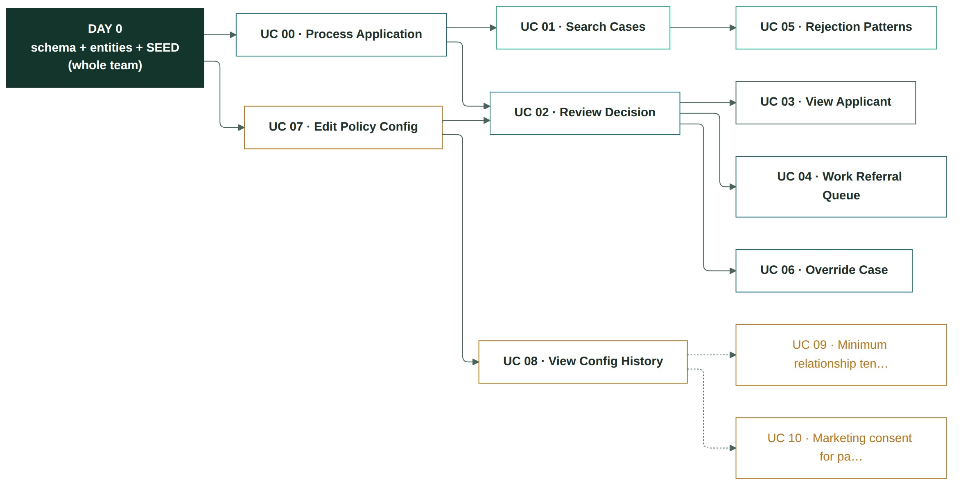
MODULE 2
Build order — what depends on what, and where to start
Rule
SUGGESTED SEQUENCE — AND WHY
1 UC 00 · Process Application — the front door, first: 202 + one durable row keyed by applicationId (the template gives the endpoint; you make it durable and idempotent). Nothing else in this module exists without this row.
2 UC 07 · Edit Policy Config — it all starts here: residencies, the restriction list and sampling-X are the engine's inputs. Verify the Day-0 seed and own the entity before anything decides.
3 UC 02 · Review Decision (the engine) — three rules against the seeded config; the registry read goes through one interface (in-memory James Whitfield map until the orchestrator stub is up).
4 UC 01 · Search Cases — the entry screen.
5 UC 04 · Referral Queue — REFERRED and sampled cases need somewhere to land; workings stay visible.
6 UC 03 · View Applicant — the proxy.
7 UC 06 · Override Case — the write path + local-manual callback.
8 UC 05 · Rejection Patterns — aggregate over rows you now have.
9 UC 08 · Config History — the audit close-out.
10 UC 09/10 · Candidates — tenure first (pure rule), consent second.
Customer Policy · Student Brief — the graph is the law; the order is advice. Deviate knowingly.

Slide 6
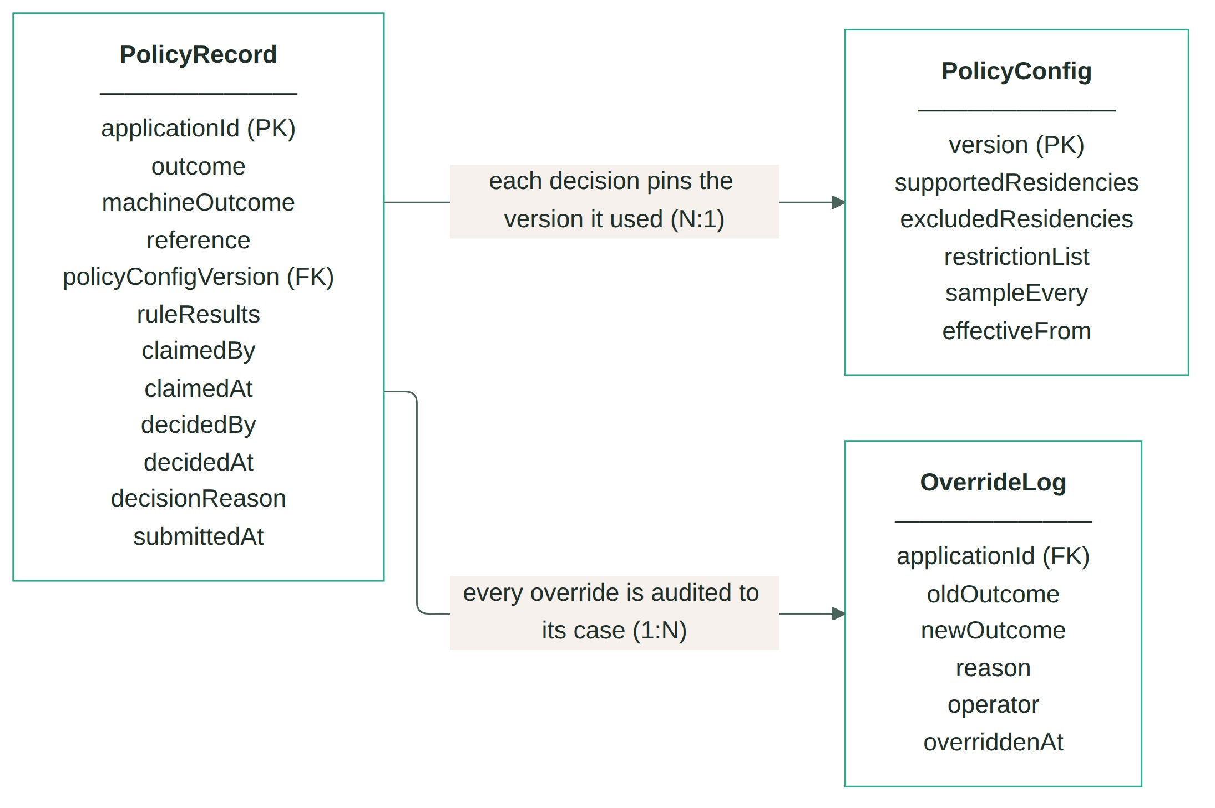
MODULE 2
Entity design comes first
Rule
• One of your very FIRST tasks is entity design. Agree the data model as a whole team before anyone writes code — the biggest problem teams have is starting with a model that is too complicated.
• Suggested key entities: PolicyRecord — one row per applicationId (unique) · PolicyConfig — insert-only, versioned lists; the current version is the highest · OverrideLog — audit trail; one row per manual override, none ever deleted. A starting point, not a mandate — be ready to defend deviations to your customer.
• Draw the ER diagram and keep it in your documentation (docs/) — updated in the same PR as any schema change. The suggestion on the right is the shape to beat.
• Every incoming request from the orchestrator is persisted. Each /execute stores exactly ONE row, keyed by applicationId — and that id is the ONLY applicant data in your schema. The application payload itself is NEVER stored.
SUGGESTED ER — STARTING POINT
Customer Policy · Student Brief — agree the model on Day 0; the ER diagram is part of your documentation

Slide 7
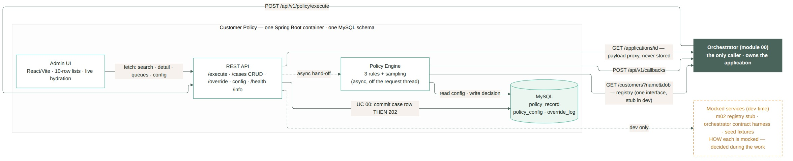
MODULE 2
The shape of what you build
Rule
Same uniform shape as module 1 plus ONE extra outbound read: the customer registry lives in the orchestrator, so the engine reaches out through a single client interface — in-memory stub in dev, real GET in integration. Kill it and cases park instead of guessing.
Customer Policy · Student Brief — components and the calls between them; your names may differ, the shape should not

Slide 8
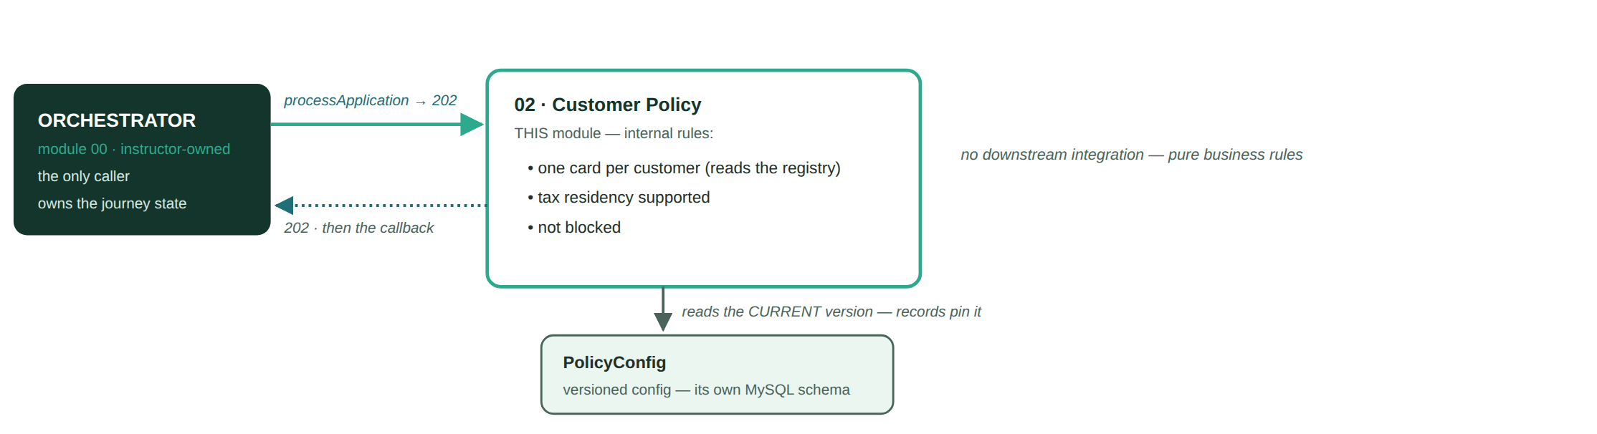
MODULE 02
Where you sit — in one picture
Rule
Customer Policy — the orchestrator calls you · your rules decide · your config is versioned · your downstream is mocked

Slide 9
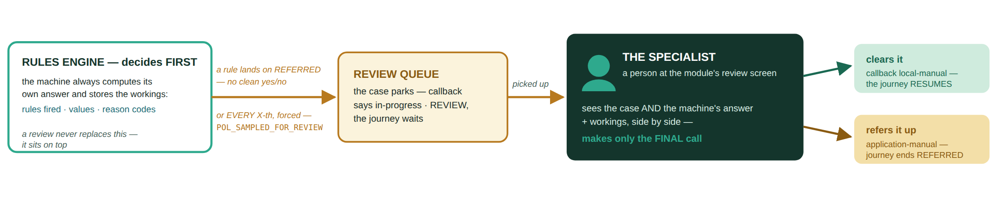
MODULE 02
Manual review — a specialist decides
Rule
Customer Policy — in: a rule lands on REFERRED, or every X-th forced sample · the specialist sees the workings and makes only the final call · out: local-manual resumes, application-manual REFERS

Slide 10
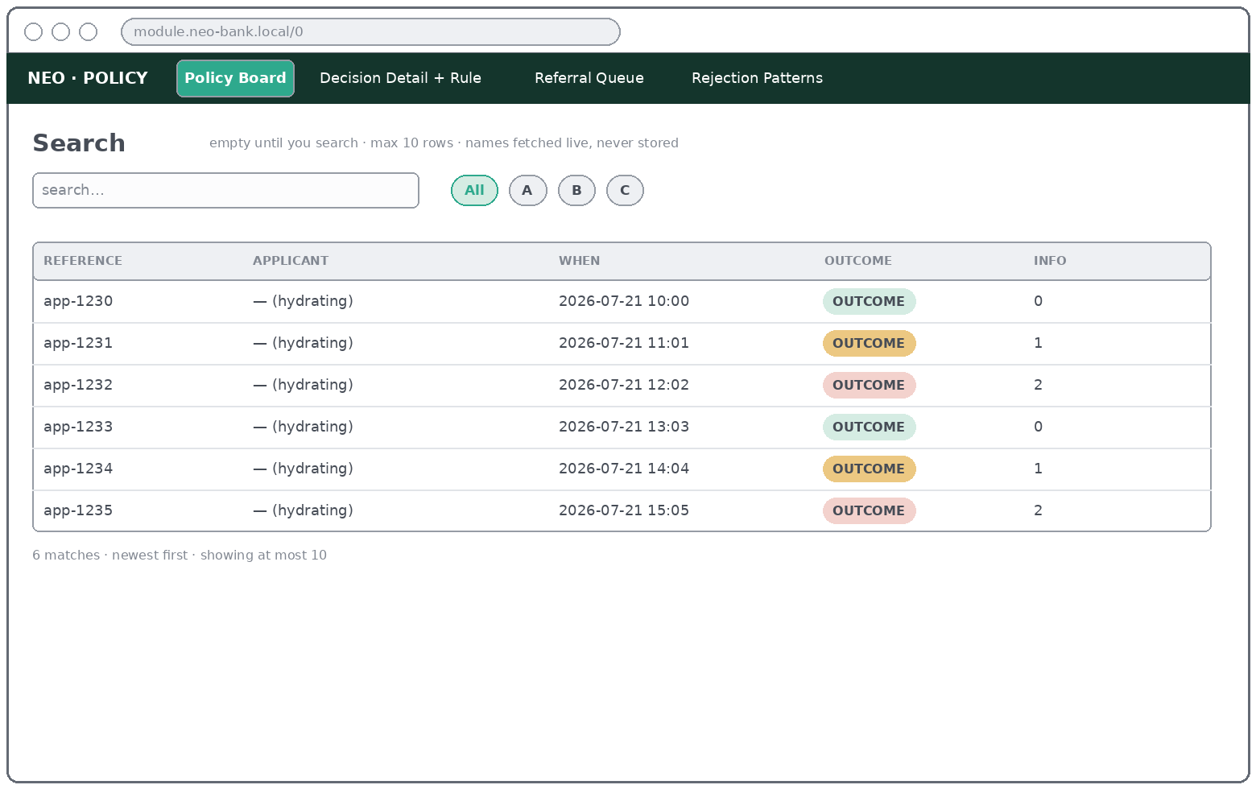
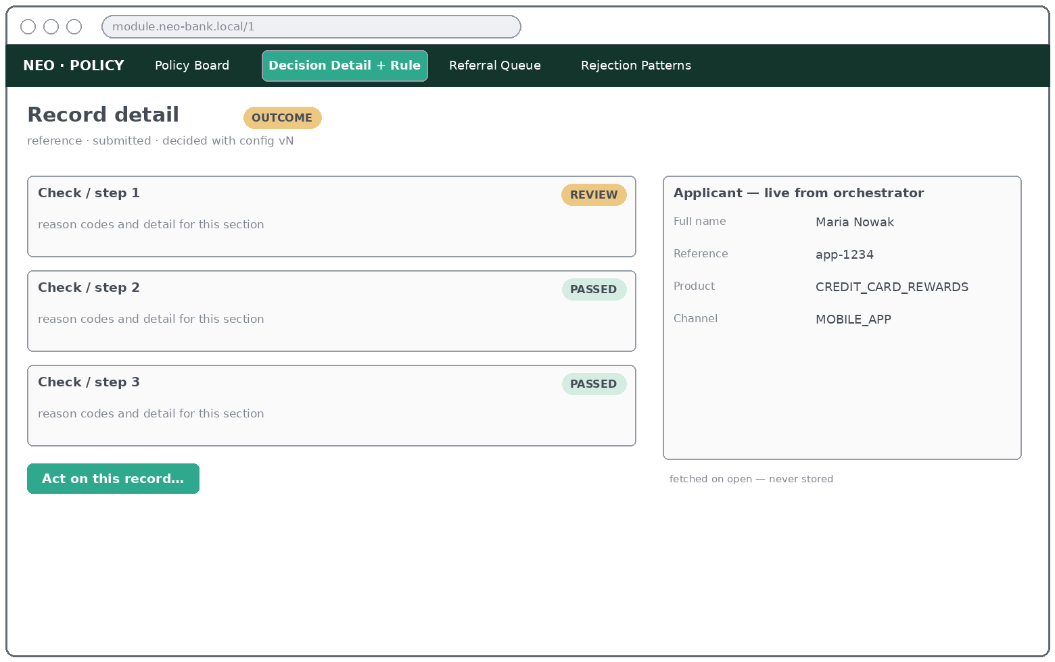
MODULE 2
How it is used — steps per use case (1/3)
Rule
UC 00 · Process Application
UC 01 · Search Cases
• 1 No human involved — the orchestrator POSTs, the 202 goes back instantly
• 2 The row exists before the ack; a crash after it loses nothing
• 3 Search the id on the board: the case shows as in-progress until the engine decides
• 1 Type a name or application id — the board is empty until you do
• 2 At most 10 rows appear, newest first; refine if flagged "more"
• 3 Click a row → Decision Detail
UC 02 · Review Decision
UC 03 · View Applicant
• 1 Open a case from the board
• 2 Read the outcome badge + one card per rule — sampled cases show the machine's own answer too
• 3 Every reason is on screen — never just the first
• 1 Open any case — the sidebar loads the applicant live
• 2 Orchestrator down? The case still renders; the sidebar degrades
• 3 Nothing applicant-related is ever stored locally
Customer Policy · Student Brief — your UI may look different, the JOB each screen does may not

Slide 11
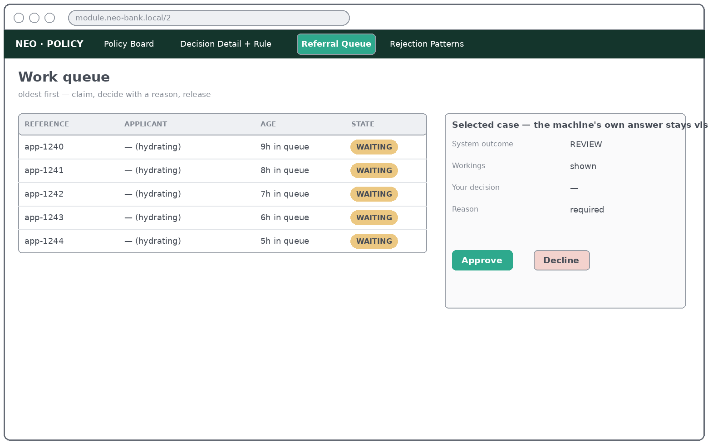
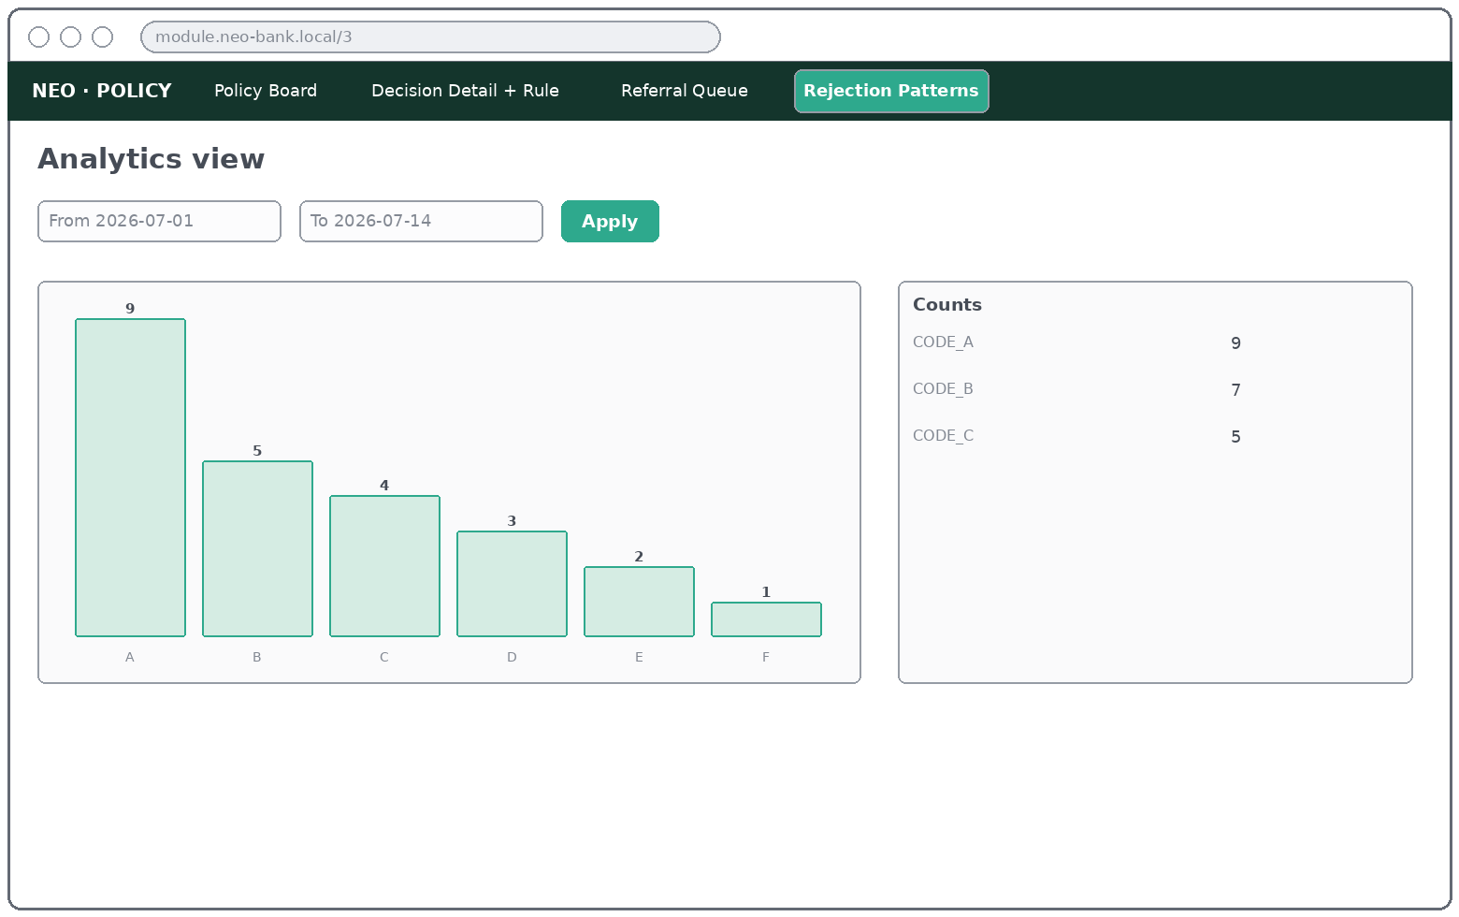
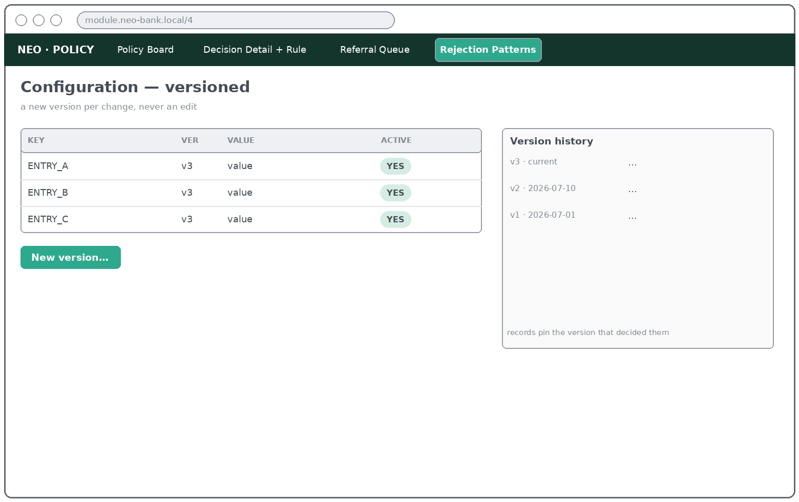
MODULE 2
How it is used — steps per use case (2/3)
Rule
UC 04 · Work Referral Queue
UC 05 · Rejection Patterns
• 1 Open the queue — oldest referred case first, claim it
• 2 Read the machine's workings — they are always on screen
• 3 Decide with a reason — the journey resumes, the trace is permanent
• 1 Pick a from/to range and apply
• 2 Read the ranked chart — rejections vs review causes
• 3 Sampling on top is normal — a rejection code spiking is the alarm
UC 06 · Override Case
UC 07 · Edit Policy Config
• 1 Open the case → "Override decision…"
• 2 Pick the new outcome; reason + operator are mandatory
• 3 Confirm — the trace is permanent, the journey resumes
• 1 Policy Configuration → edit lists, restriction entries or the sampling rate
• 2 Save — a NEW version appears; nothing old is edited
• 3 The very next application decides under the new version
Customer Policy · Student Brief — your UI may look different, the JOB each screen does may not

Slide 12
MODULE 2
How it is used — steps per use case (3/3)
Rule
UC 08 · View Config History
• 1 Open the history — every version, oldest first
• 2 The current version is marked
• 3 Old cases still point at the version that decided them
Customer Policy · Student Brief — your UI may look different, the JOB each screen does may not

Slide 13
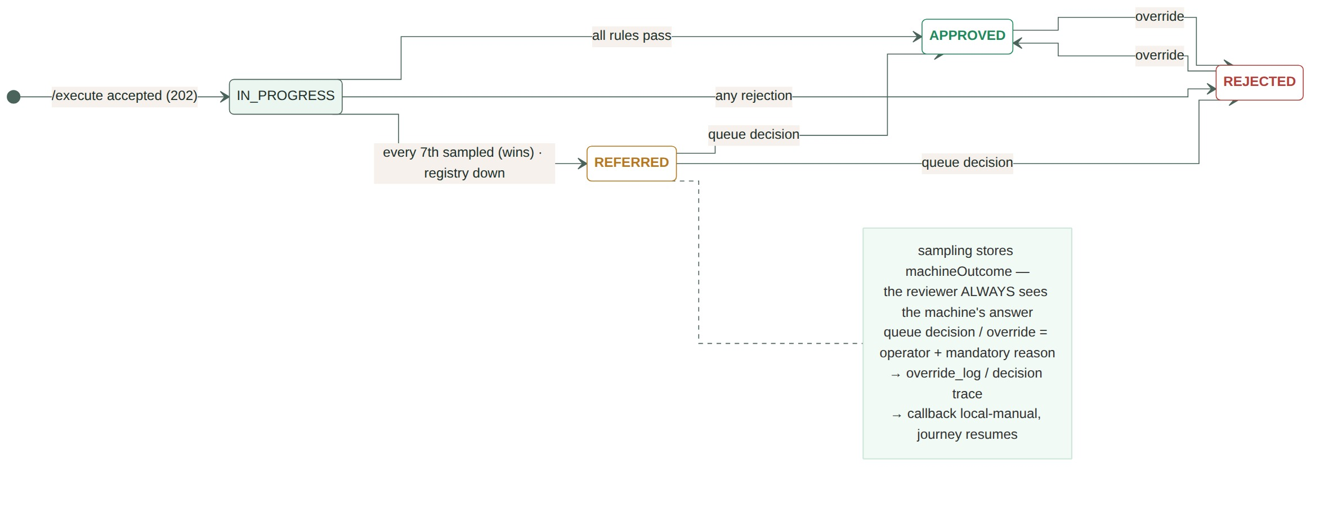
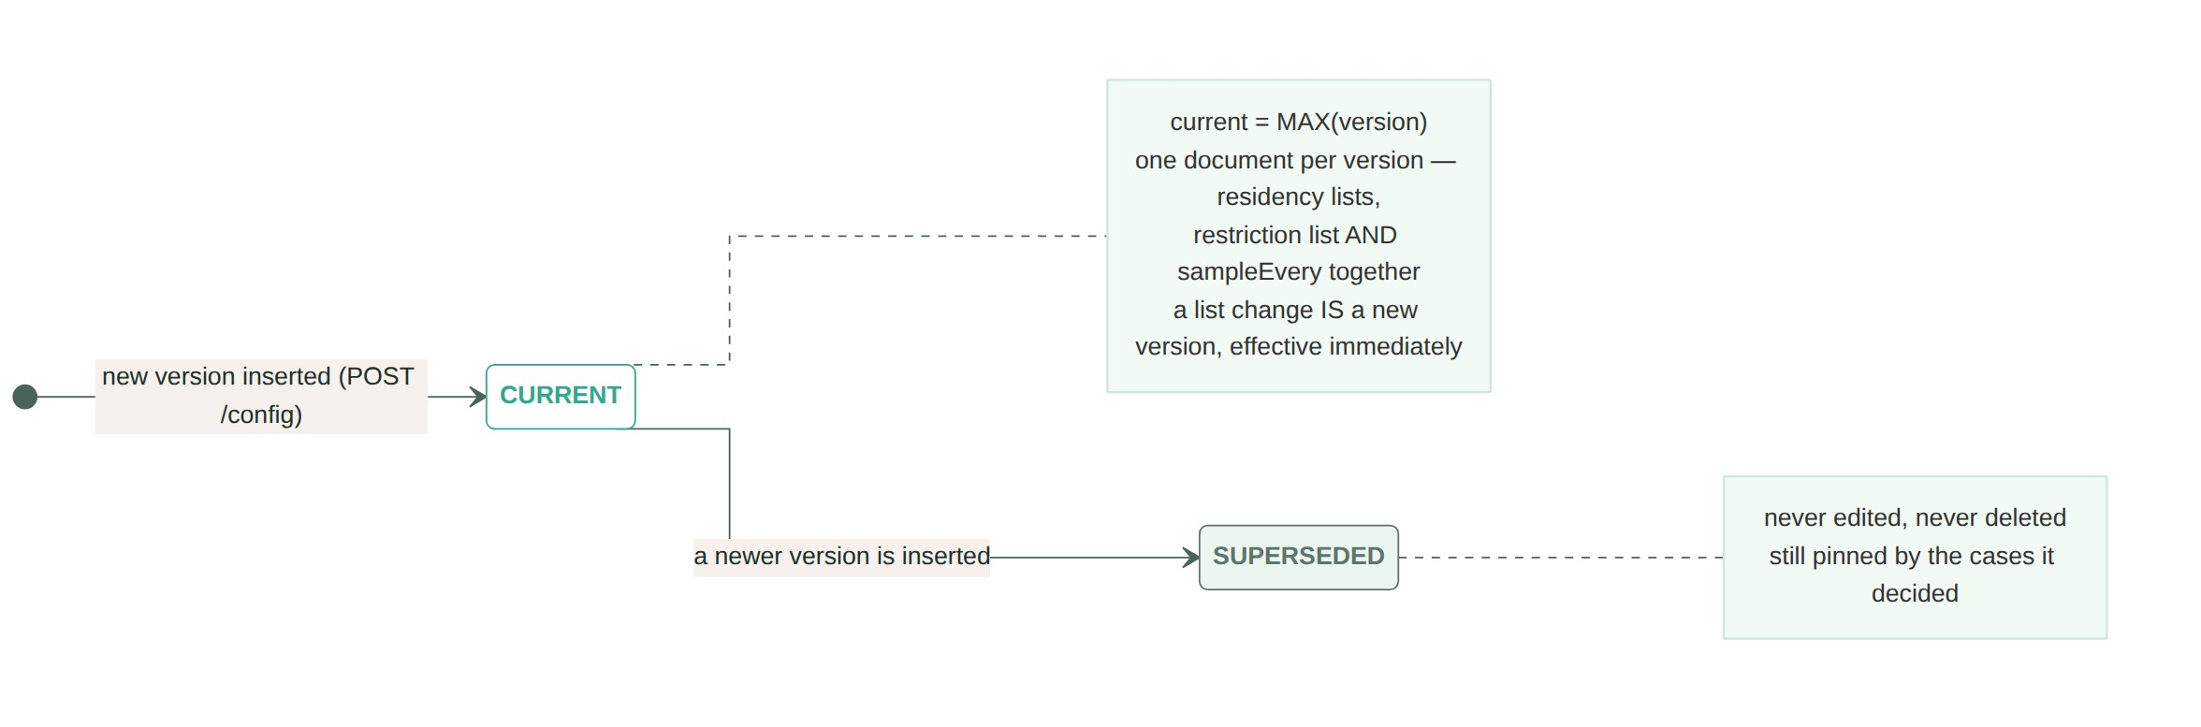
MODULE 2
Expected state transitions
Rule
Dashed amber = a human decision — the ONLY way an outcome ever changes. Your REFERRED state has three entrances; can you name all three? What must a queue decision always carry, and what does the orchestrator hear when it happens? A repeated /execute for the same applicationId must NOT create a second row, a second registry call or a second decision. Prove it.
Compliance adds a residency on Tuesday; an auditor asks on Friday why Monday's case rejected. What must your case record remember for the old answer to still be explainable? And which single config field, changed, alters how often your queue fills up — without touching any rule?
Customer Policy · Student Brief — outcomes are terminal for the machine

Slide 14
MODULE 2
You are done when
Rule
• Every use case's acceptance criteria are complete — elicited from your customer, agreed, and verified per case against the running app. This is THE definition of done; nothing below substitutes for it.
• The orchestrator's contract check passes against your running container — 202 then callback, statuses mapped exactly as the table on slide 3, and a repeated /execute changes nothing.
• A bank employee can do their whole job from your UI — find a case, understand exactly why it decided what it decided, work the referral queue with the machine's workings on screen, fix a wrong decision with a reason, and change policy without a deploy.
• Your schema contains zero applicant data — and your lists stay within the 10-row rule.
• Quality holds — ≥ 70% line coverage on business logic, main green on a fresh clone, docker compose up works offline.
• The deliverables exist — presentation, user instructions a new operator could follow, the what-we-mocked register, upgrade notes, C4 diagram.
• The API is documented and idempotent — OpenAPI 3.0 (Swagger) served per service (mock app included), and repeating any call changes nothing the second time.
A far more detailed version of this brief exists — your instructor holds it, in the role of your customer. The teams that do best are the ones that ask the most precise questions, earliest.
Customer Policy · Student Brief — an acceptance criterion that fails beats an extra that works

Slide 15
MODULE 2 · APPENDIX
Worked examples — the cast
Rule
who / what arrives
outcome
status
what we expect to see
Maria Nowak — GB tax resident, no card, no restriction
APPROVED
completed
the happy path — one reason: POL_ALL_CHECKS_PASSED
Sofia Ruiz — tax resident GB AND US
REJECTED
rejected
the exclusion wins over the supported residency — the classic first-attempt bug
James Whitfield — already holds one of the bank's cards
REJECTED
rejected
the registry answers; policy, not module 7, is where one-card-per-customer lives
An applicant on the restriction list
REJECTED
rejected
exact match on the bank's own data, reason preserved forever
The 7th application — all rules pass
REFERRED
application-manual
sampling outranks the rules; the reviewer sees the machine's APPROVED and confirms it
The registry does not answer
REFERRED
application-manual
a person decides — the module never guesses
A reviewer decides a referred case
(changes)
local-manual
reason + who + when survive forever; the journey resumes
The locked reason codes for your domain: POL_ALL_CHECKS_PASSED · POL_EXISTING_PRODUCT_HELD · POL_TAX_RESIDENCY_UNSUPPORTED · POL_TAX_RESIDENCY_EXCLUDED · POL_CUSTOMER_BLOCKED · POL_MANUAL_APPROVED · POL_MANUAL_DECLINED. Read that list against the examples above very carefully.
Customer Policy · Student Brief — examples, not the target: your target is the acceptance criteria per use case

