Slide 1

Gotta tag ’em all

Slide 2
What is CamTag?
Challenge your friends in a picture tagging battle
Get to know each other
Explore your surroundings
Experience Artificial Intelligence first hand

Slide 3
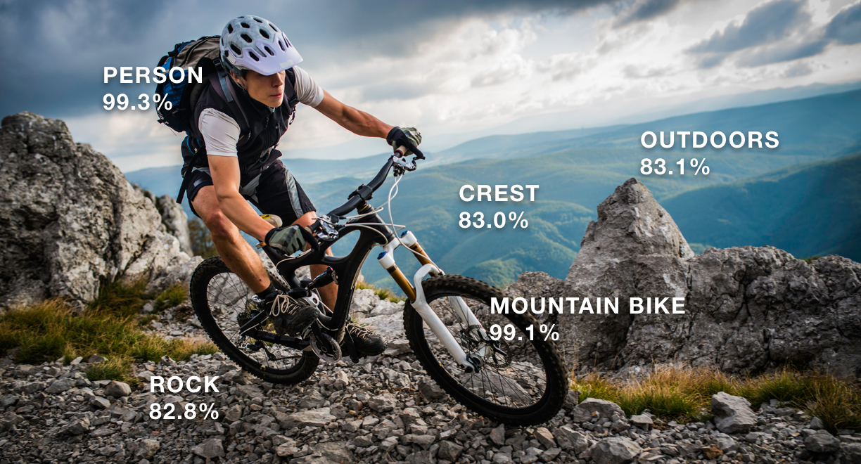
AI technology
{ Image:
{ S3Object:
{ Bucket: 'camtag',
Name: 'hejssan20190319_092913_2711458751719782771.jpg' } } }
[ { Name: 'Cell Phone',
Confidence: 99.8579330444336,
Instances: [],
Parents: [ [Object], [Object] ] },
{ Name: 'Mobile Phone',
Confidence: 99.8579330444336,
Instances: [ [Object] ],
Parents: [ [Object], [Object] ] },
{ Name: 'Electronics',
Confidence: 99.8579330444336,
Instances: [],
Parents: [] },
{ Name: 'Phone',
Confidence: 99.8579330444336,
Instances: [],
Parents: [ [Object] ] },
{ Name: 'Monitor',
Confidence: 99.73231506347656,
Instances: [ [Object] ],
Parents: [ [Object], [Object] ] },
{ Name: 'Display',
Confidence: 99.73231506347656,
Instances: [],
Parents: [ [Object], [Object] ] },
{ Name: 'Screen',
Confidence: 99.73231506347656,
Instances: [],
Parents: [ [Object] ] },
Image analyzing
Tags
Confidence rating

Slide 4
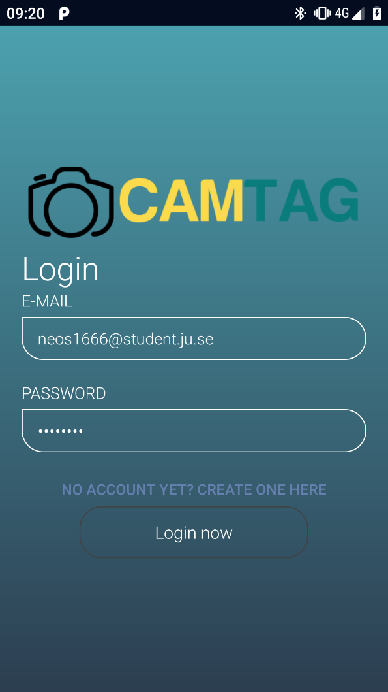
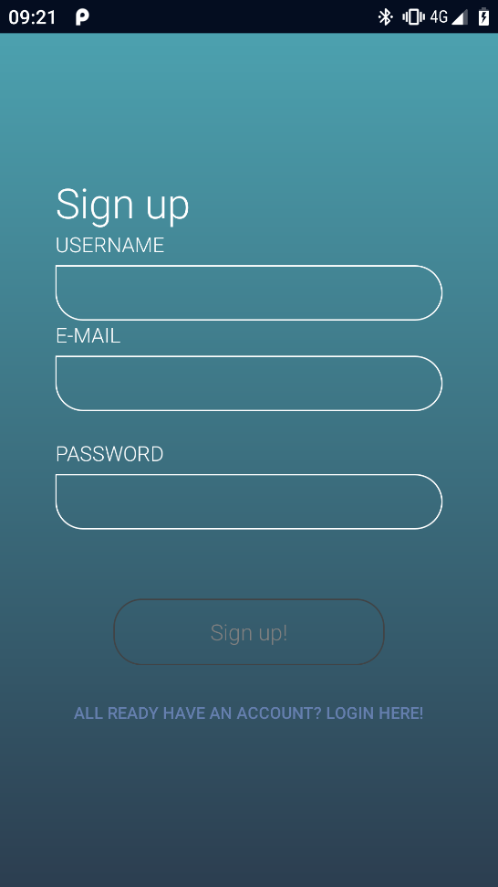
Login / Sign up
Login with e-mail
Simple sign up
Auto login

Slide 5
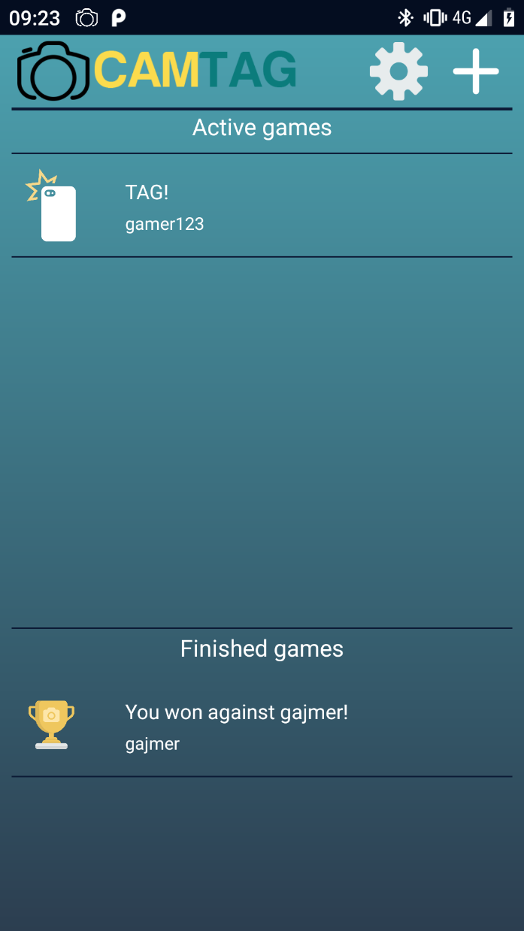
Main menu
New game
Active games
Finished games
Profile

Slide 6
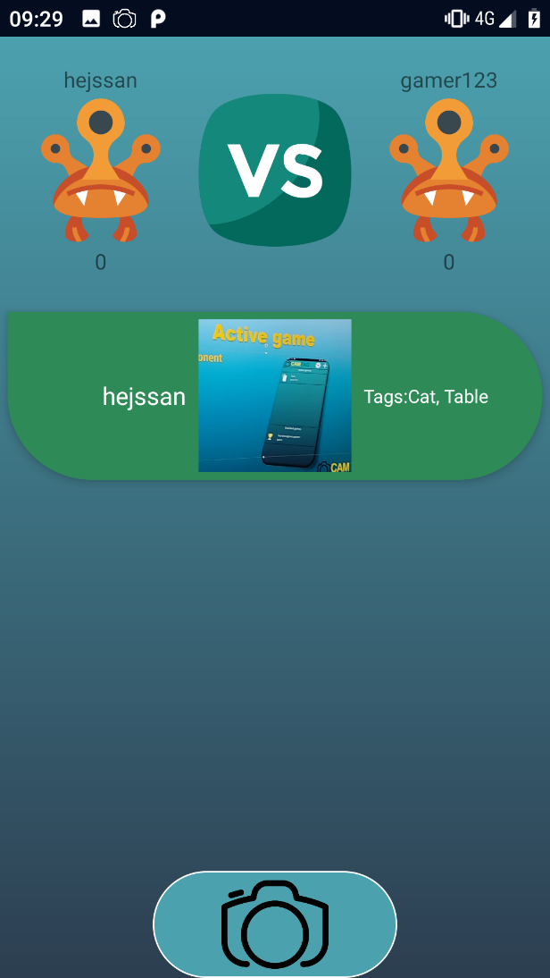
Active game
View opponent profile
Round overview
View post details
Tag

Slide 7
DEMO

