Slide 1

CPT204 GROUP-138 PROJECT
Urban Infrastructure Inspection System
CPT204 Group Project · AY 2025–26
Smart City · Data Processing · Graph Routing
21 May 2026
Zifan Wang · 2362457
Yuanhao Cheng · 2362404

Slide 2
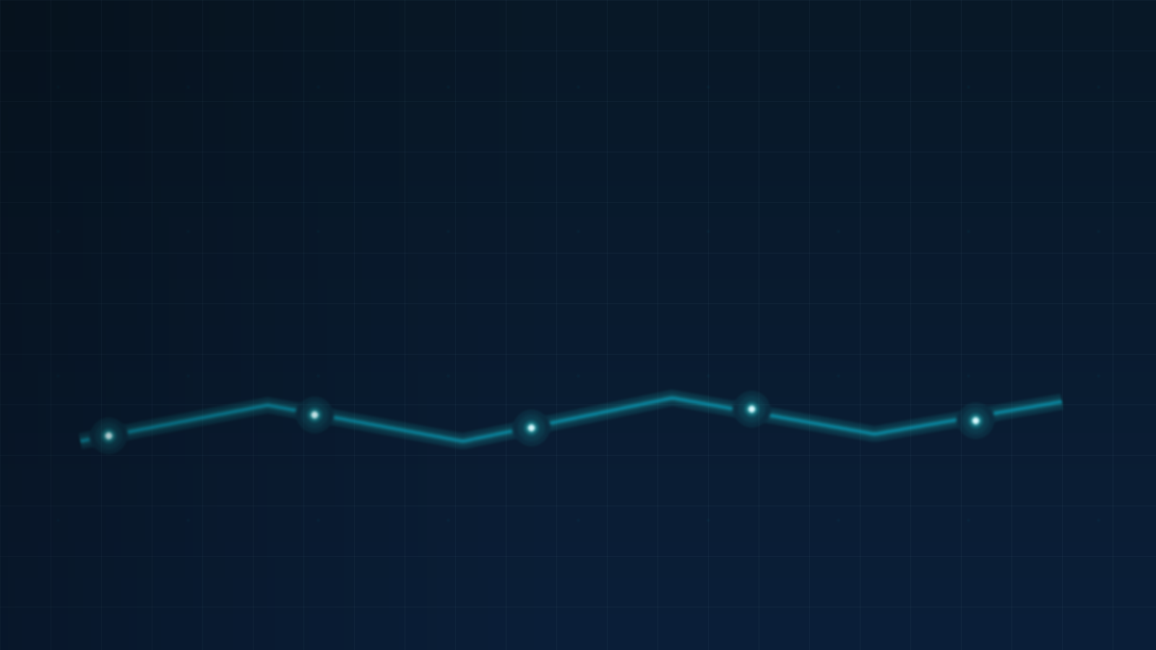
Presentation Overview
A five-step roadmap of the project presentation
01
02
03
04
05
Project Introduction
Task A — Sorting
Task B — Graph Routes
Task C — OOP Design
Analysis & Reflection
Project scope
Top-10 ranking
Shortest paths
Application design
Team reflection
02

Slide 3

Project Introduction — Purpose, Data & Datasets
From candidate datasets to inspection route planning.
Candidate Datasets
Sorting & Ranking
Weighted Graph
Output
candidates_A/B/C.csv 1,000 locations per dataset Goal: rank inspection targets.
Ranking rule applied to all datasets. Top 10 selected from each dataset.
paths.csv ~2,600 edges ~1,000 nodes City infrastructure network.
Top 10 × 3 datasets 30 selected targets 4 prescribed route cases.
→
→
→
Dataset Profiles
System Pipeline
A Nearly sorted · 98.3%
B Random order
C 41 tie groups ID tie-break
InspectionSystem.main() → Ranking → Location[3][10] → Routing
Purpose: rank inspection targets, then plan shortest routes on a weighted city graph.
03

Slide 4
Task A — Selecting the Top 10 from Each Dataset
Ranking workflow and sorting algorithm evaluation.
Dataset Input
Ranking Rule
Sorting Benchmark
Top 10 Selection
Task B Targets
candidates_A/B/C.csv
priority_score ↓ location_id ↑
Bubble · Quick · Merge
Top 10 × 3 datasets
30 targets for routing
Algorithms Tested
Ranking Rule
Selection & Choice
Bubble Sort Simple · input-sensitive
Quick Sort Fast average · pivot-sensitive
Merge Sort Consistent O(n log n)
Location.compareTo() 1. Higher priority_score first 2. If tied: smaller location_id first
Quick Sort on a fresh copy for Top 10 output. Production: Merge Sort for consistent O(n log n) performance.
Recommended for production
The 30 selected targets become important nodes for graph route planning in Task B.
04

Slide 5
Task A — Timing Comparison & Top 10 Output
Runtime results highlight how input order affects sorting performance.
Algorithm Runtime Comparison
Runtime in milliseconds (ms)
Main Finding
A → Bubble Sort B/C → Merge Sort
Set
Input Order
Bubble
Quick
Merge
Fastest
A
98.3% near sorted
0.421 ms
7.710 ms
0.787 ms
Bubble
Top 10 Output
B
Random
13.076 ms
1.871 ms
1.848 ms
Merge
Dataset A: L0001–L0010 Dataset B: L0101–L0110 Dataset C: L0201–L0210 Saved as: taskA_top30_targets.csv
C
41 tie groups
1.799 ms
3.638 ms
0.298 ms
Merge
Fastest runtime by dataset
A
Bubble · 0.421 ms
Insight
B
Merge · 1.848 ms
Near-sorted input benefits Bubble Sort, while Merge Sort performs consistently across random and tie-heavy data.
C
Merge · 0.298 ms
Top 30 Targets ready for Task B
05

Slide 6

Task B — Graph Build & Shortest-Path Algorithm
Weighted graph construction and bidirectional shortest-path search.
Graph Build & Data Structure
Bidirectional Dijkstra Workflow
Load paths.csv into an undirected weighted graph.
Search from both ends, then stop when frontiers meet.
paths.csv
↓
Weighted Graph
↓
Meeting point
Target
GraphIndex
Start
↓
forward search
backward search
Fast neighbour lookup
~1,000 nodes · fast neighbour lookup
Waypoint Routes
Reuse & Constraints
One shortest-path search per leg, then join segment paths. 7 legs across 4 cases.
Clear arrays between legs · positive weights only · no A* without node coordinates.
06

Slide 7

Task B — Query Cases & Results
Shortest-path query results with waypoint handling and search performance.
Route Query Results
Case 4 Route Pattern
Start → Waypoint 1 → Waypoint 2 → Destination
Case
Visit Order
Segments
Cost
Start
WP1
WP2
Dest.
1
L0001 → L0001
1
0
2
L0001 → L0010
1
27
L0001
L0105
L0205
L0201
3
L0001 → L0105 → L0101
2
39
4
L0001 → L0105 → L0205 → L0201
3
48
Route Cost Breakdown
7 segments · 1.228 ms
Case 2 uses the full graph, not only the Top 30 selected targets.
Case 3: 22 + 17 = 39 Case 4: 22 + 18 + 8 = 48
Full graph search
07

Slide 8

Task C — Application Architecture & Data Model
Layered OOP design connects ranking, selection, graph construction, and routing.
Layered Package Architecture
Data Model & In-Memory Handoff
Each package has a clear responsibility and communicates through a clean data flow.
A coherent OOP Java application, not isolated algorithm scripts.
Application Layer
app · InspectionSystem.main()
Location location_id priority_score
Edge from_location to_location weight
Analysis / Workflow Layer
analysis · Task A runner / Task B runner
Algorithm Layer
sorting · BubbleSort · QuickSort · MergeSort
Graph nodes weighted edges
GraphIndex fast neighbour lookup
Graph Layer
graph · Dijkstra · GraphIndex
IO Layer
io · CSV loaders / output writers
In-Memory Handoff
Task A
Location[3][10]
Task B
Model Layer
model · Location · Edge · Graph
Task A produces selected targets; Task B consumes them for routing.
08

Slide 9
Task C — Object-Oriented Design in Practice
Clean architecture shows how OOP principles are applied in the Java system.
OOP Principles
Workflow Orchestration
Design Benefits
Encapsulation
Location and Edge keep data and comparison logic clear.
Cleaner code structure
InspectionSystem
SRP
Each class focuses on one responsibility.
Easier debugging
Task A Runner
Reusable algorithms
Comparable<Location>
A shared ranking rule supports consistent sorting.
Location[3][10]
Lower module coupling
Composition
InspectionSystem wires components instead of deep inheritance.
Task B Runner
Clear Task A → Task B integration
Utility Loaders
CSV loading is separated from algorithm logic.
Runners orchestrate workflows
Model layer has no upward dependencies.
The implementation is a structured OOP Java application, not a collection of isolated algorithm scripts.
09

Slide 10
Project Reflection — Teamwork & EDI
Planning, collaboration, fair contribution, challenges, and future improvement.
01 Planning
02 Collaboration
03 EDI & Contribution
04 Challenges
05 Future Work
Split Task A sorting and Task B routing early. Stored demo outputs in output/ for checking.
Git + IntelliJ throughout. Peer code review before submission. Joint debugging for Cases 3–4.
Fair 50/50 target. Both students on camera. Shared speaking time and clear credit.
Quick Sort pivot. Waypoint order followed specification. GraphIndex tuned for seven fast searches.
Use Merge Sort for larger datasets. Improve pivot strategy. Update GraphIndex when graph changes.
A balanced team workflow supported both technical correctness and fair contribution.
10

Slide 11
Summary
Task A — Sorting
Thank you
Evaluated Bubble, Quick, and Merge Sort. Selected Top 10 targets from each dataset.
Task B — Graph Routes
Built the weighted graph from paths.csv. Solved required shortest-path cases.
Route complete
Task C — OOP & Reflection
Integrated ranking and routing in an OOP Java system. Reflected on teamwork, EDI, and future improvement.
11

