Slide 1
Efficient Image Retrieval via Decoupling Diffusion into Online and Offline Processing
Fan Yang^{1,2}, Ryota Hinami^{1,2}, Yusuke Matsui¹, Steven Ly^{2,3}, Shin'ichi Satoh^{2,1}
¹The University of Tokyo, Japan
²National Institute of Informatics, Japan
³University of Southern California, USA

Slide 2
Introduction to Diffusion
Mainly follows Donoser et al. [CVPR2013] and Iscen et al. [CVPR2017]
Diffusion processes for retrieval revisited, Donoser et al., CVPR 2013
Efficient diffusion on region manifolds: Recovering small objects with compact cnn representations, Iscen et al., CVPR 2017

Slide 3
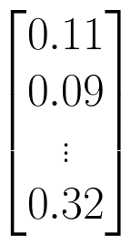
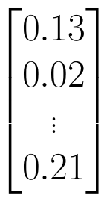
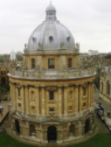
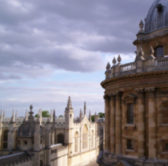



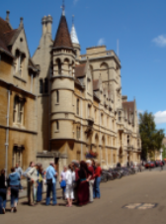

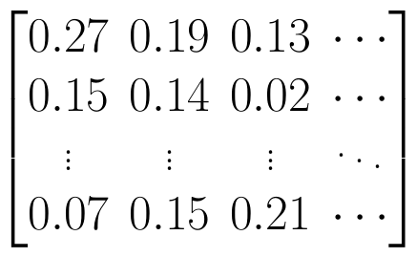
Image Retrieval
Query
Database
Ranking
ID | Score
3 | 0.97
110 | 0.91
57 | 0.87
... | ...
...
Extract
features
Data- dependent
Data- independent
Diffusion
Euclidean
...
cosine
...
We improved
Ranking methods

Slide 4


K-NN vs. Diffusion
Query
Database element
Retrieved result
Blobs
Circles
Moons
Speed
Performance
k-NN search
Speed
Performance
Diffusion

Slide 5
K-NN vs. Diffusion
Query
Database element
Retrieved result
Blobs
Circles
Moons
Speed
Performance
k-NN search
Our contributions
Speed
Performance
Diffusion

Slide 6
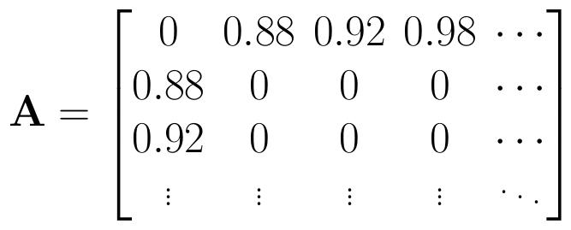
Preliminaries of Diffusion
Graph construction
Step1: Extract features of images
Step2: Perform k-NN search, using cosine similarity as the metric
e.g.
query: ①
neighbors: ② ③ ④
similarities: ①-② 0.88, ①-③ 0.92, ①-④ 0.98
Step3: Construct graph with k-NN search results
0.92
2
1
3
0.88
4
0.98
affinity matrix
Node: image
Edge: similarity between images

Slide 7
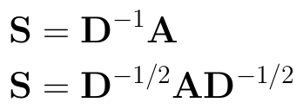
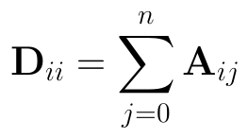
Preliminaries of Diffusion
Graph normalization
Normalize similarities to transition probabilities:
e.g.
[0.88, 0.92, 0.98] -> [32%, 33%, 35%]
Popular choices of normalization
33%
2
1
3
32%
4
35%
transition matrix / stochastic matrix
degree matrix
Node: image
Edge: transition probabilities

Slide 8

Preliminaries of Diffusion
Random walk
Start from a single node (place a droplet of ink onto the node)
Node: image
Edge: transition probabilities

Slide 9
Preliminaries of Diffusion
Random walk
Start from a single node (place a droplet of ink onto the node)
Random transition to other nodes
Node: image
Edge: transition probabilities

Slide 10
Preliminaries of Diffusion
Random walk
Start from a single node (place a droplet of ink onto the node)
Random transition to other nodes
Converge to a stable state
Node: image
Edge: transition probabilities

Slide 11

Preliminaries of Diffusion
Random walk
Start from a single node (place a droplet of ink onto the node)
Random transition to other nodes
Converge to a stable state
Obtain ranking scores (amount of ink on each node)
ID | Score
1 | 0.45
4 | 0.23
3 | 0.17
2 | 0.11
... | ...
Node: image
score vector
Edge: transition probabilities

Slide 12

Preliminaries of Diffusion
Random walk step
the first droplet of ink
99% probability to transition
1% probability to restart
when

Slide 13





Preliminaries of Diffusion
Random walk step
Closed-form solution
the first droplet of ink
99% probability to transition
1% probability to restart
iterate steps
when
score vector
Laplacian matrix
solve

Slide 14

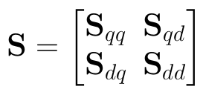


Preliminaries of Diffusion
Handling unseen queries
Decompose transition/stochastic matrix
Closed-form solution for any new queries
2
1
3
4
Images in database
query's NN:
1
2
4
A query image

Slide 15


Preliminaries of Diffusion
Truncation
An approach to scale up diffusion for large datasets
Apply diffusion on the truncated graph
Query's L-NN

Slide 16
Proposed Method
We propose an efficient diffusion with significant improvement in retrieval performance

Slide 17






Proposed Method
Can we move
online steps offline?
What makes the previous diffusion slow?
Online
Offline
k-NN search
construct graph
truncate
normalize
initialize
solve
closed-form solution

Slide 18






Proposed Method
Overview of proposed method
linear combination
Online
Offline
k-NN search
initialize
construct graph
normalize
truncate
solve

Slide 19



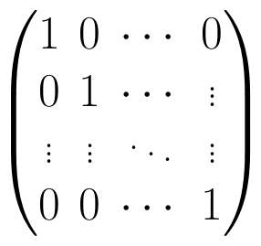



Proposed Method
Offline Pre-computations
i-th node
i-th node
Amount of ink
on each node

Slide 20
Proposed Method
Database-side truncation
database element's L-NN
i-th node

Slide 21






Proposed Method
Early truncation vs. Late truncation
normalize
create
truncate
truncate
normalization after truncation
normalization before
truncation
(proposed)
normalize
create

Slide 22
Proposed Method
Early truncation
truncate
normalize
We call this subgraph normalization
21%
0.6
0.7
0.6
0.7
25%
23%
0.9
0.4
0.8
0.7
0.8
0.9
0.5
31%

Slide 23
Proposed Method
Late truncation
normalize
truncate
In real implementation, we apply truncation to Laplacian
25%
0.6
0.7
0.6
0.7
11%
27%
0.9
0.4
0.8
0.7
0.8
0.9
0.5
36%

Slide 24
Proposed Method
Early truncation utilizes the truncated graph in normalization and results in misleading high transition probabilities to partial manifolds after truncation
Late truncation utilizes the complete graph in normalization which avoids the problem in early truncation
21%
25%
25%
23%
11%
27%
31%
36%

Slide 25
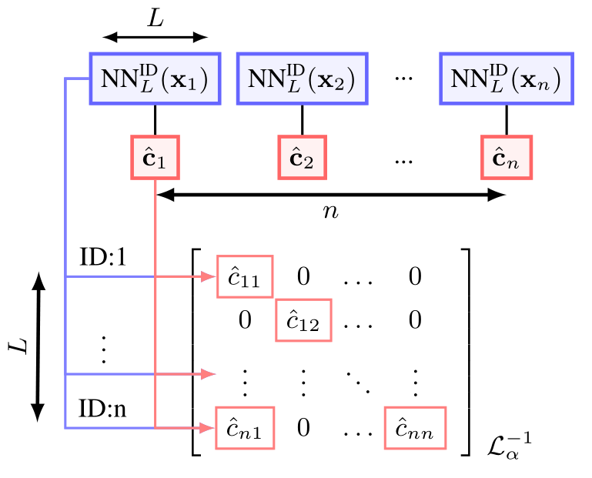
Proposed Method
Sparsified structure
We maintain a sparsified inverse of Laplacian, which takes Ο(L*n) memory.
L<<n (e.g. L=2k, n=100k)

Slide 26
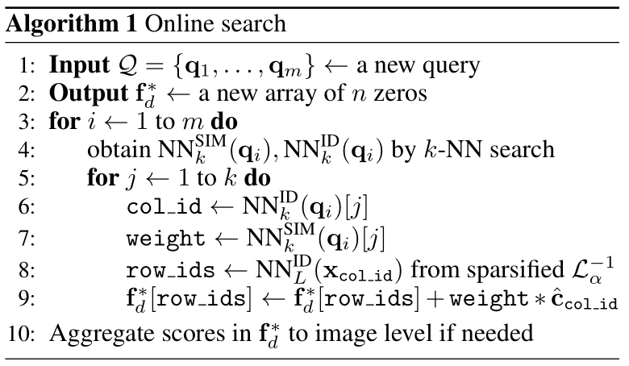
Proposed Method
Online search
This algorithm computes the above linear combination

Slide 27
Experiments and Results
We show that our method improved both the speed and the performance

Slide 28
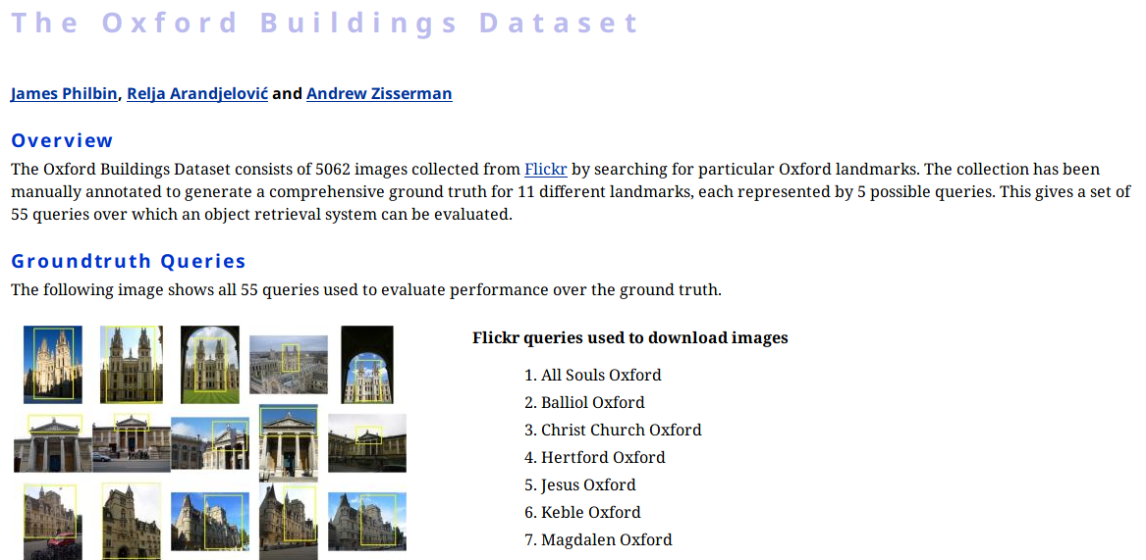
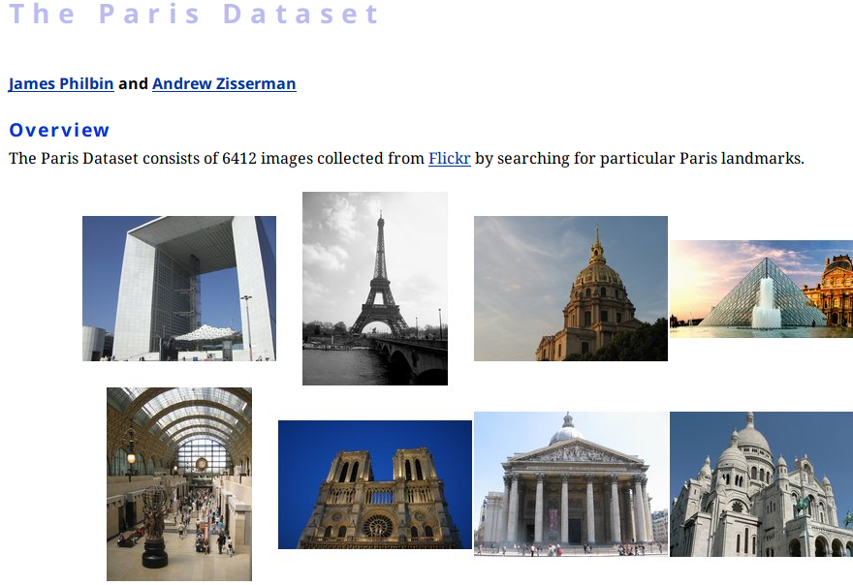
Datasets
55 query
5062 gallery
Flickr 100k as distractors
55 query
6412 gallery

Slide 29
Experiment Settings
Features
512-d and 1,024-d R-MAC descriptors based on VGG and ResNet respectively (provided online by Iscen et al. https://github.com/ahmetius/diffusion-retrieval)
Parameters
We follow the parameters in previous works and we comfirm that deviating from these parameters results in worse performance
Library
We use Facebook FAISS (https://github.com/facebookresearch/faiss) to conduct k-NN search

Slide 30
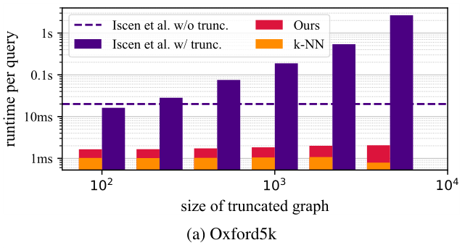
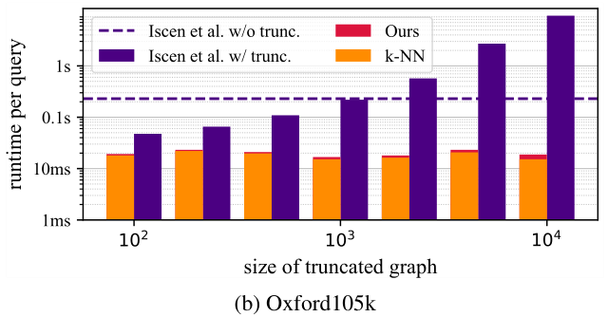
Runtime Computational Efficiency
We evaluate the computational efficiency between k-NN search, Iscen's method [CVPR2017], and our proposed method
10x faster
speed
≈
proposed method
k-NN search
Efficient diffusion on region manifolds: Recovering small objects with compact cnn representations, Iscen et al., CVPR 2017

Slide 31
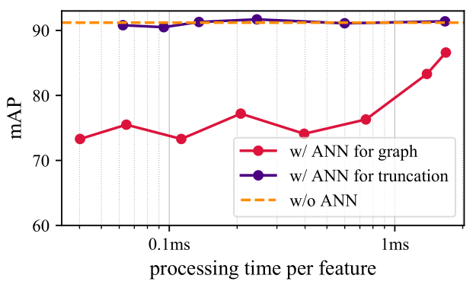
Pre-computational Efficiency
We adopt ANN (approximate nearest neighbor) search to accelerate the offline computation
Truncation only requires a coarse set of the top results
Graph construction is negatively affected by even small differences in the scores
100k~ Images | Ours | Iscen's [CVPR2018]
Offline Time Cost | ~6mins | a few hours
Fast spectral ranking for similarity search, Iscen et al., CVPR 2018

Slide 32
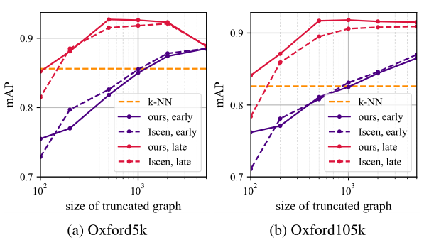
Influence of Subgraph Normalization
We show the effectiveness of our proposed late truncation by using our proposed method and Iscen's method [CVPR2017]
performs better
Efficient diffusion on region manifolds: Recovering small objects with compact cnn representations, Iscen et al., CVPR 2017

Slide 33
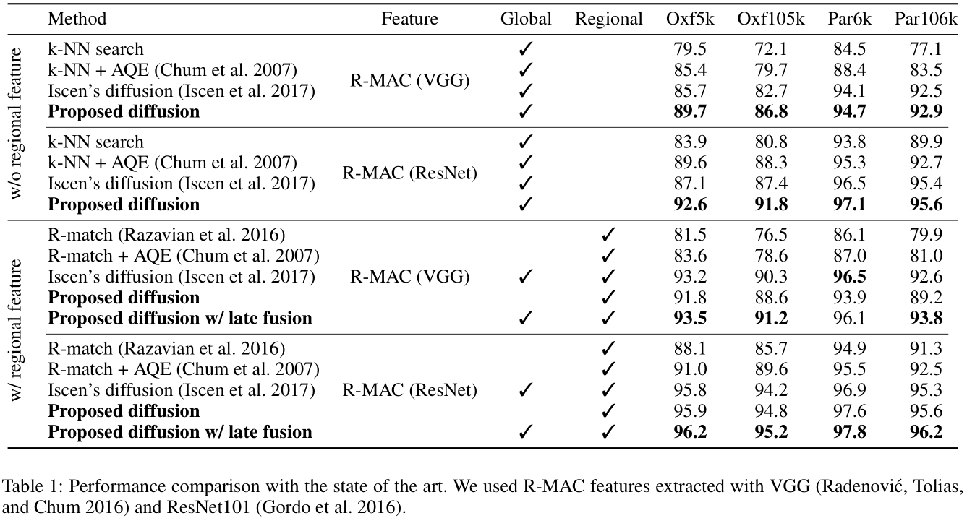
Comparison to Other Methods
4%
5%

Slide 34
Thank you!
Fan Yang
2018/11/13

