Slide 1
Intelligent Cane
Supplementary obstacle awareness
A local sensing and feedback prototype
Neural-Nexus
Dulnith, Thenul, Chamith, Suneth
IoTrix 2.0 / Track A / 5 October 2026
Notes:
0:00–0:20. Dulnith. Show the physical prototype immediately. Say: We are Neural-Nexus. Our Intelligent Cane explores affordable obstacle feedback for white-cane users. We have connected an ESP32-C3, ultrasonic sensor, inertial sensor, vibration motor and buzzer. We will demonstrate the local feedback loop and explain what remains. All four members must attend with cameras on. The latest organizer announcement sets 4 minutes demonstration, 2 minutes progress and 4 minutes Q&A; it supersedes the PDF recommendation of 12 minutes. Sources: user-supplied announcement and component confirmation; README.md; supplied Semi Final Guidelines and Evaluation Criteria.pdf.

Slide 2
Distance controls vibration and beep urgency
Below 60 cm
Vibration and obstacle beeps begin
At 10 cm
Motor duty reaches 100%
Programmed mapping at selected readings. Physical response still needs measurement.
Notes:
0:20–2:30. Thenul. Keep the sensor and IMU fixed. Show a flat target at 80, 40, 20 and 10 cm and the actual USB distance reading. Invite the judge to observe sound or feel the secured module. Say: The chart shows the programmed mapping. The live readings show what the hardware is doing. Thresholds apply to measured distance; noise at 60 cm is possible. Values are calculated from integer motor duties 0, 0, 103, 162, 224, 255 divided by 255 and rounded to one decimal place. They are not physical test results or calibrated vibration strength. Missing/invalid ranges disable obstacle feedback; an independent IMU alarm may still sound. Source: firmware/core-sensing/ProximityFeedback.h:13–26 and core-sensing.ino:510–521.

Slide 3
Cane orientation and local operation
65°
The alarm also triggers at 2.5 g
Tilt alarm threshold
A cane movement alarm does not establish that its user fell.
Below 30°
Alarm clears when the trigger is absent
Local obstacle feedback runs without a phone connection.
Notes:
2:30–4:00. Chamith. Keep the obstacle far away, gently tilt the mounted sensor and restore it. Explain that tilt references the sensor Z axis and there is no 1.5-second debounce. Do not drop the hardware or simulate a human fall. Show near/far feedback with the phone disconnected. If BLE has already been verified, briefly show NUS notifications first; otherwise use USB. Say that BLE is implemented but caregiver location delivery is future work. Source: core-sensing.ino:473–491 and :516–521. This is expected firmware behavior; physical operation needs a real demonstration.

Slide 4
Current progress
Area | Current evidence
Hardware | Team connected the five basic components
Firmware | ESP32-C3 build passes
Logic tests | Existing proximity and buzzer tests pass
Physical performance | Accuracy, latency, BLE range and runtime records pending
LKR 2,800
Listed base electronics
Excludes power, cane, enclosure and unpriced divider
Notes:
4:00–5:00. Suneth. Say: Our hardware is connected. The active firmware implements proximity feedback, the cane alarm and BLE telemetry. The C3 build passes and our existing feedback tests pass. We still need physical measurement records. Do not claim full test coverage. Host checks cover boundaries, invalid values, monotonic feedback, polarity, beep transitions and timer rollover. Compile used Arduino-ESP32 3.3.2 and succeeded. BLE is code-implemented, not confirmed here as physically tested. Cost sum: 1400+450+600+250+100=2800 LKR; required divider cost is unentered. Sources: docs/test-logs/2026-10-05-software-validation.md; hardware/BOM.md; user component confirmation.

Slide 5
Priorities before the final
Current limitation | Next engineering step
One sensing direction Ambiguous missing Echo | Repeat surface and distance tests Add persistent-fault feedback
Cane tilt can trigger false alarms | Test normal handling and pickup Improve event classification
Caregiver connection is unfinished | Build one phone-to-caregiver alert Show delivery and connection status
Secure mounting and measured power use support each step.
Notes:
5:00–6:00. Suneth. The event website lists the final on 17 October 2026. Prioritize electrical verification, stable mounting and repeated sensing tests, then improve diagnostic feedback and motion classification. Scope one caregiver integration against available time. Camera/AI and downward sensing remain future work. Explain that 60 cm warning distance itself needs usability evaluation. Source: https://iotrix20.vercel.app/ (read 5 October 2026); docs/architecture.md; source firmware. These are plans, not completed mitigations.

Slide 6
Questions and live checks
Sensing coverage
Electrical interfaces
BLE and future caregiver alerts
Testing and failure behavior
Neural-Nexus
Notes:
6:00–10:00. All four members. Dulnith handles problem/scope, Thenul ranging/feedback, Chamith firmware/interfaces, Suneth evidence/roadmap. These are suggested speaking roles. Invite one judge-selected target movement. For network loss, demonstrate local feedback. For missing Echo, state unknown range and present behavior, then planned fault indication. For human falls, state the current limitation. For why BLE, explain small messages to a nearby phone without claiming measured power/latency. Appendix slides follow only for questions. Sources: active firmware, docs/architecture.md, hardware/wiring.md, organizer announcement.

Slide 7
Architecture and interfaces
Element | Role | Interface
HC-SR04 | Forward distance input | TRIG 0 / ECHO 1
GY-521 / MPU6050 | Acceleration and tilt input | I2C 4 / 5
ESP32-C3 | Local feedback calculation | Embedded C++
Motor module / buzzer | Tactile and audible outputs | GPIO 6 / 7
Terminal | Sensor and alert telemetry | USB / BLE NUS
Planned: phone location and network delivery to a caregiver service
Notes:
Q&A appendix. ECHO GPIO 1 requires a divider or level converter for a standard 5 V HC-SR04. Motor GPIO 6 drives a module signal input, not bare motor current. The IMU module includes a gyro, but the current alarm uses acceleration. Sensor sampling is attempted every 40 ms, telemetry every 250 ms. Echo and BLE operations block, so no hard timing bound is established. Source: firmware/core-sensing/core-sensing.ino; hardware/wiring.md.

Slide 8
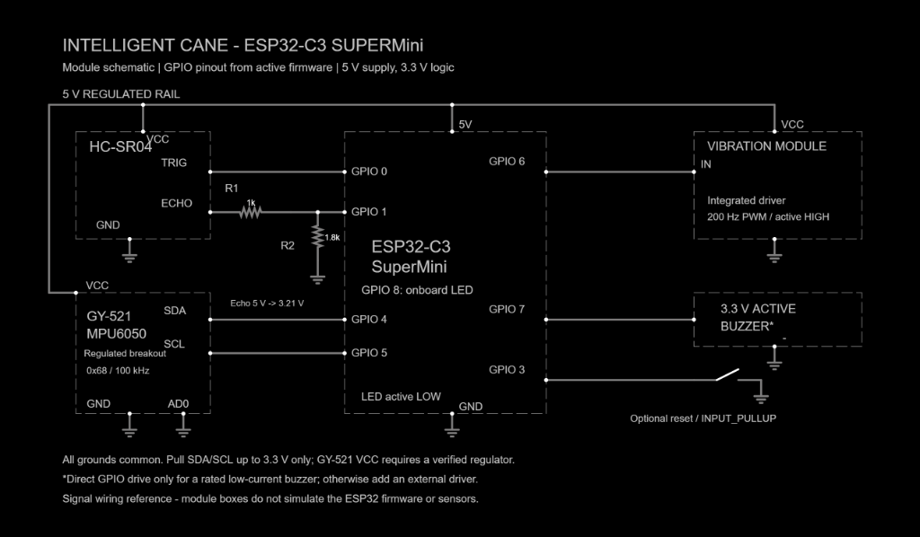
Electrical wiring reference
Confirm the physical Echo divider and actuator drivers before powering.
Notes:
Q&A appendix. This is the repository wiring reference, not a photograph or proof that the divider is fitted. Power off before rewiring. Standard HC-SR04 Echo is 5 V; a 1 kOhm upper and 1.8 kOhm lower resistor produce about 3.21 V. Confirm GY-521 pull-ups are to 3.3 V and verify the actual module driver and buzzer current. Sources: hardware/circuit_diagram.png; https://documentation.espressif.com/esp32-c3_datasheet_en.html Table 5-4; https://www.adafruit.com/product/3942.

