Slide 1
A neural circuit for coordinating reaching with grasping: Autocompensating variable initial apertures, perturbations to target size, and perturbations to target orientation
Antonio Ulloa & Daniel Bullock
Department of Cognitive and Neural Systems
Boston University

Slide 2
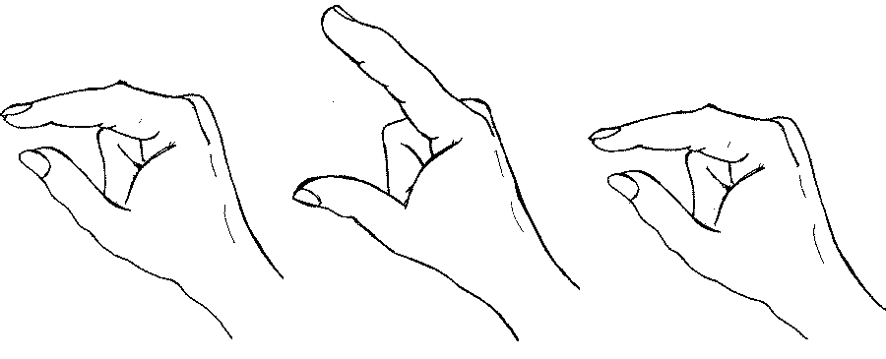
Grasping with precision grip
GRIP APERTURE
HAND ORIENTATION
HAND/WRIST TRANSPORT
Maintain synchrony despite perturbations.

Slide 3
Outline
Data constraints
Prior work
Model construction
Simulation results
Conclusions

Slide 4
Properties of prehension
Transport, aperture, and orientation components are synchronized.
Maximum aperture is larger for faster movements.
Movement pauses when any component is perturbed.
Grip partially closes for large apertures or when movement pauses.

Slide 5
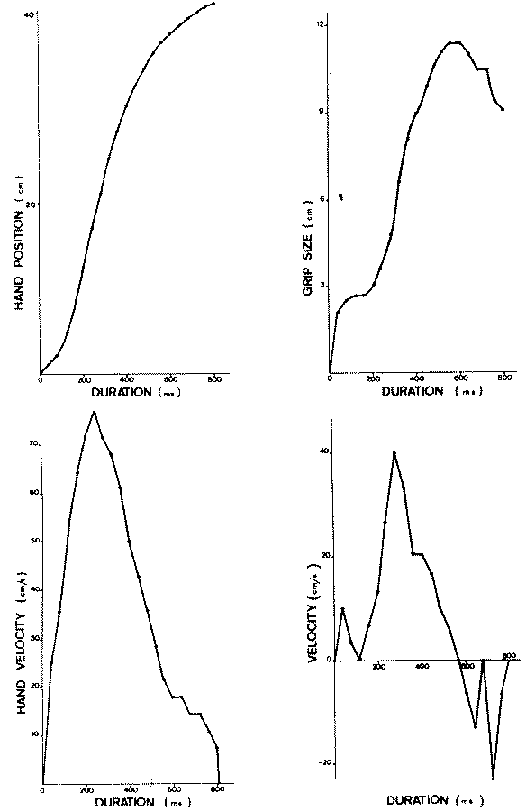
Components are synchronized
Jeannerod (1984)

Slide 6
Maximum aperture is larger for faster movements
Wing, Turton and Fraser (1986) reported an increase in maximum aperture as a function of movement speed.
Wallace and Weeks (1988) also reported increases of maximum aperture when the time allowed for movement decreased.

Slide 7
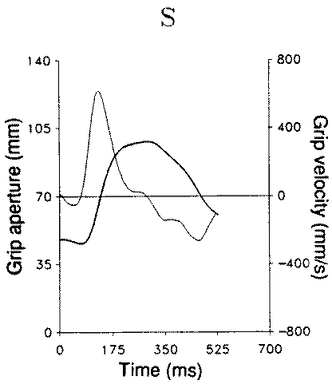
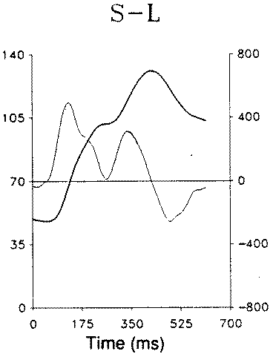
Aperture pauses when object size is perturbed
Aperture
Aperture
velocity
Paulignan et al. (1991a)

Slide 8
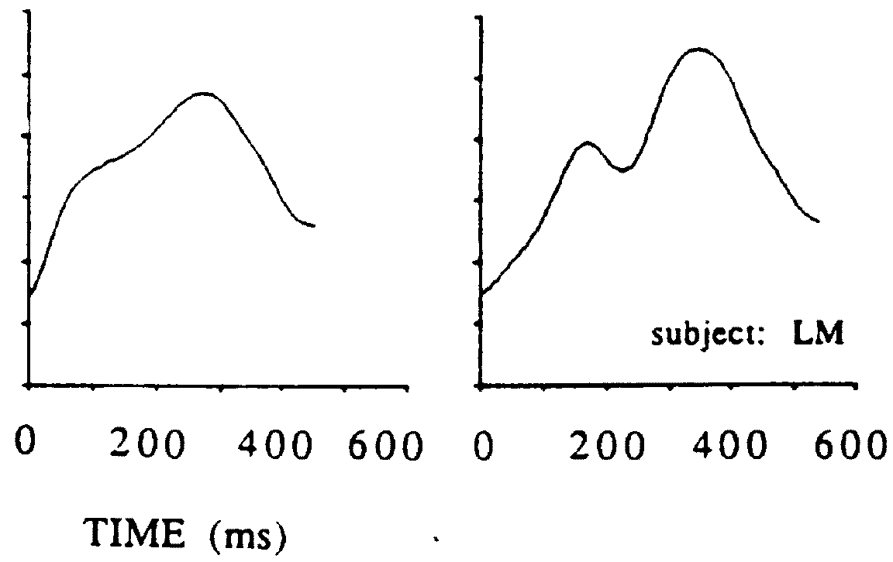
Aperture also pauses when object location is perturbed
aperture (cm)
Paulignan et al. (1991b)

Slide 9
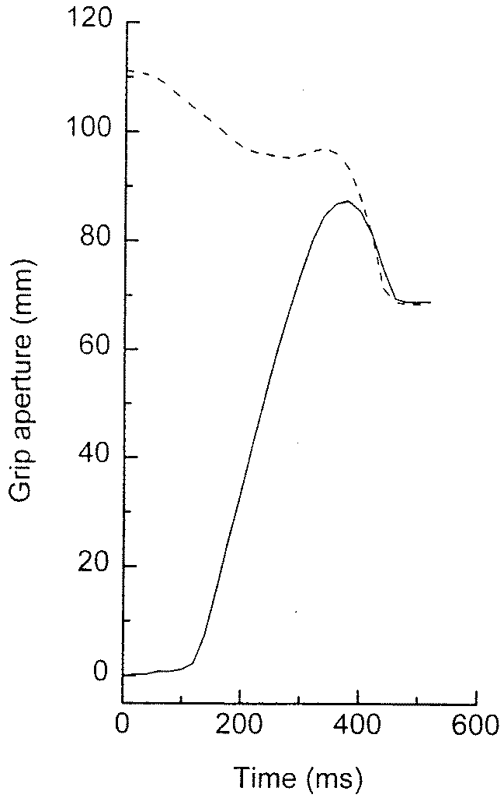
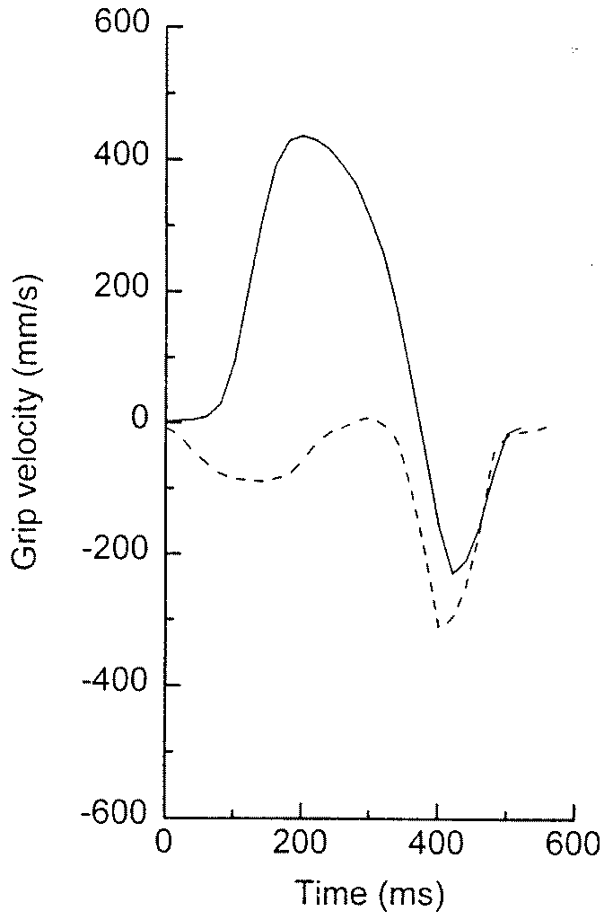
Grip partial closures
----- Extended
Initial aperture
___
Control
Saling et al., 1996

Slide 10
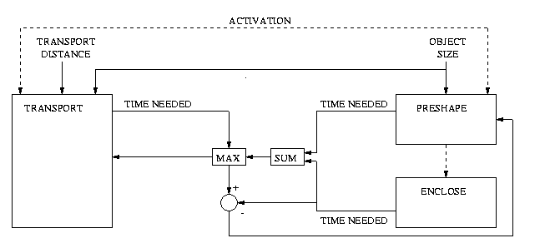
Prior proposal: Hoff and Arbib (1993) model
Extensive temporal pre-computation.
Explicit function to pre-program maximum aperture.

Slide 11
Problematic properties of the Hoff and Arbib model
Pre-movement computations: Confining, complex, and unnecessary.
Constant enclose time: Zaal et al (1998) found that enclose time increases with transport amplitude.
Maximum aperture only depends on object size: Wing et al (1986) reported increases in aperture with transport velocity.

Slide 12
Voluntarily-gated, variable-speed movement in the VITE (vector-integration-to-endpoint) model
Bullock & Grossberg (1988),
Bullock, Cisek, and Grossberg (1998)
T
D
P
GO
x
Model specified as a system of differential equations.

Slide 13
Synchronous movement of components of the reaching synergy in VITE with a shared GO signal
Te
De
Pe
elbow
Ts
Ds
Ps
shoulder
Tw
Dw
Pw
wrist
GO(t)
x
GO
x
x

Slide 14
Adding velocity command cells and a coordinating GO signal for three synergies
TO
DO
PO
orientation
TA
DA
PA
aperture
TT
DT
PT
transport
x
VO
GO
VA
x
VT
x

Slide 15
Creating a functional transient aperture overshoot by coupling transport/orientation velocities to aperture
TO
DO
PO
-Error scales with velocity.
-Overshoot provides tolerance for error (avoids collisions of fingers with object.)
TA
DA
PA
TT
DT
PT
x
VO
Coupling
gains
GO
VA
x
VT
x

Slide 16
Use common GO to slow prehension during transient discrepancies between target representations
TO
DO
PO
EO
EA
TA
DA
PA
ET
TT
DT
PT
x
VO
Inhibition
GO
VA
x
VT
x

Slide 17
Simple biomechanical effect
TO
DO
PO
EO
Modeled for simplicity as a central self-inhibition of aperture.
EA
TA
DA
PA
ET
TT
DT
PT
x
VO
GO
VA
x
VT
x

Slide 18
Simulations of the properties of prehension
Transport, aperture, and orientation components are synchronized.
Maximum aperture is larger for faster movements.
Movement pauses when any component is perturbed.
Grip partially closes for large apertures or movement pausing.

Slide 19
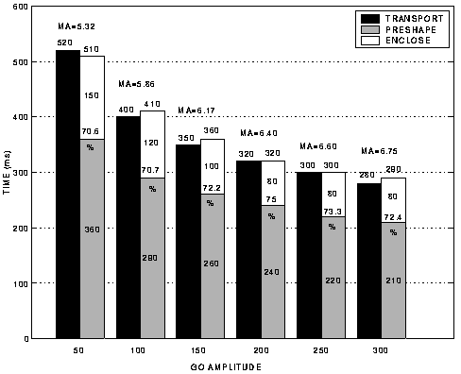
Simulations: Synchronization of components during global rate scaling

Slide 20
Simulations: Larger maximum aperture for faster movements
MA = 5.32
.
.
.
MA = 6.17
.
.
.
MA = 6.75

Slide 21
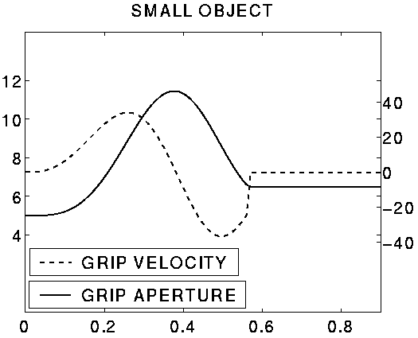
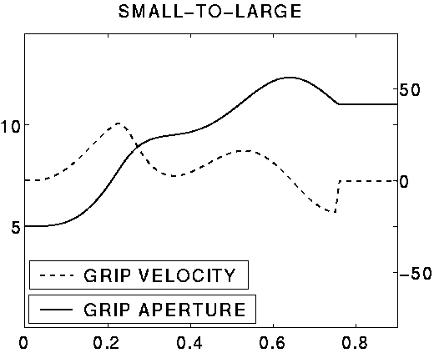
Simulations: Aperture pauses when object size is perturbed
aperture (cm)
aperture velocity (cm/s)
time (s)
time (s)

Slide 22
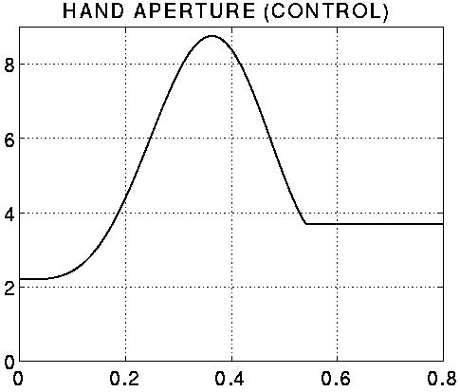
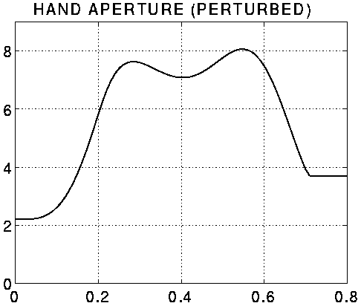
Simulations: Aperture also pauses when object location is perturbed
aperture (cm)
aperture (cm)
time (s)
time (s)

Slide 23
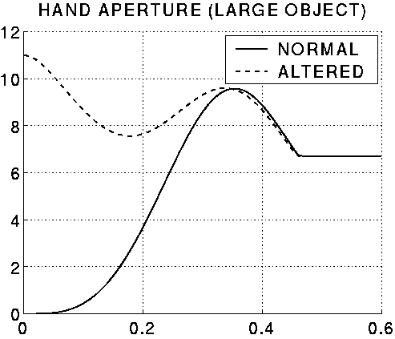
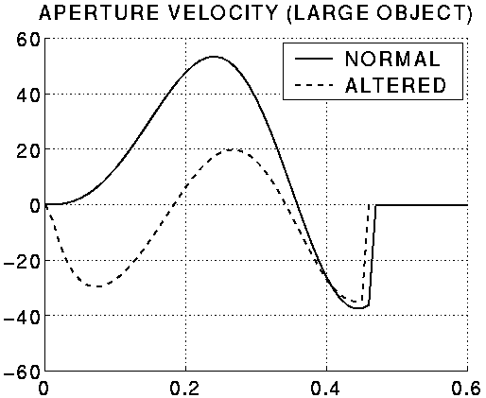
Simulations: Partial grip closure
aperture (cm)
aperture velocity (cm/s)
time (s)
time (s)

Slide 24
Conclusions
On-the-fly trajectory generation is more robust than fussy pre-planning.
Common GO signal: synchronization of components.
Cross-coupling: larger maximum apertures for faster movements.
Target discrepancies: movement pausing.
Aperture self-inhibition: partial grip closures.
Model has a natural neurobiological interpretation: (1) interaction between parietal and motor cortex; (2) GO signal emerging from the basal ganglia.

Slide 25
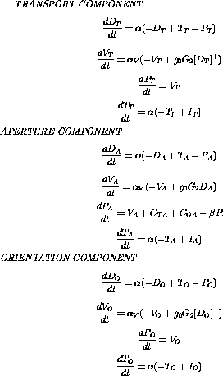
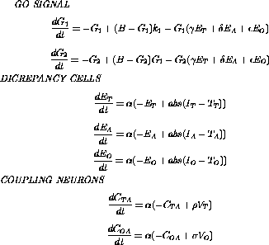
Equations

Slide 26
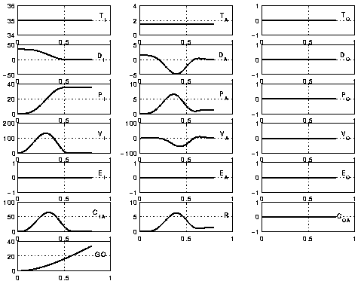
Internal variables (control)

Slide 27
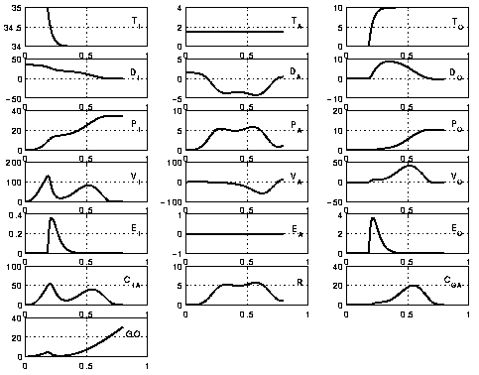
Internal variables (location/orientation perturbation

