Slide 1
Neural models that coordinate reaching with grasping and adapt grip forces during lifting
Oral defense
Antonio Ulloa
Department of Cognitive and Neural Systems
Boston University

Slide 2
Thesis committee
First reader: Daniel Bullock
Second reader: Frank Guenther
Third reader: Elliot Saltzman
Reviewer: Juan López Coronado
Reviewer & chair: Michele Rucci

Slide 3
Financial support
Consejo Nacional de Ciencia y Tecnología (México)
Instituto de Cooperación Iberoamericana (Spain)
Neurocore Lab, Universidad Politécnica de Cartagena (Spain)
California State University

Slide 4
Part One: A neural model that coordinates reaching with grasping
Part Two: A neural model that
adapts grip forces during lifting

Slide 5
Part One: A neural model that coordinates reaching with grasping

Slide 6

Grasping with precision grip
GRIP APERTURE
HAND ORIENTATION
HAND/WRIST TRANSPORT
Maintain synchrony despite perturbations.

Slide 7
Outline
Data constraints
Prior work
Model construction
Simulation results
Conclusions

Slide 8
Properties of prehension
Transport, aperture, and orientation components are synchronized.
Maximum aperture occurs at 60-80% of movement time.
Maximum aperture is larger for faster movements.
Movement pauses when any component is perturbed.
Grip partially closes for large apertures or when movement pauses.

Slide 9

Components are synchronized
Jeannerod (1984)

Slide 10
Maximum aperture occurs at 60-80% of movement time
Jeannerod (1984): 74-80% of MT
Wallace & Weeks (1988): 60-68% of MT
Jakobson & Goodale (1991): 2/3 of MT
Paulignan & Jeannerod (1996): 70-80% MT

Slide 11
Maximum aperture is larger for faster movements
Wing, Turton and Fraser (1986) reported an increase in maximum aperture as a function of movement speed.
Wallace and Weeks (1988) also reported increases of maximum aperture when the time allowed for movement decreased.

Slide 12


Aperture pauses when object size is perturbed
Aperture
Aperture
velocity
Paulignan et al. (1991a)

Slide 13

Aperture also pauses when object location is perturbed
aperture (cm)
Paulignan et al. (1991b)

Slide 14


Grip partial closures
----- Extended
Initial aperture
___
Control
Saling et al., 1996

Slide 15

Prior proposal: Hoff and Arbib (1993) model
Extensive temporal pre-computation.
Explicit function to pre-program maximum aperture.

Slide 16
Problematic properties of the Hoff and Arbib model
Pre-movement computations: Confining, complex, and unnecessary.
Constant enclose time: Zaal et al (1998) found that enclose time increases with transport amplitude.
Maximum aperture only depends on object size: Wing et al (1986) reported increases in aperture with transport velocity.

Slide 17
Voluntarily-gated, variable-speed movement in the VITE (vector-integration-to-endpoint) model
Bullock & Grossberg (1988),
Bullock, Cisek, and Grossberg (1998)
T
D
P
GO
x
Model specified as a system of differential equations.

Slide 18
Synchronous movement of components of the reaching synergy in VITE with a shared GO signal
Te
De
Pe
elbow
Ts
Ds
Ps
shoulder
Tw
Dw
Pw
wrist
GO(t)
x
GO
x
x

Slide 19
Adding velocity command cells and a coordinating GO signal for three synergies
TO
DO
PO
orientation
TA
DA
PA
aperture
TT
DT
PT
transport
x
VO
GO
VA
x
VT
x

Slide 20
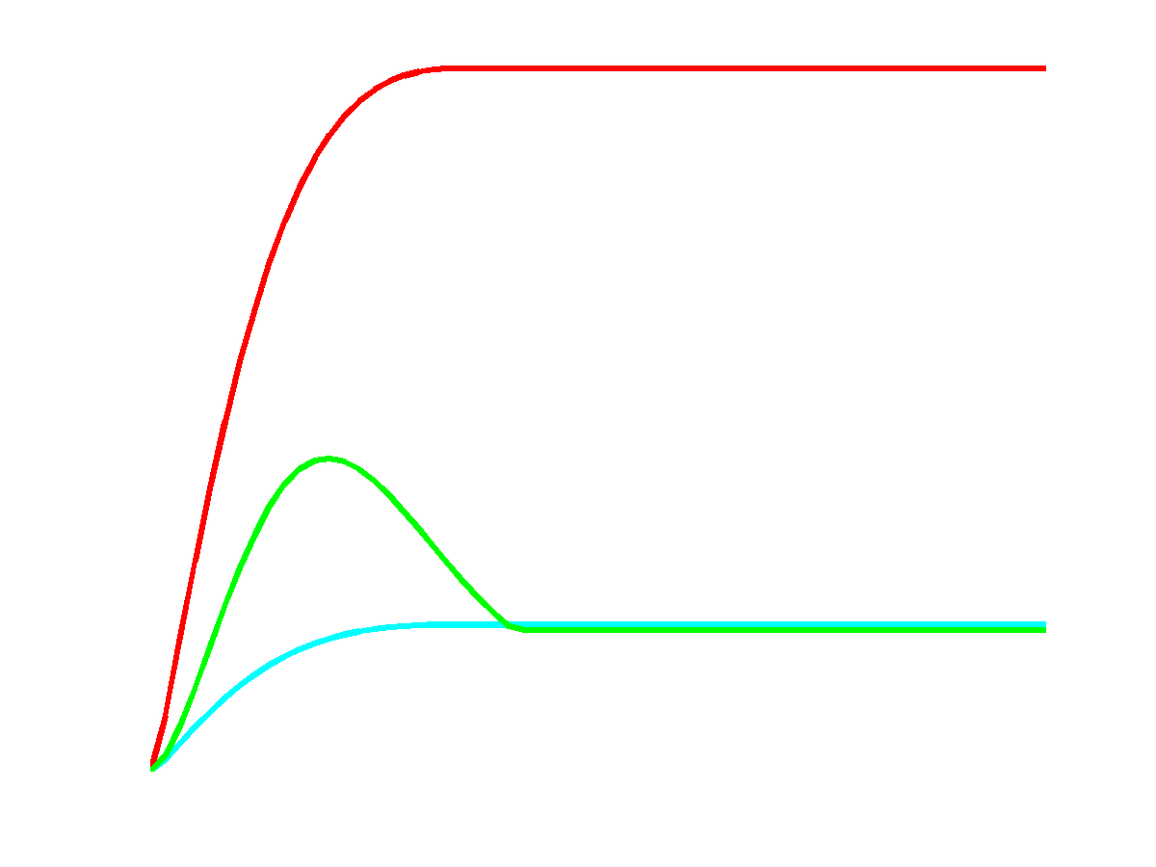
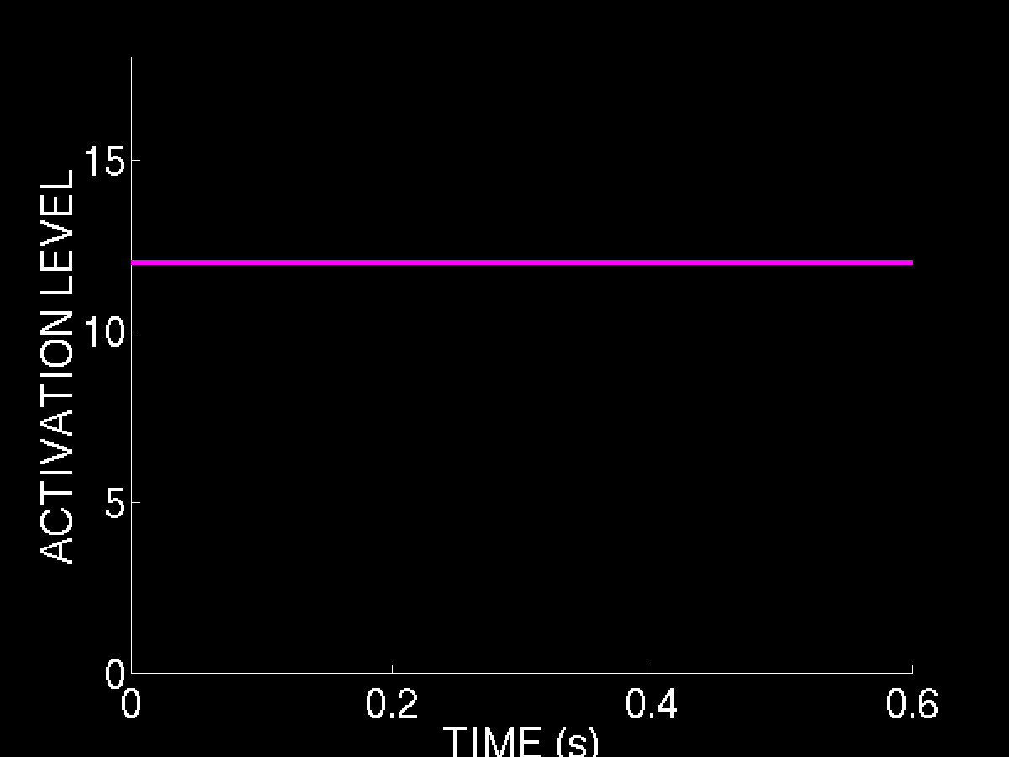
Synchronous movement of prehension components
transport
GO signal
aperture
orientation

Slide 21
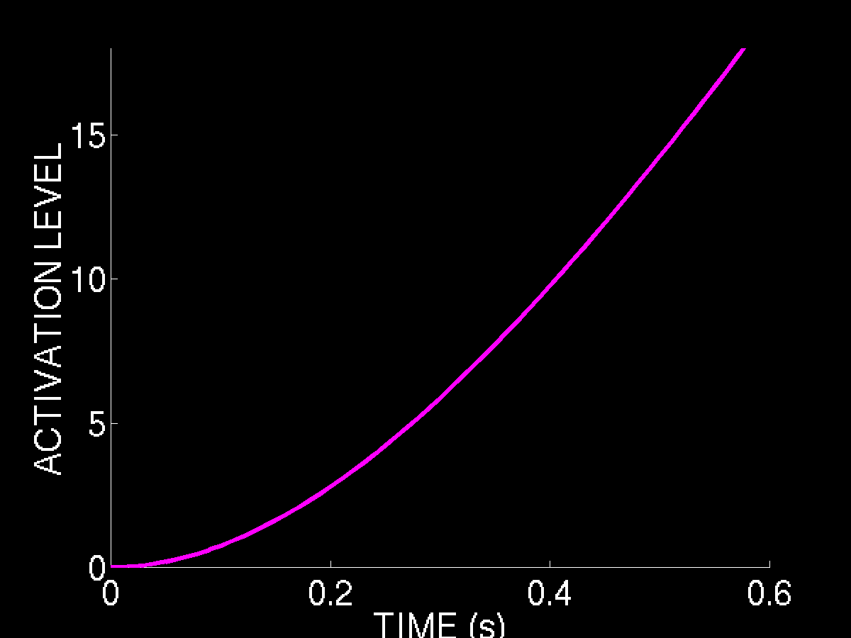
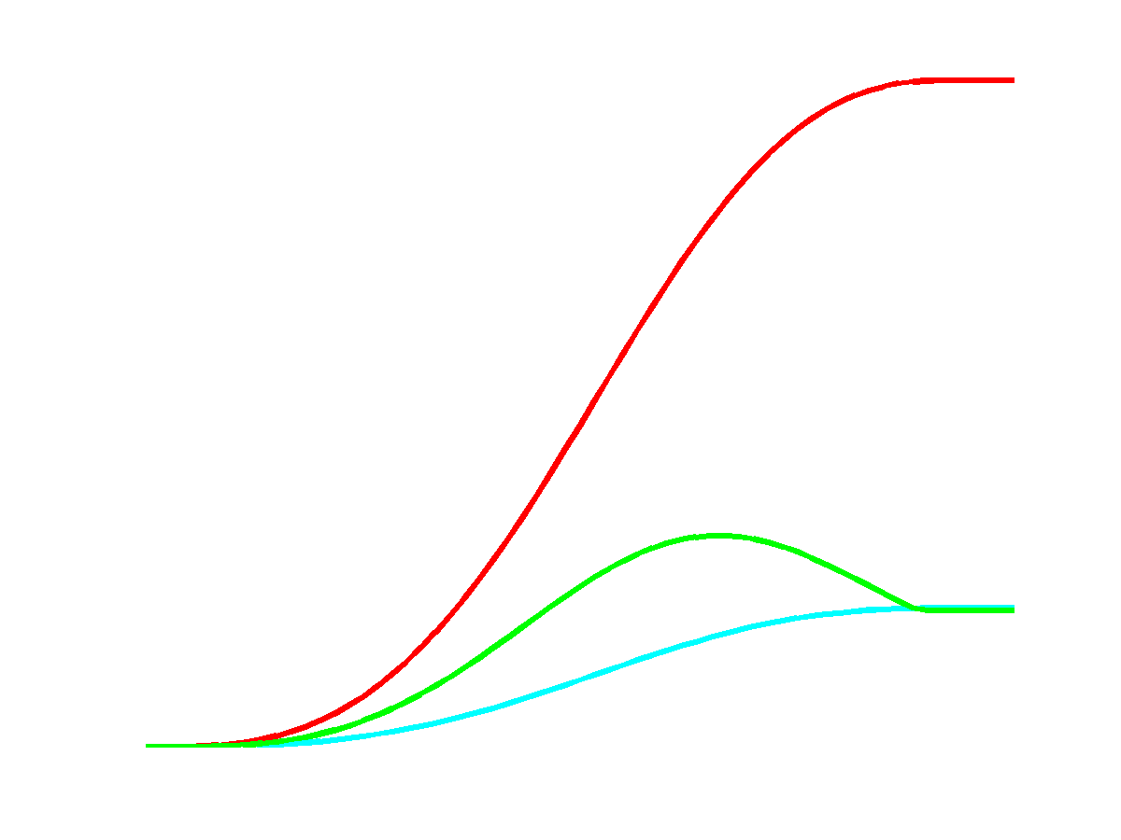
Synchronous movement of prehension components
GO signal
transport
aperture
orientation

Slide 22
Creating a functional transient aperture overshoot by coupling transport/orientation velocities to aperture
TO
DO
PO
-Error scales with velocity.
-Overshoot provides tolerance for error (avoids collisions of fingers with object.)
TA
DA
PA
TT
DT
PT
x
VO
Coupling
gains
GO
VA
x
VT
x

Slide 23
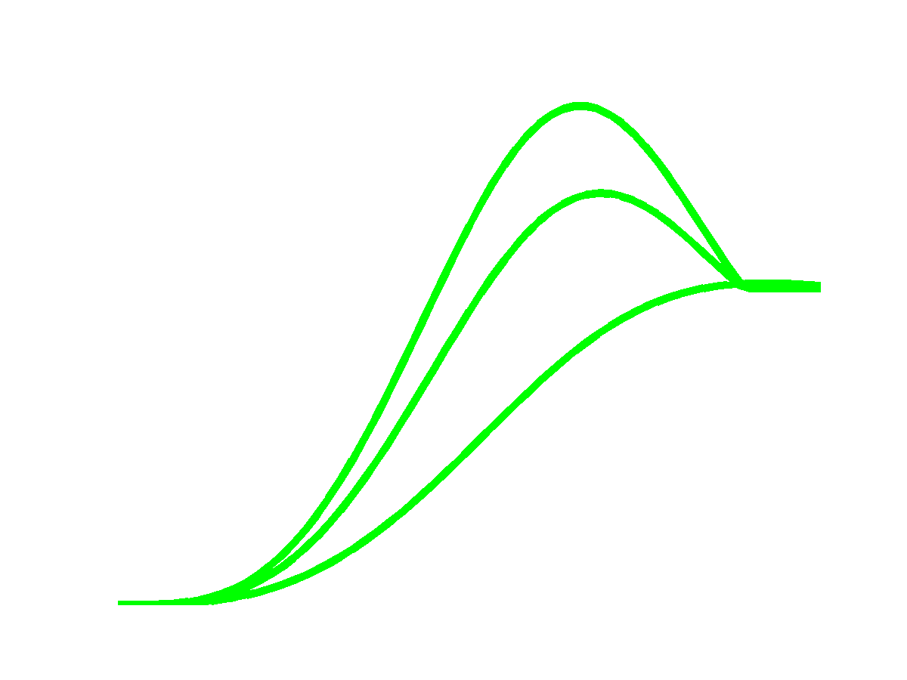
Maximum aperture magnitude depends on coupling gain coefficient ρ
ρ=0.5
ρ=0.25
ρ=0

Slide 24
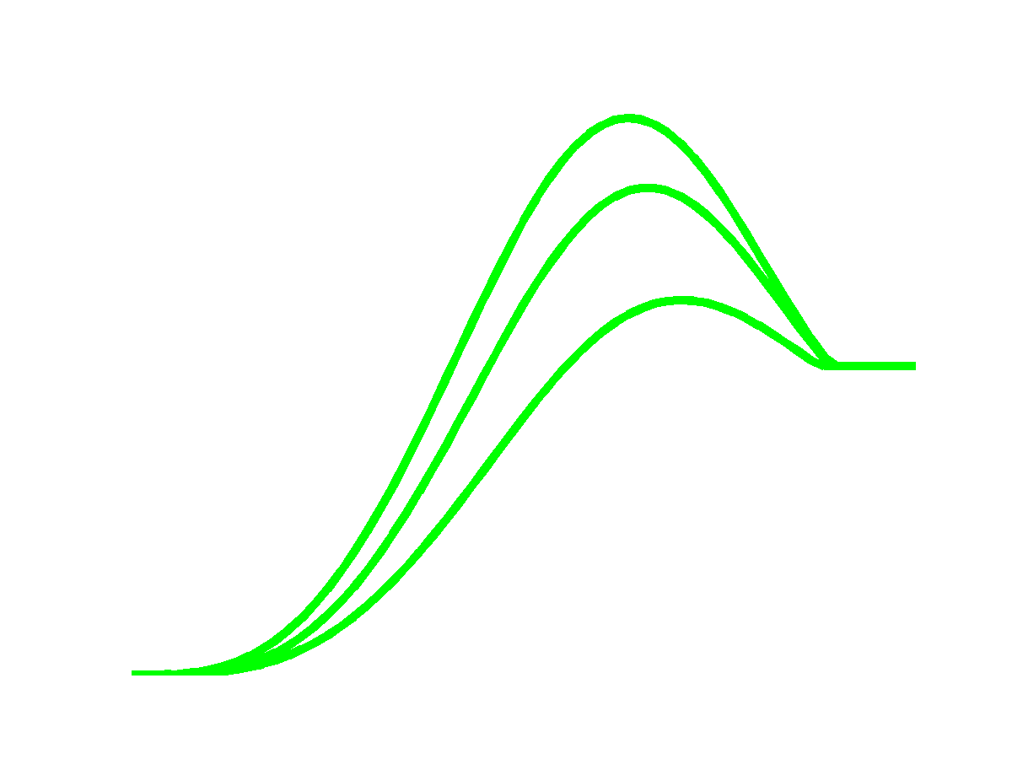
Maximum aperture occurrence depends on coupling cell integration rate α
α=300
α= 30
α= 10

Slide 25
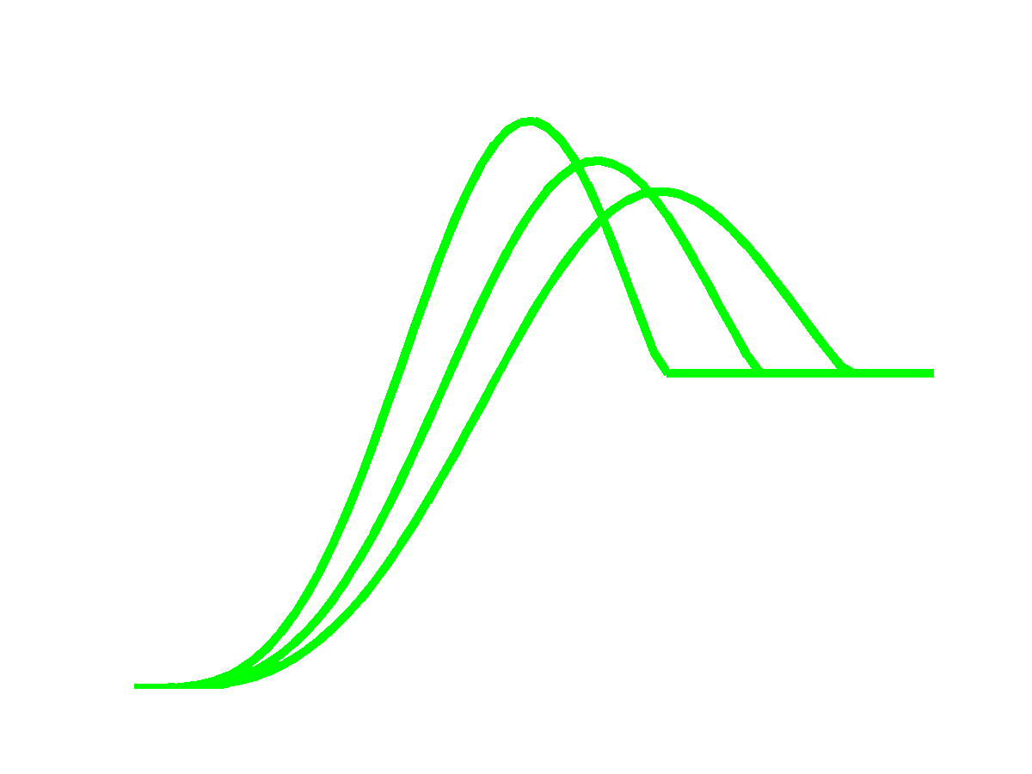
Maximum apertures are larger for larger movement velocities
GO=100
GO=60
GO=40

Slide 26
Use common GO to slow prehension during transient discrepancies between target representations
TO
DO
PO
EO
EA
TA
DA
PA
ET
TT
DT
PT
x
VO
Inhibition
GO
VA
x
VT
x

Slide 27
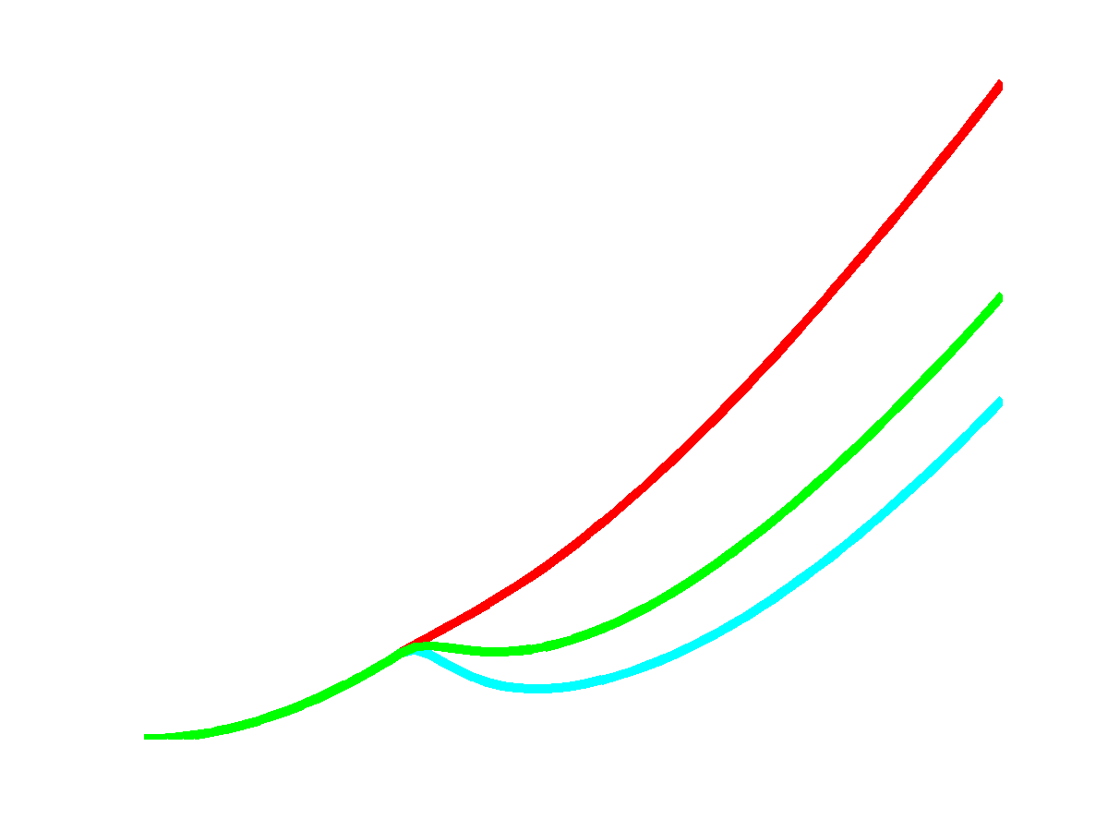
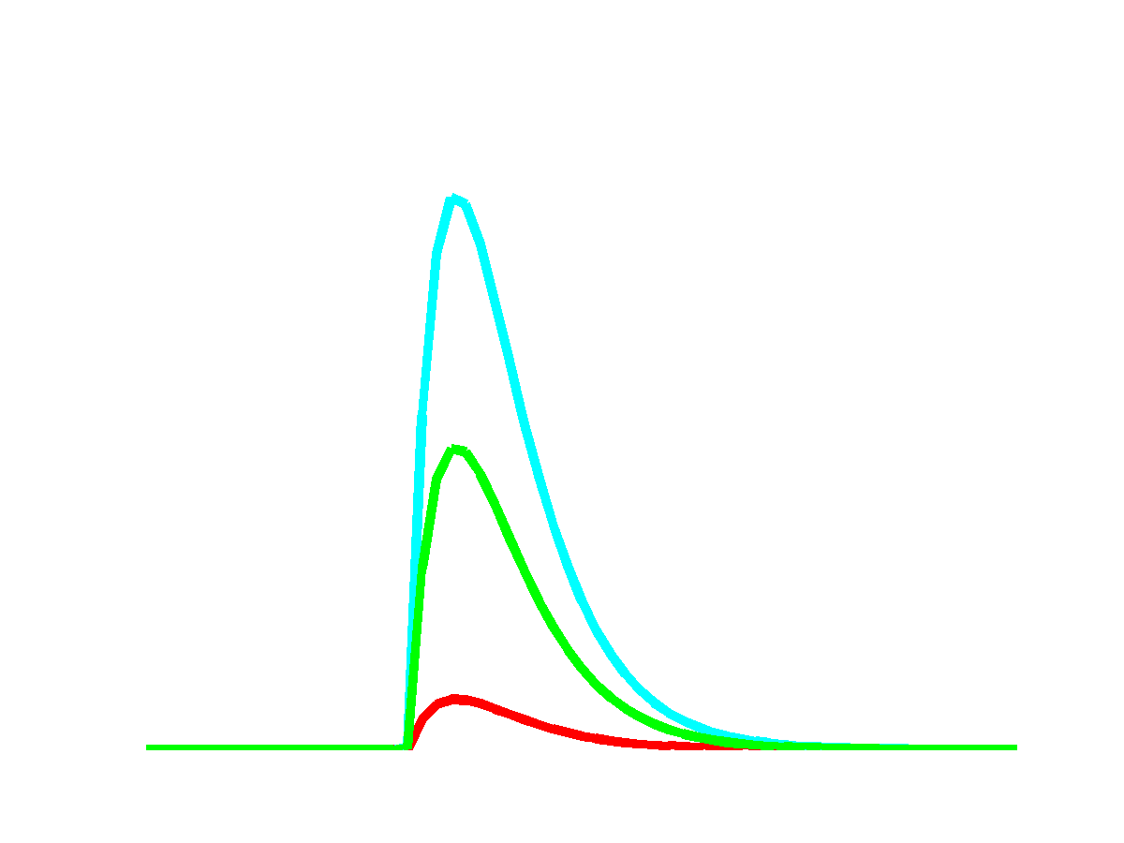
Response of GO signal for different discrepancies in transport
Discrepancy cell
24-25
24-30
24-35

Slide 28
Simple biomechanical effect
TO
DO
PO
EO
Modeled for simplicity as a central self-inhibition of aperture.
EA
TA
DA
PA
ET
TT
DT
PT
x
VO
GO
VA
x
VT
x

Slide 29
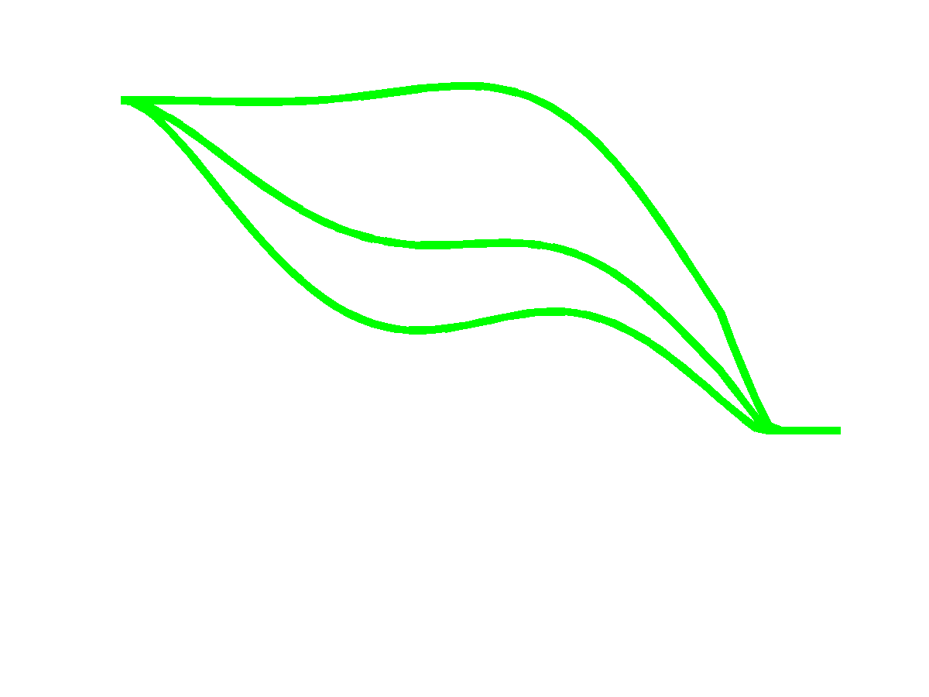
Response in grip aperture for different self-inhibition coefficient β
β=0
β=2
β=3.5

Slide 30
Simulations of the properties of prehension
Transport, aperture, and orientation components are synchronized.
Maximum aperture occurs at 60-80% of movement time.
Maximum aperture is larger for faster movements.
Movement pauses when any component is perturbed.
Grip partially closes for large apertures or movement pausing.

Slide 31
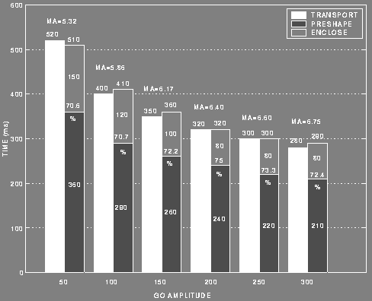
Simulations: Synchronization of components during global rate scaling

Slide 32
Simulations: Maximum aperture occurs at around 70-75% of MT
70.6
75.0
70.7
73.3
72.2
72.4

Slide 33
Simulations: Larger maximum aperture for faster movements
MA = 5.32
.
.
.
MA = 6.17
.
.
.
MA = 6.75

Slide 34


Simulations: Aperture pauses when object size is perturbed
aperture (cm)
aperture velocity (cm/s)
time (s)
time (s)

Slide 35


Simulations: Aperture also pauses when object location is perturbed
aperture (cm)
aperture (cm)
time (s)
time (s)

Slide 36


Simulations: Partial grip closure
aperture (cm)
aperture velocity (cm/s)
time (s)
time (s)

Slide 37
Conclusions
Pre-planning is unnecessary.
On-the-fly trajectory generation is robust in the face of perturbations.
Common GO signal: synchronization of components.
Cross-coupling: maximum apertures at 60-80% of MT, and larger maximum apertures for faster movements.
Target discrepancies: movement pausing-slowing.
Aperture self-inhibition: partial grip closures.

Slide 38
Conclusions
The model complies with other properties of grasping: transport velocity profile is bell-shaped, shorter enclose times for larger objects.
Model has a natural neurobiological interpretation: (1) interaction between parietal and motor cortex; (2) GO signal emerging from the basal ganglia.

Slide 39
Part Two: A neural model that adapts grip forces during lifting

Slide 40

Lifting
LOAD FORCE
GRIP FORCE
GRAVITY FORCE

Slide 41
Outline
Data constraints
Prior work
Model
Simulation results
Conclusions

Slide 42

Grip force precedes load force
Johansson and Westling., 1984

Slide 43

Different textures
Johansson and Westling, 1984
SILK
SUEDE
SANDPAPER

Slide 44

Different weights
800 grs
400 grs
200 grs
800 grs
400 grs
200 grs
Johansson and Westling, 1988

Slide 45

Johansson’s model

Slide 46
Main requirements for a grip force adjustment model
The model should be able to make predictive grip force adjustments.
The model should work with the aperture and transport components of prehension model.
The model should have a reactive component, but be able to learn a predictive component.
The model should be able to reset its force adjustment to allow lowering.

Slide 47
Grip force model reactive component
HAND
ARM
ea
∈a
GF
LF
∈t
et
S
Oa
Ot
R
Pa
Pt
Va
Vt
Da
Dt
Ta
Tt
GO

Slide 48
Occurrence of slip error
CUE onset
GO onset
SLIP onset
GRIP FORCE onset

Slide 49

Thompson’s cerebellar circuit for eye blink conditioning
Thompson, 1988

Slide 50
Grip force model
Ci
HAND
ARM
mi
ea
∈a
GF
LF
∈t
et
gj
lj
fj
IO
S
Oa
Ot
R
cf
Pa
Pt
p
Va
Vt
zij
Da
Dt
n
wi
Ta
Tt
GO

Slide 51

Nuclear cell response for different ISIs
Error onset (-.050s, .050s, .150s)
(ISI = .150s, .250s, .350s)
GO onset (-.100s, 0s, .100s)
Cue onset
(-.200s)

Slide 52

Learning

Slide 53

Performing

Slide 54

Other models attribute most of learning load to MF-DCN synapse
Medina and Mauk, 1999

Slide 55


Simulations: Different textures

Slide 56


Simulations: Different weights

Slide 57

Replacing

Slide 58
Conclusions
The adaptive model works as a side loop in the aperture control part of prehension.
The adaptive model works in anticipation of the voluntary lift movement to preempt slippage.
The adaptive model resets its compensation when aperture is voluntarily increased.

Slide 59

Internal variables (control)

Slide 60

Internal variables (location/orientation perturbation)

Slide 61


Reach-to-grasp equations

Slide 62


Grip force equations

Slide 63
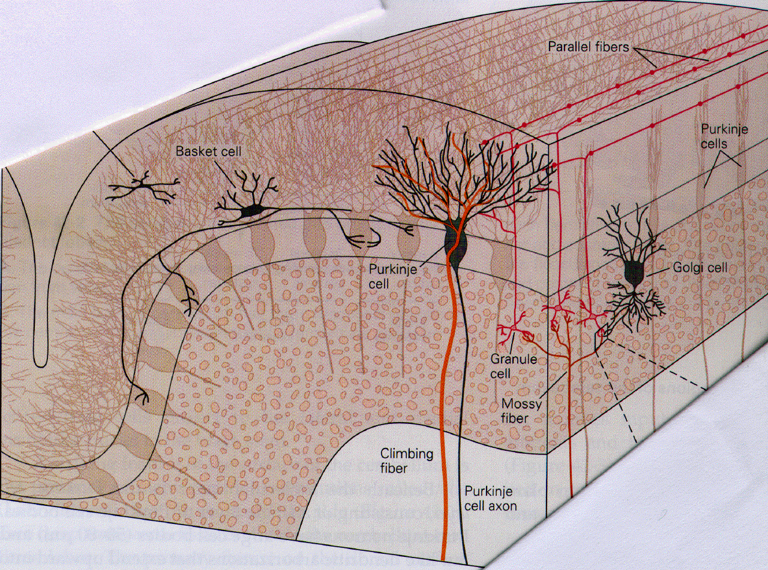
Cerebellar cortex cell types
Kandel, Schwartz and Jessell, 2000

Slide 64
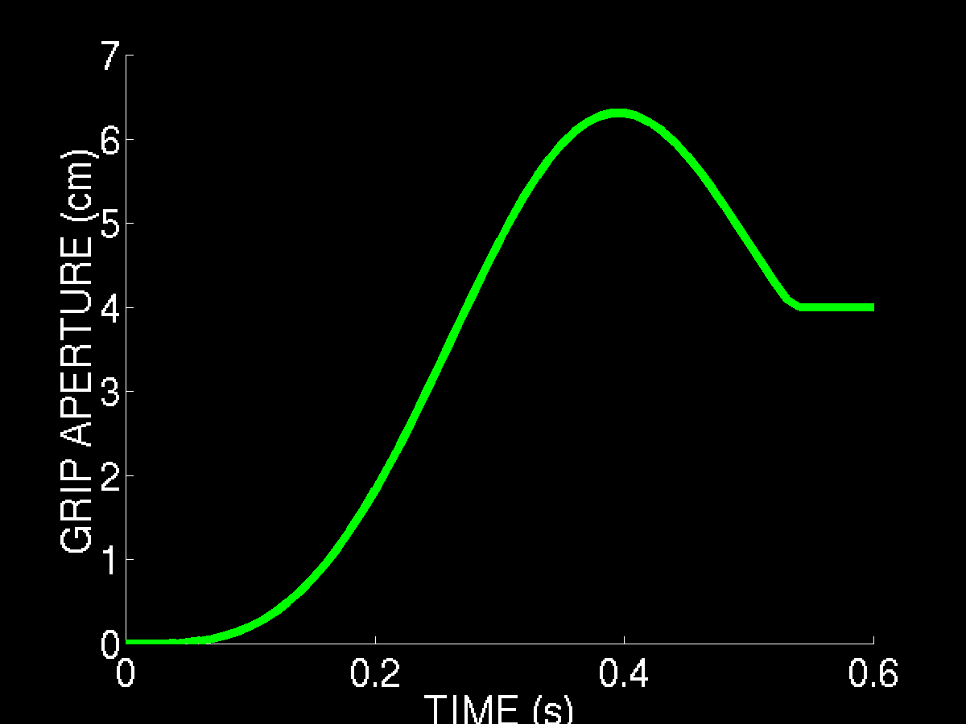
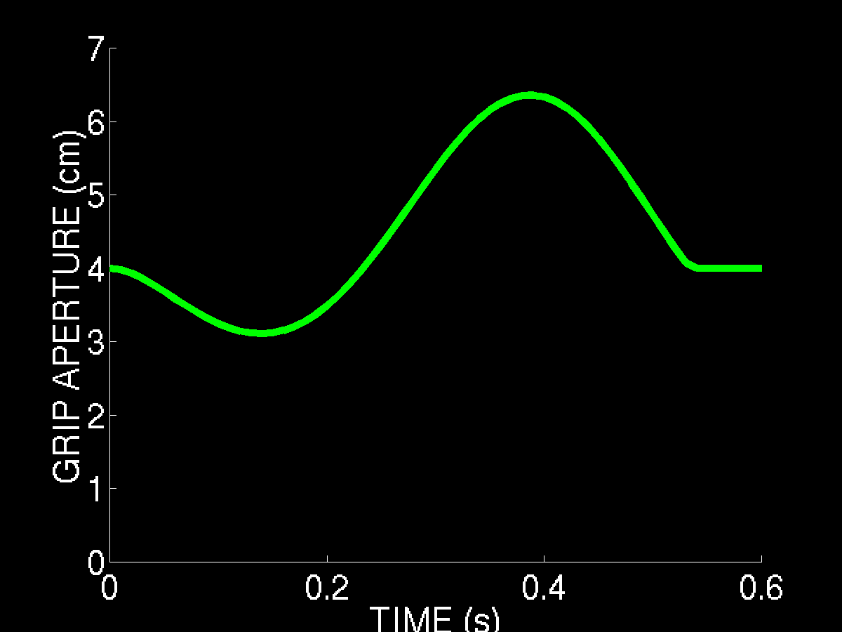
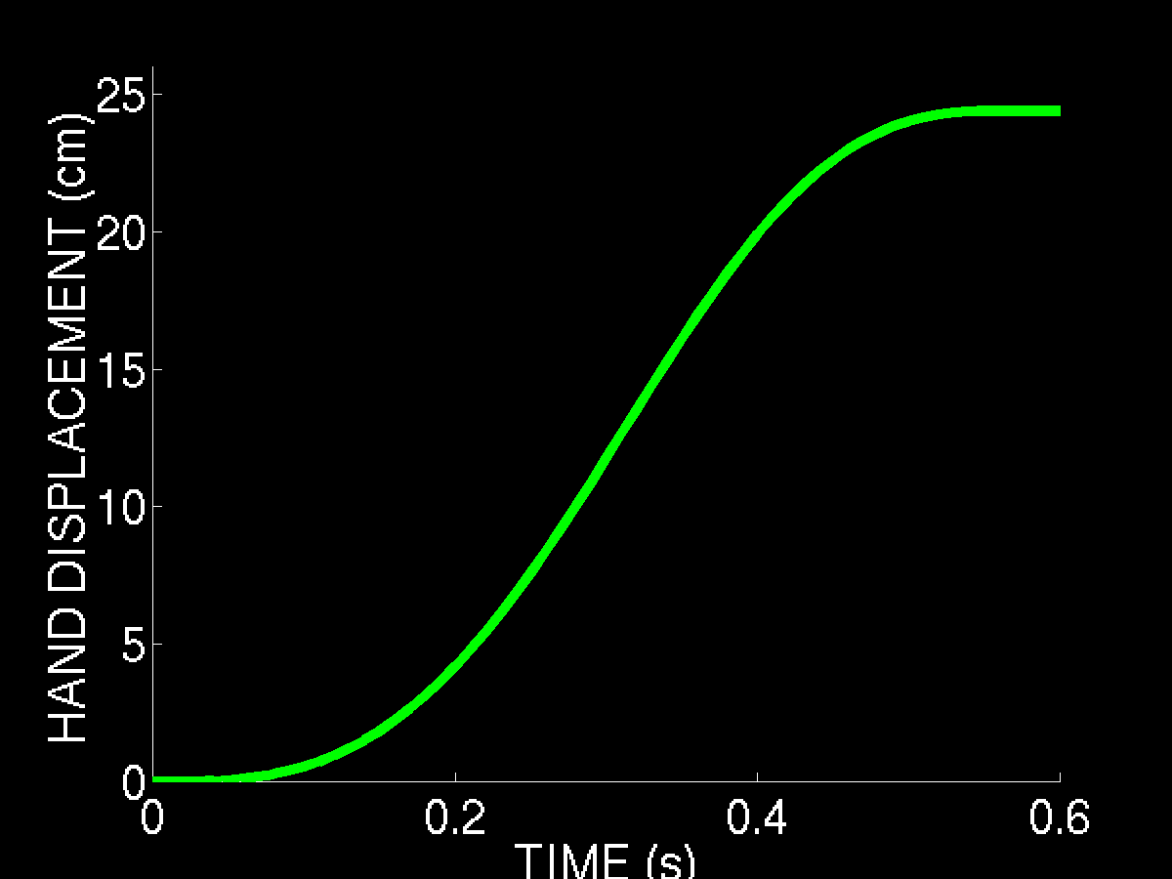
Prediction: perturbation to Pa

Slide 65
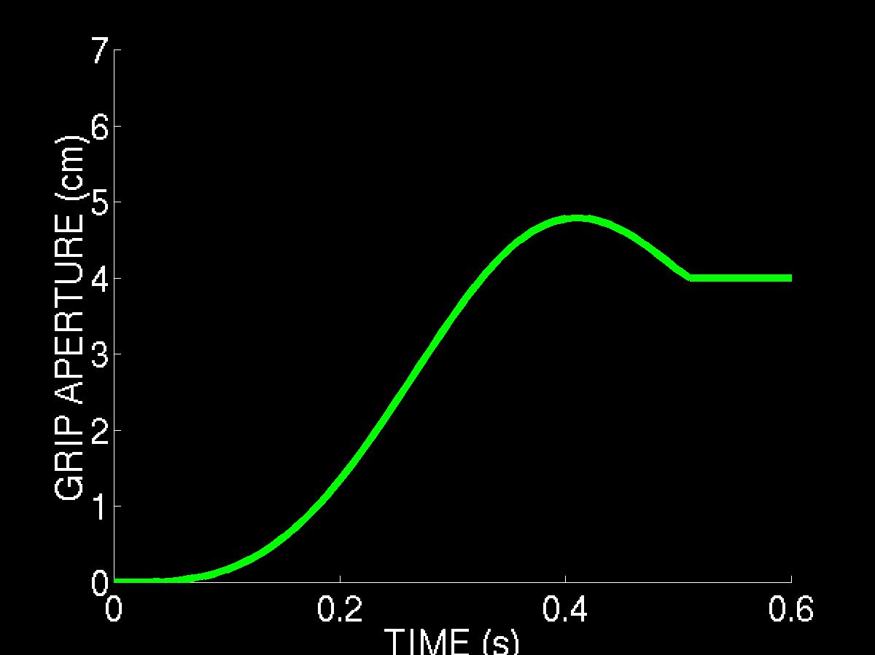
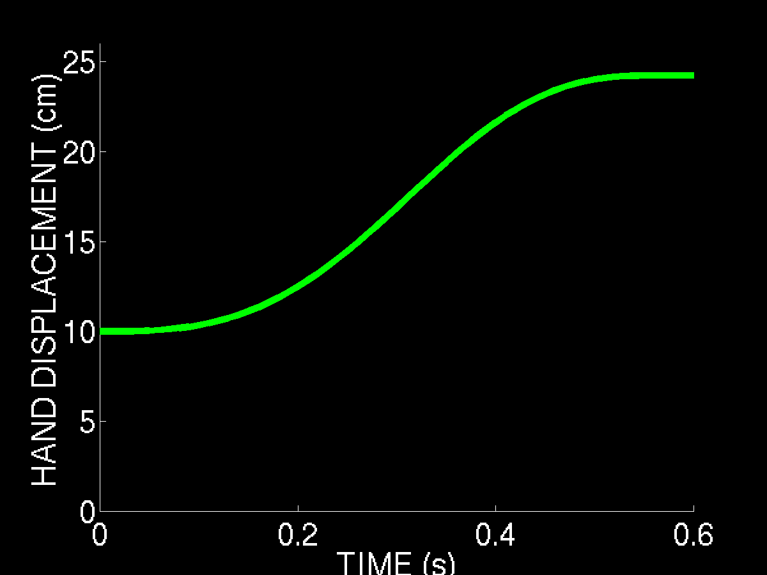
Push perturbation to Pt

Slide 66
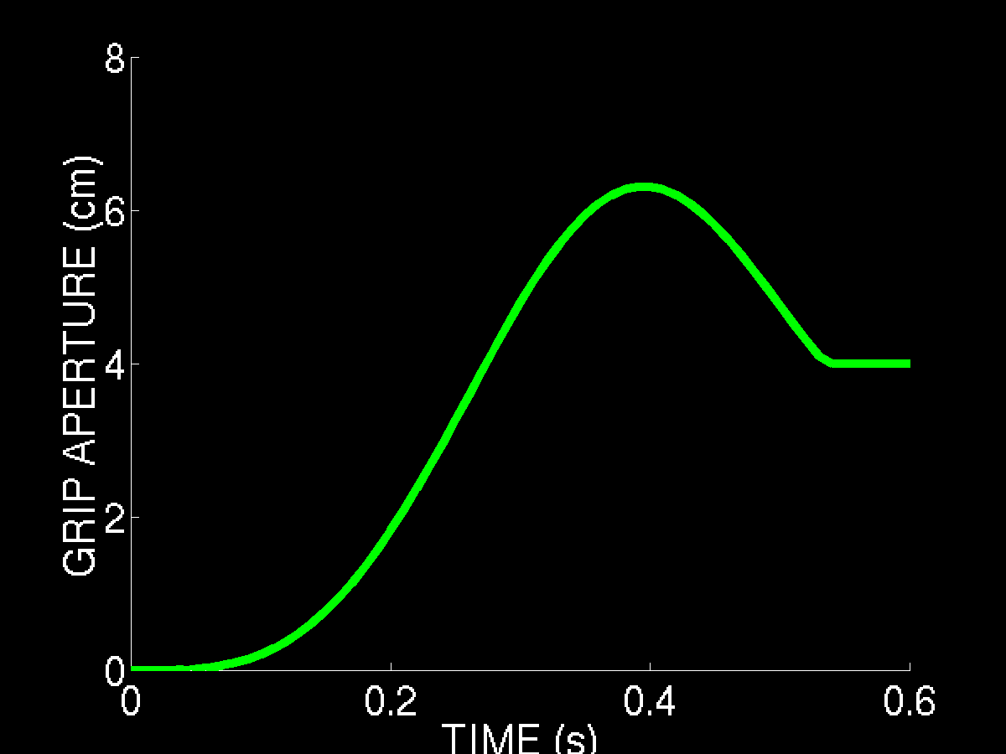
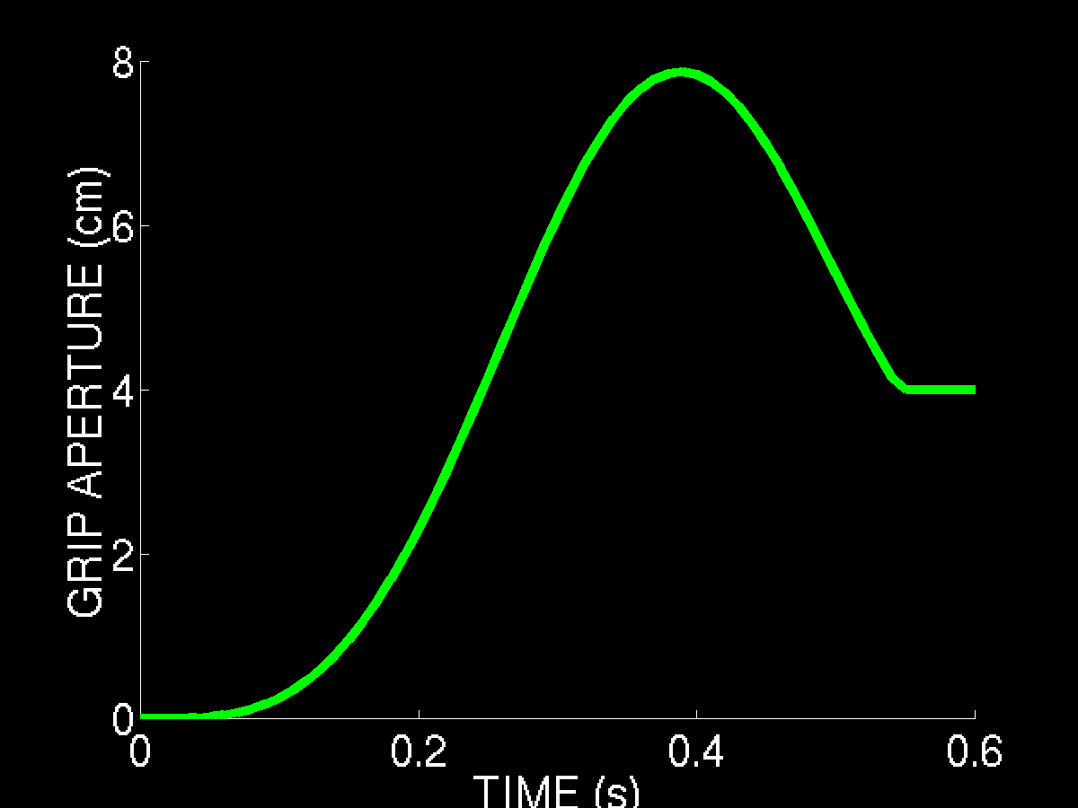
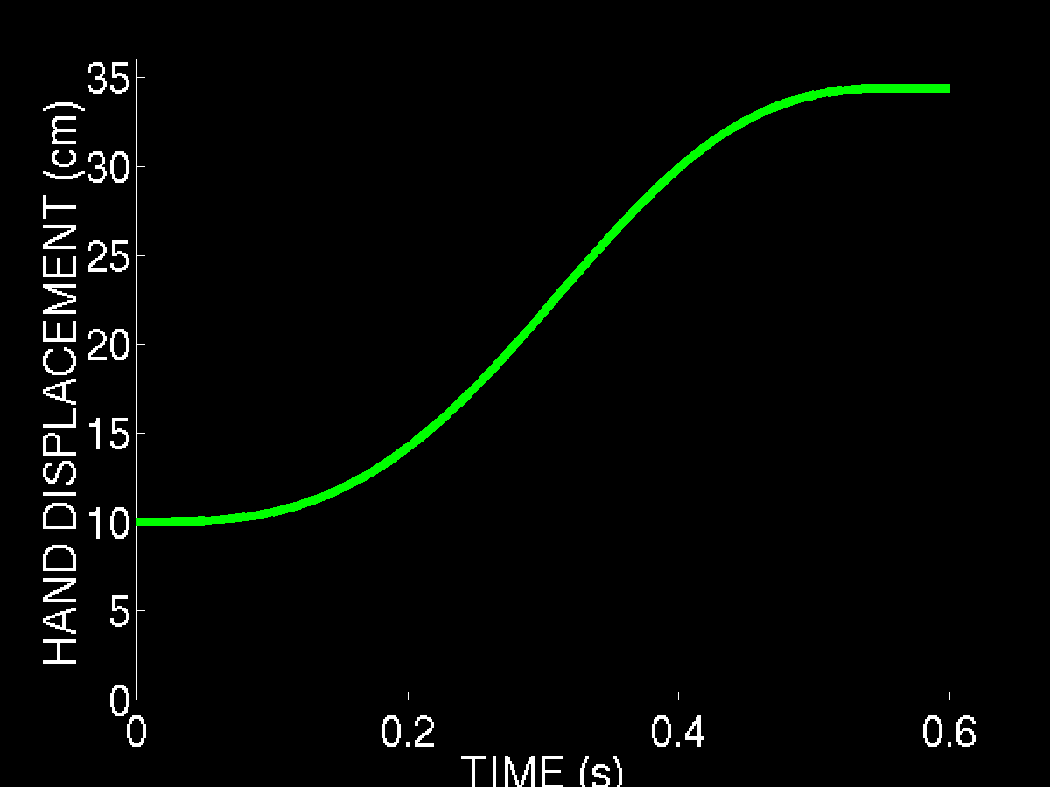
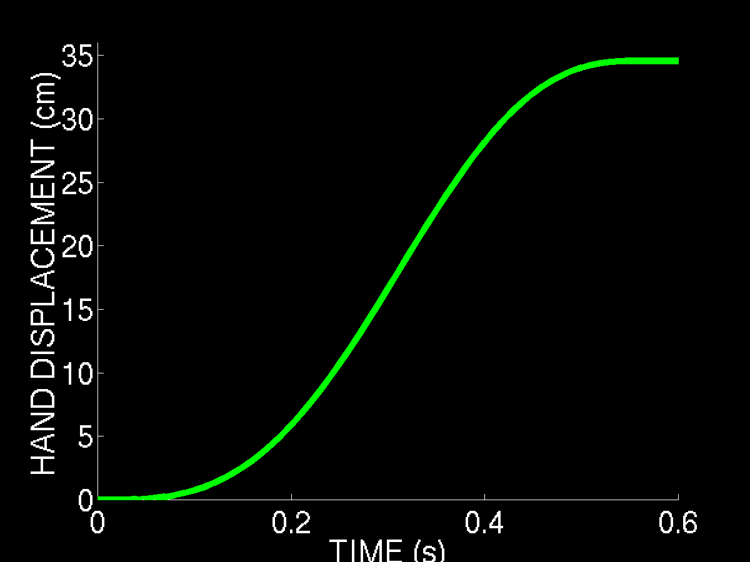
Pull perturbation to Pt

Slide 67
Sensitivity to parameters
Coupling neurons: Vt, Vo (how much velocities influence aperture).
Discrepancy cells: Et, Ea, Eo (how much discrepancies will slow movement).
Self-inhibition: -R (how much the cost of an open grip will influence grip aperture).

Slide 68
Sensitivity to parameters
Synchronization? It depends on GO signal.
MA at 60-80% MT? It depends on integration rate of coupling cells.
Larger MA for faster movements? Any parameter set will do.
Movement pauses? Any parameter set will do.
Aperture closures? Any parameter set will do.

Slide 69
Neurophysiological correlates
Cross-coupling: Either an efferent copy from cortex through pons-cerebellum; or velocity vectors routed to the spinal cord to affect grip aperture.
Discrepancy cells: Either discrepancy between novelty target in frontal cortex and old target; or competition of two targets in PPC.

Slide 70
Corresponding cell types
DVV: area 4 phasic MT
DV: posterior area 5 phasic
GO signal: globus pallidus
TPV: area 5 or 7b
PPV: anterior area 5 tonic
OFPV: area 4 phasic-tonic

