Slide 1
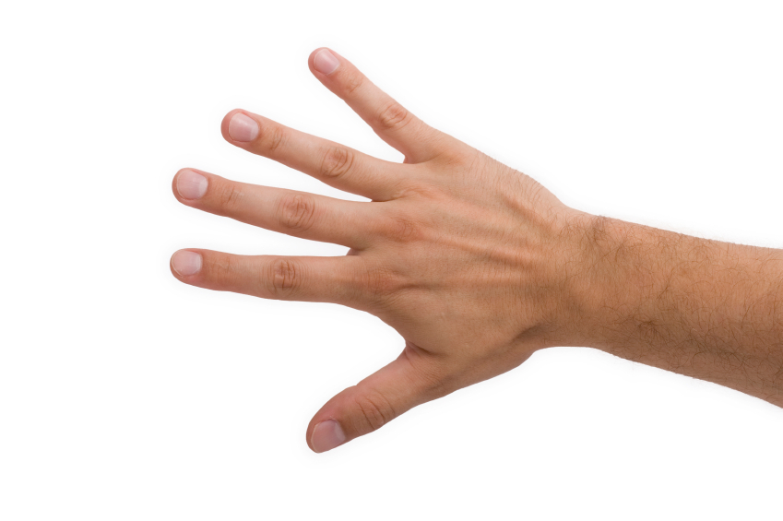
Back of Hand
Thumb
Index Finger
Middle Finger
Ring Finger
Little Finger
Wrist/Forearm
Residual Limb

