Slide 1

Dan Goodman, Marcel Stimberg, Romain Brette, … http://briansimulator.org

Slide 2
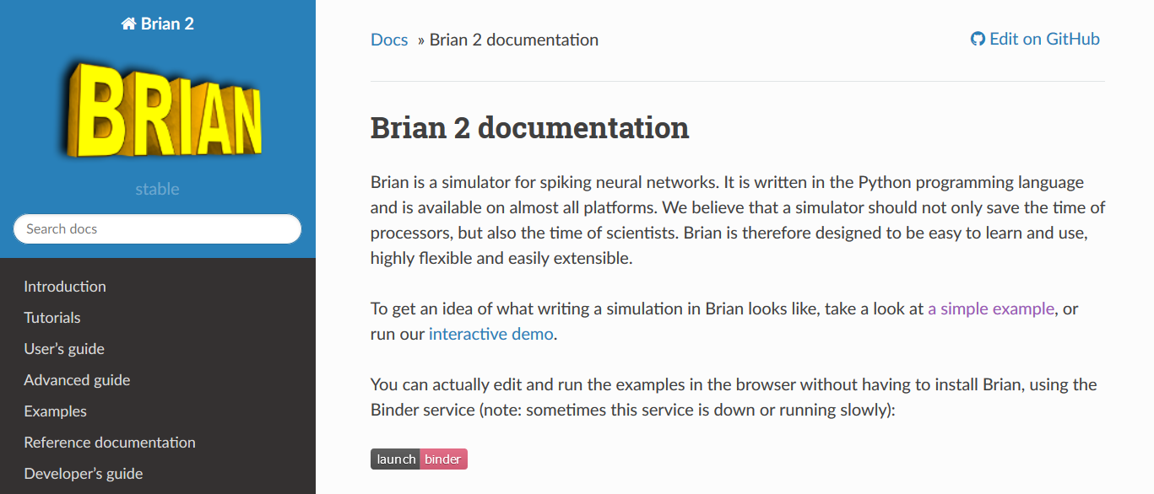
What is Brian?
Simulator for spiking neural networks
Focus on
Easy to learn and use
Flexibility
Performance
Reliability
Install:
conda install –c conda-forge brian2
Documentation: https://brian2.readthedocs.io

Slide 3
Demo
A live demo?
Surely nothing could go wrong?

Slide 4
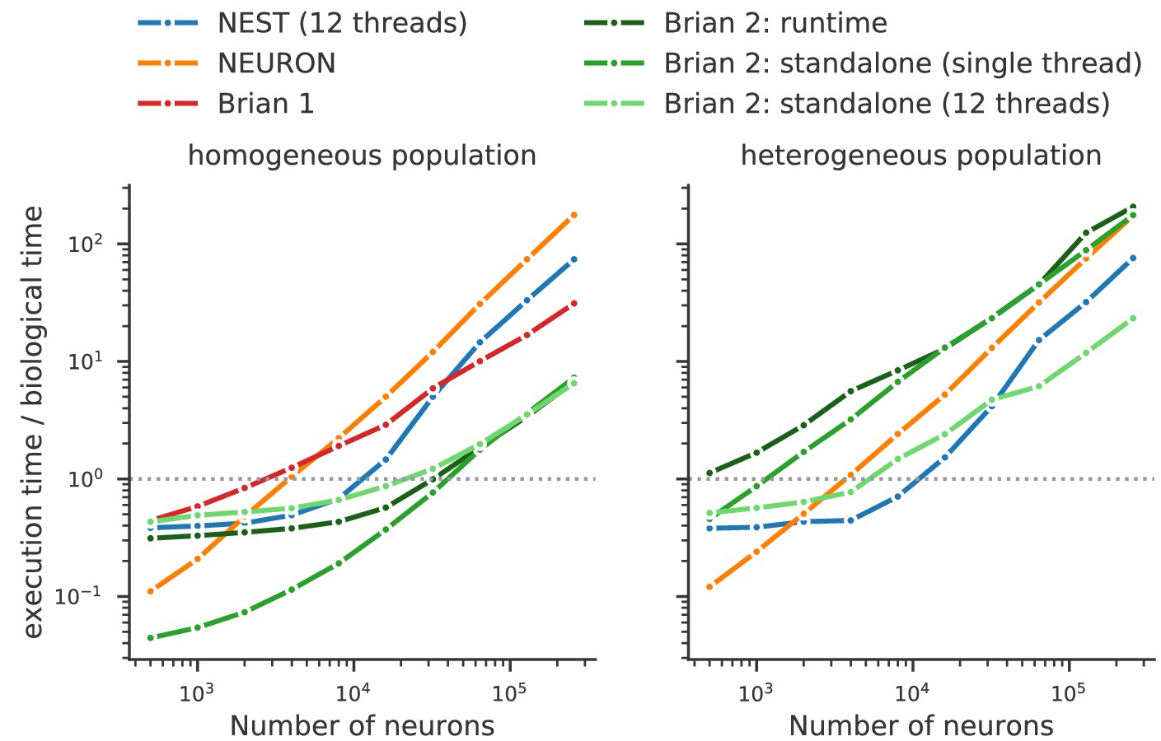
Performance
Runtime code generation
Brian model converted to C++
Allows code specialised for model
Heterogeneous:
Similar to NEST (3x faster for large)
8x faster than NEURON
Homogeneous:
12x faster than NEST, even with 1 thread
27x faster than NEURON
Stimberg, Brette, Goodman (2020) eLife

Slide 5
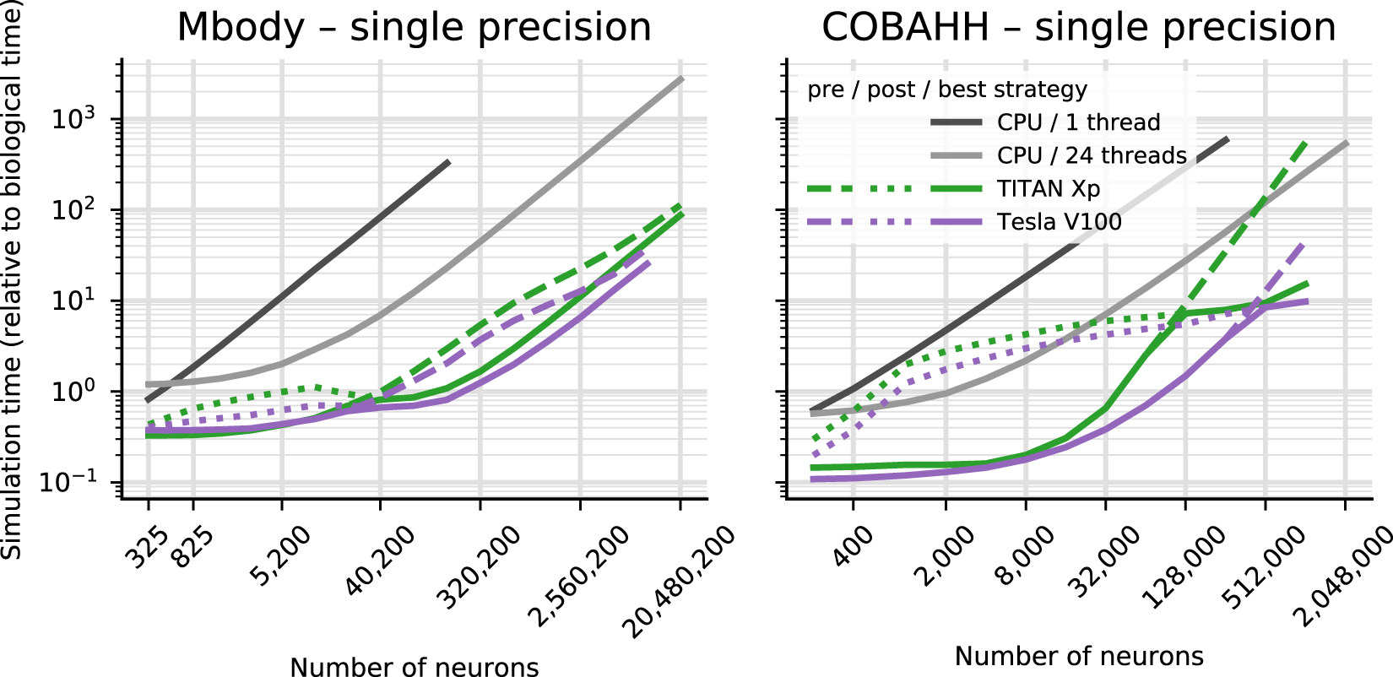
GPU support via Brian2GeNN
GeNN
A GPU simulator for SNNs
Thomas Nowotny (Sussex) and team
Brian2GeNN
Brian code on GPU using GeNN backend
Simply add the lines
import brian2genn set_device(‘genn’)
Up to 400x faster than single CPU
Most models supported
Stimberg, Goodman, Nowotny (2020) Sci. Rep.

Slide 6
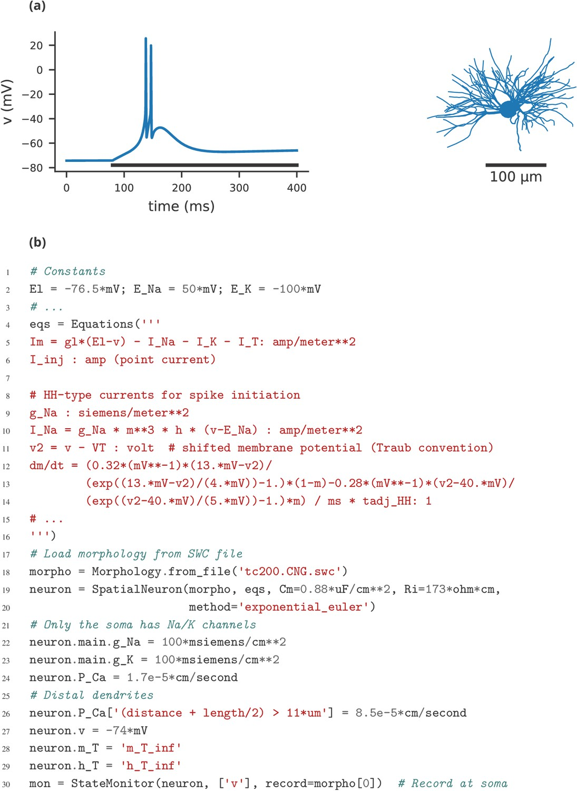
Limitations
Single machine
No support for large, distributed simulations on supercomputers.
We think there’s plenty of work to do on “small” networks (e.g. up to 10M neuron).
If you need this, try NEST.
Focus on single compartment neurons
Some support for multi-compartmental neurons.
For simple things, can use Brian.
If this is your main focus, try NEURON.

Slide 7
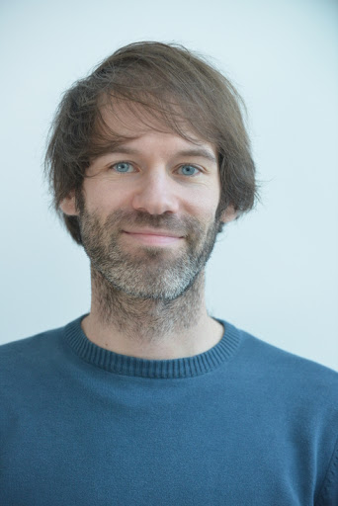
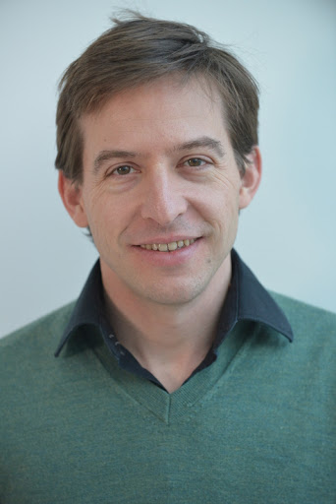

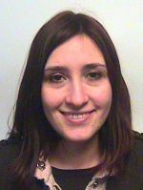
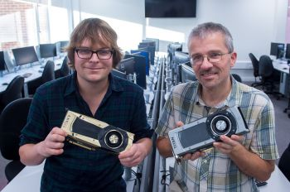
Thanks! Any questions?
Brian team
Marcel Stimberg
Romain Brette
GeNN team
James
Turner
Esin
Yavuz
James
Knight
Thomas
Nowotny
Cyrille Rossant, Victor Benichoux, Pierre Yger, Werner Beroux, Konrad Wartke, Daniel Bliss, Jan-Hendrik Schleimer, Moritz Augustin, Romain Cazé, Dominik Krzemiński, Martino Sorbaro, Benjamin Evans, Meng Dong, Alex Seeholzer, Daan Sprenkels, Edward Betts, Thomas McColgan, Charlee Fletterman, Mihir Vaidya, Teo Stocco, Dylan Richard Muir, Adrien F. Vincent, Kapil Kumar, Matthieu Recugnat, Paul Brodersen, Guillaume Dumas, Aleksandra Teska, Vigneswaran Chandrasekaran
… and all the Brian users

