Slide 1
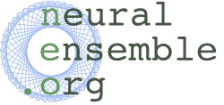
NeuralEnsemble is a community-based initiative to promote and
co-ordinate open-source software development in neuroscience.
Neuroinformatics tutorial
1.7 Open source initiatives
Notes:
<number>

Slide 2
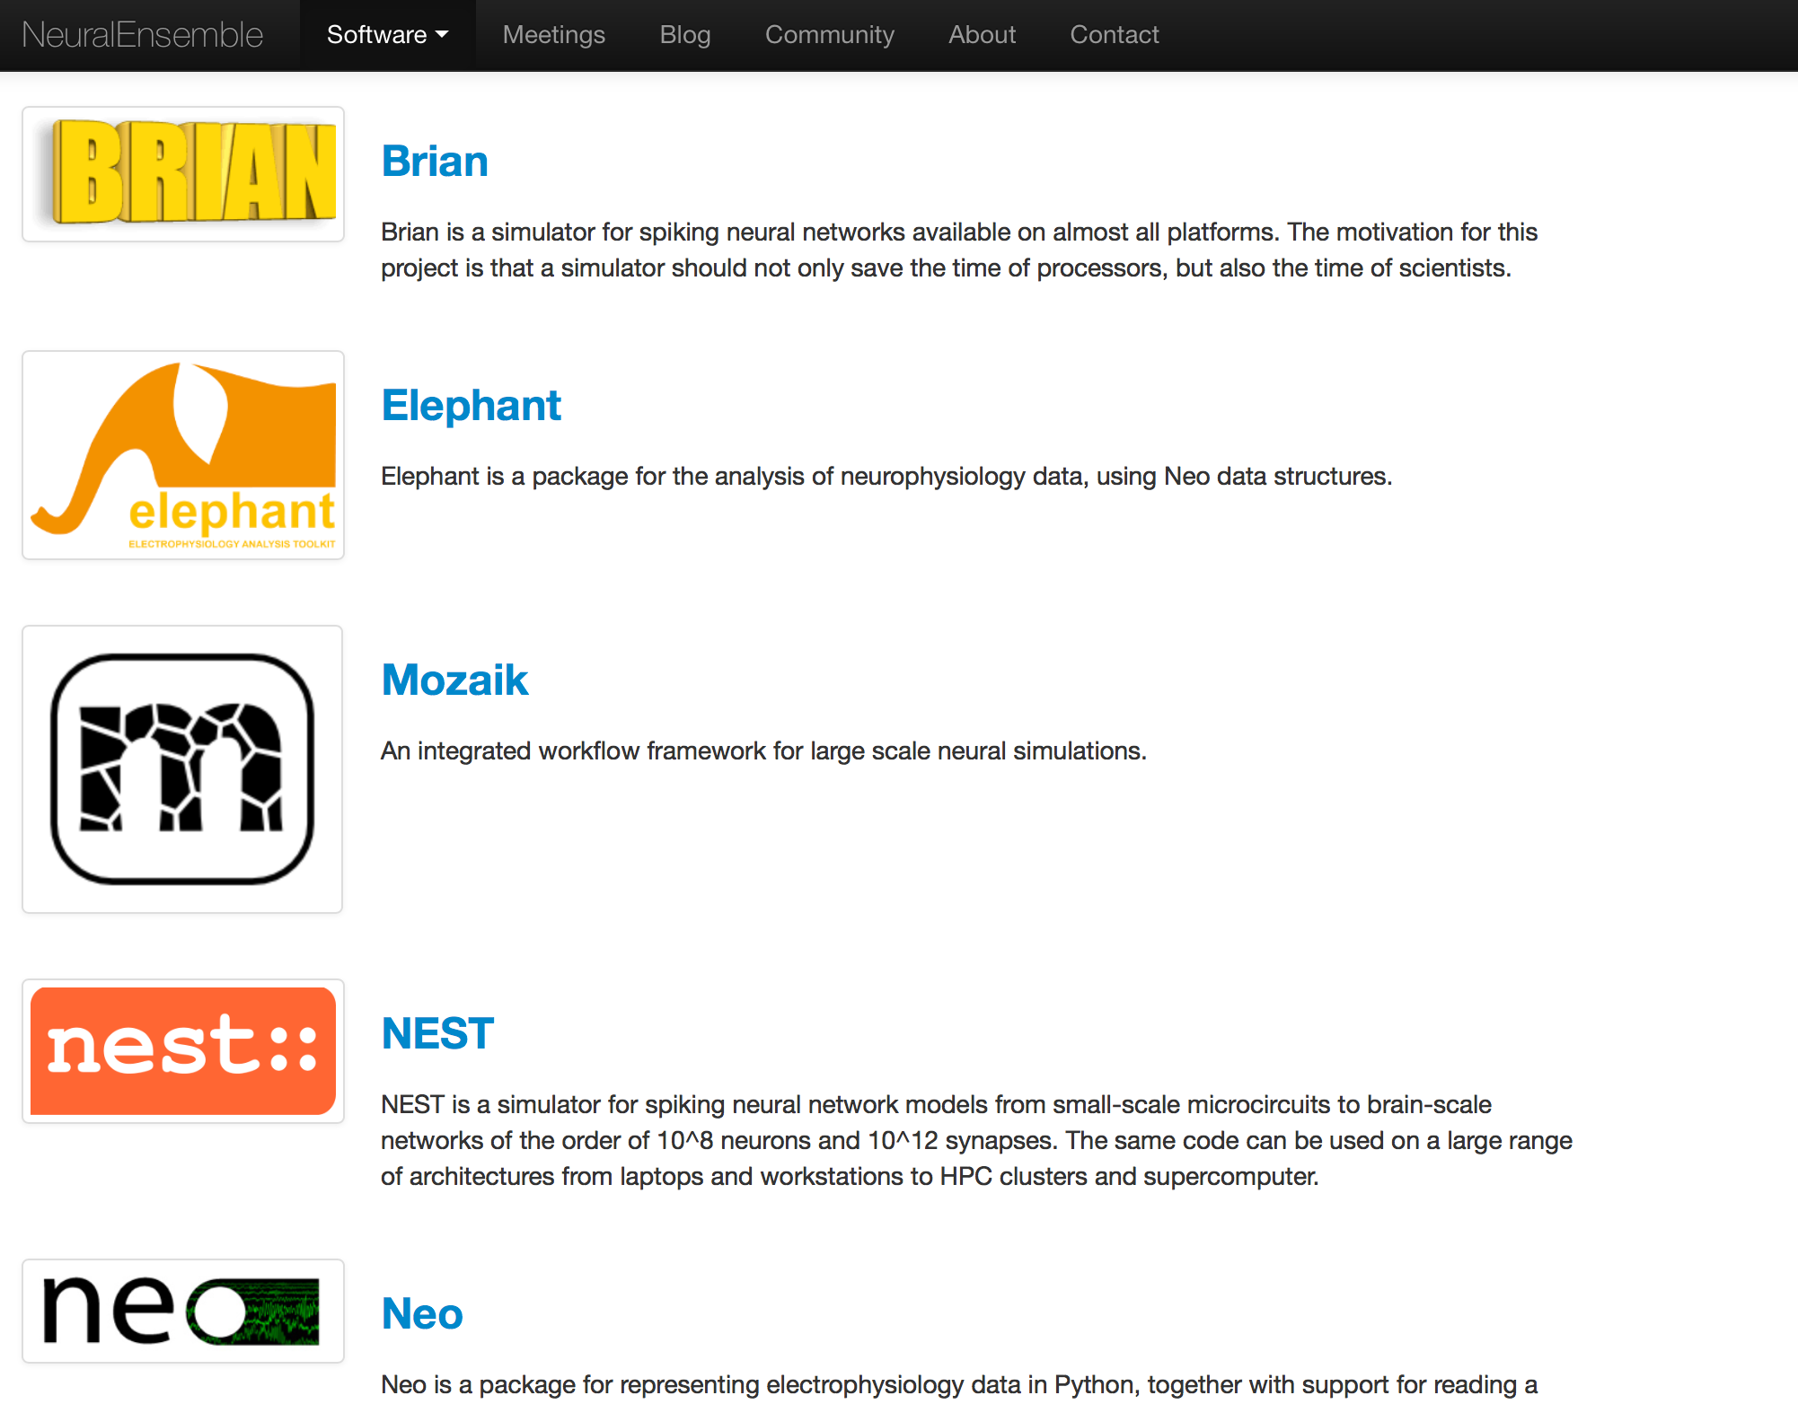
Software
NeuralEnsemble hosts a number of software projects for computational and systems neuroscience, including PyNN, Neo, Elephant, OpenElectrophy and libNeuroML, mostly hosted on GitHub.
By grouping these projects together under the NeuralEnsemble umbrella, our aim is to maximize interoperability and build components that can easily be combined into powerful systems for brain simulations and advanced data analysis.
Notes:
<number>

Slide 3
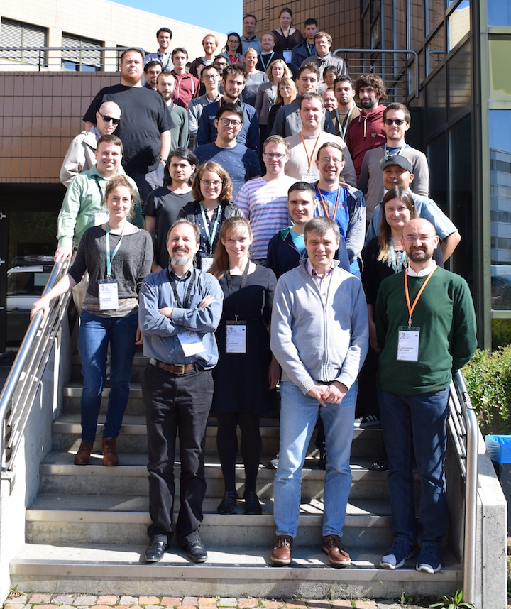
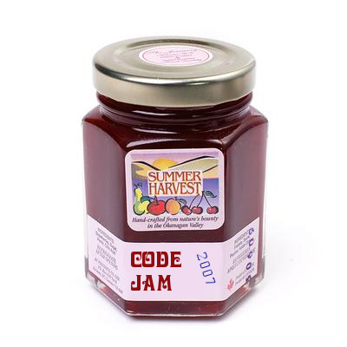
Workshops
We organize an annual "CodeJam" workshop, bringing together scientists, graduate students, and scientific programmers to share ideas, present their work, and write code together.
These workshops have been hugely effective in catalyzing open-source neuroscience software development.
Notes:
<number>

Slide 4
Community
There is a NeuralEnsemble Google group for discussion of collaborative neuroscience software development (mainly in Python, but users of other languages are welcome!) and to provide software support.
If you have any questions about any of the software hosted by NeuralEnsemble, please join the group and post a message in one of the forums.
https://groups.google.com/forum/#!forum/neuralensemble
Notes:
<number>

