Slide 1
SimTracker
http://mariannebezaire.com/simtracker/
MATLAB GUI-based tool to use with NEURON hoc models following the template at: https://github.com/mbezaire/ca1. Assists with code versioning, jobscript creation, parameter tracking, supercomputer/NSG usage for large-scale models, results organization and analysis. Under development; can be used with NEURON+Python with slight modifications to hoc template.
Neuroinformatics tutorial
1.3 Analysis tools

Slide 2
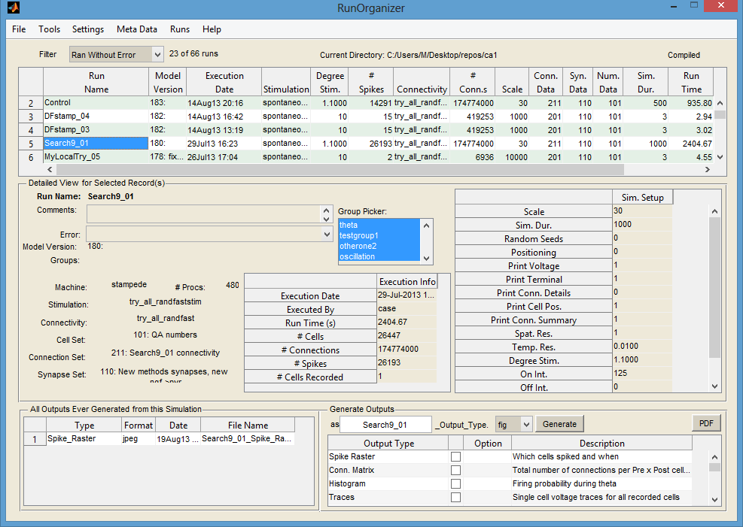
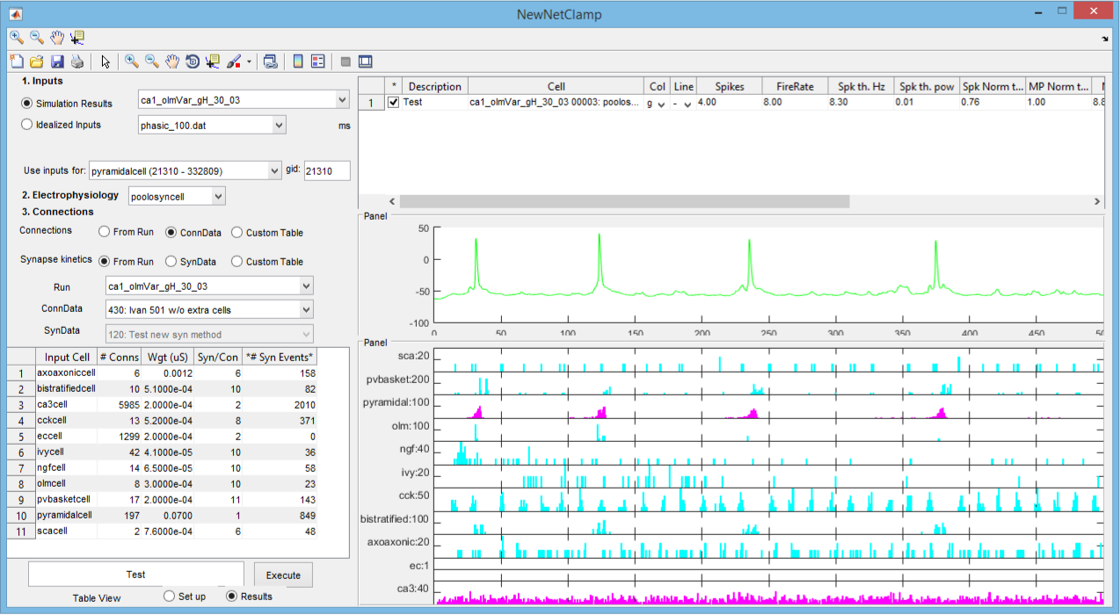
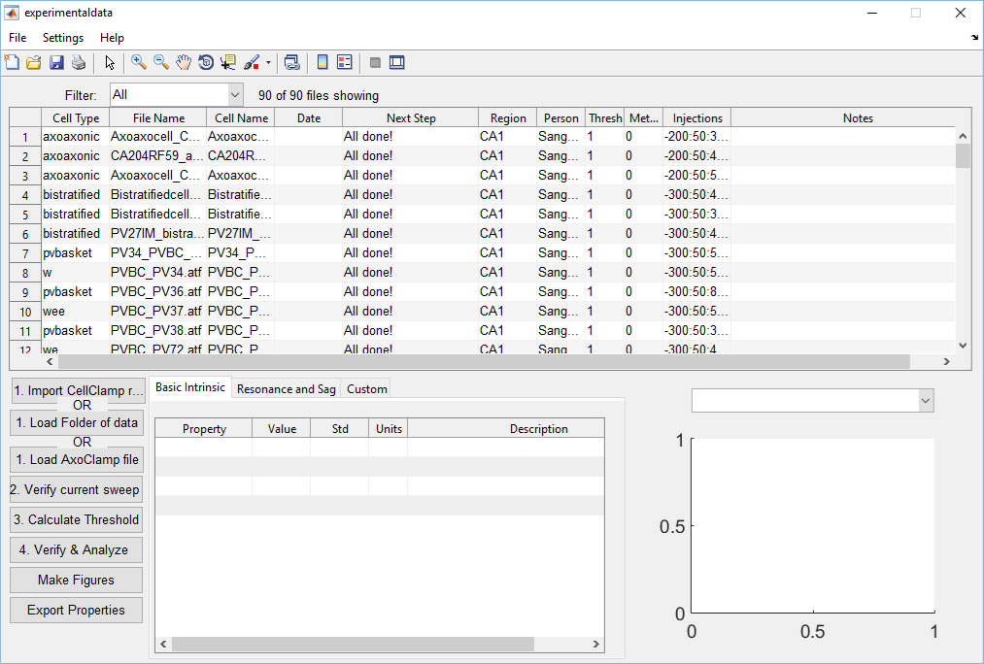
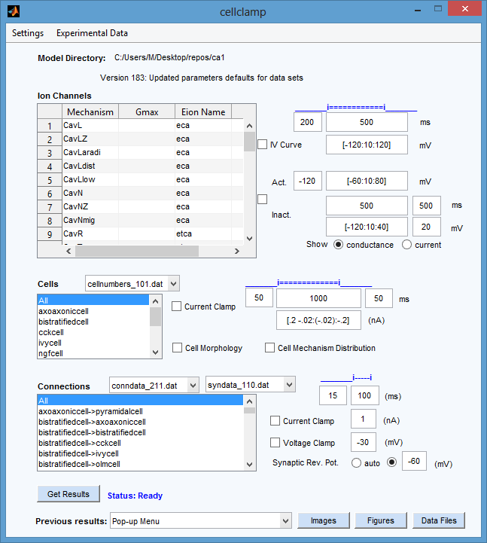
1
Full featured menu bar allows archiving, backup, interaction with supercomputers
Filter to view simulations in various stages or filter by various criteria
Manage multiple models
List all simulations
Uniquely name each run, store comments associated with each run
Track errors for failed simulations
Track the model version used in the simulation
Add tags/labels to simulations for organizing
Track all output figures ever generated from simulation
Analyze simulation in a variety of ways, produce output figures
Includes additional tools to characterize model & experimental cell data and to run network clamped single-cell simulations.
2
3
4
5
8
7
6
9
10
Additional tools within SimTracker
Network Clamp CellData CellClamp

Slide 3


SimTracker availability: http://mariannebezaire.com/simtracker/
Can be downloaded as compiled version for Linux, Mac, or Windows (Docker image will be available for Linux)
MATLAB scripts can be downloaded directly for a customizable version
NEURON model templates available:
Currently used with large scale CA1 network model (Bezaire et al, 2016 eLife) and with smaller models, https://github.com/mbezaire/ca1
Example ringdemo parallel NEURON template to use with SimTracker, http://bitbucket.org/mbezaire/ringdemo
Supercomputer usage:
Jobscript templates set up for use with SDSC’s Comet and Trestles, and TACC’s Stampede
Can be used with NSG using REST interface or separately
Future plans:
Create full template in NEURON+Python
Make SimTracker functionality available in Python and perhaps able to talk with tools in NeuralEnsemble

