Slide 1
NEURON
http://neuron.yale.edu
NEURON is a tool for developing, simulating, and analysing empirically-based models of neurons and networks of neurons. NEURON supports all classes of spiking models and runs on both desktops and supercomputers.
Neuroinformatics tutorial
1.4 Simulation environments
Notes:
1

Slide 2
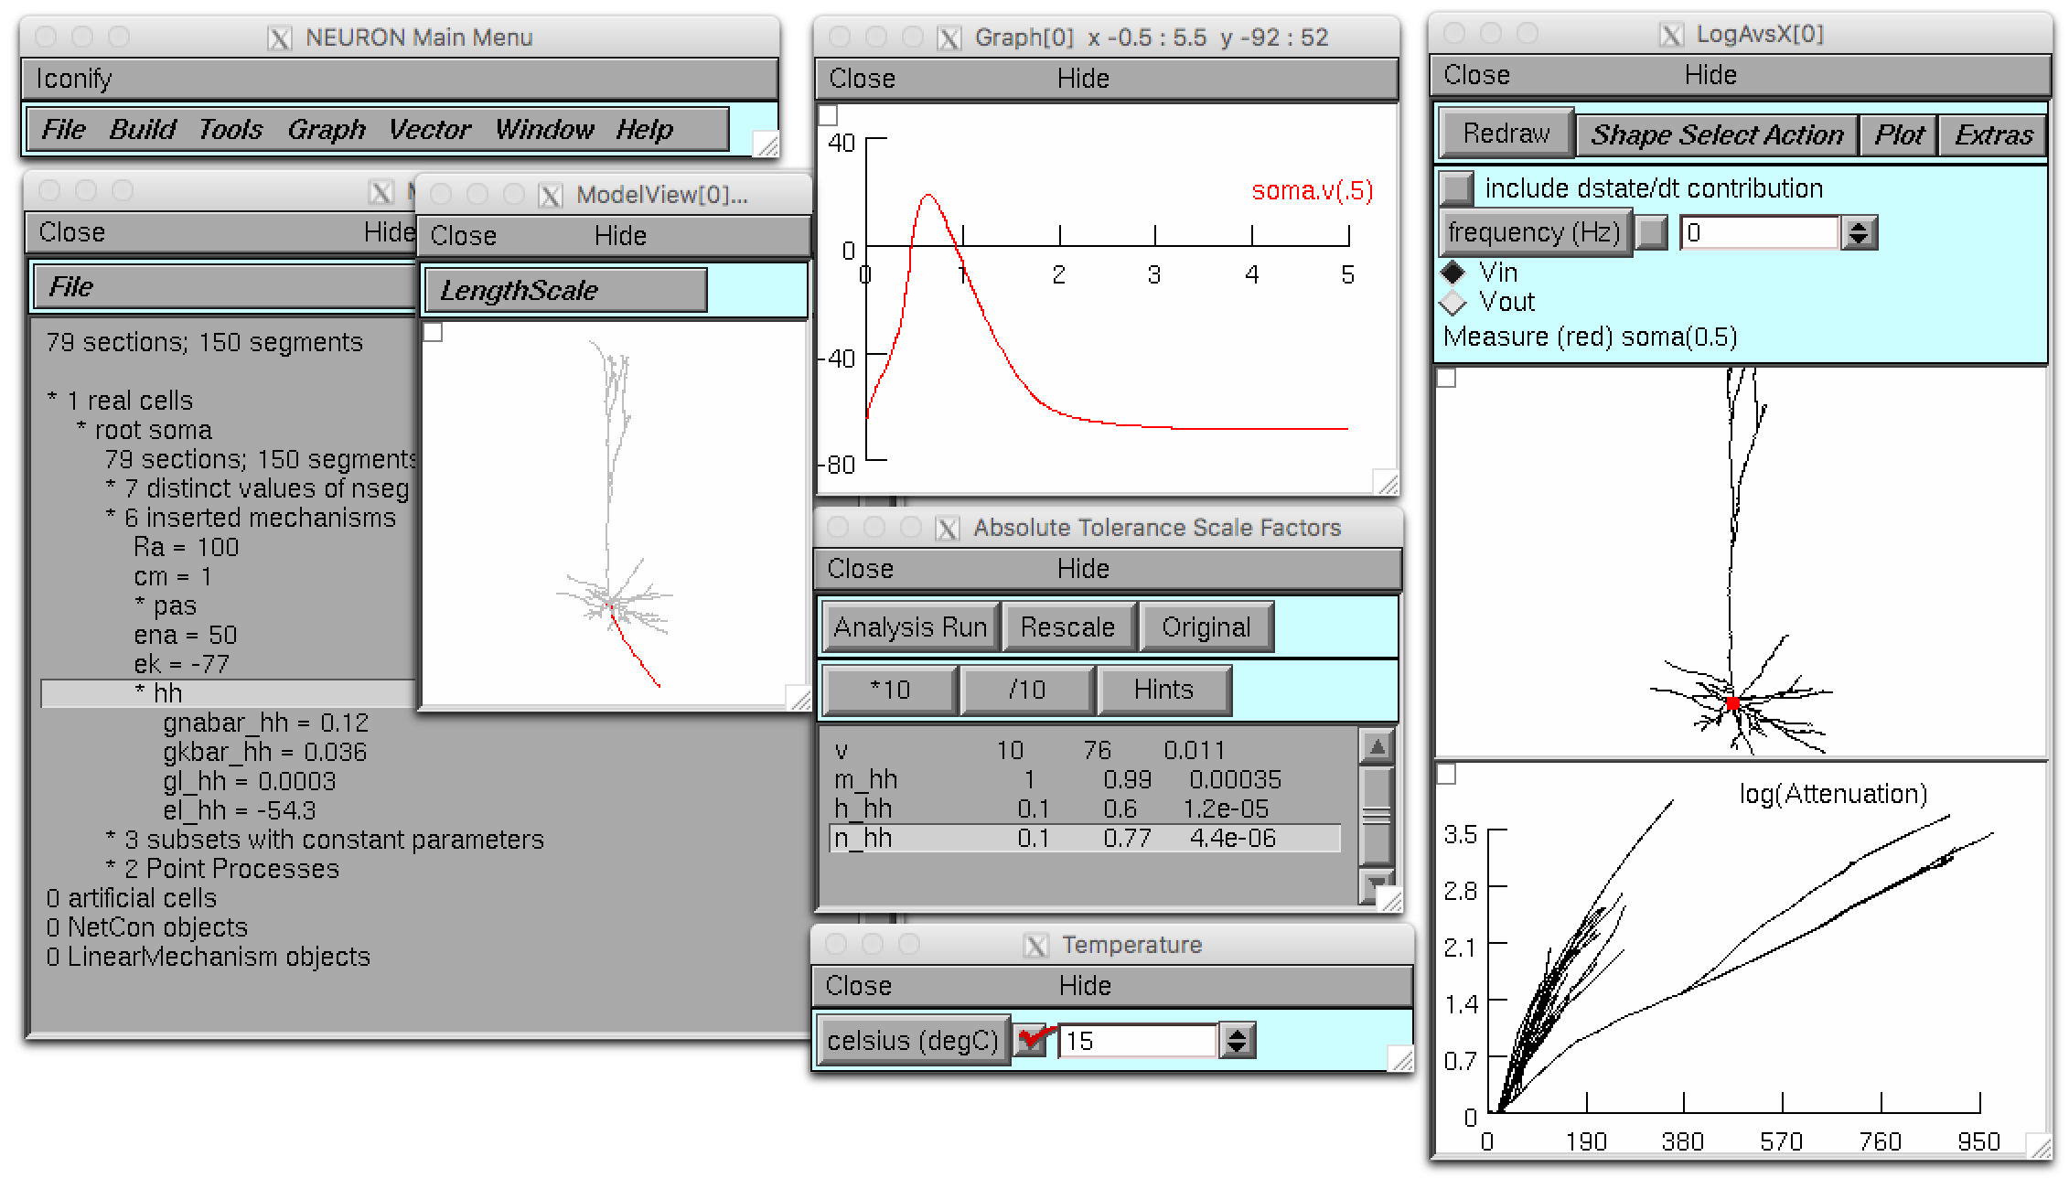
Powerful GUI tools • Fully Python scriptable • Large networks and single cells • Morphologically and biophysically detailed cells, integrate-and-fire cells, and anything in between • Run on a single core or on 128,000 processors.
Notes:
2

Slide 3
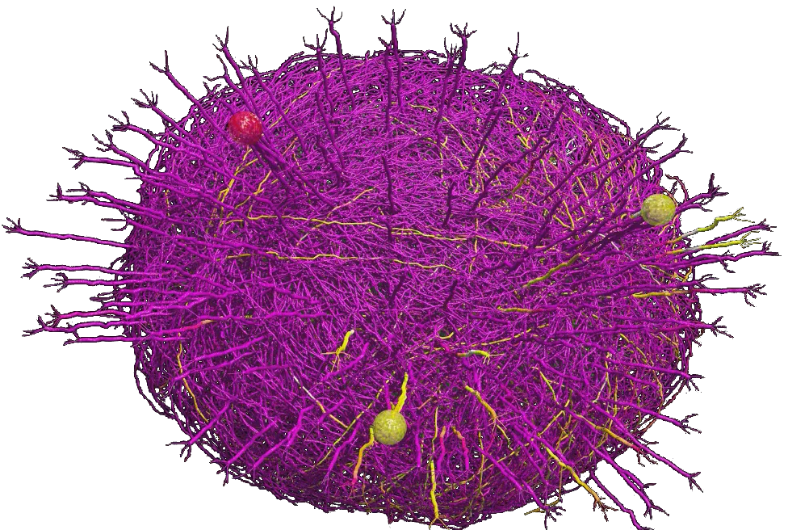
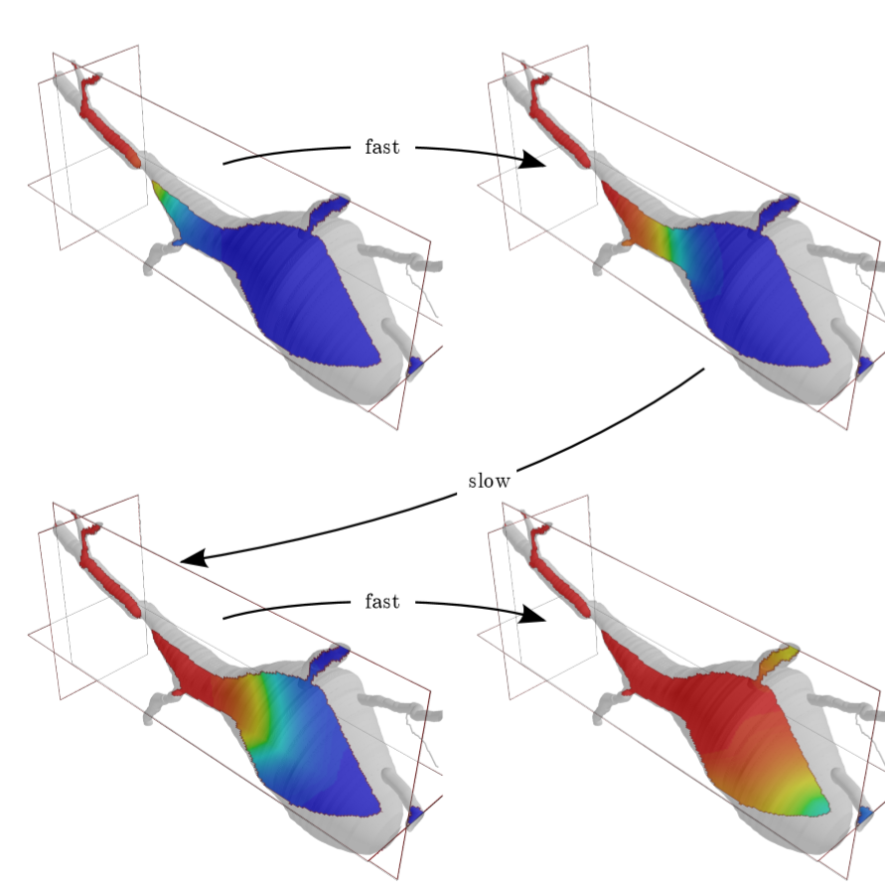
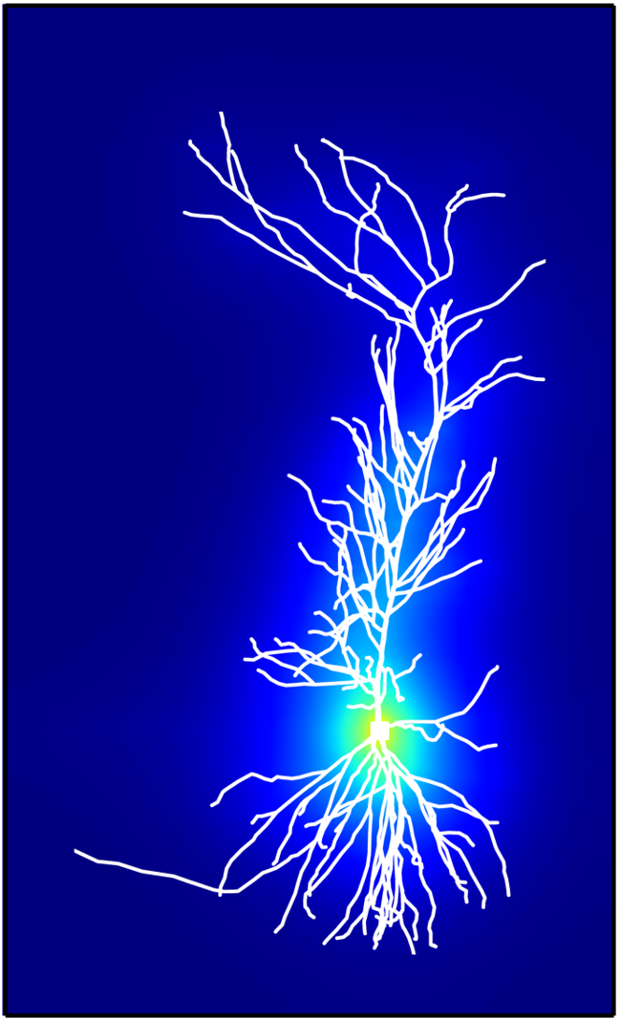
Recent developments
Reaction Diffusion (rxd)
SBML export.
Extracellular and accelerated 3D intracellular simulation.
JIT compilation for faster simulation.
Python API
Matplotlib support for RangeVarPlot and PlotShape.
Cleaner interfaces. Meaningful return types.
Mechanism introspection.
Documentation
More rxd tutorials and examples.
Updated Python programmer’s reference.
Migliore et al 2014. Olfactory bulb network model. Up to 69,000 cells. modeldb.yale.edu/151681
3D intra- (left) and extracellular (right) reaction-diffusion simulations.
Notes:
3

Slide 4
More NEURON Resources
API documentation (both Python and HOC):
https://neuron.yale.edu/neuron/static/py_doc/index.html
ModelDB (over 675 NEURON models):
http://modeldb.yale.edu
NEURON forum (over 16,000 posts):
https://neuron.yale.edu/phpBB/
Tutorials:
http://neuron.yale.edu/neuron/docs
NEURON courses:
Week-long NEURON course every summer.
Day-long NEURON course before Society for Neuroscience conferences.
Notes:
4

