Slide 1
Bayesian Inference in Waveform Signals based on BAYSIG
Nauman Aslam
Dr. Kamal AbuHassan
Research Fellow in Computational Intelligence
Anglia Ruskin IT Research Institute
HBP CodeJam#7
11th-14th January 2016, Manchester, UK

Slide 2
BAYSIG
BAYSIG is a new probabilistic modelling language that enhances the expressiveness of statistical models.
It has been invented and developed by Dr Tom Nielsen (Founder of OpenBrain Ltd) and funded by the BBSRC grants to Dr Tom Matheson (University of Leicester).
It allows you to perform Bayesian statistical inference in a variety of models based on different kinds of data.
BAYSIG has an online channel known as BayesHive (https://bayeshive.com).
BayesHive has a point-and-click interface to build statistical models and load data.

Slide 3

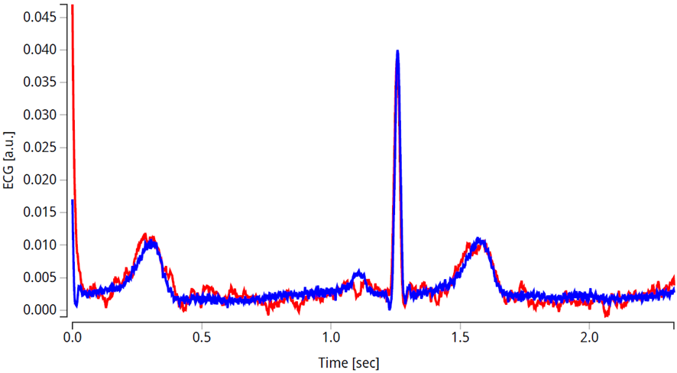
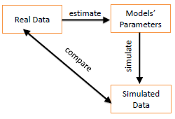
Bayesian Inference in ECG Models
Using Bayesian inference to estimate parameters from real ECG data.
One aim is to assess the differences in the estimated parameters between healthy subjects and patients with abnormal cardiovascular conditions.

Slide 4
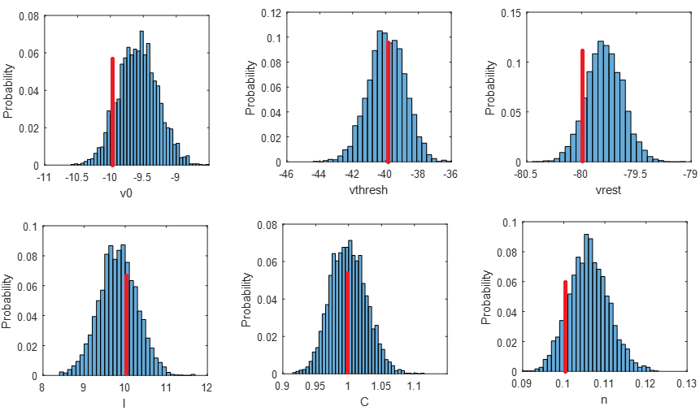
Bayesian Inference in qIF Neuron Model
AbuHassan K, Nielsen T, Marra V, Hossain A, Matheson T (in preparation) Parameter Estimation for a Noisy Quadratic Integrate-and-Fire Neuron Model based on Bayesian Inference.
This research employs Bayesian inference to estimate the parameters of a noisy quadratic integrate-and-fire neuron model from synthetic voltage traces.
The bounding limits for the uniform prior distributions
Summarized results from Bayesian inference
Parameters | Lower limit | Upper limit
v₀ | -50 mV | 0 mV
v_{threshold} | -60 mV | 0 mV
v_{rest} | -100 mV | v_{threshold}
I | -50 pA | 50 pA
n | 0 mV | 1 mV

Slide 5
Bayesian Inference in qIF Neuron Model
AbuHassan K, Nielsen T, Marra V, Hossain A, Matheson T (to be submitted) Parameter Estimation for a Noisy Quadratic Integrate-and-Fire Neuron Model based on Bayesian Inference.
A posterior predictive check (PPC) was used to assess the results of parameter estimation.
Reference data (red) were compared to the simulated data (blue) generated by the model
Sample recording from a regular spiking pyramidal cell responding to in-vivo-like current injection. (Gerstner and Naud, 2009)
Notes:
PPC can be defined as, "simulating replicated data under the fitted model and then comparing these to the observed data"

Slide 6
Thank you

