Slide 1
Neuronvisio and Sumatra
Run, Store, Search, Locate and Reload simulations' results
Michele Mattioni -- mattioni@ebi.ac.uk

Slide 2
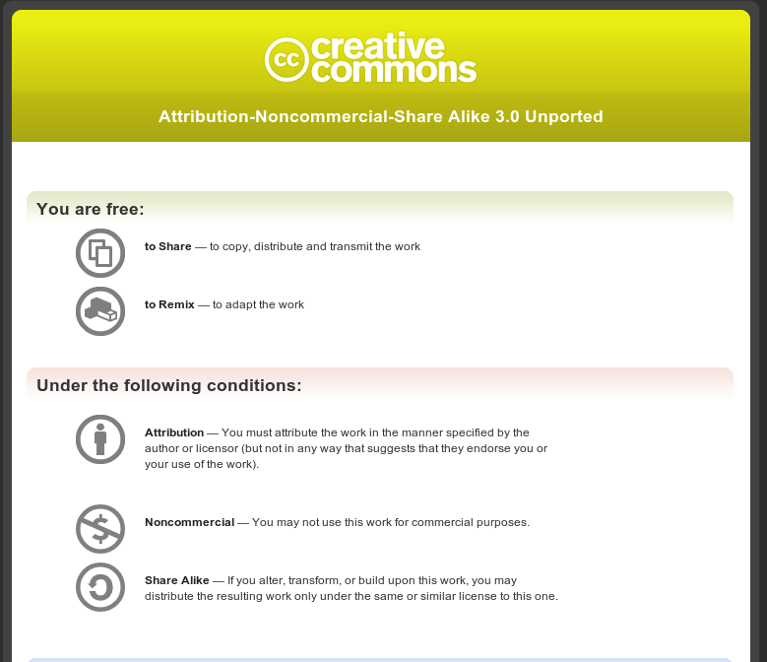

Slide 3
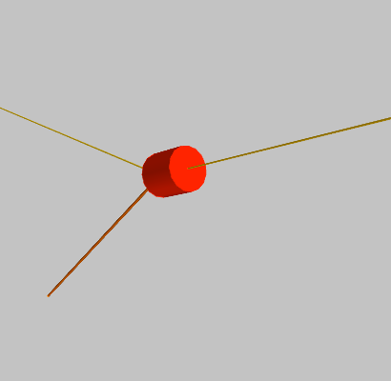
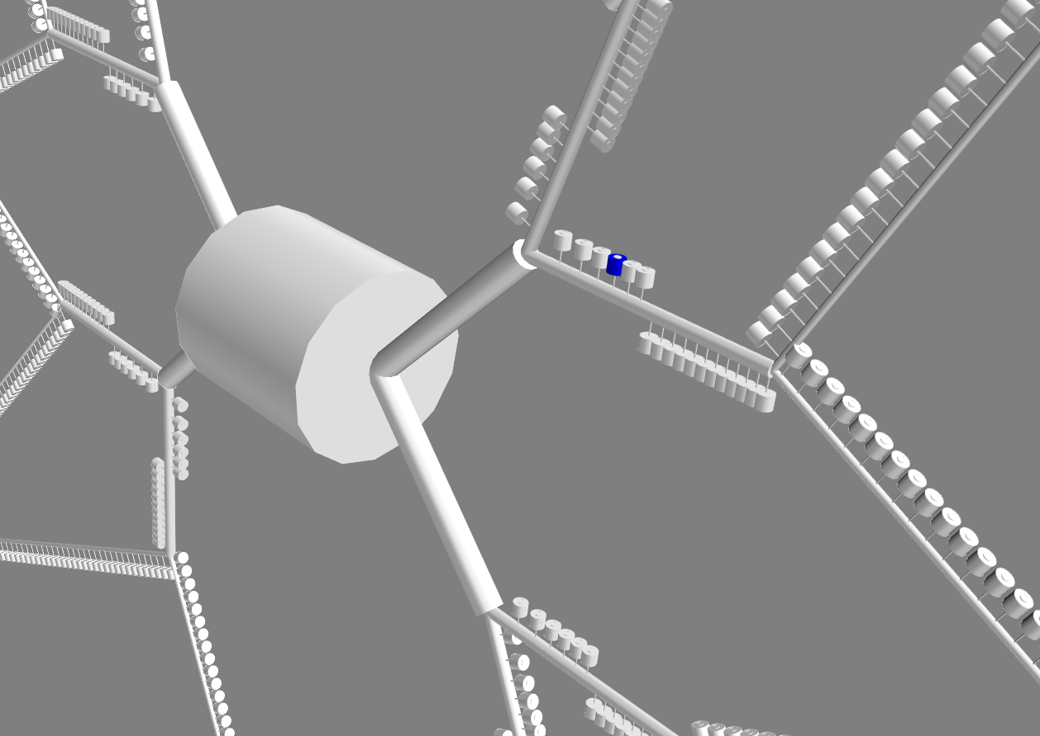
Complexity increase

Slide 4
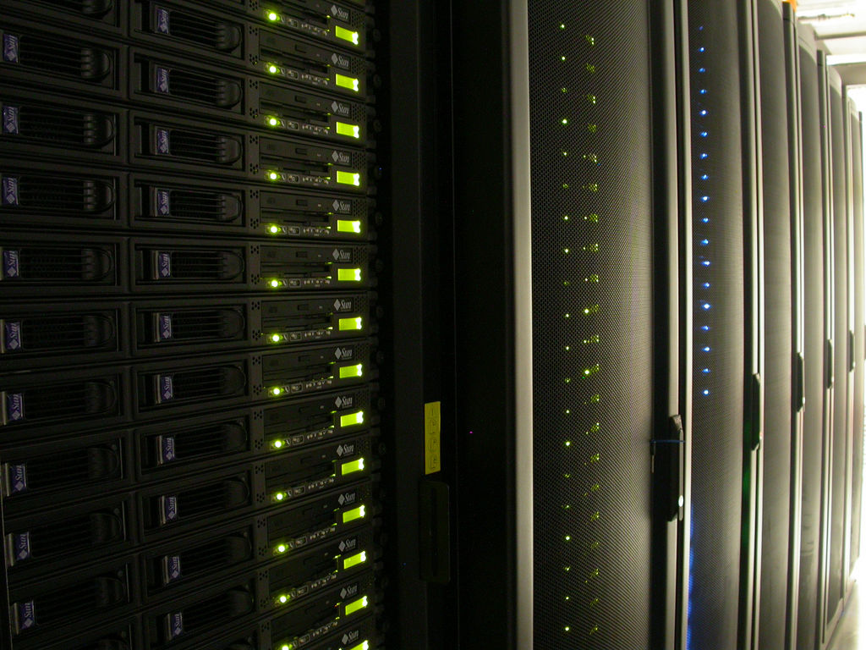
Tons of Jobs executed
http://www.flickr.com/photos/mmayo/6340736/

Slide 5
Two main areas:
Computed Results
Simulations Details

Slide 6
My current framework to handle this
Neuronvisio
Sumatra
+

Slide 7
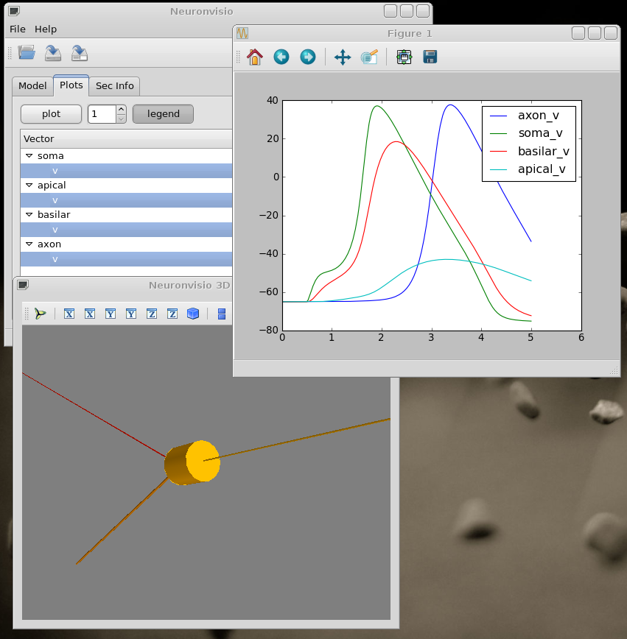
Neuronvisio -- background
Graphical User Interface helper for NEURON
3D model visualization using Mayavi
plotting of any vectors/variables
Save/Reload of simulation results
http://mattions.github.com/neuronvisio/

Slide 8
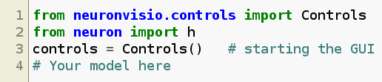
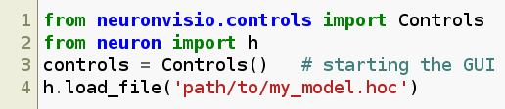
Integrate with your existing model easily
if in Python
if in Hoc

Slide 9
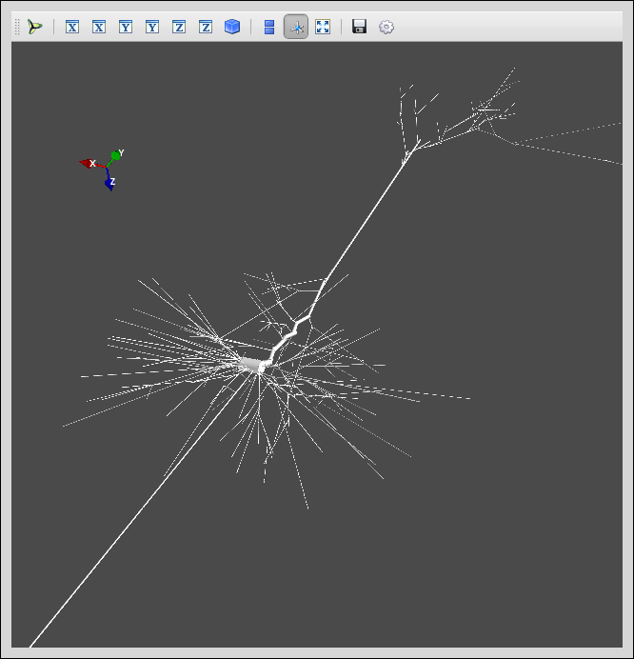
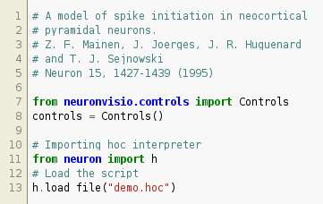
Pyramidal cell in Model Db

Slide 10
Neuronvisio -- saving simulation results
Geometry
Computed Array
+
NeuroML
HDF format

Slide 11
Why HDF (Hierarchical Data Format)
store any kind of python list/numpy array (using PyTable)
extremely optimized for numerical data
extremely good with enourmous amount of data
hierarchic structure easy to expand
sqlite approach didn't work...

Slide 12
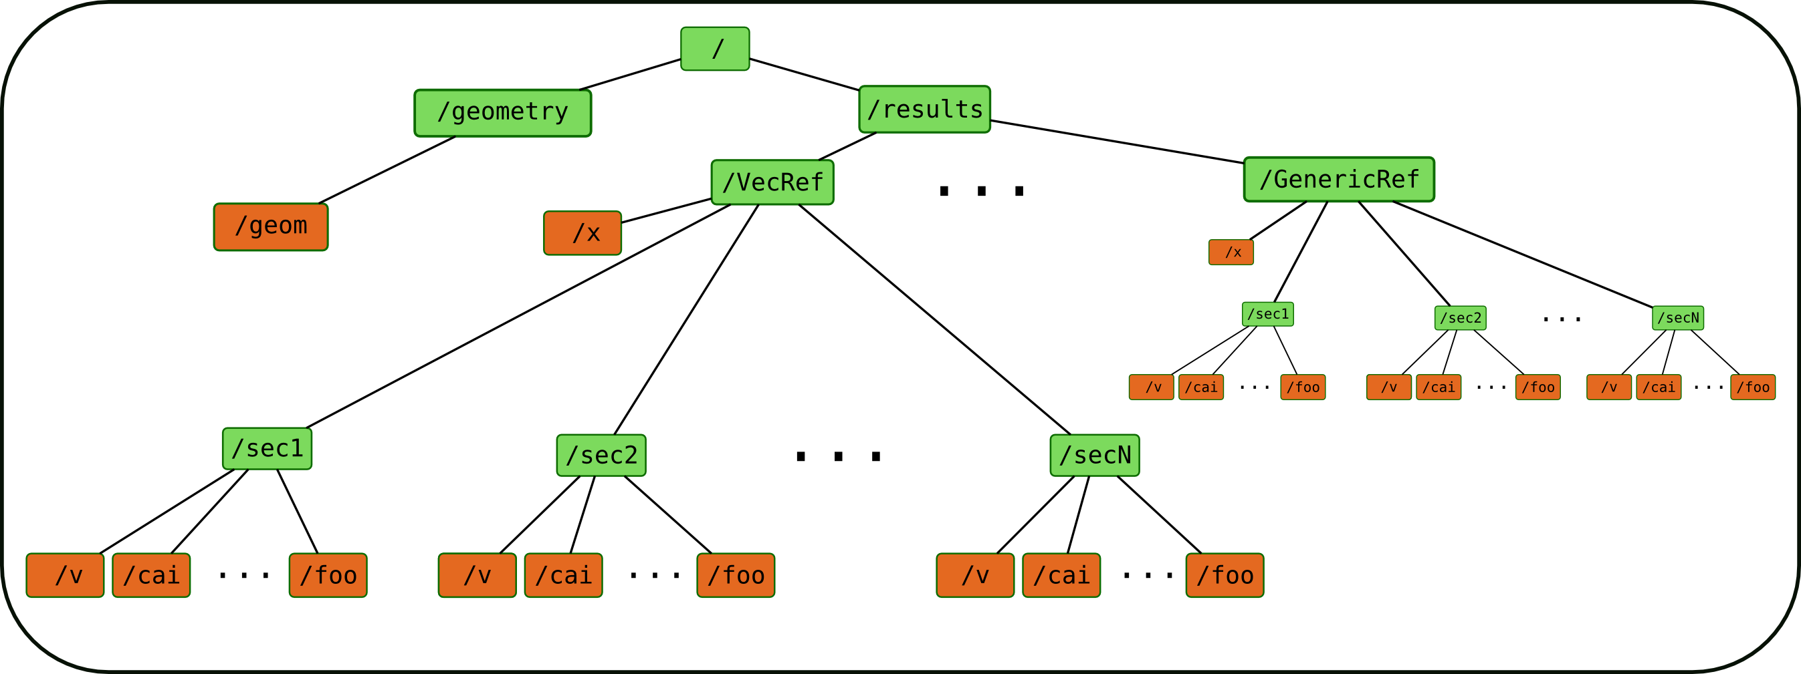
Neuronvisio HDF file structure

Slide 13
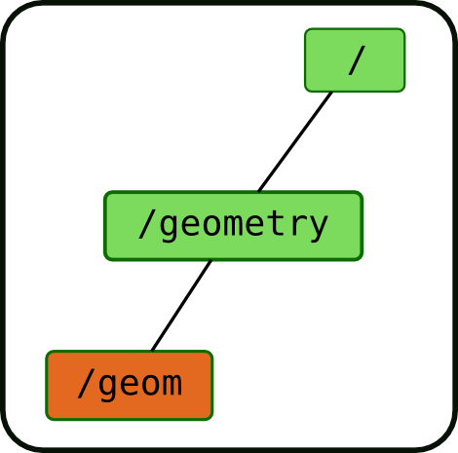
The tree in details - geometry
geometry leaf: NeuroML rep of the model

Slide 14
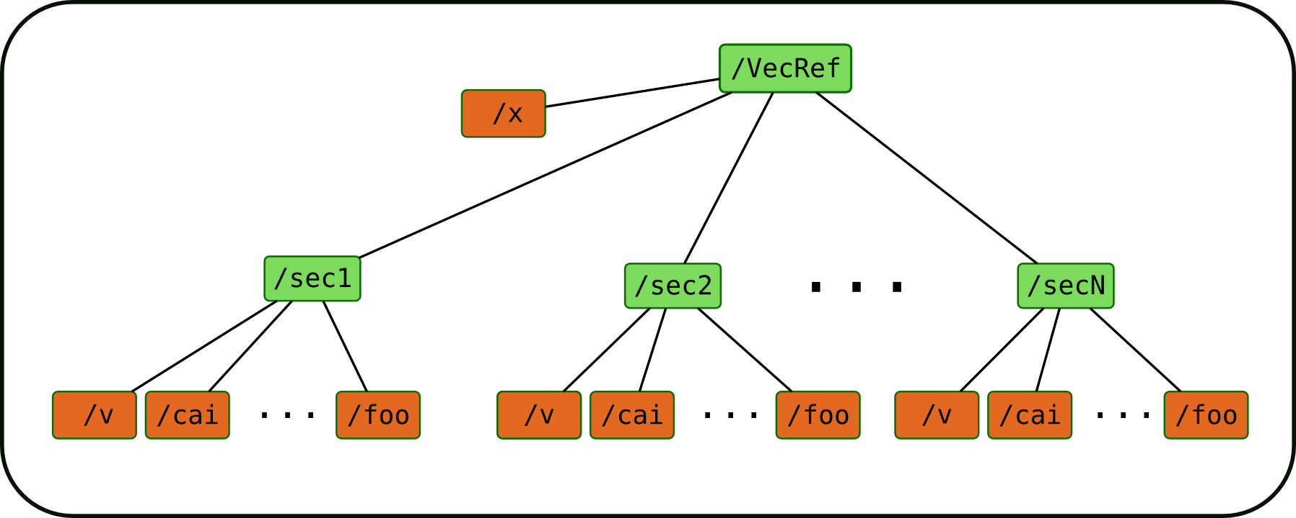
The tree in details -- vecRef
Final leaf is an array with computed data.
Every variable has its own array, with the name
Every GenericRef has an indipendent var

Slide 15
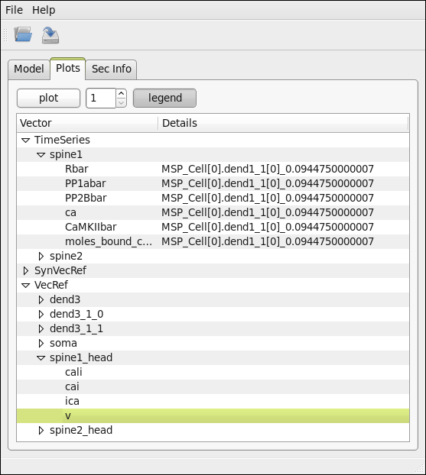
Loaded the results of a simulation.

Slide 16
Second area to tackle
Computed Results
Simulations Details
Neuronvisio

Slide 17
Simulations details:
Model specific:
Parameters used/ Initial conditions
Stimulations applied: where, when, how?
Which kind of geometry?
...
Code specific:
which version of the software did I use?
which dependencies have I used?
...
Simulation specific:
Reason: why we ran it?
Outcome: how did it go?
...

Slide 18

http://neuralensemble.org/trac/sumatra
Slide from Andrew Davison (main developer),
http://neuralensemble.org/meetings/talks/CodeJam3_Davison_Sumatra.pdf

Slide 19



Adding git to smt supported vcs
Code under version control
  Accepted version control:
    Mercurial (hg)
    Subversion (svn)
    Git (git) (I patched it! Power of the opensource..)
Scripts organized as Main class and parameter_file

Slide 20
How to run the simulation with Sumatra
smt run ­­simulator=python ­­main=main.py default.param
After Configuration
smt run default.param

Slide 21
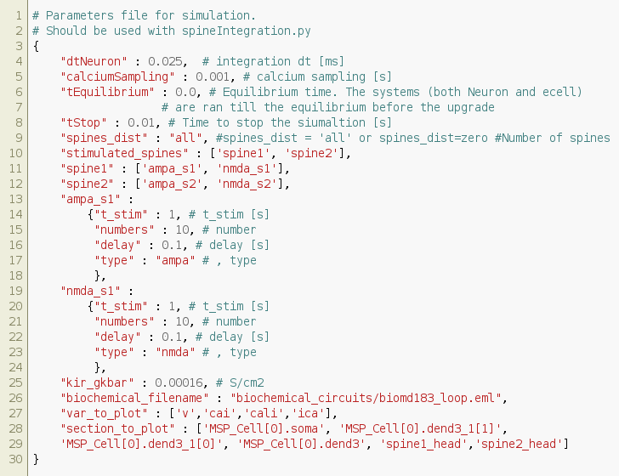
A part of my param file

Slide 22
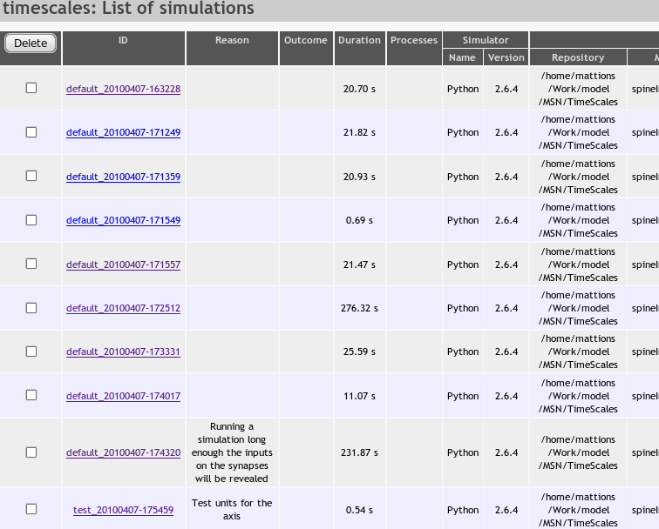
Sumatra web interface

Slide 23
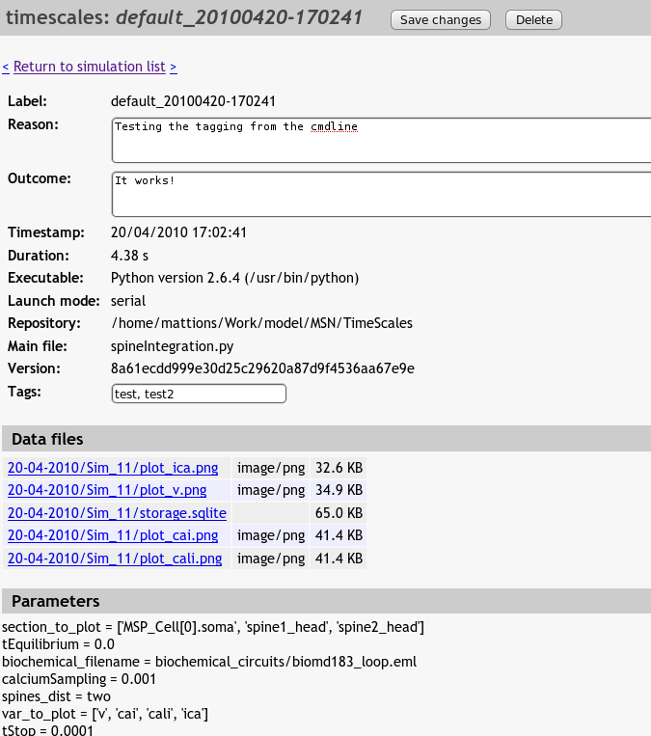
Retrieving the simulation details

Slide 24
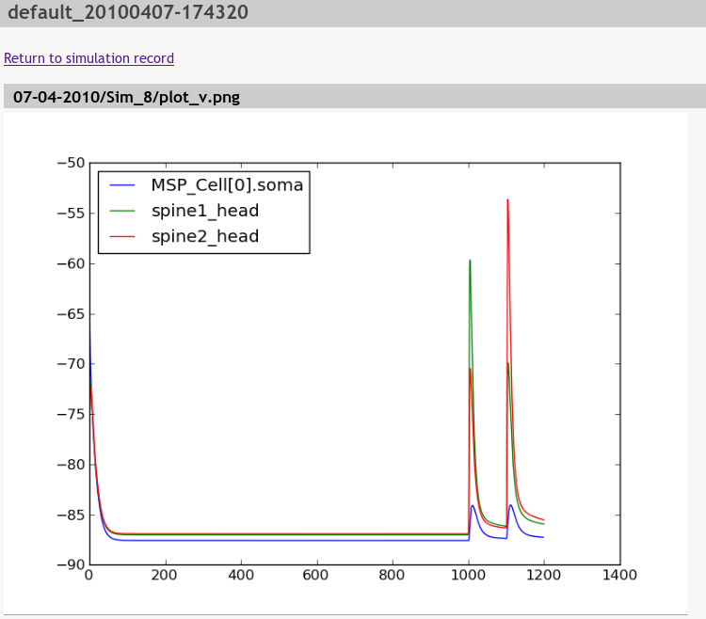
Accessing the plot from the link

Slide 25
Summing up
parameters & deps
automatically tracked
To run the simulation:
smt run default.param
To browse ans search within the simulations
smtweb
To load them in Neuronvisio:
run nrnvisio Data/DD-MM-YYYY/Sim_N
everything is
archived and
searchable
all the data are
accessible: further
analysis/modifying
the plot/explore
something else

Slide 26
Acknowledgement
Nicolas Le Novère
The Computational Systems Neurobiology group @EBI
Gael Varoquaux
Andrew Davison
CodeJam4 organizers

Slide 27
The end
Computed Results
Simulations Details
Neuronvisio
Sumatra
Thanks.

