Slide 1
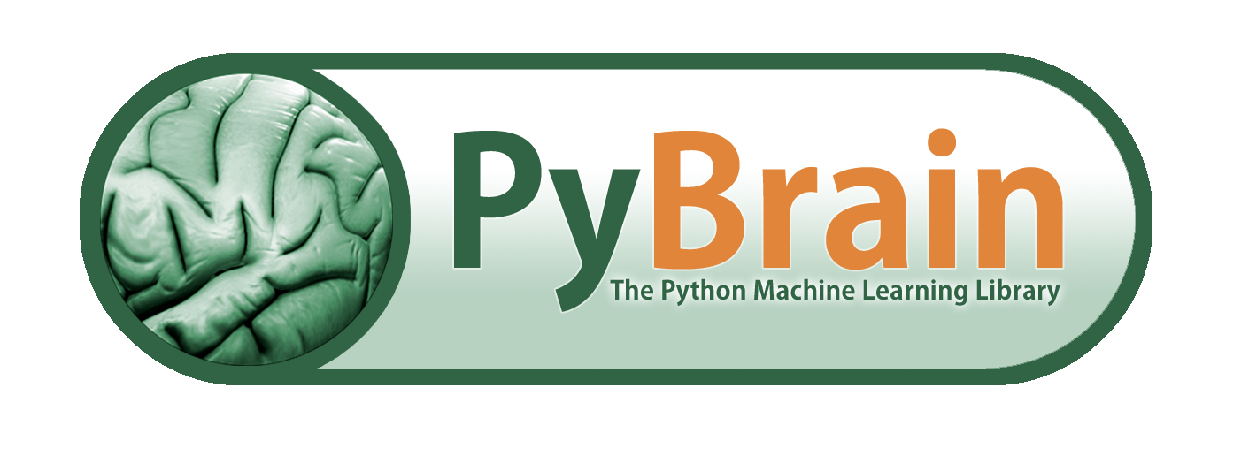
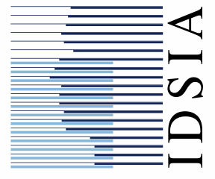
A machine learning perspective on neural networks and learning tools
Tom Schaul

Slide 2
Overview
PyBrain: training artificial neural networks for classification, (sequence) prediction and control
Neural networks
Modular structure
Available architectures
Training
Supervised learning
Optimization
Reinforcement learning (RL)

Slide 3
Disclaimer
Only version 0.3, you may encounter
inconsistencies
bugs
undocumented “features”
But growing
10+ contributors
100+ followers (github, mailing list)
1000+ downloads

Slide 4
(Our) Neural Networks
No spikes
Continuous activations
Discrete time steps

Slide 5




Network Structure: Modules
output
output error
Derivatives
derivatives
Module
Parameters
parameters
input
input error

Slide 6
Network Structure: Connections
output
output error
Module
input
input error
output
output error
FullConnection
Module
input
input error
output
output error
Module
input
input error

Slide 7

Network Structure: Graphs, Recurrency, Nesting
Module
Module
Module
Module
Module
Module

Slide 8
Network Components: Modules
Module types
layers of neurons
additive or multiplicative
sigmoidal squashing functions
stochastic outputs
gate units
memory cells (e.g. LSTM cells)
…

Slide 9
Network Components: Connections
Connection
Fully connected or sparse
Time-recurrent
Weight-sharing
may contain parameters
…

Slide 10
Network Architectures
Feed-forward networks, including
Deep Belief Nets
Restricted Boltzmann Machines (RBM)
Recurrent networks, including
Reservoirs (Echo State networks)
Bidirectional networks
Long Short-Term Memory (LSTM) architectures
Multi-Dimensional Recurrent Networks (MDRNN)
Custom-designed topologies

Slide 11
Overview
Neural networks
Modular structure
Available architectures
Training
Supervised learning
Optimization
Reinforcement learning (RL)

Slide 12
Training: Supervised Learning
compare to target
output
output error
derivatives
Backpropagation
Derivatives
gradient update on parameters
Module
Parameters
parameters
input
input error

Slide 13

Training: Black-box Optimization
BlackBoxOptimizer
fitness function based on e.g. MSE, accuracy, rewards
multiple fitness values: multi-objective optimization
update parameters
fitness
Black box
parameters
Parameters

Slide 14
Optimization Algorithms
(Stochastic) Hill-climbing
Particle Swarm Optimization (PSO)
(Natural) Evolution Strategies (ES)
Covariance Matrix Adaptation (CMA)
Genetic Algorithms (GA)
Co-evolution
Multi-Objective Optimization (NSGA-II)
…

Slide 15
Training: Reinforcement Learning
Environment
action
state
Task
Environment
Experiment
action
reward
observation
Agent

Slide 16


RL: Agents, Learners, Exploration
action
reward
observation
Explorer
Module
DataSet
Learner
LearningAgent

Slide 17
RL: Learning Algorithms and Exploration
Value-based RL
Q-Learning, SARSA
Fitted-Q Iteration
Policy Gradient RL
REINFORCE
Natural Actor-Critic
Exploration methods
Epsilon-Greedy
Boltzmann
State-Dependent Exploration

Slide 18
RL: Environments and Tasks
2D Mazes (MDP / POMDP)
Pole balancing
3D environments (ODE, FlexCube)
Board games (e.g. Atari-Go, Pente)

Slide 19
Also in PyBrain
Unsupervised learning and preprocessing
Support Vector Machines (through LIBSVM)
Tools
Plotting / Visualization
netCDF support
XML read/write support
arac: fast C version

Slide 20
References
Source download, documentation
www.pybrain.org
Mailing list (200+ members)
groups.google.com/group/pybrain
Feature requests
github.com/pybrain/pybrain/issues
Citation T. Schaul, J. Bayer, D. Wierstra, Y. Sun, M. Felder, F. Sehnke, T. Rückstieß and J. Schmidhuber. PyBrain. Journal of Machine Learning Research, 2010.

Slide 21
Acknowledgements
Justin Bayer
Martin Felder
Thomas Rückstiess
Frank Sehnke
Daan Wierstra
and many more who contributed code, suggestions, bug fixes …
… and you for your attention!

