Slide 1
HBP Brain Simulation Platform Validation Automation
HBP CodeJam #7

Slide 2
Goals
Integrate and build tools to support easier and automated validation of models
Simplify sharing results of validations
Build open community where scientists can contribute validations

Slide 3
DATA
CODE
models
Reference data
Task
extract data
Validation toolkit
report

Slide 4
An example
https://bbp.epfl.ch/nmc-portal/anatomical-circuit-properties

Slide 5
Validation Driven Refinement
Like TDD but for Models:
The validations make transparent the properties of your model.
Continuous Refinement system, get a more iterative approach and identify quickly regressions

Slide 6
Provenance
We need to have a convenient way to retrieve provenance of the reference dataset (SP5 integration)
We need to be able to retrieve the circuit and code used by the validation.

Slide 7
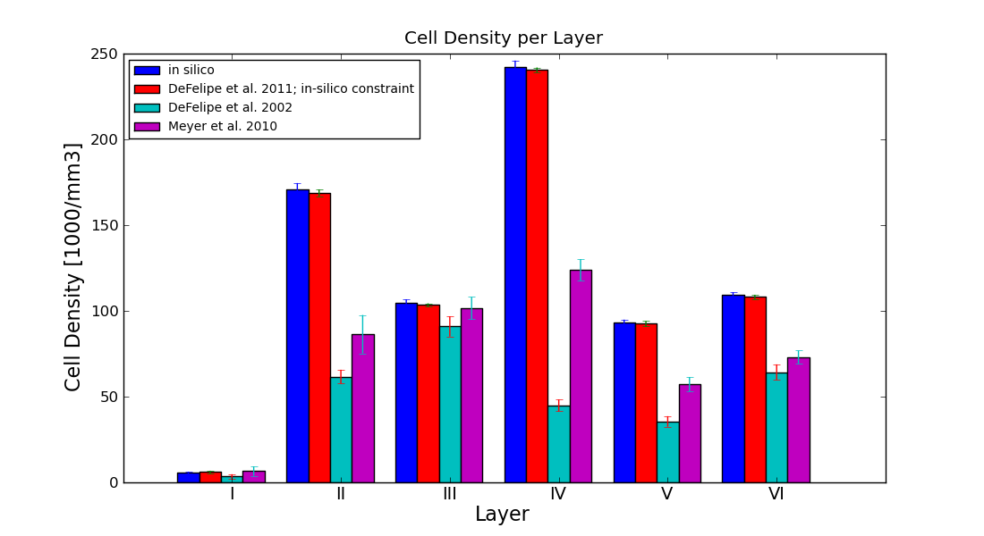
Data quality

Slide 8

Community
Validations can be re-run by other researchers
Others can contribute to the library of validations
Lower the entry barrier by providing a validation development environment
Sciunit/NeuronUnit
Collaboratory integration

Slide 9
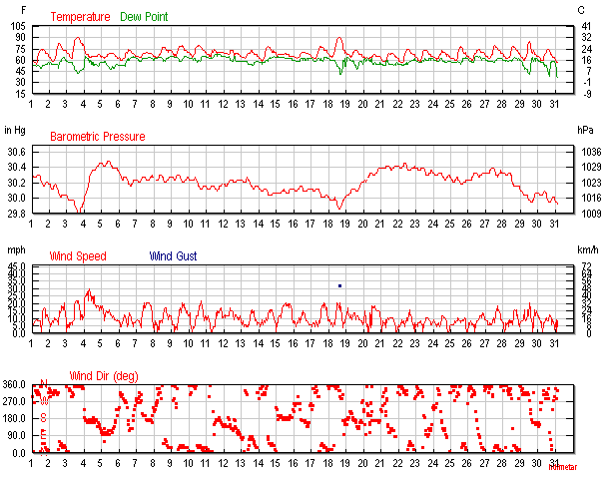
Reporting
Evaluate model evolution over time
Models can be finicky

Slide 10
Reporting
Compare concurrent models or variation of the models
Assess impact of simplification
has to to seamlessly run on simplified models
Help to bridge the community

Slide 11
Status
Validation suite can be run through a web service upon registration of the circuit.
We have integrated 7 of the validations written by scientists
Once run, validation results displayed along with relevant model in the collaboratory
Notes:
Add a slide about NI and bad data , trusted data.
Ontology enabled data query (data is not hardcoded) Cell densities barrel, vision,
Difficult manage how you trust the data. , history, deprecation.
==========================================
Sometimes it needs to run a simulation for a validation.
==========================================

Slide 12
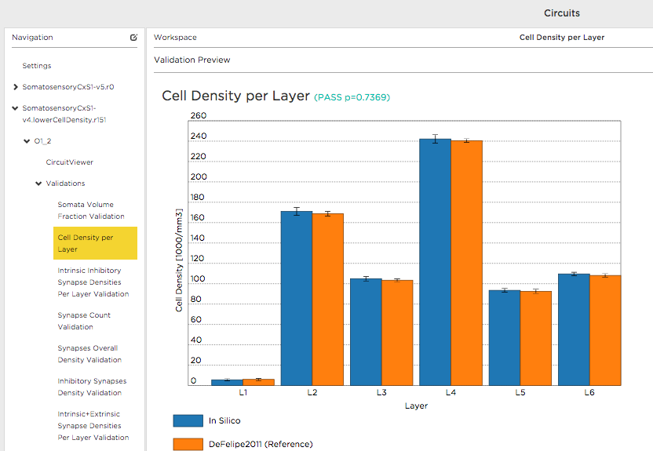
Demo
https://collab.humanbrainproject.eu/#/collab/172/nav/1231

Slide 13
Test suite for hippocampus
The need for a hippocampus community test suite was raised during during the HBP Hippocamp CA1.
Sára Sáray a master student of Szabolcs Káli implemented a first suite of tests for CA1 pyramidal cells using the neuronunit framework.
https://github.com/BlueBrain/neuronunit

Slide 14
Test suite for hippocampus
Test somatic features (A), sodium block (B) and nonlinear EPSP summation at oblique dendrites (C) for 5 published pyramidal cell models.

Slide 15
Next
Better integration with NeuroInformatic platform
Query dataset
Registration integrated into NI platform
Integration of neurounit suite
Better reporting capabilities
Validation development environment

