Slide 1
Fluent Validation

Slide 2
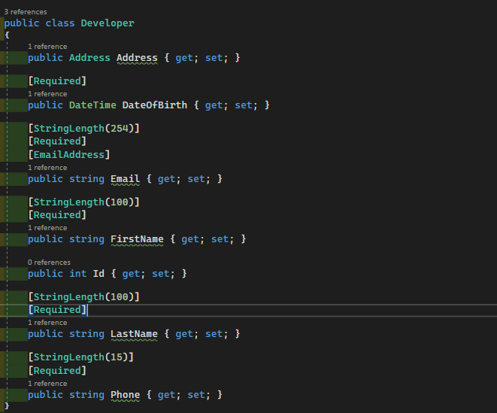
How do we validate models now?
Decorate models with data annotations
Write custom methods in the model class to perform complex validations

Slide 3
The problem with DataAnnotations
Validation rules are tightly coupled with models
Add complexity to Models/DTOs
Difficult to make dynamic and conditional validations
Difficult to extend and scale
Can’t validate classes that we don’t have access to
Difficult to unit test - will not recurse through validations on complex properties

Slide 4
Introducing Fluent Validation
Fluent Validation is a validation library for .NET, used for building strongly typed validation rules for business objects
Fluent validation is one way of setting up dedicated validator objects, that you would use when you want to treat validation logic as separate from business logic
Fluent validations use Fluent interface and lambda expressions to build validation rules
Makes validations clean and easy to both create and maintain

Slide 5
Advantages of Fluent Validation
Speed of development
Decoupling validation rules and models
Speed of execution
Ability to work with odd relationships and dependent entities.
Efficient unit testing
Broad 3rd Party Support
Notes:
Speed of development- It is easy to work with.
Decoupling validation rules and models- Fluent Validation allows you to separate validation rules from your model and helps you structure the rules so that they are nice and readable.
Speed of execution- The rules are immutable objects meaning you can create them once and cache them. When the rules are part of the model, you’re needlessly setting them up every time. This is not a problem when working with one simple entity, but quickly becomes a performance problem when you’re working with multiple complex validators over thousands of rows.
Ability to work with odd relationships and dependent entities. Many of the entities we work with have dependencies on other things in the system, even though they’re not ‘formally’ related. With fluent validation, we could write validators that handle this easily.
Efficient unit testing- Validation rules are easy to test.
Broad 3rd Party Support – libraries exist that can integrate Fluent Validation with Swagger/Swashbuckle and Angular, for example.

Slide 6
How to do set up Fluent Validation

Slide 7
Installation
Install FluentValidation:
PM> Install-Package FluentValidation.AspNetCore
If you’re using Swashbuckle, also install:
PM> Install-Package MicroElements.Swashbuckle.FluentValidation

Slide 8
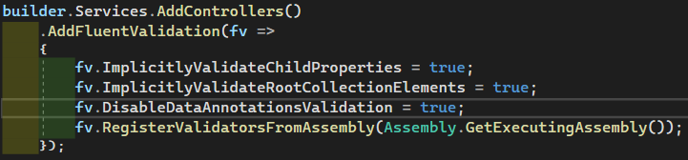

Configuration
In your program.cs (.Net 6) or ConfigureServices() of your startup.cs (Pre .Net 6):
If you’re using Swashbuckle also add this to Services.AddSwaggerGen():

Slide 9
Inject Validations
Register your validators with your service provider in your program.cs (.net 6) or startup.cs (pre .net 6):

Slide 10
Add Validators
To define a set of validation rules for a particular object, you will need to create a class that inherits from AbstractValidator<T>, where T is the type of class that you wish to validate.
To specify a validation rule for a particular property, call the RuleFor method, passing a lambda expression that indicates the property that you wish to validate.
Comprehensive list of built-in validators can be found in the Built-in Validators — FluentValidation documentation
Custom validators can also be built: Custom Validators — FluentValidation documentation
Notes:
Usage: You don’t need to explicitly check the ModelState in controllers to see if the input is valid. The FluentValidation ASP.NET middleware will automatically find our validator, and if validation fails it will prepare the ModelState and our action will return a 400 response.

Slide 11
Using Validators
You don’t need to explicitly check the ModelState in controllers to see if the input is valid. The FluentValidation ASP.NET middleware will automatically find our validator, and if validation fails it will prepare the ModelState and our action will return a 400 response.
You can also explicitly validate the models anywhere. The Validate method returns a ValidationResult object. This contains two properties:
IsValid - a boolean that says whether the validation succeeded.
Errors - a collection of ValidationFailure objects containing details about any validation failures.

Slide 12
See demo app for examples

