Slide 1
● GOLDENEYE CAPSTONE 2 · YOLOv8n · best.onnx
HTU · SPRING 2025 / 2026
◆ CAPSTONE PROJECT 2 · ALHUSSEIN TECHNICAL UNIVERSITY
GOLDENEYE
Find. Confirm. Save.
An AI-based aerial human-detection system that assists search and rescue in desert environments — built around a lightweight YOLOv8n detector.
BACHELOR OF SCIENCE
DATA SCIENCE & ARTIFICIAL INTELLIGENCE
YOLOv8n
Aerial · drone-view
Single class · human
Edge-ready
AUTHORS
Hamza Jad Allah · Suhaib Alajami · Omar Malkawi
SUPERVISOR
Dr. Rami Al-Ouran
GOLDENEYE · CAPSTONE 2
01 / 19

Slide 2
● 01 · THE PROBLEM
02 / 19
◆ SEARCH AND RESCUE IN THE DESERT
On the ground, the desert is
slow, costly, and hard to search.
Ground missions in remote desert areas are limited by four factors — the same four a camera in the air can cut through.
01
02
03
04
Terrain
Visibility
Area size
Communications
Dunes and rough ground slow teams and block line of sight.
Low contrast — people blend into sand-coloured backgrounds.
Huge open areas take far too long to sweep on foot.
Signal is often weak or non-existent in the field.
GOLDENEYE · THE PROBLEM
02 / 19

Slide 3
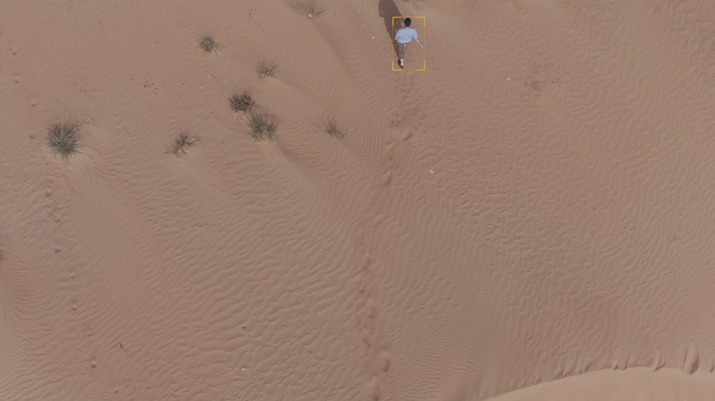
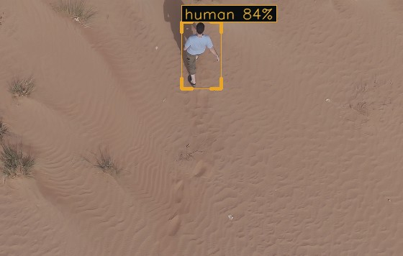
● 01 · THE PROBLEM
03 / 19 · A REAL TEST FRAME
◆ ONE PERSON, A WHOLE DUNE FIELD
Find the person. Now do it 1,000 times.
Zoomed in
human 84%
The target is a handful of pixels in a 4K frame. A spotter tires; a detector scans every frame the same way — exactly the problem GoldenEye solves.
Real 4K test frame (3840×2160) · GoldenEye output
1 human · 84% · ~20 m
GOLDENEYE · THE NEEDLE IN A HAYSTACK
03 / 19

Slide 4
● 02 · THE IDEA
04 / 19
◆ THE GOLDENEYE IDEA
Let a drone scan the desert, and
point teams to likely targets.
GoldenEye reads a drone-view image, finds each person, and draws a box with a confidence score — an intelligent support tool for the operator, not a replacement.
→
→
→
Aerial image
GoldenEye
Detections
Operator
drone-view
YOLOv8n
box + confidence
faster decision
GOLDENEYE · THE IDEA
04 / 19

Slide 5
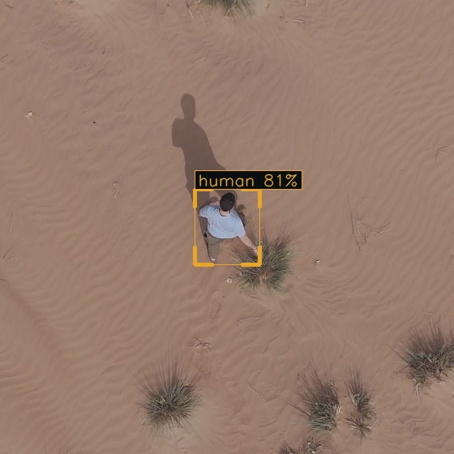
● 02 · THE SYSTEM
05 / 19 · WHAT IT DOES
◆ CAPABILITIES
It finds people from the air —
and shows where and how sure.
Detects humans in aerial desert imagery
Top-down and high-oblique drone views
A bounding box around every detection
A confidence score for each box
One target class — human
Real detection · test set
human 81% · ~20 m
GOLDENEYE · WHAT IT DOES

Slide 6
● 03 · IMPLEMENTATION
06 / 19 · HOW WE BUILT IT
◆ A STRUCTURED, STEP-BY-STEP BUILD
From problem to a deployable model,
one stage at a time.
1
2
3
4
5
6
7
8
9
Define
Dataset
Select
Fine-tune
Validate
Test
Build app
Edge prep
Document
requirements
YOLO format
YOLOv8n
100 epochs
best weights
unseen set
inference
Pi 5 + AI
report
Stages 1–3 · Scope & data
Stages 4–6 · Train, validate, test
Stages 7–9 · Product & deploy
GOLDENEYE · IMPLEMENTATION STAGES
06 / 19

Slide 7
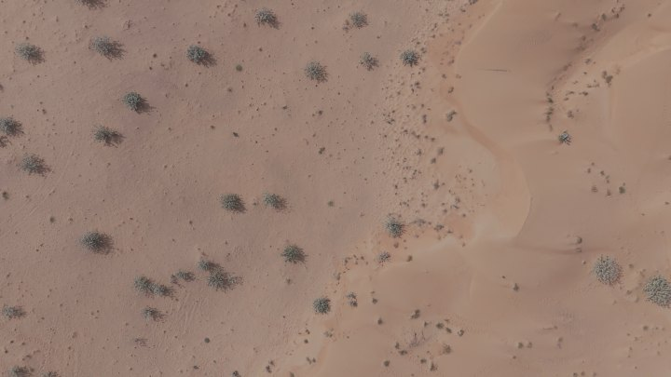
● 03 · DATASET
07 / 19 · THE DATA
◆ A PRIVATE DESERT DATASET
Aerial desert imagery,
labelled in YOLO format.
The fine-tuning data is a private SAR dataset from the Shaheen project, built for Middle-Eastern desert conditions — varied appearance, clothing, poses, and backgrounds.
One label file per image · class human
Split into train / validation / test
Includes background images with no people
Example frame · aerial desert terrain
3840×2160
◆ TRAIN / VALIDATION / TEST SPLIT
688
763
343
■ train 4,939 ■ validation 706 ■ test 1,411
Humans
Background
Humans
test set
no people
validation
GOLDENEYE · DATASET
07 / 19

Slide 8
● 03 · MODEL
08 / 19 · WHY YOLOv8n
◆ THE RIGHT MODEL FOR THE EDGE
YOLOv8n — accuracy, speed,
and size in balance.
We compared YOLO sizes on a baseline SAR dataset. The nano model won: it detects small targets well while staying light enough for edge hardware.
3.0M
8.1
73
1
Parameters
GFLOPs
Layers
Class
3,005,843
at 640×640
YOLOv8n
human
Bigger models score marginally higher but cost far more compute — unsuitable for a battery-powered field device. Nano keeps inference fast and the footprint tiny.
GOLDENEYE · MODEL
08 / 19

Slide 9
● 03 · TRAINING
09 / 19 · HOW WE TRAINED IT
◆ FINE-TUNING CONFIGURATION
Fine-tuned for the desert,
with augmentation for robustness.
◆ TRAINING CONFIGURATION
◆ DATA AUGMENTATION
Epochs
100
Colour, scale, and translation changes · horizontal flip · mosaic · mixup.
Image size
640
Batch size
16
Optimizer
AdamW
Initial LR
0.001
Weight decay
0.0005
Why it matters — augmentation teaches the model to handle different desert lighting, human positions, and scales, so it generalises beyond the exact training frames.
Patience
20
Framework
Ultralytics YOLO
Environment
Tesla T4 GPU
GOLDENEYE · TRAINING
09 / 19

Slide 10
● 04 · RESULTS
10 / 19 · FINAL TEST EVALUATION
◆ ON THE UNSEEN TEST SET · 1,411 IMAGES
0.979 mAP@0.5, 0.985 recall.
0.975
0.985
0.979
0.980
Precision
Recall
mAP@0.5
F1 score
test set
test set
test set
test set
Recall is the metric that matters most here — in search and rescue, missing a person is far worse than a false alarm. At 0.985, the model finds nearly everyone.
GOLDENEYE · RESULTS
10 / 19

Slide 11
● 04 · RESULTS
11 / 19 · DOES IT GENERALISE?
◆ VALIDATION VS. TEST
A tiny gap means it
didn't just memorise.
◆ VALIDATION VS. TEST SCORES
◆ VALIDATION
1.0
P 0.988 · R 0.990 · mAP 0.994 · 706 imgs
0.9
◆ TEST
P 0.975 · R 0.985 · mAP 0.979 · 1,411 imgs
0.8
The drop is only ~1–2 points — strong evidence the model transfers to unseen desert images.
0.7
Precision
Recall
mAP@0.5
■ validation ■ test
GOLDENEYE · GENERALISATION
11 / 19

Slide 12
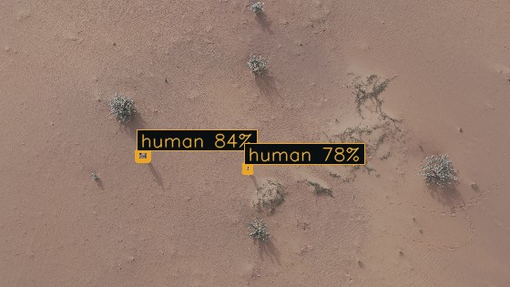
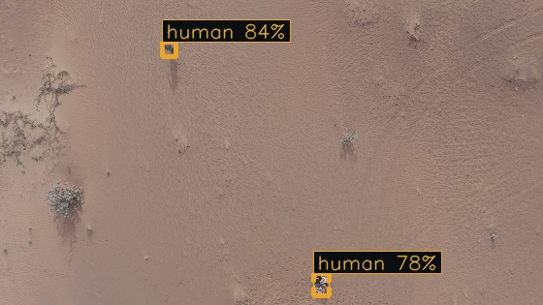
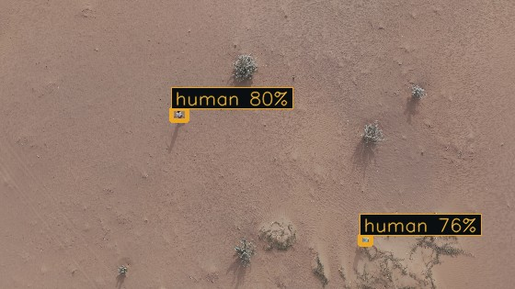
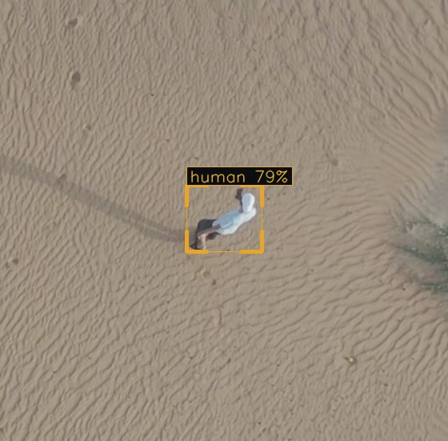
● 04 · RESULTS
12 / 19 · IT WORKS — REAL DETECTIONS
◆ MODEL OUTPUT ON HELD-OUT TEST IMAGES
Real detections, across altitudes.
Two people · among vegetation
~30 m · 84%/78%
Two people · spaced apart
~30 m · 84%
Two people · open sand
~30 m · 80%
Single person · higher up
~35 m · 79%
GOLDENEYE · REAL DETECTIONS
12 / 19

Slide 13
● 04 · RESULTS
13 / 19 · NOT CRYING WOLF
◆ BACKGROUND IMAGE · NO PEOPLE PRESENT
On an empty desert, it stays quiet.
The test set includes 763 background images with no people.
On this frame — bushes, dunes, shadows, but no human — the model draws nothing. That restraint keeps precision at 0.975: few false alarms, so operators keep trusting the alerts.
NO FALSE POSITIVES HERE
Real background test frame · model output
0 detections ✓
GOLDENEYE · PRECISION CHECK
13 / 19

Slide 14
● 04 · RESULTS
14 / 19 · THE HONEST PART
◆ MAP@0.5 VS. MAP@0.5–95
It finds people reliably;
the box isn't always pixel-perfect.
0.979
0.626
Why the gap?
Aerial people are only a handful of pixels. Detection (is someone there?) is easy; tight box alignment under strict overlap thresholds is hard — a known small-object effect.
mAP@0.5
mAP@0.5–95
loose box match
strict box match
Truth (green) vs prediction (amber): on a tiny target, a few pixels of shift cost a lot of overlap (IoU).
For SAR this is acceptable: knowing where to look matters more than a perfect box.
small shift
GOLDENEYE · LOCALISATION
14 / 19

Slide 15
● 05 · APPLICATION
15 / 19 · THE WORKING APP
◆ FROM A NOTEBOOK TO A USABLE TOOL
One inference pipeline,
three ways to use it.
◆ INFERENCE WORKFLOW
→
→
→
→
Frame in
Preprocess
YOLOv8n
Filter + NMS
Draw + show
image/video/live
resize · normalise
ONNX Runtime
drop weak/dup
box + confidence
MODE 01
MODE 02
MODE 03
Image
Video
Live
Upload one image; get an annotated result with boxes and scores.
Upload a video; every frame becomes an annotated MP4 + a detection CSV.
Stream a camera or screen share; detections appear in real time.
GOLDENEYE · APPLICATION
15 / 19

Slide 16
● 05 · APPLICATION
16 / 19 · SPEED
◆ LOW LATENCY, NEAR REAL-TIME
A frame in and out in
under 4 milliseconds.
0.6
2.7
0.5
3.8
Preprocess
Inference
Postprocess
Total
ms / image
ms / image
ms / image
ms / image
Measured on a Tesla T4 GPU — this is GPU-side speed, not a Raspberry Pi figure. It confirms the model is light enough for real-time workflows.
GOLDENEYE · SPEED
16 / 19

Slide 17
● 05 · EDGE DEPLOYMENT
17 / 19 · DESIGNED FOR THE FIELD
◆ CLOSER TO THE DRONE CAMERA
Built to run on a
Raspberry Pi 5 with AI acceleration.
◆ INTENDED EDGE PATH
→
→
Drone camera
Pi 5 + AI accel
Detection
aerial RGB
on-board inference
box · score · alert
~3M parameters — light enough for embedded hardware
Reported honestly — all measured results were obtained on a Tesla T4 GPU. On-device Raspberry Pi benchmarking (FPS, latency, power, temperature) is planned future work, not yet measured.
Detection near the camera, no cloud needed
Output: alert · screenshot · optional GPS log
GOLDENEYE · EDGE DEPLOYMENT
17 / 19

Slide 18
● 06 · REFLECTION
18 / 19 · LIMITATIONS & FUTURE WORK
◆ HONEST ABOUT WHAT'S LEFT
What's still hard,
and where it goes next.
LIMITATIONS
CURRENT
FUTURE WORK
NEXT
▸
Box localisation — tight alignment drops at strict IoU (0.626).
▸
Larger input sizes (960 / 1280) for small-object detection.
▸
Small objects — people can be only a few pixels from high altitude.
▸
More desert data across regions, altitudes, and lighting.
▸
Domain dependence — one desert dataset; other regions untested.
▸
Raspberry Pi benchmark — FPS, latency, power, temperature.
▸
No embedded benchmark yet — only GPU results so far.
▸
GPS logging per detection and a clearer operator interface.
GOLDENEYE · LIMITATIONS & FUTURE WORK
18 / 19

Slide 19
● ACTIVE CAPSTONE 2 · OPEN FOR QUESTIONS
YOLOv8n · mAP@0.5 0.979
Thank you.
We're glad to take questions — on the dataset, the model, the results, or the path to edge deployment.
Omar Malkawi
Suhaib Alajami
Hamza Jad Allah
Supervisor · Dr. Rami Al-Ouran
Acknowledgement — the private desert dataset used for fine-tuning was obtained from the Shaheen project. Their contribution is gratefully acknowledged.
GOLDENEYE · THANK YOU
19 / 19

