Slide 1
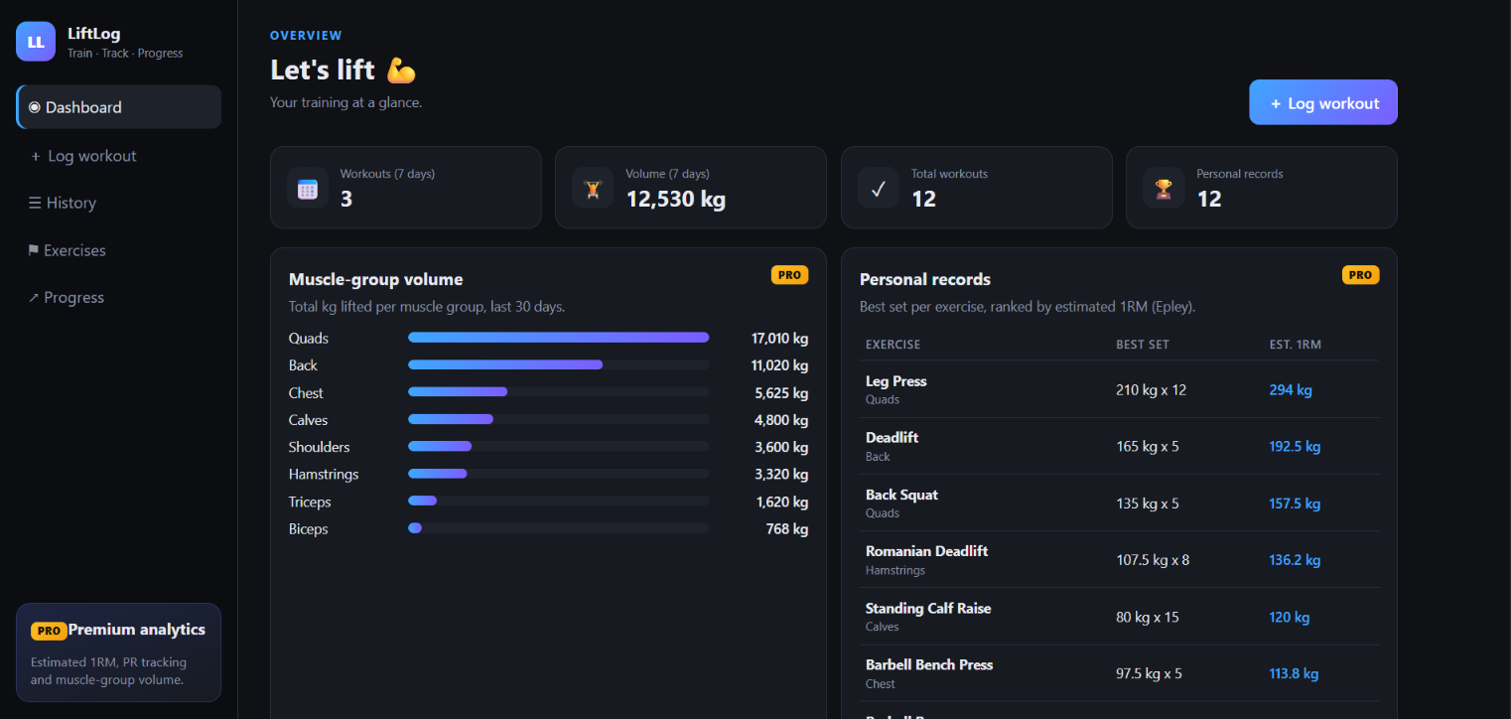
LiftLog
DEVOPS CAPSTONE · SESSION 21
A strength-training tracker, built, secured and shipped with GitOps on Amazon EKS
Live on EKS behind an AWS Application Load Balancer
Shreyas S · October 2026
Notes:
Hi, I'm Shreyas. This is LiftLog, my DevOps capstone: a workout tracker that I built, containerised, scanned, deployed to Amazon EKS with Terraform, Helm and Argo CD, and monitored with Prometheus and Grafana. I'll walk through what it does, the architecture, the pipeline, the infrastructure, and what I learned.

Slide 2






What LiftLog does
11
Exercise library
Workout logging
21 seeded exercises by muscle group
Sets with weight, reps and RPE
REST endpoints
14
History
Personal records
Every session with volume per workout
Best set ranked by estimated 1RM
automated tests
3
Volume analytics
Progress charts
Weekly totals and muscle-group split
Estimated 1RM over time per lift
PRO analytics views
Notes:
LiftLog lets you build an exercise library, log workouts set by set, and see premium-style analytics: personal records ranked by estimated one-rep max using the Epley formula, weekly and muscle-group volume, and progress charts per lift. The backend exposes 11 REST endpoints and is covered by 14 automated tests.

Slide 3








Tech stack
Frontend
Backend
Database
Containers
React 19 · Vite 8 · nginx (non-root)
Python 3.12 · FastAPI · SQLAlchemy · Alembic
PostgreSQL 16 on a gp3 EBS volume
Docker multi-stage · Compose
CI/CD
Infrastructure
Kubernetes
Observability
GitHub Actions · GHCR · Trivy
Terraform · AWS VPC · EKS 1.36
Helm · ALB Ingress · HPA · Argo CD
Prometheus · Grafana · ServiceMonitor
Notes:
The stack: a React and Vite frontend served by an unprivileged nginx, a FastAPI backend with SQLAlchemy and Alembic migrations, and PostgreSQL. Everything ships as Docker images built in GitHub Actions, scanned by Trivy and pushed to GitHub Container Registry. Terraform builds the AWS VPC and EKS cluster, Helm and Argo CD deploy the app, and Prometheus and Grafana monitor it.

Slide 4
Architecture
Amazon EKS · VPC 10.20.0.0/16 · ap-southeast-2
Browser
LiftLog UI
ALB Ingress
/ web · /api api
frontend ×2
React · nginx
backend ×2
FastAPI · HPA 2–6
PostgreSQL
gp3 EBS volume
deploy
scrape /metrics
Argo CD
GitOps sync
Prometheus
+ Grafana
pull
pull
Developer
git push
GitHub Actions
test · build · Trivy
Git repo
values-eks.yaml
GHCR
images :commit-sha
push images
Notes:
Users reach the app through an AWS Application Load Balancer created from the Kubernetes Ingress: slash goes to the frontend, slash-api to the FastAPI backend, which stores data in PostgreSQL on an EBS volume. Prometheus scrapes the backend's metrics endpoint. On the delivery side, a push triggers GitHub Actions, which tests, builds and scans the images, pushes them to GHCR tagged with the commit SHA, and commits that SHA to the Git repo. Argo CD inside the cluster pulls that change and rolls it out, so CI never needs cluster credentials.

Slide 5





CI/CD: from git push to production
1. Push
2. Test
3. Build
4. Trivy gate
5. Publish
6. GitOps
7. Argo CD
git push to main
pytest (14) + frontend build
backend + frontend images
fail on fixable HIGH/CRITICAL
GHCR, tagged :commit-sha
commit the SHA to Git
sync + rolling update
3 jobs
≈ 2 min
0
test → build & scan → GitOps
push to green pipeline
cloud credentials stored in CI
Notes:
Every push to main runs three jobs. First, tests: 14 pytest cases plus the frontend production build. Second, both images are built and scanned with Trivy; any fixable high or critical vulnerability fails the build, and only then are images pushed to GHCR tagged with the commit SHA. Third, a GitOps job commits that SHA into values-eks.yaml. Argo CD sees the commit and performs a rolling update. The whole loop takes about two minutes, and CI holds no AWS credentials at all.

Slide 6
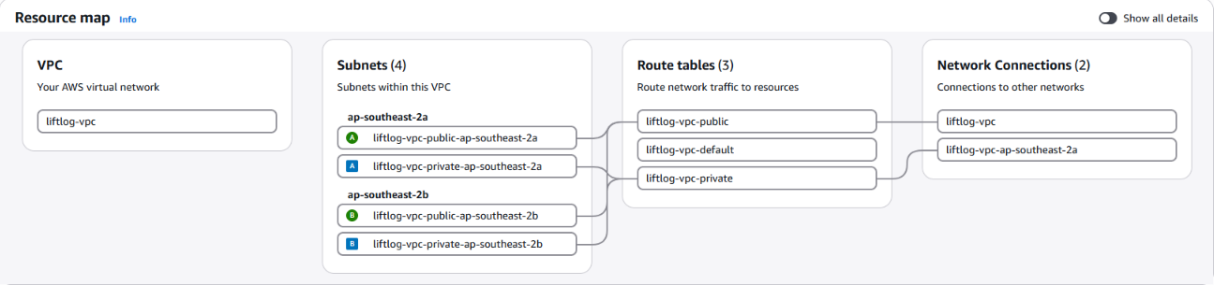
Infrastructure as code with Terraform
64
2 + 2
1.36
2
resources in one plan
public + private subnets
EKS Kubernetes version
m7i-flex.large worker nodes
terraform plan
64 to add
terraform apply
VPC + EKS ≈ 20 min
terraform destroy
64 destroyed, $0 left
liftlog-vpc in the AWS console: subnets, route tables, internet gateway
Notes:
Terraform provisions the whole platform in ap-southeast-2: a VPC with two public and two private subnets across two availability zones, a NAT gateway, and an EKS 1.36 cluster with a managed node group of two m7i-flex.large instances. Add-ons include the EBS CSI driver for the Postgres volume and metrics-server for autoscaling, and pods get AWS permissions through EKS Pod Identity. A single plan creates 64 resources, and destroy removes all of them.

Slide 7
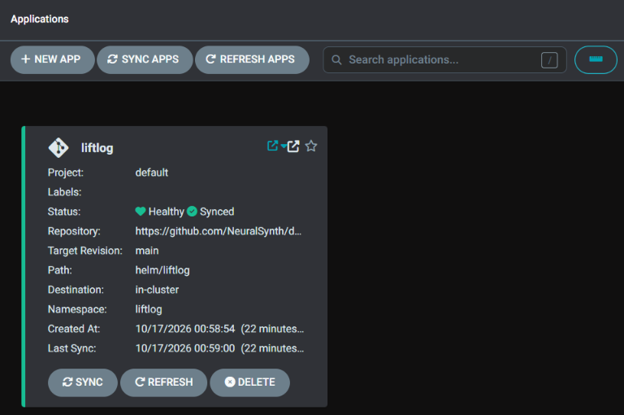



Kubernetes on EKS: Helm + Argo CD
Helm chart
backend + frontend ×2, HPA 2–6, ServiceMonitor
ALB Ingress
/ → frontend, /api → backend
Persistent Postgres
gp3 EBS volume via the EBS CSI driver
Argo CD
auto-sync and self-heal from Git
Argo CD on EKS: liftlog is Healthy and Synced to main
Notes:
The Helm chart deploys two backend and two frontend replicas, with a horizontal pod autoscaler for the backend, Postgres on an EBS volume, ClusterIP services, an ALB Ingress, and a ServiceMonitor for Prometheus. I installed it once with helm upgrade --install, then handed it to Argo CD, which keeps the cluster in sync with Git and self-heals any manual drift.

Slide 8
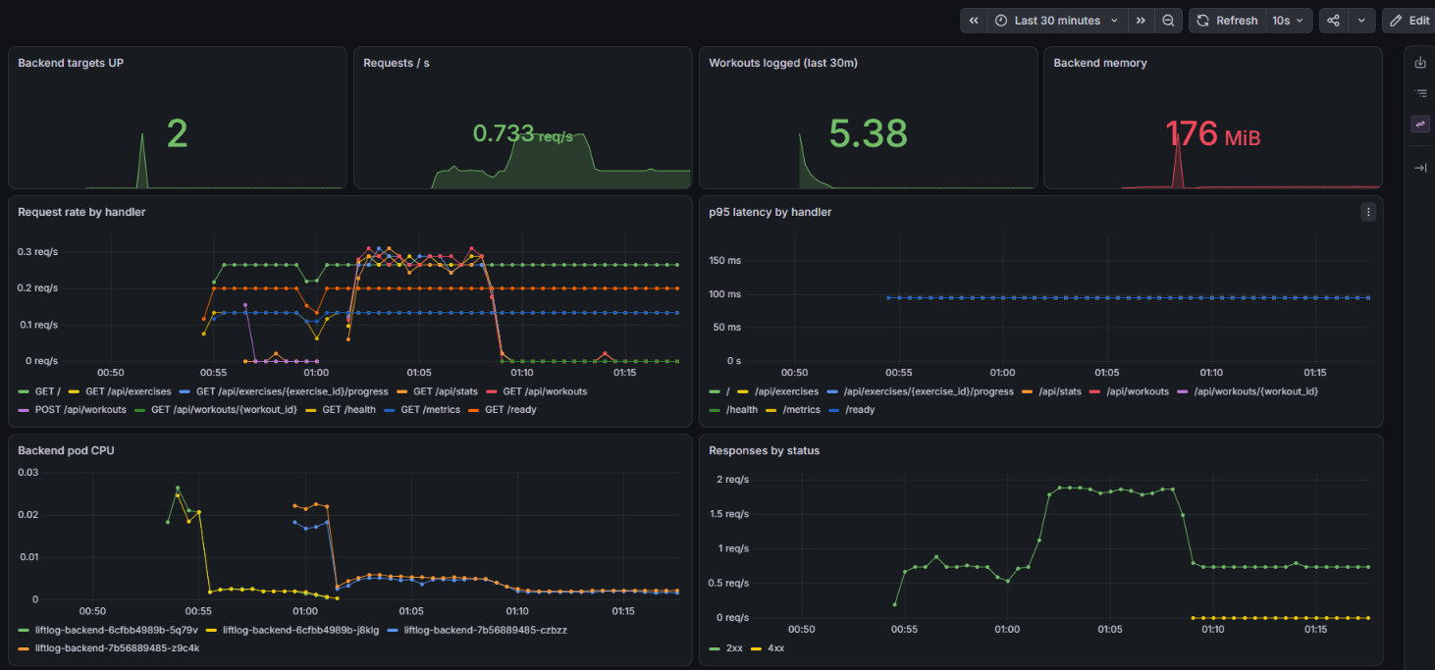
Observability: Prometheus + Grafana
2/2
backend targets UP
8
panels, defined in Git
≈ 95 ms
p95 API latency
Grafana dashboard-as-code: LiftLog API (EKS)
Notes:
The backend exposes Prometheus metrics at slash-metrics. kube-prometheus-stack runs Prometheus and Grafana in the cluster, and the chart's ServiceMonitor scrapes both backend pods every 15 seconds; both targets show UP. The Grafana dashboard is stored in Git as a ConfigMap and shows request rate, p95 latency per endpoint, workouts logged, memory, CPU and responses by status.

Slide 9



DevSecOps: security built into the pipeline
Trivy gate
fixable HIGH/CRITICAL fails the build
Non-root containers
backend uid 10001, frontend uid 101
No long-lived keys
aws login, GITHUB_TOKEN, Pod Identity
Fixed, not ignored
FastAPI/starlette upgrade, new nginx base
Notes:
Security is part of the pipeline. Trivy scans both images and fails the build on any fixable high or critical vulnerability. With the starter versions it found 3 in starlette and 43 in the old nginx base image; I fixed them by upgrading FastAPI and starlette and moving to a current, unprivileged nginx image, so both scans are now clean. Both containers run as non-root users, and there are no long-lived keys anywhere: aws login locally, the built-in GITHUB_TOKEN in CI, and EKS Pod Identity in the cluster.

Slide 10



Key learnings
Respect the guardrails
Versions cost money
Storage has sharp edges
An SCP blocked the IAM OIDC provider, so I moved to EKS Pod Identity.
K8s 1.31 was in extended support at 6× the price; 1.36 is standard.
EBS lost+found broke initdb; PGDATA moved to a subdirectory.
No creds in CI
Fix, don't ignore
Tear down in order
CI writes the image SHA to Git; Argo CD pulls it.
46 fixable CVEs cleared by upgrades, not ignore rules.
Argo CD app, then Helm (ALB, EBS), then terraform destroy.
Notes:
What I learned: managed AWS accounts have guardrails, and a service control policy blocked the IAM OIDC provider, so EKS Pod Identity was the right tool. Kubernetes versions affect cost: 1.31 was in extended support at six times the price. Storage has sharp edges, like the lost+found directory on a fresh EBS volume breaking Postgres initdb. GitOps removes the need for cloud credentials in CI. It's better to fix vulnerable dependencies than ignore them. And tear-down order matters, so nothing is left running outside Terraform.

Slide 11


Thank you
Repository
NeuralSynth/devops-heros-s21-liftlog
Walkthrough video
LiftLog: tested, scanned, shipped with GitOps, and observed on Amazon EKS
youtu.be/2FtC1-wvGKg
Evidence
docs/evidence in the repository
Notes:
Thank you. The repository, the walkthrough video and the full evidence for every grading module are linked here. Happy to take questions.

