Slide 1
RESEARCH PAPER PRESENTATION
Understanding and Steering Internal Safety Features in Large Language Models
Group members
Pollob Das — 0112230824
Avishek Biswas — 0112330531
Syeda Afrin Sultana — 0112330180
Saidur Rahaman Shihab — 0112330711
MD. SIAM AFROZ TANMOY — 0112230123

Slide 2
What is Our Research About?
Large Language Models can generate human-like responses, but they sometimes produce harmful content or fail to resist jailbreak attacks.
Our research focuses on understanding the internal safety features of these models and how they influence model behavior.
Identify important internal features related to safe and unsafe behavior.
Understand their causal role in model responses.
Use activation steering to guide models toward safer outputs while maintaining helpfulness and fluency.

Slide 3
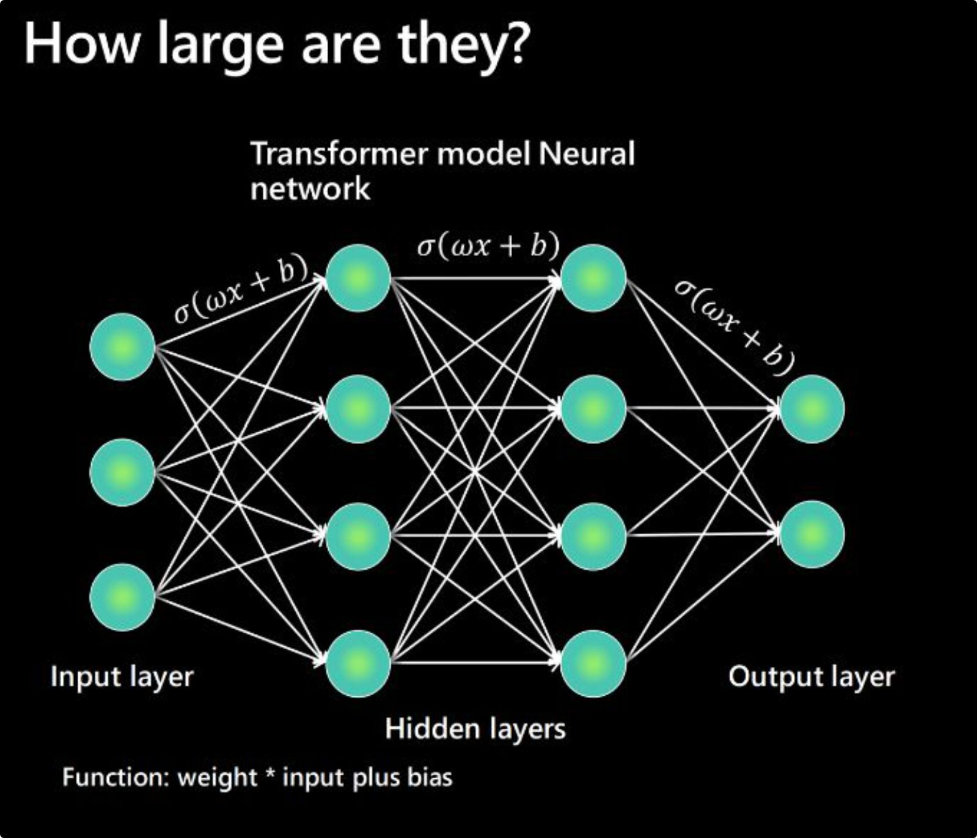
Why Are We Interested in This Research?
LLMs are increasingly used in education, healthcare, business, and everyday life.
They can still generate harmful or misleading responses.
Jailbreak attacks can bypass existing safety mechanisms.
Current safety methods do not always explain why a model produces unsafe responses.
We want to understand what happens inside the model when it generates safe or unsafe responses.

Slide 4
P-Attributes: Complex Problem Solving
P1: In-depth Knowledge — Strong
P2: Conflicting Requirements — Strong
Transformer architecture, linear algebra, causal inference, Sparse Autoencoders, and activation patching.
Balance safety with helpfulness and fluency; stronger steering may reduce response quality.
P3: Depth of Analysis — Strong
P4: Infrequently Encountered Issues — Strong
Design experiments to identify causal features and understand their effects on model behavior.
Feature superposition and overlapping representations are uncommon in traditional engineering problems.

Slide 5
P-Attributes: Standards, Stakeholders, and Interdependence
P5: Outside Codes and Standards — Partial
P6: Diverse Stakeholders — Moderate (Indirect)
P7: Interdependence — Strong
Feature discovery → causal validation → activation steering → safety evaluation → preservation of model capabilities.
NIST AI Risk Management Framework and EU AI Act provide relevant guidance.
Developers, researchers, end users, policymakers, and vulnerable communities may have conflicting needs.

Slide 6
A-Attributes: Complex Engineering Activities
A1: Range of Resources — Diverse
A2: Level of Interaction — High
A3: Innovation — Strong
GPU computing, pretrained language models, research datasets, interpretability tools, supervisory guidance, and project time.
Technical, safety, and ethical issues are closely connected; steering may affect unrelated model behaviors.
Combine causal feature identification and activation steering to investigate and improve internal safety mechanisms.

Slide 7
A-Attributes: Consequences and Familiarity
A4: Consequences to Society and Environment
A5: Familiarity
Requires advanced knowledge of Transformer architecture and internal model representations.
Uses Sparse Autoencoders (SAEs) to identify interpretable features.
Requires causal feature analysis, activation ablation, and interaction discovery.
Investigates complex and less familiar phenomena such as redundant features and the Hydra Effect.
Improving LLM refusal mechanisms can help prevent harmful outputs and strengthen AI safety.
Vulnerable users and society may be affected by unsafe AI-generated content.
Identifying safety-critical features can help developers audit and improve LLM safety.
Misusing feature-ablation techniques may weaken safety mechanisms and enable jailbreak attacks.
Reliable safety interventions are important for responsible AI development.

Slide 8


What Do We Aim to Explore?
Identify Internal Safety Features
Use Sparse Autoencoders (SAEs) to identify internal features associated with safe and unsafe model behavior.
Validate Causal Relationships
Apply causal interventions such as feature ablation to determine how identified features influence refusal and compliance behavior.
Apply Targeted Activation Steering
Modify selected internal feature activations to encourage safe responses and improve resistance against jailbreak attacks.
Expected Research Goal: Improve LLM safety and refusal reliability while preserving helpfulness, fluency, and normal model capabilities.

Slide 9


