Slide 1
R-WRIST-EXT
1

Slide 2
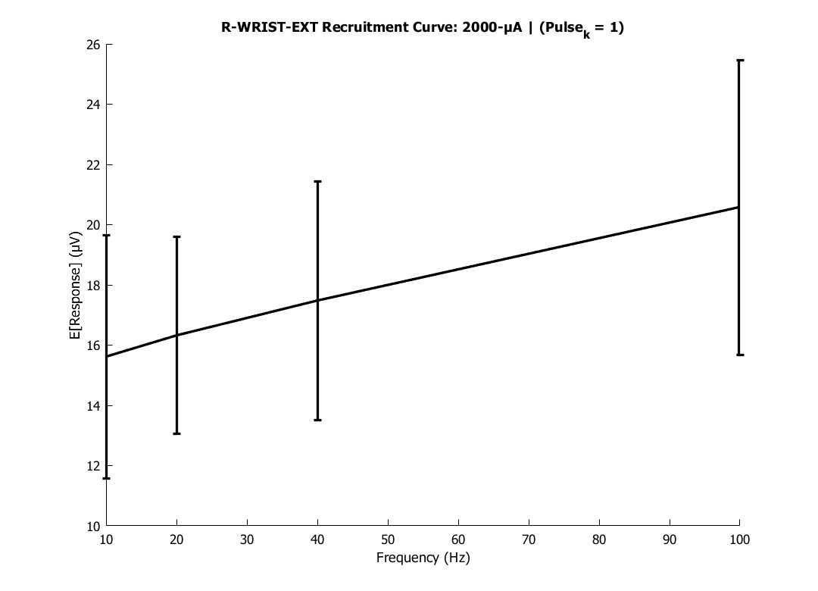
R-WRIST-EXT Recruitment Curve: 2000-μA | (Pulse_k = 1)
2

Slide 3
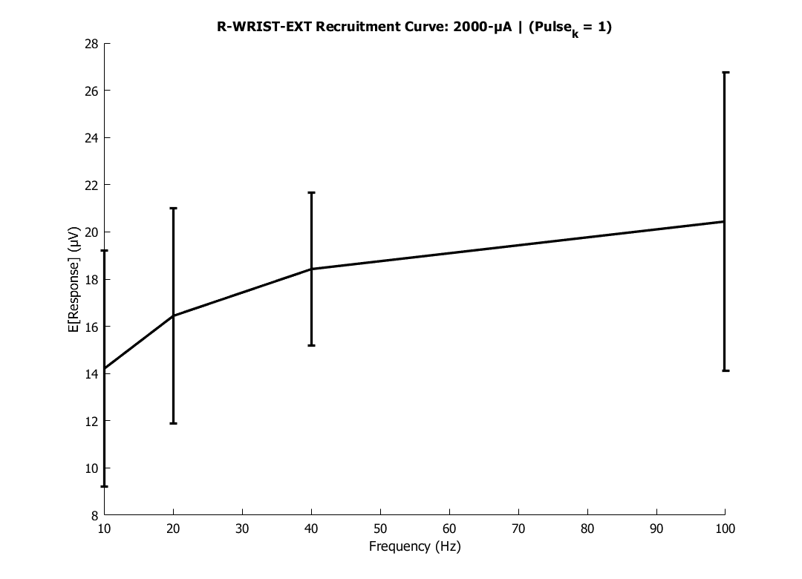
R-WRIST-EXT Recruitment Curve: 2000-μA | (Pulse_k = 1)
3

Slide 4
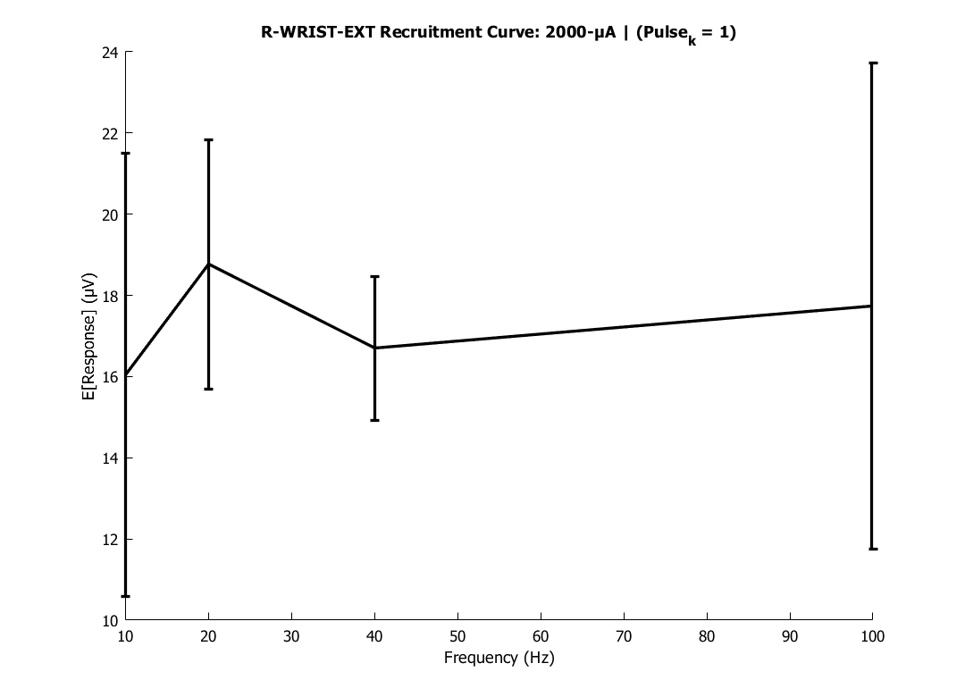
R-WRIST-EXT Recruitment Curve: 2000-μA | (Pulse_k = 1)
4

Slide 5
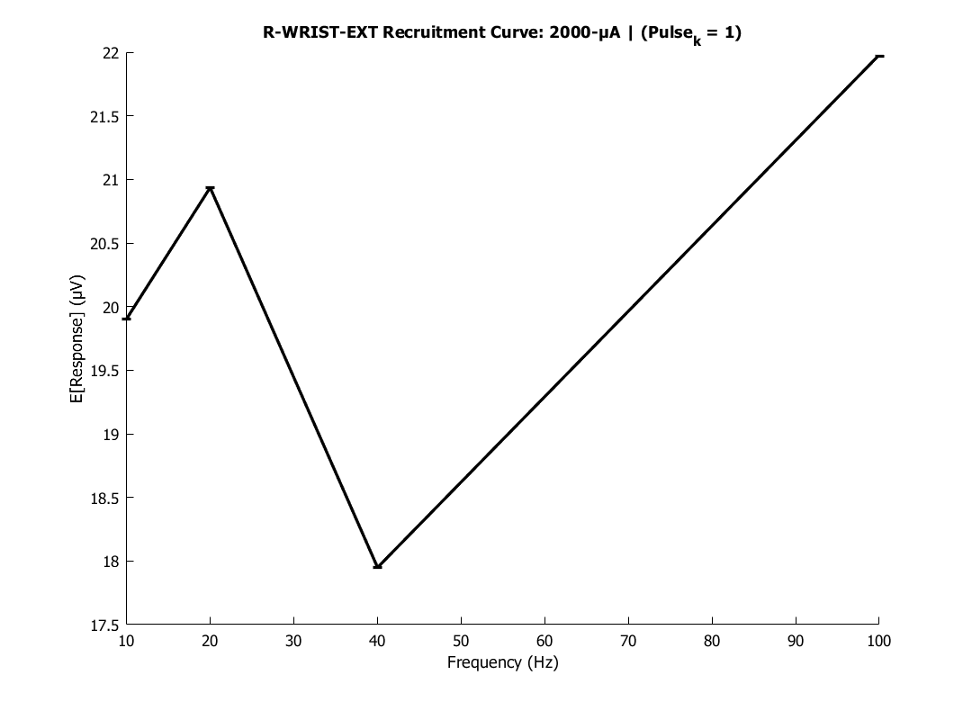
R-WRIST-EXT Recruitment Curve: 2000-μA | (Pulse_k = 1)
5

Slide 6
R-WRIST-EXT
6

Slide 7
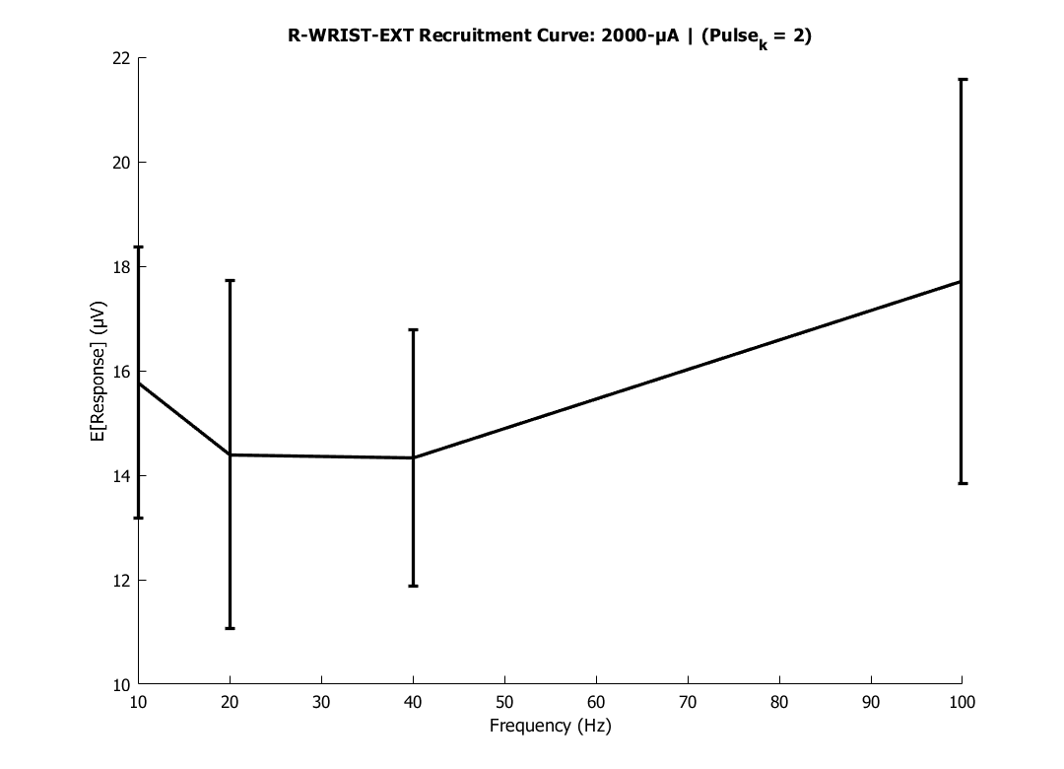
R-WRIST-EXT Recruitment Curve: 2000-μA | (Pulse_k = 2)
7

Slide 8
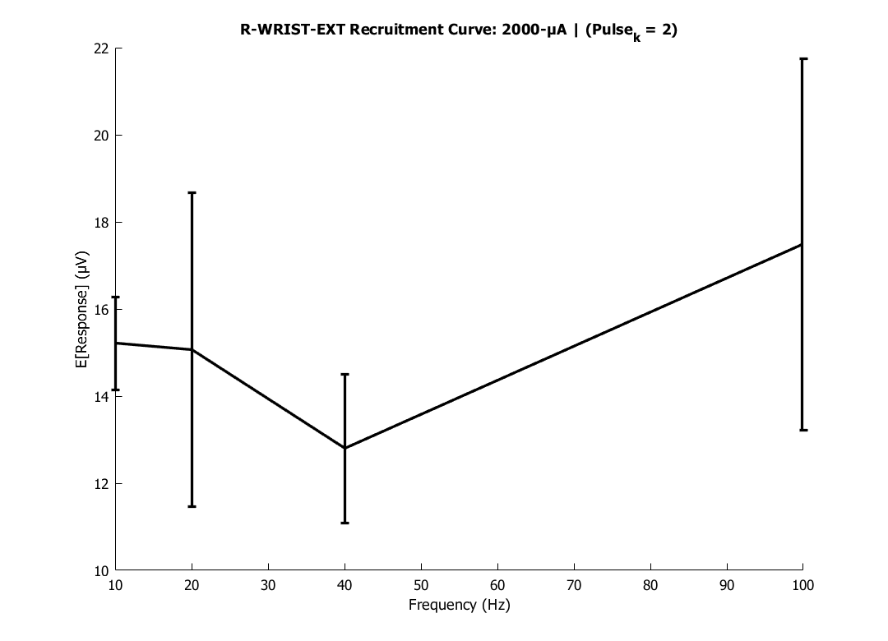
R-WRIST-EXT Recruitment Curve: 2000-μA | (Pulse_k = 2)
8

Slide 9
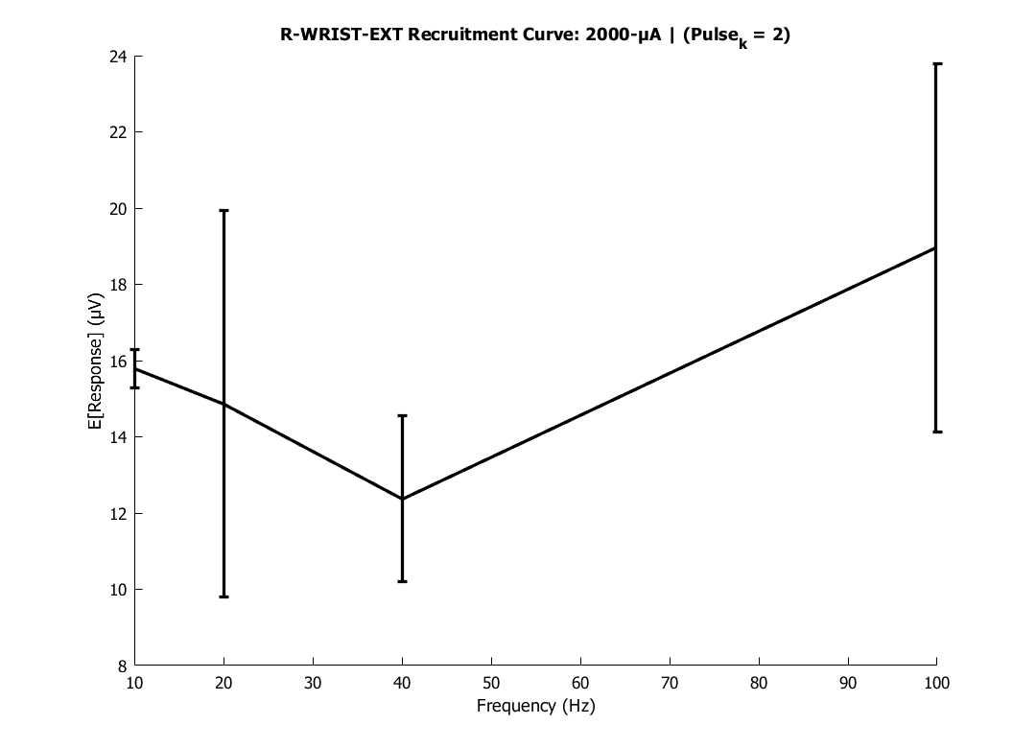
R-WRIST-EXT Recruitment Curve: 2000-μA | (Pulse_k = 2)
9

Slide 10
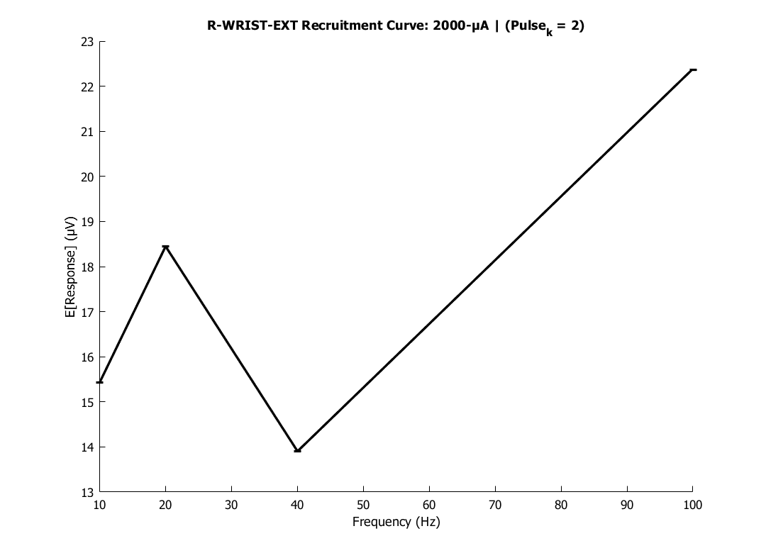
R-WRIST-EXT Recruitment Curve: 2000-μA | (Pulse_k = 2)
10

Slide 11
R-WRIST-EXT
11

Slide 12
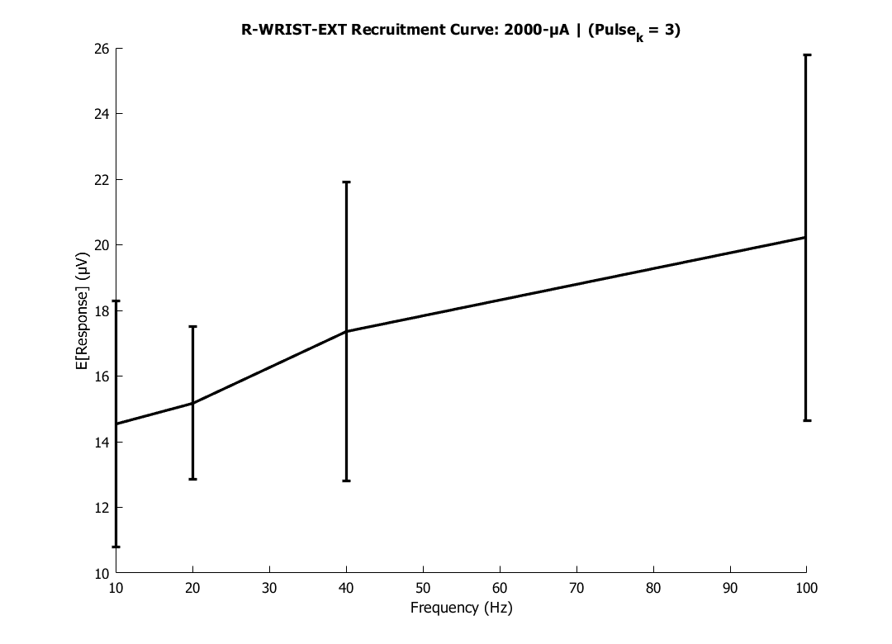
R-WRIST-EXT Recruitment Curve: 2000-μA | (Pulse_k = 3)
12

Slide 13
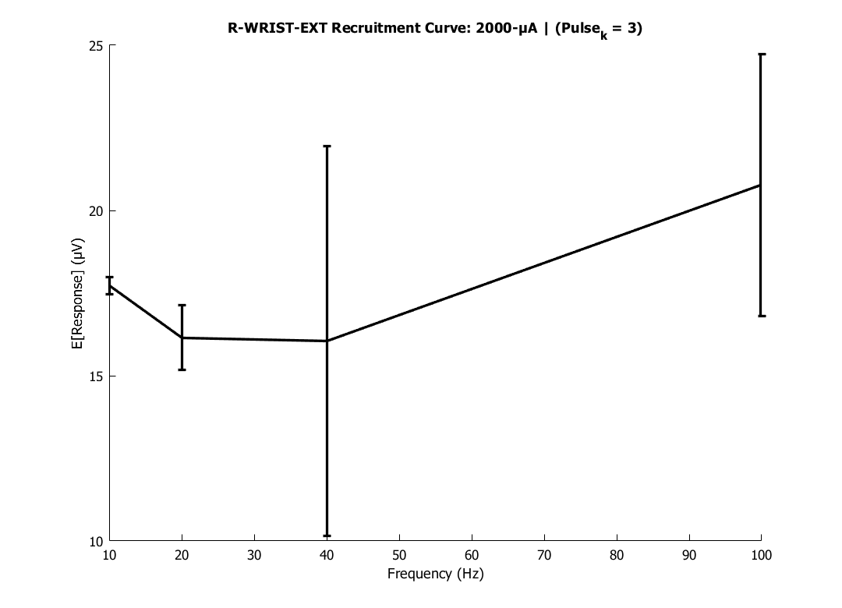
R-WRIST-EXT Recruitment Curve: 2000-μA | (Pulse_k = 3)
13

Slide 14
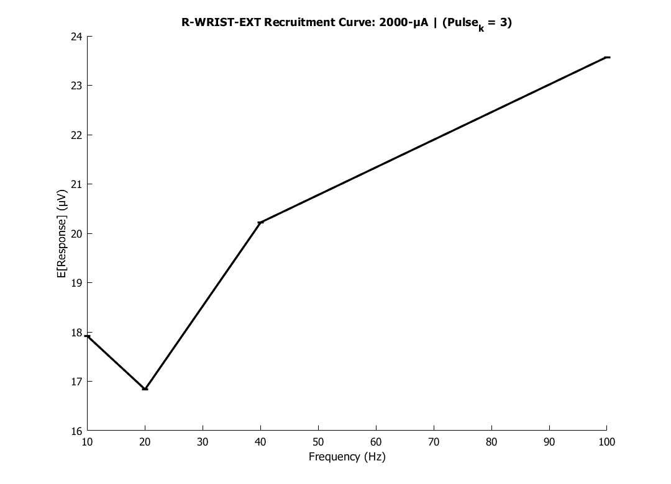
R-WRIST-EXT Recruitment Curve: 2000-μA | (Pulse_k = 3)
14

Slide 15

R-WRIST-EXT Recruitment Curve: 2000-μA | (Pulse_k = 3)
15

Slide 16
R-WRIST-EXT
16

Slide 17
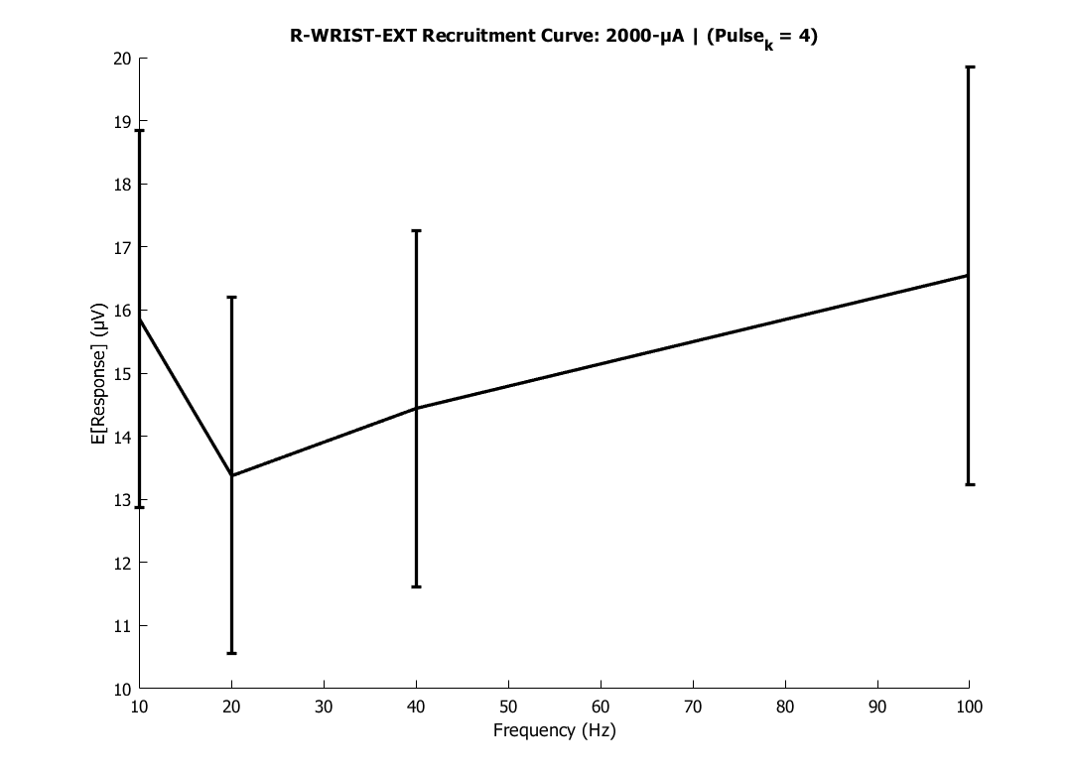
R-WRIST-EXT Recruitment Curve: 2000-μA | (Pulse_k = 4)
17

Slide 18
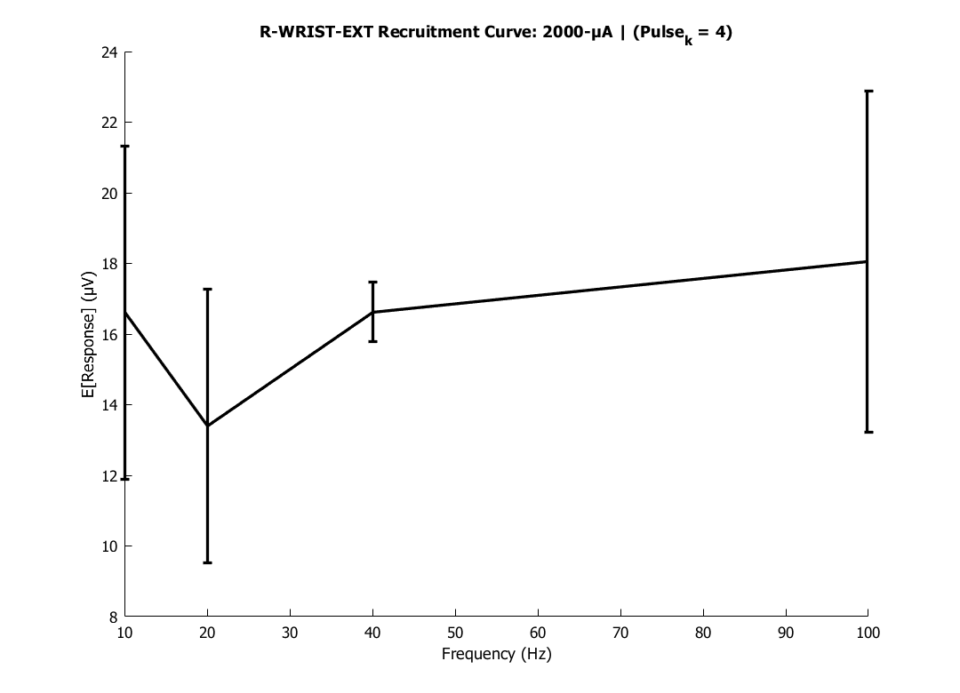
R-WRIST-EXT Recruitment Curve: 2000-μA | (Pulse_k = 4)
18

Slide 19
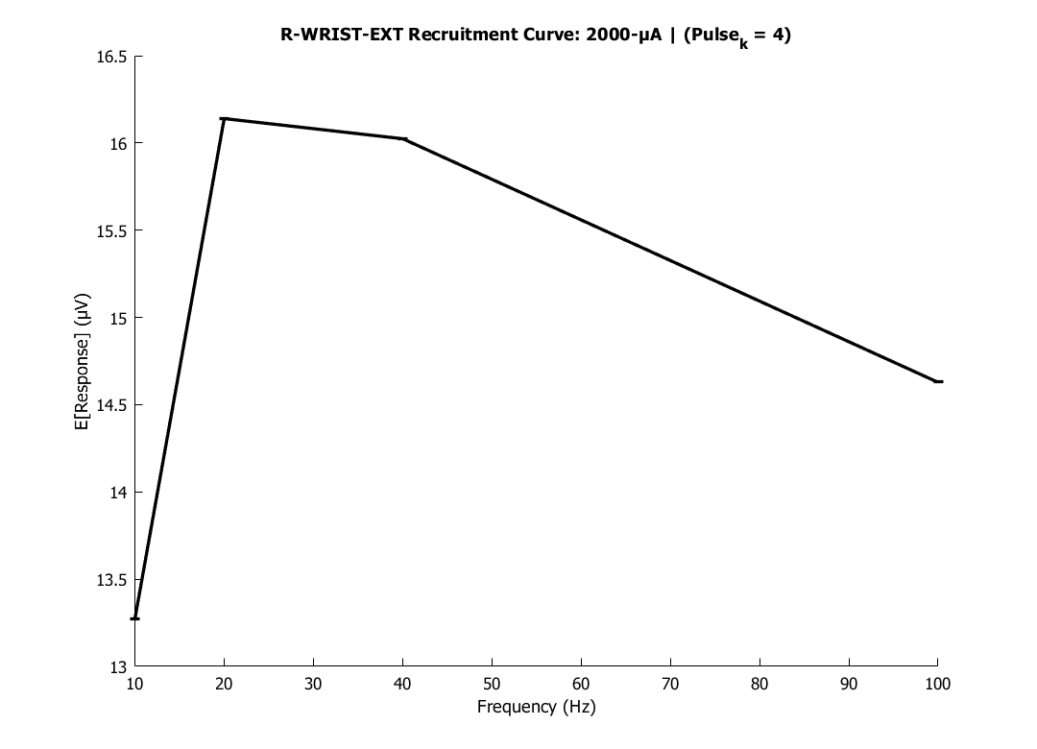
R-WRIST-EXT Recruitment Curve: 2000-μA | (Pulse_k = 4)
19

Slide 20
R-WRIST-EXT Recruitment Curve: 2000-μA | (Pulse_k = 4)
20

Slide 21
R-WRIST-EXT
21

Slide 22
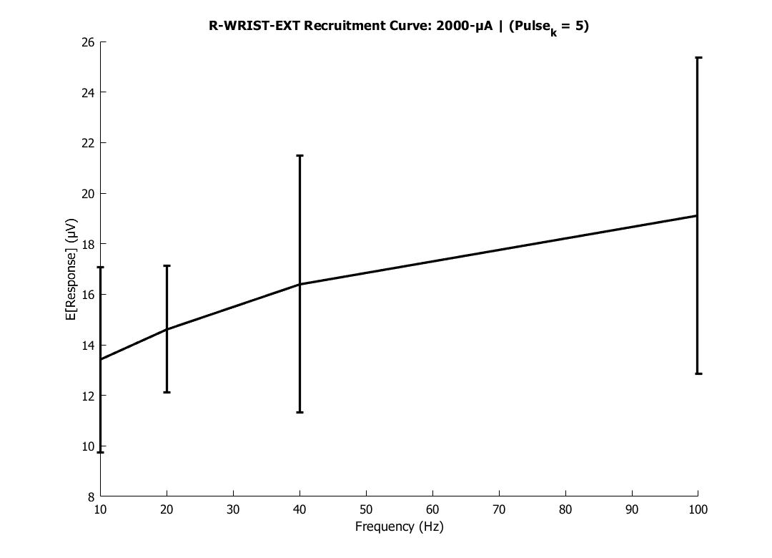
R-WRIST-EXT Recruitment Curve: 2000-μA | (Pulse_k = 5)
22

Slide 23
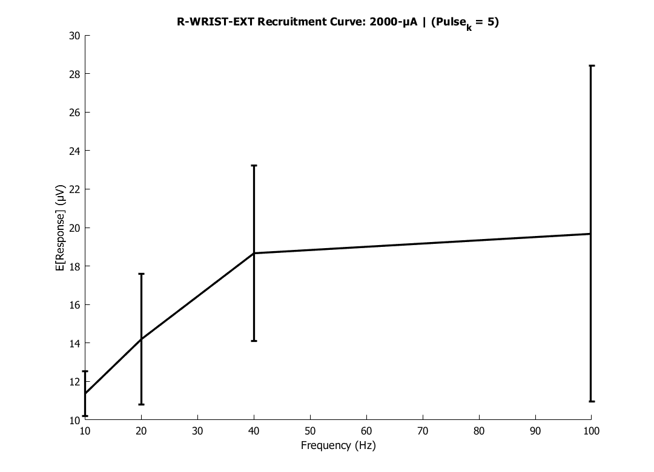
R-WRIST-EXT Recruitment Curve: 2000-μA | (Pulse_k = 5)
23

Slide 24
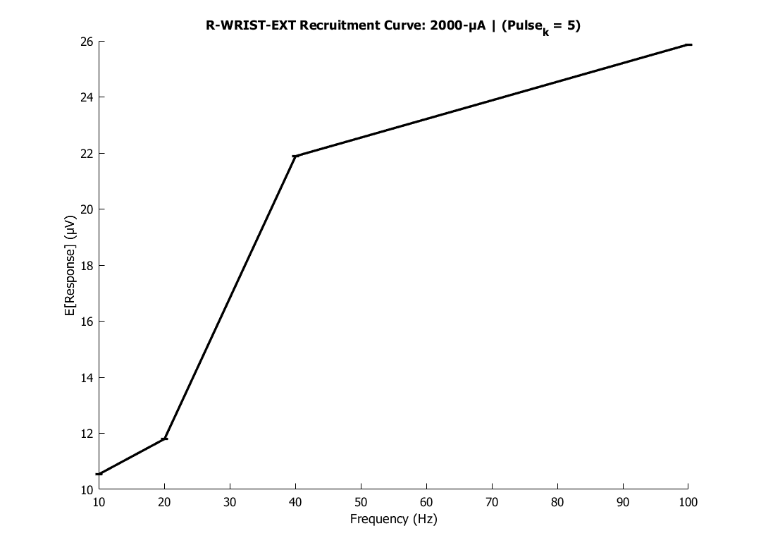
R-WRIST-EXT Recruitment Curve: 2000-μA | (Pulse_k = 5)
24

Slide 25
R-WRIST-EXT Recruitment Curve: 2000-μA | (Pulse_k = 5)
25

Slide 26
R-WRIST-EXT
26

Slide 27

R-WRIST-EXT Recruitment Curve: 2000-μA | (Pulse_k = 6)
27

Slide 28
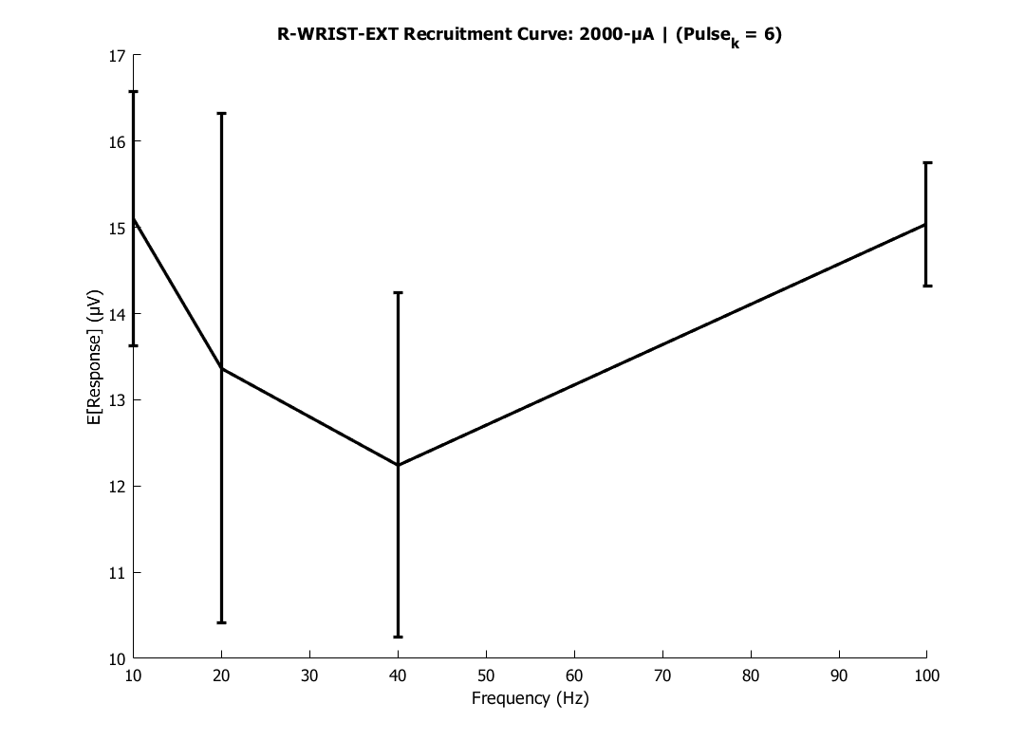
R-WRIST-EXT Recruitment Curve: 2000-μA | (Pulse_k = 6)
28

Slide 29
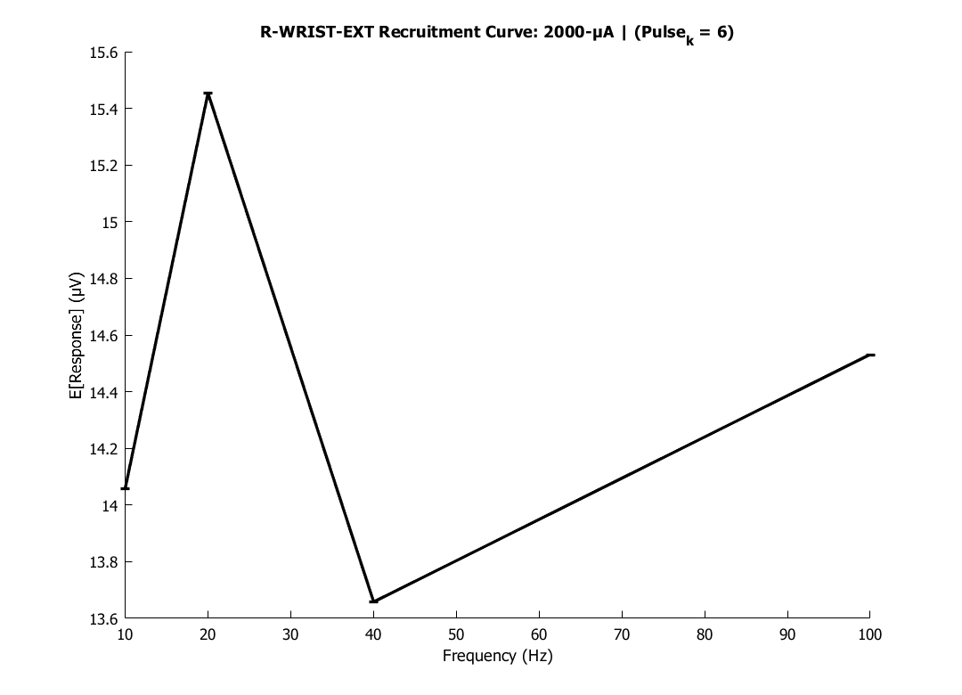
R-WRIST-EXT Recruitment Curve: 2000-μA | (Pulse_k = 6)
29

Slide 30

R-WRIST-EXT Recruitment Curve: 2000-μA | (Pulse_k = 6)
30

Slide 31
R-WRIST-EXT
31

Slide 32
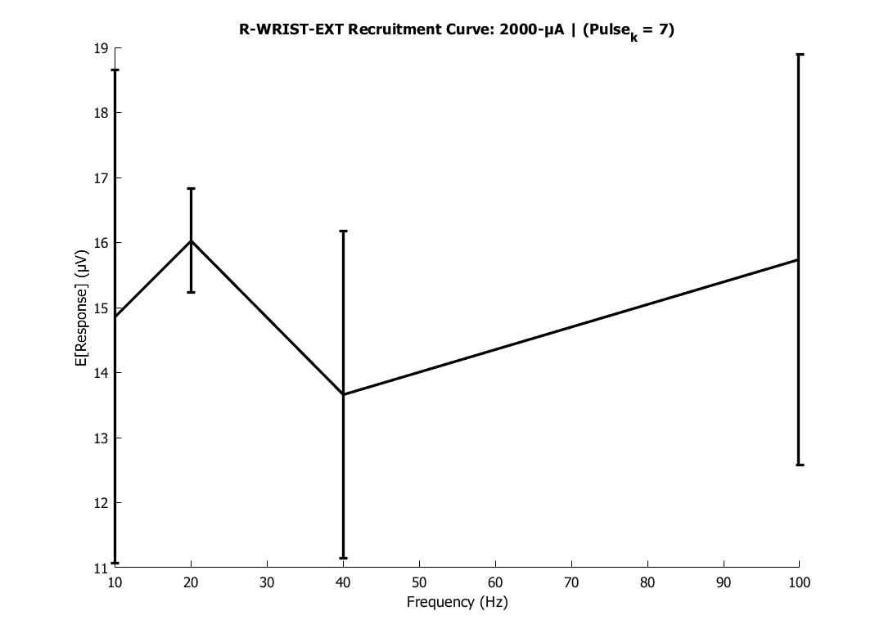
R-WRIST-EXT Recruitment Curve: 2000-μA | (Pulse_k = 7)
32

Slide 33
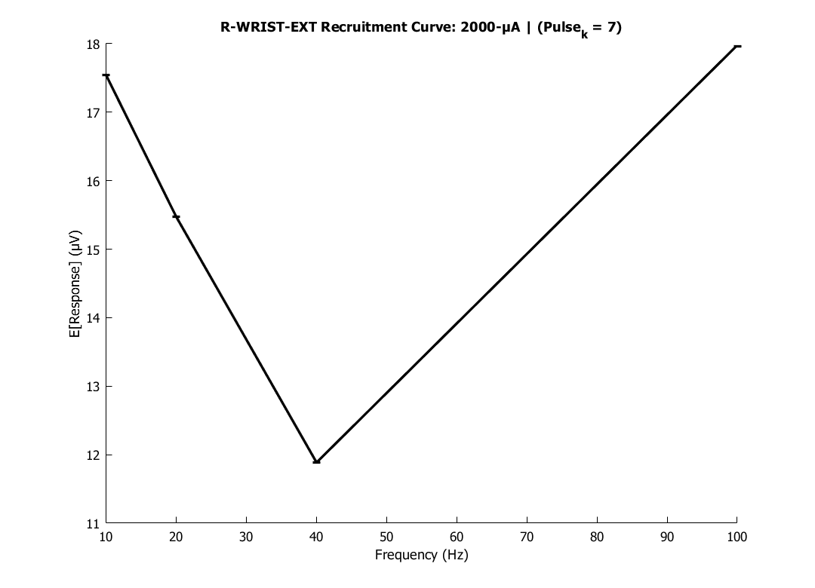
R-WRIST-EXT Recruitment Curve: 2000-μA | (Pulse_k = 7)
33

Slide 34
R-WRIST-EXT Recruitment Curve: 2000-μA | (Pulse_k = 7)
34

Slide 35
R-WRIST-EXT Recruitment Curve: 2000-μA | (Pulse_k = 7)
35

Slide 36
R-WRIST-EXT
36

Slide 37
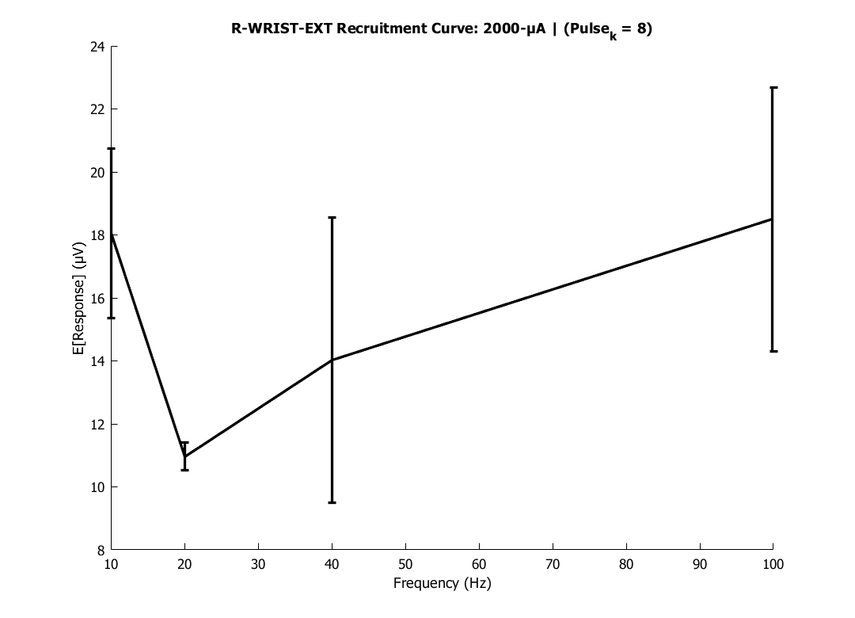
R-WRIST-EXT Recruitment Curve: 2000-μA | (Pulse_k = 8)
37

Slide 38
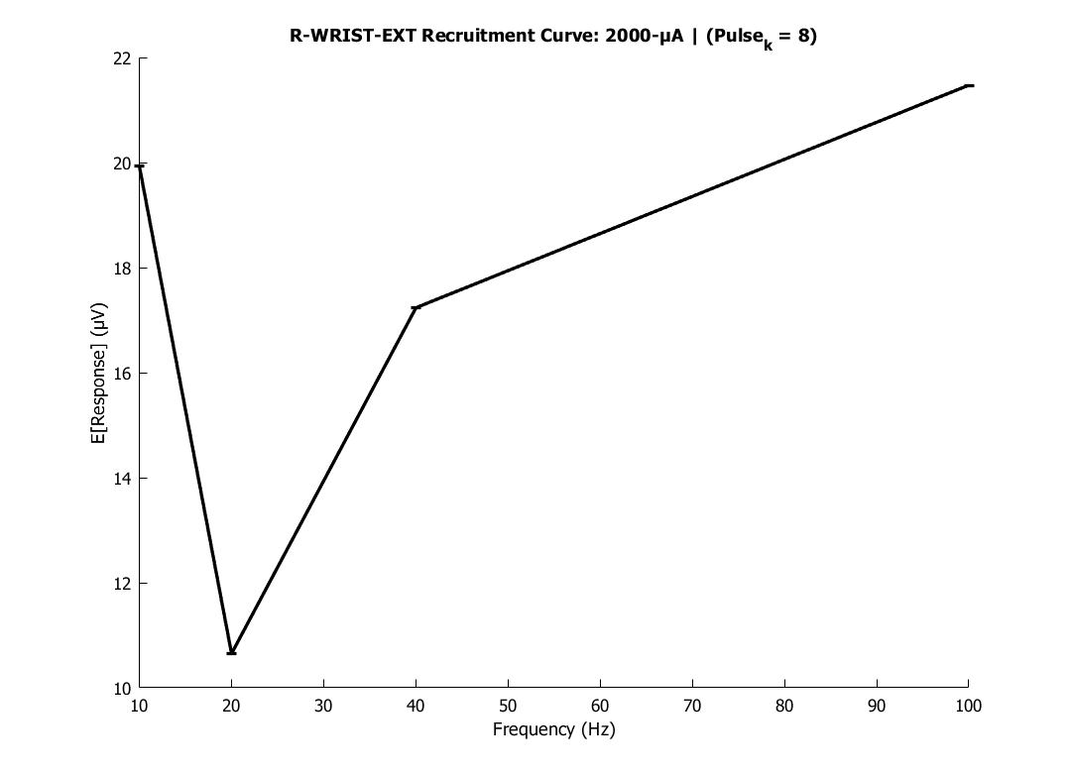
R-WRIST-EXT Recruitment Curve: 2000-μA | (Pulse_k = 8)
38

Slide 39
R-WRIST-EXT Recruitment Curve: 2000-μA | (Pulse_k = 8)
39

Slide 40
R-WRIST-EXT Recruitment Curve: 2000-μA | (Pulse_k = 8)
40

Slide 41
R-WRIST-EXT
41

Slide 42
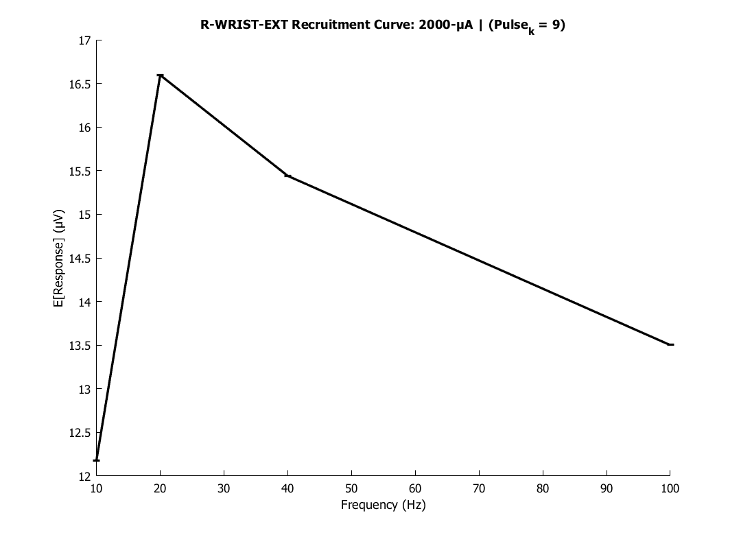
R-WRIST-EXT Recruitment Curve: 2000-μA | (Pulse_k = 9)
42

Slide 43
R-WRIST-EXT Recruitment Curve: 2000-μA | (Pulse_k = 9)
43

Slide 44
R-WRIST-EXT Recruitment Curve: 2000-μA | (Pulse_k = 9)
44

Slide 45
R-WRIST-EXT Recruitment Curve: 2000-μA | (Pulse_k = 9)
45

Slide 46
R-WRIST-EXT
46

Slide 47
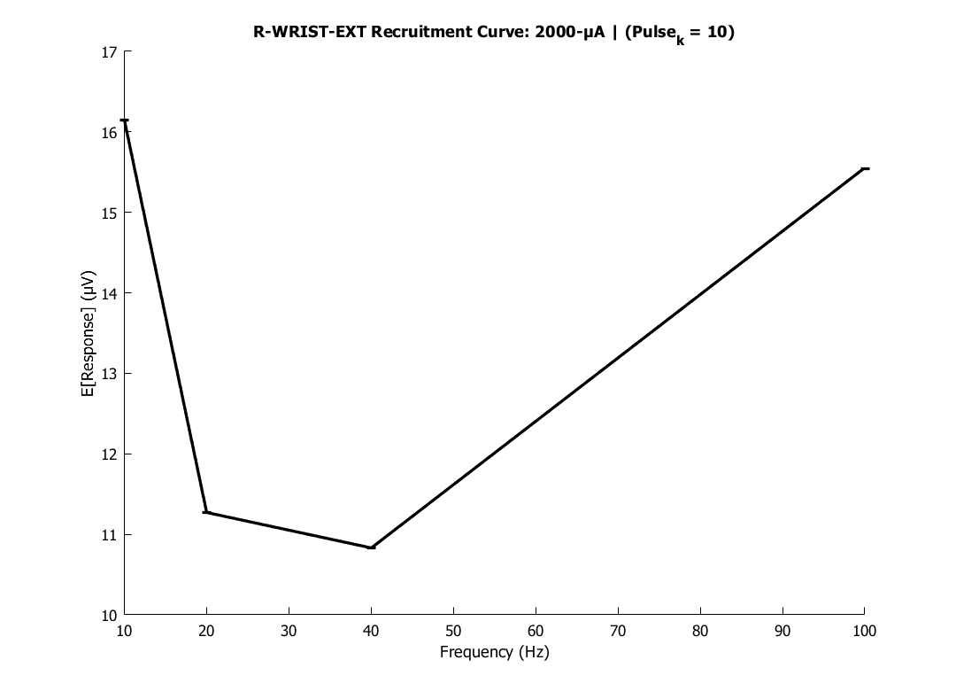
R-WRIST-EXT Recruitment Curve: 2000-μA | (Pulse_k = 10)
47

Slide 48
R-WRIST-EXT Recruitment Curve: 2000-μA | (Pulse_k = 10)
48

Slide 49
R-WRIST-EXT Recruitment Curve: 2000-μA | (Pulse_k = 10)
49

Slide 50
R-WRIST-EXT Recruitment Curve: 2000-μA | (Pulse_k = 10)
50

