Slide 1
COGS 160 · KNOWLEDGE ATLAS · SPRING 2026
The 7-Step Method
Building a PDF Relevance Filter with AI
How to use AI as a design partner — not a code monkey
Prof. David Kirsh · Cognitive Science, UCSD

Slide 2
THE SYSTEM
What Is ATLAS?
Architecture for Typed, Layered Assessment of Science
A structured credibility reasoning system
that stores scientific knowledge not as simple facts, but as structured credences — beliefs tagged with how well-supported they are, where the support comes from, and why.
The system models knowledge as an Evidence Network (Web of Belief): a directed graph where each node is a claim and each edge is a typed, weighted warrant.
When new evidence is added, credences propagate through the network and the system re-equilibrates. The network is foundherentist (Haack): both empirical directness and coherence with theoretical frameworks matter equally.
760+
Research papers across 34 topics
1,900
Evidence items (claims)
7
Warrant types (d = 0.25 to 1.0)
10
T1 neuroscience frameworks

Slide 3
ARCHITECTURE
Three Layers: EN → π → BN
Epistemic Network (EN)
Projection Function (π)
Bayesian Network (BN)
What we know
How we transfer
What we predict
Claims + warrant edges
Credence propagation
7 warrant types
Foundherentist web of belief
→
logit(p_target) = d·ω·δ·logit(p_lab)
Log-odds space
Serial/parallel combination
Dual-BN diagnostic
→
Causal DAG + CPTs
Pearl-compliant inference
Interventional queries
Design recommendations
Projection formula: logit(p_target) = d(τ,CCI) · δ_ecology · ω · δ_pop · T(t) · ∏F_dose · Ψ_interact · logit(p_lab)

Slide 4
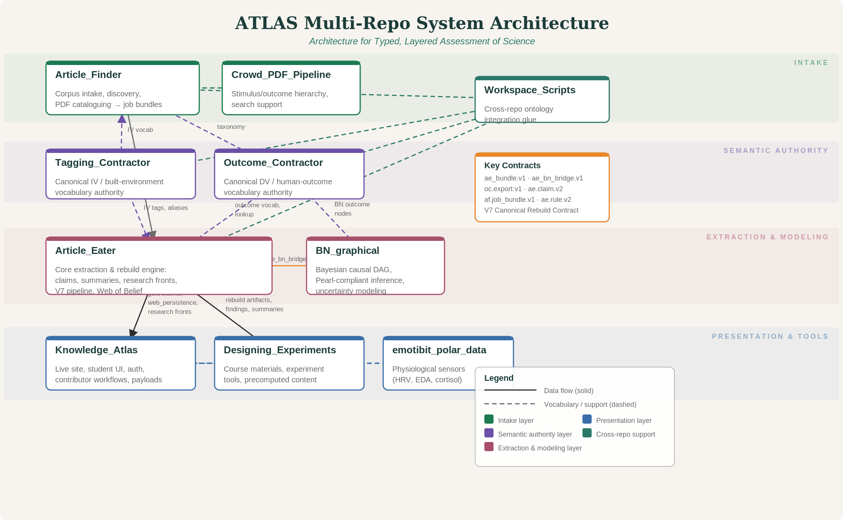
BOXOLOGY
The Multi-Repo System

Slide 5
CONTRACTS
How the Repos Talk to Each Other
Every repo boundary is governed by a formal contract: a spec that defines exactly what data crosses the boundary, in what format, and what validation must pass.
Contract | From → To | What It Specifies
af.job_bundle.v1 | Article_Finder → Article_Eater | PDF + metadata manifest + extraction directives
ae.claim.v2 (ClaimV2) | Article_Eater internal | Canonical claim schema: provenance tier, causal level, evidence basis
ae_bn_bridge.v1 | Article_Eater ↔ BN_graphical | Bidirectional: causal edges + node definitions for BN construction
oc.export.v1 | Outcome_Contractor → AF, AE, BN | DV taxonomy, term mappings, measurement instruments
EN→BN boundary | Epistemic Network → Bayesian Net | 6 invariants: determinism, traceability, bounds, monotonicity...
V7 Rebuild Export | Article_Eater → Knowledge_Atlas | gold_claims_v7.jsonl + web_persistence_v5.db + research_fronts
Codex Local Gold | Article_Eater → KA site | Science-writer summaries: 10 sections, 15 success conditions
PNU Generation | Article_Eater → KA site | Plausible neuroscience underpinning HTML pages

Slide 6
CORE ENGINE
Article Eater: PDF → Claims → Web → BN
1
PDF Intake
→
2
OCR + Mathpix
→
3
Claim Extraction
→
4
Warrant Assignment
→
5
Web Integration
6
Credence Propagation
→
7
Template Matching
→
8
BN Projection (π)
→
9
Science Summaries
KEY OUTPUTS
gold_claims_v7.jsonl
Canonical claim records with provenance
web_persistence_v5.db
Entire epistemic web (claims + edges)
research_fronts_v7.json
Research frontier analysis
PNU HTML pages
Plausible neuroscience underpinnings
Theory Tiers: T1 (10 neuroscience frameworks) → T1.5 (domain theories reduced to T1) → T2 (empirical claims, bridge warrants) → T3 (BN nodes, CPTs)

Slide 7
THE ECOSYSTEM
Supporting Repos and Their Roles
Article_Finder
af.job_bundle.v1
Tagging_Contractor
registry_v0.2.8.json
Literature discovery and intake. Imports from spreadsheets, Zotero, DOI searches. Deduplicates, enriches metadata, produces job bundles (PDFs + directives) for Article Eater.
Canonical authority for IV (environment-side) vocabulary. Defines 424 CNFA tags — measurable environmental features like luminance, ceiling height, green fraction.
Outcome_Contractor
oc.export.v1
BN_graphical
ae_bn_bridge.v1
Canonical authority for DV (outcome-side) vocabulary. Defines cognitive, affective, behavioral, physiological, and health outcomes with measurement instruments.
Bayesian causal inference engine. Takes bridge data from Article Eater, constructs Pearl-compliant DAGs, runs interventional and counterfactual queries. 45% complete.
Knowledge_Atlas
V7 Rebuild Export
Designing_Experiments
Course/experiment specs
The live website. Payload adapter transforms Article Eater outputs into JSON for the frontend. Evidence browser, topic explorer, contributor flows, student assignments.
Course materials (COGS 160), experiment protocols, 4-track student structure. Links to emotibit for physiological data collection and BN for validation.

Slide 8
WHERE THE FILTER FITS
From System Architecture to Today's Demo
Student finds
a paper
PDF Relevance
Filter
Article Eater
extracts claims
Web of Belief
updates
K-ATLAS site
shows results
→
→
→
→
The PDF Relevance Filter is the quality gate between intake and extraction.
If irrelevant papers enter the corpus, every downstream analysis is contaminated — credences propagate through the Evidence Network, so one bad paper can shift confidence scores across dozens of claims.
Today's demo: we use the 7-Step Method to build this filter with AI.

Slide 9
THE PROBLEM
Why Do We Need a Filter?
The Contamination Risk
What the Filter Must Do
130 questions across 34 topics
760+ papers in the corpus
Students and pipelines submit PDFs as evidence
A paper about "ADHD in natural classrooms" mentions both "attention" and "natural" — but it's about clinical ADHD, not attention restoration from nature.
If irrelevant papers enter the corpus, every downstream analysis is contaminated.
Given:
A K-ATLAS question + a submitted PDF
Determine:
Does this paper provide evidence
relevant to this specific question?
Output: ACCEPT / REJECT / MANUAL REVIEW
with per-check reasoning

Slide 10
THE METHOD
7 Steps from Problem to Working System
1
→
2
→
3
→
4
→
5
→
6
→
7
Convene Panel
Write Spec
Acceptance Tests
Build
Verify
Diagnose
Iterate
Assemble virtual experts
Formal component spec
Define pass/fail before code
AI writes the implementation
Run tests against spec
Trace failures to spec, not code
Refine spec, re-run
KEY INSIGHT
Steps 1–3 are where the intellectual work happens. You are the designer; the AI is your builder. The spec is where the epistemology lives — not in the code.

Slide 11
STEP 1
Convene Panel
EPISTEMOLOGIST
RESEARCH LIBRARIAN
TARGET USER
Susan Haack
(foundherentism)
Information Science
Expert
COGS 160 Student
Submitting Articles
"What makes evidence "relevant" vs. merely topically adjacent? When does keyword match fail?"
"What metadata reliably distinguishes on-topic from off-topic? What are failure modes of keyword filtering?"
"What feedback helps me understand WHY a paper was rejected, not just THAT it was?"

Slide 12
STEP 1 — THE PROMPT
What I Actually Typed Into the AI
You are running a design panel for a PDF relevance filter.
The panelists are:
- Susan Haack (epistemology, foundherentism): What makes evidence "relevant" vs. merely topically adjacent?
- A research librarian (information science): What metadata reliably distinguishes on-topic from off-topic papers?
- A COGS 160 student (target user): What feedback helps me understand WHY a paper was rejected?
The filter takes a K-ATLAS question and a paper (title + abstract).
It must produce: ACCEPT, REJECT, or MANUAL REVIEW, with step-by-step reasoning.
Each panelist: state your top 3 requirements and one thing
that would make the filter misleading or dangerous.

Slide 13
STEP 2
Write the Spec
COMPONENT: PDFRelevanceFilter
INPUT: question + paper_title + abstract
OUTPUT: Verdict + per-check reasoning
PIPELINE (7 sequential checks):
1. Document Type Acceptability
2. False Keyword Detection
3. Topic Overlap (Both Sides)
4. Evidence Type Match
5. Dependent Variable Alignment
6. Relevance Tier Classification
7. Final Reasoning Synthesis
What the Spec Defines
For each topic:
Environment-side keywords Outcome-side keywords False-keyword exclusions
For each check:
What counts as PASS What counts as WARN What counts as FAIL
For classification:
DIRECT = topic + DV + evidence
INDIRECT = topic but wrong DV
CONTEXTUAL = right DV, wrong env
IRRELEVANT = neither matches

Slide 14
STEP 3
Acceptance Tests — Before Any Code
Question SQ-001: "What empirical evidence supports the claim that natural environments restore directed attention better than urban environments?"
Direct Hit
ACCEPT
Off-Topic
REJECT
"Attention restoration after cognitive fatigue in simulated nature"
"Structural analysis of reinforced concrete beams"
All 7 checks pass — env + outcome keywords both match
Wrong document type — computational simulation, not research
Adjacent but Wrong DV
MANUAL REVIEW
False Keyword Match
REJECT
"Shinrin-yoku and salivary cortisol responses"
"ADHD in natural classroom settings"
Nature keywords match, but cortisol ≠ attention. Same environment, wrong outcome.
"Attention deficit" triggers false-keyword exclusion — clinical ADHD, not ART
Test 3 is the case that matters. A naive filter accepts it. Ours doesn't.

Slide 15
STEPS 4–5
Build and Verify
Step 4: Build
Step 5: Verify
AI receives the spec + acceptance tests + question bank JSON + topic keyword banks. Instruction: build a single-page HTML/JS app.
Result: ~600 lines of JS, 7-check pipeline, interactive demo.
Time: ~15 minutes. (The spec took 2 hours.)
Run all 5 acceptance tests. 4 pass, 1 fails.
The ARS validation paper was classified DIRECT, but it should be INDIRECT — it measures instrument validity, not the IV→DV effect.
STEPS 6–7: DIAGNOSE & ITERATE
Diagnosis: The ARS paper mentions "attention restoration" and "environments" so the keyword filter says DIRECT. But it measures scale reliability, not the actual IV→DV effect. The fix is in the spec: add "validation," "reliability," "psychometric" as instrument-markers that downgrade to INDIRECT. Iteration: Update spec → AI regenerates the affected check → re-run all tests (not just the failure) → add new edge cases discovered during diagnosis.

Slide 16
WHAT TO TAKE AWAY
You Are the Designer. AI Is the Builder.
1
The spec did the intellectual work
The 7 checks, keyword banks, tier rules, false-keyword exclusions — all designed before a line of code. AI wrote the JS in minutes. The spec is where the epistemology lives.
2
Failures go back to the spec
When the shinrin-yoku paper was misclassified, the fix was adding keywords — not editing JavaScript. You debug your design, not your code.
3
You bring the domain knowledge
AI doesn't know that cortisol ≠ attention, or that an ARS validation paper isn't measuring the IV→DV effect. Your expertise is what makes the filter work.
4
This method scales to your track work
Every exercise in this course uses the same 7 steps. The filter was just the demo. Your track project is where you apply it.

