Slide 1
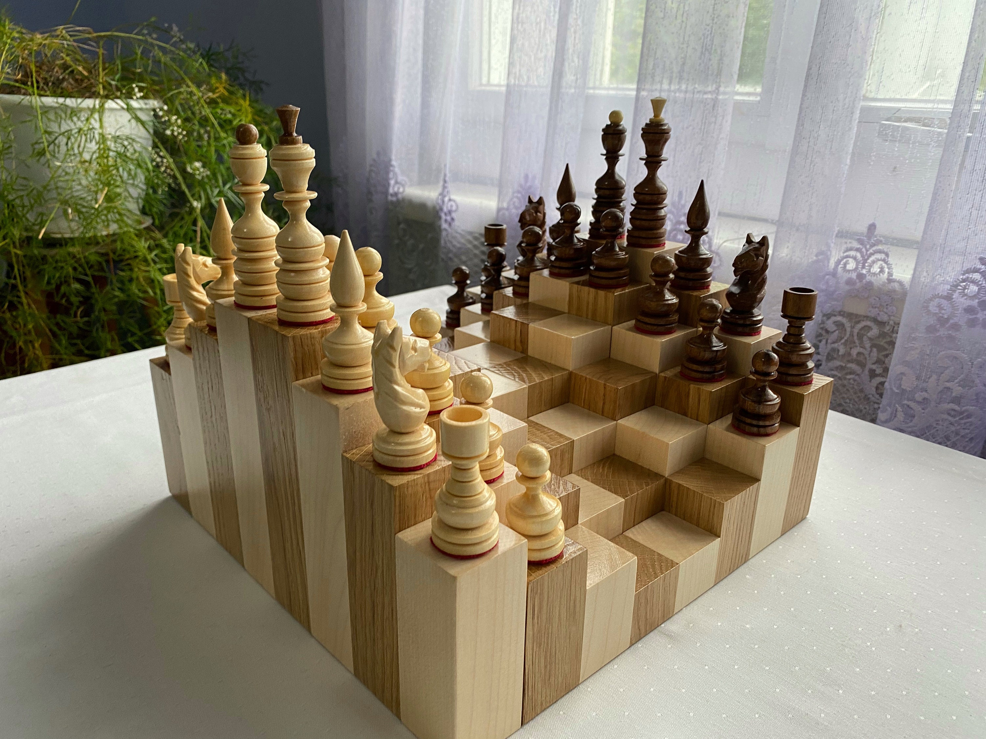
COG NEURO FOR ARCHITECTURE · UCSD
Reimagining Space
How activity space explains human behaviour in buildings.
David Kirsh
Cognitive Science · UC San Diego
One of four topologically identical chess boards (Kirsh 2025, Fig 1d).
Design Lab Singapore

Slide 2
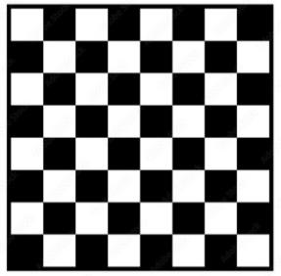
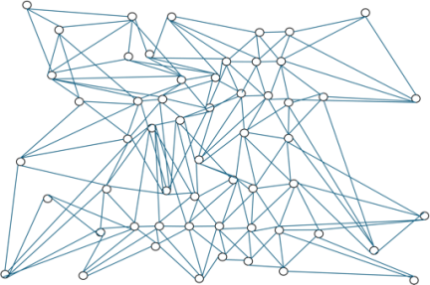
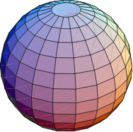
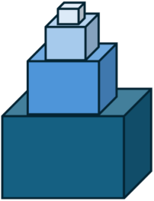
KIRSH 2025 · FIGURE 1 · FORMAL ≠ PHYSICAL ≠ PSYCHOLOGICAL
Four activity spaces to play chess.
Same state space; four physical realisations; four psychological experiences. Any game you can play on the flat board you can play on the sphere — but not equally well.
1a
1b
1c
1d
Standard board
Abstract graph
Spherical chess
Stacked boxes
a 2-D grid of 64 cells
64 nodes, one-step links
grid warped onto a sphere
rings mapped onto 3-D surfaces
Same state space. Different physical space. Different psychological space.

Slide 3
THE CENTRAL QUESTION · THREE LEVELS OF ANALYSIS
How space shapes task performance.
Every activity lives at three levels. Our actions are a function of how the first two shape the third.
1
2
3
Logical
Physical
Psychological
state space; goals and legal transitions
layout, materials, affordances, visibility
how we decide what to do next
· What is the abstract structure of the task?
· Which states are reachable from which?
· What counts as success?
· Invariant under physical realisation.
· Where in the room do actions happen?
· How accessible, visible, reachable is each station?
· Light, acoustics, thermal, lines of sight
· What affordances does the material reveal?
· What mental model does the agent bring?
· What external cues guide the next move?
· Attention bubble; working memory; fatigue
· Different brains, different strategies.
Our actions are a function of how Logical + Physical shape Psychological.

Slide 4
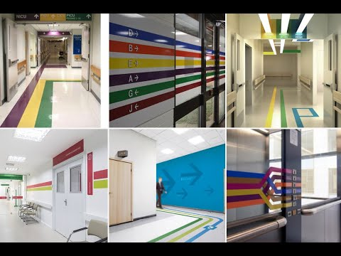
RELEVANCE · WHY THIS MATTERS NOW
Buildings are becoming adaptive.
We do not yet have a principled way to design rooms that host many tasks at once — or that rearrange themselves to host the next one.
1
Adaptive rooms need a design theory
Furniture and lighting that move on their own require rules about when to move — rules that speak all three levels.
2
One space, many tasks
A lobby hosts arrivals, queues, conversations, and cleaning — four activity spaces sharing one floor.
3
Things get confusing easily
Without a map of cognitive load and attention bubbles, multi-task space devolves into visual noise.
4
A job for the three levels
Hospital wayfinding: a single physical corridor, many activity spaces (patients, staff, visitors, orderlies).
Architects need the logical + psychological skills to see what their geometry will actually do.
Architecture becomes cognitive design when rooms must serve many activity spaces at once.

Slide 5
FROM THEORY TO TOOL
2
A research assistant
that has read everything in the field.
Activity-space theory tells an architect what to look for. The next slide shows a tool that brings the backing literature, the causal mechanisms, and the neural evidence to the same desk — and cites every claim it makes.

Slide 6
ARTICLE EATER + KNOWLEDGE ATLAS
A senior researcher at your desk.
Twenty-five years of cognitive-neuroscience-for-architecture literature — read, synthesised, and queryable. Not a chatbot: a senior research colleague that cites its sources, flags what it does not know, and helps you understand the technical literature.
GREAT QUESTIONS IT ANSWERS
WHAT MAKES IT AN EXPERT
1
Should hospital waiting rooms include biophilic elements — and which?
· Cites the primary literature behind every claim, with DOI and citation count
· Distinguishes settled science from active disagreement
· Reasons across Kirsh's three levels — logical, physical, cognitive
· Flags the epistemic gap: where the evidence runs out
· Preserves neurodiversity — not one-size-fits-all recommendations
· Updates continuously as new papers enter the corpus
2
How does daylight at workstations affect afternoon attention?
3
What ceiling height supports creative versus focused work?
4
How do open-plan acoustics alter cognitive load over a workday?
5
Which wayfinding cues reduce stress for elderly hospital visitors?
6
What classroom layouts support attention in neurodiverse students?
Like consulting a colleague who has read every relevant paper — because it has.

