Slide 1
COGS 160 · KNOWLEDGE ATLAS · SPRING 2026
ATLAS System Architecture
Architecture for Typed, Layered Assessment of Science
A federated multi-repo system for structured credibility reasoning
Prof. David Kirsh · Cognitive Science, UCSD

Slide 2
THE SYSTEM
What Is ATLAS?
Architecture for Typed, Layered Assessment of Science
A structured credibility reasoning system
that stores scientific knowledge not as simple facts, but as structured credences — beliefs tagged with how well-supported they are, where the support comes from, and why.
The system models knowledge as an Evidence Network (Web of Belief): a directed graph where each node is a claim and each edge is a typed, weighted warrant.
When new evidence is added, credences propagate through the network and the system re-equilibrates. The network is foundherentist (Haack): both empirical directness and coherence with theoretical frameworks matter equally.
760+
Research papers across 34 topics
1,900
Evidence items (claims)
7
Warrant types (d = 0.25 to 1.0)
10
T1 neuroscience frameworks

Slide 3
ARCHITECTURE
Three Layers: EN → π → BN
Epistemic Network (EN)
Projection Function (π)
Bayesian Network (BN)
What we know
How we transfer
What we predict
Claims + warrant edges
Credence propagation
7 warrant types
Foundherentist web of belief
→
logit(p_target) = d·ω·δ·logit(p_lab)
Log-odds space
Serial/parallel combination
Dual-BN diagnostic
→
Causal DAG + CPTs
Pearl-compliant inference
Interventional queries
Design recommendations
Projection formula: logit(p_target) = d(τ,CCI) · δ_ecology · ω · δ_pop · T(t) · ∏F_dose · Ψ_interact · logit(p_lab)

Slide 4
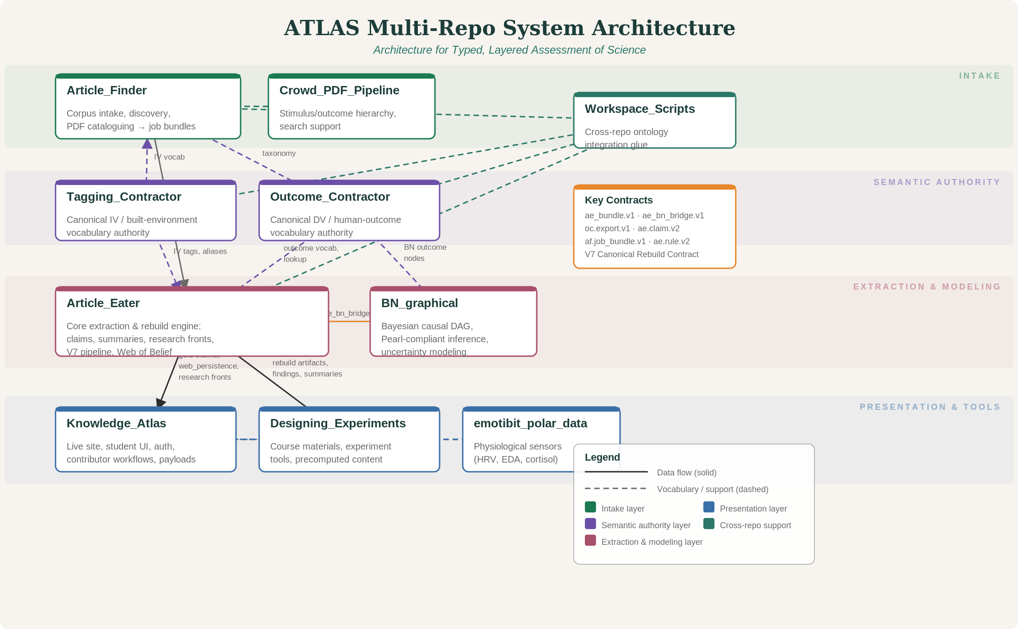
BOXOLOGY
The Multi-Repo System

Slide 5
CONTRACTS
How the Repos Talk to Each Other
Every repo boundary is governed by a formal contract: a spec that defines exactly what data crosses the boundary, in what format, and what validation must pass.
Contract | From → To | What It Specifies
af.job_bundle.v1 | Article_Finder → Article_Eater | PDF + metadata manifest + extraction directives
ae.claim.v2 (ClaimV2) | Article_Eater internal | Canonical claim schema: provenance tier, causal level, evidence basis
ae_bn_bridge.v1 | Article_Eater ↔ BN_graphical | Bidirectional: causal edges + node definitions for BN construction
oc.export.v1 | Outcome_Contractor → AF, AE, BN | DV taxonomy, term mappings, measurement instruments
EN→BN boundary | Epistemic Network → Bayesian Net | 6 invariants: determinism, traceability, bounds, monotonicity...
V7 Rebuild Export | Article_Eater → Knowledge_Atlas | gold_claims_v7.jsonl + web_persistence_v5.db + research_fronts
Codex Local Gold | Article_Eater → KA site | Science-writer summaries: 10 sections, 15 success conditions
PNU Generation | Article_Eater → KA site | Plausible neuroscience underpinning HTML pages

Slide 6
CORE ENGINE
Article Eater: PDF → Claims → Web → BN
1
PDF Intake
→
2
OCR + Mathpix
→
3
Claim Extraction
→
4
Warrant Assignment
→
5
Web Integration
6
Credence Propagation
→
7
Template Matching
→
8
BN Projection (π)
→
9
Science Summaries
KEY OUTPUTS
gold_claims_v7.jsonl
Canonical claim records with provenance
web_persistence_v5.db
Entire epistemic web (claims + edges)
research_fronts_v7.json
Research frontier analysis
PNU HTML pages
Plausible neuroscience underpinnings
Theory Tiers: T1 (10 neuroscience frameworks) → T1.5 (domain theories reduced to T1) → T2 (empirical claims, bridge warrants) → T3 (BN nodes, CPTs)

Slide 7
THE ECOSYSTEM
Supporting Repos and Their Roles
Article_Finder
af.job_bundle.v1
Tagging_Contractor
registry_v0.2.8.json
Literature discovery and intake. Imports from spreadsheets, Zotero, DOI searches. Deduplicates, enriches metadata, produces job bundles (PDFs + directives) for Article Eater.
Canonical authority for IV (environment-side) vocabulary. Defines 424 CNFA tags — measurable environmental features like luminance, ceiling height, green fraction.
Outcome_Contractor
oc.export.v1
BN_graphical
ae_bn_bridge.v1
Canonical authority for DV (outcome-side) vocabulary. Defines cognitive, affective, behavioral, physiological, and health outcomes with measurement instruments.
Bayesian causal inference engine. Takes bridge data from Article Eater, constructs Pearl-compliant DAGs, runs interventional and counterfactual queries. 45% complete.
Knowledge_Atlas
V7 Rebuild Export
Designing_Experiments
Course/experiment specs
The live website. Payload adapter transforms Article Eater outputs into JSON for the frontend. Evidence browser, topic explorer, contributor flows, student assignments.
Course materials (COGS 160), experiment protocols, 4-track student structure. Links to emotibit for physiological data collection and BN for validation.

Slide 8
PIPELINES
Five Cross-Repo Pipelines
A
Corpus Intake → Extraction
Article_Finder discovers and packages papers; Article_Eater extracts claims, summaries, and research fronts.
B
Semantic Authority Injection
Tagging_Contractor (IVs) and Outcome_Contractor (DVs) supply controlled vocabularies to both Finder and Eater.
C
Canonical Rebuild → Site Payloads
Article_Eater rebuilds the database; Knowledge_Atlas adapts it into JSON payloads for the live website.
D
Rebuild → Course Content
Designing_Experiments reads rebuild artifacts to generate precomputed teaching content and experiment tools.
E
Evidence → Causal Modelling
Article_Eater claims and Outcome_Contractor nodes feed into BN_graphical for Bayesian causal inference.

