Slide 1
Compare different results with different pipeline version

Slide 2
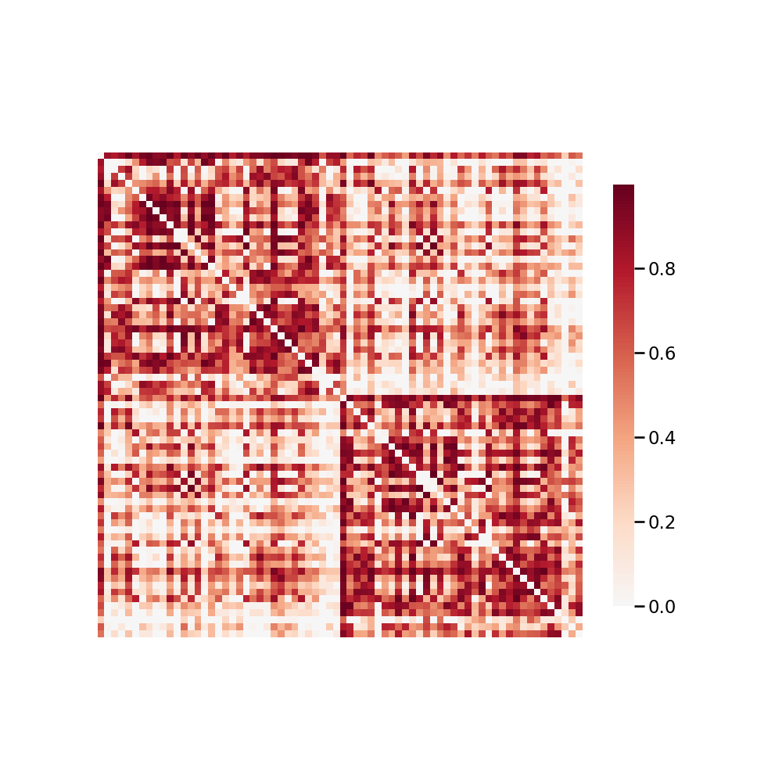
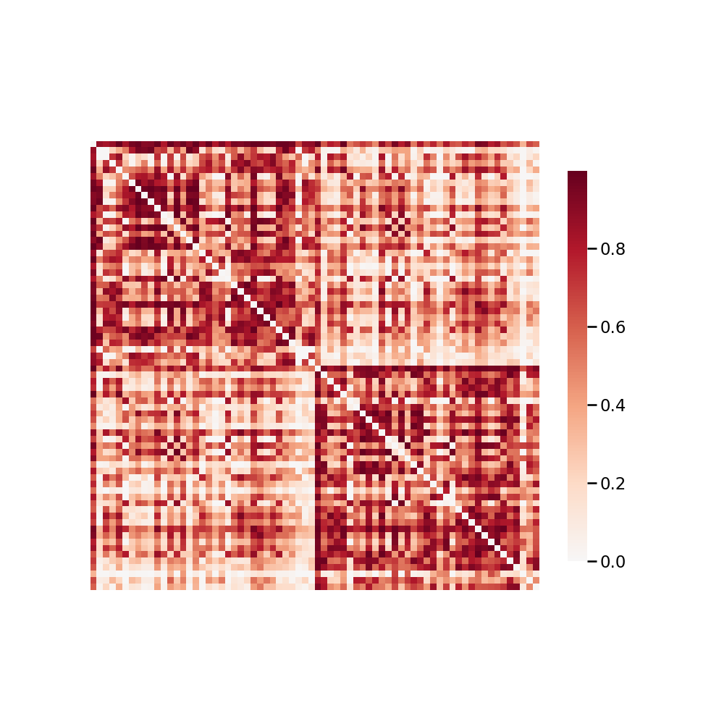
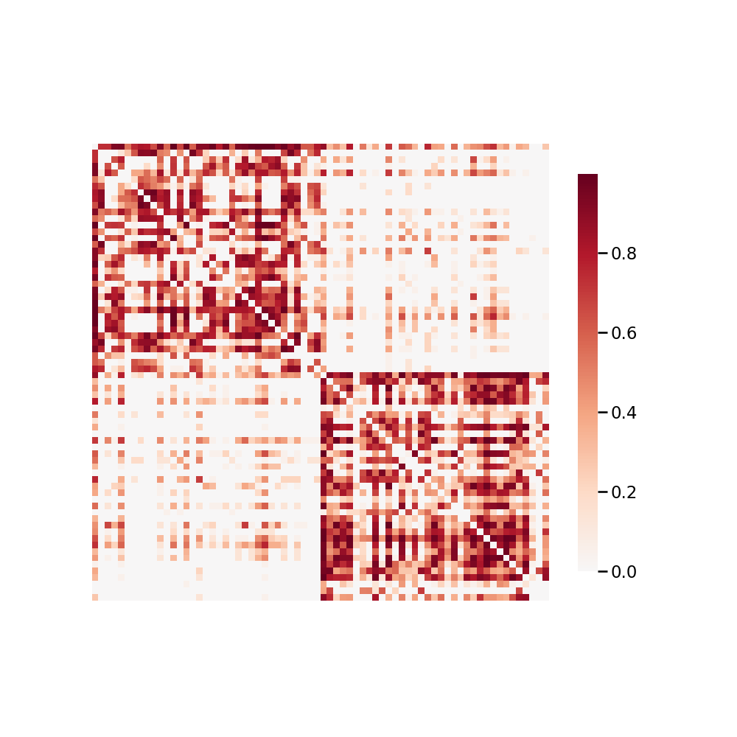
Data: BNU1
FAST
DiPy’s TissueClassifierHMRF
Seeds = ‘20’

Slide 3
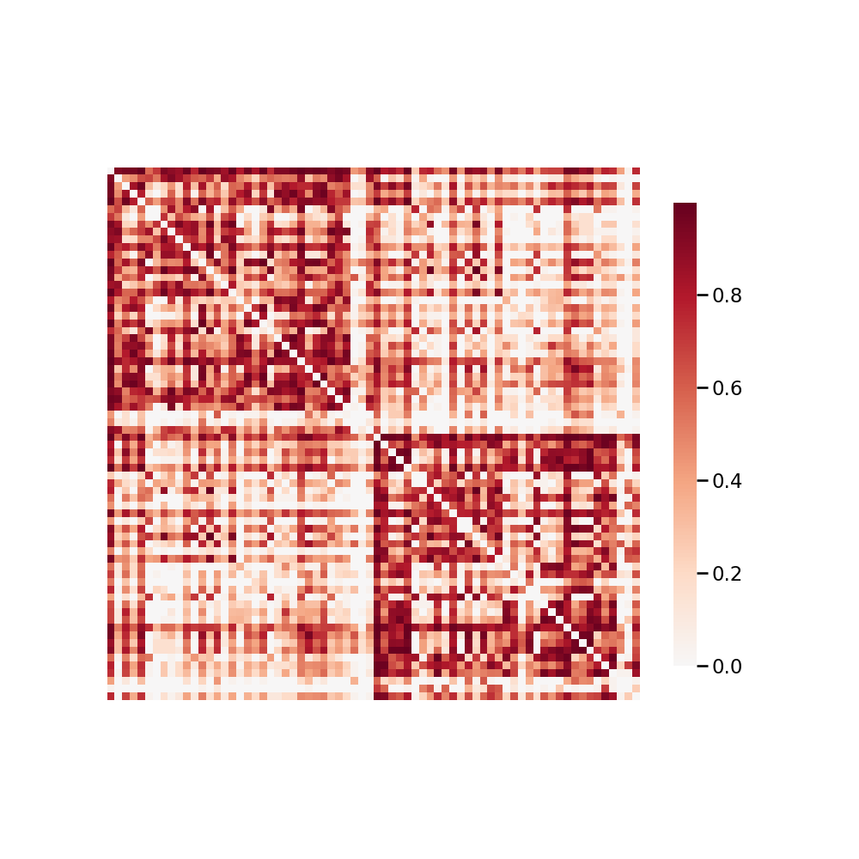
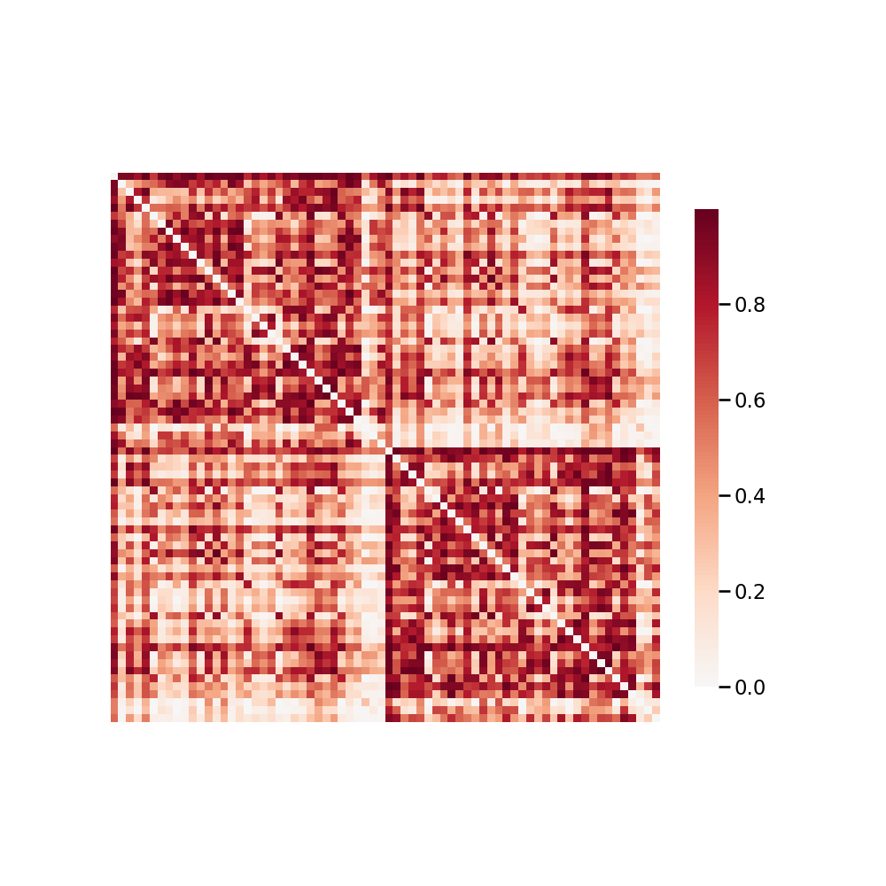
Data: SWU4_1_1
FAST
DiPy’s TissueClassifierHMRF

Slide 4
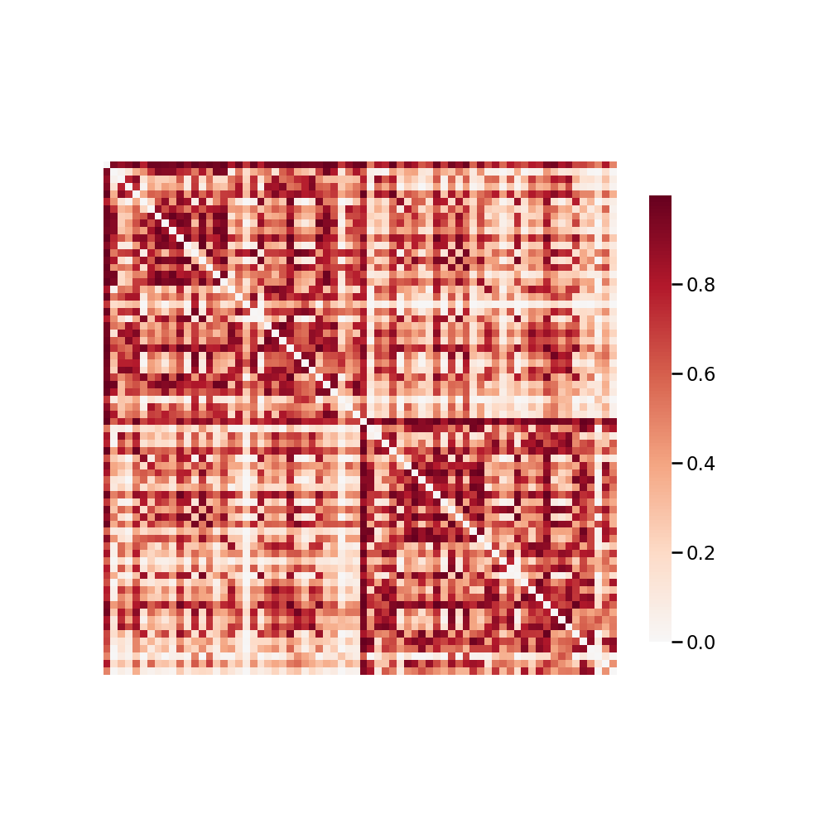
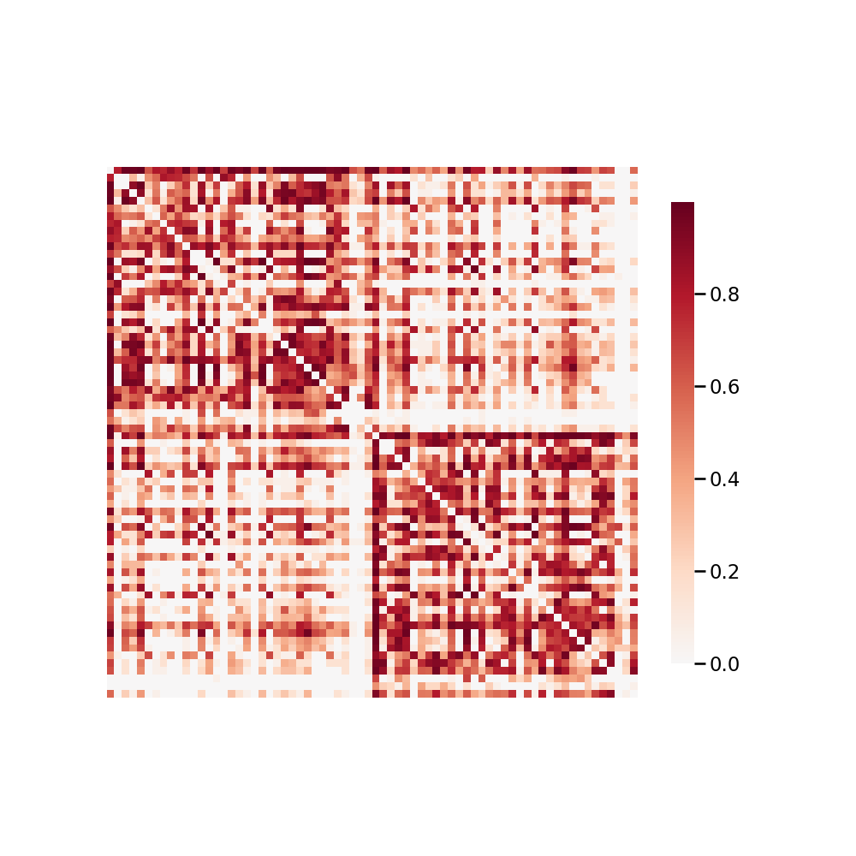
Data: SWU4_1_3
FAST
DiPy’s TissueClassifierHMRF

Slide 5
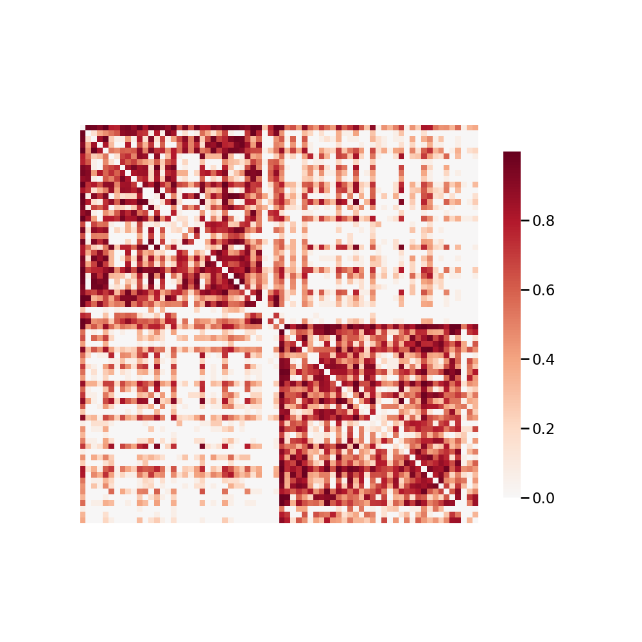
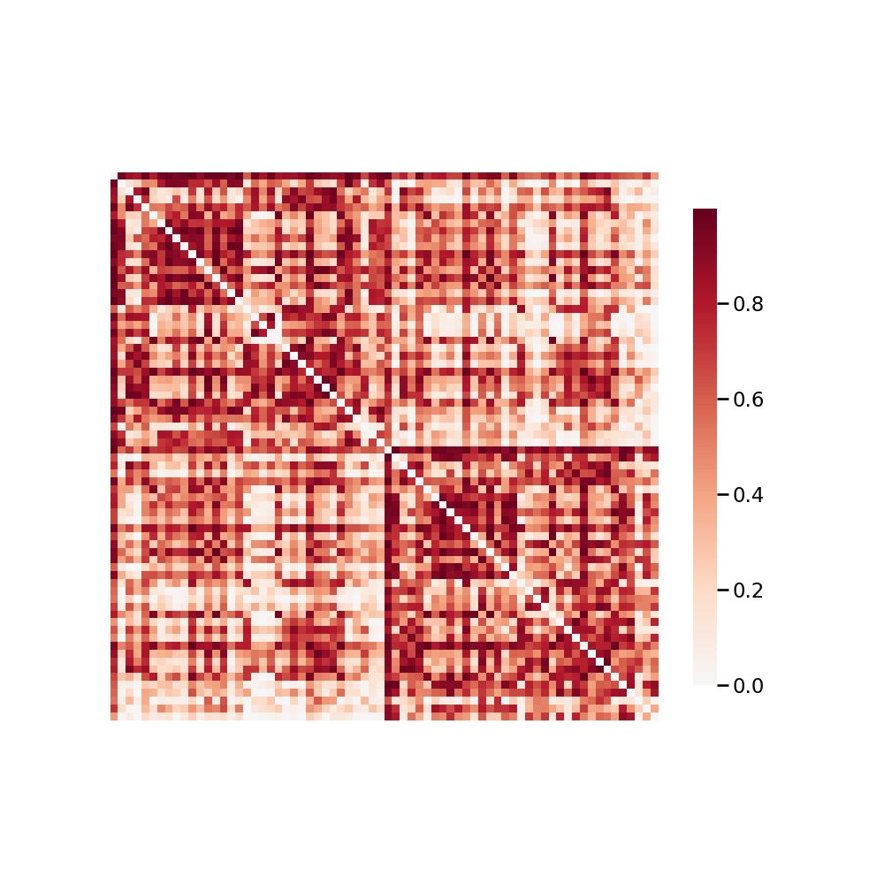
Data: SWU4_1_3
FAST
DiPy’s TissueClassifierHMRF

