Slide 1
Qa of FAST

Slide 2
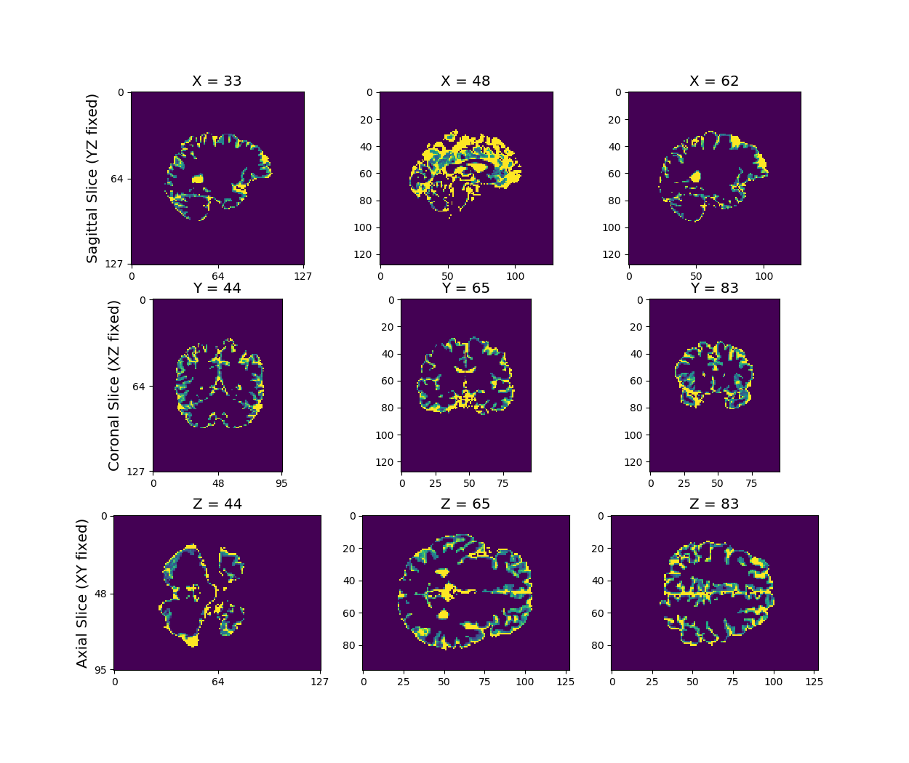
Qa of white matter

Slide 3
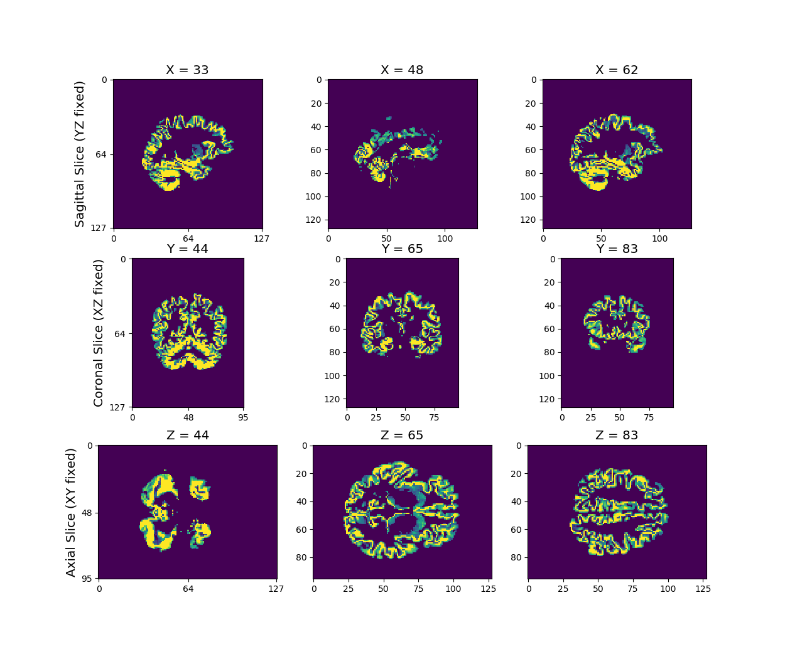
Qa of gray matter

Slide 4
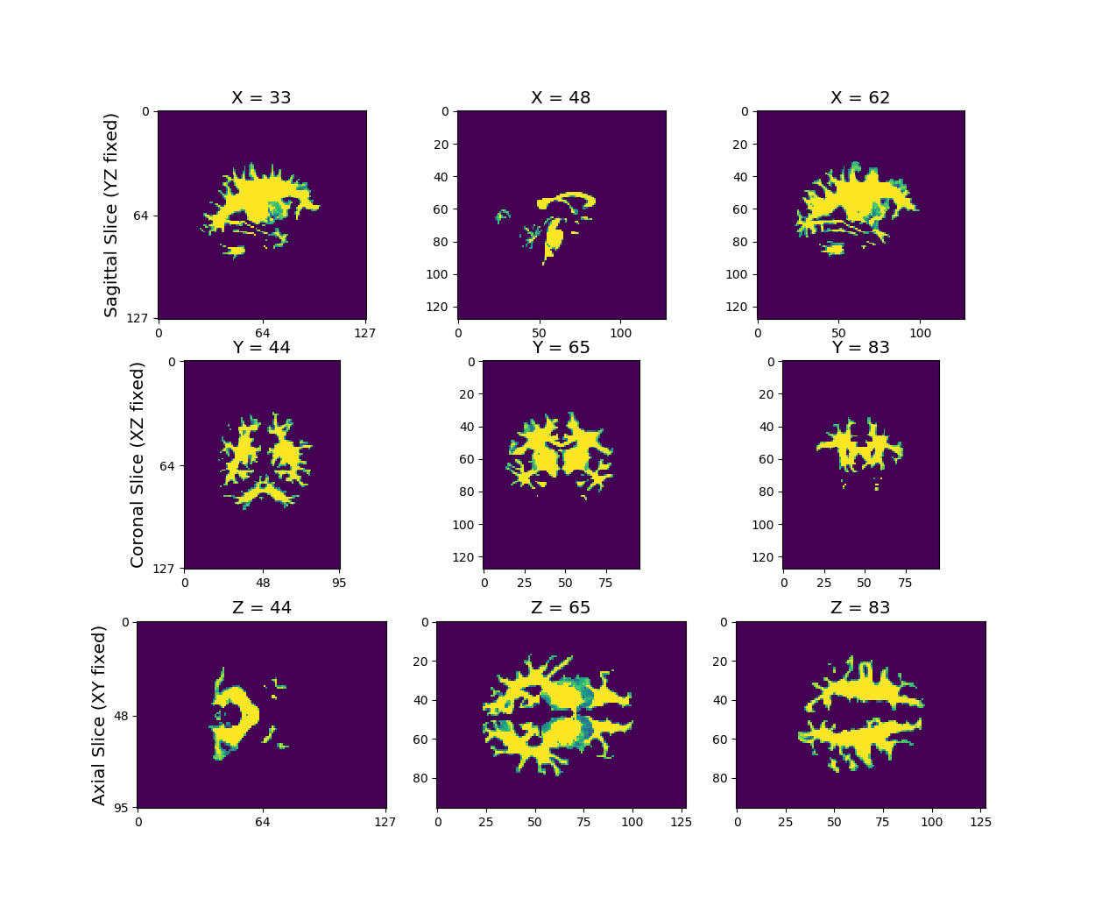
Qa of CSF

Slide 5
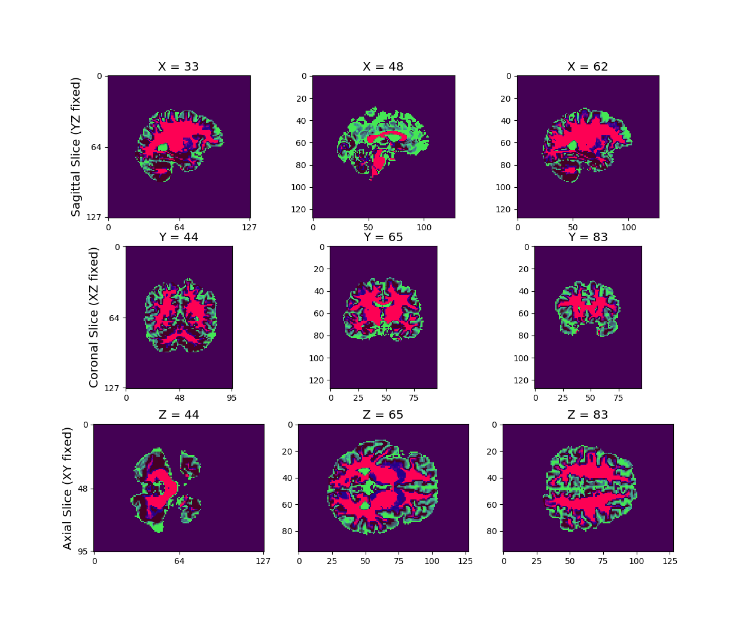
Qa of overlay

