Slide 2
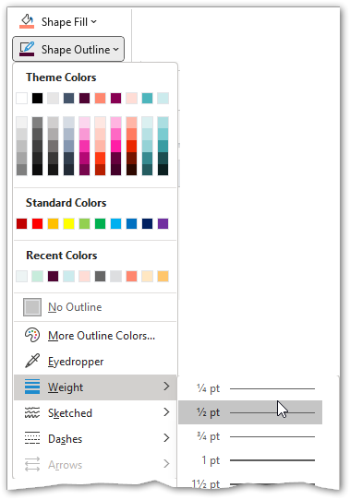
Colour scheme charts and tables
Remove this slide
Dark plum*
RGB
79/4/51
Plum *
RGB
135/0/82
Blue *
RGB
77/181/188
Grey
RGB
102/102/102
Green
RGB
84/185/134
Yellow
RGB
255/198/109
Orange *
RGB
255/135/111
Light orange *
RGB
255/221/214
Light blue *
RGB
204/235/237
Light grey
RGB
221/222/224
Light green
RGB
199/236/220
Light yellow
RGB
255/231/194
Colour * = part of KI Office colour scheme
For accessibility, on graphics you should have a border of 0.5 pt. in black to make it easier to see the difference between different colours e.g. bars in a chart.
Link colour is by default plum www.ki.se, must be changed
to white if the background is dark.

Slide 3
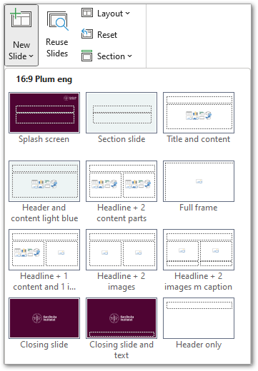
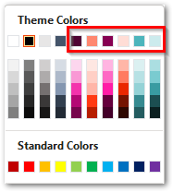
Instruction page 1/3
Remove this slide
Click the New Slide button to select different layout pages.
Click the Layout button to change the layout of the existing page.
To colour objects use KI theme colours
Click the Reset button to restore on the page according to the template's layout page.

Slide 4
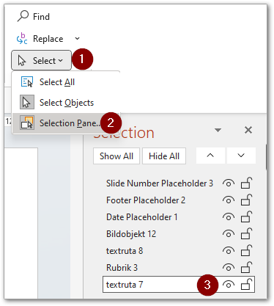
Accessibility instruction page 2/3
Remove this slide
Screen readers do not read information contained in the footer,
this is an alternative to a footer.
Type in details in the text box (framed) below
Copy text box to first slide, placement doesn't matter
Make it invisible (it will be read aloud by screen readers)
Home ribbon tab - Select - Selection pane
Click on the eye to hide
Author/Presenter
Title of the presentation

Slide 5
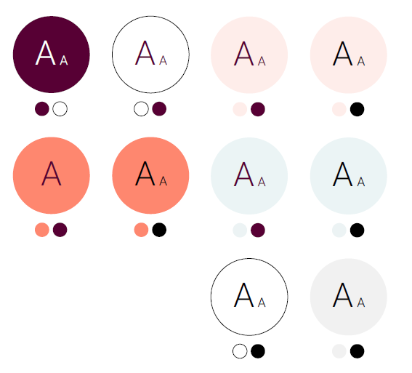
Accessibility instruction page 3/3
Remove this slide
Colour accessibility
The circles with the letters show possible colour combinations that generally meet the accessibility requirements.
The size of the text also affects the colour impression and thus the readability, especially in digital media. Therefore, there are specific recommendations regarding text sizes. Here you start from plain text in large scale of at least 18 pt/24 pt and smaller text of at least 14 pt/18.5 pt.
All colour combinations except plum on orange work in both large as small scale. NB! In digital channels, generally used larger typography than in printed matter (e.g. 16 pt body text on the web corresponds to about 9 pt body text in print).

