Slide 1
Low-Budget Movies at the Box Office
Project Luther: Revenge of Benson
Directed by: Steven Bierer
Produced in cooperation with Metis Data Science (Seattle Unit)

Slide 2




Released: November 15, 2002
Budget: $100 million
Box Office: $262.0 million
Released: February 14, 2003
Budget: $19 million
Box Office: $22.2 million

Slide 3

Overview
Studios must generate revenue to keep producing
What determines box office success?
Especially for lower-budget films
Based on factors available at release

Slide 4

Methods - Scraping and Filtering
Feature films (2008-2018) from IMDb.com
Removed movies with no budget or sales data
Data Element | Type | Transformation
Gross Box Office Sales | Numerical | Log
Opening Weekend Sales | Numerical | Log
Budget | Numerical | Log
Release Date | Numerical | Time filtering and averaging
Genre: Family, Comedy | Categorical | Dummy var
MPAA Rating: G, PG, etc | Categorical | Assigned rank (0 to 4)
User Rating and Count | Numerical | Not used

Slide 5
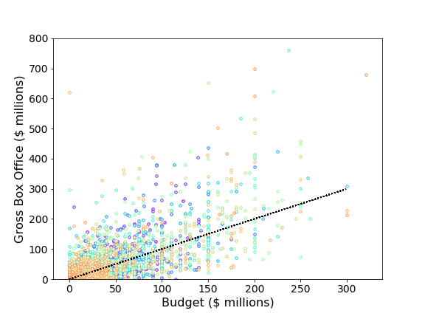
Analysis
Sales versus budget for all movies (n = 5887)
Wide variability in box office across all films
Good prediction with 1st-order model
Dominated by budget
R² = .483 (log)
R² = .421 (original)
Same model on low-budget movies not good

Slide 6
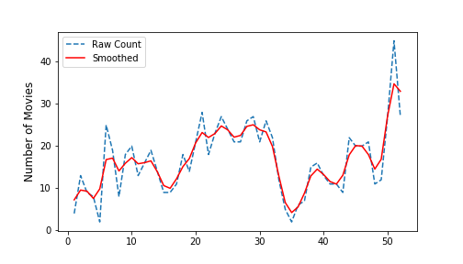
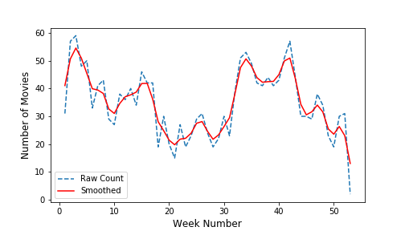
Analysis
High-budget
Seasonal trends for release date are nearly opposite for low-budget (n=1848) and high-budget movies (n=866)
Normalized “seasonality scores” were added as features
Low-budget

Slide 7
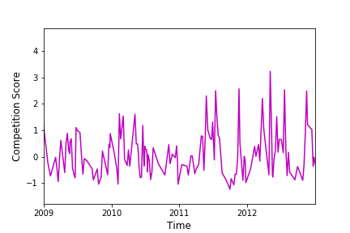
Analysis
High-budget “Competition” Score
Competition with high-budget movies was quantified based on opening week ticket sales

Slide 8
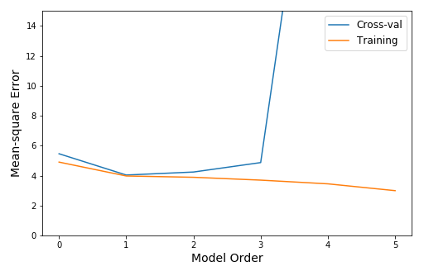
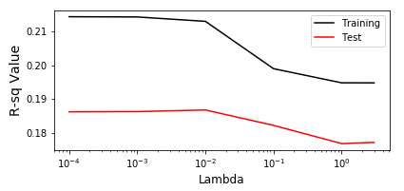
Analysis
Low-budget data
Cross-validation analysis suggested a 2nd- or 3rd-order model
Lasso Regularization for 2nd-order model refined feature selection

Slide 9
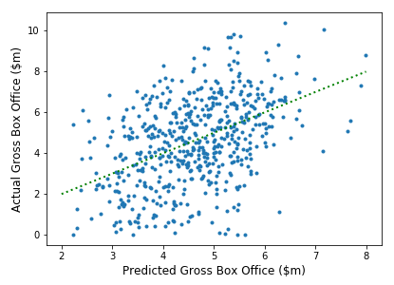
Conclusions - Low-budget data
A final R-squared value (untrained, transformed data) of only 0.19 was achieved.
Important features:
Budget*LB-Season (-)
Budget*Comedy (+)
LB-Season*HB-Competiton (-)
Comedy * MPAA-Lvl (-)

Slide 10
Future Analysis
Evaluate influence of genre
Genre-specific competition, week-by-week
Include measure of pre-release “buzz”
Early proxy for critical reception??
Implement as mixed model
Random effects of year, genre, etc
More data!

Slide 11


Slide 13
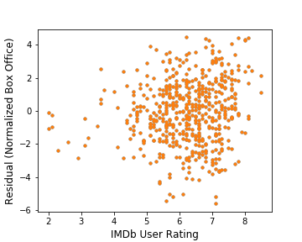
Appendix
Residual Error vs IMDb Movie Rating

