Slide 1
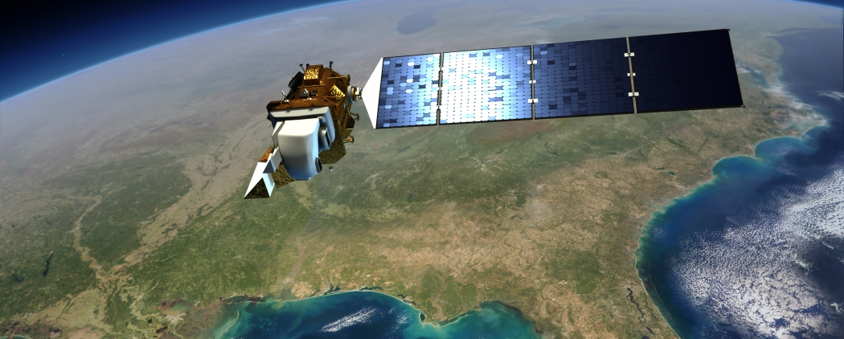
LandSat Image Classification
Steven Bierer
Metis Data Science Bootcamp, Seattle

Slide 2
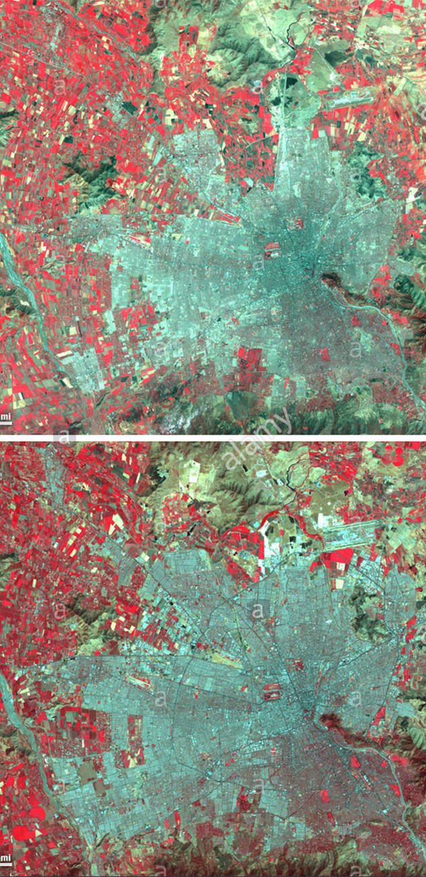
LandSat Program
Program to acquire images of Earth
LandSat 4 launched in 1982
Multiple spectral bands
Used in agriculture, ecology

Slide 3

Image data set
Source: UC Irvine Machine Learning Repository
6435 labeled images
9x9 grid of pixels (each 80m x 80m)
Four spectral components
Green, Red, Near IR, IR
Magnitudes of 0 - 255
Six labeled terrain types
Cotton Crop, Vegetation, Red Soil, Grey Soil, Damp Soil, Very Damp Soil

Slide 4
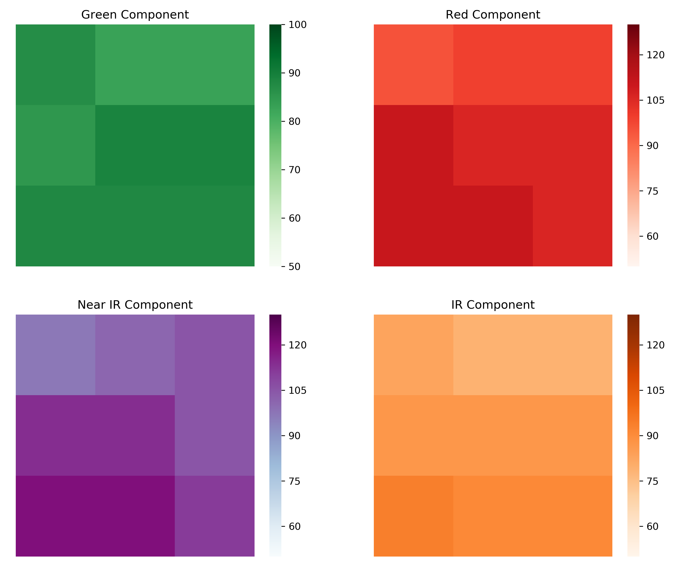
1A
2A
3A
1B
4A
5A
6A
7A
8A
9A
1C
1D

Slide 5
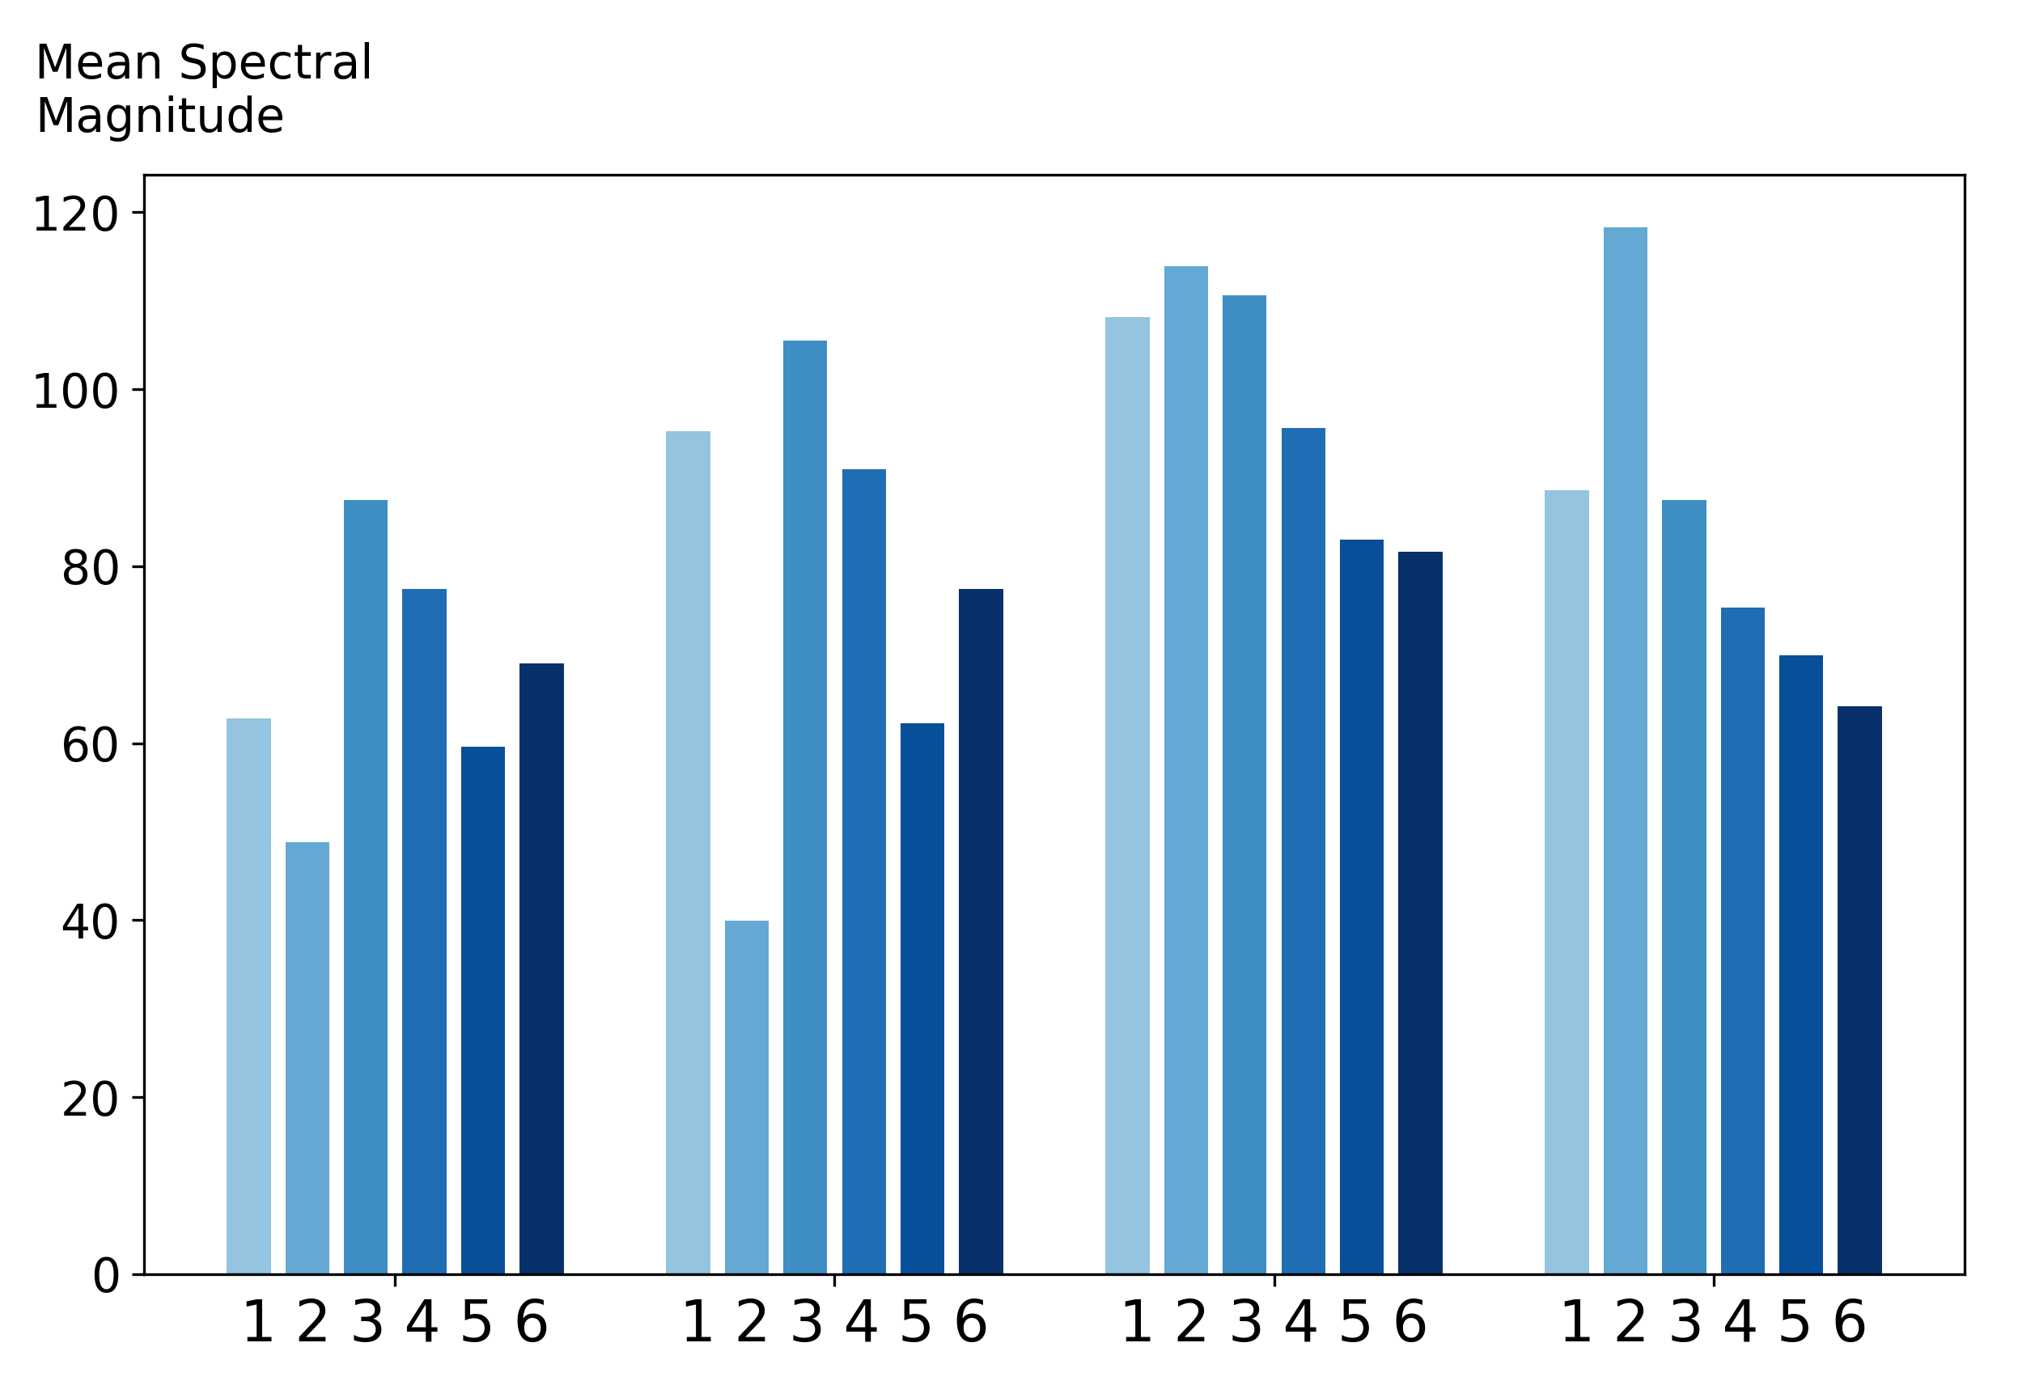
Classify based on “spectral signatures”
Green
Red
Near IR
IR

Slide 6
Classification training
Cross-validation scoring based on accuracy
Weighted to offset class imbalance
Principal components
36 -> 7 features
Model | Transform | Parameter | Optimal Val. | Accuracy
KNN | None | # Neighbors | 4 | 0.83
 | PC |  | 8 | 0.79
Logistic Reg. | None | C Value | 0.1 | 0.74
 | PC |  | 10 | 0.73
Random Forest | None | # Estimators | 100 | 0.84
 | PC |  | 100 | 0.83
0.99 !
(full training)

Slide 7
Cost-Benefit Adjustment
Extra cost for misclassifying cotton crop
Extra cost for misclassifying vegetation with cotton crop
Don’t care about grey/damp soil confusions
[1-class probability]
[ — COSTS —]
[ — | —]
[ — | —]
[ — | —]
= [ cost score ]
[ class probability ]
[ — BENEFITS —]
[ — | —]
[ — | —]
[ — | —]
= [ benefit score]
[ class prediction ] = argmax( benefit score - cost score )

Slide 8
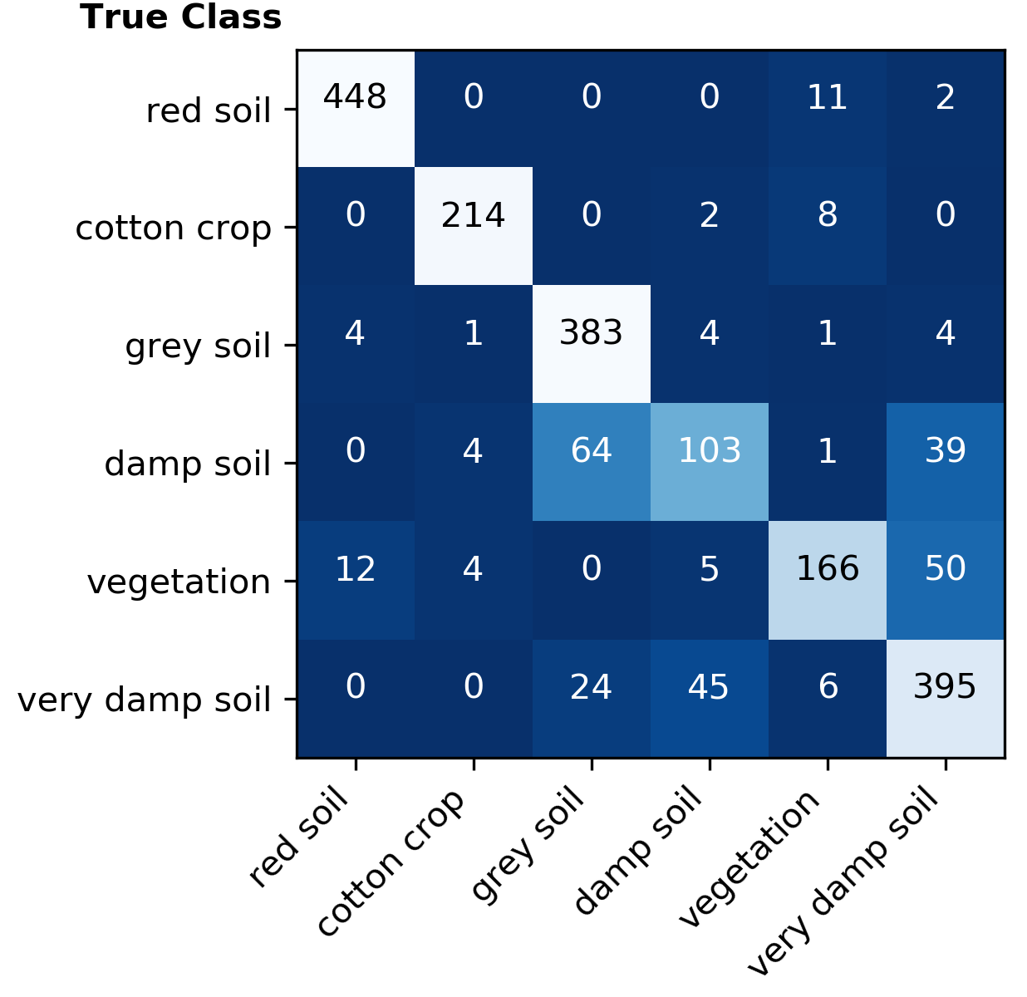
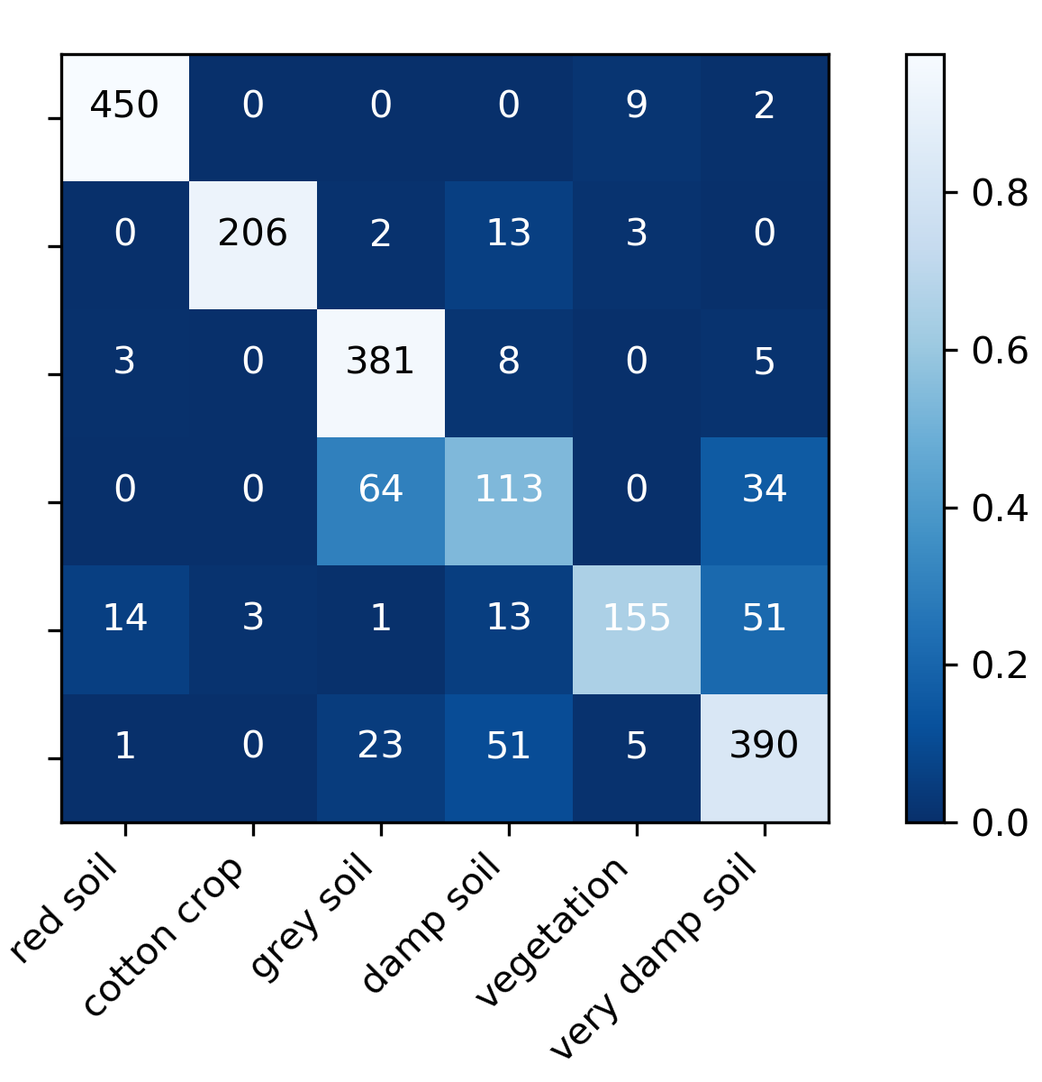
Classification results
Without Adjustment
Precision(cotton) = 0.96
With Adjustment
Precision(cotton) = 0.99
Fraction
of whole
Predicted Class

Slide 9
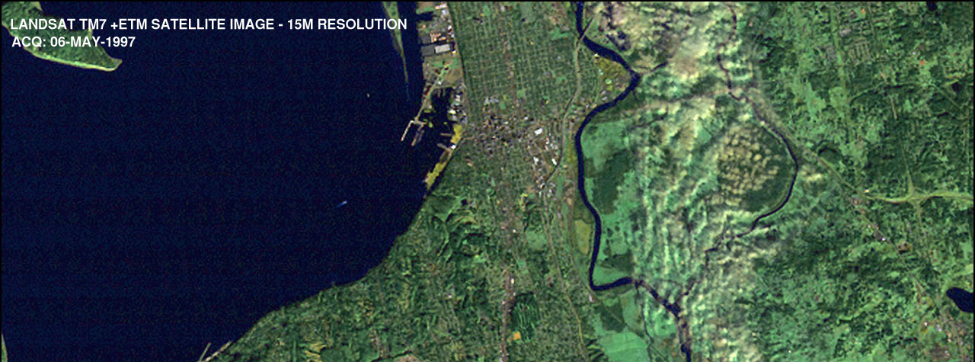
Future considerations
Rotation-invariant PCA
“Hu” Image Moments
Larger image training set
More sophisticated classifier
e.g. Deep Learning

Slide 10
Appendix
precision recall f1-score support
red soil 0.96 0.98 0.97 461.0
cotton crop 0.99 0.92 0.95 224.0
grey soil 0.81 0.96 0.88 397.0
damp soil 0.57 0.54 0.55 211.0
vegetation 0.90 0.65 0.76 237.0
very damp soil 0.81 0.83 0.82 470.0
avg / total 0.85 0.85 0.85 2000.0
-- Metric ----- Average Scores ----
Accuracy: 0.848
Precision: 0.840
Recall: 0.813
F1 Score: 0.822
precision recall f1-score support
red soil 0.97 0.97 0.97 461.0
cotton crop 0.96 0.96 0.96 224.0
grey soil 0.81 0.96 0.88 397.0
damp soil 0.65 0.49 0.56 211.0
vegetation 0.86 0.70 0.77 237.0
very damp soil 0.81 0.84 0.82 470.0
avg / total 0.85 0.85 0.85 2000.0
-- Metric ----- Average Scores ----
Accuracy: 0.855
Precision: 0.842
Recall: 0.820
F1 Score: 0.827

Slide 11
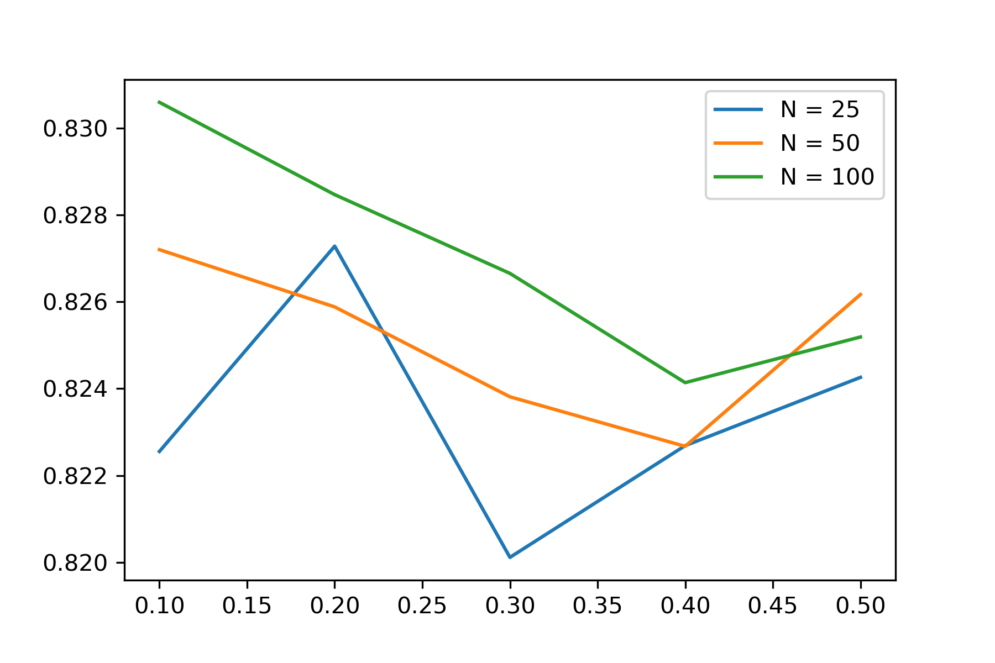
Weighted
Accuracy
Random Forest on PCA projections
Max Features (fraction)

