Slide 1
NeuroML: Where are we at?
Padraig Gleeson
Department of Neuroscience, Physiology and Pharmacology
University College London

Slide 2
Overview
What can already be done with NeuroML v1.x?
Limitations – need for NeuroML v2.0
Distinction between NeuroML v2.0 and LEMS
Model component hierarchy for NeuroML v2.0
Initial implementation of libNeuroML – import & export in various formats

Slide 3
What is NeuroML?
Standard computational language for archiving/exchanging (components of) neuronal models
Required since most simulators (e.g. NEURON, GENESIS) and other comp neuro applications have their own proprietary formats
Focus to date on multicompartmental conductance based models, i.e.
    Neuronal morphologies
    Ion channels/synapse models
    3D positions & connectivity of cells in networks
Version 1.x was pragmatic solution to interoperability problem

Slide 4
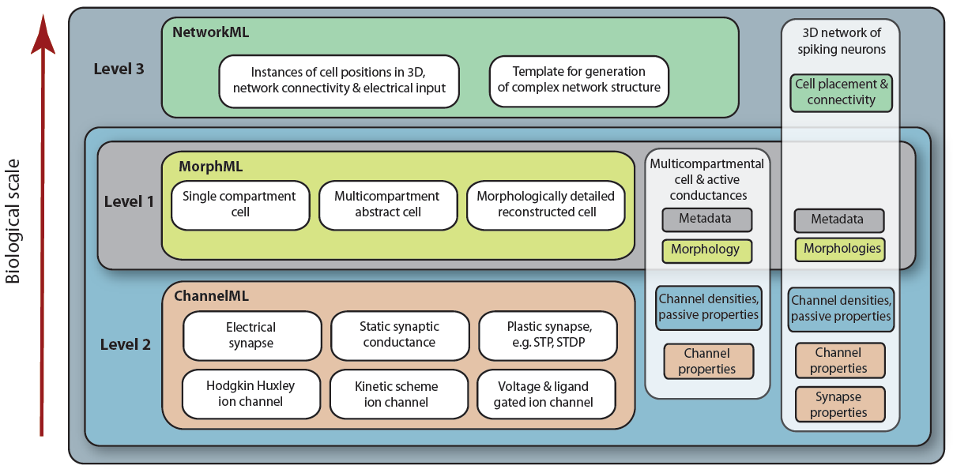
NeuroML v1.x

Slide 5
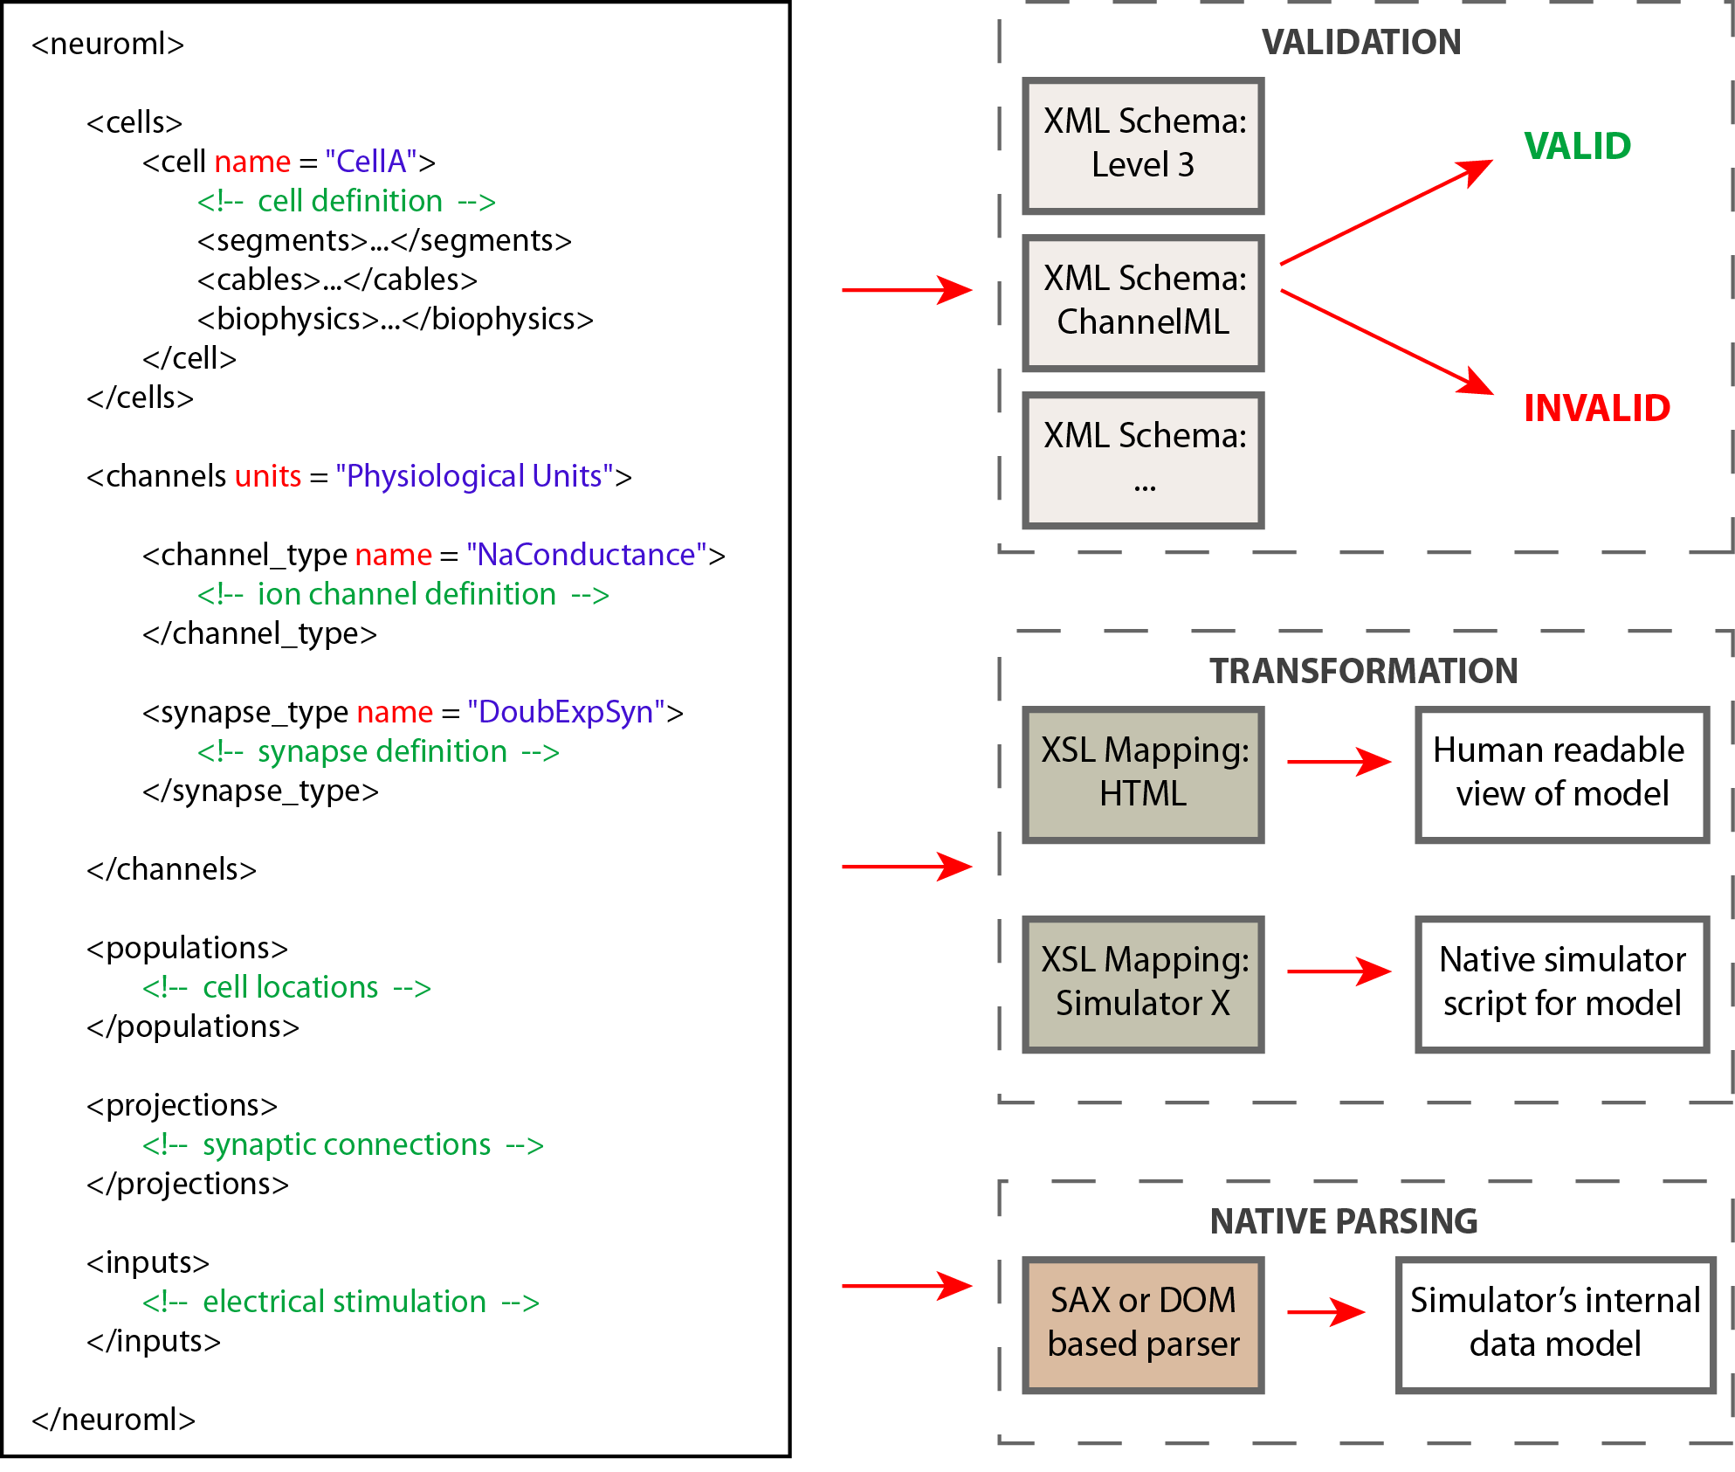

Slide 6

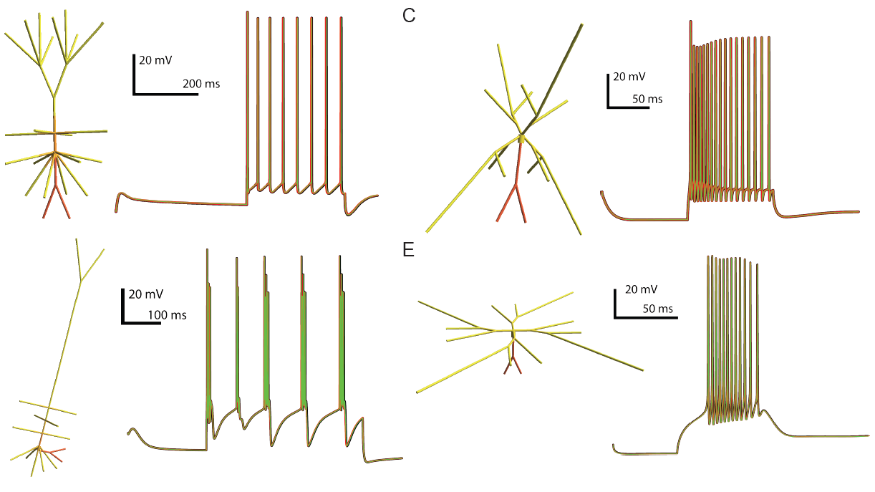

NEURON
GENESIS
MOOSE
LTS interneuron
nucleus reticularis thalami cell

Slide 7
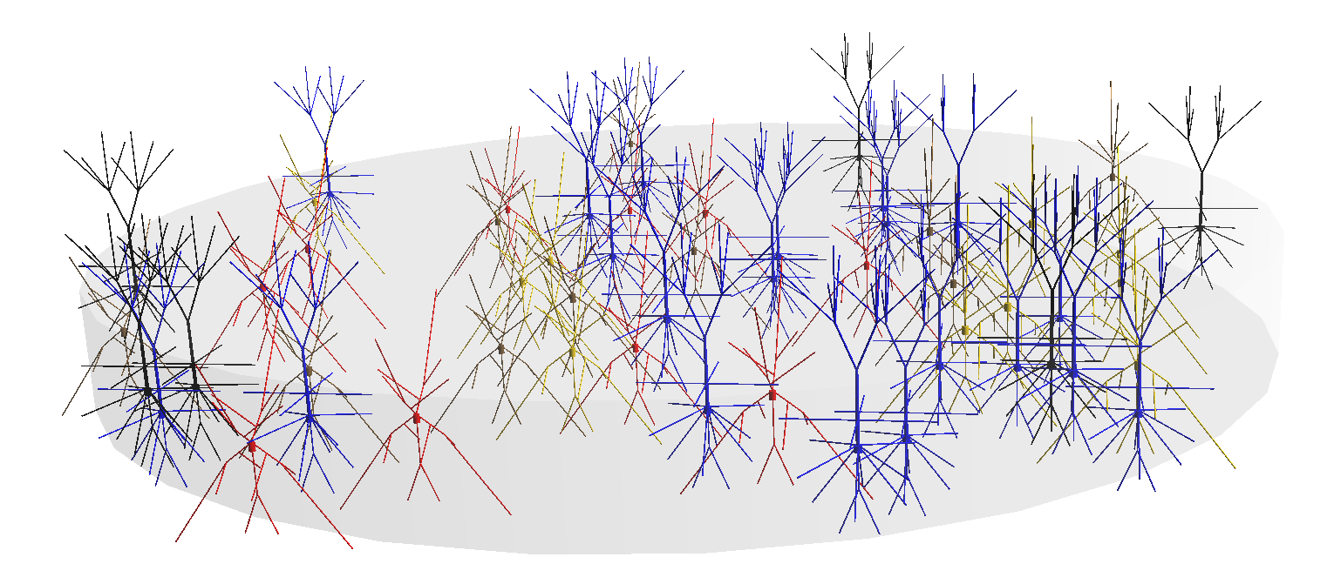
Layer 2/3 Network model based on Traub et al. 2003 cells
20 RS pyramidal cells
6 FRB pyramidal cells
10 LTS interneurons
10 axo-axonic interneurons
10 basket cells

Slide 8
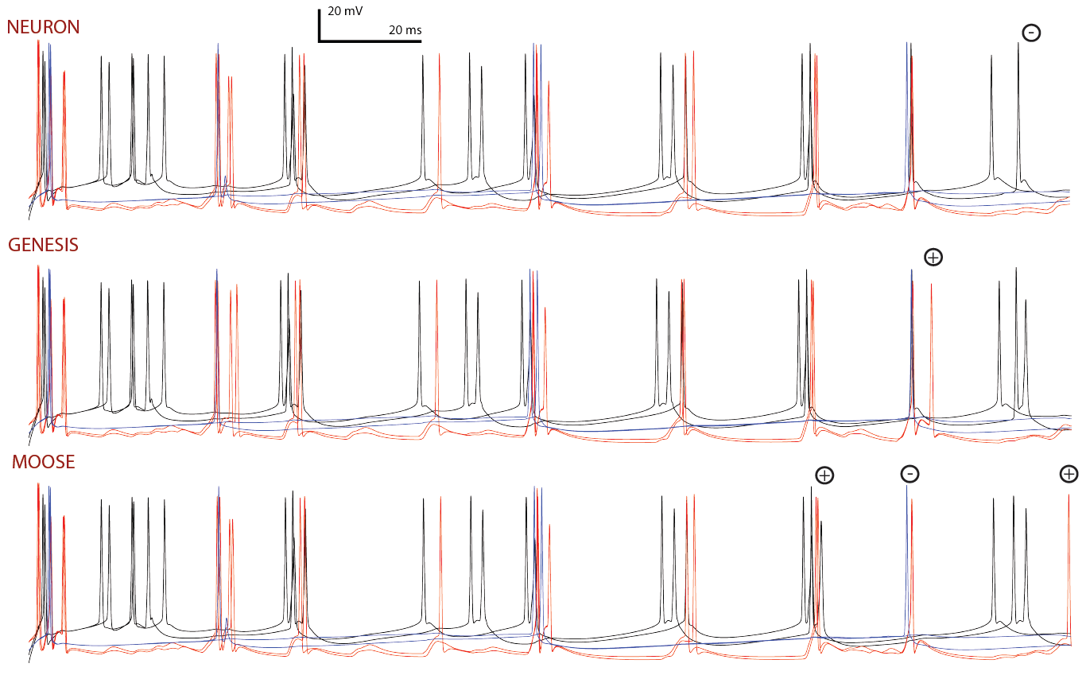
RS pyramidal cells
FRB pyramidal cells
LTS interneurons
Gleeson et al.
2010

Slide 9
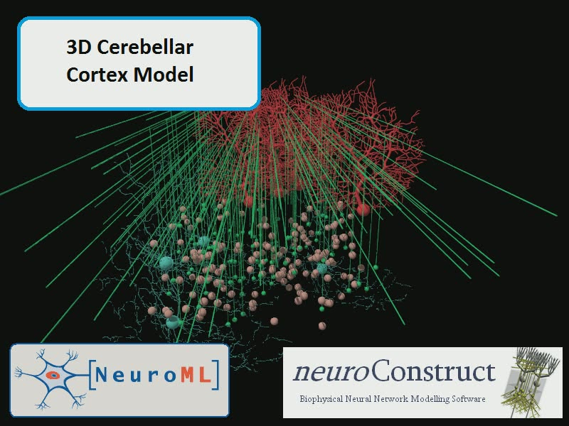

Slide 10
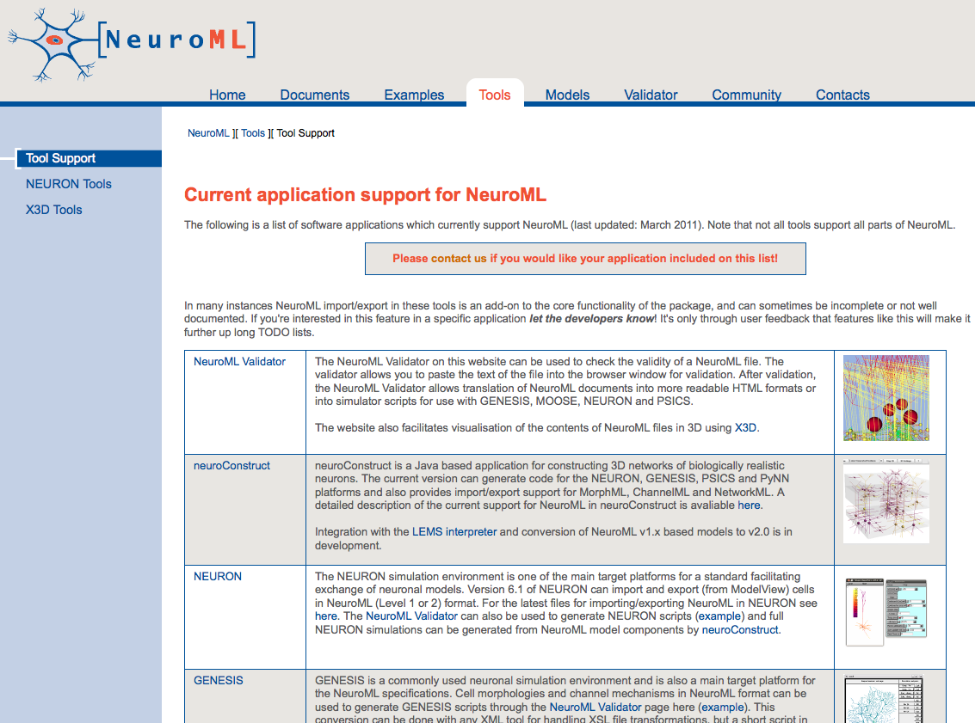
Tools with NeuroML support
25 freely available software packages & databases with some NeuroML support
4+ more with support in pipeline
Notes:
There are a number of objects in GENESIS for implementing plastic synapses (e.g. facsynchan, hebbsynchan), but these are based on different formalisms than the STP and STDP synaptic mechanisms used in NeuroML. It is hoped that through ongoing contacts with the developers of GENESIS 3, and other interested parties such as the PyNN developers,
community wide agreement can be reached regarding a core set of synaptic plasticity models for future support.

Slide 11
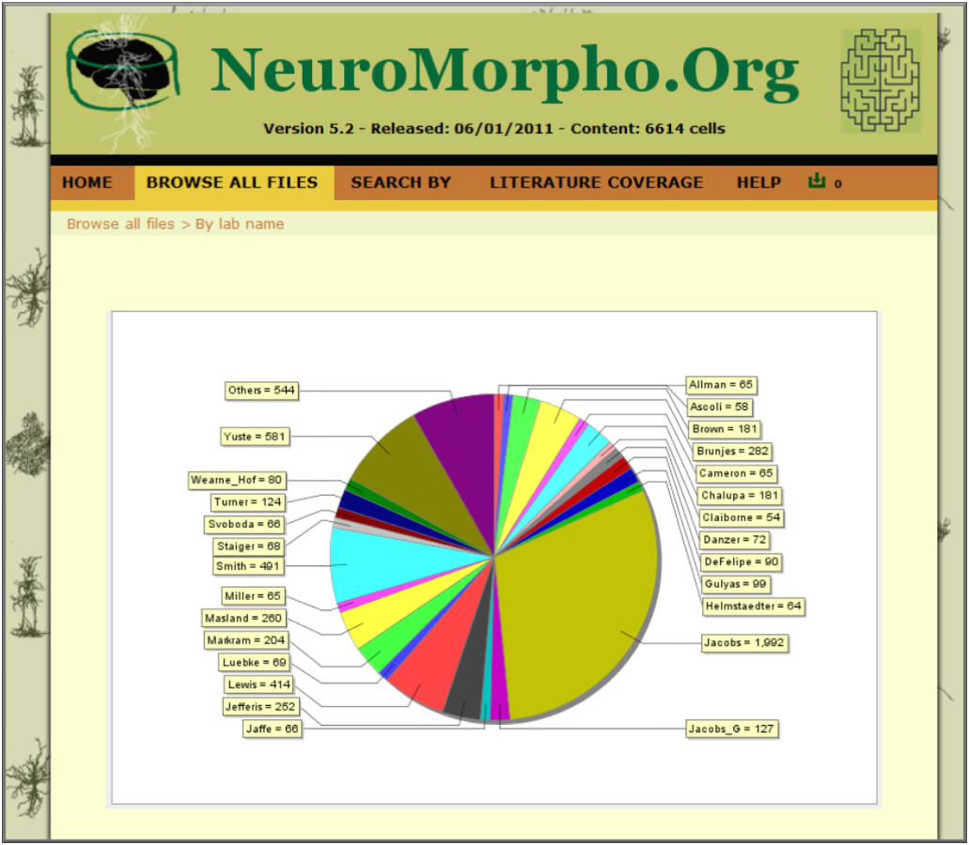
Repository of 7200+ reconstructed neurons from diverse brain regions & species
Can all be downloaded in NeuroML format
Notes:
There are a number of objects in GENESIS for implementing plastic synapses (e.g. facsynchan, hebbsynchan), but these are based on different formalisms than the STP and STDP synaptic mechanisms used in NeuroML. It is hoped that through ongoing contacts with the developers of GENESIS 3, and other interested parties such as the PyNN developers,
community wide agreement can be reached regarding a core set of synaptic plasticity models for future support.

Slide 12
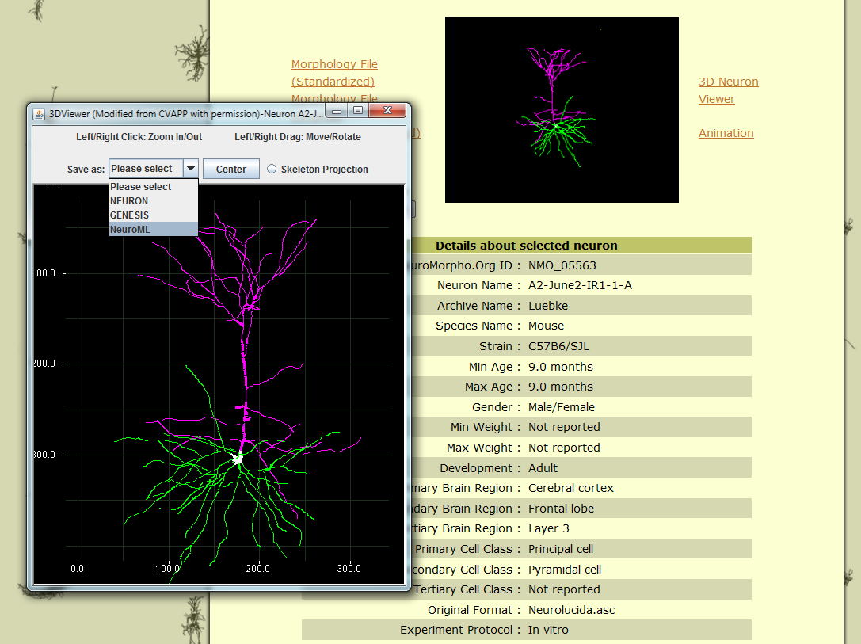

Slide 13
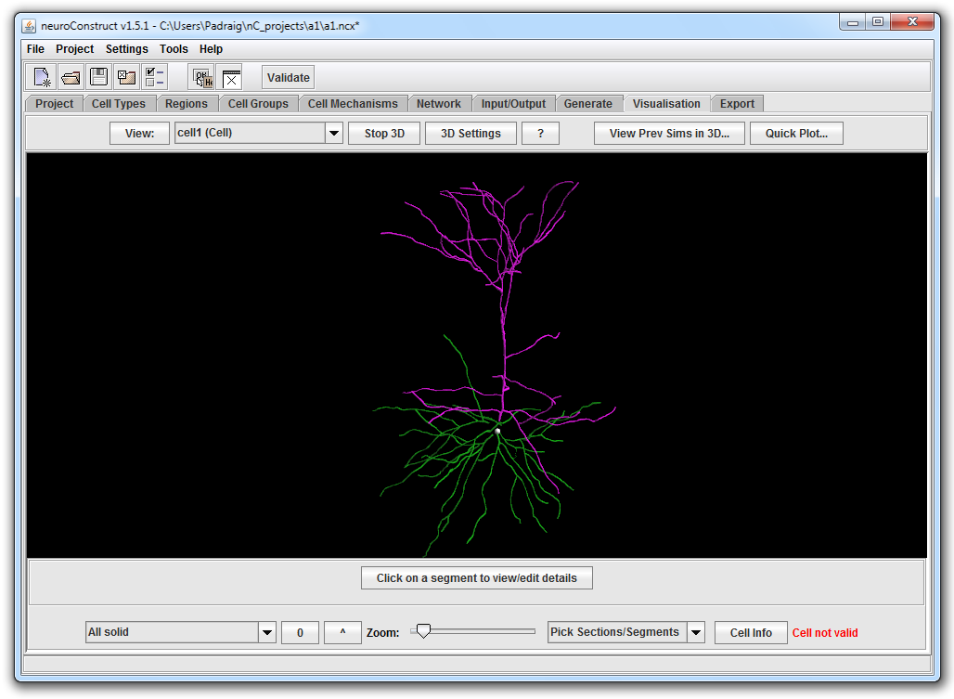
nC.bat –neuroml MyMorphology.xml

Slide 14
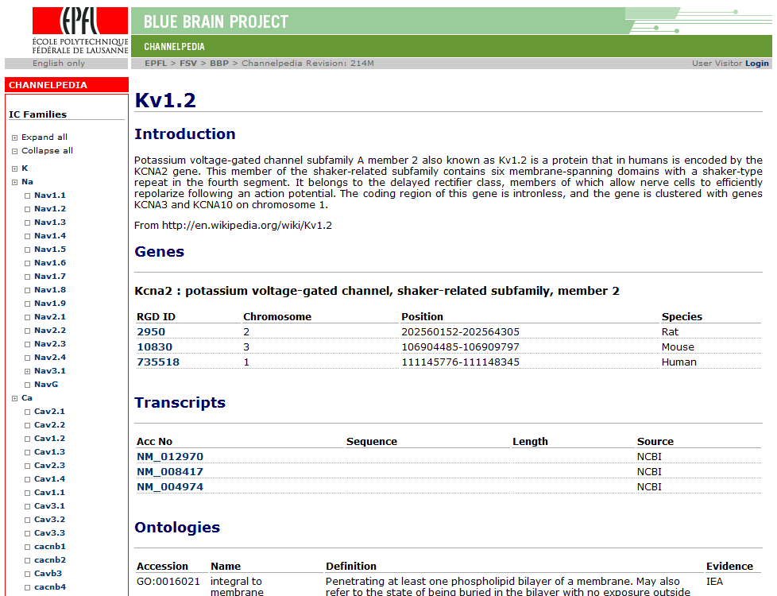

Slide 15
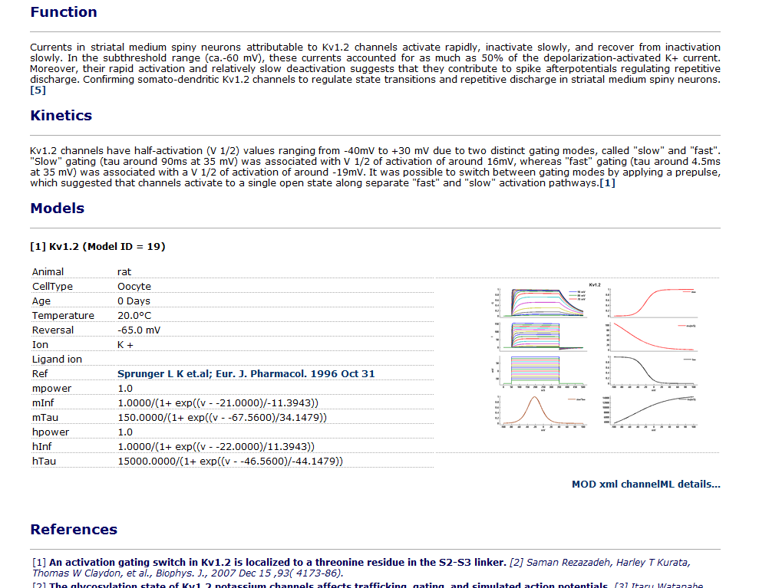
Around 50 of the 180+ channels have models associated with them
All can be downloaded in ChannelML

Slide 16
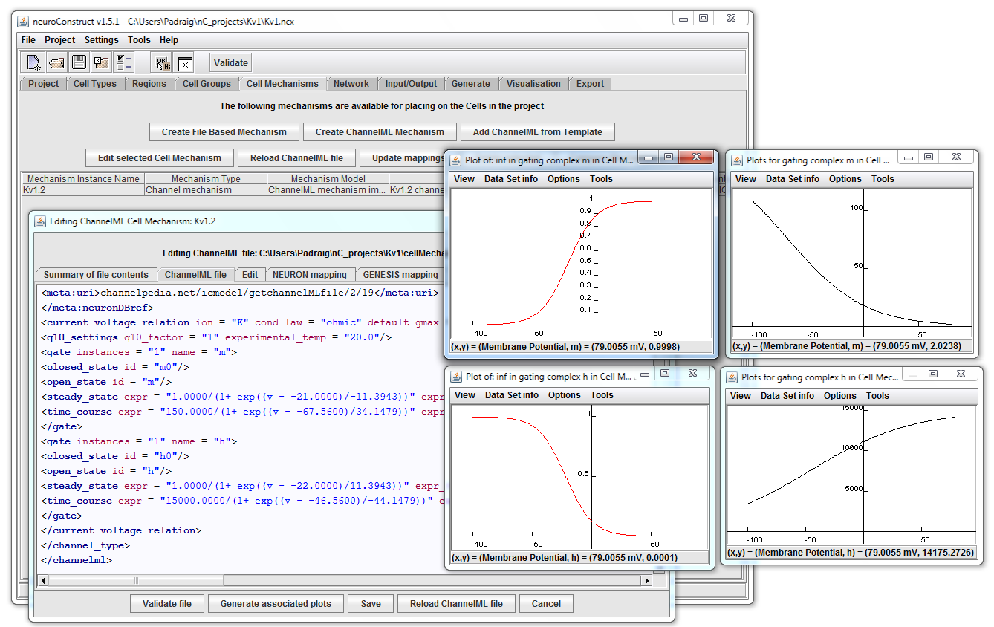
nC.bat –neuroml Kv1.2.xml

Slide 17
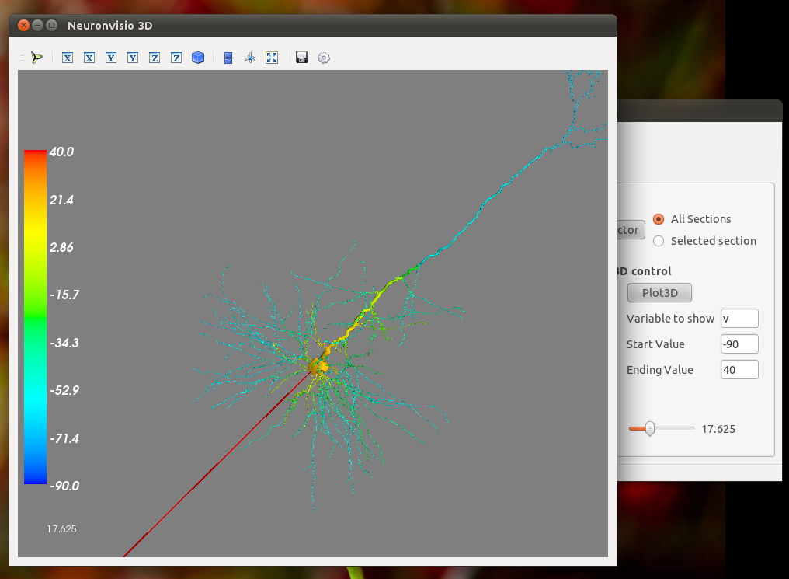
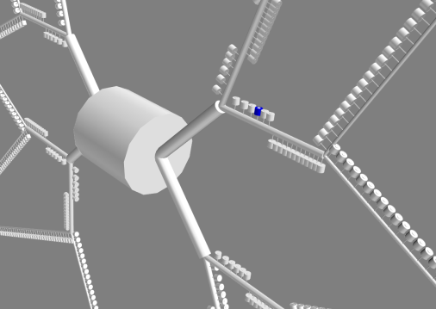
Neuronvisio

Slide 18
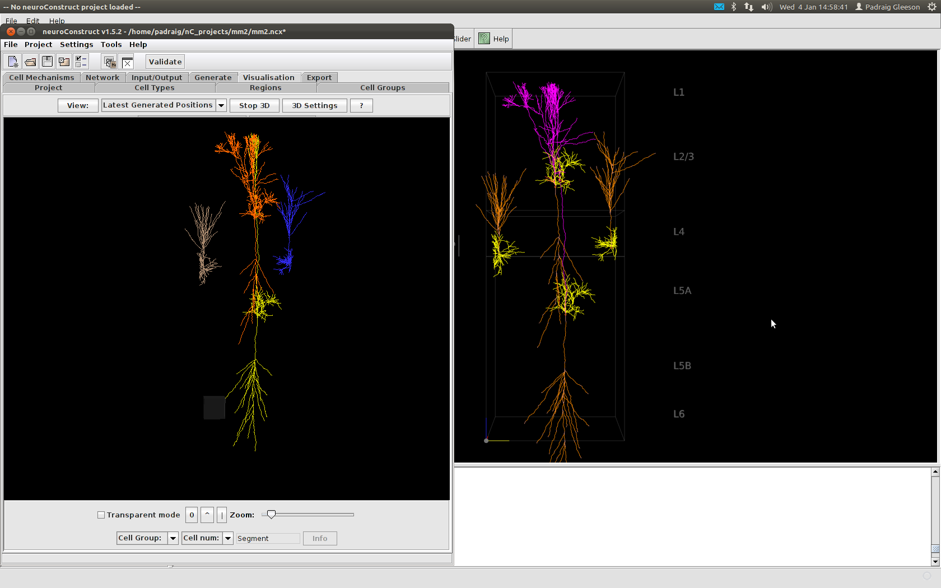
NeuGen

Slide 19
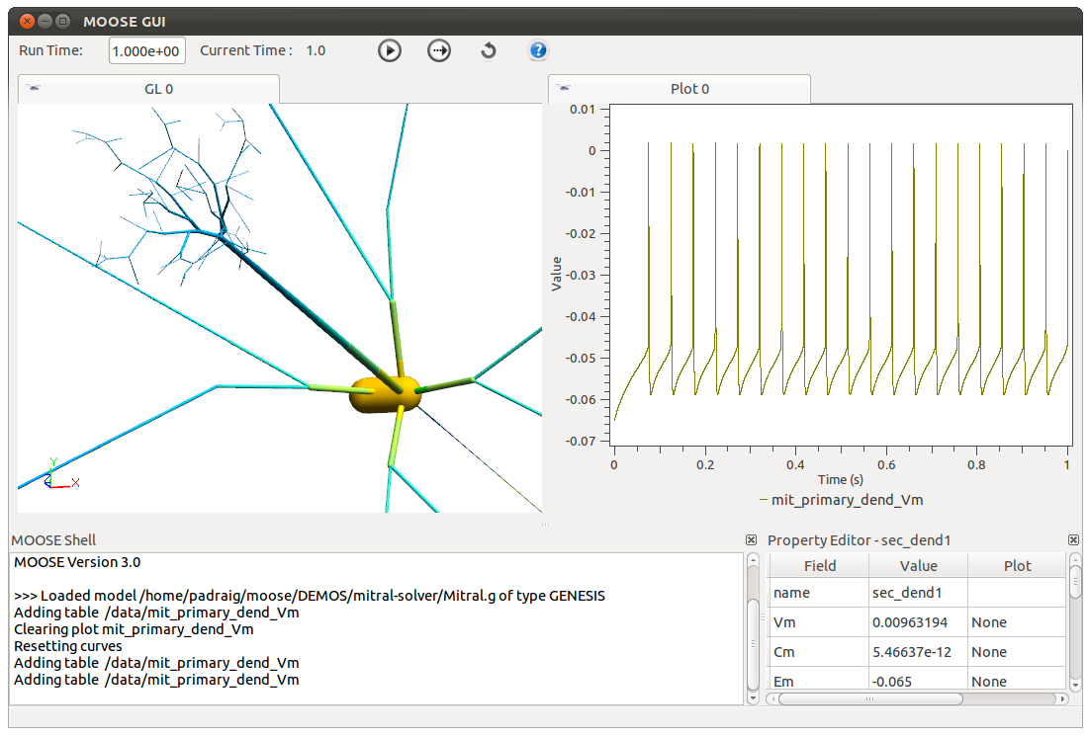
MOOSE

Slide 20
Limitations of NeuroML v1.x
Implicit definitions of ion channels, synapse models, etc.
Lack of extensibility
Support for conductance based models, but not simpler, faster abstract cell models
Lack of integration with other standards such as SBML & CellML

Slide 21
Version 2.0 requirement: Explicit definitions of model component behaviour
Definitions of HH channel, fixed/STP synapse model behaviour were specified in text in NeuroML v1.x documentation
  Required simulator to natively support the same channel/synapse model; or developer could read the documentation & implement it
NeuroML v2.0 contains a way to describe behaviour of model components in simulator independent & machine readable manner

Slide 22
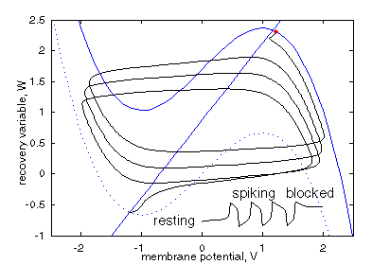

Example: Fitzhugh-Nagumo cell model
Simplified version of 4 variable HH model
2 state variables, 2 ODEs
Image from Scholarpedia.org

Slide 23
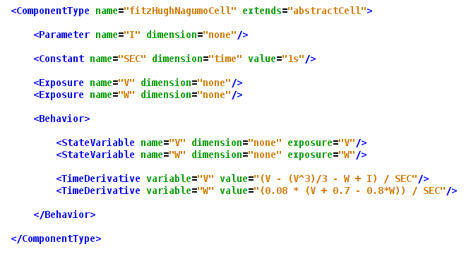
Original model
Model expressed in LEMS (Low Entropy Model
Specification language)

Slide 24
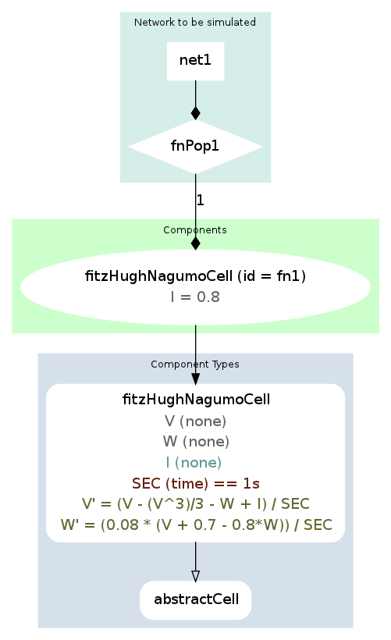
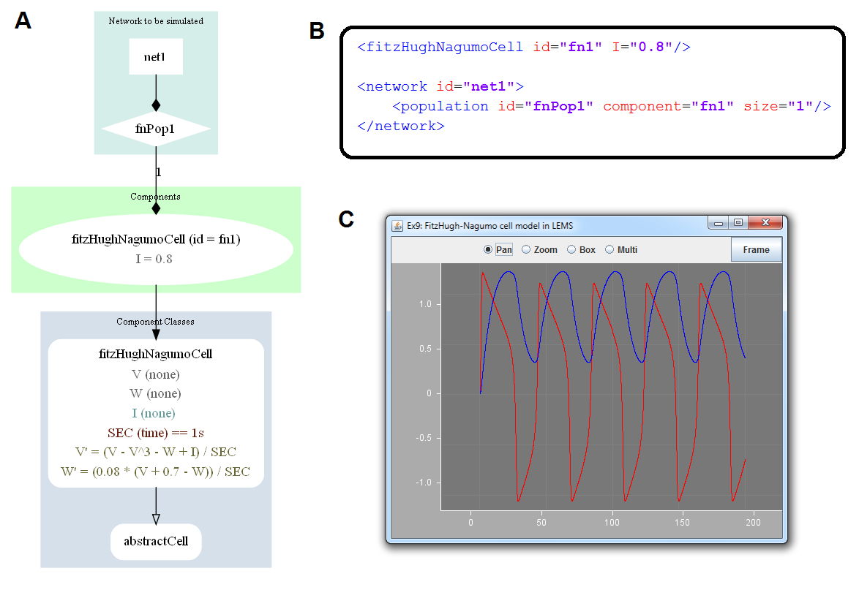
Component instance in NeuroML v2.0
A
V
W

Slide 25
What’s the relationship between LEMS & NeuroML 2?
LEMS: Low Entropy Model Specification
Defines reusable/extensible ComponentTypes to use as basis for Components in dynamical model
Not neuroscience specific
NeuroML v2.0 files will be standalone XML descriptions of <cell>, <ionChannel>, <synapse>, etc. models, as in v1.x
Can be validated with updated XML Schema
Very neuroscience specific

Slide 26
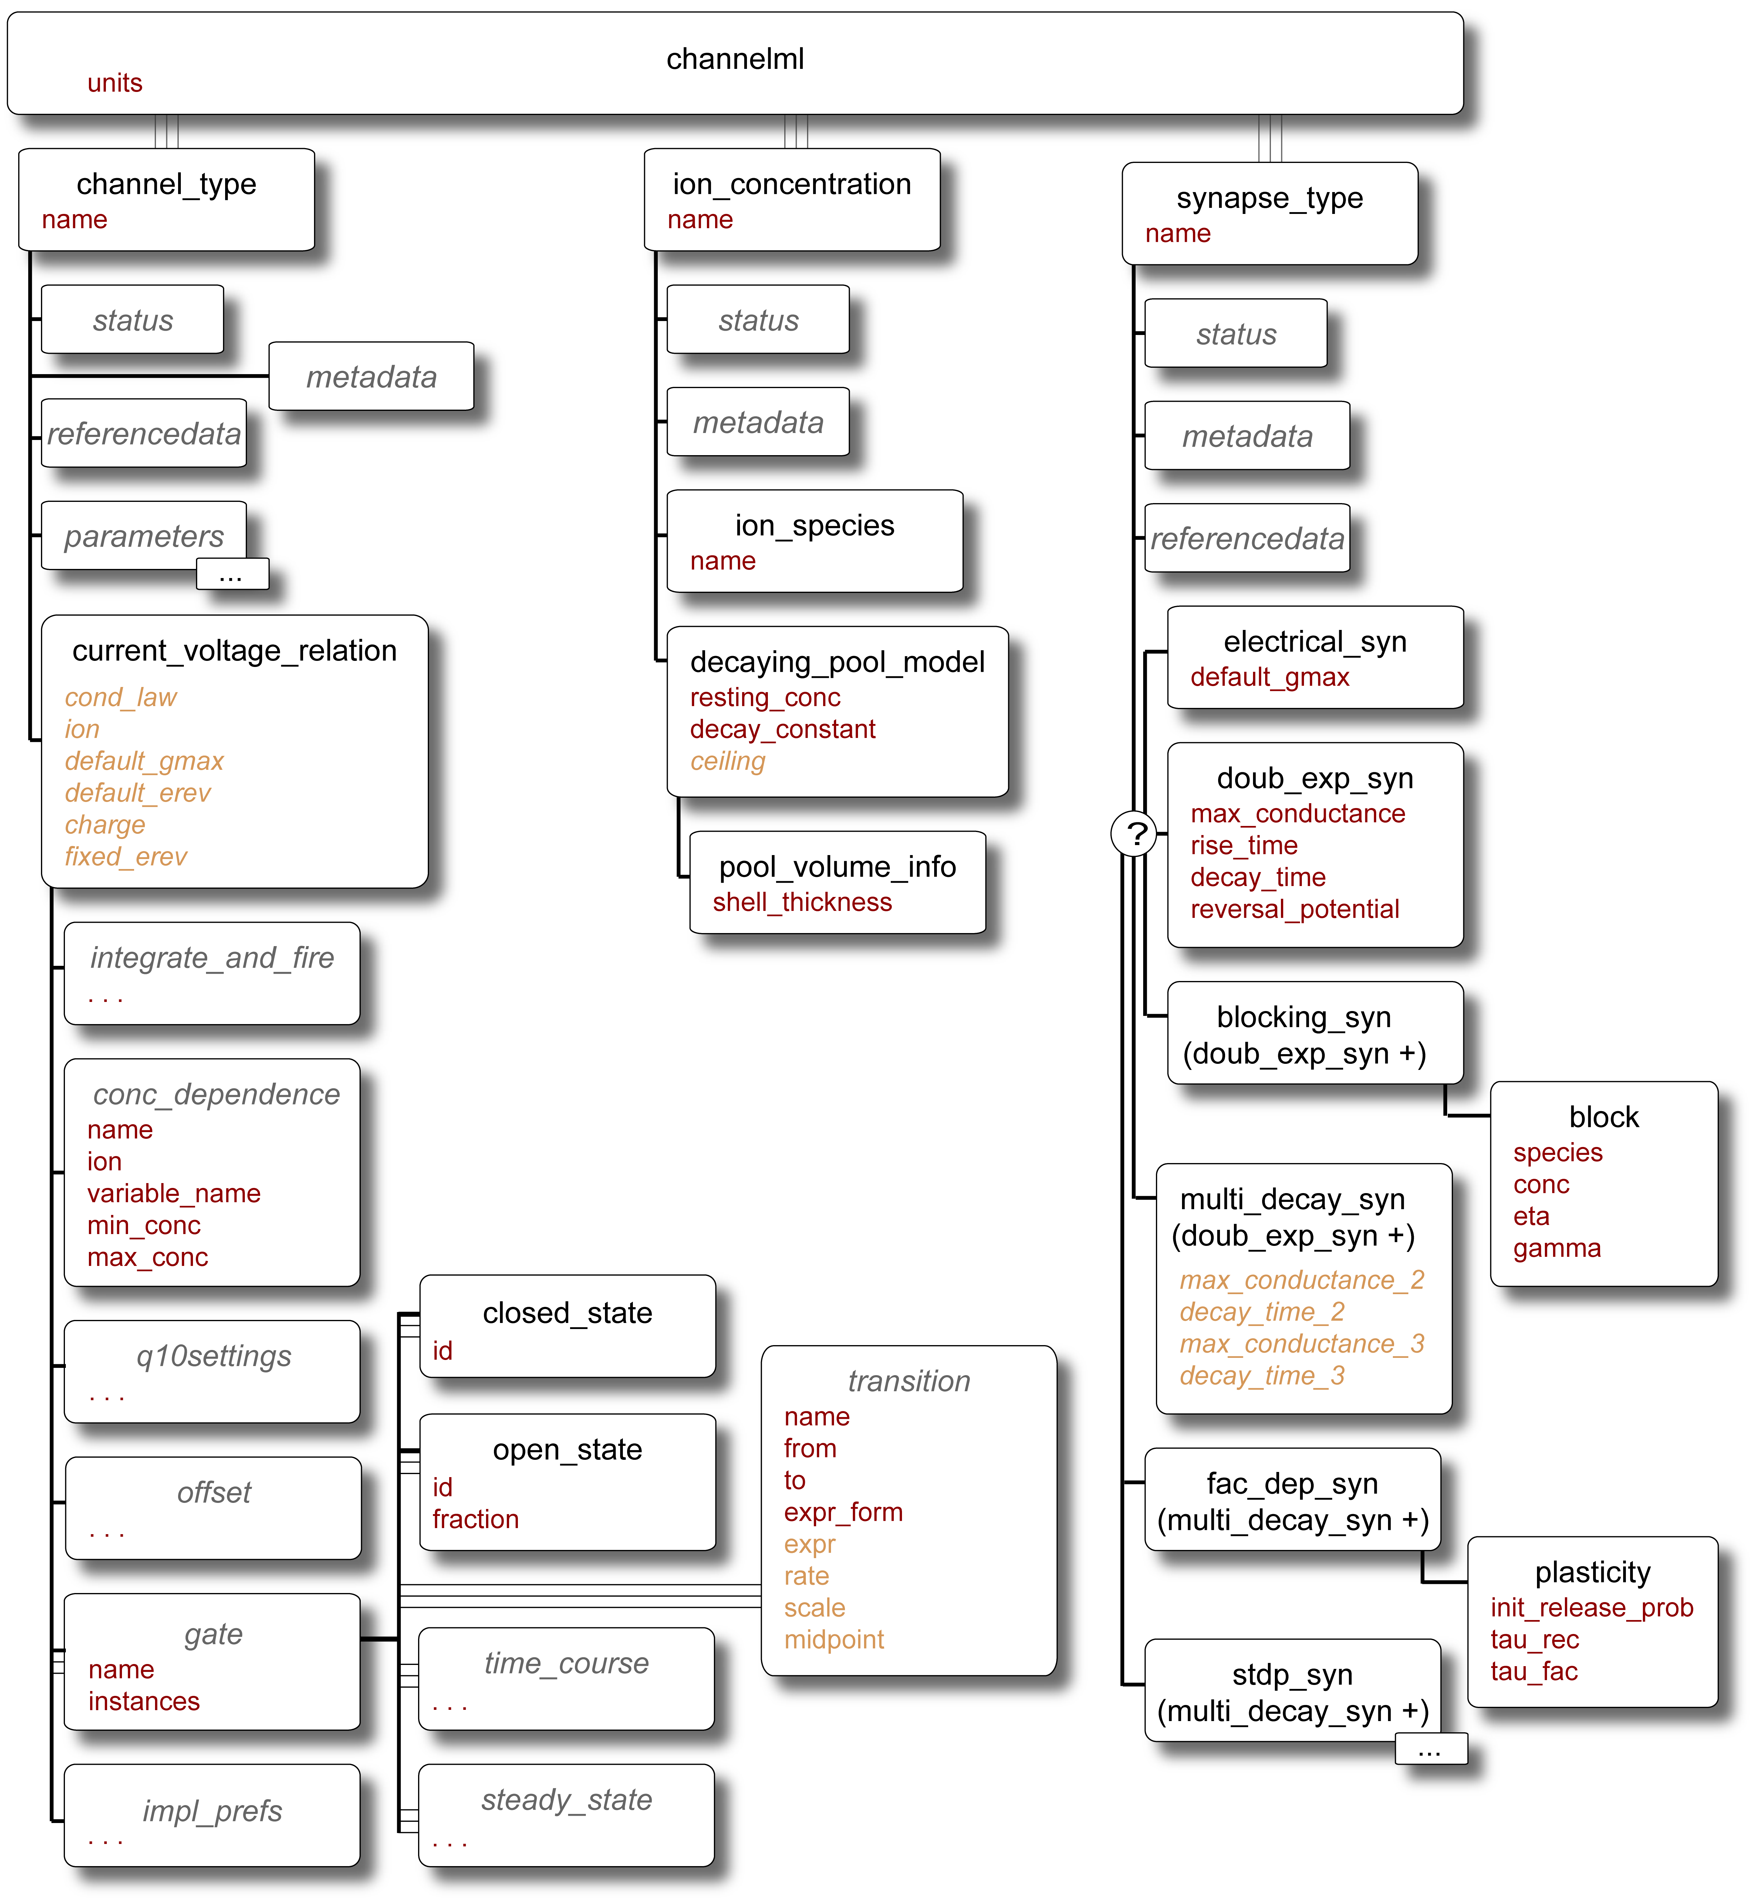
Version 2.0 Requirement:
Extensibility
In NeuroML version 1.x a core set of channel & synapse models were defined
Slow process to add definitions, specifications & mappings to simulators for new model types

Slide 27
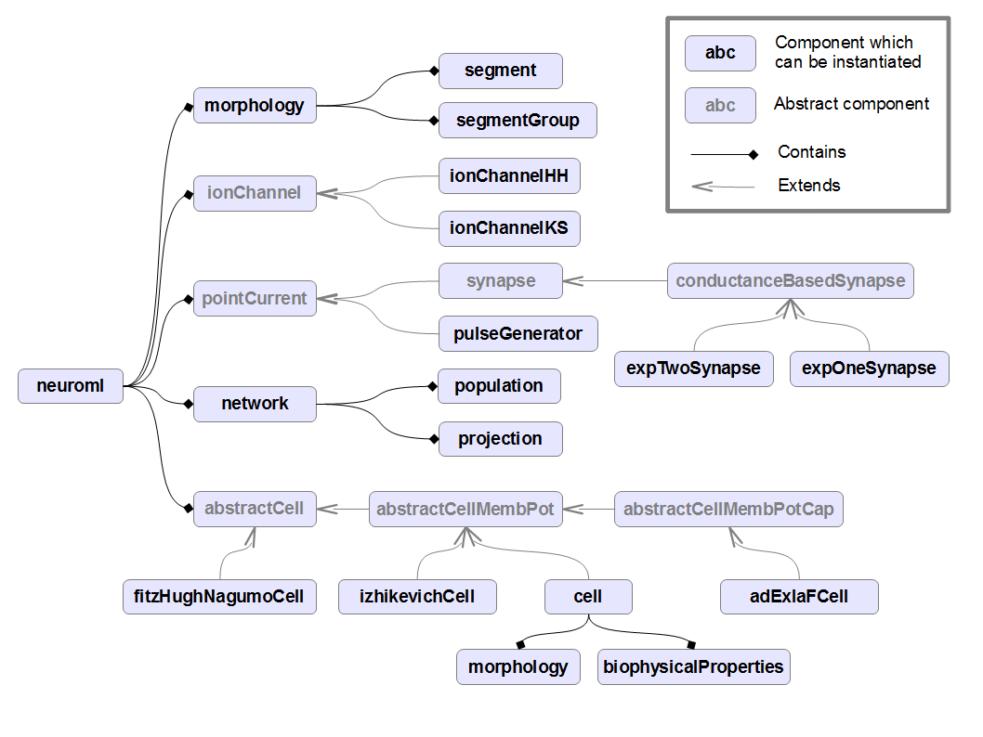

Slide 28
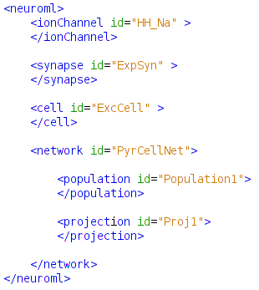

Slide 30
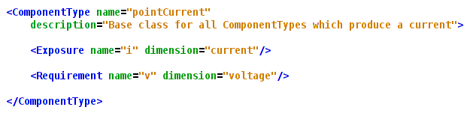

Slide 31
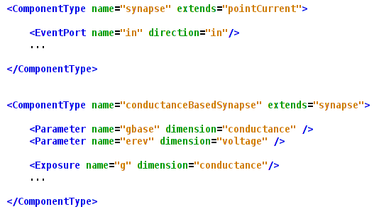

Slide 33
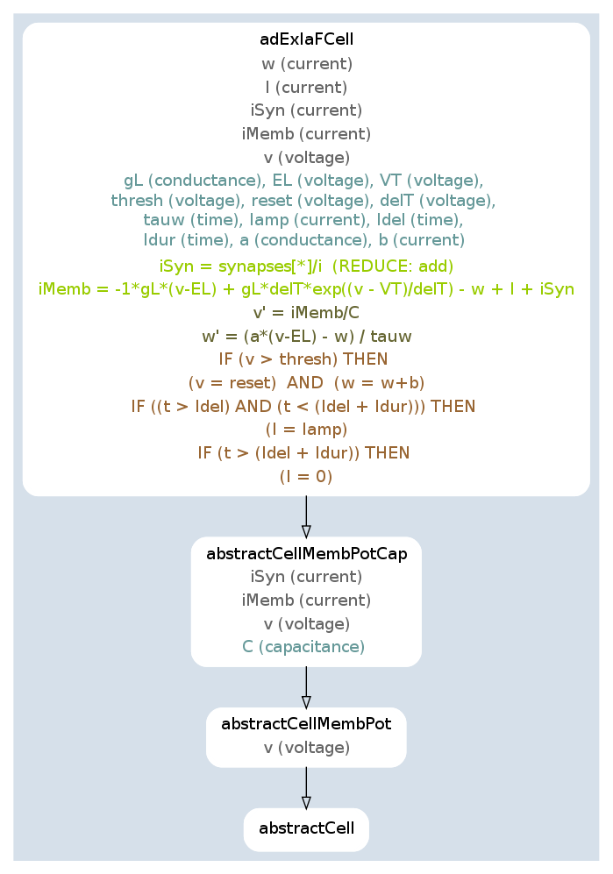
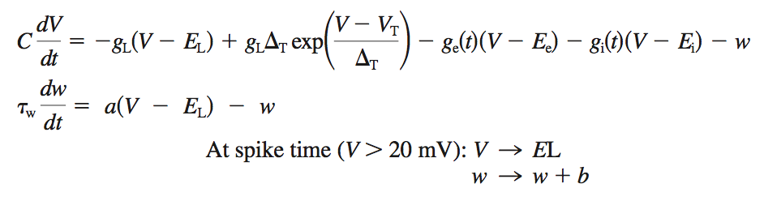
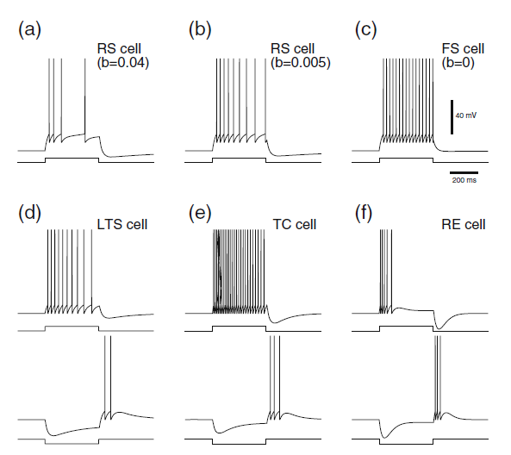
Adaptive Exponential
Integrate & Fire cell

Slide 36
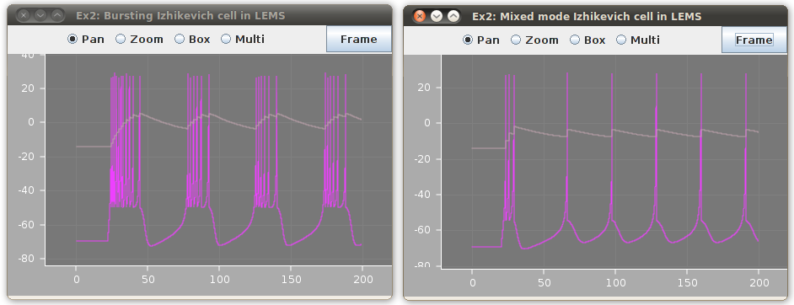
libNeuroML (Java) = LEMS + core classes + export/import
./nml2.sh examples/NeuroML2_Ex2_Izh.xml

Slide 37
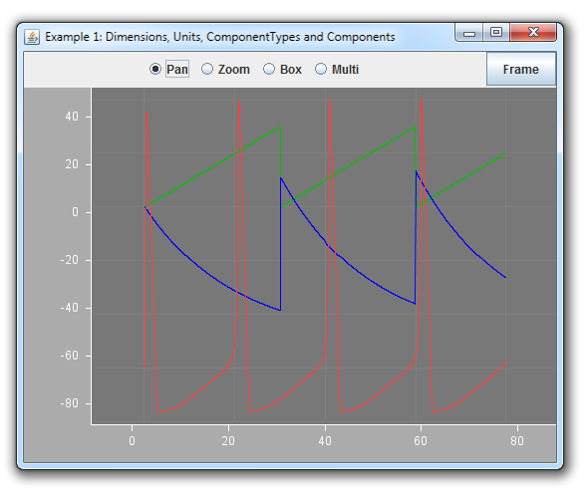
LEMS Reference Implementation
Java package for parsing & executing any LEMS file
lems.bat examples/example1.xml

Slide 38
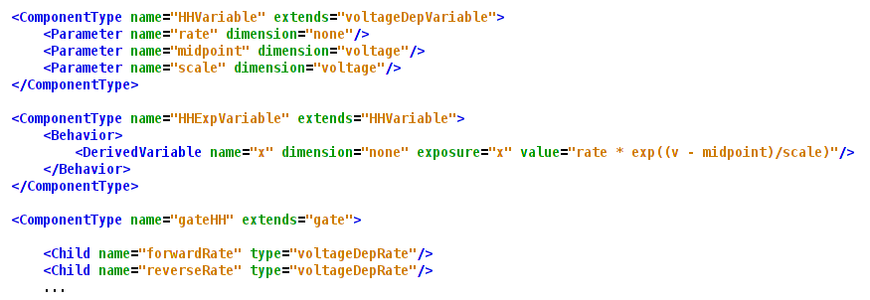
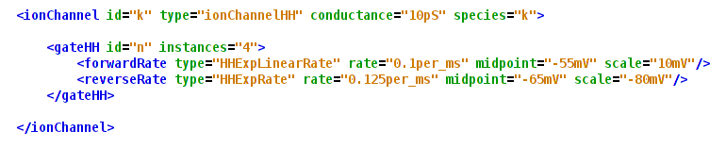
Ion channels
LEMS
NeuroML

Slide 39
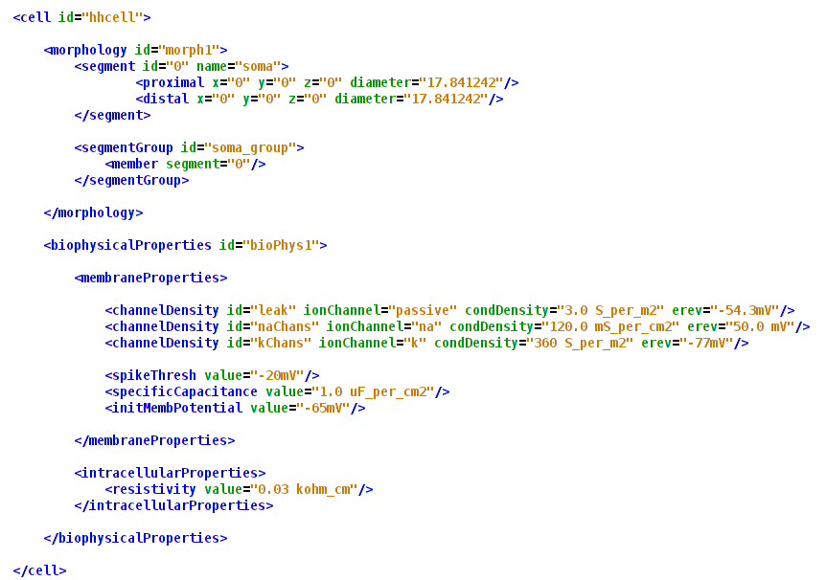

Slide 40
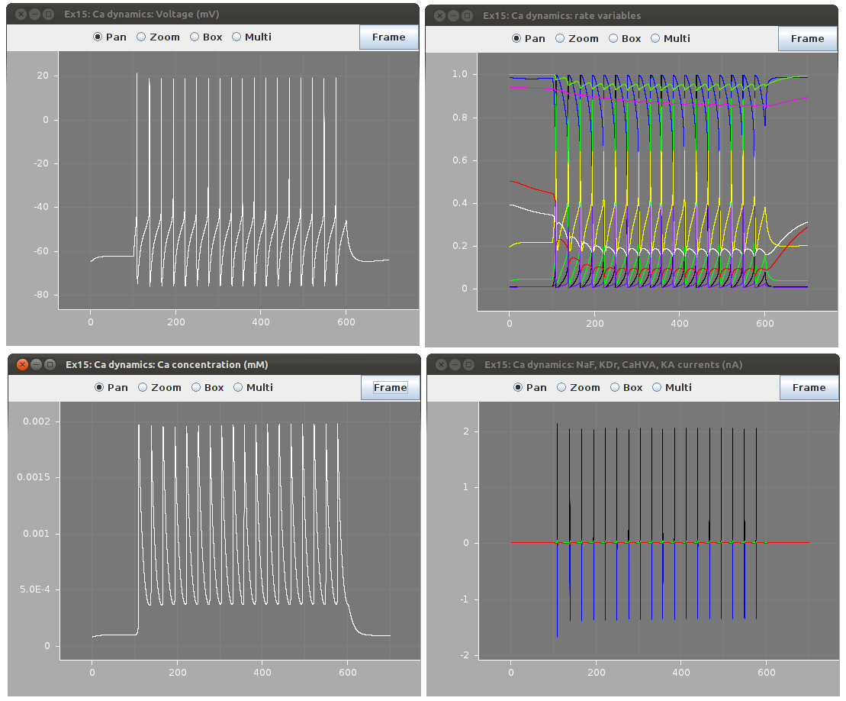

Slide 41
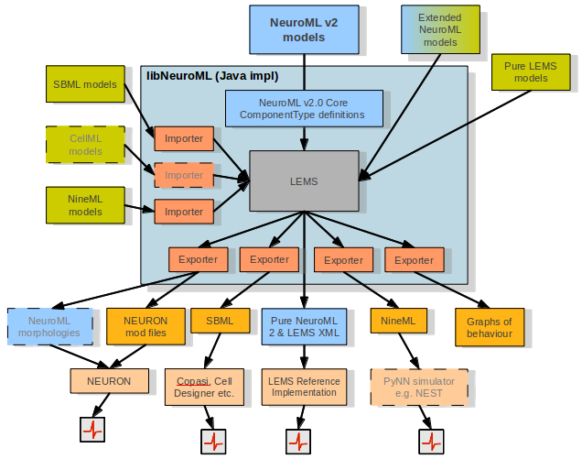

Slide 42
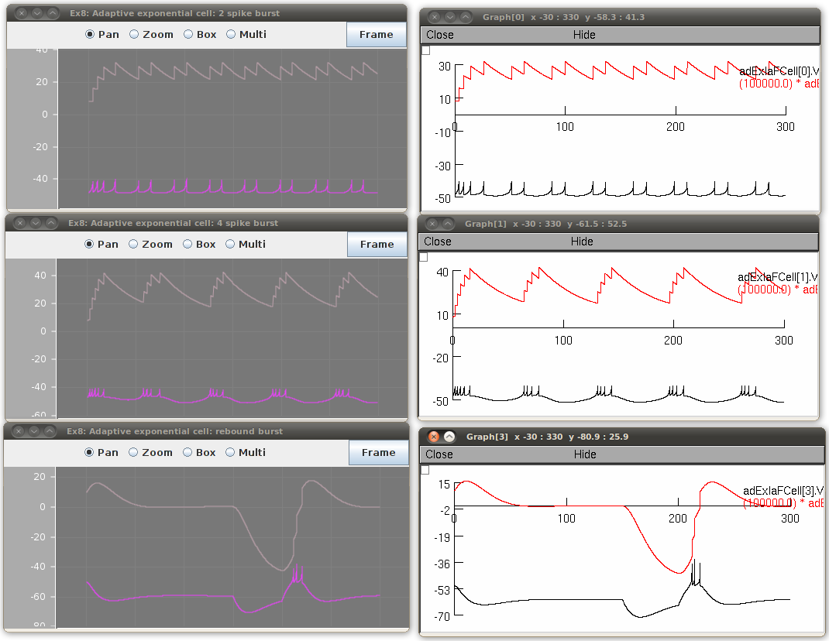
NeuroML 2 to NEURON
nml2.bat examples/NeuroML2_Ex8_AdEx.xml -neuron

Slide 43
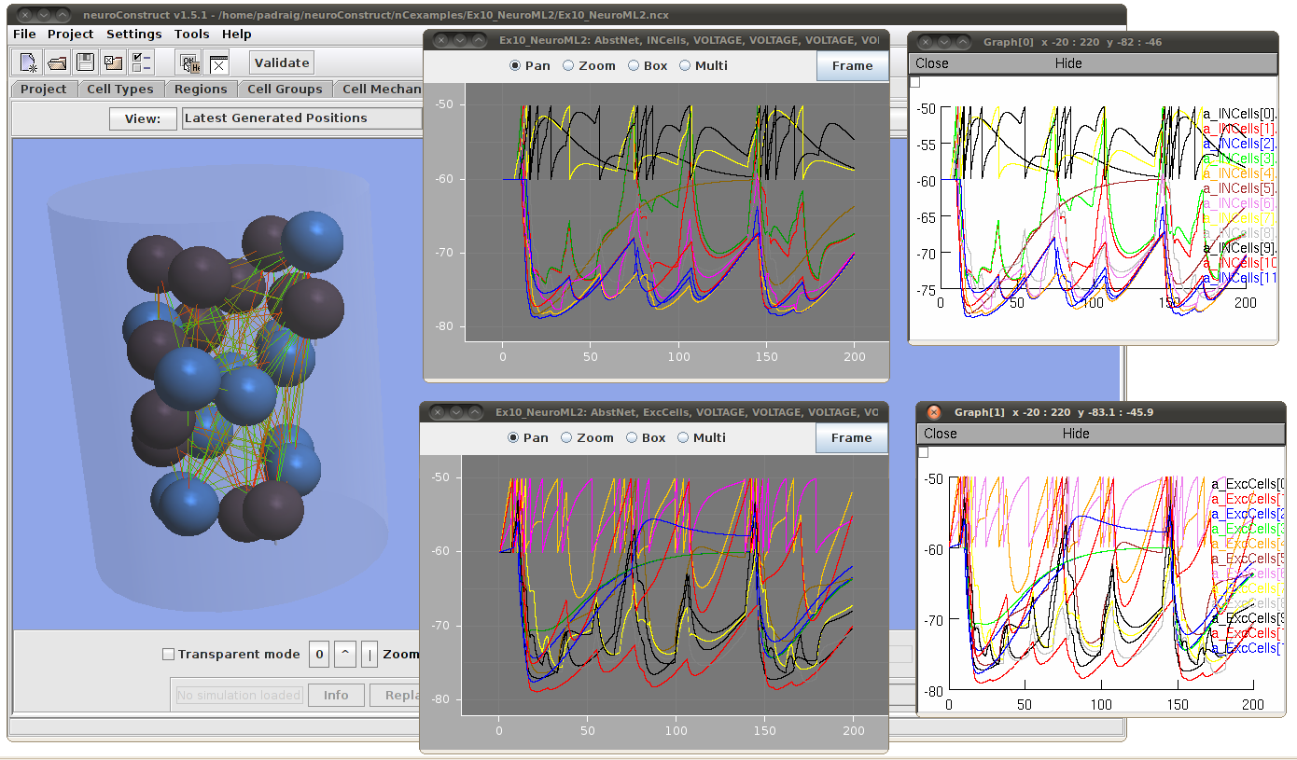
Integration of libNeuroML with neuroConstruct

Slide 44
Version 2.0 Requirement: Integration with SBML & CellML
Systems Biology Markup Language – widely used as “lingua franca” in Systems Biology software
Describes signalling pathways, metabolic and gene regulatory networks
Many tools exist that can read & write the format
Database exists (BioModels) with hundreds of converted, curated models

Slide 45
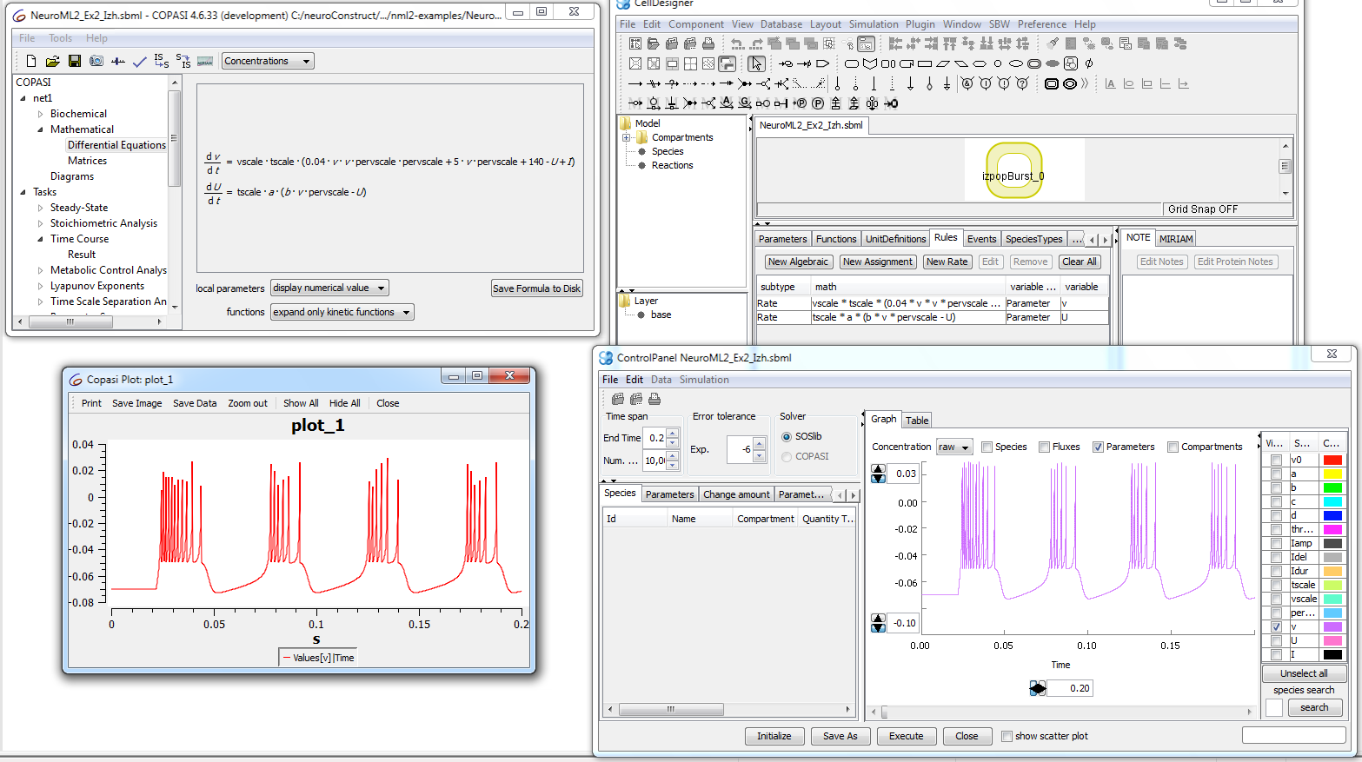
NeuroML 2 to SBML
./nml2 examples/NeuroML2_Ex2_Izh.xml -sbml

Slide 46
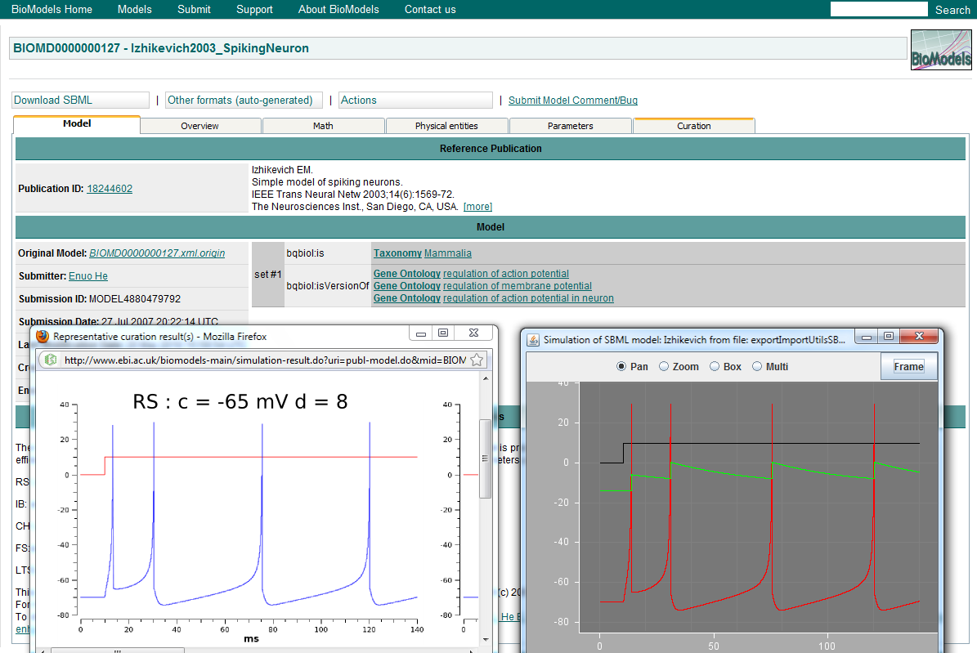
SBML to LEMS

Slide 47
SBML to LEMS
SBML to LEMS tested against SBML Test Suite
331 out of 952 tests passed

Slide 48
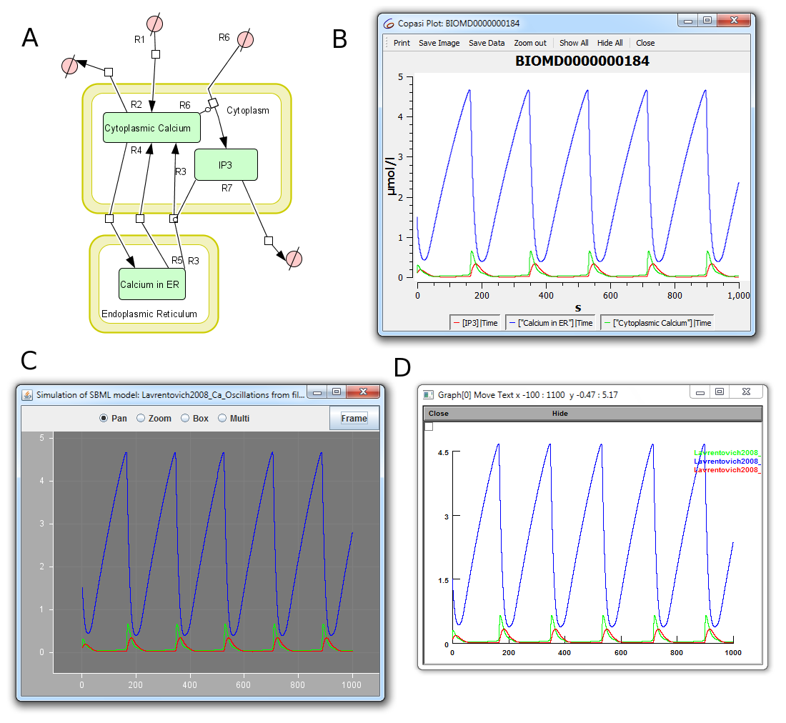
SBML model of spontaneous Ca²⁺ oscillations in astrocytes from
BioModels database
A: Schematic of species & reactions
B: Model on Copasi (SBML simulator)
C: Model converted to LEMS
D: Model converted to NEURON

Slide 49
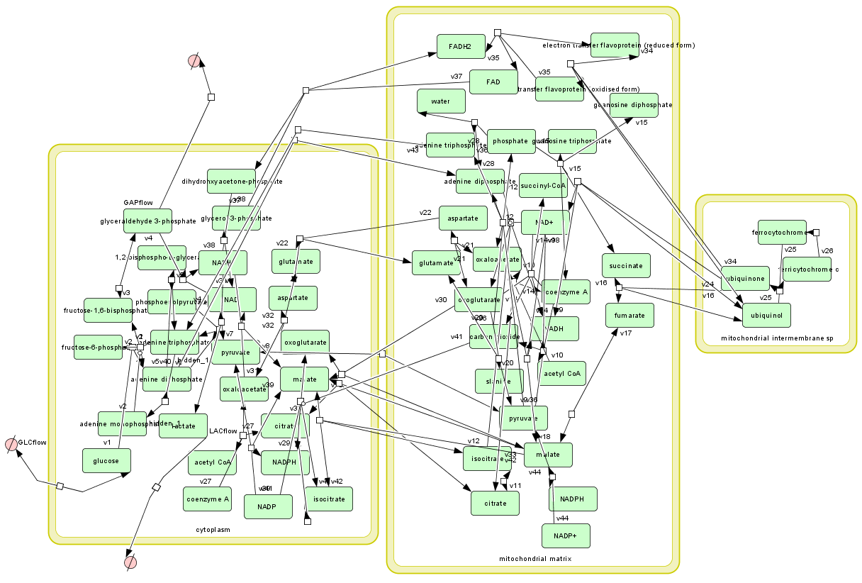
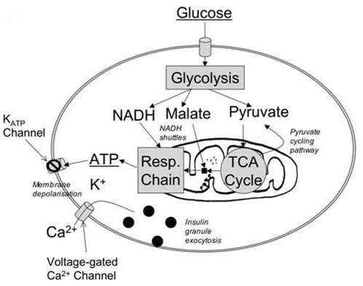
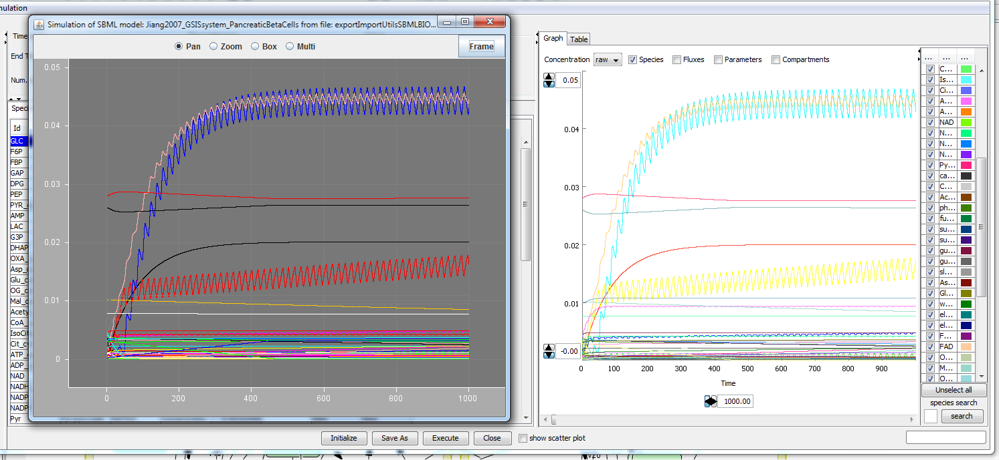
Example: A kinetics core model of the Glucose-simulated insulin secretion network of pancreatic beta cells

Slide 50
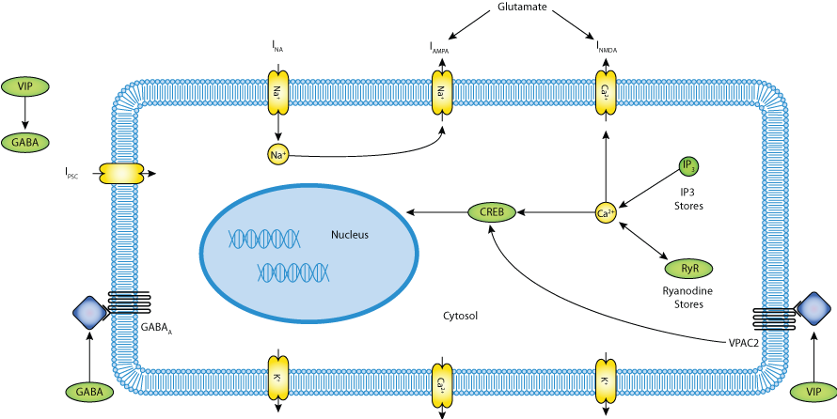
Todo: CellML
Repository of hundreds of models from all areas of biology
Example: A multiscale model to investigate circadian rhythmicity of pacemaker neurons in the suprachiasmatic nucleus

Slide 52
NeuroML 2 to LEMS limitations
LEMS interpreter can only handle single compartment cells
Multi compartment cells are valid & can be loaded by LEMS but no PDE support yet (but that can be left to the simulators...)
Network generation templates not yet well supported, but network of NeuroML 2 cells can be generated by neuroConstruct

Slide 53
Plans for closer integration with NineML
INCF sponsored language for describing networks of spiking neurons
Similar aims – abstract description of model components – developed in parallel with LEMS & NeuroML 2
Useful work in past year developing Python API & code generation for NEST & NEURON
NeuroML & NineML can benefit from each other's strengths – should be transparent for user!

Slide 54
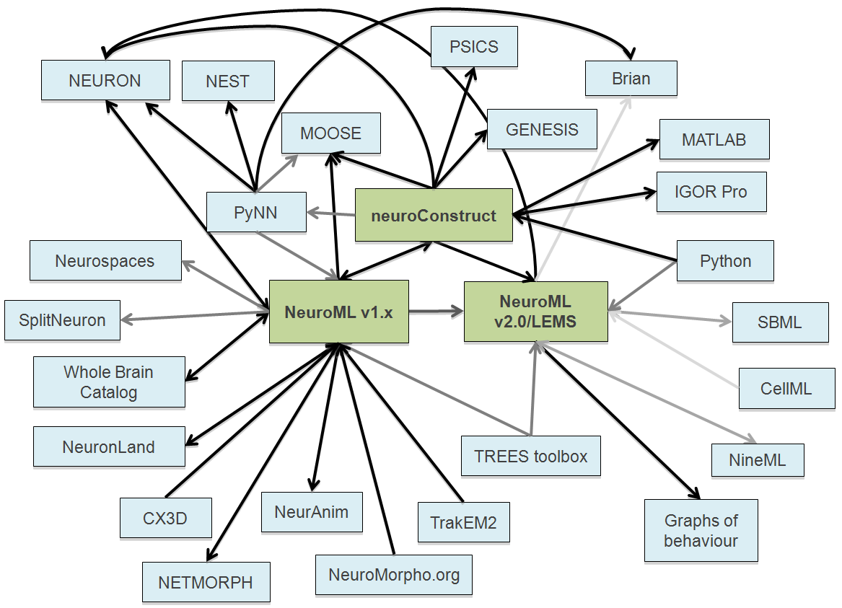

Slide 55
Conclusions
NeuroML v1.x a useful pragmatic solution for detailed conductance based models of the type used by NEURON, GENESIS and associated tools and databases
NeuroML v2.0 builds on this to allow more explicit definition of component behaviour and allow specification of a wider range of cell, channel & synapse models
Closer integration with languages such as SBML will allow neuronal models with greater detail of subcellular signalling, metabolic pathways & gene expression

