Slide 1

Simulating multi-electrode recordings from a large-scale cortical slice model
Richard Tomsett^{1,2}
Marcus Kaiser^{1,3,4}
School of Computing Science, Newcastle University
2. Institute of Ageing and Health, Newcastle University
3. Institute of Neuroscience, Newcastle University
4. Department of Brain and Cognitive Sciences, Seoul National University

Slide 2
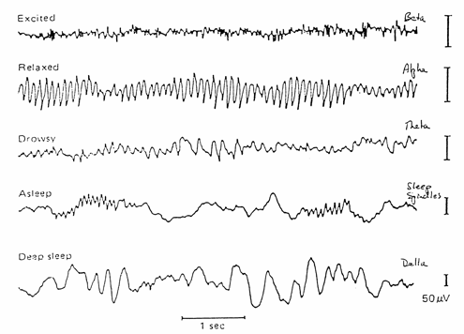
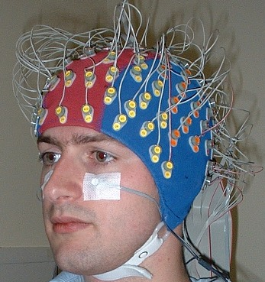
Brain dynamics

Slide 3
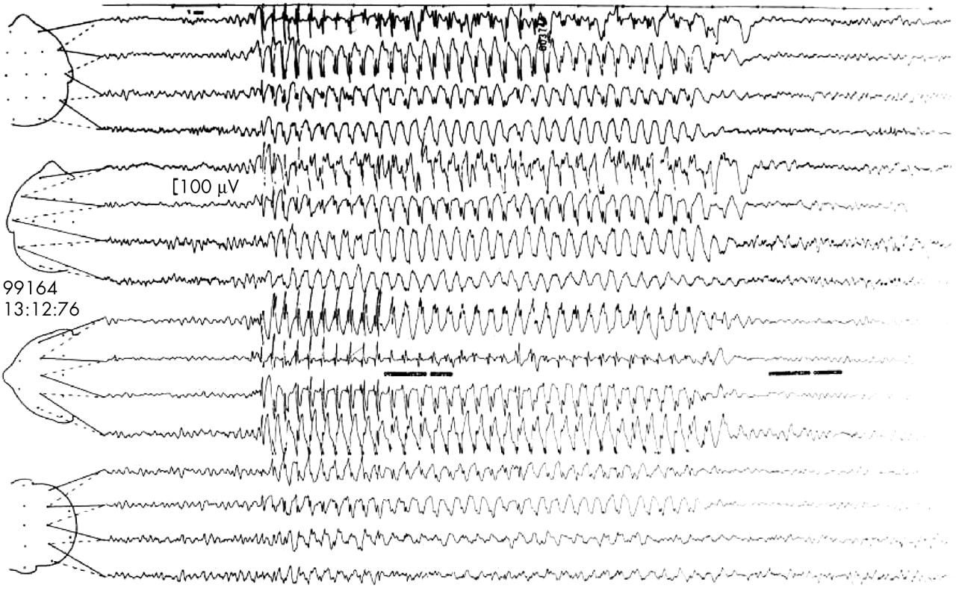
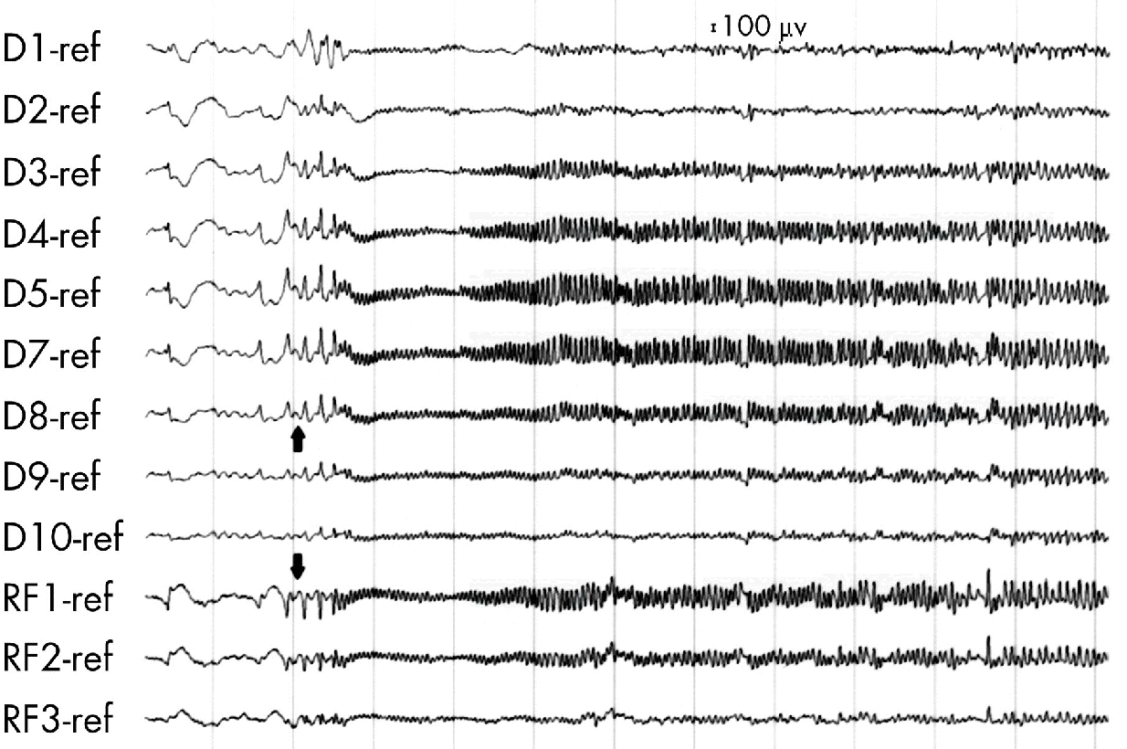
Pathological dynamics

Slide 4
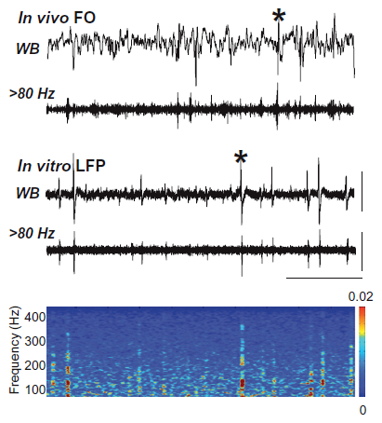
Studies in vitro
Roopun et al, PNAS 2010

Slide 5
What network properties cause pathological dynamics?
Local network scale
Focus: connectivity

Slide 6
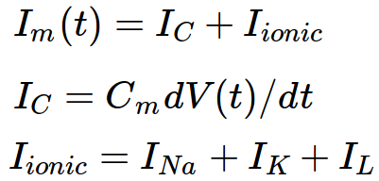
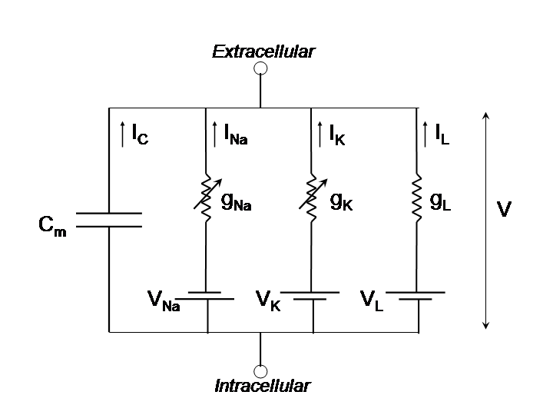
Conductance-based models

Slide 7
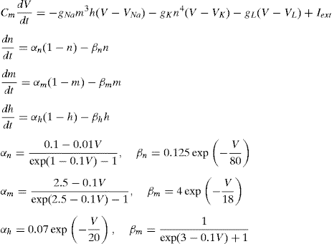
Conductance-based models
Hodgkin and Huxley, J Physiol 1952

Slide 8
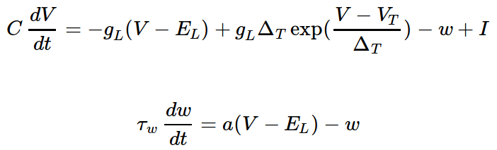
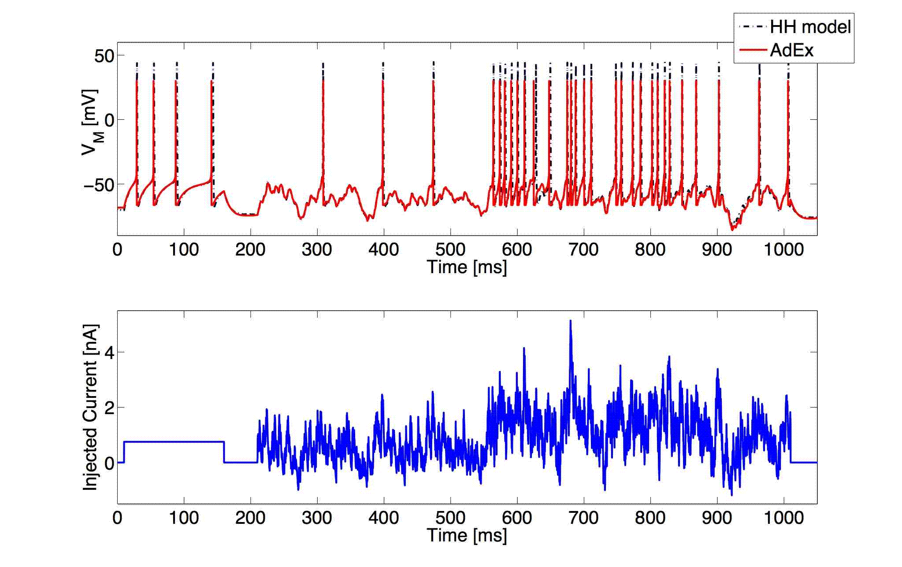
Adaptive-Exponential model
Brette and Gerstner, J Neurophysiol 2005

Slide 9
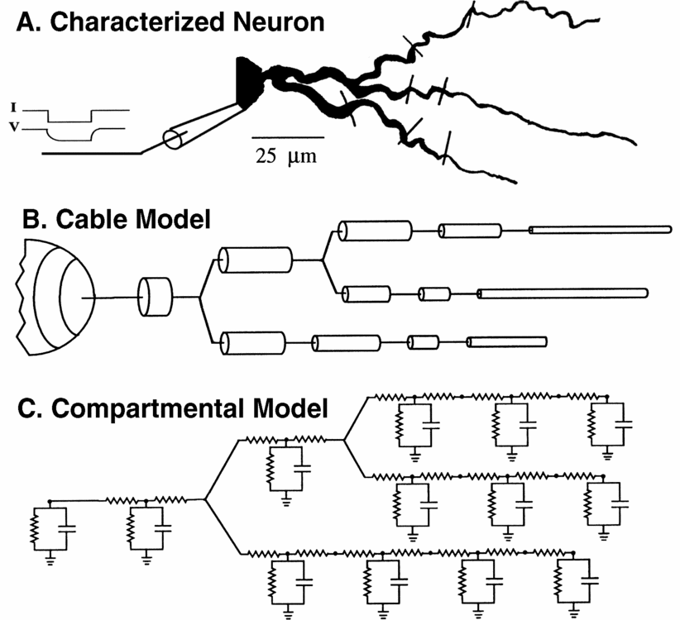
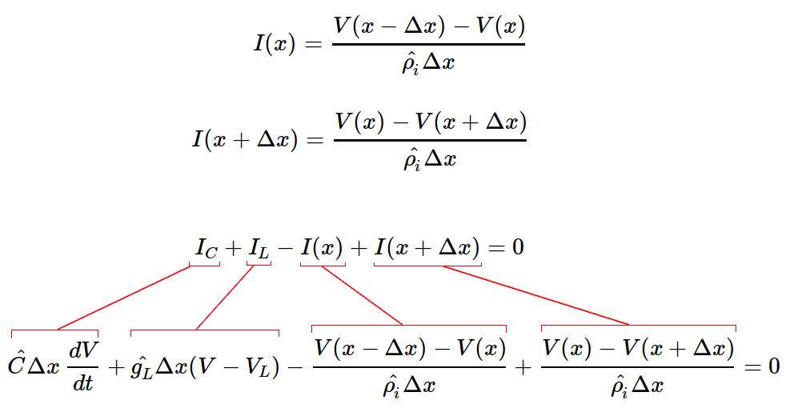
Compartmental models
Niebur, Scholarpedia 2008

Slide 10
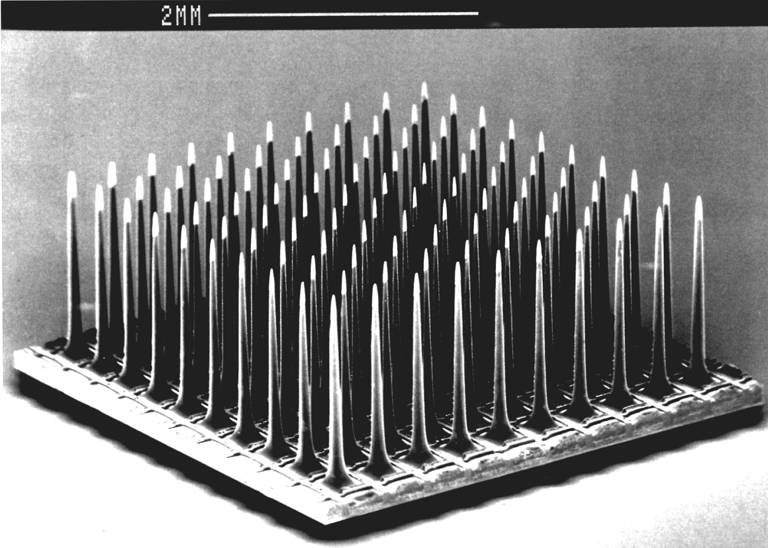
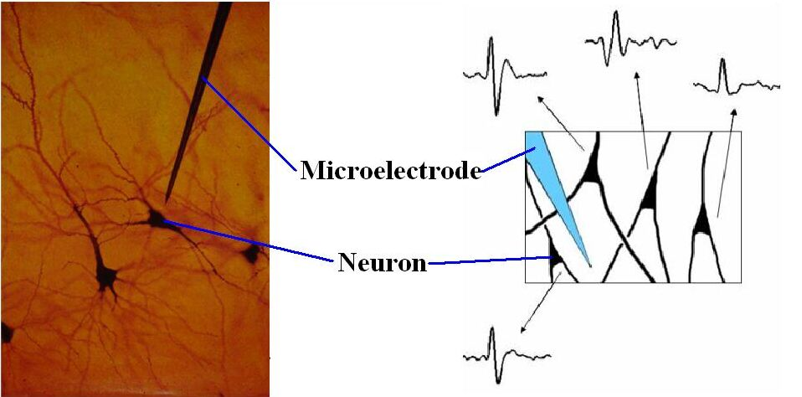
What do electrodes measure?

Slide 11

What do electrodes measure?

Slide 12
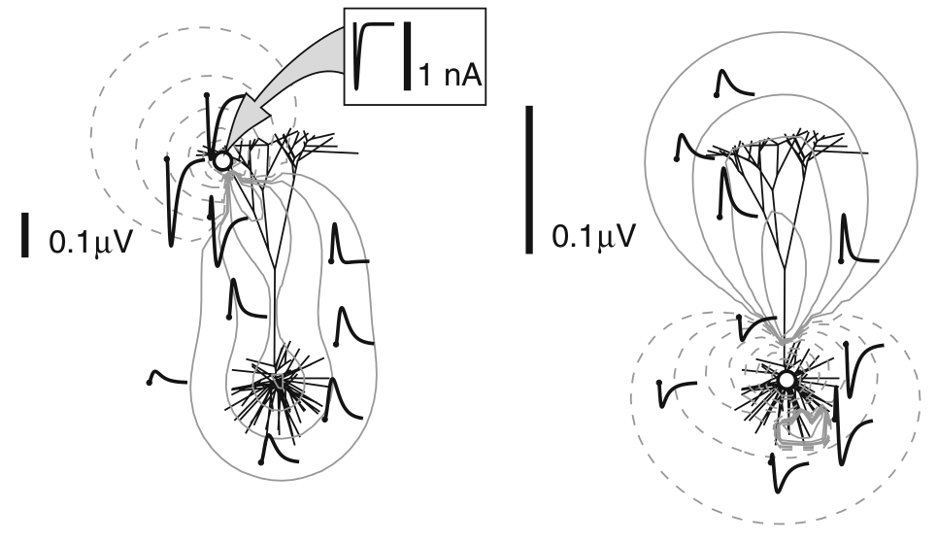
Effect of neuron branching structure on measured extracellular potential
Linden et al, J Comput Neurosci 2010

Slide 13
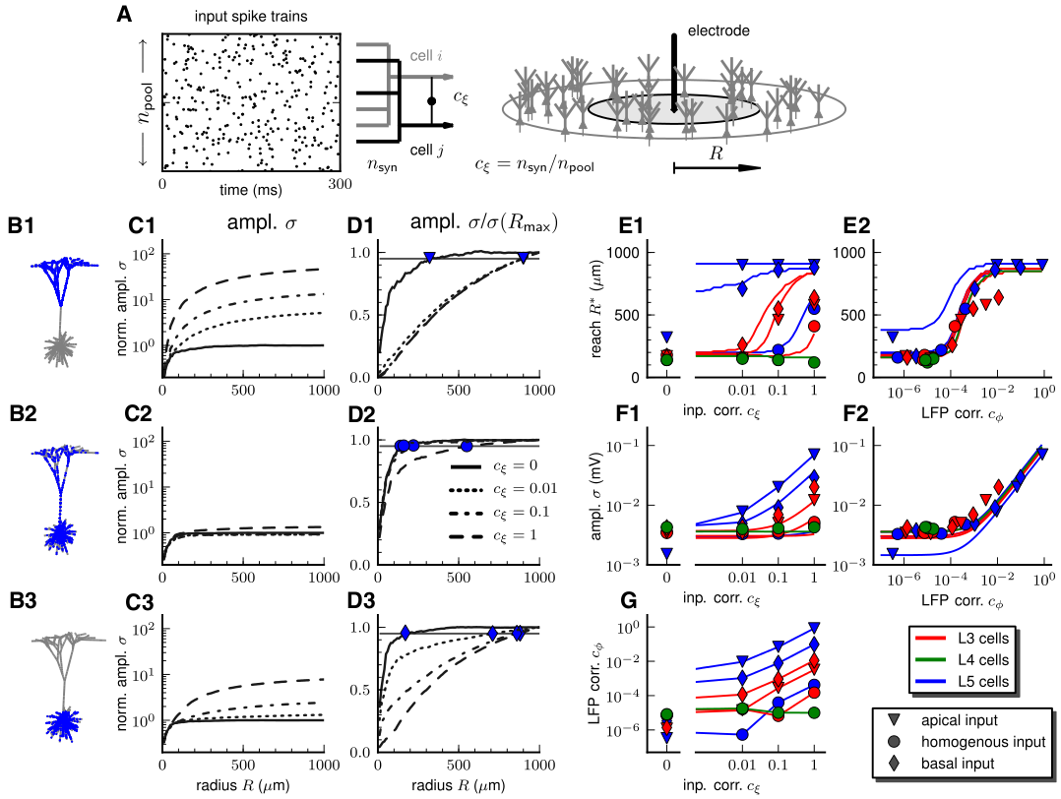
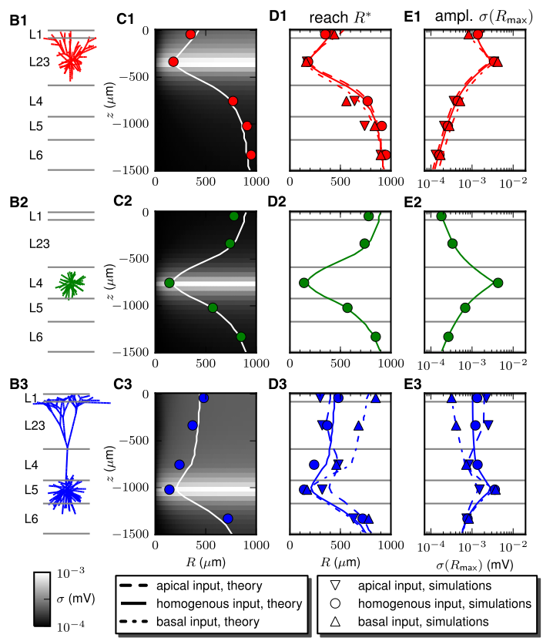
Spatial properties of field potentials
Linden et al, Neuron 2011

Slide 14
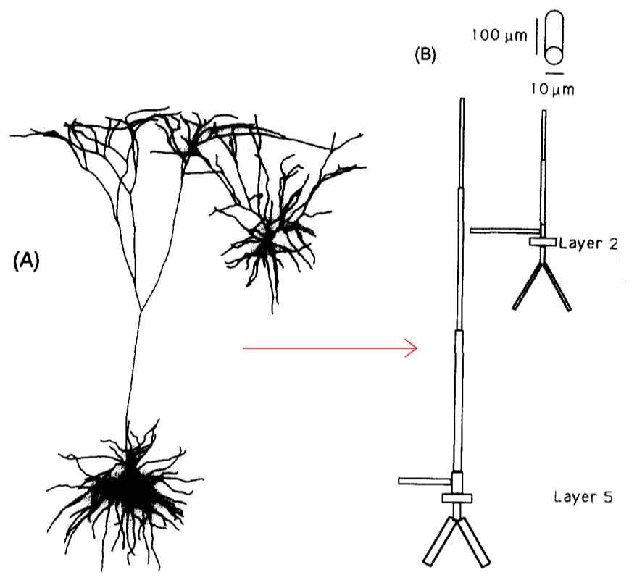
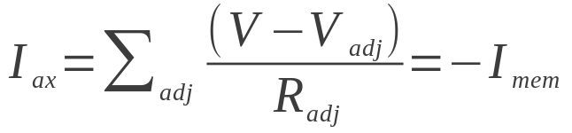
Reduced neuron model for population LFPs
Bush and Sejnowski, J Neurosci Methods, 1993

Slide 15
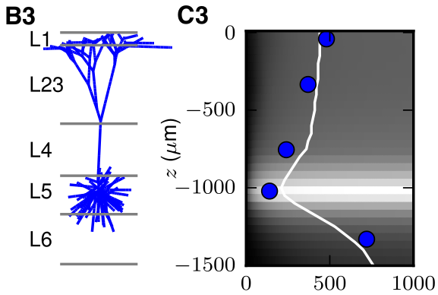
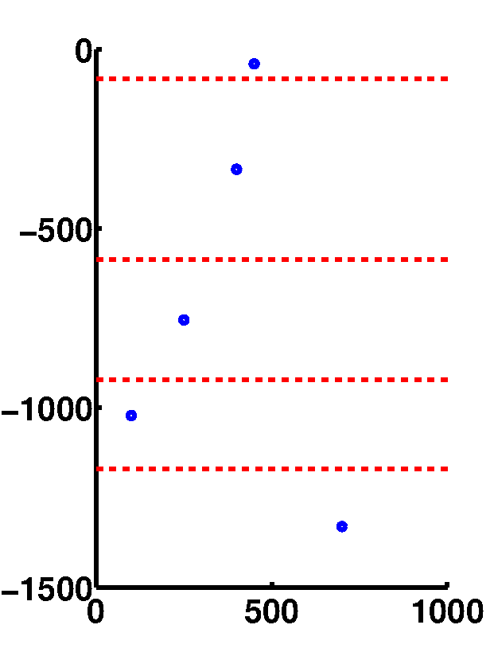
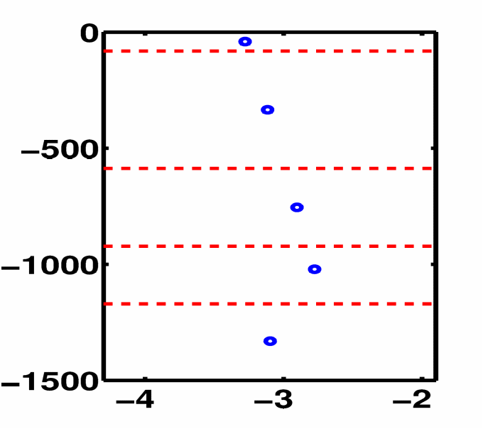
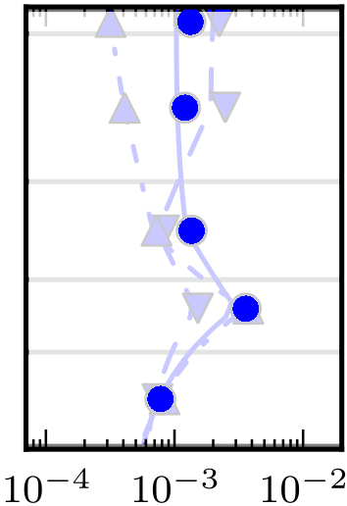
Reduced model LFP comparison

Slide 16
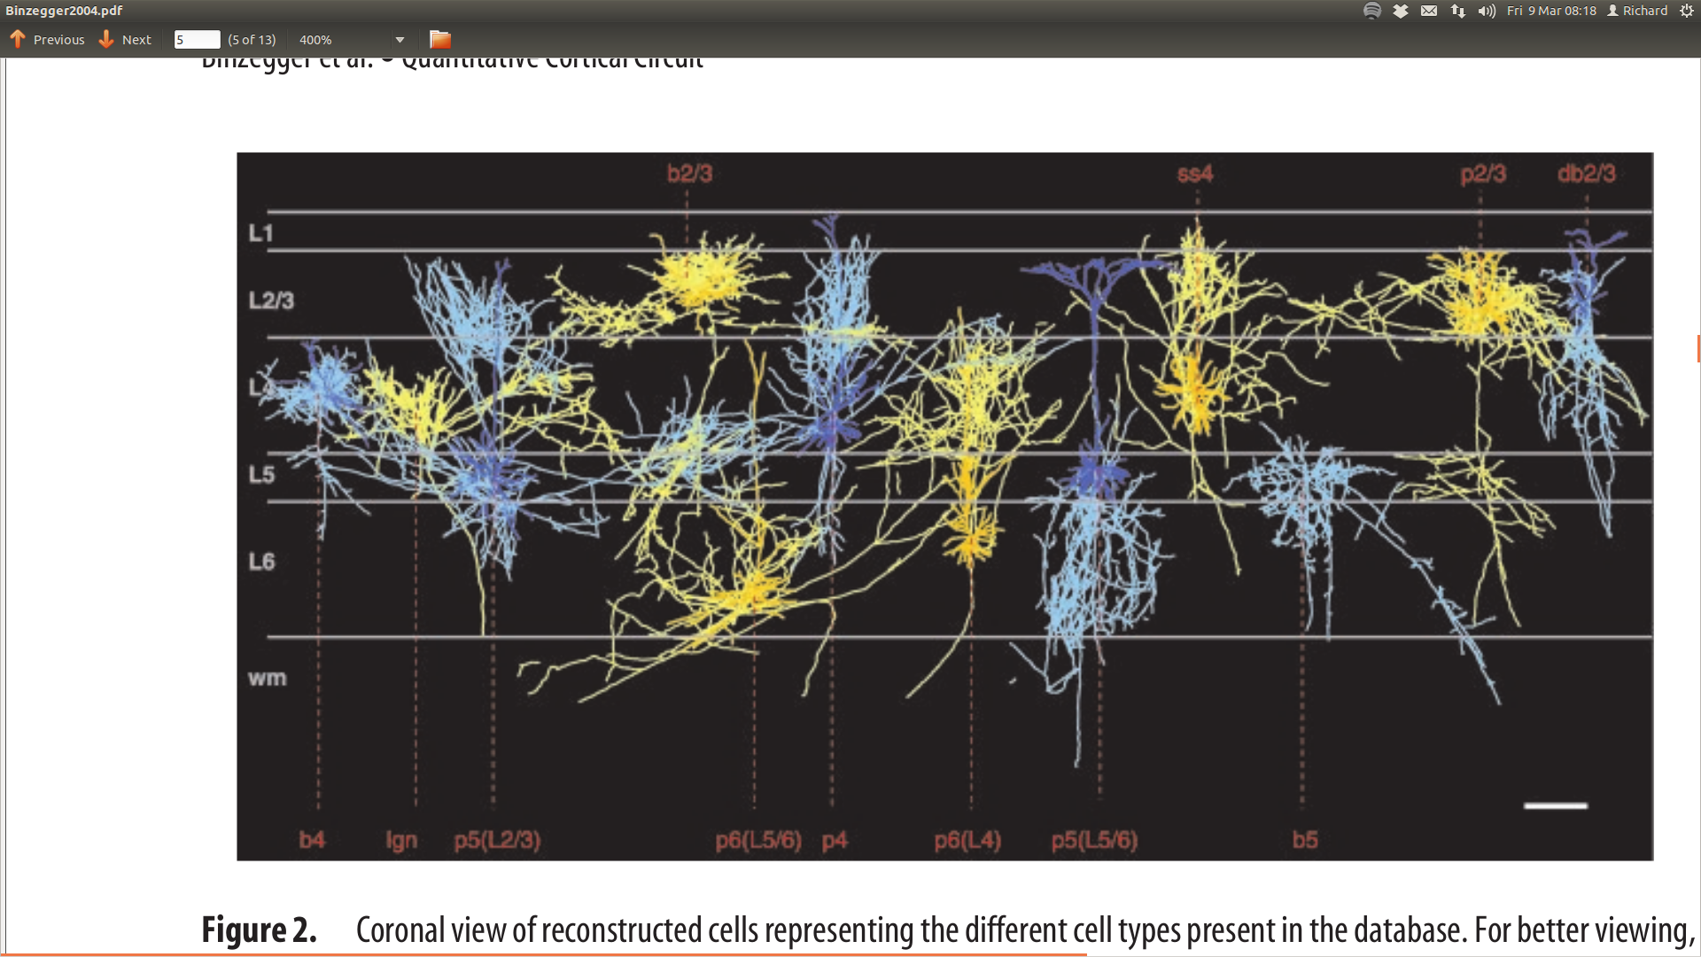
Cortex structure
Binzegger et al, J Neurosci, 2004

Slide 17
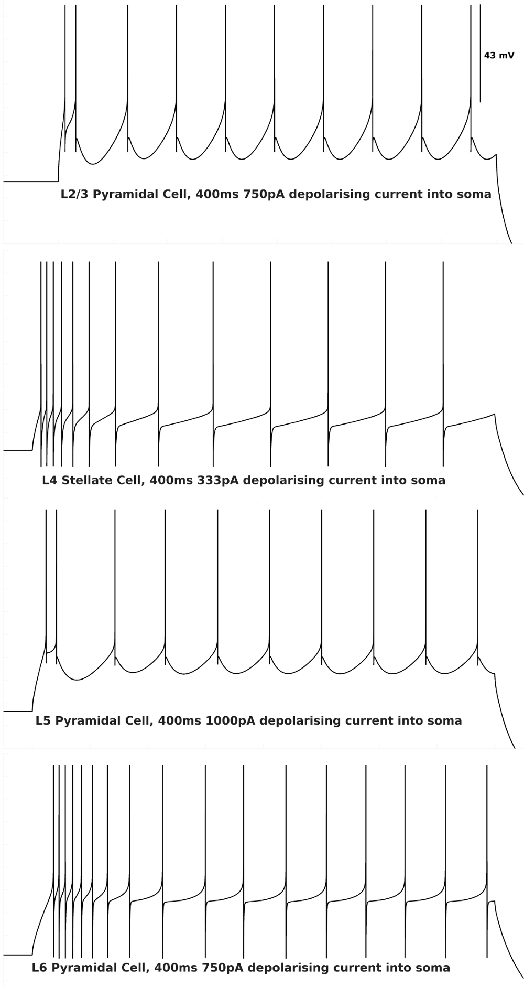
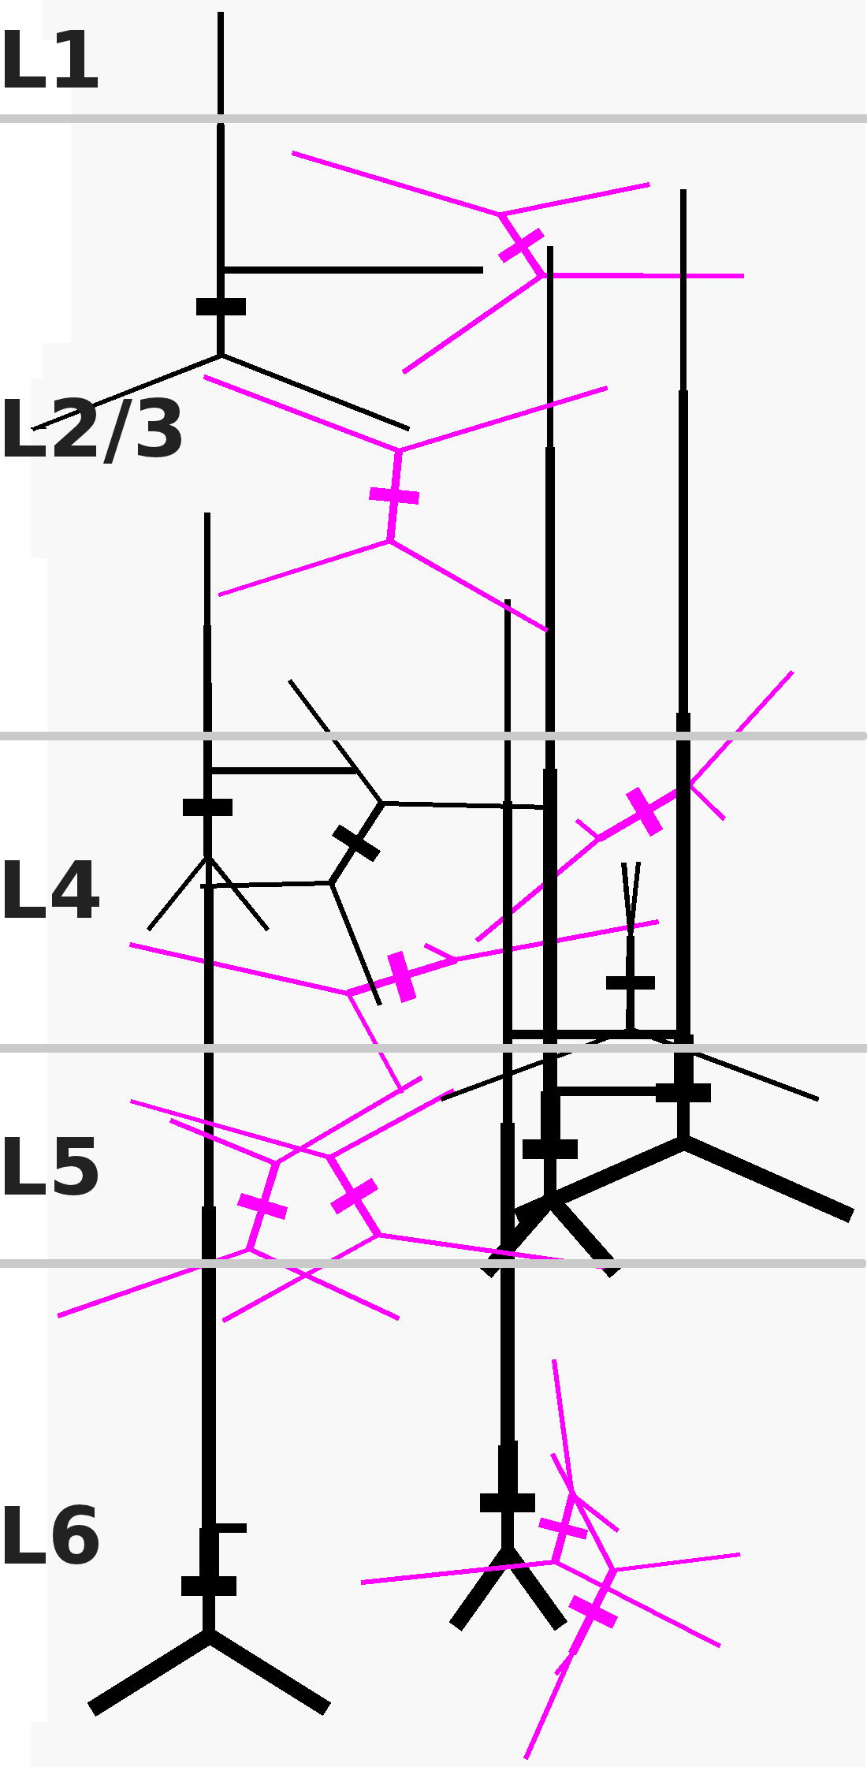
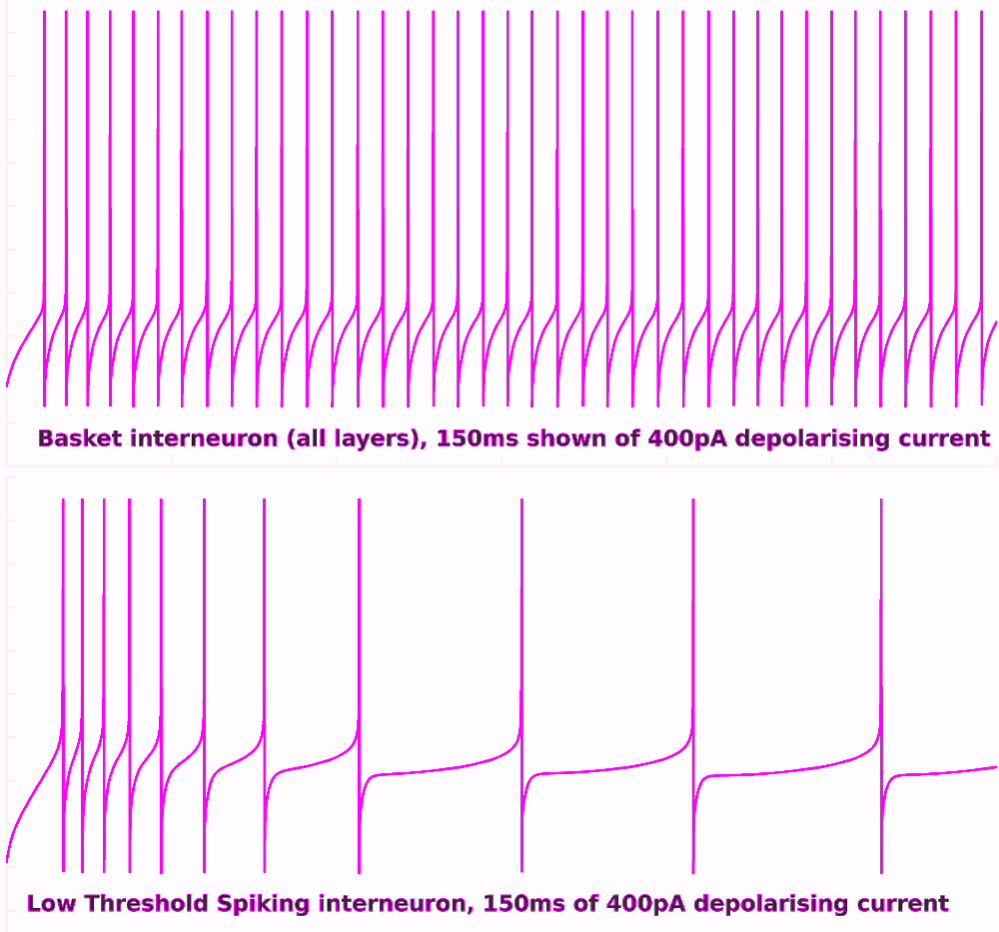
Model structure & dynamics

Slide 18
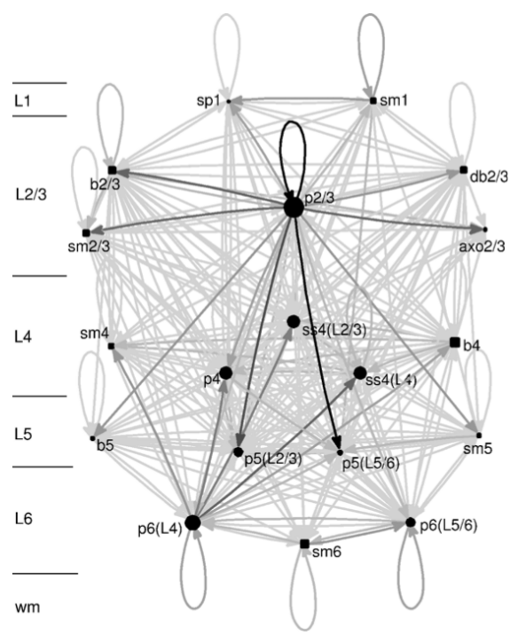
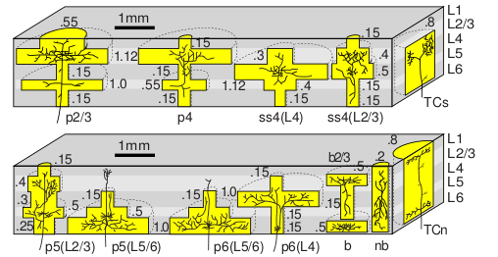
Connectivity
Izhikevich and Edelman, PNAS 2008
Binzegger et al, Neural Networks, 2009

Slide 19
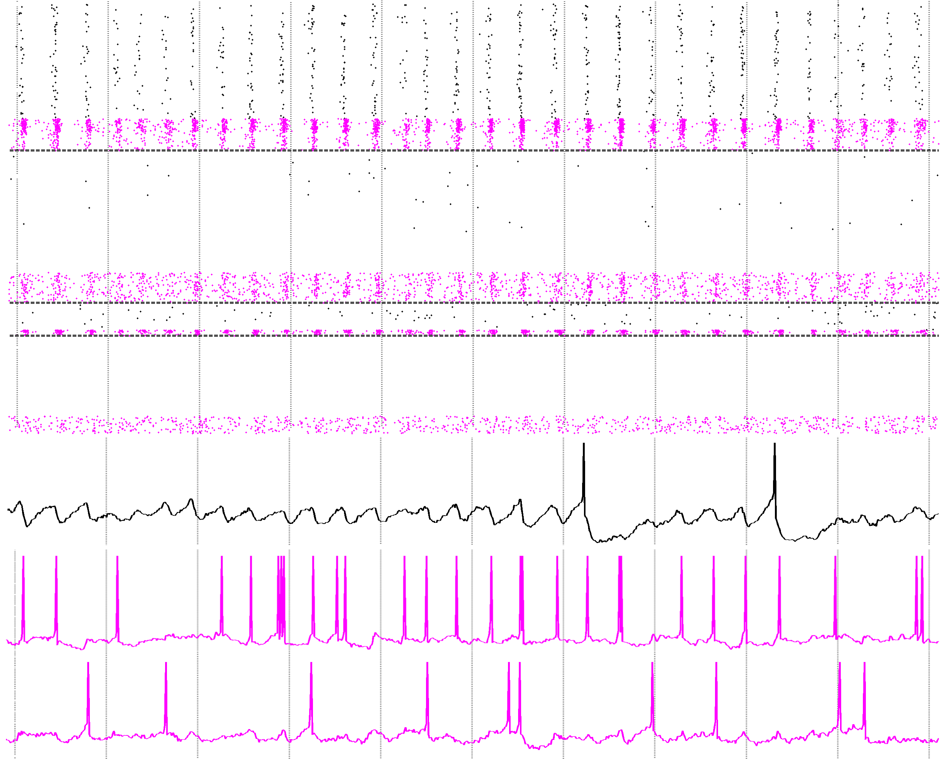
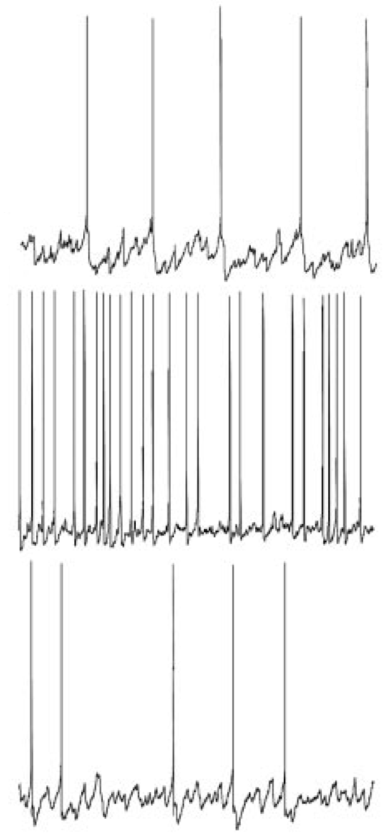
Neuron spiking:
Layer 2/3
Layer 4
Layer 5
Layer 6
L2/3 Pyramidal cell e.g.:
L2/3 Basket interneuron e.g.:
L2/3 LTS interneuron e.g.:
Experimental data from rat auditory cortex in vitro:
L2/3 Pyramidal cell e.g.:
L2/3 Basket interneuron e.g.:
L2/3 LTS interneuron e.g.:
Cunningham et al. PNAS 2004

Slide 20
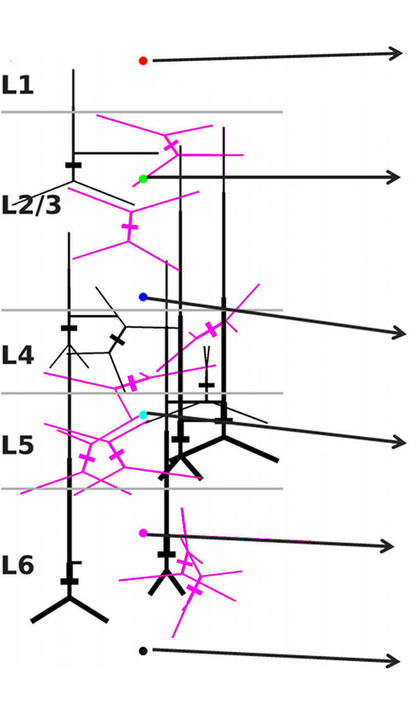
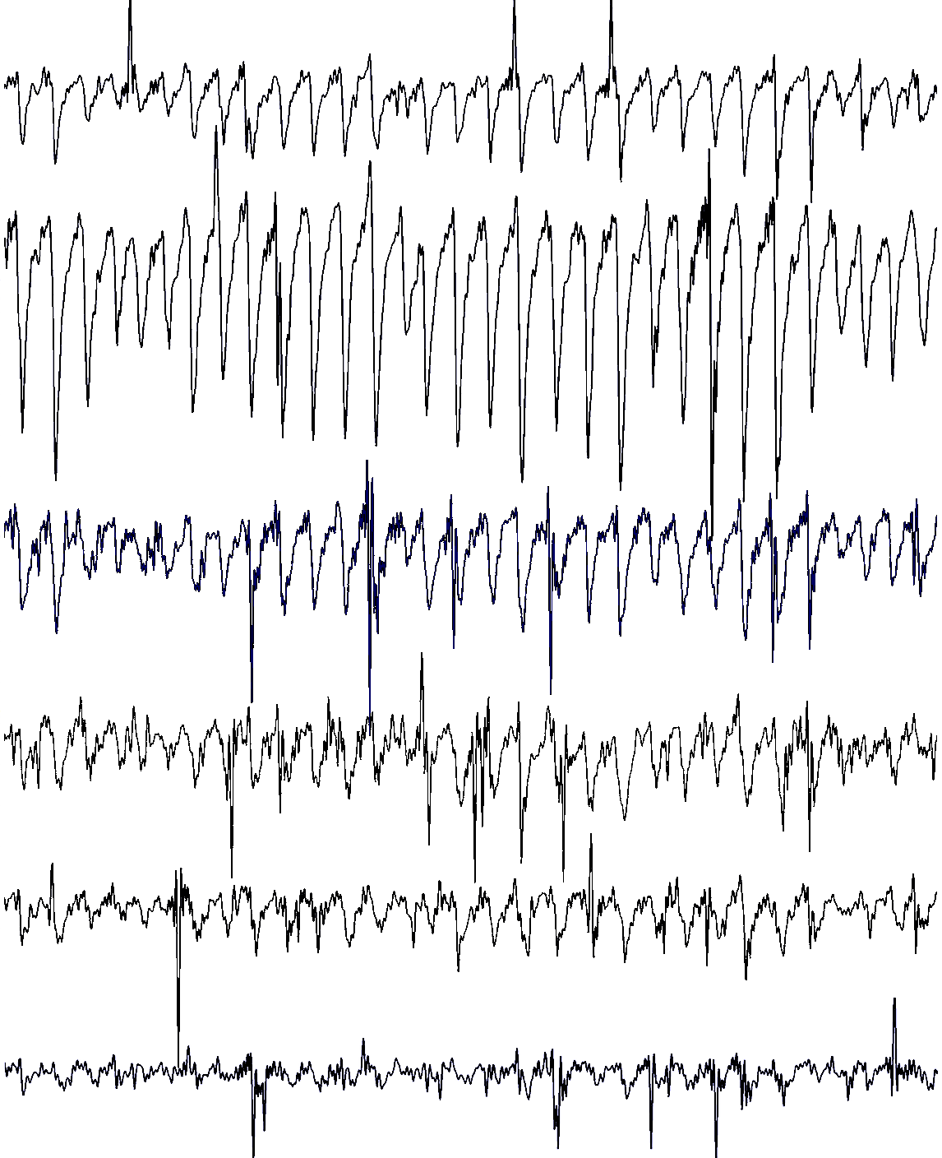
Neuron spiking:
Layer 2/3
Layer 4
Layer 5
Layer 6
L2/3 Pyramidal cell e.g.:
L2/3 Basket interneuron e.g.:
L2/3 LTS interneuron e.g.:
Simulated LFPs:

Slide 21
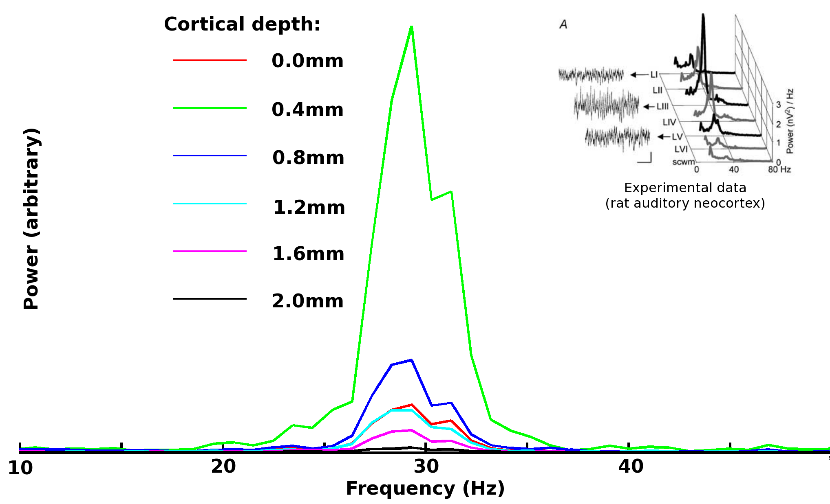
Cunningham et al. PNAS 2004

Slide 22
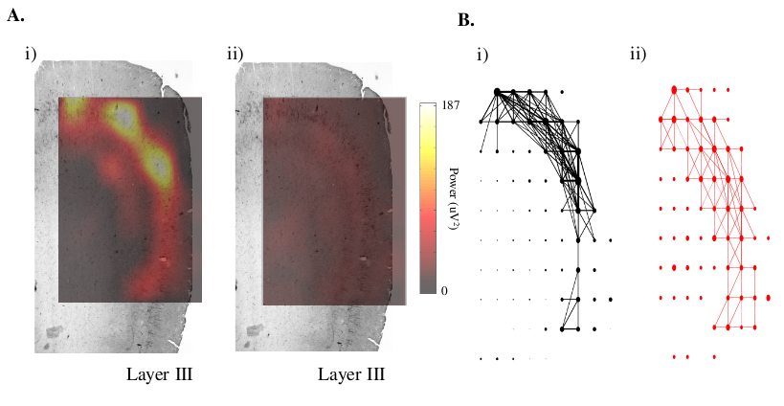
Network investigations in vitro
M Ainsworth, J Simonotto, M Kaiser, M Whittington & M Cunningham, unpublished data

Slide 23
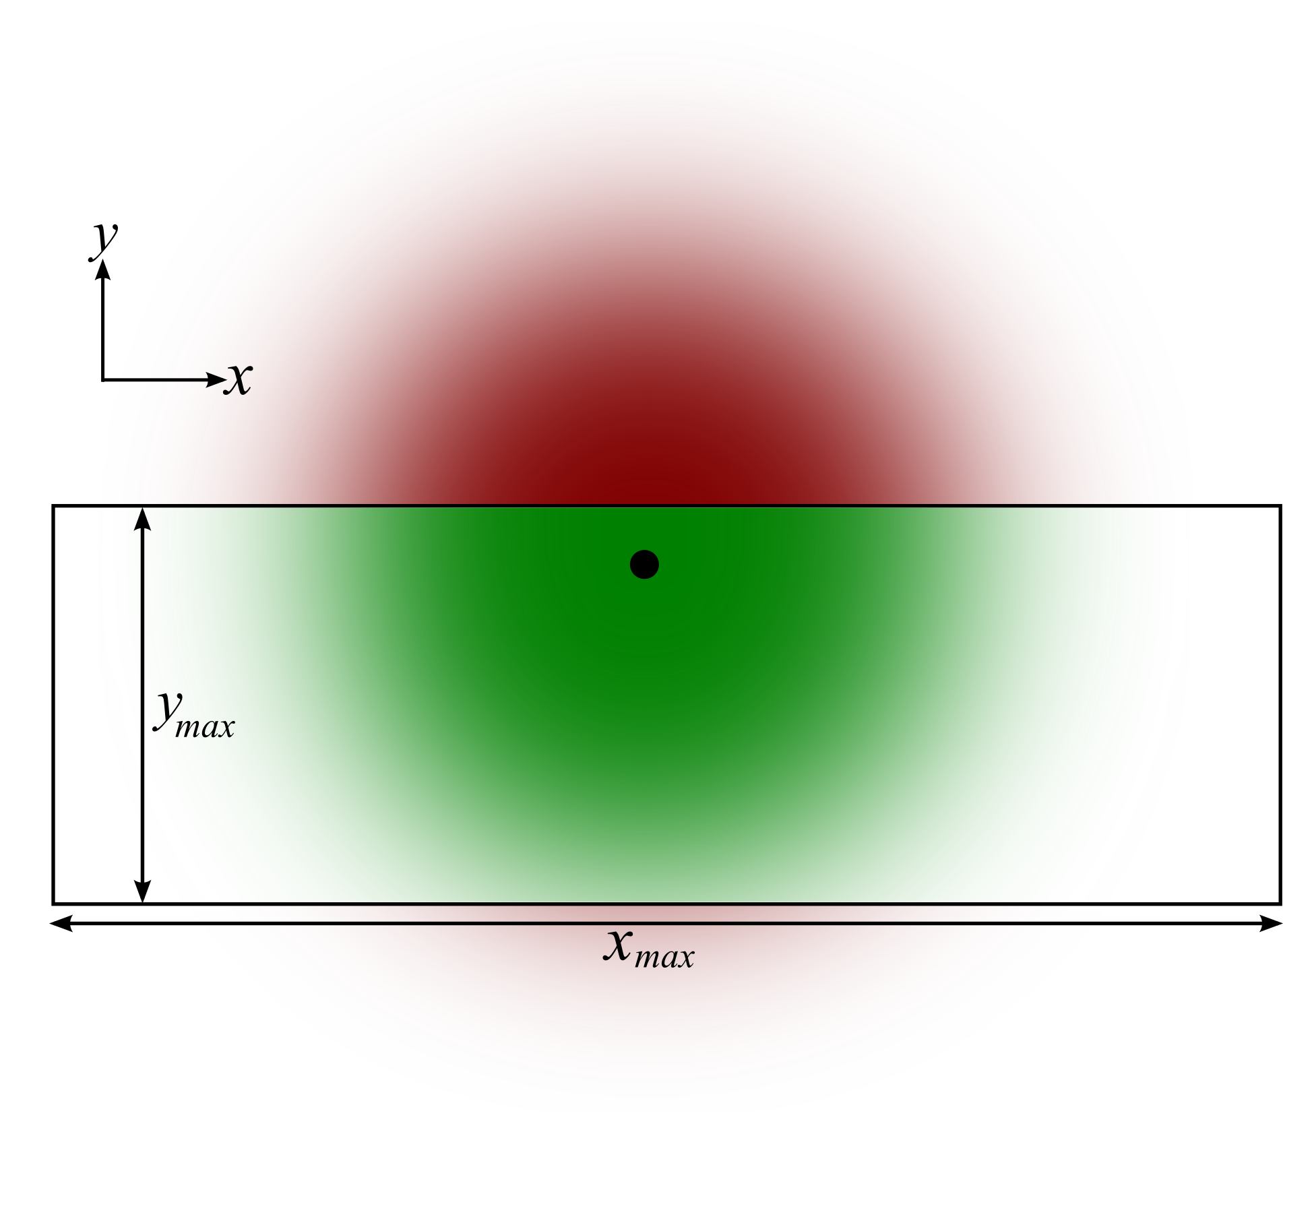
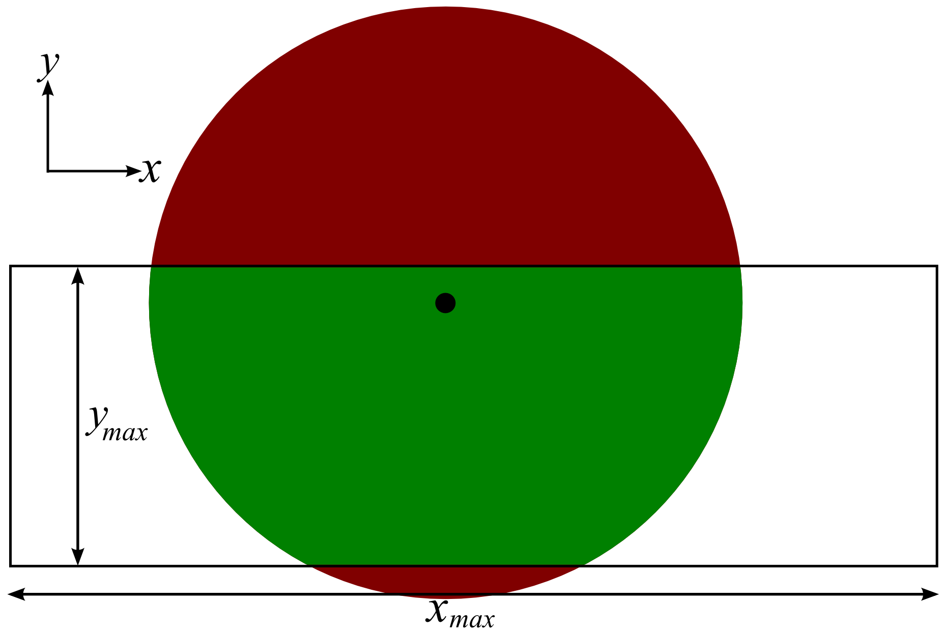
Effect of connectivity profile on dynamics

Slide 24
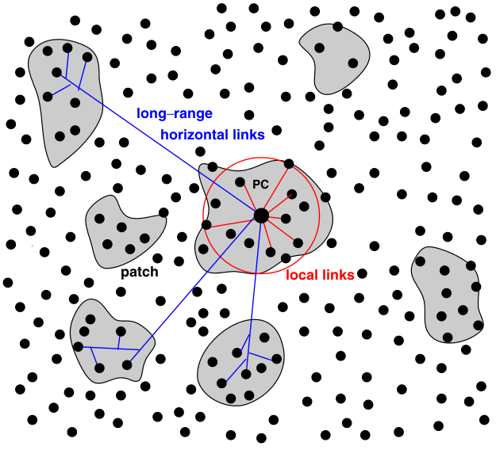
Effect of connectivity profile on dynamics
Voges et al, J Comput Neurosci, 2010

Slide 25
Acknowledgements
Supervisor: Marcus Kaiser
Matt Ainsworth, Miles Whittington, Mark Cunningham
Jennifer Simonotto
Funding: BBSRC

