Slide 1

Stephen D. Larson
NeuroML Workshop
Edinburgh, UK
03/13/12

Slide 2



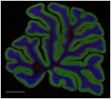
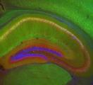

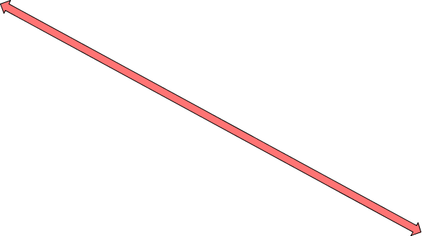

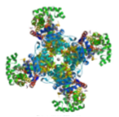
A multi-scale data problem
Whole brain data (20 um microscopic MRI)
Mosiac LM images (1 GB+)
Conventional LM images
Individual cell morphologies
Scale
EM volumes & reconstructions
Solved molecular structures

Slide 3
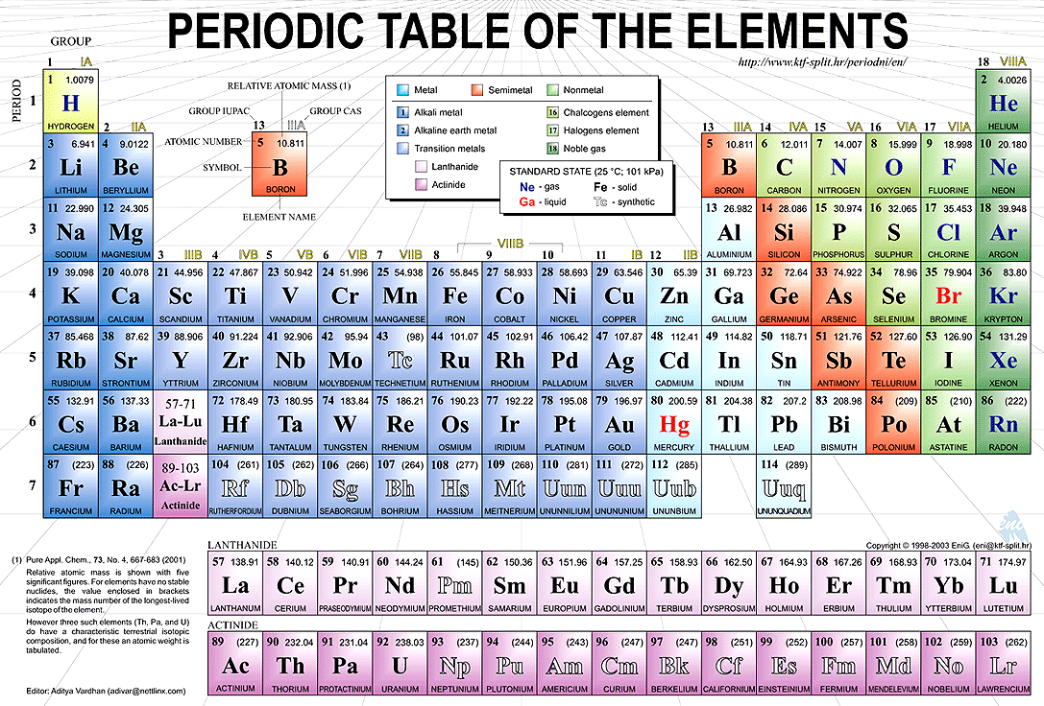
Framework of parts

Slide 4
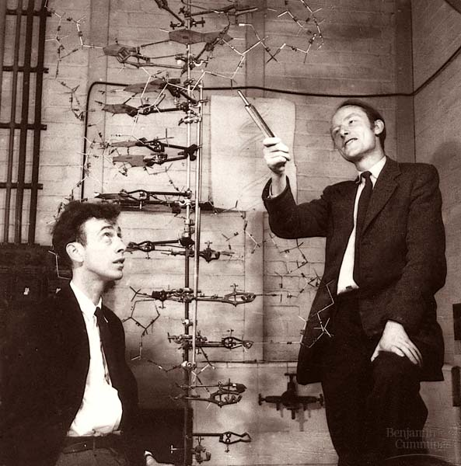
Multi-scale synthesis in biology
Watson & Crick, 1953

Slide 5

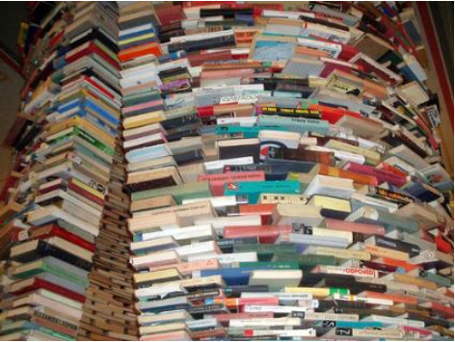
Organizing frameworks for knowledge
Knowledge in words, terminologies and logical relationships (the “what”)

Slide 6
Past

Slide 7
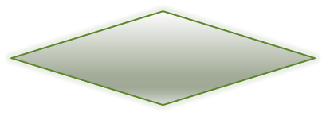
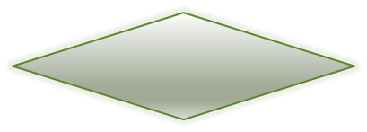



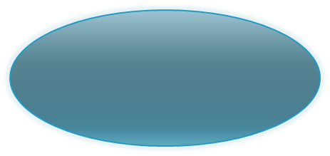


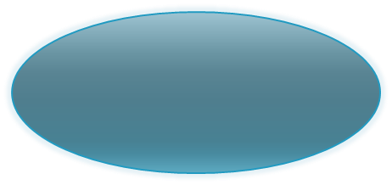


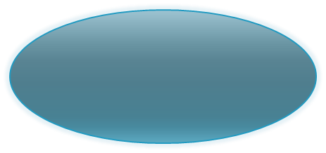








Shared building blocks
Calbindin
Calbindin
Has part
Cerebellum Purkinje neuron
Has part
Cerebellum Purkinje cell axon
Cerebellum Purkinje cell dendrite
Has part
Is part of
Cerebellum Purkinje cell soma
Is part of
Cerebellum granule cell layer
Cerebellum molecular layer
Is part of
Has part
Has part
Cerebellum Purkinje cell layer
Cerebellar cortex
Has part

Slide 8
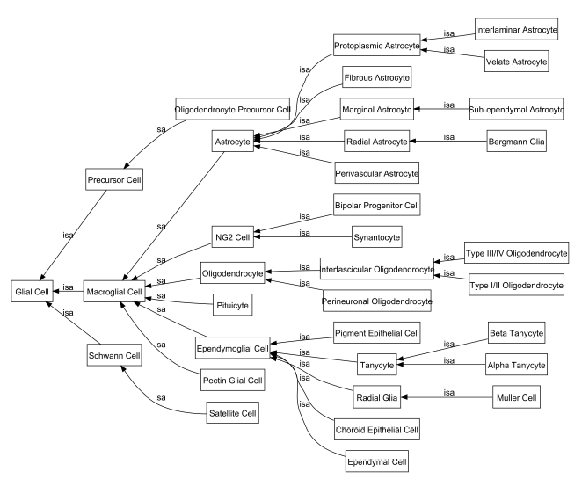
Larson et al., 2007

Slide 9
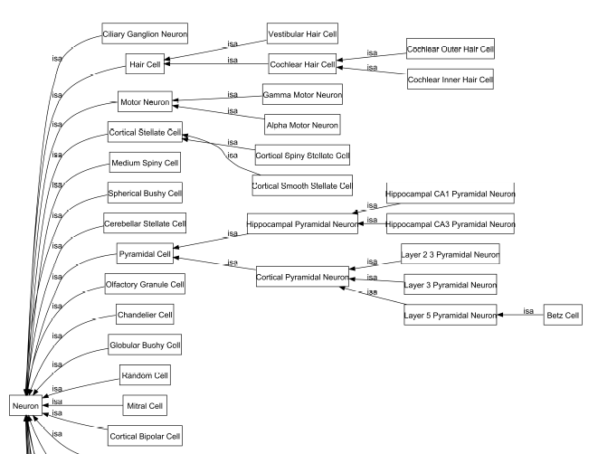
Larson et al., 2007

Slide 10
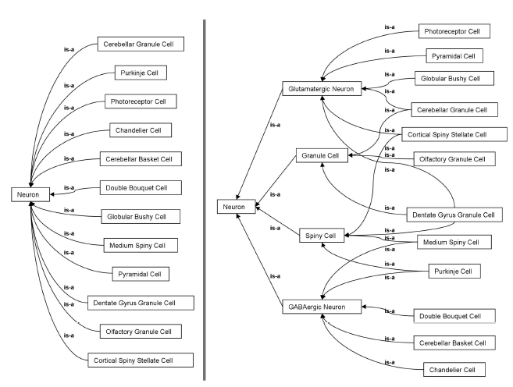
Larson et al., 2007

Slide 11
Present

Slide 12
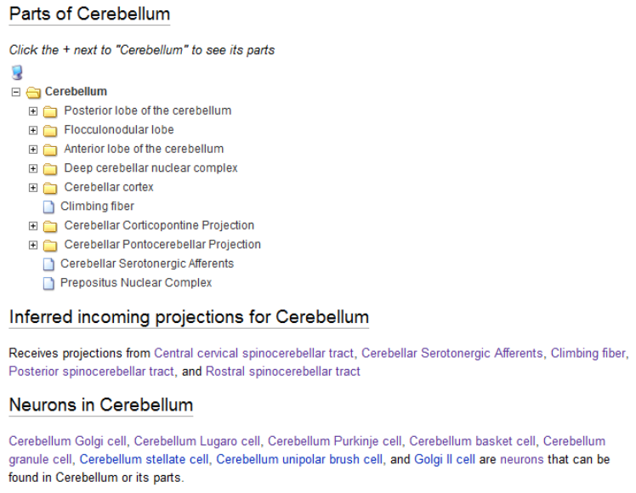
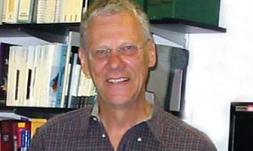
Need for an online parts list
“We need a parts catalog for the brain” – Society for Neuroscience Keynote lecture, 2009
Larry Swanson, University of Southern California

Slide 13
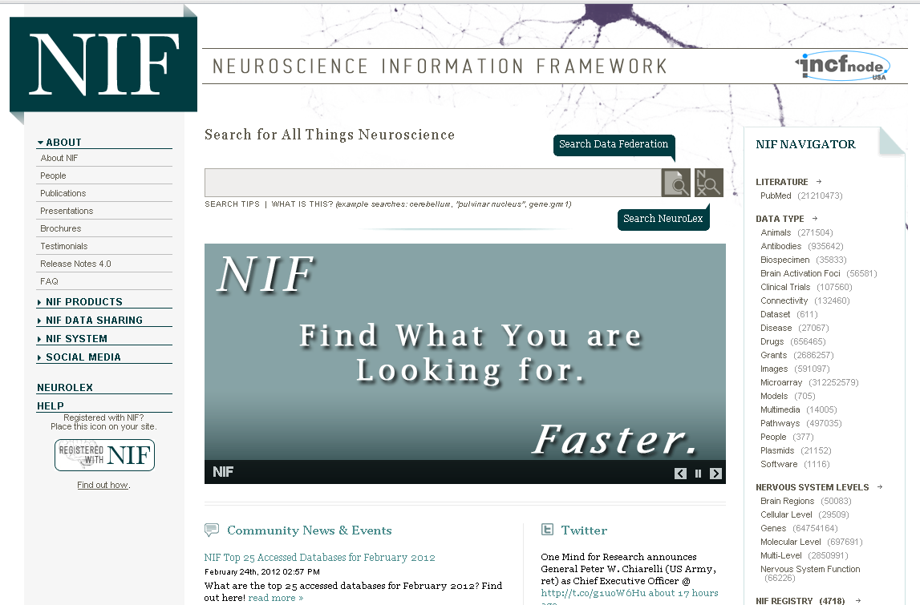
Organizing knowledge online

Slide 14
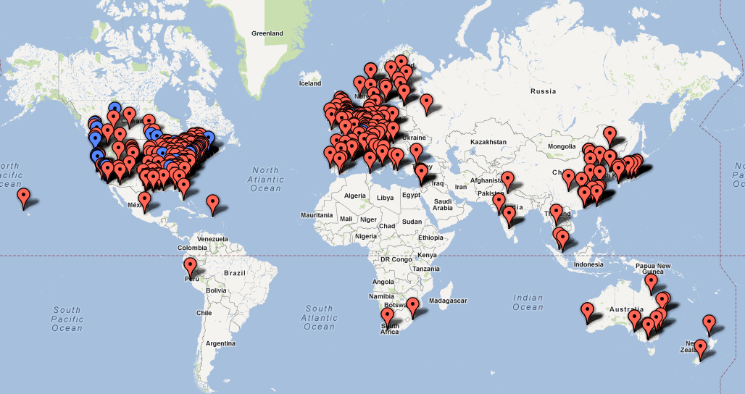
Organizing knowledge online

Slide 15

Top 25 accessed databases in NIF

Slide 16
NIF Vocabularies / ontologies
  Neurolex Wiki: Lexicon for community review and comment
    http://neurolex.org/wiki/NeuroLex_SPARQL_endpoint
  NIFSTD: set of modular OWL files normalized under BFO and available for download
    http://neuinfo.org/developers/
  NCBO Bioportal for visibility and mapping services
    http://bioportal.bioontology.org/ontologies/45355

Slide 17
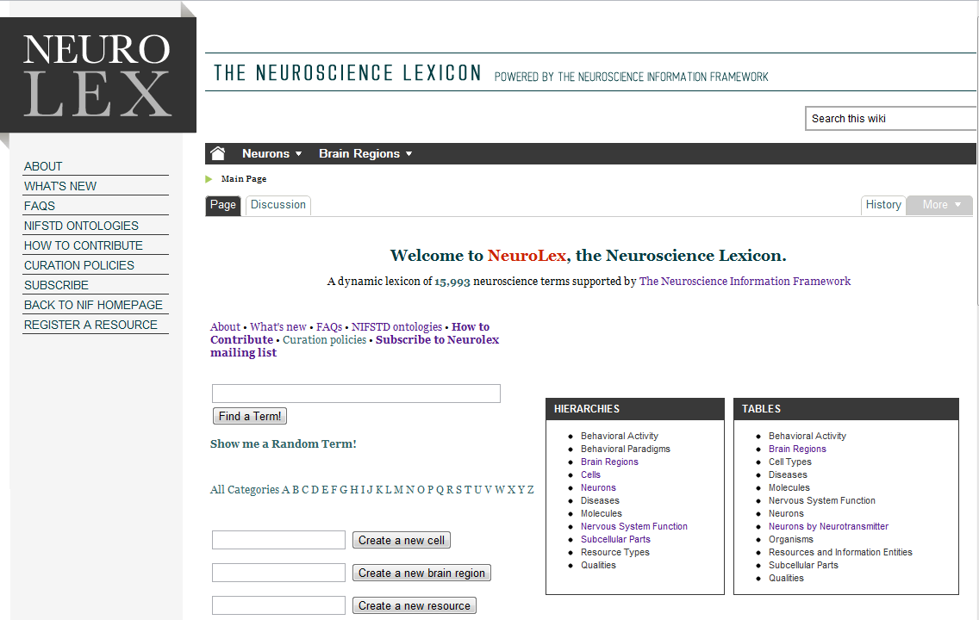
Organizing knowledge online
  Built using the same open source software that runs Wikipedia
  Extra functionality to create structured knowledge
  Allows anyone to edit or create new concepts
  ~18,000 concepts

Slide 18
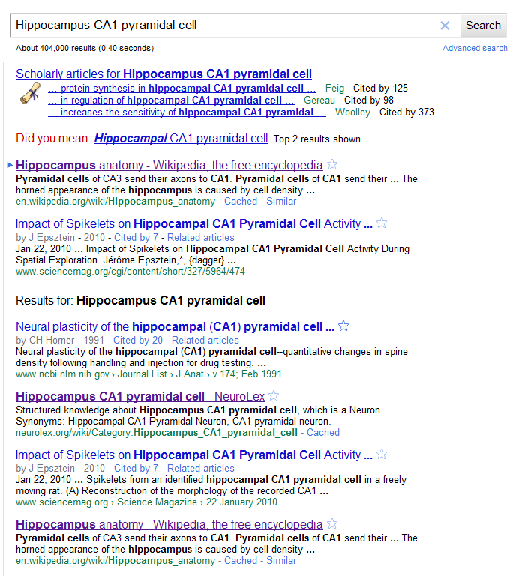
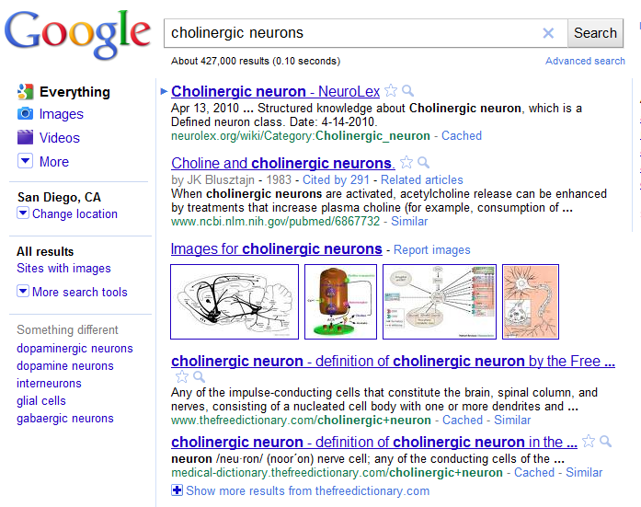
Impact: NeuroLex being found spontaneously online

Slide 19
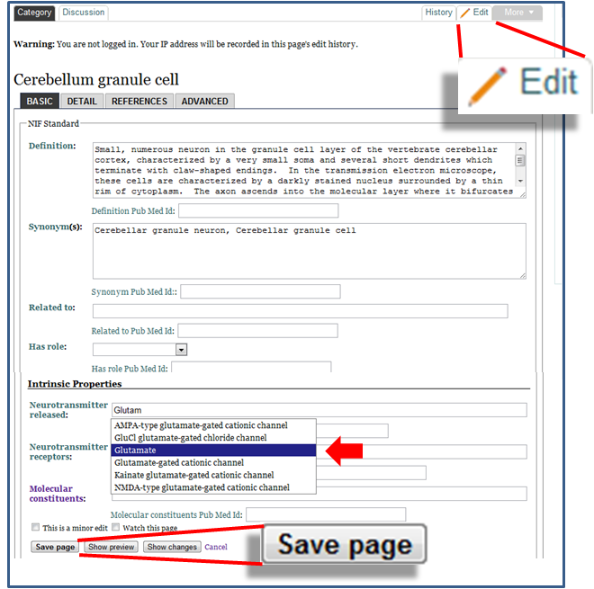

Slide 20
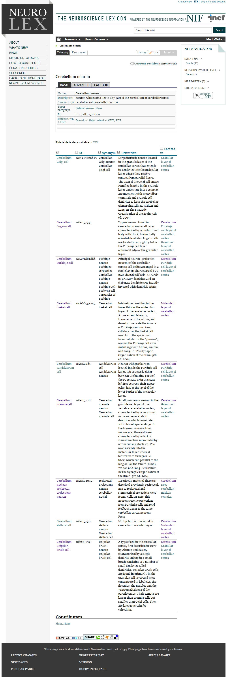
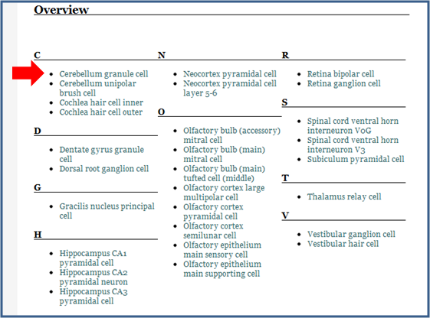
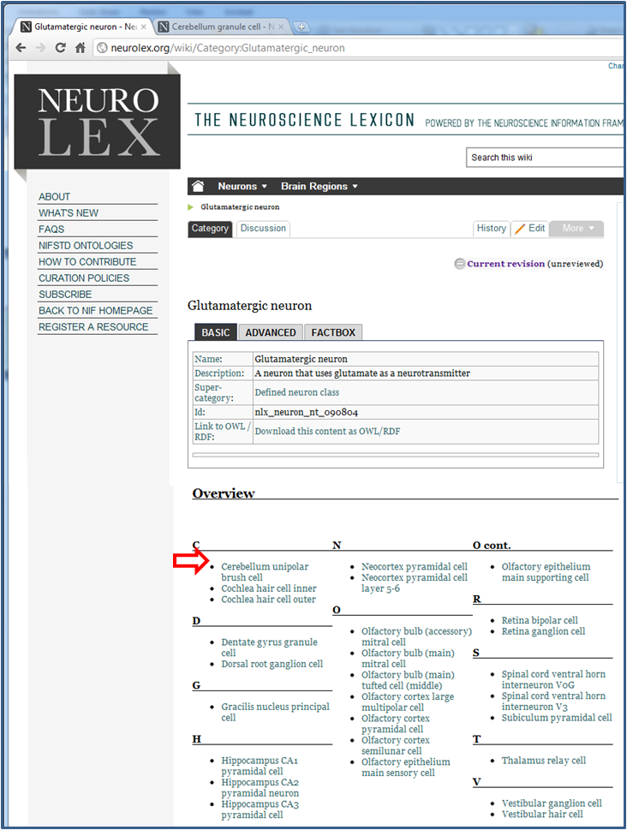
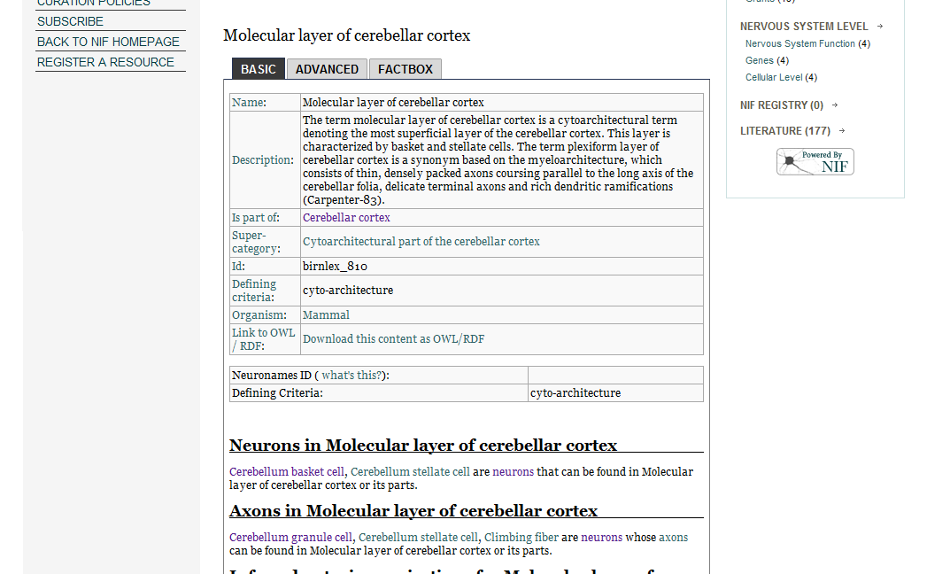

Slide 21
Low barrier to establishing computable interlinkages
across entity and spatial scale

Slide 22
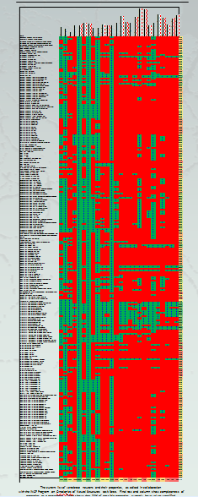
Master table of neurons?

Slide 23
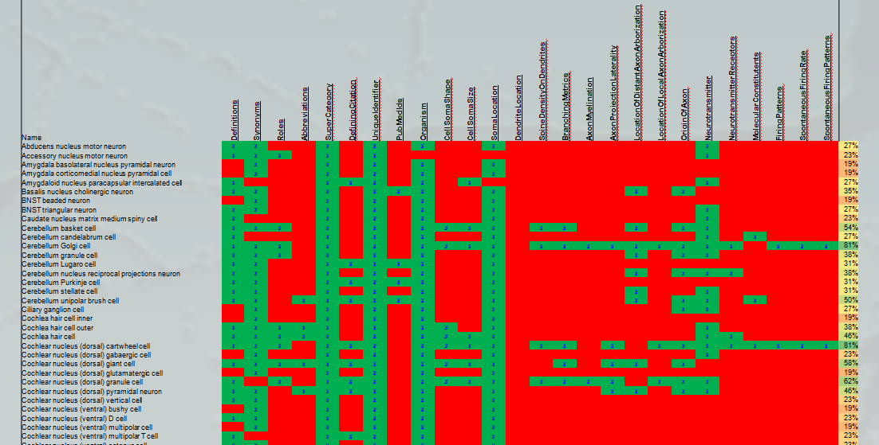
Master table of neurons?

Slide 24
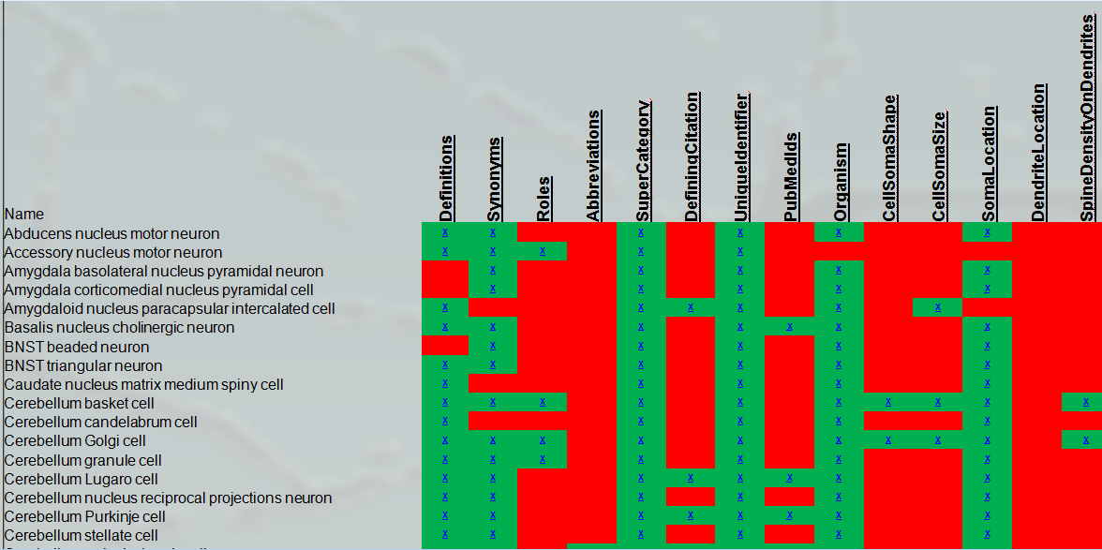
Master table of neurons?
Every row represents a wiki page that is publicly available for review and edit

Slide 25
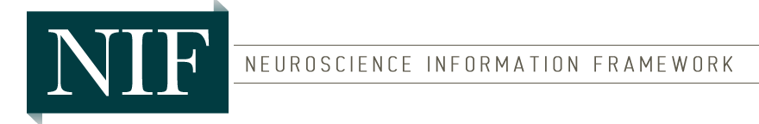
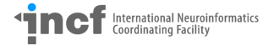

Partnerships & Community
Curators with the NIH-funded Neuroscience Information Framework and volunteers with the International Neuroinformatics Coordinating Facility
Community

Slide 26
Future

Slide 27
Future Goals
  Dominate Google searches for terms in systems biology

Slide 28
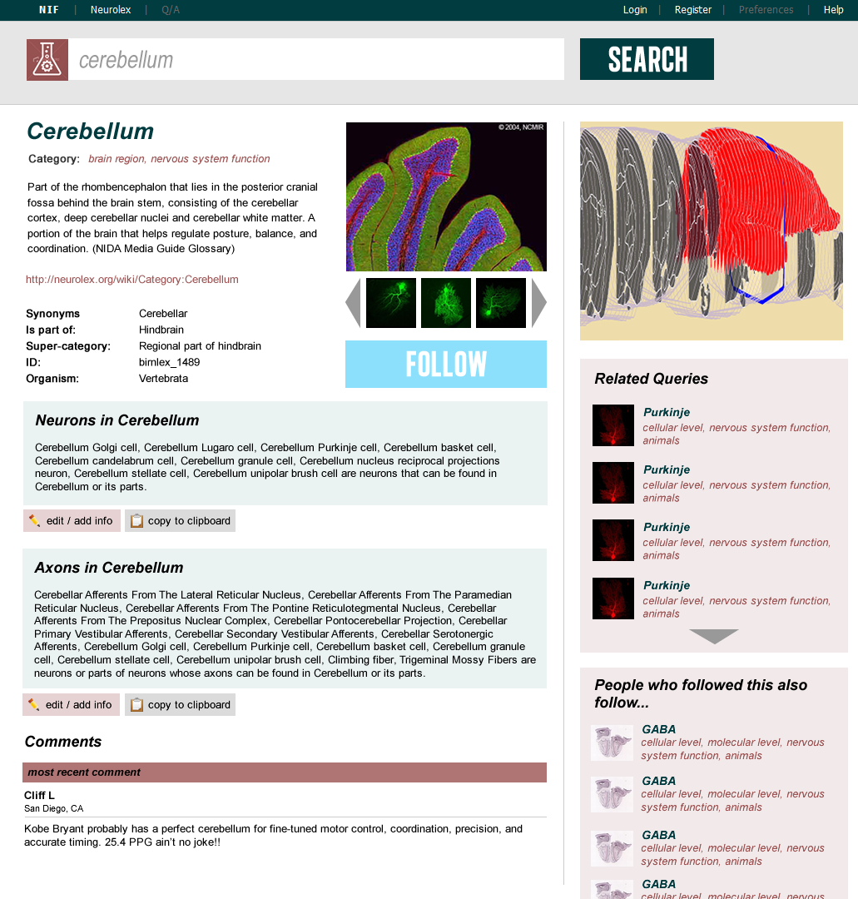
Yelp for neuroscience & systems biology

Slide 29
Future landscape?
Community
Front-end
(Dominate google searches)
Linked Data Cloud
Federated systems biology databases
(Cached and indexed for dynamic search)
Semantic MediaWiki Backend
(Create high-quality linked data)
Community of systems biology databases

Slide 30
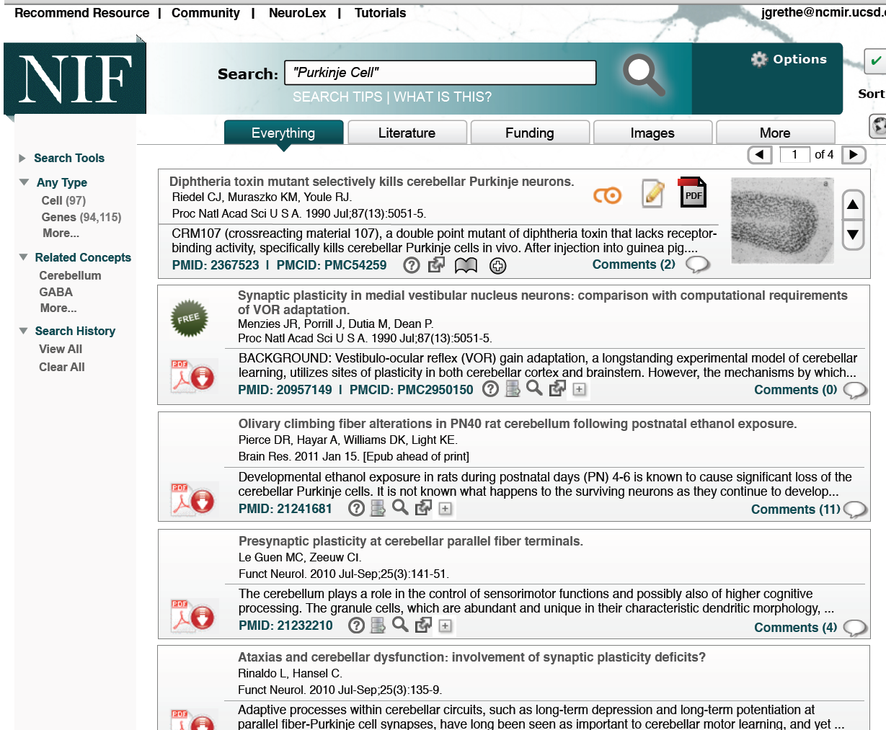

Slide 31
Future Goals
  Dominate Google searches for terms in neuroscience & systems biology
  Expose high quality linked data for neuroscience & systems biology researchers and modelers

Slide 32
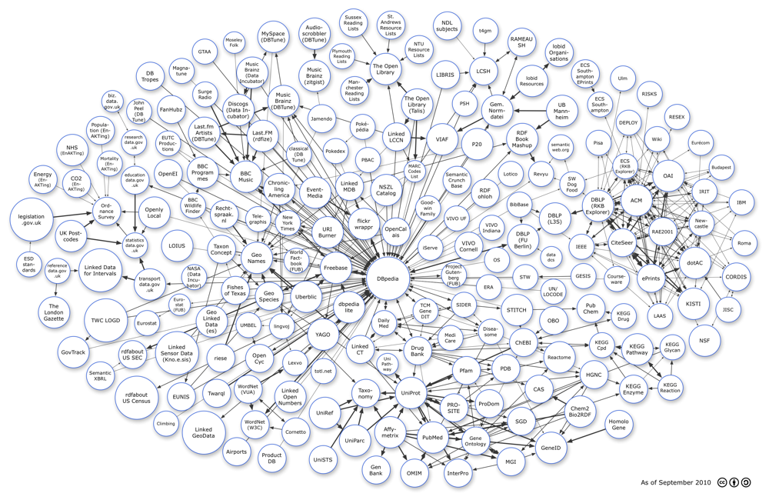
Open Linked Data Graph

Slide 34
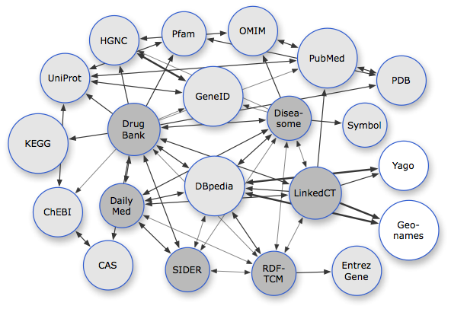
Biological Linked Data

Slide 35
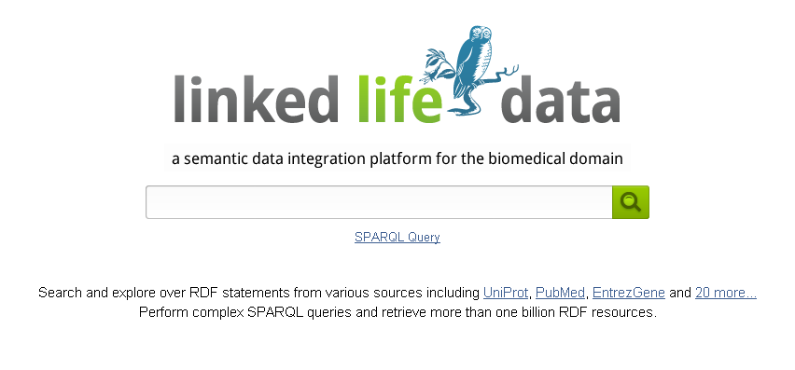
Access to linked data is getting easier

Slide 36
Problem:
Reading Linked Data is
(relatively) easy,
but community contribution
to Linked Data is
still
too hard.

Slide 37



Slide 38
Vision of interlinked systems biology graph
Interlinkages of entities across scales and disciplines point between authoritative rich graphs
Citation management: All statements of fact can be cited with ISBNs, PMIDs, DOIs.
Interface is simple, flexible, and compelling enough to incentivize scientists to contribute

Slide 39
Contributions
Acknowledgements
Described work to represent neuroscience using ontologies
Provided an introduction to NIF and NeuroLex.org and their use for creating structured data in neuroscience
Outlined some examples of use of structured data within NeuroLex.org
Pointed to a future landscape of structured information in neuroscience and systems biology
Pointed to a future ecosystem of creativity in neuroscience & systems biology built on top of open linked data
Maryann Martone (Director)
Jeff Grethe
Anita Bandrowski
Amarnath Gupta
Fahim Imam
Vadim Astahkov
Andrea Arnaud
Jonathan Cachat
Larry Lui
Vicky Rowley
Chris Condit
Xufei Qian
Jennifer Lawrence
Willy Wong
Cliff Lee
Lee Hornbrook

