Slide 1
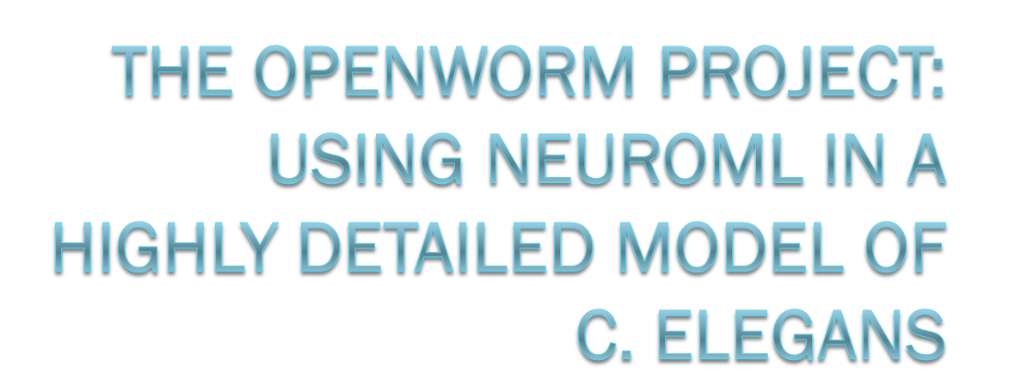

Stephen D. Larson
NeuroML Workshop
03/13/12

Slide 2
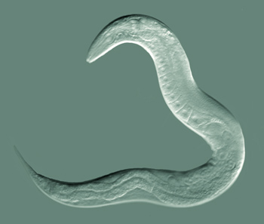
Enter the worm: c. elegans
I’ve only got 1000 cells in my whole body… please simulate me!

Slide 3
In search of nature’s design principles via simulation
How can a humble worm regulate itself?
  Reproduces
  Avoids predators
  Survives in different chemical and temperature environments
  Seeks and finds food sources in an ever changing landscape
  Distributes nutrients across its own cells
  Manages waste and eliminates it
If we can’t understand genes to behavior here, why would we expect to understand it anywhere?

Slide 4
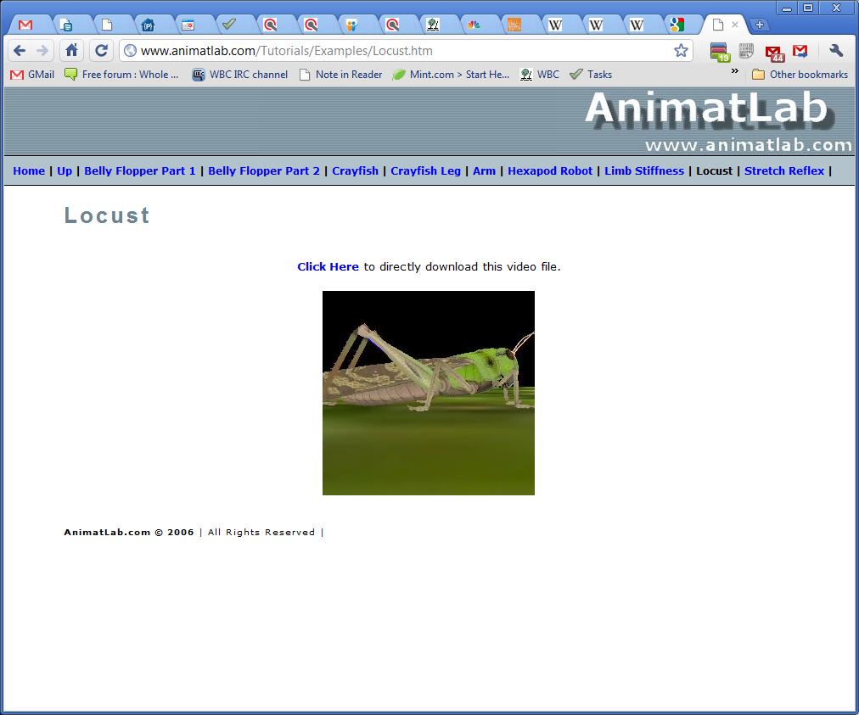
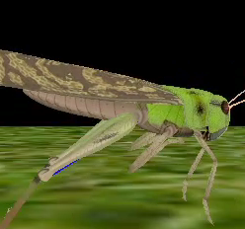
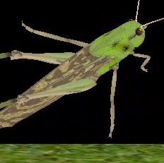
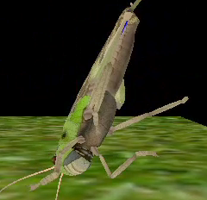
Virtual physical organisms in a computer simulation

Slide 5
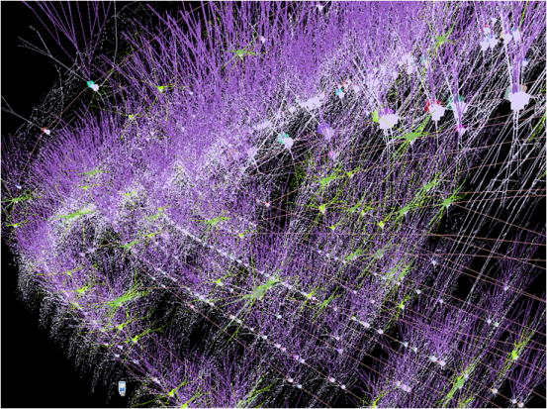
Closing the loop between a worm’s brain, body and environment
Simulated
World
Detailed simulation of cellular activity
Detailed simulation of worm body

Slide 6
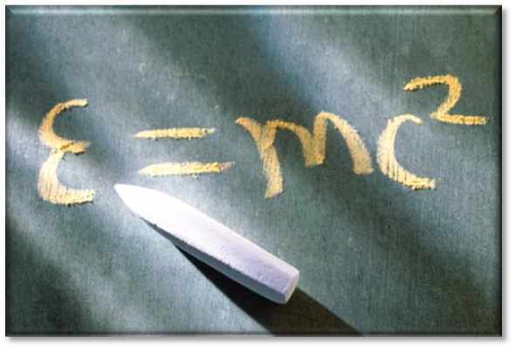
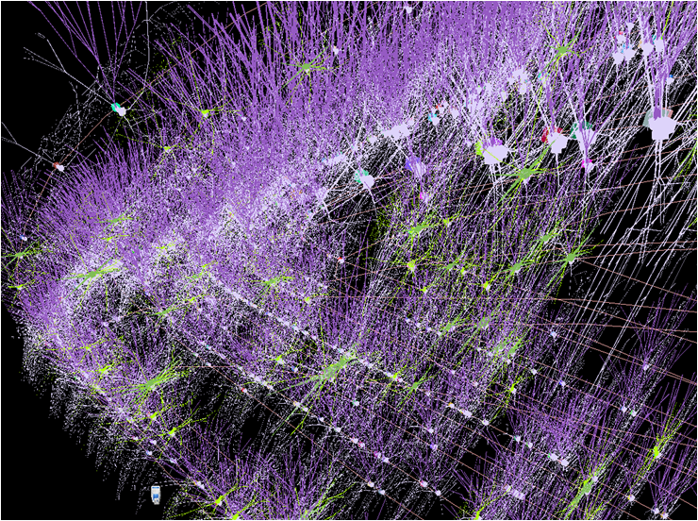
The goal: understanding a faithfully simulated organism end to end
Extracting mathematical principles from smaller biological systems is necessary if we are going to understand and reconstruct the much larger system of the human.

Slide 7
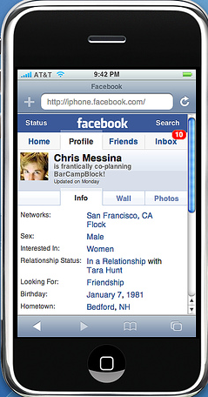
Outreach: put the model online and let the world play with it
Sex: Hermaphrodite
Interested in: Escaping my worm Matrix
Relationship status: Its complicated.

Slide 8
Worm biology
~1000 cells / 95 muscles
Neuroscience:
  302 neurons
  15k synapses
Shares cellular and molecular structures with higher organisms
  Membrane bound organelles;
  DNA complexed into chromatin and organized into discreet chromosomes
  Cell control pathways
Genome size: 97 Megabases vs human: 3000 Megabases.
C. elegans homologues identified for 60-80% of human genes (Kaletta & Hangartner, 2006)

Slide 9
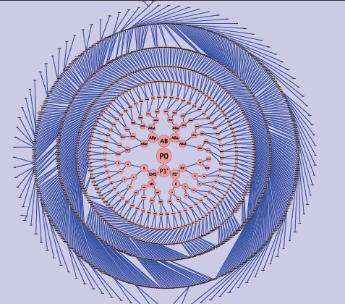
Entire cell lineage mapped
Christian Grove, Wormbase

Slide 10
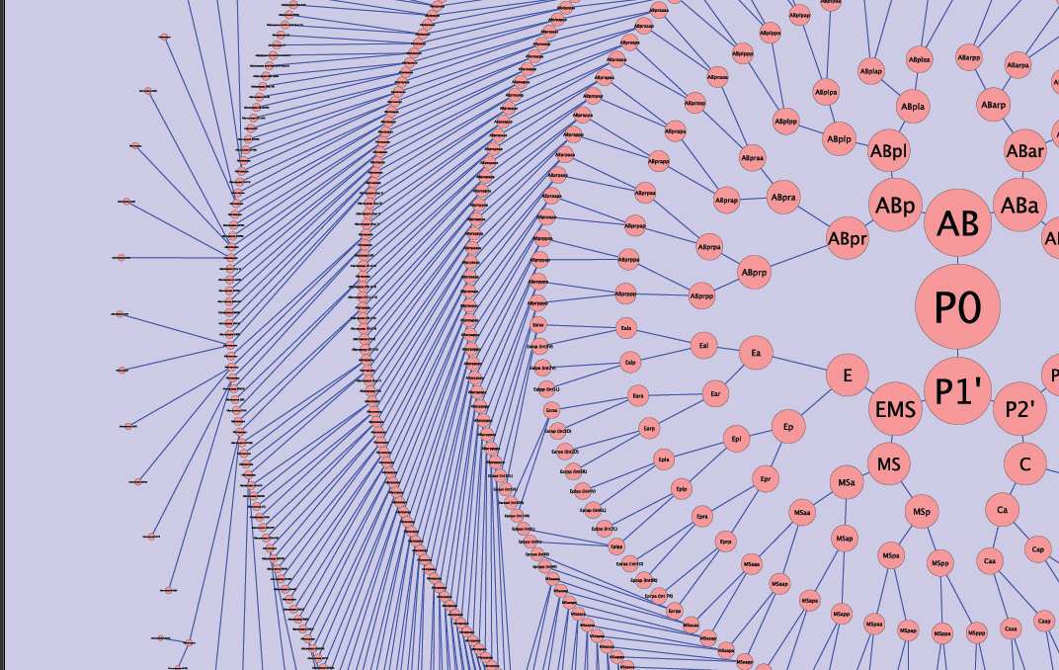
Entire cell lineage mapped
Christian Grove, Wormbase

Slide 11
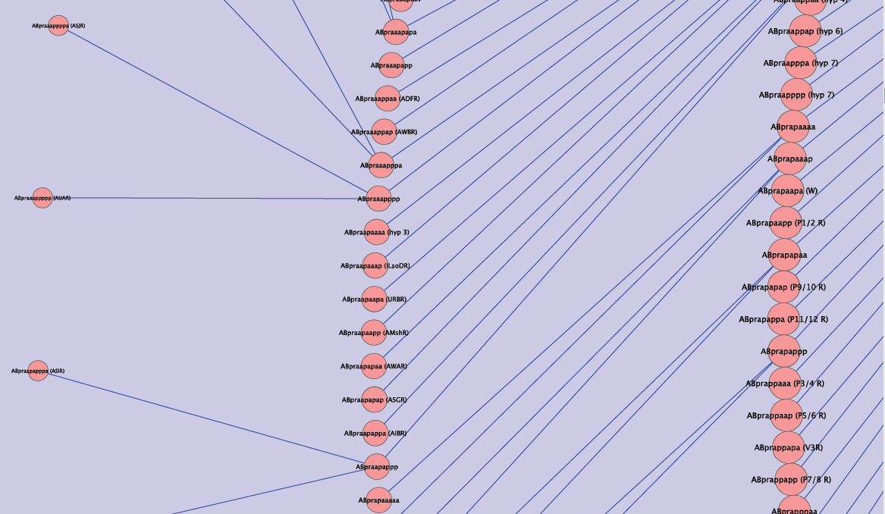
Entire cell lineage mapped
Christian Grove, Wormbase

Slide 12
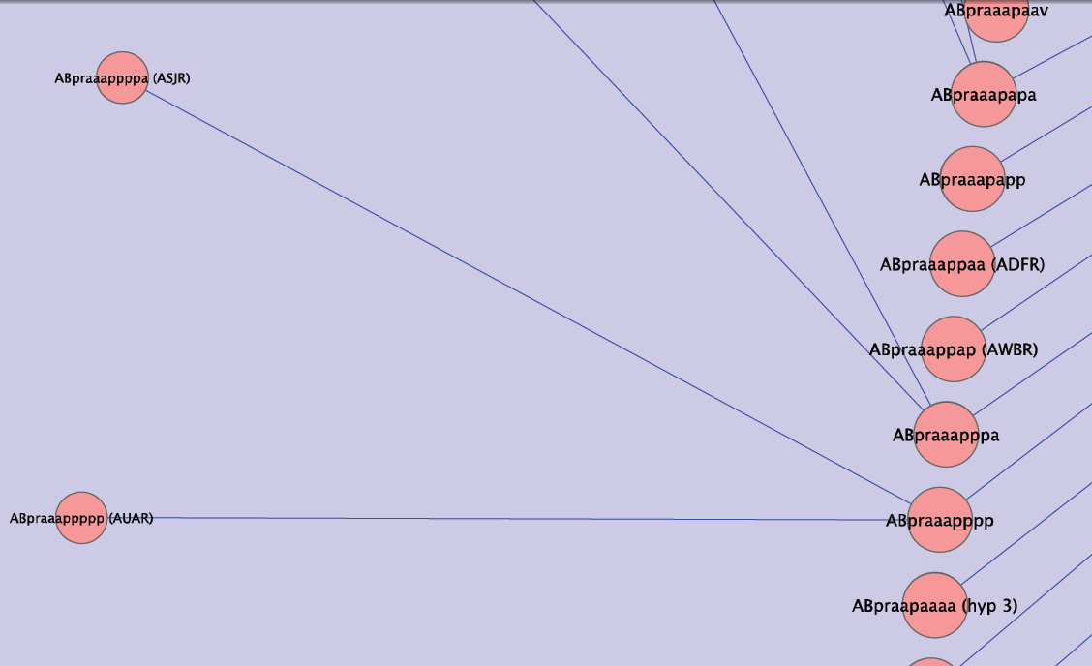
Entire cell lineage mapped
Christian Grove, Wormbase

Slide 13
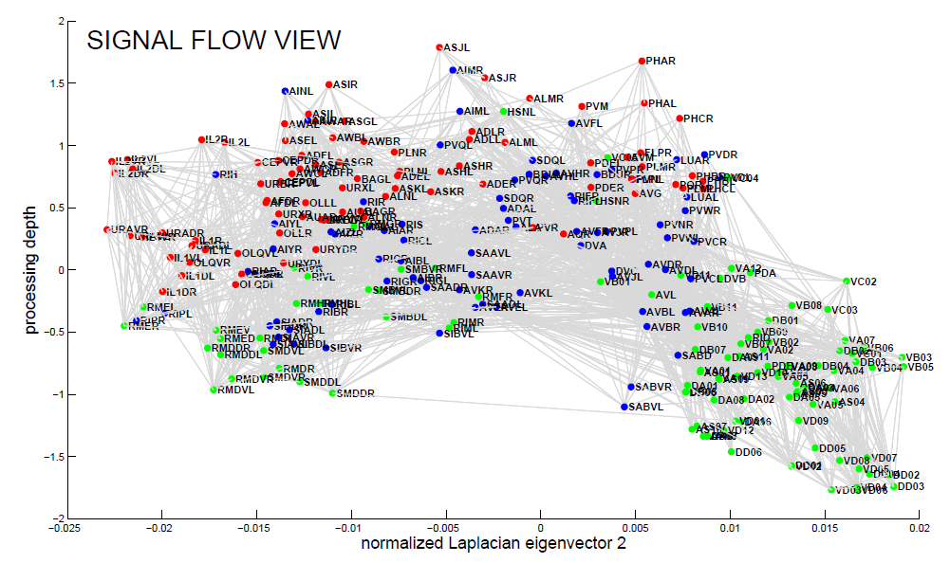
Full connectome
Varshney, Chen, Paniaqua, Hall and Chklovskii, 2011

Slide 14
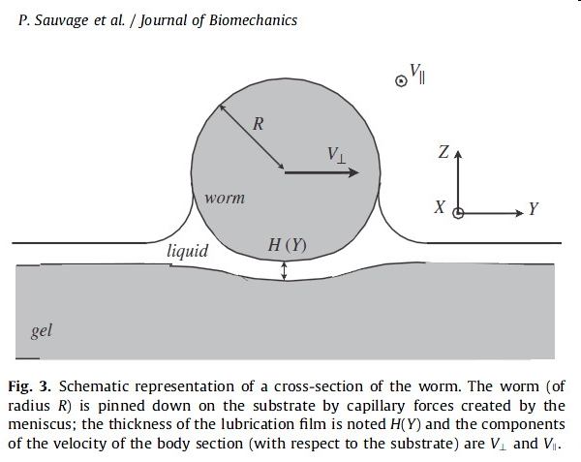
Biomechanics
P. Sauvage et al. / Journal of Biomechanics 2011

Slide 15
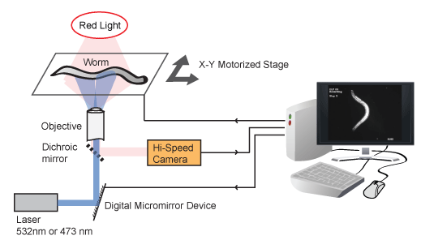
Interrogation of Behavior
Liefer et al., 2011

Slide 16

C. Elegans disease models
Kaletta & Hengartner, 2006

Slide 17
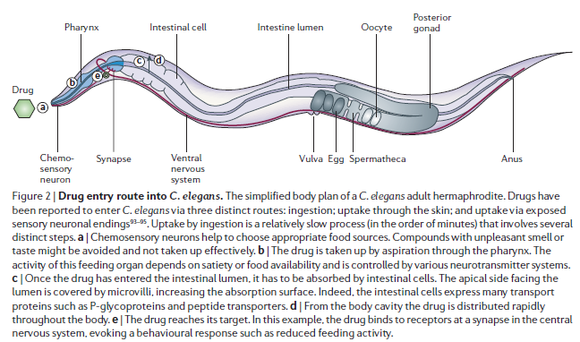
Can present drugs
Kaletta & Hengartner, 2006

Slide 18

March– Sept 2011

Slide 19
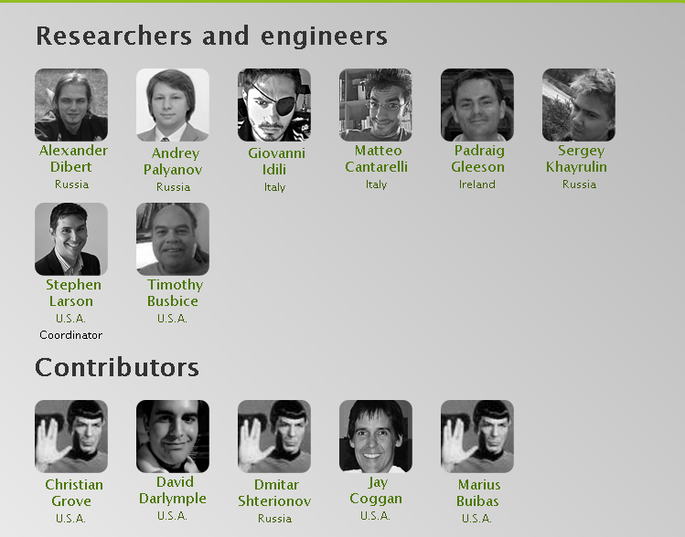

Slide 20
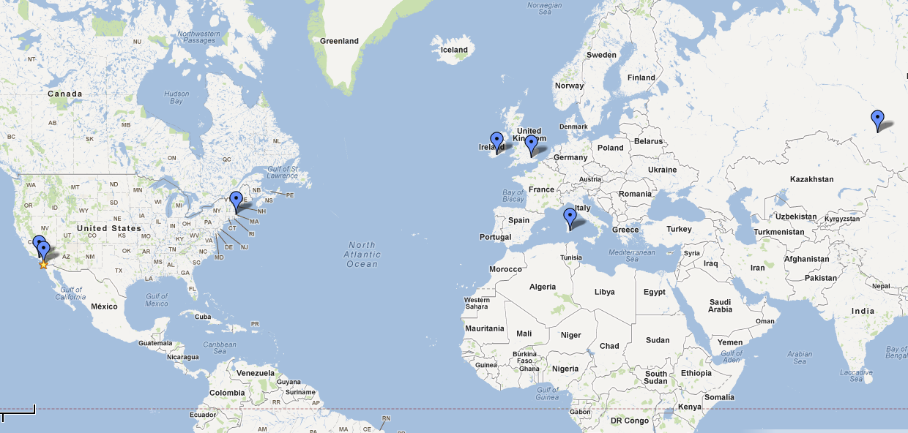
Team – A brief history

Slide 21








Collaboration technologies used

Slide 22

Mechanical model
Palayanov, Khayrulin, Dibert (submitted)

Slide 23

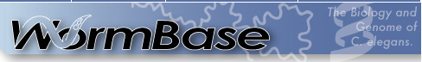
3D body plan
Christian Grove, Wormbase

Slide 24
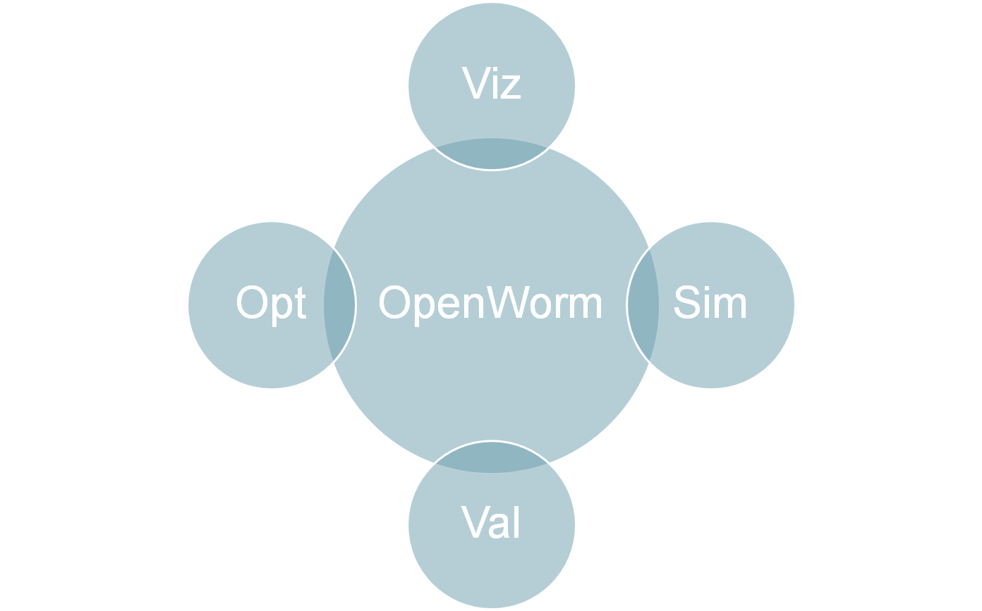
Core platform

Slide 25
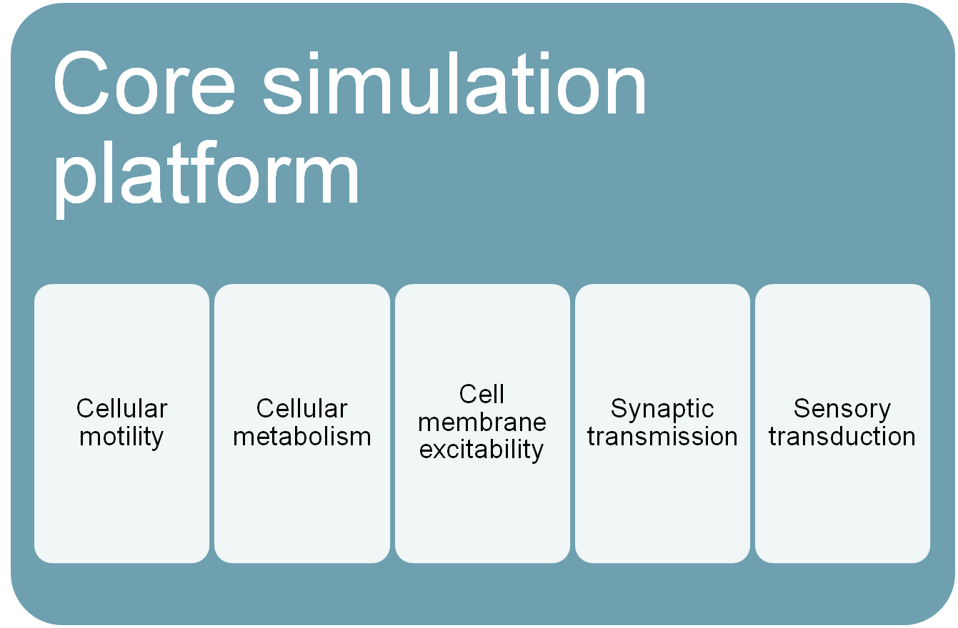
One core hooks together multiple simulation engines addressing diverse biological behavior

Slide 26
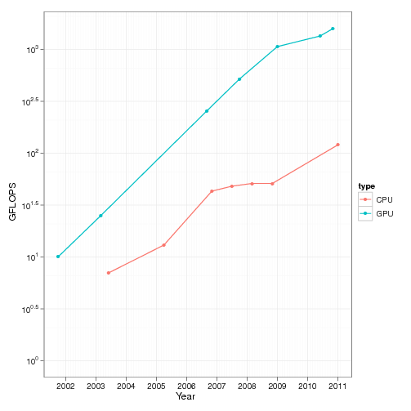
Estimates of computational complexity
Mechanical model
  ~5 Tflops
Muscle / Neuronal conductance model
  ~240 Gflops
One Amazon GPU cluster provides 2 Tflops
Source: http://csgillespie.wordpress.com/2011/01/25/cpu-and-gpu-trends-over-time/

Slide 27
Simulation engine libraries
Simulation Engine
OSGi
JavaCL
OpenCL
NVIDIA Tesla drivers

Slide 28
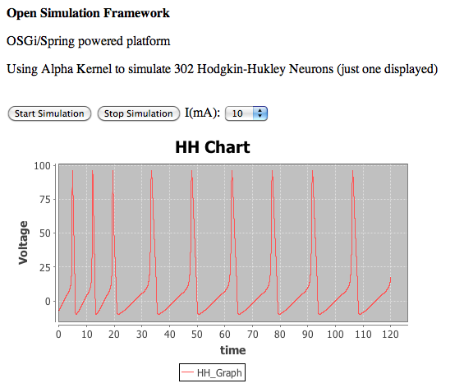
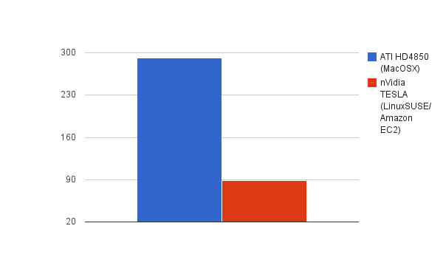
Neuronal model
ms
Architecture proof of concept using Hodgkin-Huxley neurons
GPU Performance Testing:
302 Hodgkin-Huxley neurons for 140 ms (dt = 0.01ms)

Slide 29
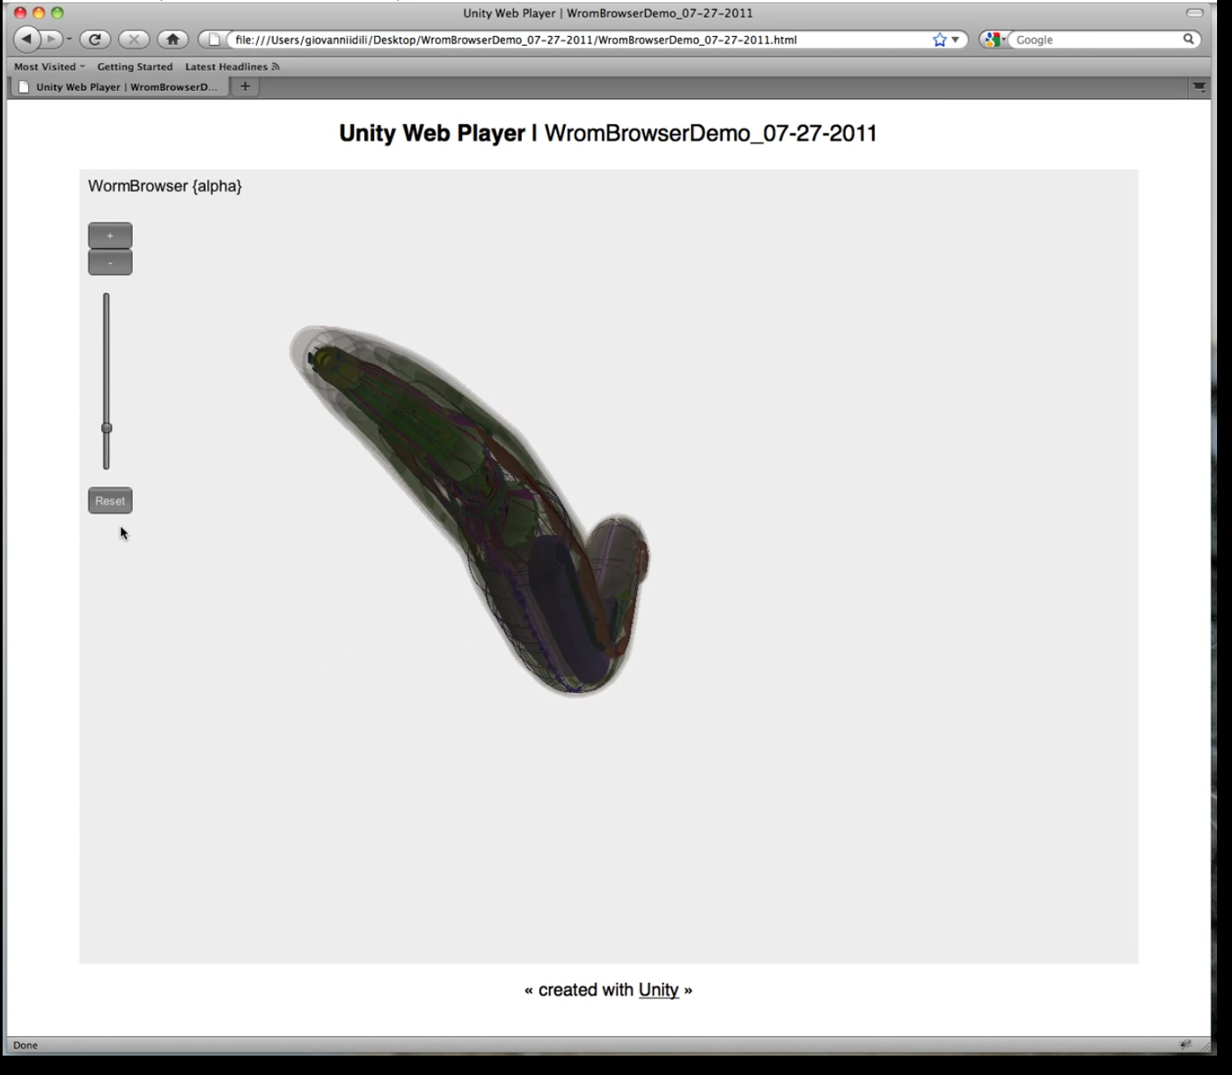
Worm Browser
http://www.youtube.com/watch?v=nAd9rMey-_0

Slide 30
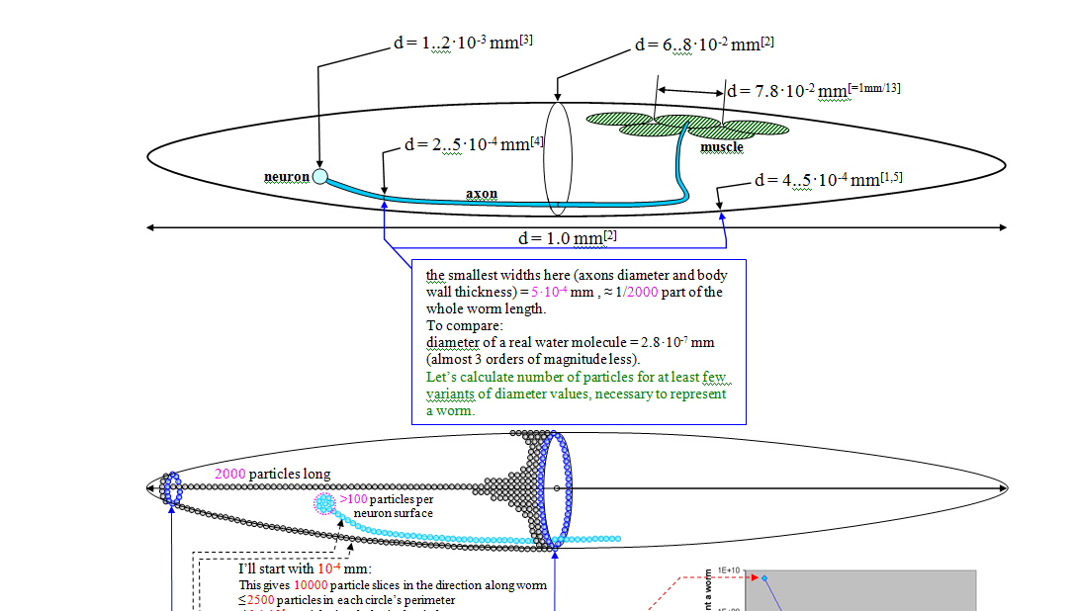
Finite element modeling

Slide 31


Slide 32
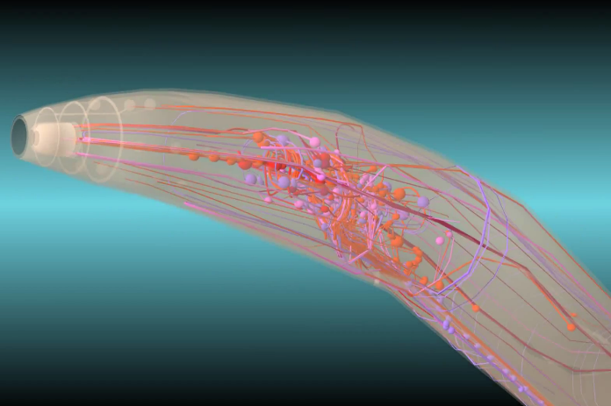
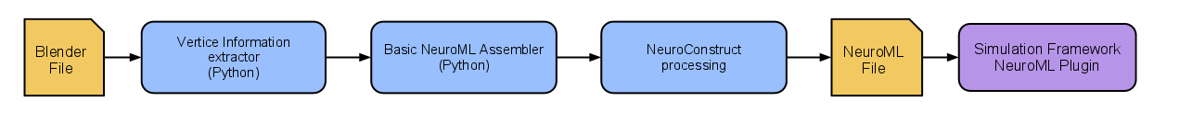
Neuron models from Blender to NeuroML

Slide 33
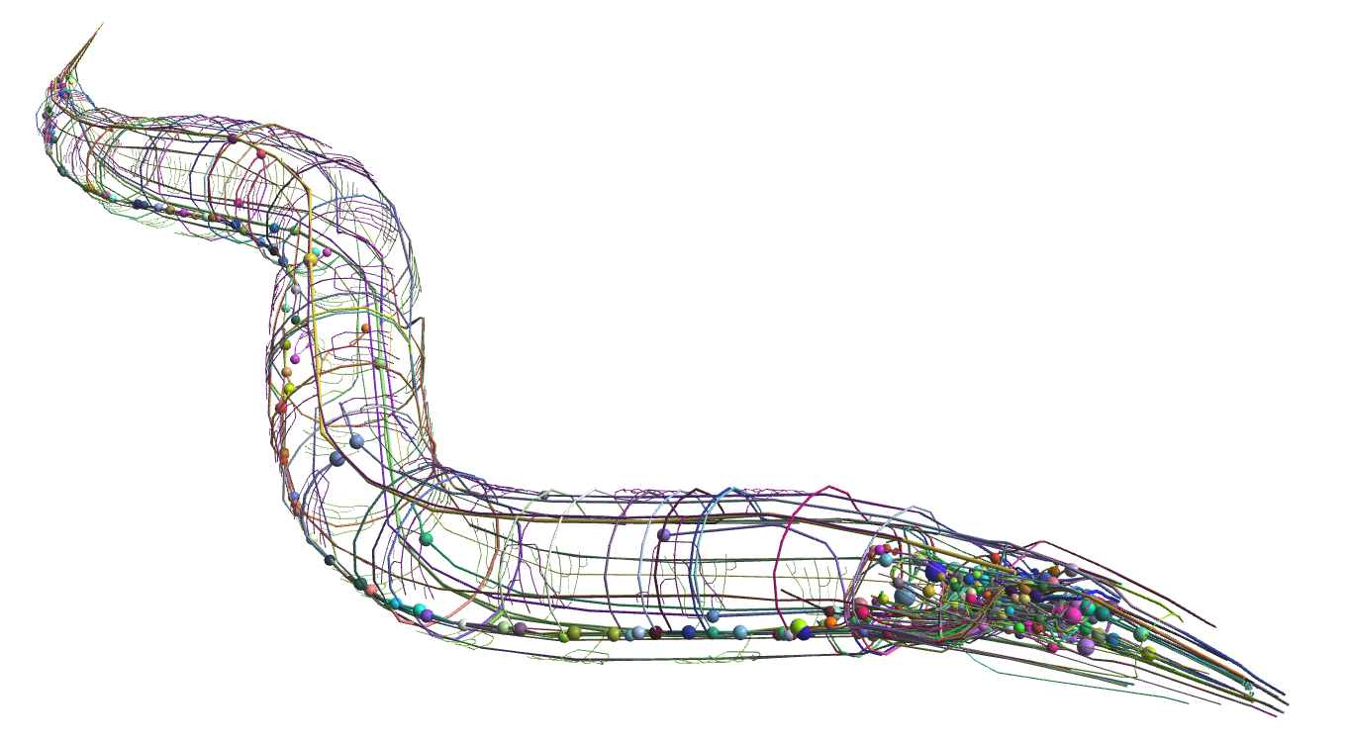
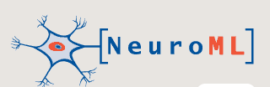
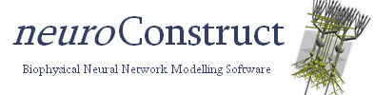
Put the parts back together
Spatial model of cells converted to NeuroML
  Sergey Khayrulin
Connections defined
  Tim Busbice + Padraig Gleeson
Ion channel placeholders
  Tim Busbice + Padraig Gleeson
Inferred neurotransmitters
  Dimitar Shterionov
http://openworm.googlecode.com
Open Worm Team, March 2012

Slide 34
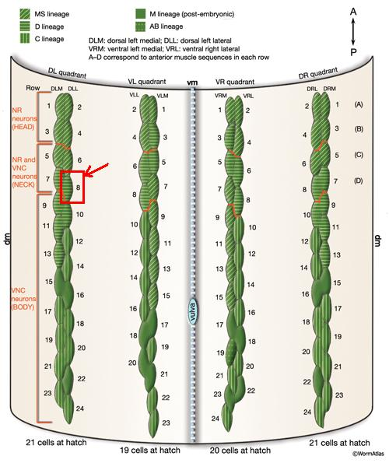
Focus on a muscle cell

Slide 35
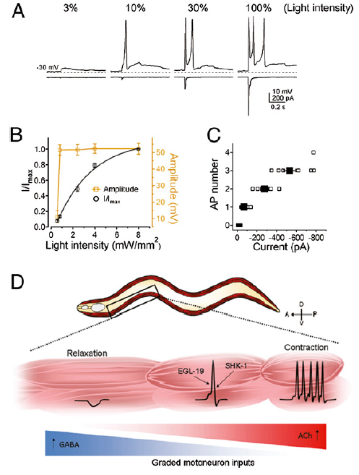
Case study: locomotion
Gao et al, 2011

Slide 36
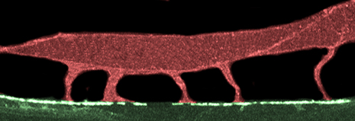
Muscle cell with “arms”
Cell Body
Cell body, 1 compartment, active currents
5 arms,
10 compartments each, passive currents
Boyle & Cohen, 2007

Slide 37
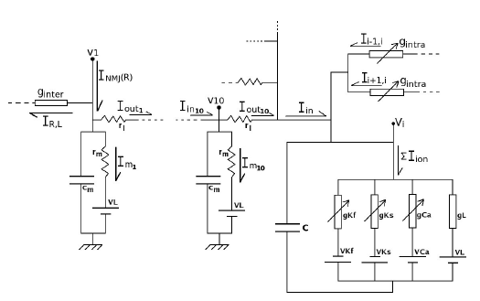
Conductance model of c. elegans muscle cell
Boyle & Cohen, 2007

Slide 38
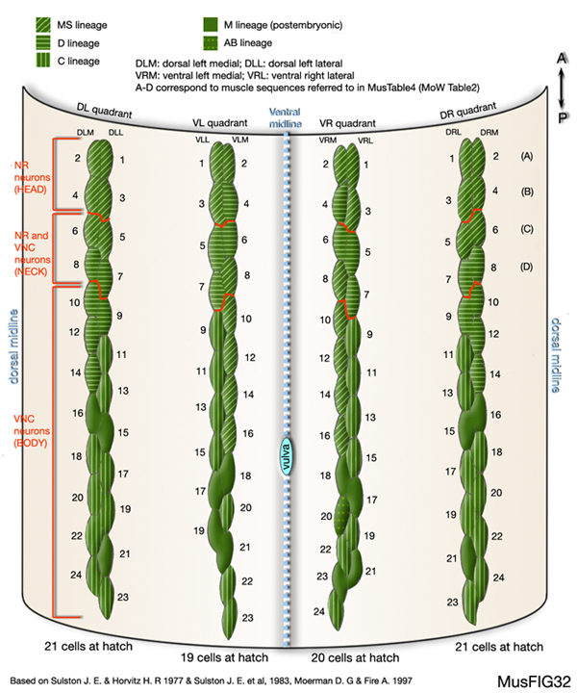
Quadrants of muscle cells
Quadrant 1
Quadrant 2
Cell Body
Cell Body
Cell Body
Cell Body
Cell Body
Cell Body
Cell Body
Cell Body
Cell Body
Cell Body
Cell Body
Cell Body

Slide 39
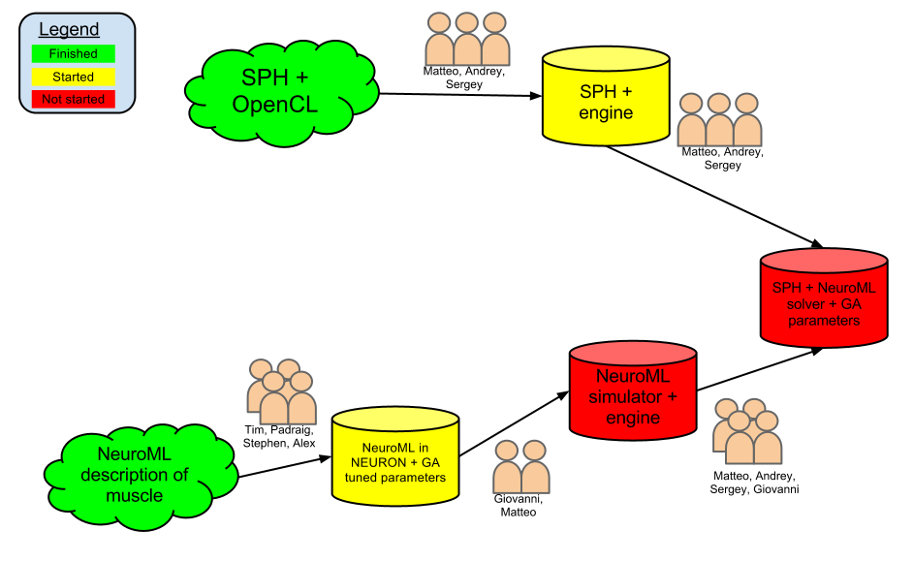
Muscle cell roadmap

Slide 40
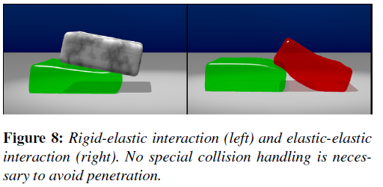
Physics: Smoothed Particle Hydrodynamics (SPH)

Slide 41
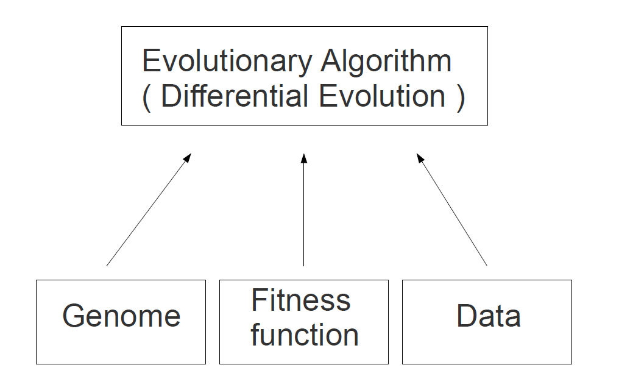
Progress with optimization
Alex Dibert

Slide 42
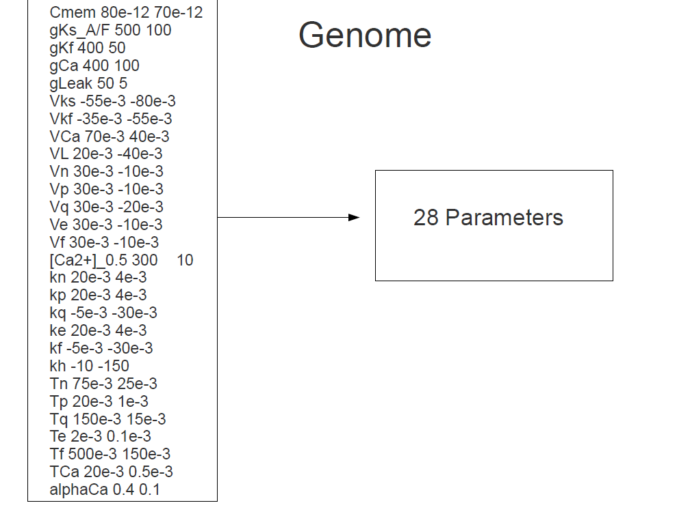
Progress with optimization
Alex Dibert

Slide 43
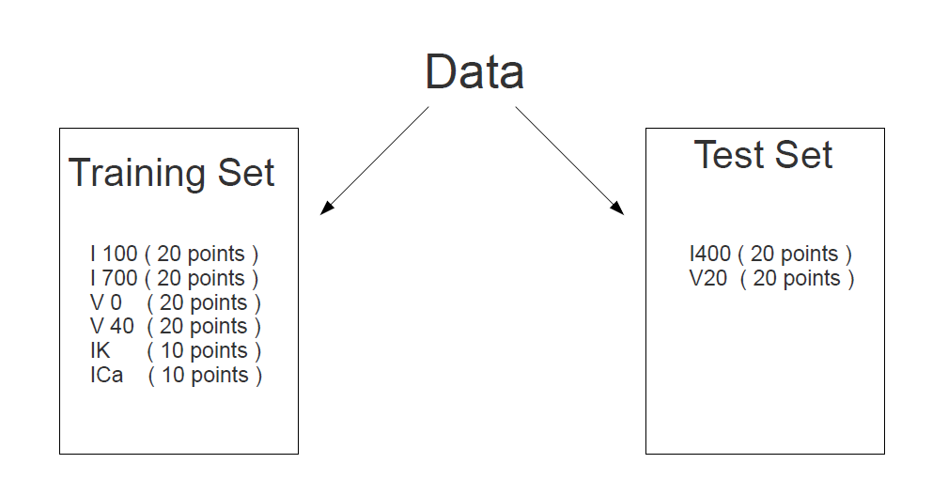
Progress with optimization
Alex Dibert

Slide 44
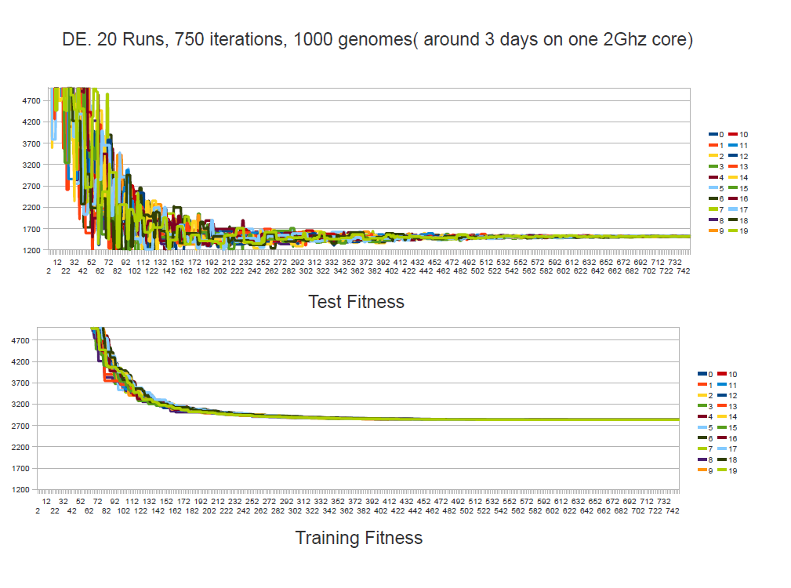
Progress with optimization
Alex Dibert

Slide 45
Current challenges
Better integration of genetic algorithms into simulation pipeline
Filling in the gaps of the ion channels for the spatial connectome
Multi-timescale integration of smoothed particle hydrodynamics and conductance based electrical activity of muscle cell

Slide 46
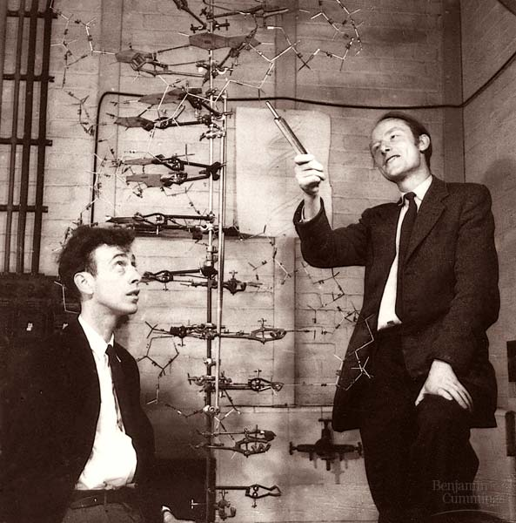
Multi-scale synthesis in c. elegans
Motivated highly detailed simulations in a small, well studied organism
Described the effort of a distributed “virtual team” of scientists and engineers
Described early results in building a framework and engine for c. elegans simulation
Described current opportunities for contribution

