Slide 1
Introduction to NeuroML 2 & LEMS
Padraig Gleeson
University College London

Slide 2
NeuroML
Standardised XML language for computational neuroscience
Version 1.x allowed specification of:
  Detailed neuronal morphologies
  Ion channels
  Synapses
  3D network structure
30+ simulators/applications/databases/libraries support NeuroML

Slide 3
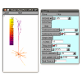

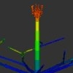
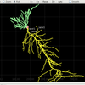

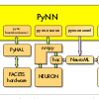
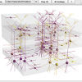

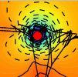
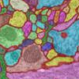
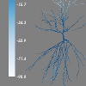
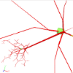
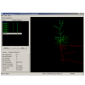

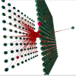
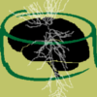
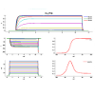
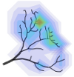
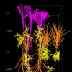
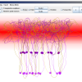
NEURON
GENESIS
MOOSE
PSICS
NeuroSpaces
PyNN
neuroConstruct
OpenWorm
LFPy
CATMAID
Neuronvisio
NeuronLand
Whole Brain
Catalog
NeurAnim
Moogli
NeuroMorpho
Channelpedia
@ BlueBrainProject
TREES
toolbox
NeuGen
CX3D

Slide 4
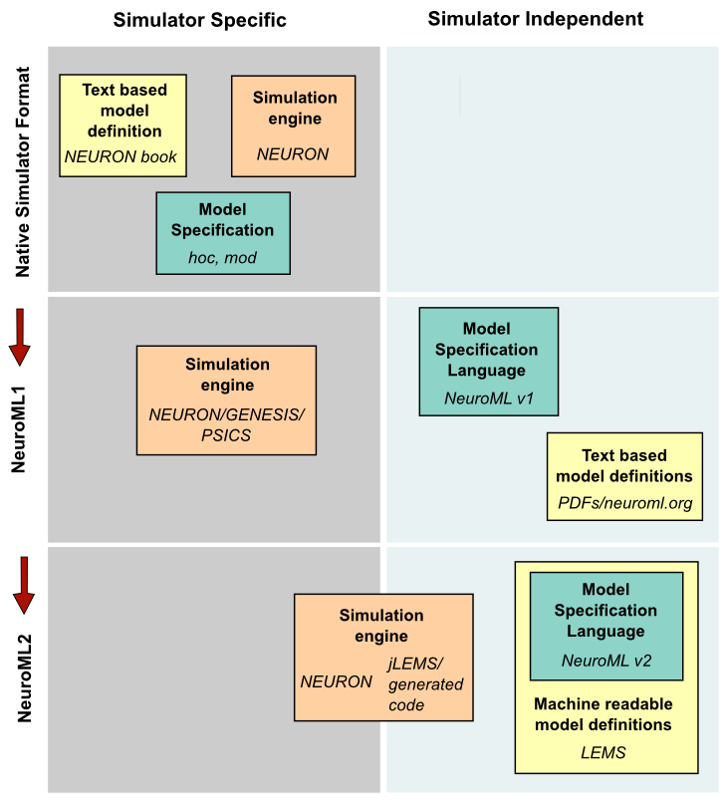

Slide 5
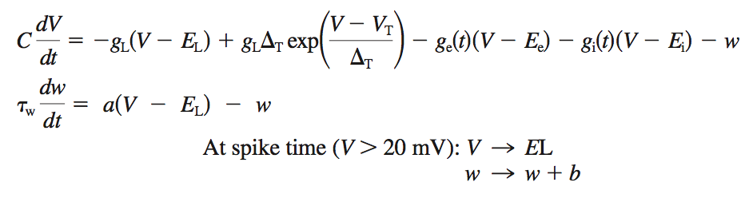
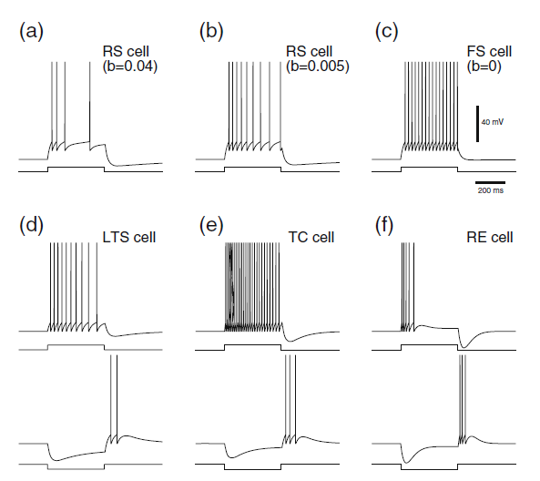
Brette & Gerstner Adaptive Exponential Integrate & Fire neuron model

Slide 6
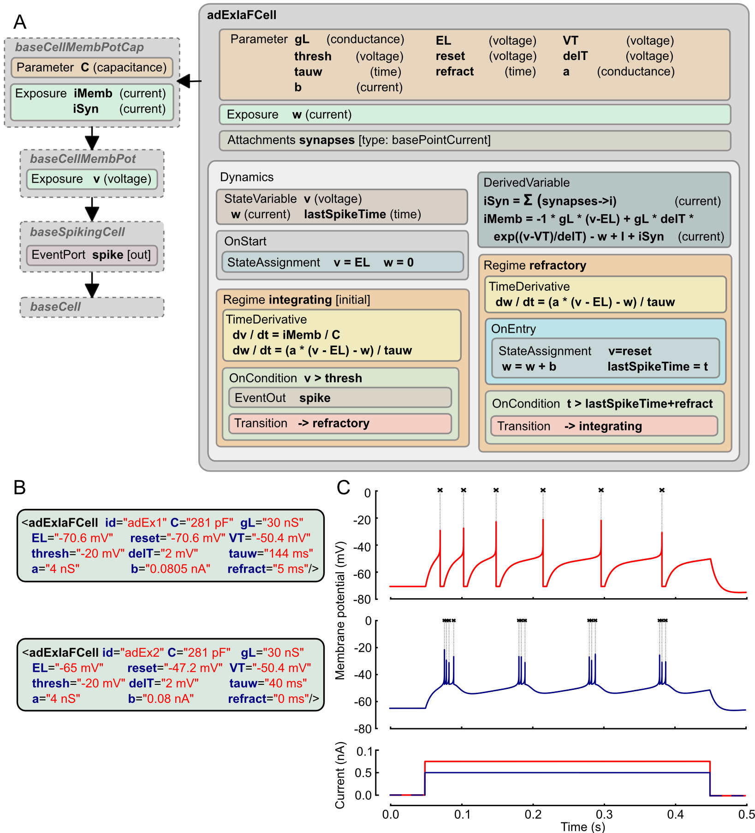
LEMS
NeuroML 2

Slide 7
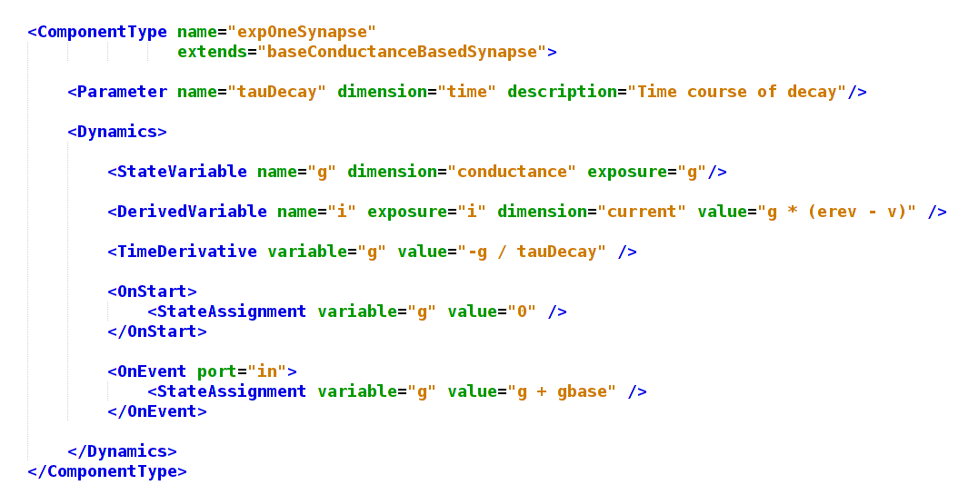

Slide 8
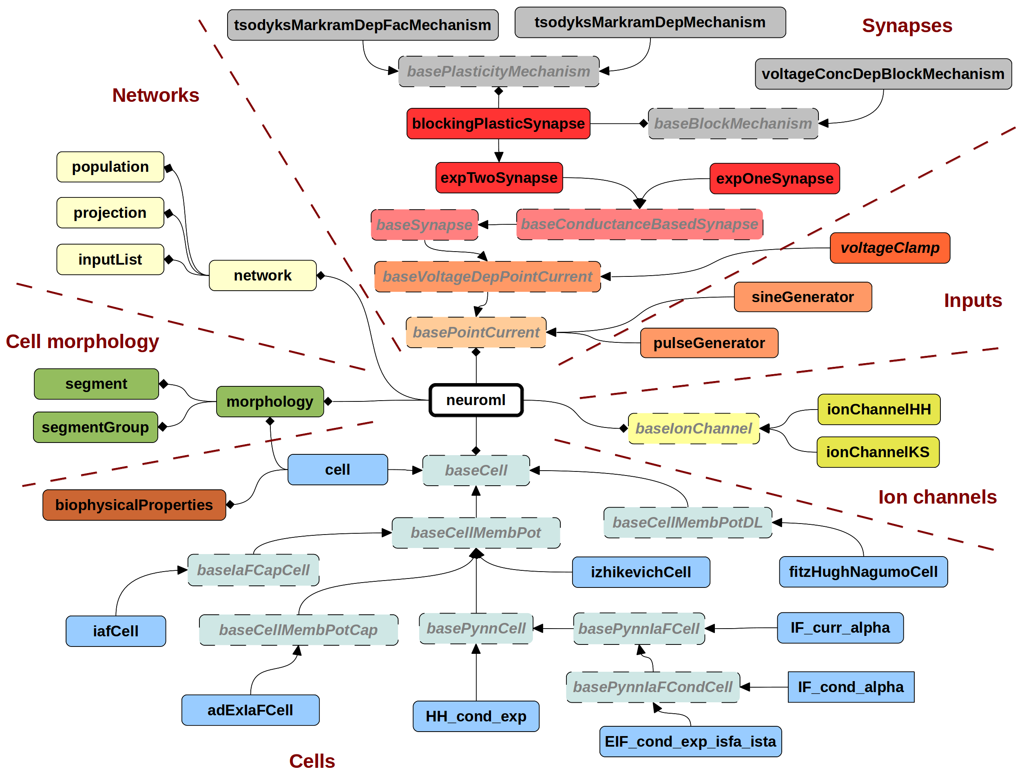
NeuroML version 2.0

Slide 9
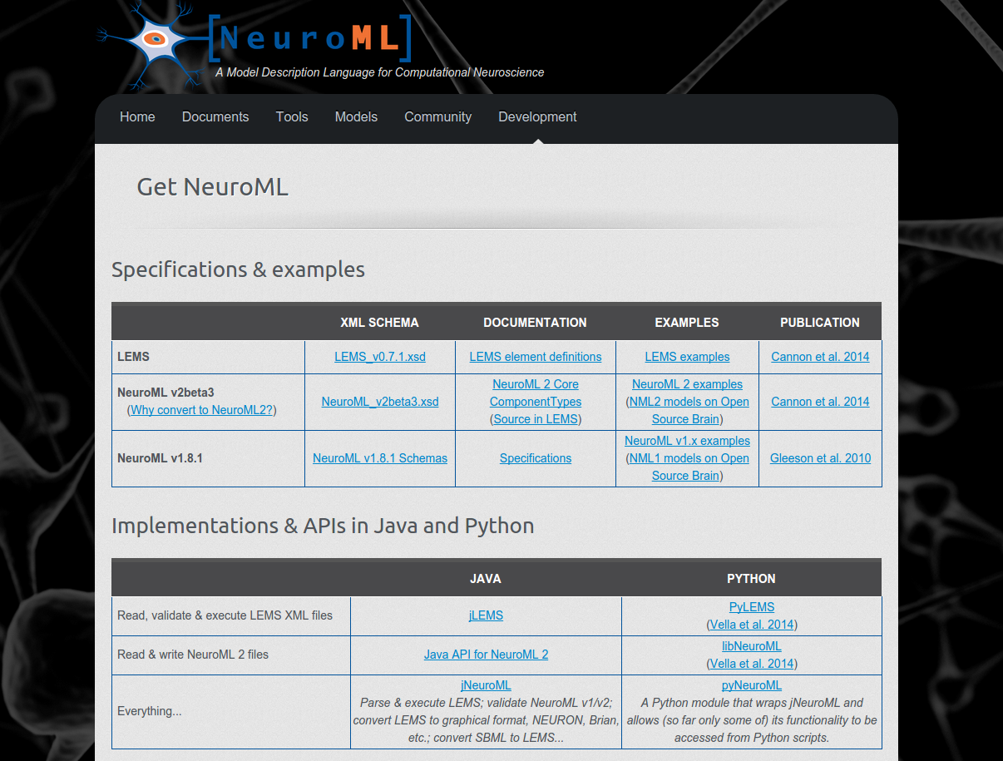
http://www.neuroml.org/getneuroml
Brian
MATLAB
NEURON

Slide 10
jNeuroML
pyNeuroML
jnml
pynml

Slide 11
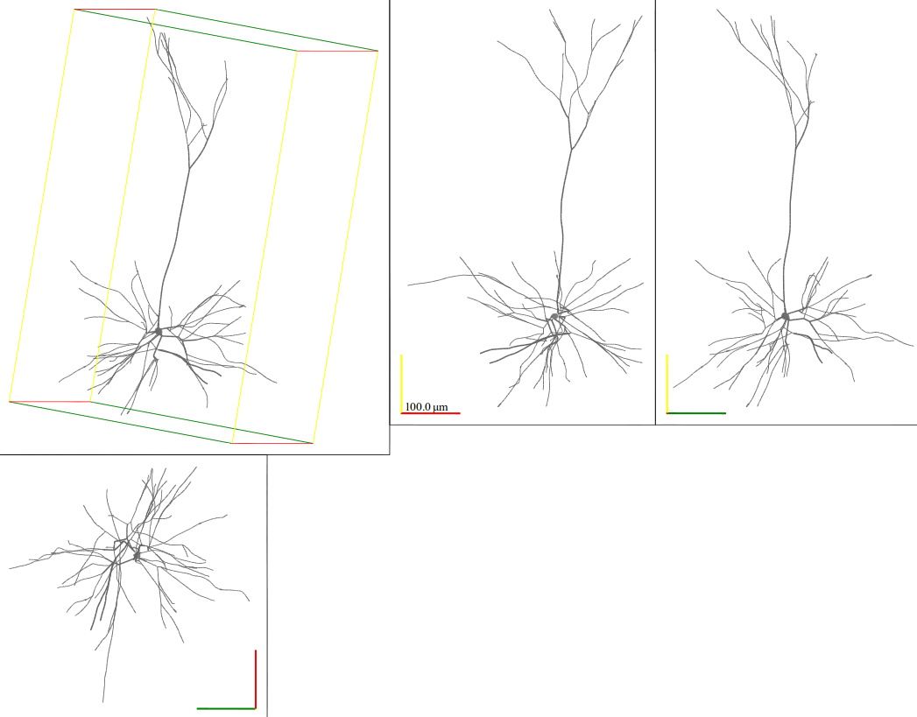
jnml MyCell.nml -svg
pynml MyCell.nml -svg
NEURON

Slide 12
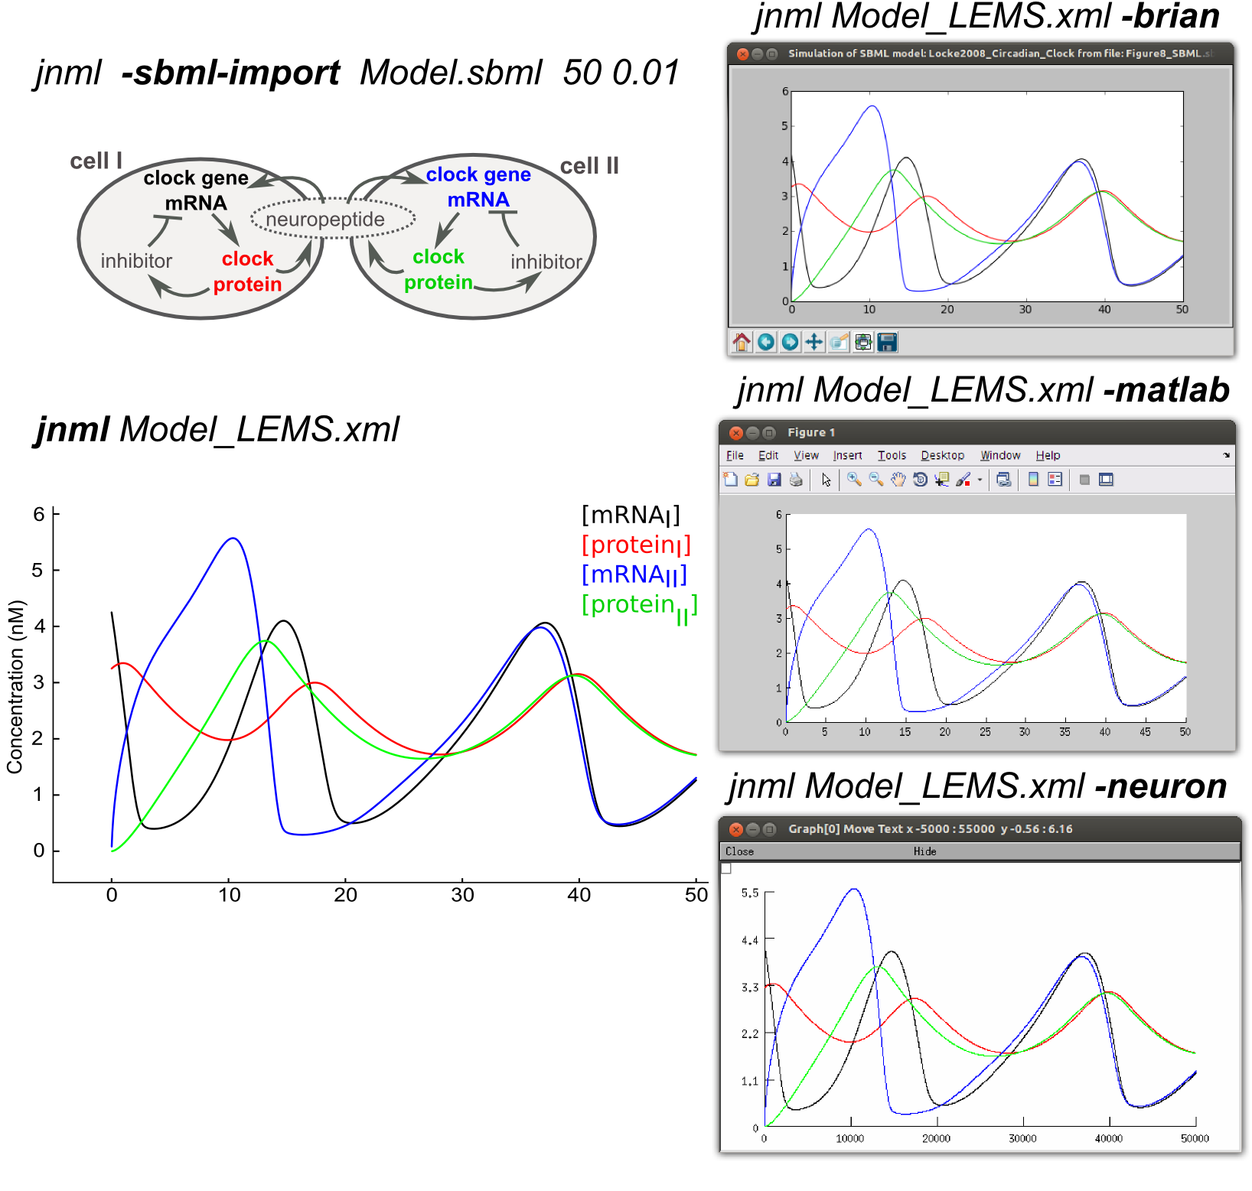
Original
SBML
model
Brian
MATLAB
Simulate
with
jNeuroML
NEURON

Slide 13
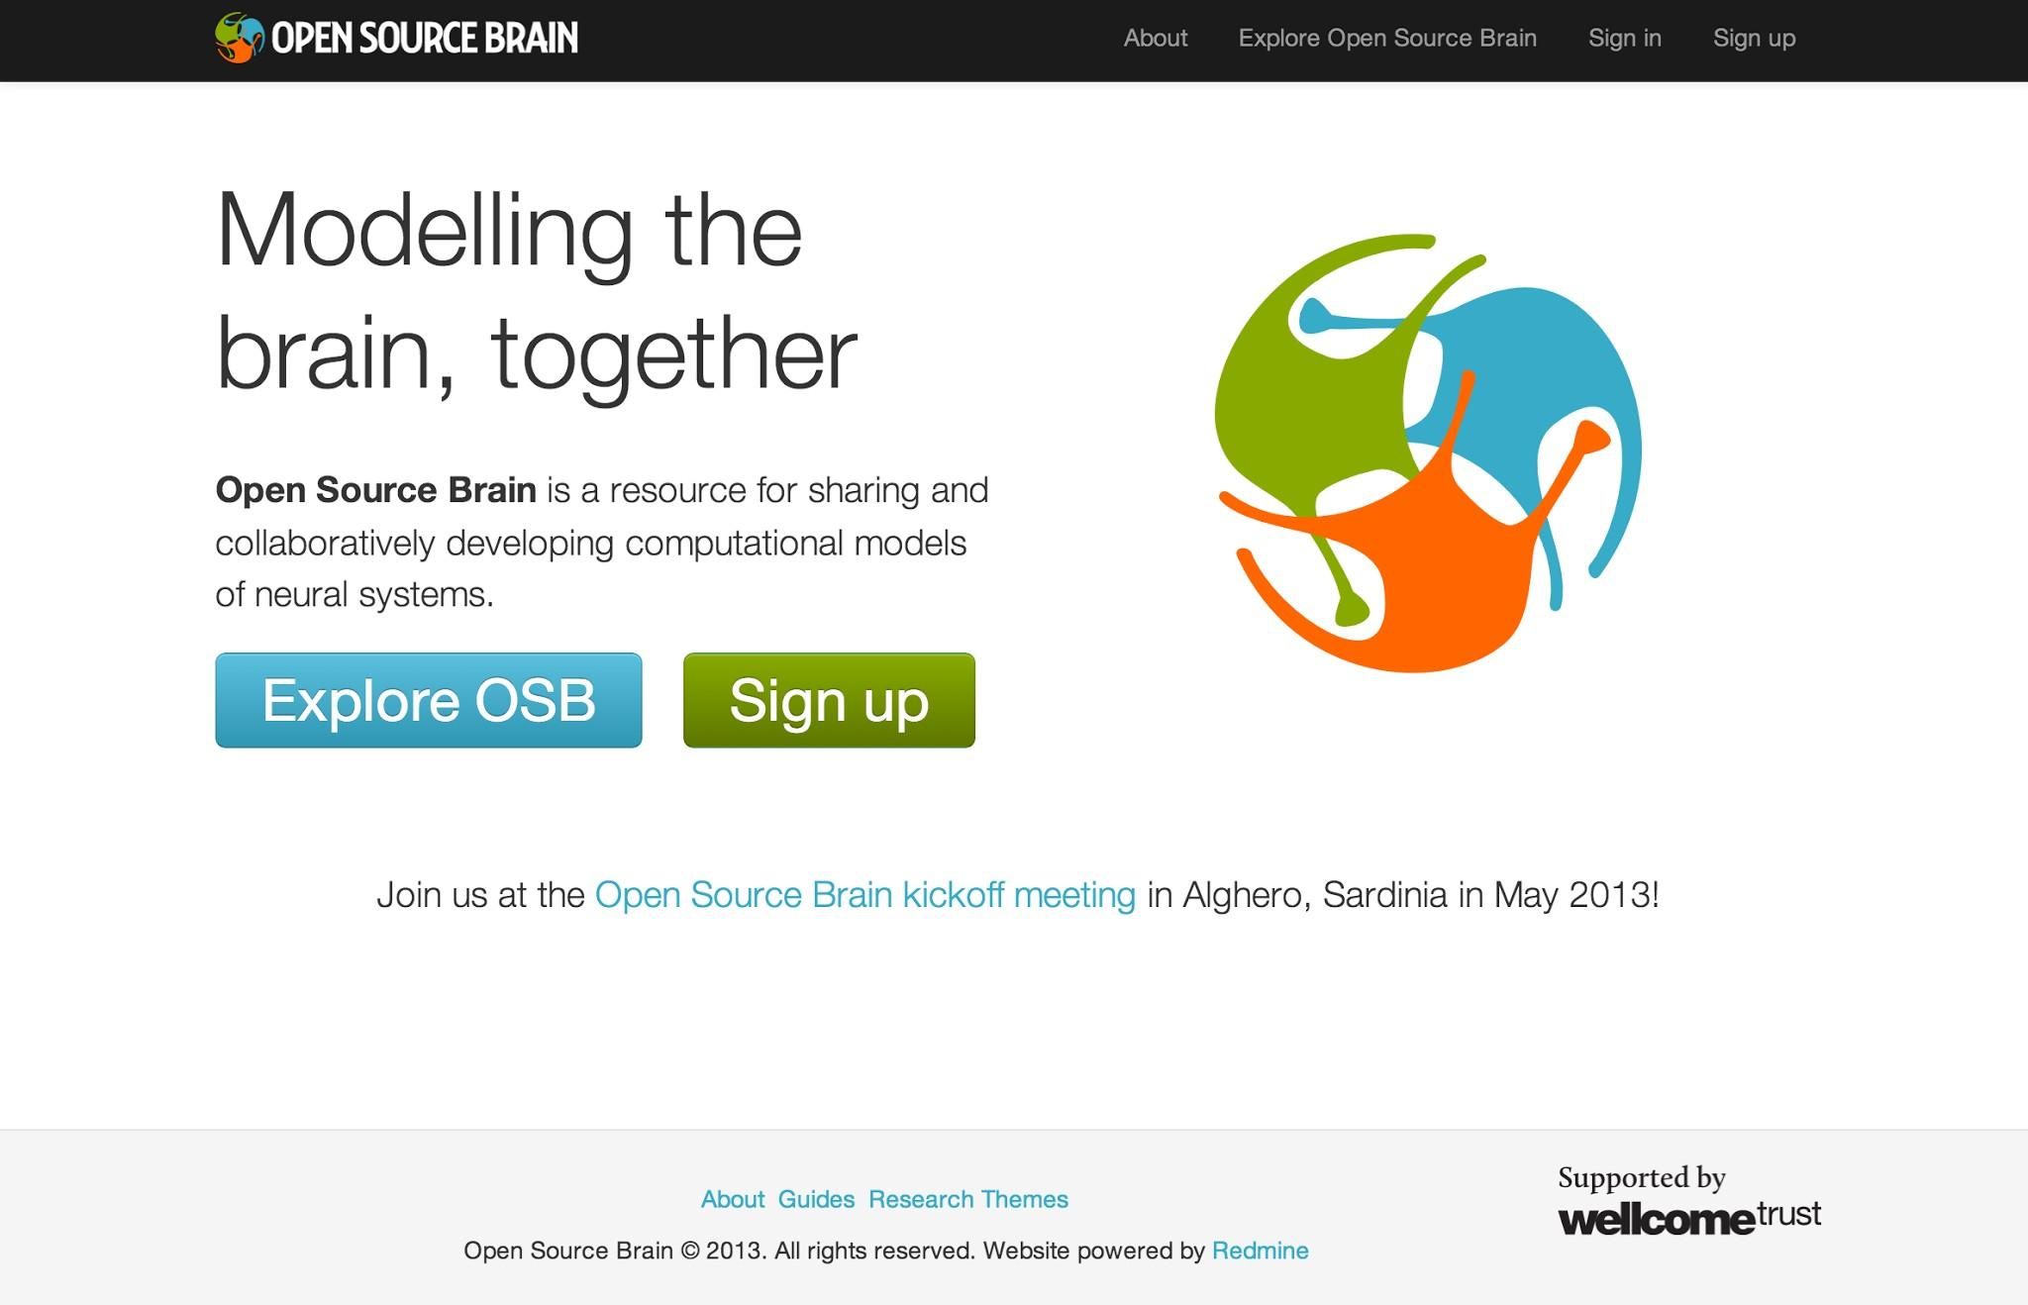
The Open Source Brain repository

Slide 14
The Open Source Brain Repository
Wellcome Trust funded project
Open source model development repository for computational neuroscience
Structured database of well tested spiking neuron & network models in standardised formats, e.g. NeuroML
Allow anyone to comment on, extend, reuse models & run them across multiple simulators: a collaboration platform
Uses tools & best practices from Open Source software development

Slide 15
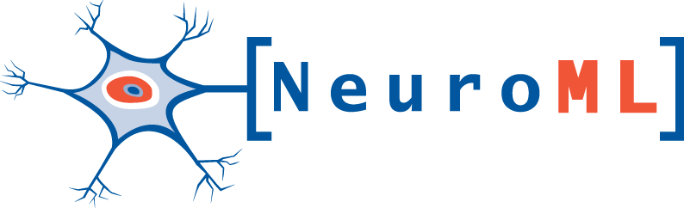


Acknowledgements
Silver Lab @ UCL
  Angus Silver
  Eugenio Piasini
  Boris Marin
  Adrian Quintana
Matteo Farinella
Yates Buckley
Matteo Cantarelli
Main Collaborators
Robert Cannon
Sharon Crook
Mike Vella
Early Adopters
  Sergio Solinas
  Egidio D'Angelo
  Volker Steuber
  Dieter Jaeger
  Andrew Davison
  Stephen Larson
  Avrama Blackwell
  Nicolas Le Novere
Members of the NeuroML community
OpenWorm project
UK INCF Node
Funding source:

