Slide 1

Branch prediction algorithms - Evaluation of Traditional and ML-Inspired Branch Prediction Algorithms
A Simulation-Based Comparative Study
Aditya Agarwal
Sai Charan
Yogesh Kumar Agrawal

Slide 2

Work done
Run ChampSim and simulate CBP evaluation traces
Simulate 4 traditional BP algos, 3 ML based algos and 1 fusion implementation of our own, replicating simplified version from mentioned research paper and BranchNet repo
1 bit predictor
2 bit predictor
2 level
Tournament
BranchNet with
CNN
LSTM
Transformer
Fusion predictor (using 2 level and BranchNet LSTM together)

Slide 3
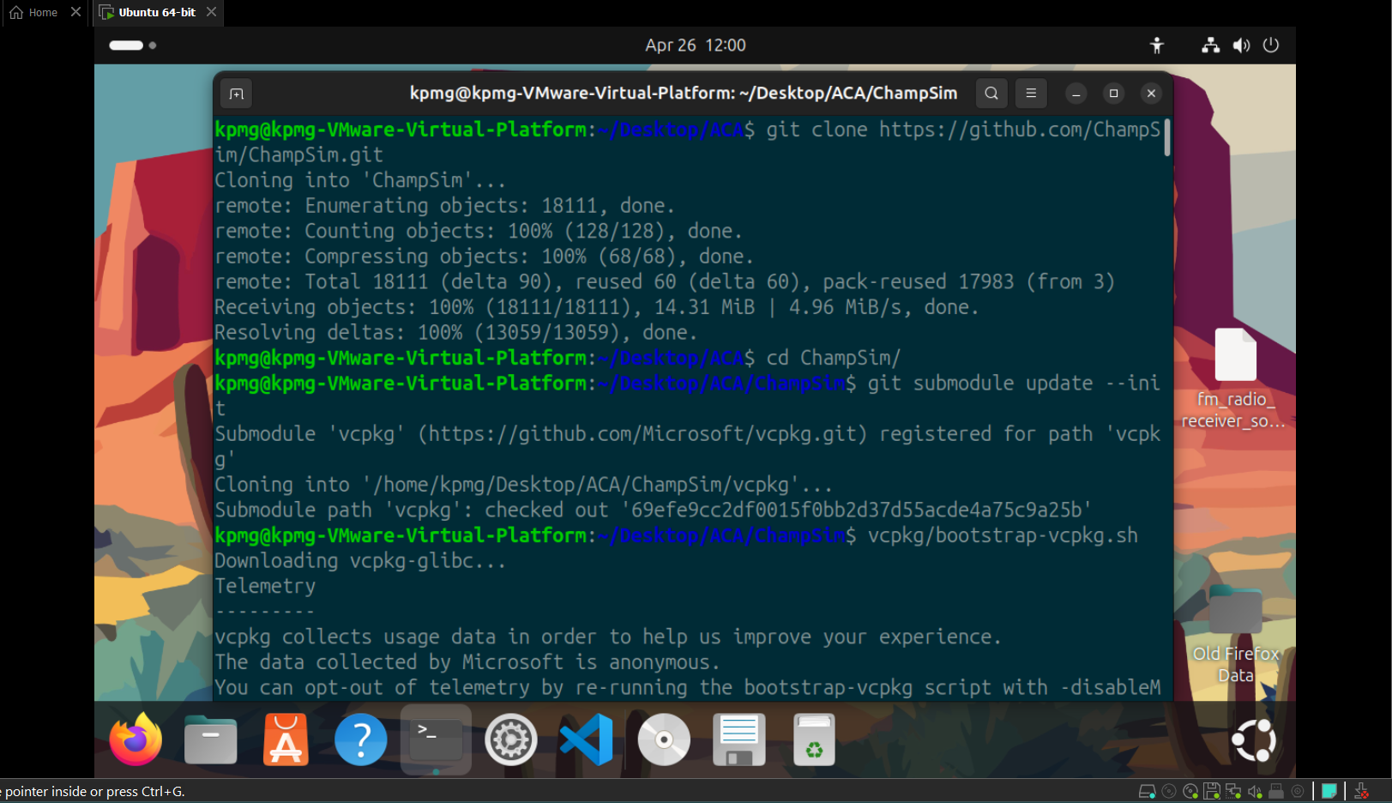
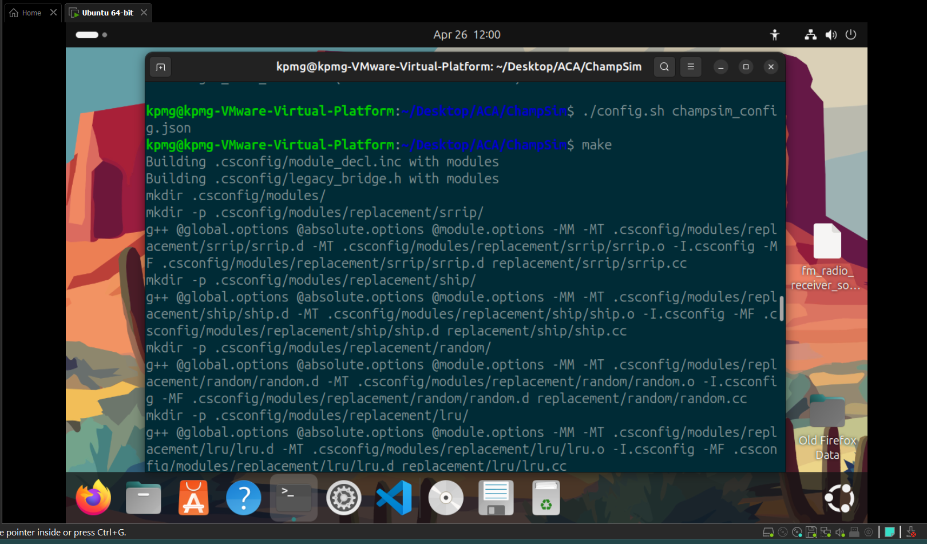
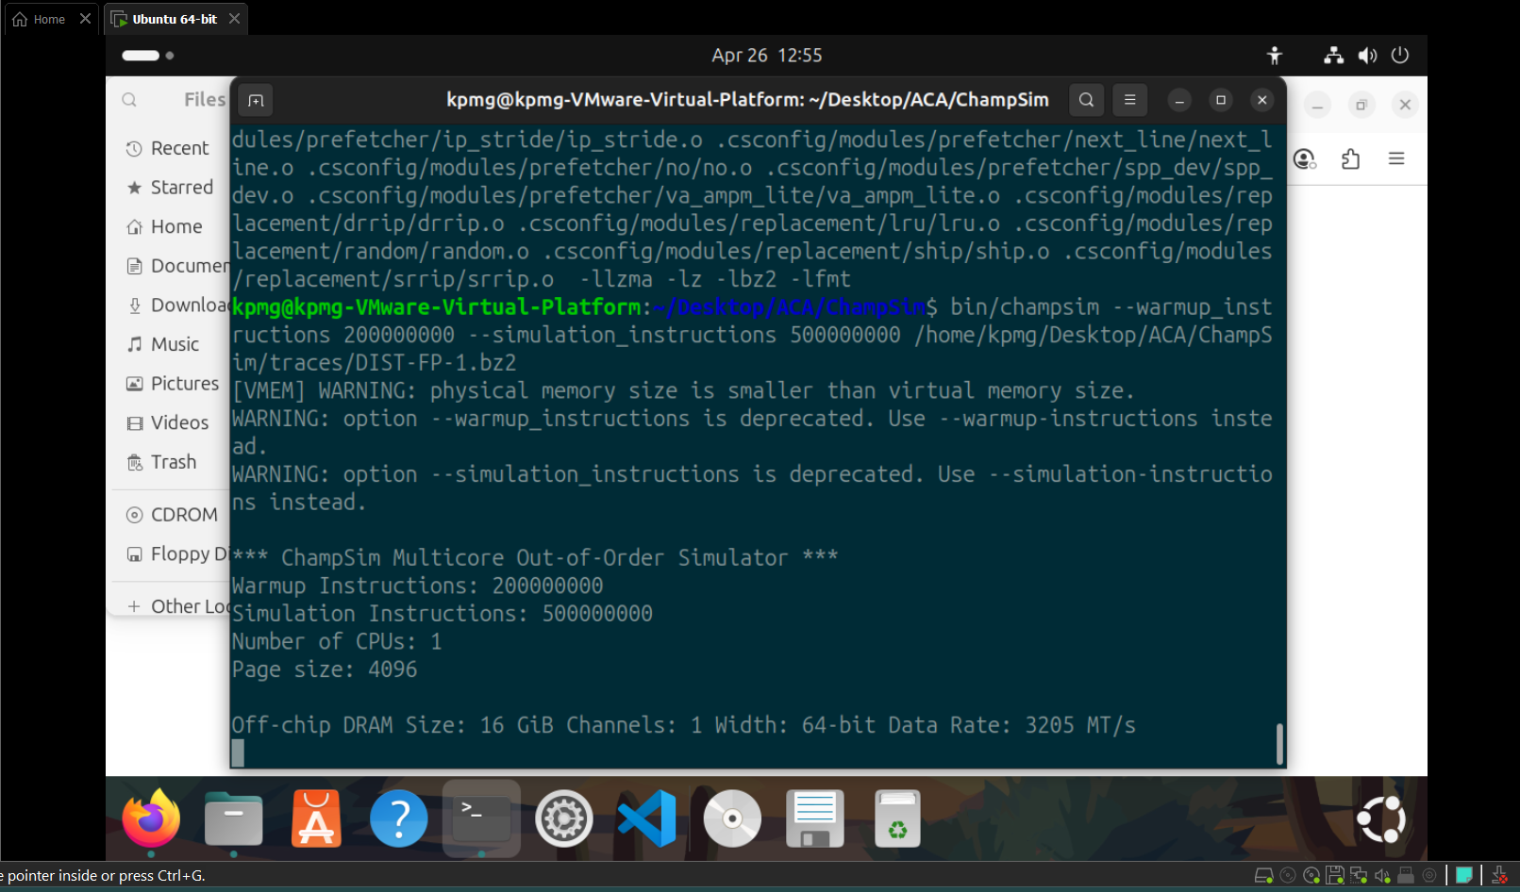

Slide 6
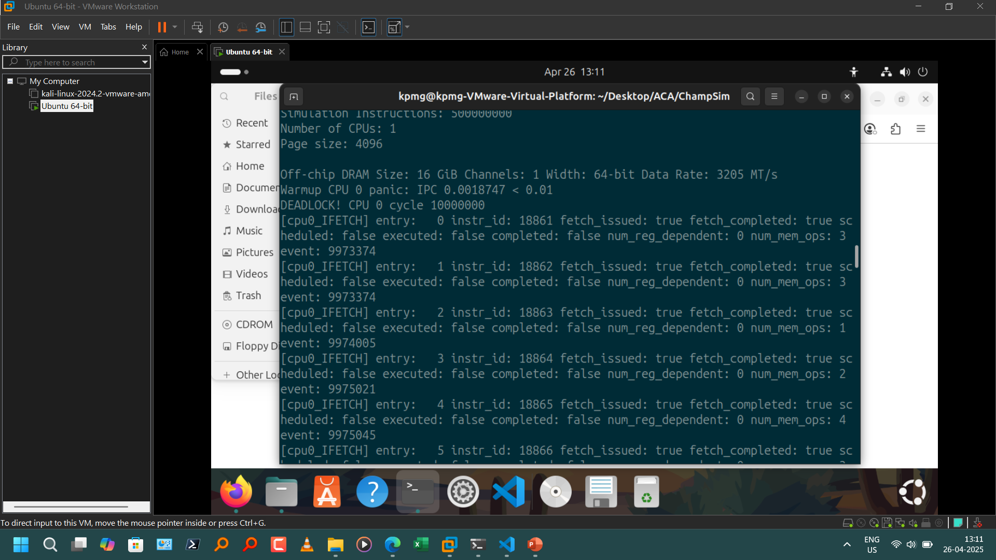

Slide 7
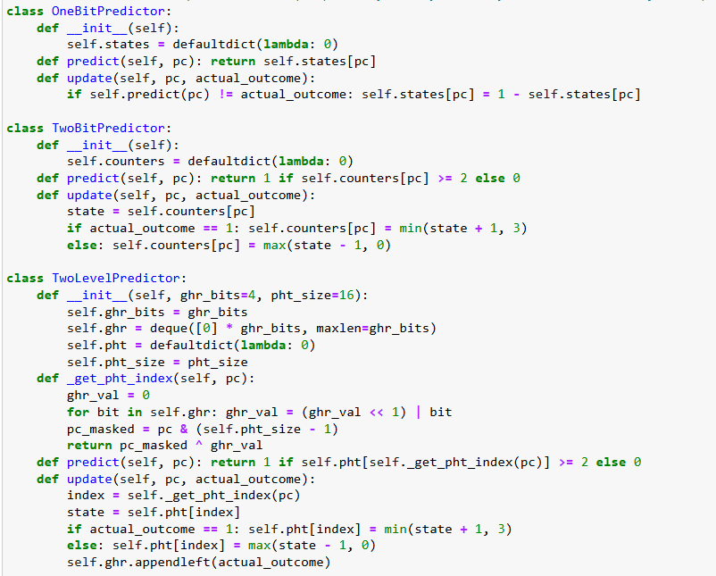
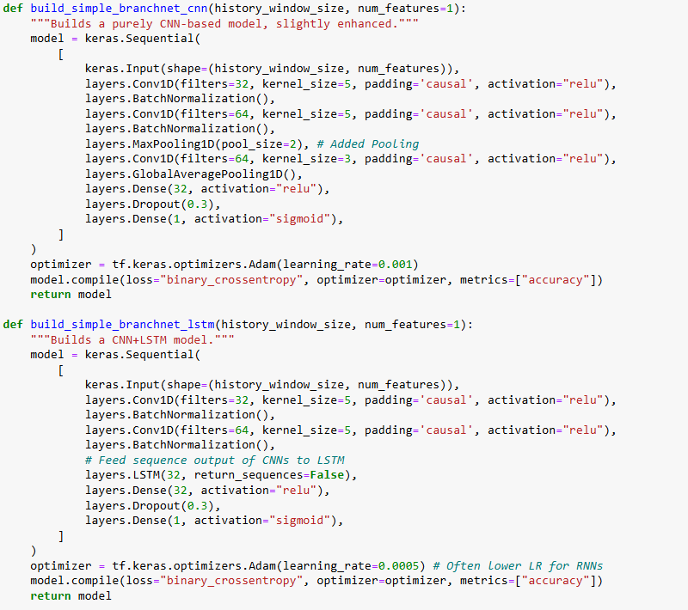

Slide 8
Predictors explored
Traditional Predictors (Baseline Hardware Concepts):
1-Bit / 2-Bit: Simple local history; use 1 or 2 state bits per branch; react only to immediate past outcomes.
2-Level (Gshare): Combines Global History Register (GHR) with PC bits via XOR to index a Pattern History Table (PHT) of 2-bit counters; captures correlation between path and branch.
Tournament: Hybrid; uses a selector table to dynamically choose between a local (2-Bit) and a global (2-Level) predictor based on recent accuracy.
ML-Inspired Models (Keras/TF Implementation, Offline Trained):
Input: Fixed window (16 steps) of past outcomes.
BranchNet_CNN: Uses 1D Convolutions & Pooling to extract spatial features/patterns from the history window.
BranchNet_LSTM: Uses CNNs for features + LSTM layer to explicitly model temporal/sequential dependencies in history.
BranchNet_Transformer: Uses Multi-Head Self-Attention to weigh the importance of different past outcomes within the window.

Slide 9
Fusion predictor explored
Goal: Combine the strengths of a fast traditional predictor (low latency, good general performance) with a potentially more accurate but complex ML predictor (offline trained, good on specific hard patterns).
Mechanism:
Uses two base predictor instances (e.g., Predictor1 = 2-Level, Predictor2 = Trained BranchNet_LSTM).
Maintains a Selector Table (indexed by PC bits) with 2-bit saturating counters.
Prediction: Checks selector state. If low (0,1), uses Predictor1's prediction. If high (2,3), uses Predictor2's prediction (requires history window input).
Update:
Get predictions from both P1 and P2 (using history window for P2) based on state before update.
Update the internal state of only the basic predictor (P1). (ML model is static).
Compare P1 and P2 correctness against the actual outcome.
Update the selector counter: shift towards the predictor that was solely correct.
Challenges: Requires passing history window to fusion logic; synchronizing state vs. prediction; potential performance overhead due to ML inference call within update logic (for selector); complexity led to exclusion from final reported simulation run.

Slide 10
The Branch instruction choosen
Goal: Create a deterministic scenario complex enough to differentiate predictor capabilities, avoiding reliance solely on noise.
Simulated Logic: Branch at PC = 0xABC
Periodic = (Iteration % 7 == 0)
Correlation = (History[Current - 5] == Not_Taken)
Outcome = Periodic XOR Correlation (Taken if exactly one condition is true)
Challenges Posed:
Non-Linearity (XOR): Simple predictors struggle to model XOR directly.
Specific History Lookback: Requires remembering state from exactly 5 steps ago, potentially beyond the scope of short GHRs or local counters.
Combined Patterns: Outcome depends on both periodicity and specific history, not just one factor.
Expected Differentiation:
Simple predictors (1/2-Bit): Expected to fail significantly.
2-Level/Tournament: Expected to capture some correlation via GHR but struggle with XOR and exact lookback distance.
ML Models: Hypothesized to perform better by learning the complex function (feature extraction + sequence modeling/attention) from the history window.

Slide 11
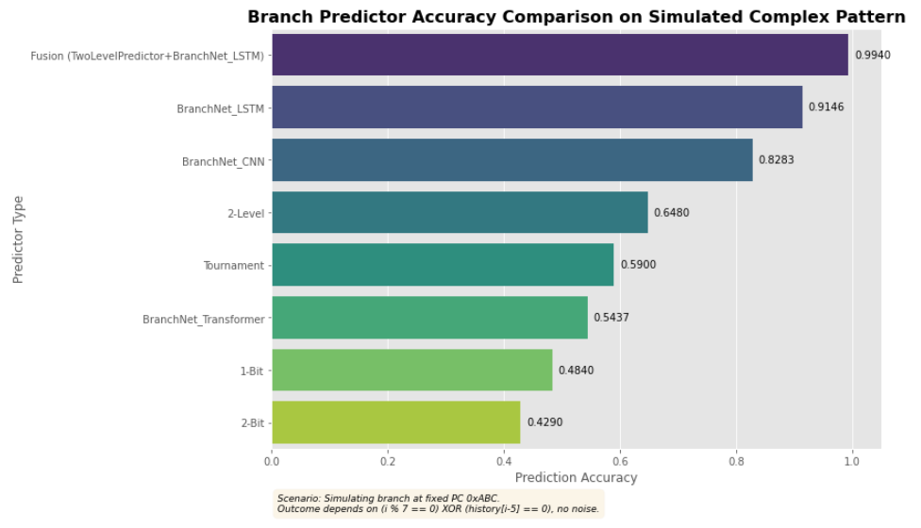
Results

Slide 12

Thank you

