Slide 1


Custom Secure VPN - Implementation of a Secure Proxy Tunnel
Demonstrating Confidentiality, Integrity, and Tunneling using Python
NETWORK SECURITY
CS G513
Pratik Pawar, Akshata Rane, Aditya Agarwal

Slide 2
Introduction & Motivation
Project Goal: To design and implement a functional, albeit simplified, secure tunnel demonstrating core network security principles in a practical context.
Core Functionality: Creates an encrypted TCP channel between a client and a server, allowing the client to proxy specific application traffic (e.g., web browser) securely through the server.
Motivation:
Understand practical challenges of securing data in transit.
Explore implementation of encryption and integrity mechanisms.
Provide a tangible example of proxying and tunneling concepts.
Analyze security trade-offs in a custom implementation.

Slide 3


Application and use cases
Primary Use Case: Bypassing local network restrictions (e.g., accessing blocked sites on restrictive Wi-Fi) by routing traffic through an unrestricted server.
Secondary Use Cases:
Basic IP Masking: Hiding the client's source IP address from the destination web server (which sees the proxy server's IP).
Enhanced Privacy (Tunnel Segment): Protecting browser traffic from eavesdropping on the network between the client and the proxy server.

Slide 4
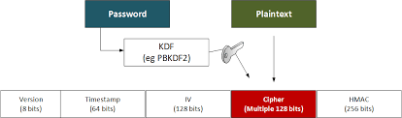
Core concept 1 – Encryption and data intergrity
Goal: Prevent eavesdropping on data transmitted between client and server.
Mechanism: Symmetric Encryption using AES (Advanced Encryption Standard).
Implemented via Python cryptography.fernet.
Fernet uses AES-128 in CBC (Cipher Block Chaining) mode by default.
Process:
Both client and server share a secret key.
Sender encrypts plaintext data using the key -> generates unintelligible ciphertext.
Receiver uses the same key to decrypt ciphertext -> recovers original plaintext.

Slide 5
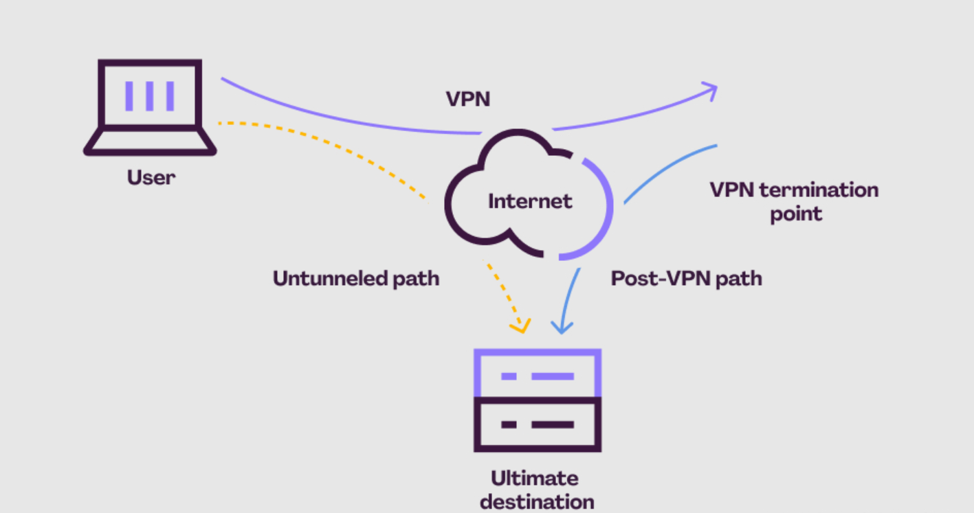
Core concept 2 – TCP tunneling
Tunneling: Encapsulating one network protocol within another. Here, HTTP/S requests/responses are encapsulated within our custom encrypted TCP stream between client and server.
Proxying: The client.py script acts as an intermediary (proxy) for the browser.
It listens locally (127.0.0.1:8080).
Browser directs traffic to this local address.
client.py intercepts, processes (encrypts), and forwards traffic into the tunnel.
Mechanism: Uses standard Python socket library for TCP connection management (establishing connection, sending sendall(), receiving recv()).
Effect: Traffic between client and server travels within a single, protected TCP flow. Destination websites see traffic originating from the server's IP.

Slide 6
Workflow
Client Role:
Receives plain HTTP/S request from browser.
Parses target URL/host.
Encrypts only the target info for the server.
Receives encrypted full web response from server.
Decrypts and sends plain full web response to browser.
Server Role:
Receives encrypted target info from client.
Decrypts target info.
Uses requests library to make plain HTTP/S request to the actual target website.
Receives plain web response from the target website.
Encrypts the entire web response.
Sends encrypted response back to the client.

Slide 7
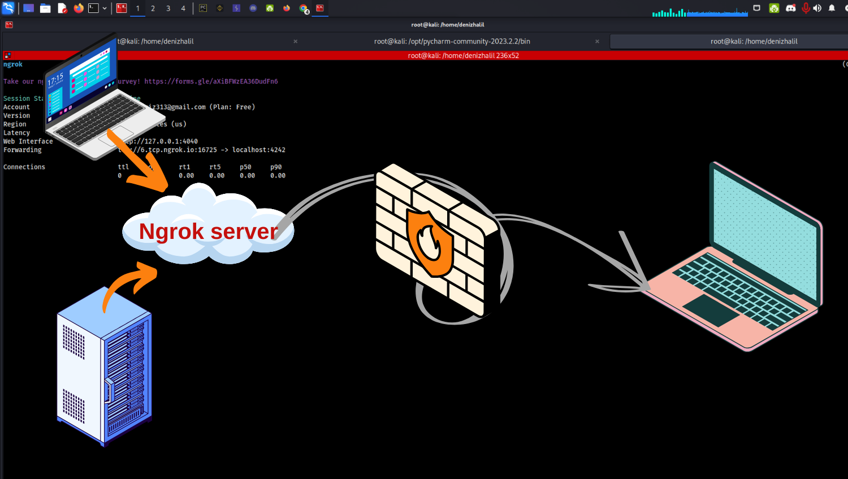
Challenges
Challenge 1: Server Reachability & NAT Traversal
Issue: Server running behind a mobile hotspot wasn't directly reachable from the public internet due to Network Address Translation (NAT).
Solution Explored: Required understanding and implementing port forwarding on routers, and utilizing tunneling services (ngrok)
Challenge 2: Handling HTTPS Traffic (Proxy Complexity)
Issue: Simple proxying of HTTPS via the CONNECT method requires careful handling. A basic implementation might just forward the host/port, relying on the server's requests library, which may not perfectly mimic a true tunnel for TLS.
Acknowledgement: The current implementation relies on requests on the server side to handle the TLS connection to the destination. A more robust proxy would need to handle the CONNECT response correctly and potentially tunnel raw TCP after connection establishment.
Challenge 3: Robust Data Framing & Parsing
Issue: Ensuring complete messages are sent/received over TCP (stream-based protocol) without data corruption or mixing requires proper framing. Simple recv() calls might get partial data. The basic HTTP parsing in the client is fragile.
Mitigation: Used sendall() for sending. For receiving, read in chunks within a loop. Acknowledged that more robust framing (e.g., prefixing messages with length) or HTTP parsing libraries would be needed for production.

Slide 8
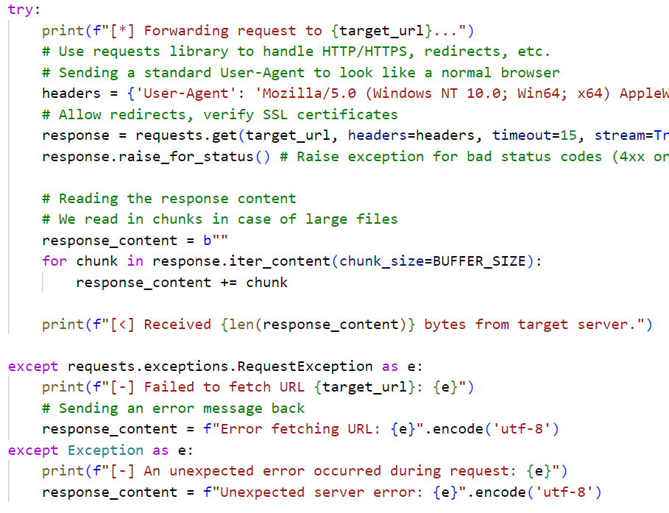

Slide 9
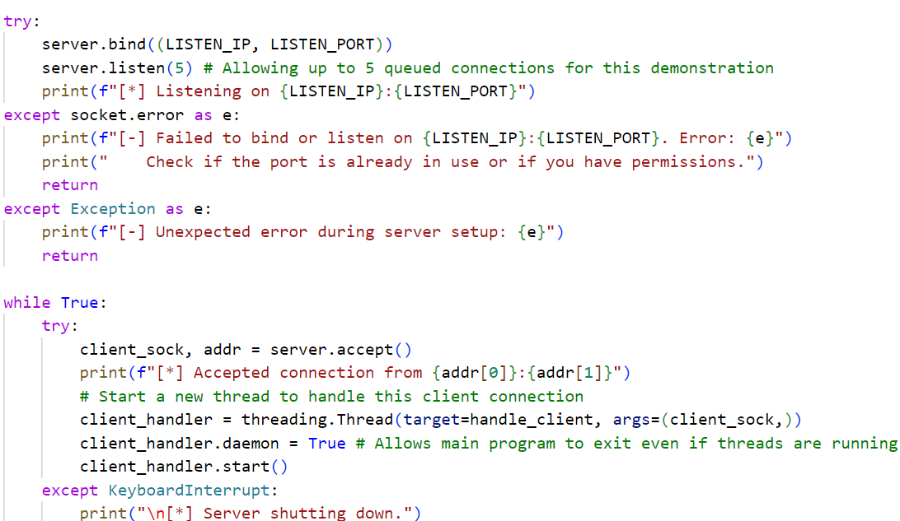

Slide 10
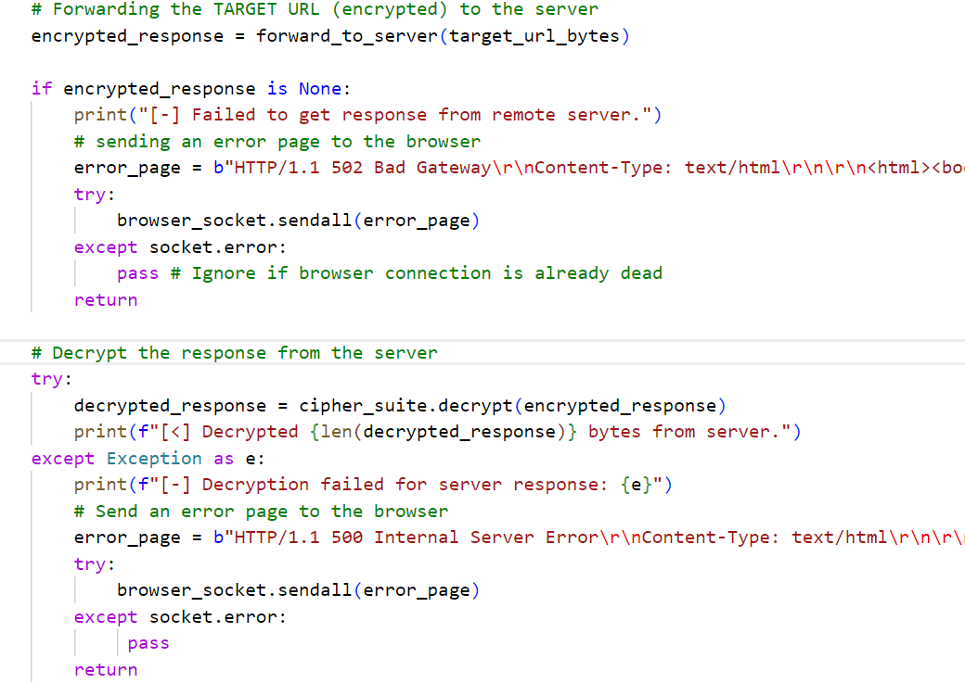

Slide 11





Demo →

Slide 12




Demo →
Internet
Internet
ISP Laptop
Proxy server laptop
User
Github: NeuroNut/Custom-VPN-implementation: Network Security Project Component

Slide 13
Thank you

