Slide 1
fMRI Pipeline: Production of the stim & Scans to 3D Surface
Veronica Tarka, veronica.tarka@mail.mcgill.ca
Zaida Escila Martinez Moreno, zaida.martinezmoreno@mail.mcgill.ca

Slide 2
Programs required
SPM
FreeSurfer
AFNI/SUMA
FSL
FSLeyes very nice for viewing volumes for QA
MatLab
XQuartz
With the exception of MatLab, all programs are free to download with comprehensive installation instructions available on each respective website.

Slide 3
Pre-existing scripts/documents
SparsedRandTonesStimuli.m
For creation of stimuli. It needs these extra scripts to run:
Amp_to_dB.m
RandOrderRowVector.m
RealRand.m
OnsetFiles.m
For the generation of the onset files.
ku_code.m
For t-testing and creating tuning map
jet_inv_cm.txt
Colormap to match Brainstorm’s
fMRIprotocol.pdf
Final protocol from MRI scan
For voxel sizes/TRs
These will be referenced later on and will be useful to have.

Slide 4
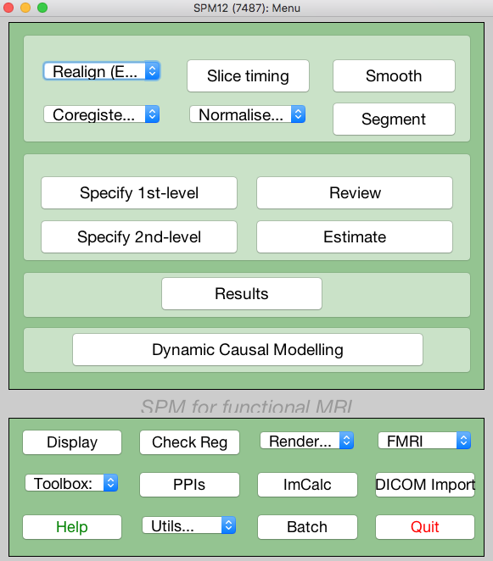
SPM: Convert DICOM to NIfTI
Most programs work with NIfTI, so need to convert from DICOM
Convert all files acquired from fMRI scanner
NIfTI file titles straightforward, makes sorting easy:
Starts with “f”: functional scan
Number after first dash = run
Number after final dash = volume
Starts with “s”: structural scan
Several supporting scans that can be used for special functions
Important one just the anatomical scan (in our case starts with s17)

Slide 5
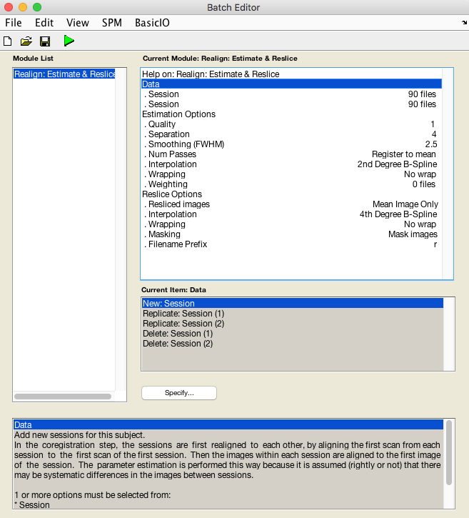
SPM: Realign (Est & Res)
Func volumes from all runs in separate sessions
Resliced Images: select ”Mean Image Only”

Slide 6
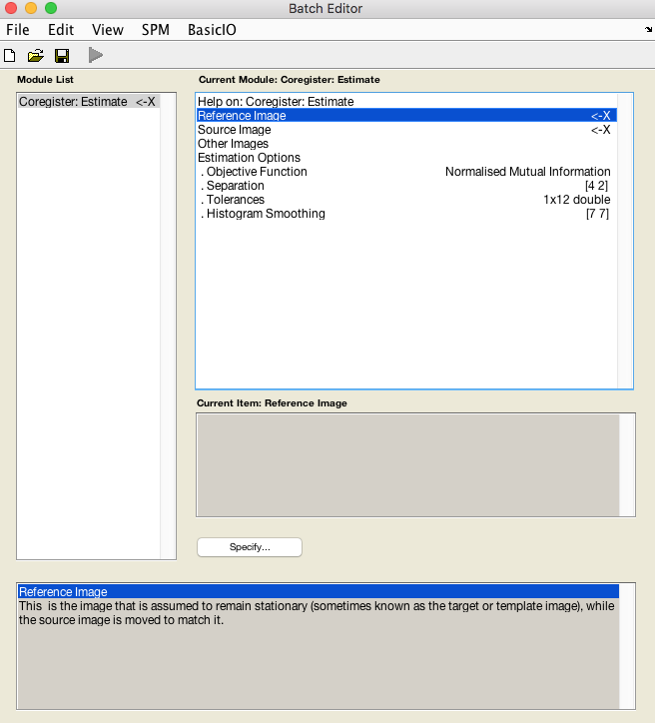
SPM: Coregister (Estimate)
Reference image: mean func from Realign step
Source image: anatomical

Slide 7
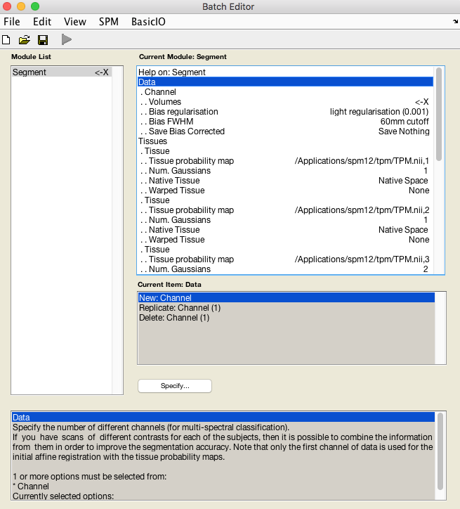
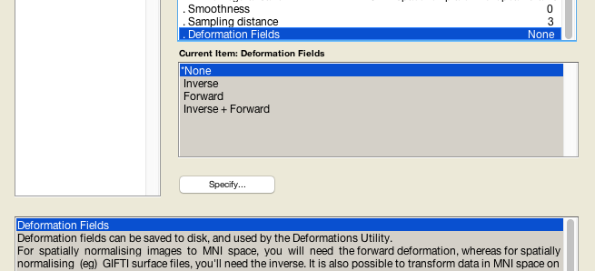
SPM: Segment
Volumes: anatomical
Save Bias Corrected: select “save bias corrected”
Deformation Fields: select ”Forward”

Slide 8
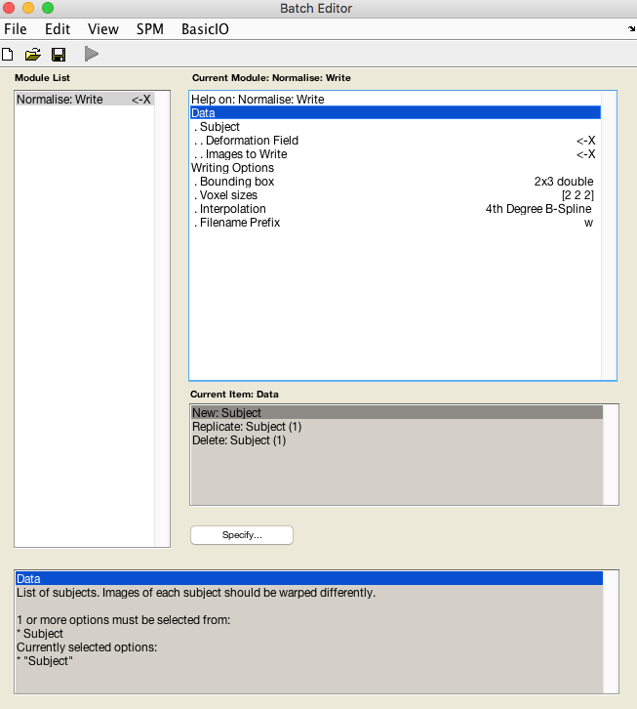
SPM: Normalise (Write)
Deformation Field: y_s*.nii
Images to Write: all func
Voxel sizes: update to actual size (optional)

Slide 9
Matlab: create multiple conditions file
To generate the file that will indicate the multiple conditions that were played at specific times, it is necessary to run the code “OnsetFiles.m”, located in the CreationStim folder.
To run this file, all the Frequencies text files that are produced by the “SparsedRandTonesStimuli.m” should be on the same folder. Once that “OnsetFiles.m” is run, it will create a .mat file with the name of the run that should be selected in the “Conditions” option in SPM, as indicated in the next slide.

Slide 10
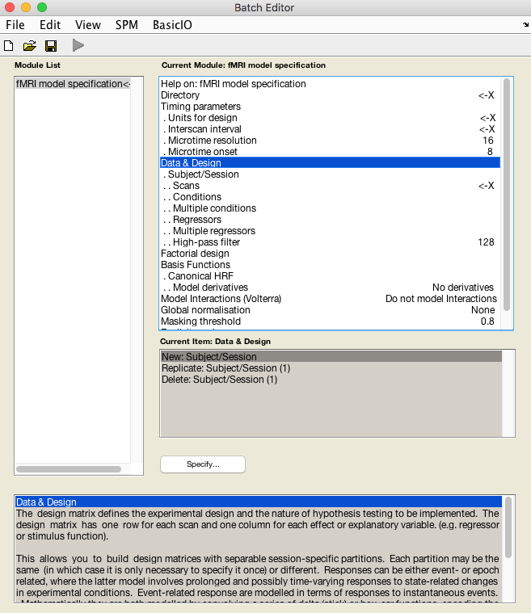
SPM: First-Level Analysis
Directory: where you want the SPM.mat file saved
Units for design: scans or seconds depending on how your onset times are measured
Interscan Interval: your TR
Data & Design: one subject per run
Scans: all normalized func (files that start with w)
Multiple conditions: load the Run1/2.matfile
Multiple regressors: rp_*.txt file
High-pass filter: 270

Slide 11
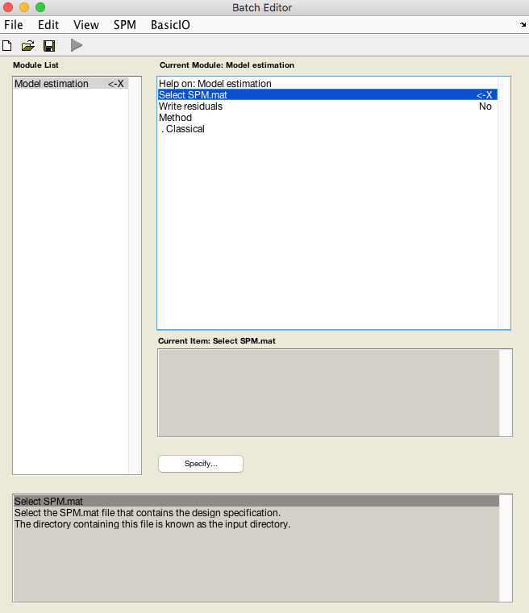
SPM: Estimate
Select your SPM.mat file written in the 1st level analysis

Slide 12
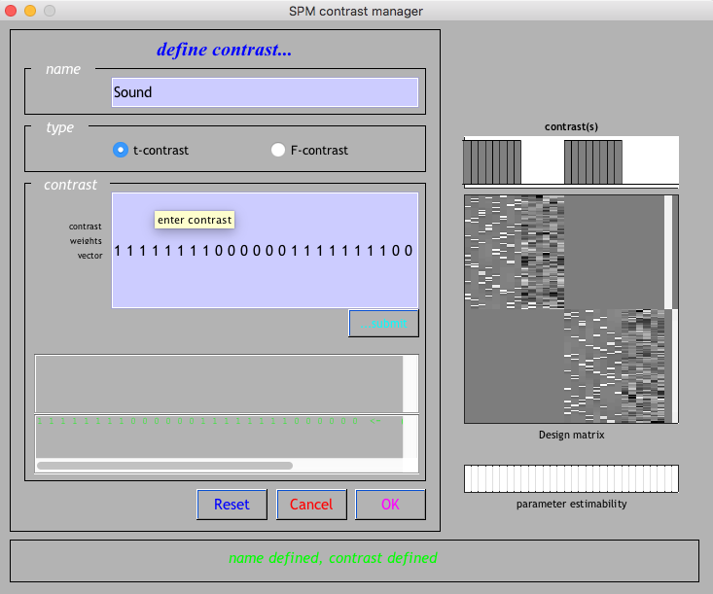
SPM: Results
Whatever name you want
Type a 1 for each condition and a 0 for each regressor for each run (only one run pictured here)

Slide 13
SPM: Results (cont)
Select your contrast, then:
Apply masking: none
P value adjustment to control: FWE
P value (FWE): 0.05 (or whatever you want)
Extent threshold: 0

Slide 14
MatLab: Manual t-test
Make sure ku_code.mat (named as such after Kuwook Cha, its author) is in the same file as all the beta_*.nii files produced from the first-level analysis
Several adjustable lines such as p-value and output file name

Slide 15
FreeSurfer: Recon-all to construct surface
Find folder where FreeSurfer is installed (/Applications/freesurfer usually)
Add structural to this folder
Source FreeSurfer variables in bash:
export FREESURFER_HOME=/Applications/freesurfer
source $FREESURFER_HOME/SetUpFreeSurfer.sh
At command line:
recon-all –i structural.nii –subject subjectName –all
Could take several hours (up to 36)
Creates directory under ”subjects” with name subjectName and a folder called “surf” with all the surface files in it

Slide 16
AFNI: Convert FS surface to SUMA
In bash:
@SUMA_Make_Spec_FS –NIFTI –inflate 800 –fspath pathToSubject –sid subjectName
Creates files in SUMA directory under fspath directory
fspath should be location of “surf” and “orig” directories created in FreeSurfer’s recon-all
subjectName only used for file naming
For ease, you can move the SUMA directory into Documents for easy access in the future

Slide 17
Work only in tcsh, not bash, for afni/suma.

Slide 18
AFNI: Convert tuning map NIfTI to readable HEAD/BRIK format
Add tuning map in NIfTI format into SUMA directory
In bash (make sure your working directory is the SUMA directory):
3dcopy tuningMap.nii newFileName
3drefit –view tlrc –space MNI newFileName+tlrc.

Slide 19
AFNI/SUMA: Overlay tuning map on surface
Open AFNI (open it through tcsh shell, not bash):
tcsh
afni –niml
Open SUMA:
suma –spec subjectName_both.spec –sv subjectName_SurfVol.nii
With SUMA window selected, press ”t” to make SUMA and AFNI talk
Select overlay (the converted tuning map) and make sure it looks right on the surface
Can adjust coloring by right clicking colormap and by pressing “pos” to only display positive values
Press “.” to rotate through surface states

Slide 20
AFNI/SUMA: Output surface to niml.dset
Close SUMA and reload it with only the rh.spec file
suma –spec subjectName_rh.spec –sv subjectName_SurfVol.nii
Choose desired overlay
Select “Define Datamode” in AFNI window, then “Plugins”, then “Vol2Surf” and select the options detailed in the next slide
Repeat these steps for lh.spec file, creating a new niml.dset file for the LH

Slide 21
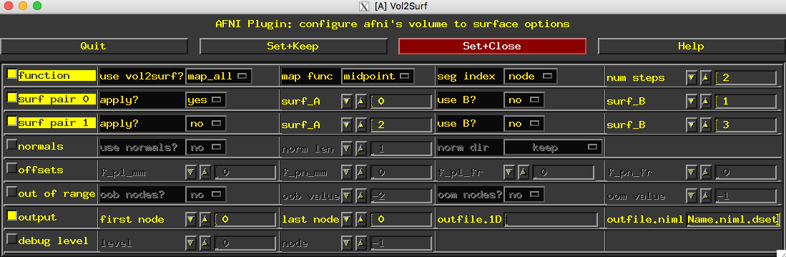
AFNI/SUMA: Output surface to niml.dset (cont)
map_all
midpoint
node
Name of your file followed by niml.dset

Slide 22
AFNI/SUMA: Smooth the surface
In tcsh:
SurfSmooth –spec subj_rh.spec –surf rh.smoothwm.gii /
–met HEAT_07 -input Name.niml.dset –fwhm 5 –output sName.niml.dset
(repeat for left hemisphere, replacing all rh with lh, and inputting the different niml.dset)

Slide 23
AFNI/SUMA: Load jet inverse colormap
In tcsh:
MakeColorMap –f jet_inv_cm.txt –nc numberOfRows –suma_cmap

Slide 24
SUMA: Load smoothed niml.dset
In tcsh:
suma –spec subjectName_rh.spec –sv subjectName_SurfVol.nii/
–input rhDataSet.niml.dset
Once open, select “view”, then “Object Controller”
Load jet inverse colormap by clicking ”New” under “Bias” and selecting the cmap file
Adjust options according to the following slide

Slide 25
Construct mask
Load smoothed dataset into SUMA
Select Tools –> Draw ROI, use pen then join your outline with ”Join” and save.
In tcsh,
ROI2dataset –prefix outputName.niml.dset –input mask.niml.roi
ConvertDset -o_niml –pad_to_node d:SmoothedMap.niml.dset –input SmoothedMap.niml.dset –prefix pad_SmoothedMap.niml.dset
ConvertDset –o_niml –pad_to_node d:SmoothedMap.niml.dset –input mask.niml.dset –prefix pad_mask.niml.dset
Note, you may have to switch the mask file to be the one you pad to (the one after d:) if it is the file with more nodes.
3dcalc –a pad_mask.niml.dset -b pad_SmoothedMap.lh.niml.dset -expr 'step(a)*b' -prefix OUTPUT.lh.niml.dset

Slide 26
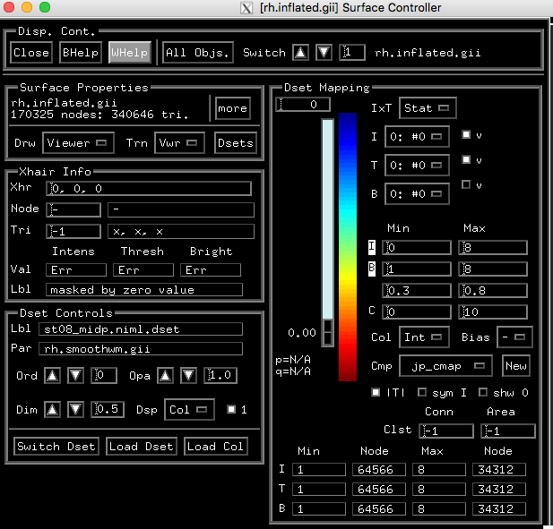
SUMA: Load smoothed niml.dset (cont)
Adjust intensity
Deselect “sym”
Lower “Dim” and press “a” to turn off attenuation

